Slide 1
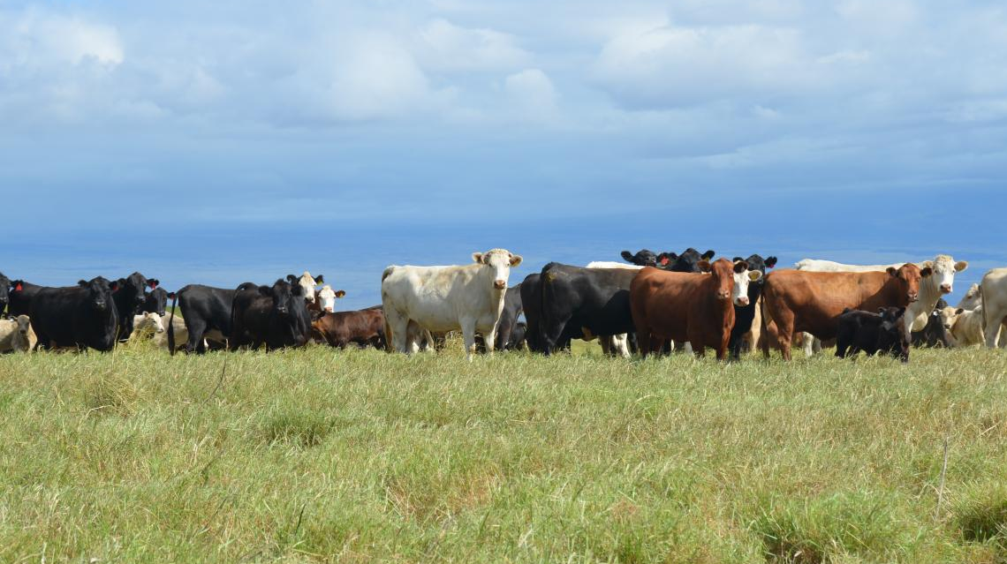
Cattle Market Update and the Cattle Cycle
Derrell S. Peel
Breedlove Professor of Agribusiness and
Extension Livestock Marketing Specialist
Oklahoma State University

Slide 2
MED. & LRG. #1 FEEDER STEER PRICES
Data Source: USDA-AMS, Compiled by LMIC
Livestock Marketing Information Center

Slide 3
Fed and Feeder Steer Prices

Slide 4
Price-Weight Relationship

Slide 5
Boner Cow Price, Average Dressing

Slide 6
Bred Cow Price

Slide 7
U.S. Beef Cow Inventory

Slide 8
Figure 1. Beef Cow Inventory and Steer Prices

Slide 9
Cattle on Feed

Slide 10
HEIFERS ON FEED AS A PERCENT OF TOTAL CATTLE ON FEED

Slide 11
KANSAS FEEDLOT CLOSEOUTS
Data Source: KSU Focus on Feedlots, Compiled by LMIC
Livestock Marketing Information Center

Slide 12
2023 Meat Production and Consumption
 | Production |  |  |  |  | Consum. Change | Consum. Per Capita | Consum. Change
 | 2021 | 2022 | 2021- 2022 | 2023 | 2022- 2023 | 2021-2022 | 2023 | 2022-2023
 | Million lbs. | Million lbs. | % Change | Million lbs. | % Change | % Change | Retail Lbs. | % Change
Beef | 27948 | 28291 | +1.2 | 26683 | -5.7 | 0.0 | 57.0 | -3.2
Pork | 27675 | 26996 | -2.5 | 27124 | +0.5 | -0.3 | 49.1 | -3.5
Broilers | 44419 | 45711 | +2.9 | 45896 | 0.4 | +2.1 | 98.8 | 0.3
Total | 106352 | 107001 | +0.6 | 106233 | -0.7 | +0.7 | 223.4 | -1.1
2023 forecast
LMIC, September 28, 2023

Slide 13
BOXED BEEF CUTOUT VALUE
Data Source: USDA-AMS
Livestock Marketing Information Center

Slide 14
Cattle Slaughter Federally Inspected, 1000 Head
 | 2020 | 2021 | 2022 | % Change 2020-2021 | % Change 2021-2022 | YTD % Change 2022-2023
Steers | 15856 | 16145 | 15810 | +1.8 | -2.1 | -5.2
Heifers | 9445 | 9827 | 10292 | +4.0 | +4.8 | -1.6
S+H Total | 25302 | 25972 | 26102 | +2.7 | +0.5 | -3.8
Dairy Cows | 3064 | 3106 | 3047 | +1.4 | -1.9 | +4.7
Beef Cows | 3268 | 3562 | 3951 | +9.0 | +10.9 | -13.3
Cows Total | 6331 | 6669 | 6998 | +5.3 | +4.9 | -
Bulls | 518 | 544 | 565 | +5.0 | +3.8 | -6.2
Total | 32152 | 33185 | 33665 | +3.2 | +1.4 | -4.2
Latest data: September 23, 2023

Slide 15
Female Cattle Slaughter % of Total Cattle Slaughter

Slide 16
HEIFERS HELD AS BEEF COW REPLACEMENTS
Data Source: USDA-NASS
Livestock Marketing Information Center

Slide 17
Beef Herd Culling

Slide 18
US Beef Cow Inventory

Slide 19
Heifer Retention and Cow Culling
Herd Expansion

Slide 20
Cattle Slaughter

Slide 21
BEEF PRODUCTION vs. CATTLE INVENTORY
Data Source: USDA-NASS, Compiled & Forecasts by LMIC
Livestock Marketing Information Center

Slide 22
AVERAGE ANNUAL CATTLE PRICES
Data Source: USDA-AMS, Compiled and Forecasts by LMIC
Livestock Marketing Information Center

Slide 23
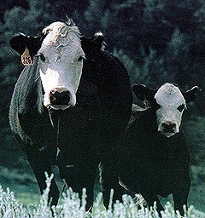
The Weekly Email Newsletter From OSU Animal Science and Agricultural Economics
Send Email to derrell.peel@okstate.edu
or scan >>>>>>>>>>>

