Slide 1
Research Update: OSU Agricultural Economics
Kellie Curry Raper
Professor & Livestock Marketing Specialist

Slide 2
Oklahoma’s Rural Cooperatives: Economic Impact – Dr. Phil Kenkel
WHO
Agricultural Cooperatives, Rural Electric Cooperatives, and Farm Credit Associations
Economic Impacts
$3.4 Billion Direct Economic Expenditures
4,132 jobs = $426,000 in payroll
$5.5 Billion Overall Economic Impact
11,539 jobs = $1.6 Billion in labor income
Farm Credit Cooperatives Alone
$112 Million Economic Impact, 561 jobs, $103 Million Payroll

Slide 3
In the Ag Law World – Dr. Shannon Ferrell
Farm Transition Simulator (Beta testing)
Simulates cash flow sufficiency across multiple transition strategies ranging from “Split it down the middle” to a lifetime equity buyout
Farm bill language change proposal
Collaboration (OSU, TAMU) to propose Farm Bill language changes allowing broader range of entity forms without interfering with payment limits
New handbooks by year end for:
Solar Leasing, Battery/energy storage leasing, Carbon contracts
Wind Energy Leasing 2nd Edition

Slide 4
Rural and Community Development: Dr. Brian Whitacre
Broadband Impacts
Fiber broadband ~ 2%-3% in rural value
Better broadband ~ New rural and urban business births
(w/A. Van Leuven)
Rural Hospital Services
Clinics and CT/MRI scans, Delivery Rooms
Small changes in service = Better financial outcomes for hospitals

Slide 5
Rural and Community Development: Dr. Andrew Van Leuven
Childcare Availability – Rural & Urban
Supply is constraining factor
Community Social Capital ~ Rural job growth
Banking Deserts are mostly in the actual desert
Arizona, Nevada
Most Americans have access within 10 miles of home

Slide 6
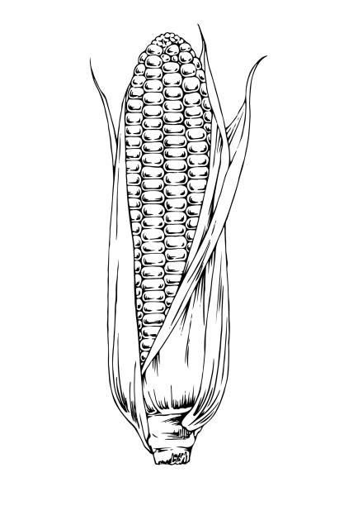
Sustainability and Climate: Dr. Wade Brorsen and Dr. Deepthi Kolady
Livestock and Meat
Cell-cultured meat is destined to be a novelty product (Brorsen)
Cannot compete economically with beef, pork, and chicken, even assuming phenomenal technological advances
Some consumers were willing to pay more for carbon friendly rib-eye steak when given information that rotational grazing reduces greenhouse gas. (Kolady)
Crops
Farmers’ preferences for carbon payments differ between conservation practices of no-till and cover crops in South Dakota (Kolady)
Farmers more concerned with climate change are more likely to enroll in carbon market programs and demand smaller carbon payments
50-year corn yield loss estimates due to climate change ~ 19% (Brorsen)
If technological change continues on pace with the past 40 years, yields will continue to go up, but not as fast as in the past.

Slide 7
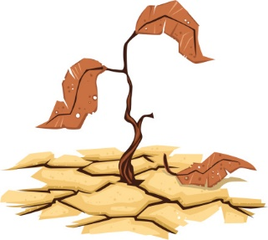
Sustainability and Climate: Dr. Dayton Lambert
Drought Impacts in Tillman/Harmon/Jackson Counties
(with Ph.D. candidate, Katie Welch)
2011-2013
$172 million was lost in the region’s economy.
Job loss ~ 3,699
AG disaster relief insurance reduced economic value loss by 58% and job loss by 62%.
2021/2022:
Working on these estimates now

Slide 8
Beef Cattle Management
Oklahoma cattlemen are more likely to vaccinate calves for respiratory disease (76%) than the breeding herd (54%) (K. Harwell (MS), A. Hagerman, K. Raper, H. Shear, R. Biggs)
Lack of disease knowledge influences breeding herd vaccination
Herd size and use of other vaccines drives calf respiratory vaccination
Rotational Patch-Burn Grazing vs. Traditional Burning
(H. Baker (MS), H. Shear, D. Peel, K. Raper, S. Fuhlendorf)
Burning 2 patches/year increases availability of quality forage
Lessens drought impact
Increased burn costs negated by winter feed cost savings

Slide 9
Beef Cattle Marketing
Impact of Days Weaned on Feeder Cattle Premiums in Oklahoma
Amadeo Panyi (PhD Candidate), Kellie Curry Raper, Derrell Peel
Increasing premiums ($/cwt) as weaning periods increase from 60 to 105 days
Analysis of stocker producers’ calf purchasing preferences
Mengyu Yin (PhD Graduate), Kellie Curry Raper, Derrell Peel, and Amy Hagerman ~ JARE 2023
Preferences for breed, geographic source, health management, animal type, transaction type and distance
Risk-Takers, Amazon Shoppers, Risk Avoiders, and Upscale Shoppers
Adverse Selection in the Cattle Procurement Market
Kayla Hildebrand (PhD Graduate) and Chanjin Chung ~ JARE 2023
Private private fed cattle transaction data
Examines potential selection bias in the cash fed cattle market price, suggesting that cattle sold in the cash market are assumed to be of lower quality than cattle sold through advanced marketing agreements, where carcass data alleviates information asymmetries.

Slide 10
Farm Management
The future of precision nitrogen recommendations looks to be field-level recommendations rather than variable rate recommendations (Brorsen)
Should Producers of Rain fed Wheat Enroll in Agricultural Risk Coverage or Price Loss Coverage?
(Ph.D. candidate, Leann Westbrook with Dr. Dayton Lambert)
Yes. Stack ARC or PLC on crop insurance.
Planting summer crops is recommended in addition to the above.
Farm Management Resources – Dr. Courtney Bir
Free farm financial planning for producers
Focus on beginning farmer rancher issues (part of a multi stakeholder initiative)
Niche agriculture- bees, vegetables, non traditional crops/livestock

Slide 11
Consumer Behavior – Dr. Bailey Norwood
Consumers will pay more for potting mix made from Eastern Red Cedar bio char, providing a way to harvest this invasive shrub and turn it into a valuable product.
Homeowners are willing to accept alternative lawns that encourage biodiversity.
Bread made from different wheat varieties imparts different tastes to consumers.
Used to develop a method for making flavor profiles for OSU varieties.

Slide 12
Department of Agricultural Economics Links
https://agriculture.okstate.edu/departments-programs/agecon
https://agriculture.okstate.edu/departments-programs/agecon/faculty/
https://experts.okstate.edu/

