Slide 1
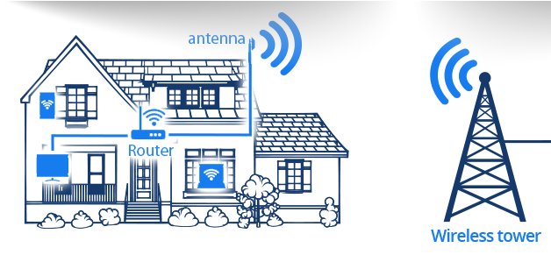
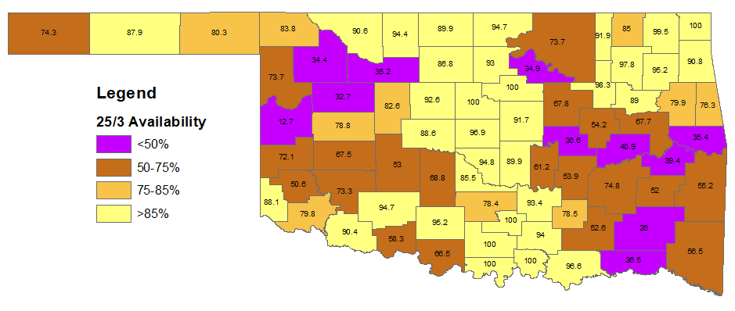
Broadband in Oklahoma: Mapping, Economic Impacts, And the road ahead
Presentation for Rural Economic Outlook Conference
October 13, 2021
Brian Whitacre
Professor and Neustadt Chair
Notes:
NOTE:
To change the image on this slide, select the picture and delete it. Then click the Pictures icon in the placeholder to insert your own image.

Slide 2
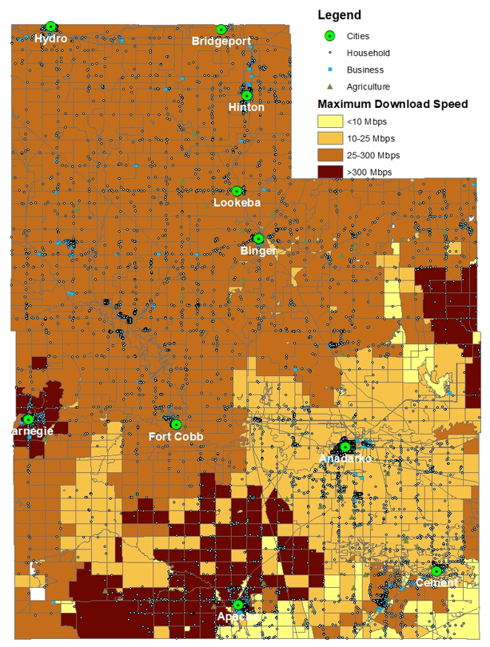
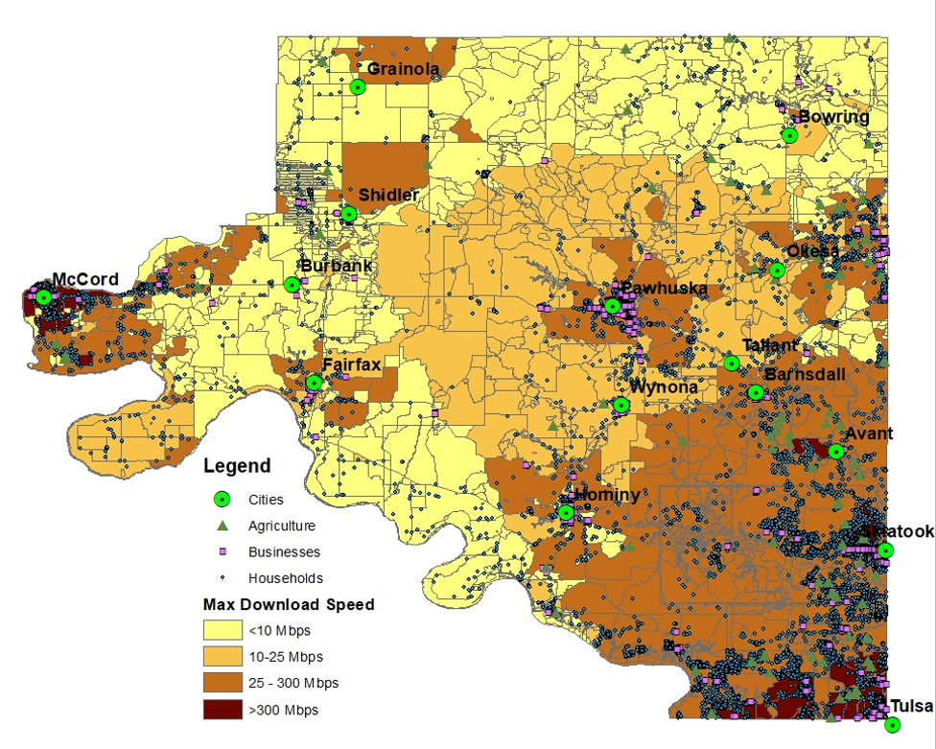
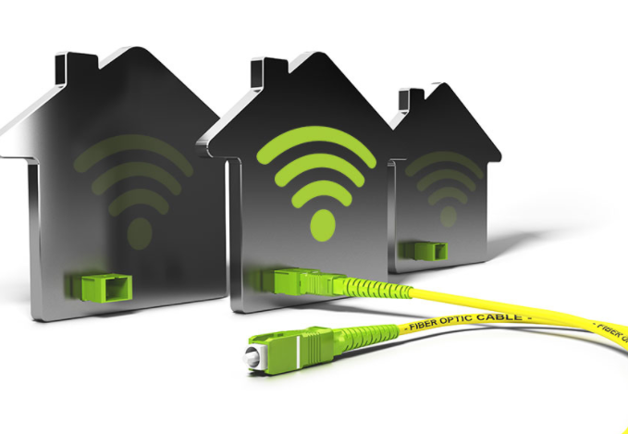
Agenda
“Broadband” history & future (?)
Definition
Which technologies dominate?
Broadband’s Economic Impacts
Early research & more recent findings
Oklahoma’s Broadband Situation
Availability vs. Adoption
Mapping Updates
Moving Forward
OK Rural Broadband Expansion Council
Lots of recent policy action!

Slide 3
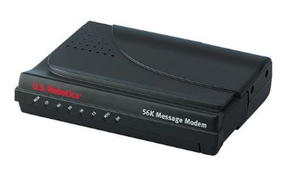
“Broadband” History (& Future?)
High-speed, always-on Internet access
From ANY technology
Speed threshold: Whatever the Federal Communications Commission (FCC) says it is!
1996: 0.2 Mbps in any direction
2010: 4 Mbps download / 1 Mbps upload
2015: 25 Mbps download / 3 Mbps upload
Some advocates say 25 / 3 threshold is outdated
Netflix connection requires 5 Mbps
Zoom calls require 1 Mbps
Amazon recommends 15 Mbps for best-quality video
Recent legislation emphasizes 100/100 or 100/20 speeds
“Fixed” vs. “Mobile”
Anything meeting the 25/3 threshold qualifies as broadband.
Satellite considered “fixed”; cellular connections considered “mobile”
FCC considers them complements, not substitutes (for now)
Dial-up modem: 0.056 Mbps
Mbps = Megabits per second
The opposite of broadband!

Slide 4
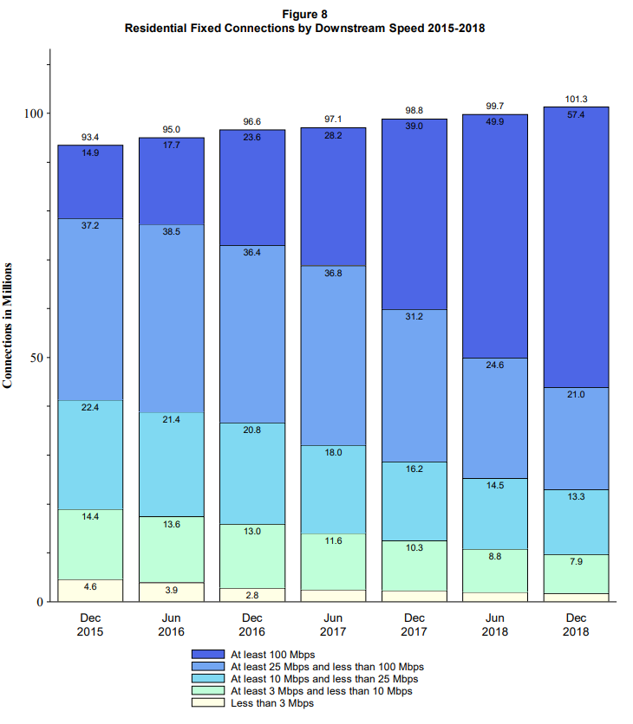
More Speed Over Time…
More than 50% of Residential Fixed Connections were 100Mbps+ in 2018
Source: FCC Internet Access Services Report (Dec. 2020)

Slide 5
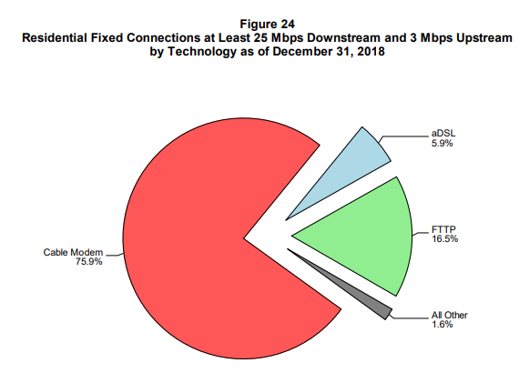
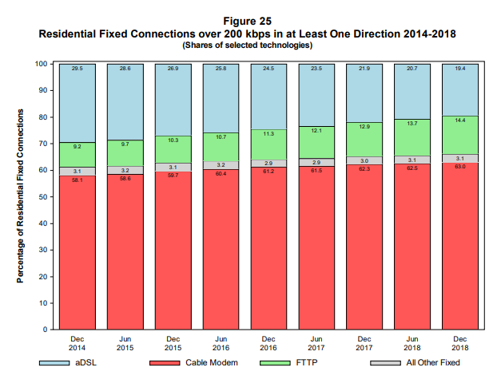
Cable Modem Still Dominant for Fixed Connections
Approximately 75% of 25/3 Residential Fixed Connections were via Cable Modem in 2018
Source: FCC Internet Access Services Report (Dec. 2020)

Slide 6
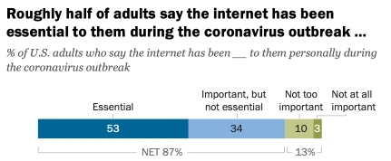
Why is Broadband Important?
Most in U.S. use it for a wide range of daily activities
COVID-19 made this crystal-clear
Those without a connection are being left behind

Slide 7
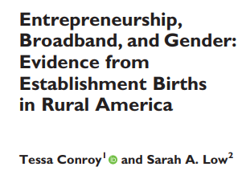
Broadband and Rural Economic Development
Lots of research to support the idea that “broadband matters” for a variety of rural quality of life outcomes:
Income growth
Civic engagement
Unemployment reduction
Firm location
Entrepreneurship
Housing values
Farm productivity

Slide 8
A couple of recent, relevant findings…

Slide 9
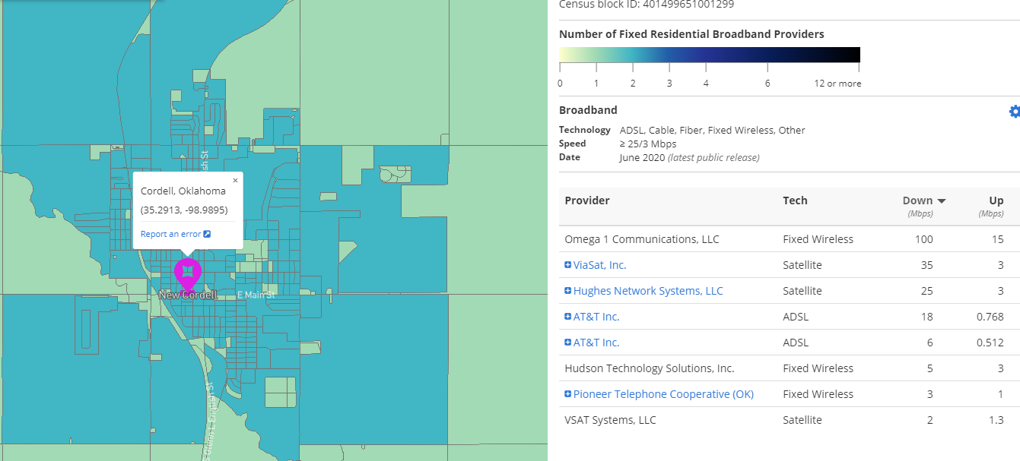
Broadband Data - Availability
Rural broadband availability is dramatically overstated by the FCC data / reports
https://broadbandmap.fcc.gov/#/
All providers report census blocks served to FCC, every 6 months
If 1 provider serves 1 house in a Census block, the whole block is considered served
Known to overstate access!

Slide 10
Why the Broadband Availability Data is Bad
Currently using this method
Moving to this method (data not available until late 2022(?))
These houses are in a “served” block but do not actually have service

Slide 11
Oklahoma’s Broadband Availability Situation
All
US
TX
KS
Rural
OK
KS
AR
US
TX
OK
AR
Source: FCC Broadband Report, 2021 (Data from Dec. 2019)

Slide 12
Progress Over the Years
83%
US
61%
72%
OK
34%
Source: FCC Broadband Reports, 2016 – 2021 (Data from 2 years prior)

Slide 13
Broadband Availability and Adoption in OK
Availability: Where the technology exists and is accessible for OK residents
25/3 Fixed Terrestrial Availability:
Adoption: The % of households subscribing to a broadband provider
% of Households with different
types of connection
 | Rural (%) | Urban (%)
U.S. | 82.8 | 98.8
Oklahoma | 71.8 | 96.3
Texas | 83.9 | 98.2
Kansas | 87.3 | 98.7
Source: FCC 2021 Broadband Deployment Report (Data is as of Dec. 2019)
 | Any broadband | Cable, DSL, Fiber | Mobile-only | Satellite
U.S. | 86.4 | 70.8 | 11.8 | 6.5
Oklahoma | 83.6 | 59.4 | 17.5 | 9.2
Texas | 86.3 | 67.6 | 14.3 | 8.3
Kansas | 85.2 | 67.9 | 12.3 | 7.2
Source: U.S. Census ACS 2019 1-yr estimates Table S2801

Slide 14
Broadband Availability in Oklahoma
Percentage of Households with 25/3 Terrestrial Broadband Availability
11 counties with < 50% Broadband Availability
Source: FCC Form 477, Dec. 2019

Slide 15
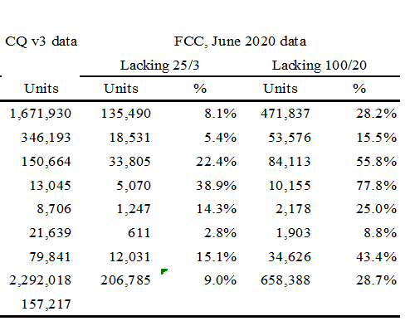
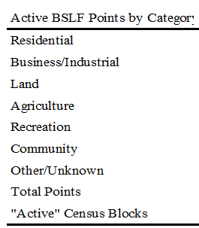
Oklahoma “Broadband Serviceable Location Fabric”
Uses data from county assessor records; imagery / commercial footprint data from Microsoft / satellite companies; property tax records; address / geolocation data
Main takeaway: Non-residential BSLF Structures Have Worse Broadband Availability

Slide 16
County-Specific Availability Maps
Grant County (Pop 4,400)
Dewey County (Pop 4,900)
Woodward County (Pop 12,500)
Caddo County (Pop 29,000)
Oklahoma County (Pop 800,000)
County funding from American Rescue Plan CAN be used for broadband
ALL Counties in OK receiving funding Ranging from $500K - $150M
Your county available by request!

Slide 17
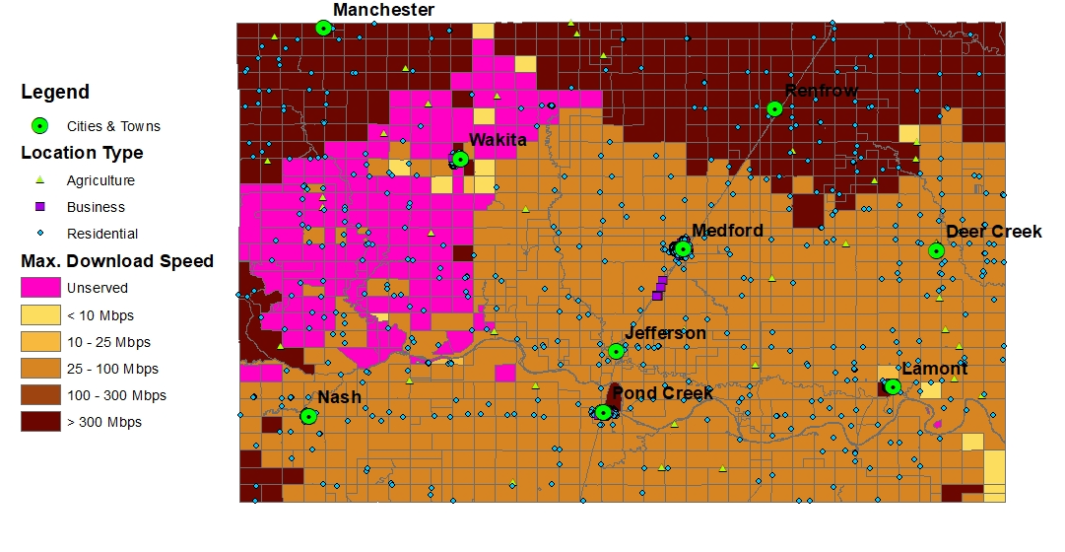
Grant County (Pop 4,400) – 90%
Source: FCC Form 477, Dec. 2019
Sources: FCC Form 477, June 2020
CostQuest Broadband Serviceable Location Fabric, 2021

Slide 18
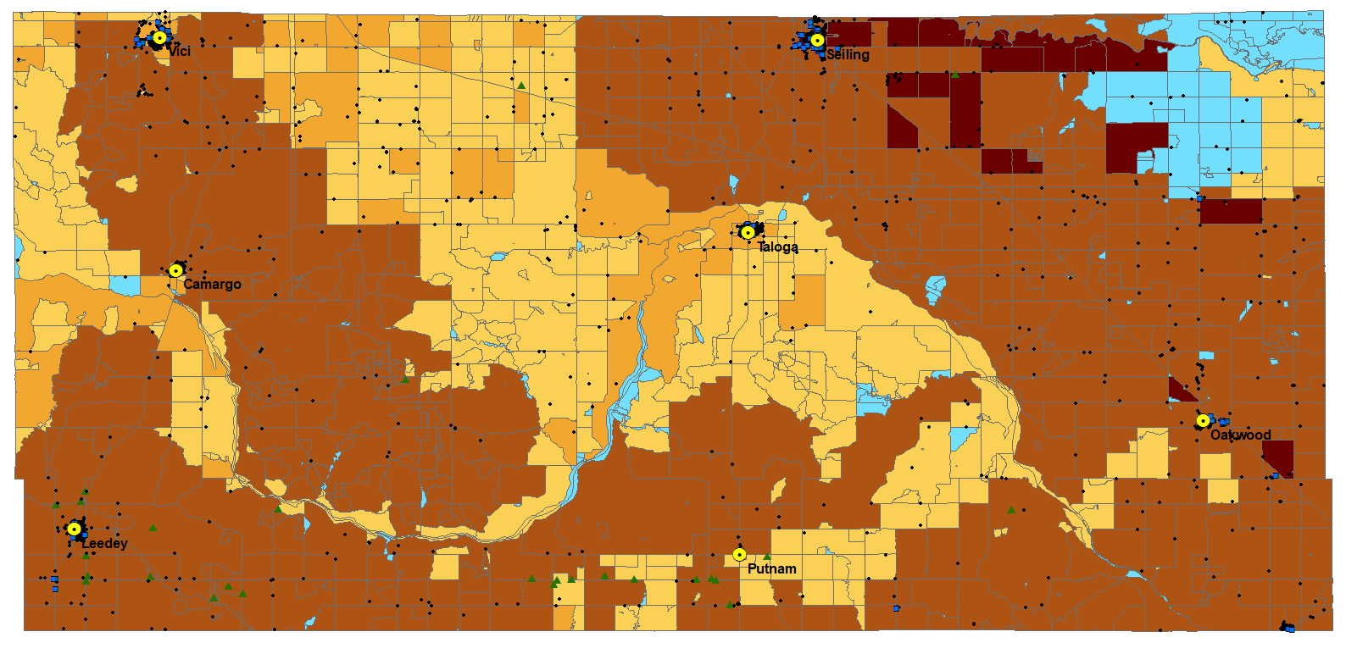
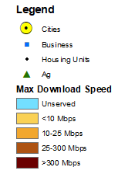
Dewey County (Pop 4,900) – 33%
Source: FCC Form 477, Dec. 2019
Sources: FCC Form 477, June 2020
CostQuest Broadband Serviceable Location Fabric, 2021

Slide 19
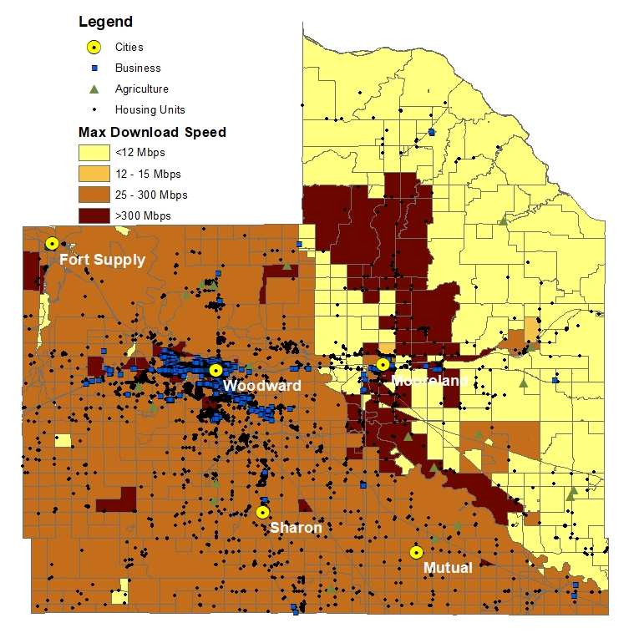
Woodward County (Pop 12,500) – 34%
Source: FCC Form 477, Dec. 2019
Sources: FCC Form 477, June 2020
CostQuest Broadband Serviceable Location Fabric, 2021

Slide 20
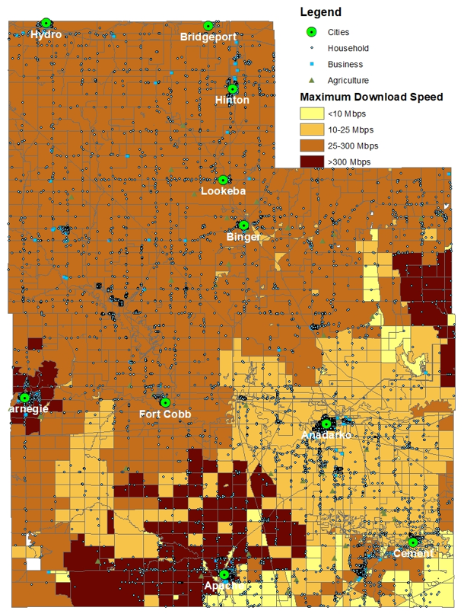
Caddo County (Pop 29,000) – 53%
Source: FCC Form 477, Dec. 2019
Sources: FCC Form 477, June 2020
CostQuest Broadband Serviceable Location Fabric, 2021

Slide 21
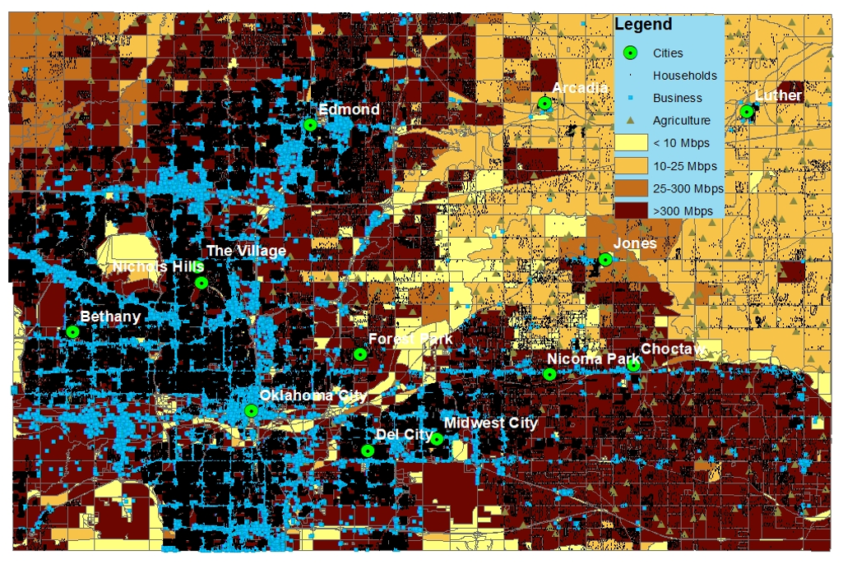
Oklahoma County (Pop 800,000) – 97%
Source: FCC Form 477, Dec. 2019
Sources: FCC Form 477, June 2020
CostQuest Broadband Serviceable Location Fabric, 2021

Slide 22
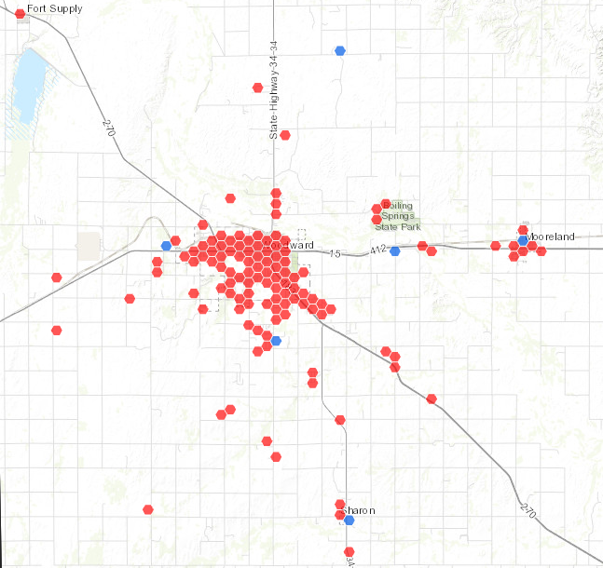
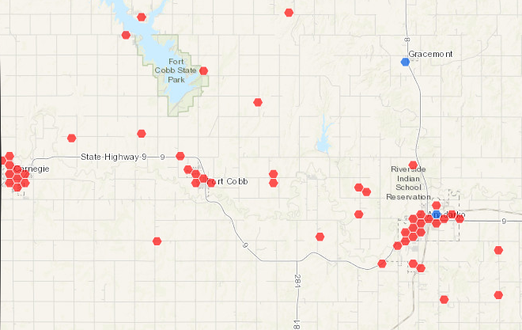
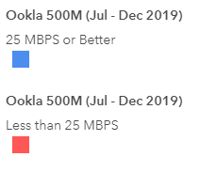
The Oklahoma Broadband Map
Currently in preliminary phase; unclear who will ultimately build
Using existing FCC Form 477 data; will use more detailed data in future
Will also incorporate:
CostQuest data (address-level, different land use categories)
Ookla speed test data
Pending funding from existing federal grant programs
Seeking to find areas with highest need to distribute ARP / state funding
Woodward
Anadarko / Ft. Cobb

Slide 23
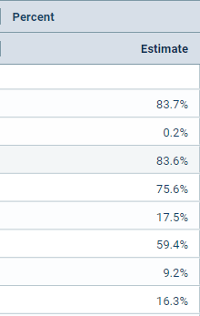
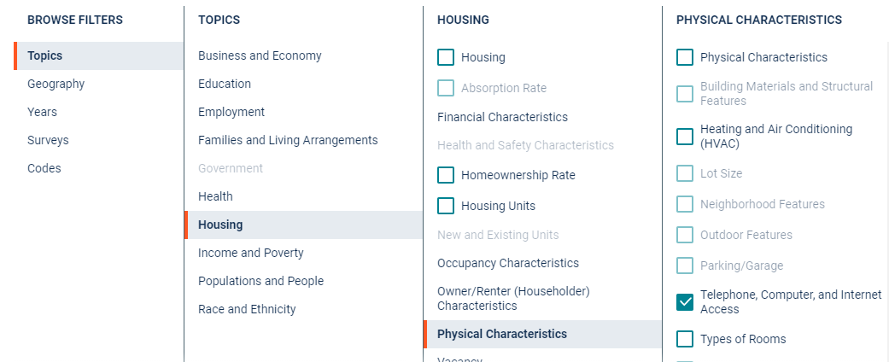
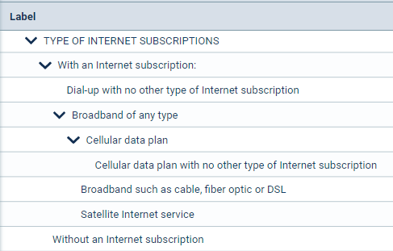
Broadband Data - Adoption
https://data.census.gov/cedsci/advanced
Data available for different geographies: counties, ZIPs, cities, states
Only 5-year averages (2015-2019) for smaller geographies
Helpful to compare local numbers to state averages
Source: U.S. Census ACS 2019 1-yr estimates Table S2801

Slide 24
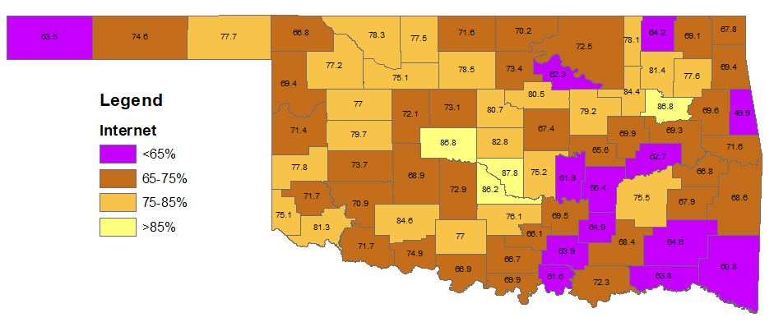
Broadband Adoption in Oklahoma
Percentage of Households with Some Type of Internet Connection
State Avg: 83.7
Source: 2019 American Community Survey 5-year Sample

Slide 25
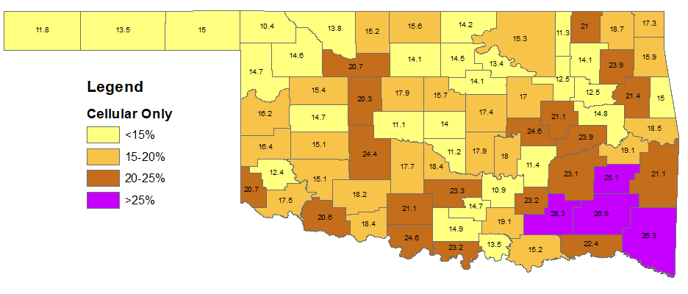
Broadband Adoption in Oklahoma
Percentage of Households with Mobile-only Connections
State Avg: 17.5
Source: 2019 American Community Survey 5-year Sample

Slide 26
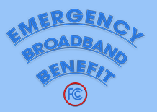
Moving Forward - Nationally
Lots of money available for broadband right now!
Availability:
American Rescue Plan (direct funds for states, counties, cities) ($350B)
Coronavirus Capital Projects Fund ($10B)
NTIA Tribal Broadband Program ($1B)
Adoption
Emergency Broadband Benefit (EBB) Program ($3.2B)
$50 - 75 / month subsidy to pay for broadband connection
$100 discount on a device (laptop / tablet)
https://getemergencybroadband.org/

Slide 27
Moving Forward – in Oklahoma
Rural Broadband Expansion Council (RBEC)
14-member council meeting monthly
Subcommittees on availability, adoption, and policy
Recently passed tax incentive for providers
Sales / use tax rebates (up to 10%) on broadband equipment in unserved / underserved areas
$42M in budget; 75% directed to rural areas
Building a state-level broadband availability map
Significant federal funds on the way
RBEC responsible for distributing funds to unserved / underserved areas

Slide 28
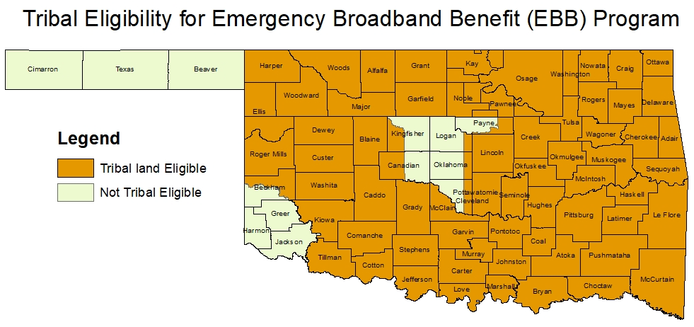
Emergency Broadband Benefit (EBB) Program
Temporary FCC program to help families afford broadband service
Up to $50 / month discount for broadband service
Up to $75 / month discount for households on Tribal lands
1-time discount of $100 for laptop / tablet
Who is eligible?
Households making <135% of Federal Poverty Guidelines
Participants of SNAP, Medicaid, Lifeline
Pell Grant recipients
Participants of Free / Reduced Lunch program
Experienced loss of income due to job loss / furlough during COVID-19
Program will likely be extended (and bumped to <200% of Poverty line)
Most OK Counties Qualify for $75 / month EBB Discount!

Slide 29
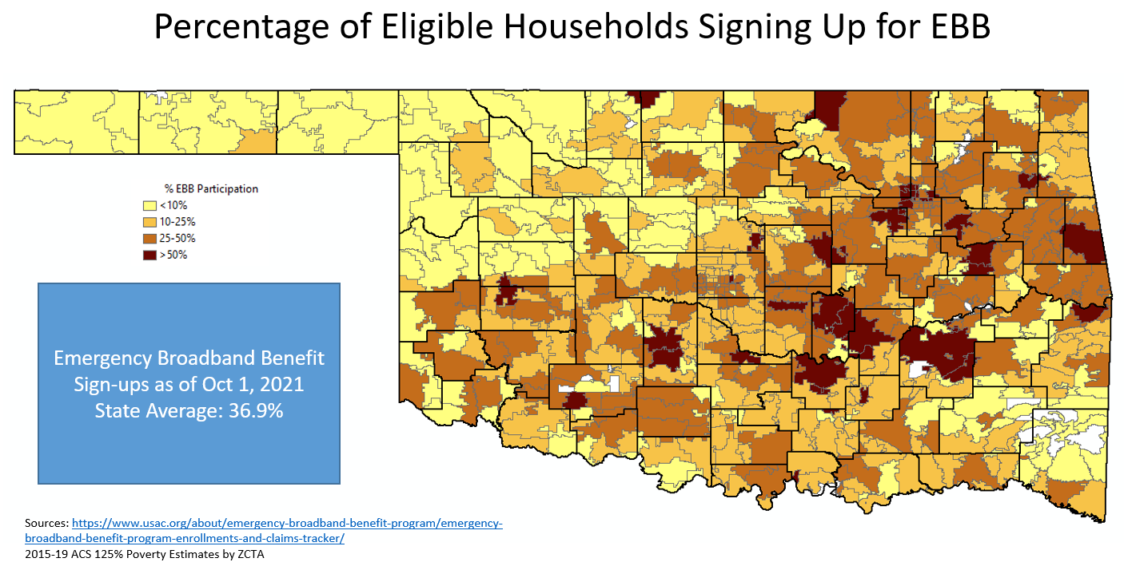
EBB Participation Rates in Oklahoma
Oklahoma is Top 5 in terms of % Participating

Slide 30
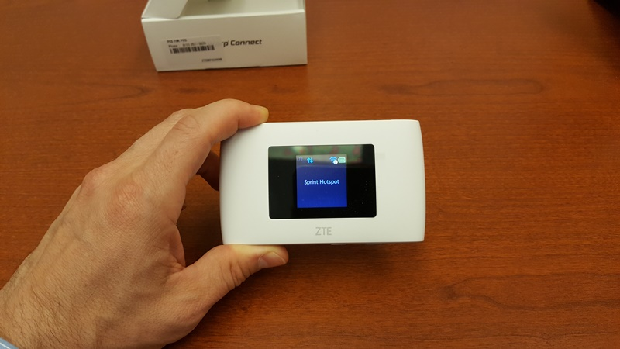
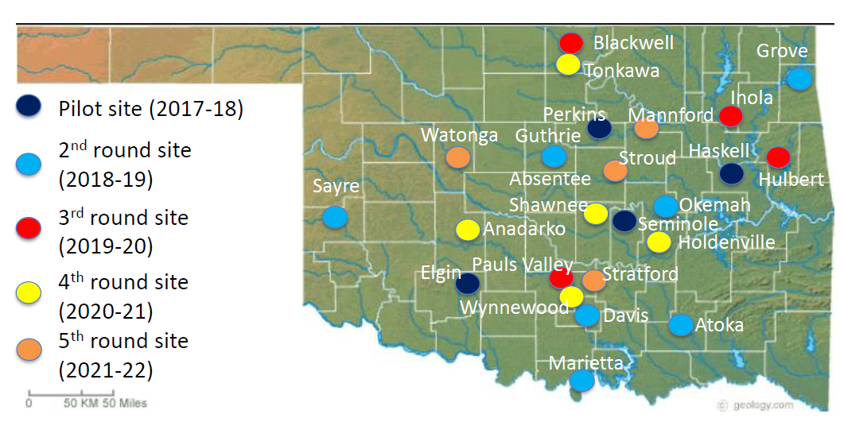
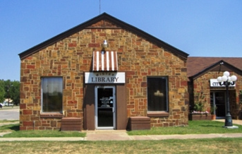
OSU Rural Library Hotspot Loan Program
Work directly with rural libraries to loan out “hotspots” that offer free Internet connections (uses cellular networks)
Most loan out devices for 1 week
OSU pays for device / data for 1st year; asks library to take over data payments in year 2
4-5 libraries added each year
Each library gets 4 – 10 devices
~165 loans / library / year
9.5 / 10 patron ranking
Piloted in 2017
Adding 4-5 libraries each year
Currently partnering with 20
12 / 15 have been able to continue on their own
5 libraries will have “Digital Navigators” soon

Slide 31
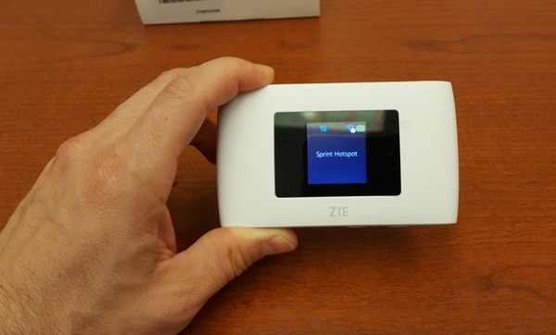
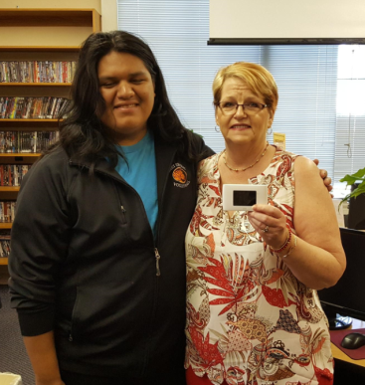
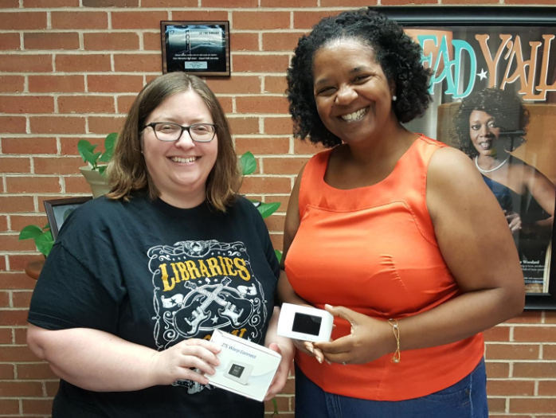
Sample Comments From Patrons
“I love it!”
“Great for research and helping my son and daughter do their homework”
“It’s a total blessing”
“Awesome program – thanks!”
“Used for Planning Community Event”
“I greatly appreciate as I am a full-time student without Internet at home”
“Thank you, thank you, thank you. It’s great!
“Wonderful program – just need more available to check out”
“Good program, used for banking / paying bills”
“So happy that we have an outstanding library that broadens our community’s opportunities – I love you library!”
“Can’t thank you enough – hope to purchase my own unit soon”
“This is a wonderful thing for the library to do.”
“Wish it was longer than a week.”
“This is a wonderful program that is extremely beneficial to my children.”
“Love it! Simple to use. No hassle and very convenient to take wherever you go.”
“Please keep doing it! Thank you!”

Slide 32
How Much Broadband Funding is On the Way?
Consolidated Appropriations Act (December 2020)
$3.2B for EBB program ($50 / month subsidies)
$1B for Tribal broadband grants
$250M for telehealth
American Rescue Plan (March 2021)
$122B for emergency school relief (devices / subscriptions for students)
$7B for Emergency Connectivity Fund (schools & libraries)
$219B State Fiscal Recovery Funds
$13B for Local Fiscal Recovery Funds
Infrastructure Package (On the way??)
$40B Broadband Infrastructure
$3B Digital Equity
$14B Broadband Benefit ($30 / month subsidies)
FCC’s Estimate to Bring Fiber to All Homes:
$45-65B
Source: Boston Consulting Group, 2018
$50-100B for Broadband!
ALL Counties in OK receiving funding Ranging from $500K - $150M

Slide 33
Summary
Mapping updates coming soon
OK has purchased a BSLF to help assess areas most in need of funding
Two components of the “digital divide”
Broadband availability still lags in OK (especially rural areas)
71.8% of rural Oklahomans have access to 25/3 (vs. 82.8% nationally)
Broadband adoption is low for some demographics
Largely driven by cost
Recent programs trying to address this (EBB)
“Digital inclusion” efforts
Funding is on the way (ARP, Infrastructure Bill)
Lots of opportunities for broadband!
Both for availability and adoption
Income | % No Internet
> $75,000 | 5.6
< $20,000 | 37.0
Source: U.S. Census ACS 2019 1-yr estimates Table S2801

