Slide 1
Wheat, Corn, Soybeans & Cotton
Kim Anderson
Agricultural Economist
Oklahoma State University

Slide 2
Oklahoma Crop Prices
Medford Ok prices
Crop | 10-12-21 | 2022 Harvest
Wheat | $7.00 | $7.16
Corn | $5.05 | $4.99 (-20)
Milo | $5.38 | $5.09
Soybeans | $11.40 | $11.43 (-80)
Canola |  | $11.45
Cotton (ICE) | $104.40 | $89

Slide 3
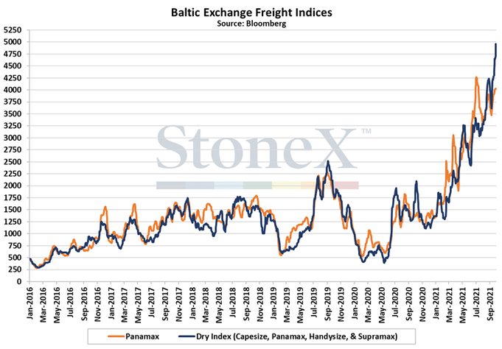
Baltic Exchange Freight Indices
4500
1500
Mar ‘21

Slide 4
Wheat

Slide 5
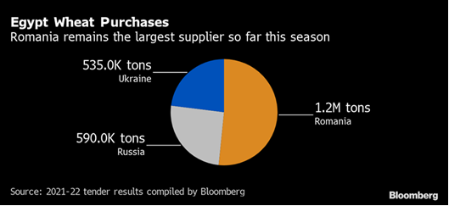
Egypt Wheat Purchases
Price ↑ $2.72 since July 1; Imports ↓ 27%;

Slide 6
Russia’s Milling Wheat Supply
Crop Year | Production | Percent => # 4 | Milling Wheat
 | Billion bu. |  | Billion Bu.
2021/22 | 2.664 | 87.5% | 2.331
2020/21 | 3.136 | 71.7% | 2.249
1st class: 14.5% protein; 32% wet gluten
2nd class: 13.5% protein; 28% wet gluten
3rd class: 12.5% protein; 23% wet gluten
4th class: 11.0% protein; 18% wet gluten

Slide 7
CIF Wheat Prices Around the World
October 2021 October 2020
Tunisia (Durum) $682 Mt ($18.56) $324 Mt ($8.82)
Egypt (HRW-Rom & Ukraine) $352 Mt ($9.56) $285 Mt ($7.75)
Shipping $31.10 Mt (85₵) $14.50 Mt (40₵)
Bangladesh (HRW-Russia) $419 Mt ($11.40) $267 Mt ($7.27)
Philippines (HW-Australia) $365 Mt ($9.93) $255 Mt ($6.94)
Medford Ok $257 Mt ( $7.00) $196 Mt ($5.33)
$9.74
$1.82
$4.13
$2.99
$1.67

Slide 8
World Wheat Situation
Ending Stocks
Okla. Price
Year
Production
Consumption
(Billion Bushels)
2014 | 26.8 | 25.7 | 8.2 | $ 6.34
2015 | 27.1 | 26.2 | 9.0 | $ 4.77
2016 | 27.8 | 27.0 | 9.7 | $ 3.44
2017 | 28.0 | 27.3 | 10.6 | $ 3.98
2018 | 26.9 | 27.0 | 10.4 | $ 5.10
2019 | 28.0 | 27.5 | 10.8 | $ 4.30
2020 | 28.5 | 28.7 | 10.6 | $ 4.55
2021 | 28.5 | 28.9 | 10.2 | $ 6.50
7-YR Avg. | 27.6 | 27.1 | 9.9 | $ 4.64
39%
35%

Slide 9
U.S. Wheat Situation
Ending Stocks
U. S. Price
Year
Production
Consumption
(Billion Bushels)
2014 | 2.03 | 2.02 | .752 | $5.99
2015 | 2.06 | 1.95 | .976 | $4.89
2016 | 2.31 | 2.22 | 1.18 | $3.89
2017 | 1.74 | 1.98 | 1.10 | $4.72
2018 | 1.89 | 2.04 | 1.08 | $5.16
2019 | 1.93 | 2.09 | 1.03 | $4.58
2020 | 1.83 | 2.11 | .845 | $5.05
2021 | 1.65 | 2.04 | .580 | $6.70
7-YR Avg. | 1.97 | 2.06 | .995 | $4.90
37%
49%
28%

Slide 10
U.S. HRW Wheat Situation
Consump-
tion
Ending Stocks
U.S. Price
Okla. Price
Year
Production
(Billion Bushels)
2014 | 739 | 692 | 294 | $5.99 | $ 6.34
2015 | 830 | 685 | 446 | $4.89 | $ 4.77
2016 | 1,082 | 943 | 589 | $3.89 | $ 3.44
2017 | 750 | 765 | 581 | $4.72 | $ 3.98
2018 | 662 | 732 | 516 | $5.16 | $ 5.10
2019 | 845 | 856 | 506 | $4.58 | $ 4.30
2020 | 659 | 743 | 428 | $5.05 | $ 4.55
2021 | 749 | 871 | 311 | $6.60 | $ 6.50
7-YR Avg. | 795 | 774 | 480 | $4.90 | $ 4.64
42%
70%
59%
36%

Slide 11
U.S. HR Wheat Situation
Ending Stocks
Okla. Price
Year
Production
Consumption
(Billion Bushels)
2014 | 1.294 | 1.282 | .506 | $ 6.34
2015 | 1.398 | 1.255 | .717 | $ 4.77
2016 | 1.573 | 1.538 | .824 | $ 3.44
2017 | 1.134 | 1.281 | .772 | $ 3.98
2018 | 1.249 | 1.315 | .779 | $ 5.10
2019 | 1.365 | 1.411 | .786 | $ 4.30
2020 | 1.190 | 1.365 | .663 | $ 4.55
2021 | 1.046 | 1.350 | .424 | $ 6.50
7-YR Avg. | 1.305 | 1.350 | 0.721 | $ 4.64
39%
31%

Slide 12
Black Sea Wheat Situation
Total
Consumption
Ending Stocks
Okla. Price
Year
Production
(Billion Bushels)
2014 | 3.558 | 3.432 | 0.560 | $ 6.34
2015 | 3.750 | 3.913 | 0.431 | $ 4.77
2016 | 4.200 | 4.061 | 0.593 | $ 3.44
2017 | 4.665 | 4.700 | 0.582 | $ 3.98
2018 | 4.067 | 4.265 | 0.406 | $ 5.10
2019 | 4.197 | 4.295 | 0.345 | $ 4.30
2020 | 4.594 | 4.439 | 0.550 | $ 4.55
2021 | 4.317 | 4.470 | 0.449 | $ 6.50
7-YR Avg. | 4.147 | 4.158 | 0.495 | $ 4.64
10%
11%

Slide 13
Bottom Line
Current Price $7.00
2022 Harvest Price $7.16
Argentina and Australian Wheat Harvest
Arg 735 Mb vs. 690 Mb Avg: Aust 1.157 Bb vs. 866 Mb Avg.
Current S & D situation hold until next August/September
Agriculture

Slide 14
Corn

Slide 15
World Corn Situation
Ending Stocks
Year
Production
Consumption
(Billion Bushels)
2014 | 41.6 | 38.8 | 11.0
2015 | 40.0 | 38.6 | 12.3
2016 | 44.4 | 42.7 | 13.9
2017 | 42.5 | 42.9 | 13.4
2018 | 44.3 | 45.1 | 12.7
2019 | 44.0 | 44.7 | 12.1
2020 | 43.9 | 44.6 | 11.4
2021 | 47.2 | 46.7 | 11.9
7-YR Avg. | 43.0 | 42.5 | 12.4
32%
25%

Slide 16
U.S. Corn Situation
Ending Stocks
U. S. Price
Okla. Price
Year
Production
Consumption
(Billion Bushels)
2014 | 14.2 | 13.7 | 1.73 | $3.70 | $4.11
2015 | 13.6 | 13.7 | 1.74 | $3.61 | $3.93
2016 | 15.1 | 14.6 | 2.29 | $3.36 | $3.39
2017 | 14.6 | 14.8 | 2.14 | $3.36 | $3.59
2018 | 14.3 | 14.3 | 2.22 | $3.61 | $3.86
2019 | 13.6 | 14.0 | 1.92 | $3.56 | $4.00
2020 | 14.1 | 14.8 | 1.24 | $4.53 | $4.10
2021 | 15.0 | 14.8 | 1.50 | $5.45 | $5.45
7-YR Avg. | 14.2 | 14.3 | 1.89 | $3.66 | $3.85
16%
8.4%
10%

Slide 17
Oklahoma Crop Prices
Crop | 10-12-21 | 2022 Harvest
Wheat | $7.00 | $7.16
Corn | $5.05 | $4.99 (-20)
Milo | $5.38 | $5.09
Soybeans | $11.40 | $11.43 (-80)
Canola |  | $11.45
Cotton (ICE) | $104.40 | $89

Slide 18
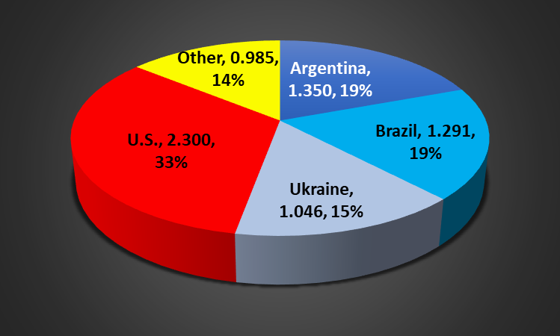
Major World Corn Exporters
Agriculture
Brazil + Argentina + Ukraine = 53%

Slide 19
Soybean

Slide 20
World Soybean Situation
Ending Stocks
Year
Production
Consumption
(Billion Bushels)
2014 | 11.8 | 11.2 | 2.9
2015 | 11.6 | 11.6 | 2.9
2016 | 12.9 | 12.2 | 3.5
2017 | 12.6 | 12.4 | 3.6
2018 | 13.3 | 12.7 | 4.2
2019 | 12.5 | 13.2 | 3.5
2020 | 13.4 | 13.3 | 3.6
2021 | 14.2 | 13.9 | 3.8
7-YR Avg. | 12.6 | 12.4 | 3.5

Slide 21
U.S. Soybean Situation
Ending Stocks
U. S. Price
Year
Production
Consumption
(Billion Bushels)
2014 | 3.9 | 3.9 | 0.19 | $10.10
2015 | 3.9 | 3.9 | 0.20 | $8.95
2016 | 4.3 | 4.2 | 0.30 | $9.47
2017 | 4.4 | 4.3 | 0.44 | $9.33
2018 | 4.4 | 4.0 | 0.91 | $8.48
2019 | 3.6 | 4.0 | 0.53 | $8.57
2020 | 4.2 | 4.5 | 0.26 | $10.80
2021 | 4.4 | 4.4 | 0.32 | $12.35
7-YR Avg. | 4.1 | 4.1 | 0.39 | $9.40

Slide 22
Oklahoma Crop Prices
Crop | 10-12-21 | 2022 Harvest
Wheat | $7.00 | $7.16
Corn | $5.05 | $4.99 (-20)
Milo | $5.38 | $5.09
Soybeans | $11.40 | $11.43 (-80)
Canola |  | $11.45
Cotton (ICE) | $104.40 | $89

Slide 23
Cotton

Slide 24
World Cotton Situation
Ending Stocks
Year
Production
Consumption
(Million Bales)
2013 | 120.4 | 109.9 | 99.9
2014 | 119.2 | 112.2 | 106.7
2015 | 96.2 | 113.2 | 90.1
2016 | 106.7 | 116.2 | 80.3
2017 | 123.8 | 122.8 | 81.1
2018 | 118.6 | 120.5 | 80.0
2019 | 121.4 | 102.9 | 97.7
2020 | 112.2 | 119.9 | 90.3
2021 | 120.3 | 123.4 | 87.3
7-YR Avg. | 114.8 | 114.7 | 90.8

Slide 25
U.S. Cotton Situation
Ending Stocks
U. S. Price
Year
Production
Consumption
(Million Bales)
2014 | 16.3 | 14.8 | 3.7 | 61.3 | ¢
2015 | 12.9 | 12.6 | 3.8 | 61.2 | ¢
2016 | 17.2 | 18.2 | 2.8 | 68.0 | ¢
2017 | 20.9 | 19.5 | 4.2 | 68.6 | ¢
2018 | 18.4 | 17.8 | 4.9 | 70.3 | ¢
2019 | 19.9 | 17.7 | 7.3 | 59.6 | ¢
2020 | 14.6 | 18.8 | 3.2 | 66.3 | ¢
2021 | 18.0 | 18.0 | 3.2 | 90.0 | ¢
7-YR Avg. | 17.2 | 17.0 | 4.3 | 65.1 | ¢
17%
18%
ICE Dec ‘21 104₵; Dec ‘22 89₵

Slide 26
Oklahoma Crop Prices
Crop | 10-12-21 | 2022 Harvest
Wheat | $7.00 | $7.16
Corn | $5.05 | $4.99 (-20)
Milo | $5.38 | $5.09
Soybeans | $11.40 | $11.43 (-80)
Canola |  | $11.45
Cotton (ICE) | $104.40 | $89

Slide 27
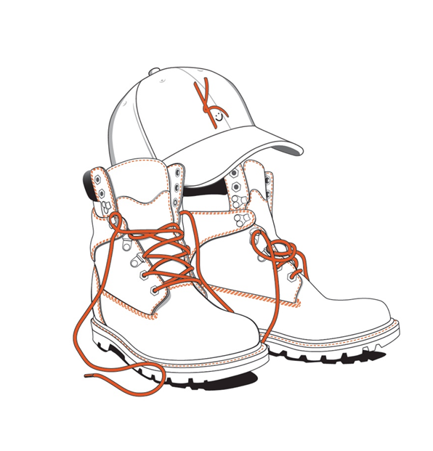
Questions and/or Comments
Kim Anderson
kim.anderson@okstate.edu
405.744.9817

Slide 28
Thought for the day
Ecclesiastes 9:11
. . . The race is not to the swift or the battle to the strong, nor does food come to the wise or wealth to the brilliant or favor to the learned; but time and chance happen to them us all.
Agriculture

