Slide 1
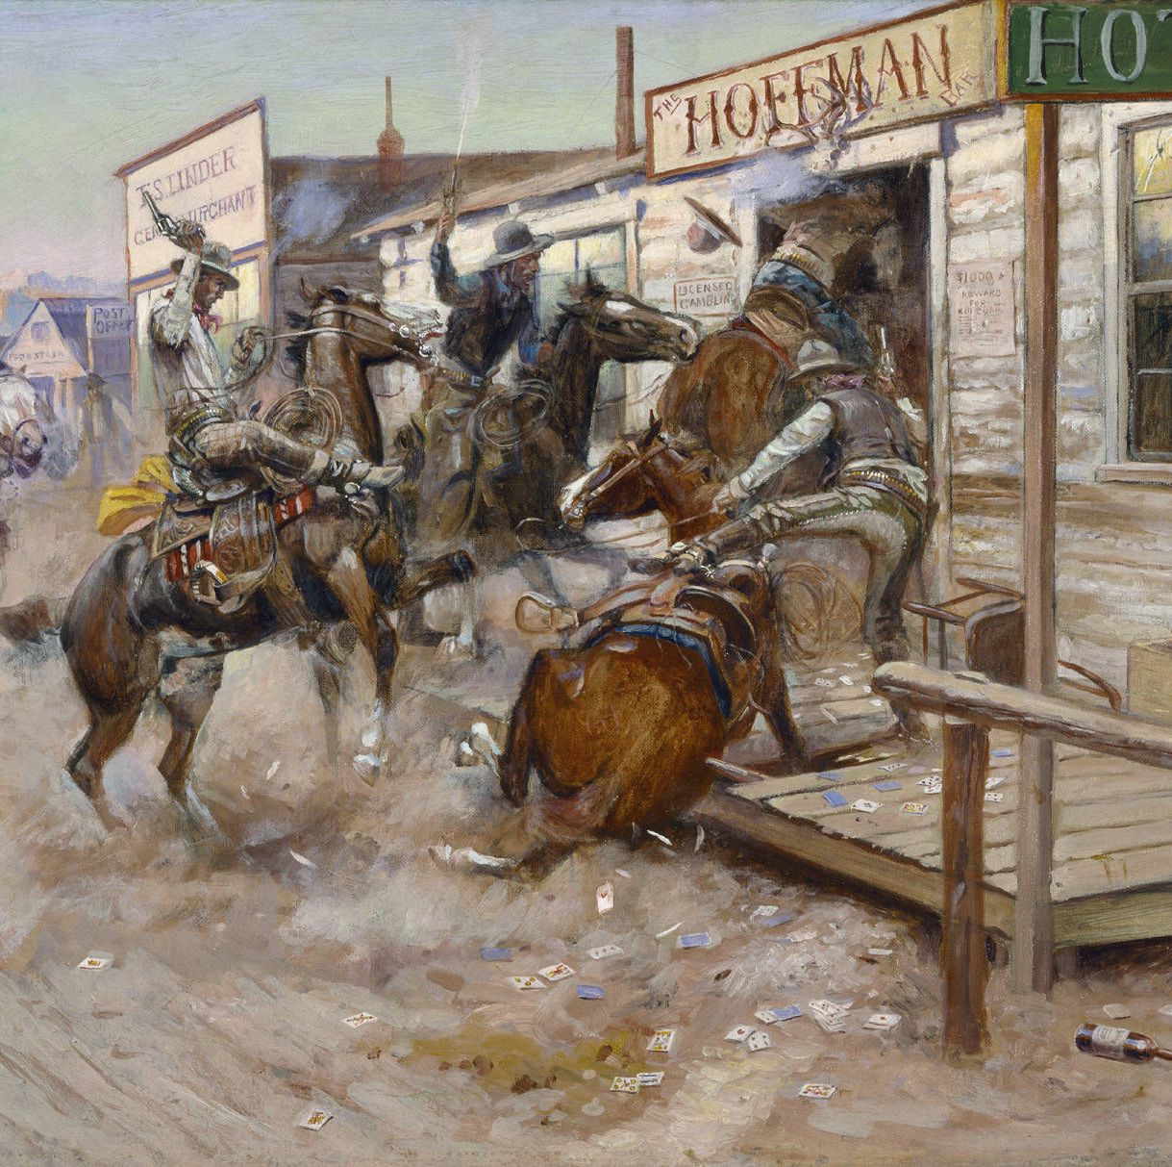

Cattle Market Outlook
Rural Economic Outlook Conference
Oklahoma State University
October 13, 2021
Derrell S. Peel
Breedlove Professor of Agribusiness and
Extension Livestock Marketing Specialist

Slide 2
Data Source: USDA-AMS
Livestock Marketing Information Center

Slide 3
Data Source: USDA-AMS
Livestock Marketing Information Center

Slide 4
Data Source: USDA-AMS
Livestock Marketing Information Center

Slide 7
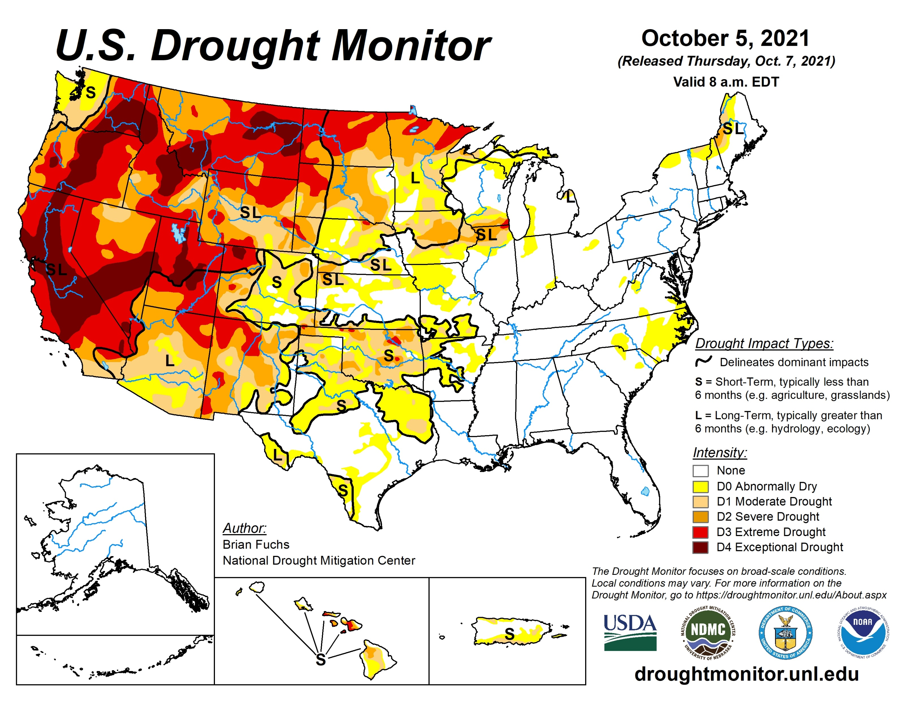

Slide 8
Data Source: USDA-NASS
Livestock Marketing Information Center

Slide 10
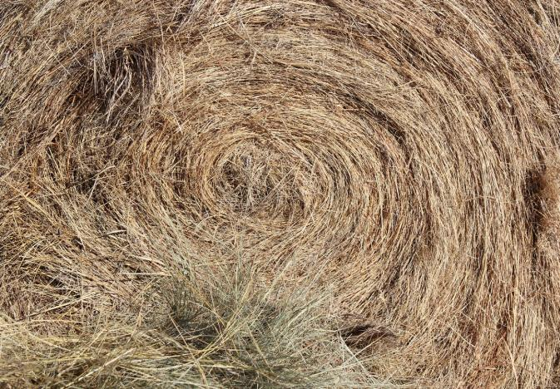
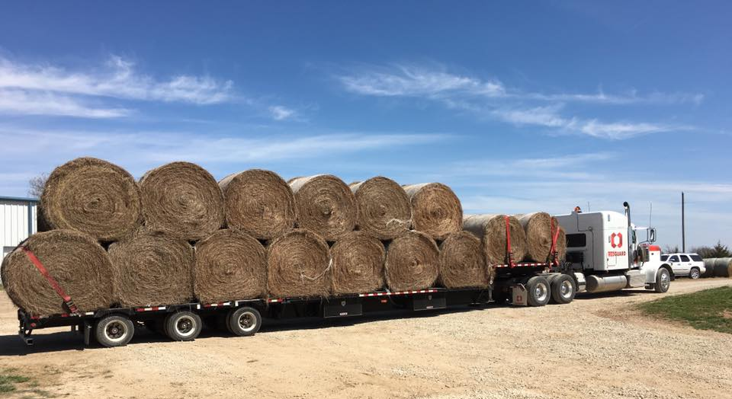
Other Hay Price, August
 | 2020 | 2021 | % Change
Oklahoma | 102 | 126 | +23.5
Missouri | 110 | 110 | -
Kansas | 95 | 103 | +8.4
Nebraska | 84 | 104 | +23.8
South Dakota | 70 | 114 | +62.9
North Dakota | 72 | 122 | +69.4
Montana | 140 | 195 | +39.3

Slide 11
Other Hay Production
Tons Per Beef Cow

Slide 12
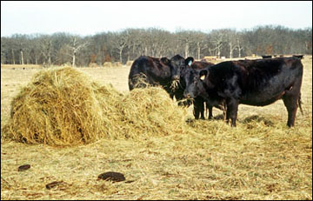
Oklahoma Hay Use per Beef Cow
1970-1984 0.87 tons/cow 1,740 lbs
2006-2020 2.25 tons/cow 4,500 lbs
Why 2,760 lbs of extra hay needed per cow?
  Bigger cows
    Does not account for increased hay use (maybe 20%)
    Should they be bigger? What size cow is most efficient?
  Wasted Hay (maybe 40 %)
    50% storage and feeding losses
  Longer Feeding Time (maybe 40 %)
    30-40 days extra feeding

Slide 13
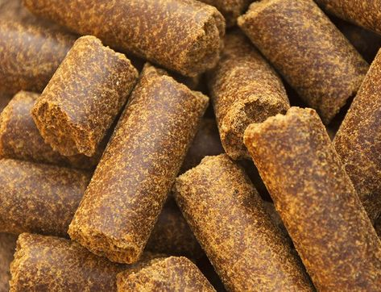
Feed Ingredient Prices, $/ton
Weekly, October 6
 | 2020 | 2021 | % Change
Soy Meal | 330 | 314 | -4.8
CSM | 320 | 335 | +4.7
Cottonseed | 210 | 375 | +78.6
Corn Gluten Feed | 190 | 225 | +18.4
DDG | 149 | 225 | +51.0
Wheat Midds | 115 | 155 | +34.8
Corn, #2 Yellow | 124 | 187 | +51.0

Slide 14
Data Source: KSU Focus on Feedlots, Compiled by LMIC
Livestock Marketing Information Center

Slide 17
Data Source: USDA-NASS
Livestock Marketing Information Center

Slide 20
Data Source: USDA-AMS & USDA-NASS
Livestock Marketing Information Center

Slide 21
Data Source: USDA-NASS, Compiled & Forecasts by LMIC
Livestock Marketing Information Center

Slide 24
Data Source: USDA-AMS, Compiled and Forecasts by LMIC
Livestock Marketing Information Center

Slide 25
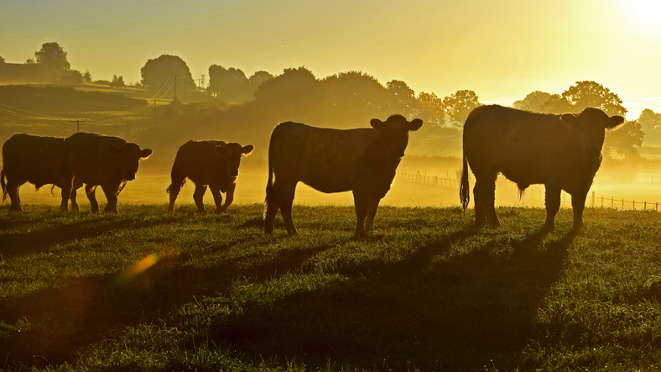
Summary
Higher cattle prices expected
Higher grain/feed/hay prices will persist
Other input prices rising
Better profitability prospects but cost management critical

Slide 26
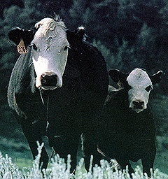

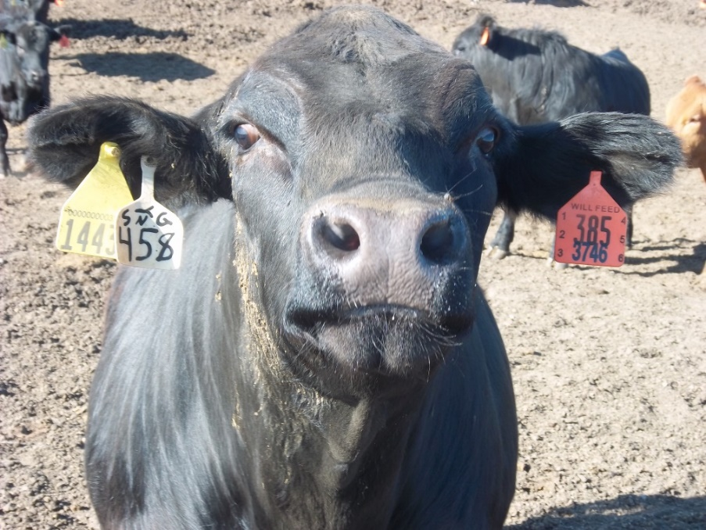
The Weekly Email Newsletter
From OSU Animal Science and Agricultural Economics
Send Email to derrell.peel@okstate.edu

