Slide 1
Agricultural Economics Department Research Overview
Courtney Bir
Assistant Professor
Oklahoma State University
courtney.bir@okstate.edu

Slide 2
General Department Overview

Slide 3
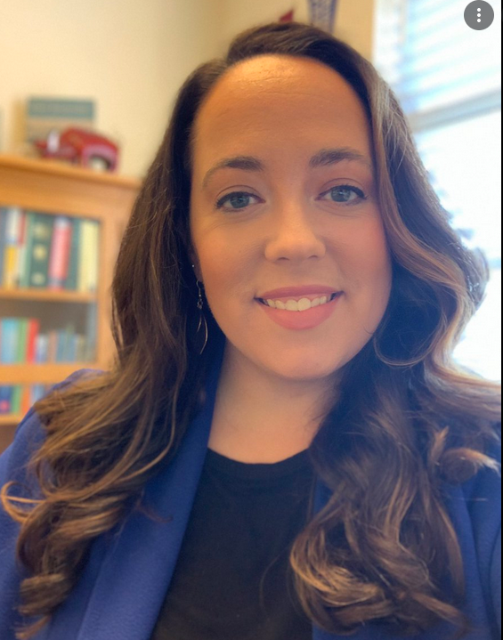
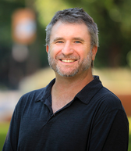
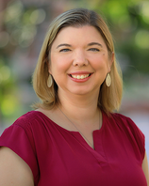
Livestock industry
Dr. Hannah Shear- cow calf industry efficiency through management choices
Dr. Dayton Lambert- Merger acquisition behavior of CR4 meat packers
Dr. Bailey Norwood- Understanding how US beef imports are used
Dr. Amy Hagerman- animal health including avian influenza, foot-and –mouth. Policy impacts

Slide 4
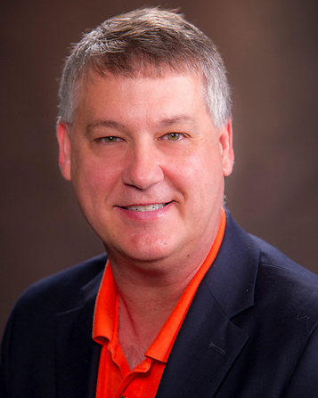
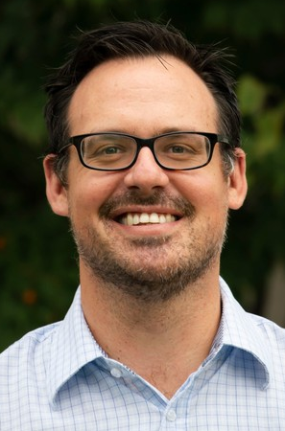
Livestock industry
Dr. Derrell Peel- Feedlot cattle death rates, effect of BRD, rangeland productivity
Dr. Eric DeVuyst-Impact of cattle genetics on profitability. Optimal producer decision making surrounding breeding date. Capsaicin use in beef cattle
Dr. Wade Brorsen-economics of test tube meat. Genetic markers on cow-calf production
Dr. Aleks Schaefer- Egg supply chains, global food trade

Slide 5
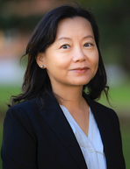
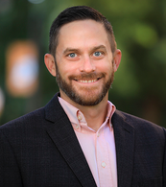
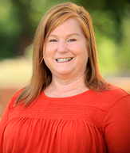
Livestock industry
Dr. Lixia Lambert- environmental implications of beef discoloration
Dr. John Michael Riley- livestock markets and food waste
Dr. Kellie Raper- Beef supply chain from consumers to feedlot. Influence of consumer perceptions and willingness to pay for production practices including hormone use in meat. Management practice adoption by cow-calf producers

Slide 6
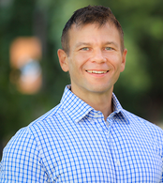
Rural Issues
Dr. Brian Whitacre- Rural Broadband Expansion Council
Dr. Amy Hagerman- impact of ability to telework on rural employment rates
Dr. Shannon Ferrell- Farm estate planning and transitions. Farm stress and mental health
Dr. Aleks Schaefer-Farm labor in food and agriculture

Slide 7
Natural Resources
Dr. Dayton Lambert-Water, carbon and infrastructure resilience
Dr. Lixia Lambert-Biofuel and bioeconomy. Climate change effects on cropping patterns

Slide 8
Crops
Dr. Rodney Holcomb- feedstock supply costs. Cost estimation of crop burning machine
Roger Sahs-Custom rate data collection through USDA-NASS
Dr. Lixia Lambert- risk analysis of rainfed wheat, drought impact analysis, industrial hemp

Slide 9
Crops
Dr. Amy Hagerman- policy impacts related to industrial hemp
Dr. Jeffrey Vitale- Economics and management practices of red winter wheat

Slide 10
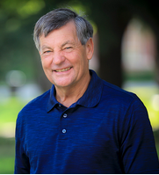
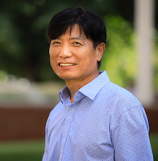
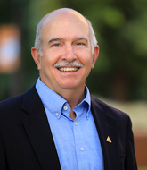
General markets, cooperatives and finance
Dr. Phil Kenkel-investigating cooperative grain market alliances. Focused on cost savings, price basis, and transportation efficiencies
Dr. Chiang Chung- Measuring market power, concentration/captive supplies/integration. Market power vs efficiency
Dr. Notie Lansford-updating the bank simulator game

Slide 11
COVID Impact
Dr. Bailey Norwood- Measuring food insecurity caused by COVID
Dr. Derrell Peel- Small scale meat processing
Dr. Rodney Holcomb- Small scale meat processing. Impact of COVID on food industry
Dr. Aleks Schaefer- Economics of vaccine lotteries, COVID-19 morbidity/ mortality US meatpacking counties

Slide 12
My Research/Extension Programing

Slide 13
A little bit about me….Courtney Bir
Assistant Professor in Agricultural Economics at Oklahoma State – Farm Management and Agricultural finance
75% extension 25% research
PhD Purdue University (Ag Econ)
M.S. Oklahoma State (Ag Econ)
B.S. Oklahoma State (Agribusiness)
B.S. Oklahoma State (Animal Science)

Slide 14
My research in general
Applied research that I use in extension programming
Producer decision making
Small scale agriculture
Consumer understanding of production and WTP, can a producer do it?
COVID impacts- food changes, small scale slaughter, behavior
Academic pursuits- better ways to elicit preferences

Slide 15
Farm Financial planning- potential for future research
Collaborative grant with FBMB grant with University of Minnesota and many other states
We use software called FINPACK
Annual financial analysis
Financial long range planning
Monthly cash flow planning
Annual cash flow planning
11 state, area, and county extension educators have gone through program training
39 farmers/ranchers have reached out for programming so far

Slide 16
Farm Financial planning-- potential for future research
End goal is to have benchmarking data through FINBIN
Will help producers make decisions
Will allow for financial research related to what producers are doing now
We need 40 completed financial plans of the “same kind” to benchmark
Will help farmers/ranchers be prepared for lender meetings
Program approved for FSA borrower training!

Slide 17
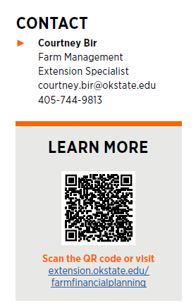
Farm Financial Planning

Slide 18
Producer Decision making- Mixed species grazing
Publication with Dr. Peel and graduate student Kayla Hintze, also a fact sheet and other extension outputs
Looked at the possibility of grazing goats alongside cattle to control red cedar and provide another revenue stream

Slide 19
Producer Decision making- Mixed species grazing
Adding a breeding goat enterprise increased NPV when compared to a stocker goat enterprise or chemical control
Still included rotational patch burning
Ongoing work happening with a real rangeland experiment that will provide better data vs the assumptions used

Slide 20
Producer Decision making- Early season calving dates
Publication in process with Dr. E. DeVuyst, Dr. Lalman and graduate student Amanda Upton, also a fact sheet and other extension outputs
Looked at the implications of calving date on expected annualized return per head
Early calving with increasingly cold winters in Jan may lead to more veterinary costs, higher death loss, and increased feed costs

Slide 21
Producer Decision making- Early season calving dates
Survey of producers and veterinarians, as well as simulated programing
Calving in mid-March resulted in highest annualized returns per head, and most producers calved in March
Variation from profit max often due to labor constraints, off farm activities, other farm enterprises etc.

Slide 22
Smaller scale production/beginning farmer rancher
Ongoing coalition to support beginning farmers and ranchers. Collaboration with NRCS, OSU, ODAFF, Langston, ONIE, Cattlemen's Foundation, Dept. of Veterans Affairs. Multiple workshops, supporting extension documents
Building out simple budgets for unique agriculture- hops, chickens, bees

Slide 23
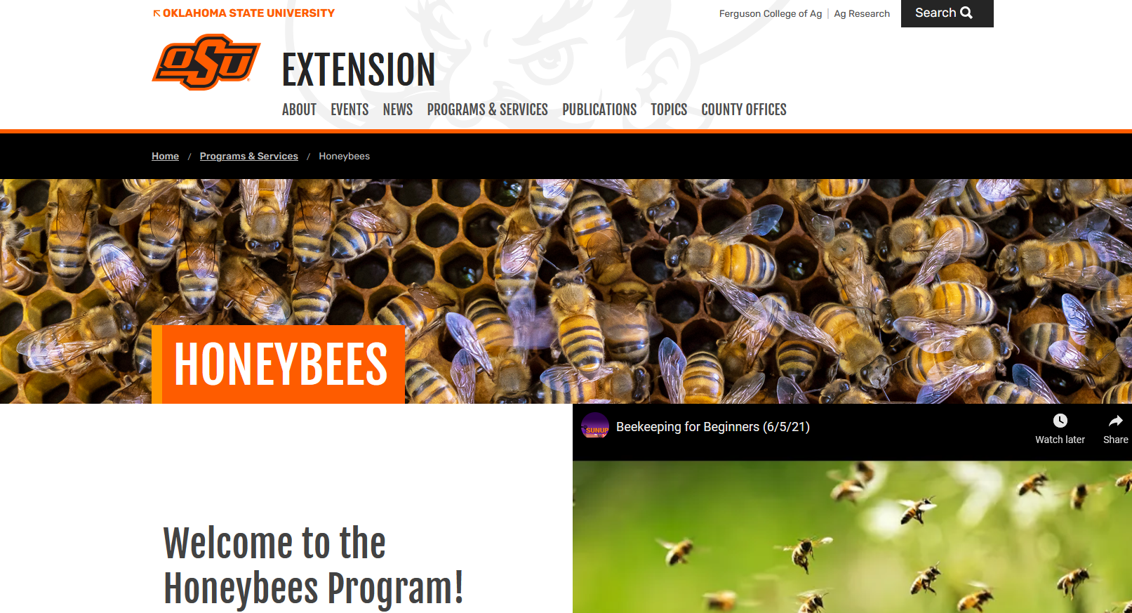
Smaller scale production/beginning farmer rancher
More supporting documents for beekeeping production and finance (bees are livestock!) coming soon:

Slide 24
Smaller scale production/beginning farmer rancher
Ongoing analysis on medium scale poultry production, quail production
Agritourism- come-and-cut flowers, pumpkin patches, economics of additional on farm winery products (in general diversifying farms)

Slide 25
Better ways to elicit preferences
Research surrounding new methodologies for choice experiments
Using social media and online data scraping
Water quality
Impacts of natural disasters (fires/hurricanes)
Food safety

Slide 26
Questions??
Courtney Bir
Assistant Professor
Oklahoma State University
courtney.bir@okstate.edu

