Slide 1

Wheat, Corn, Soybeans,
and Cotton Benchmarks
Kim Anderson
kim.anderson@okstate.edu
Oklahoma Cooperative Extension Service
Agricultural Economics, OSU

Slide 2
Kim’s Guidelines
Market land, capital, labor, and management.
Sell commodities at market price.
Must have a Strategy with Plans.
We can’t predict prices with . . . “accuracy.”
Must estimate prices: commodities, inputs, . .
The market maintains a relationship among prices.

Slide 3
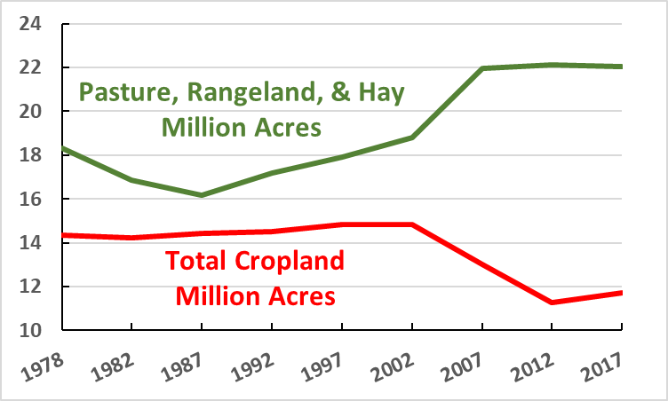
Oklahoma Total Crop Land vs Pasture, Rangeland & Hay
Source: USDA/NASS

Slide 4
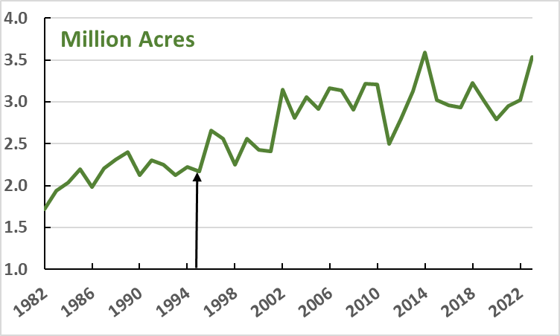
Oklahoma Hay Harvested Acres
Freedom
to Farm

Slide 5
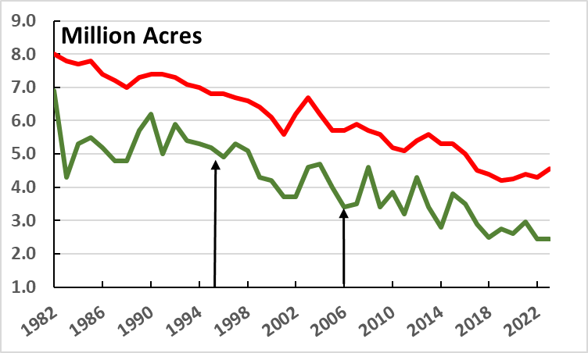
Oklahoma Wheat Planted and Harvested Acres
Freedom
to Farm
Ethanol

Slide 6
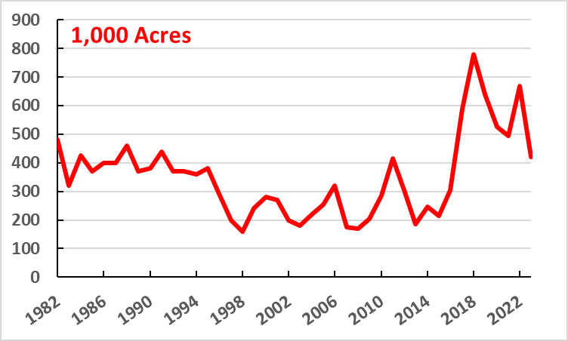
Oklahoma Cotton Planted Acres
Freedom
to Farm

Slide 7
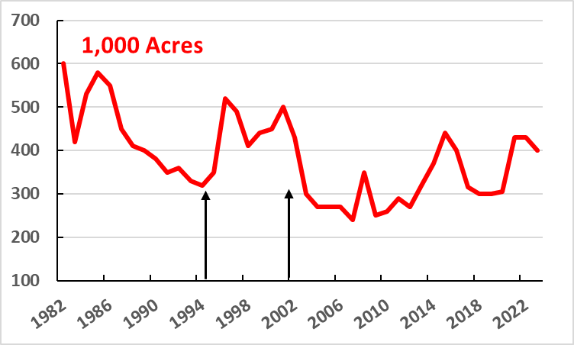
Oklahoma Sorghum Planted Acres

Slide 8
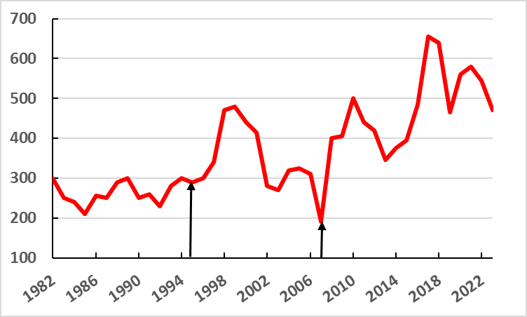
Oklahoma Soybeans Planted Acres
Freedom
to Farm
Ethanol

Slide 9

Prices to use in when to develop a strategy with plans

Slide 10
Pond Creek, Oklahoma
Name | Notes | Delivery Start | Delivery End | Basis Month | Futures Price | Basis | Cash Price
WHEAT HRW | CASH | Aug 2023 | Nov 2023 | December 2023 | 719-4 | -60 | $6.11
WHEAT HRW | NC 24 | May 2024 | Jul 2024 | July 2024 | 714-0 | -70 | $6.20
CORN | NC 23 | Oct 2023 | Nov 2023 | December 2023 | 483-6 | -15 | $4.71
MILO | NC 23 | Oct 2023 | Nov 2023 | December 2023 | 483-6 | 10 | $4.96
SOYBEAN | NC 23 | Oct 2023 | Nov 2023 | November 2023 | 1367-6 | -65 | $12.07
-$0.25
+$0.15
+$0.60
$0.25
-$0.20
-$0.40
-$0.20

Slide 11
Weatherford
Name | Notes | Delivery Start | Basis Month | Futures Price | Basis | Cash Price
WHEAT HRW | CASH | Aug 2023 | December 2023 | 717-4 | -70 | $6.01
WHEAT HRW | NC 24 | May 2024 | July 2024 | 710-4 | -85 | $6.05
CORN | NC 23 | Oct 2023 | December 2023 | 484-0 | 20 | $5.06
MILO | NC 23 | Oct 2023 | December 2023 | 484-0 | 5 | $4.91
SOYBEANS | NC 23 | Oct 2023 | November 2023 | 1368-2 | -85 | $11.87
Altus
-$0.30
-$0.10

Slide 12
Wheat

Slide 13
U.S. Wheat Situation
Ending
Stocks
U. S.
Price
Year
Production
Consumption
(Billion Bushels)
2023 | 1.73 | 1.83 | .615 | $7.50
7-YR Avg. | 1.86 | 2.03 | .930 | $5.69
$6.11
$6.20
$5.84
World Wheat Situation
Ending
Stocks
Year
Production
Consumption
2023 | 28.9 | 29.2 | 9.5
7-YR Avg. | 28.1 | 28.0 | 10.3

Slide 14
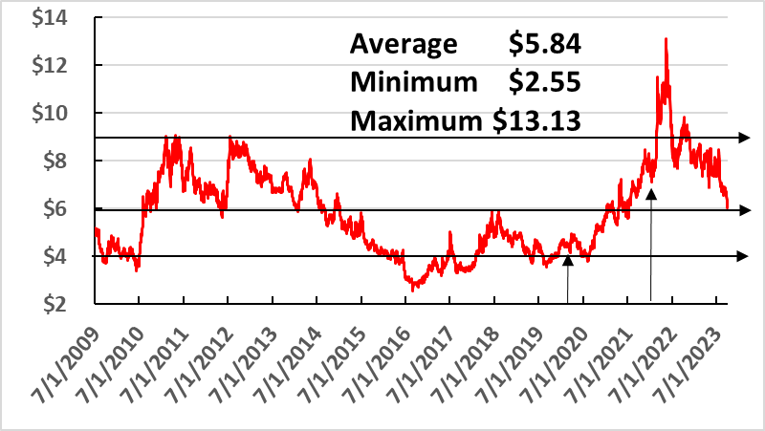
Daily Oklahoma Wheat Prices
$6.11
$6.20
$5.84

Slide 15
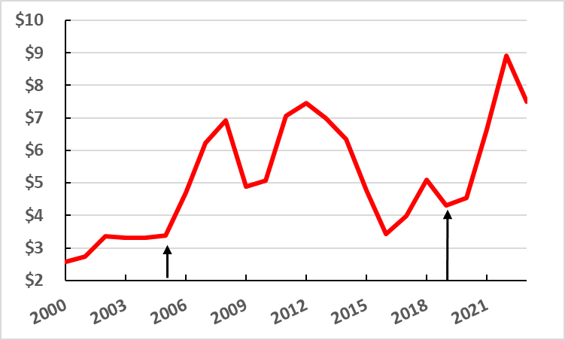
Average Annual Oklahoma Wheat Price
0.612
$6.11
$6.20
$5.84

Slide 16
Corn

Slide 17
World Corn Situation
Ending
Stocks
Year
Production
Consumption
(Billion Bushels)
2023 | 47.8 | 47.2 | 12.4
7-YR Avg. | 44.7 | 44.8 | 12.5
$4.71
$4.96
U.S. Corn Situation
$4.81
Ending
Stocks
U. S.
Price
Year
Production
Consumption
(Billion Bushels)
2023 | 15.1 | 14.4 | 2.22 | $4.90
7-YR Avg. | 14.4 | 14.5 | 1.80 | $4.42

Slide 18
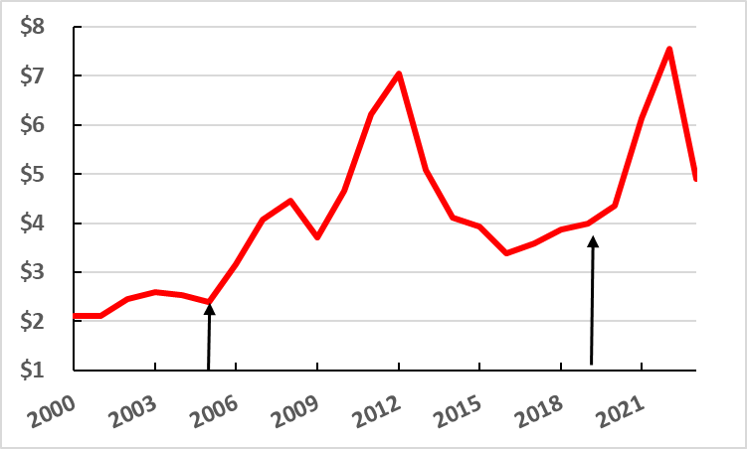
Average Annual Oklahoma Corn Price
$4.71
$4.96
$4.81

Slide 19
Soybean

Slide 20
World Soybean Situation
Ending
Stocks
Year
Production
Consumption
(Billion Bushels)
2023 | 14.7 | 14.1 | 4.4
7-YR Avg. | 13.1 | 12.9 | 3.7
$12.07
$11.77
U.S. Soybean Situation
$10.70
Ending
Stocks
U. S.
Price
Year
Production
Consumption
2023 | 4.1 | 4.2 | 0.22 | $12.90
7-YR Avg. | 4.2 | 4.3 | 0.42 | $10.59

Slide 21
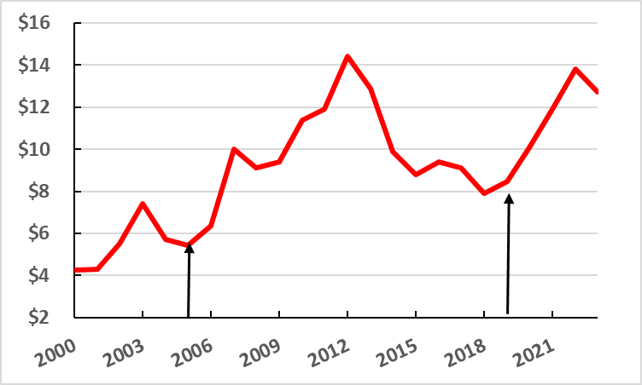
Average Annual Oklahoma Soybean Price
$12.07
$11.77
$10.70

Slide 22
Cotton

Slide 23
World Cotton Situation
Ending
Stocks
Year
Production
Consumption
(Million Bales)
2023 | 114.0 | 116.9 | 91.6
7-YR Avg. | 116.5 | 116.1 | 86.5
U.S. Cotton Situation
Ending
Stocks
U. S.
Price
Year
Production
Consumption
2023 | 13.1 | 14.5 | 3.0 | 80.0¢
7-YR Avg. | 17.6 | 17.7 | 4.4 | 72.3¢

Slide 24
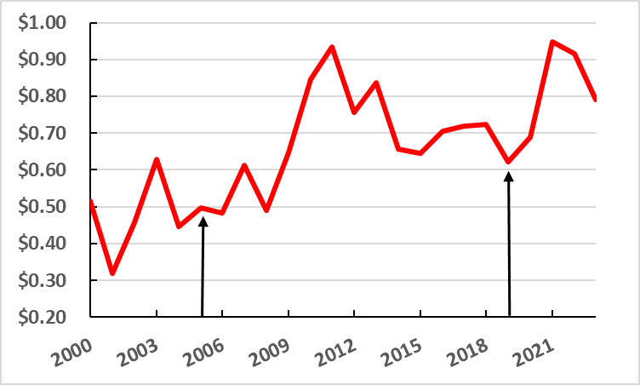
Average Annual Cotton Price
$0.80+
$0.75

Slide 25

Questions? Or Comments.
kim.anderson@okstate.edu

Slide 26

Peter F. Drucker
There are no solutions with respect to the future. There are only choices between courses of action, each imperfect, each risky, each uncertain, and each requiring different efforts and involving different costs. But, nothing can help the manager more than to realize what alternatives are available and what they imply.

