Slide 1


Where are we in the Farm Bill Process?
Dr. Bart Fischer
Co-Director & AgriLife Assistant Professor
Agricultural & Food Policy Center (AFPC)
Rural Economic Outlook Conference
Stillwater, OK
October 11, 2023

Slide 2
Farm Policy:
Potential Improvements?

Slide 3
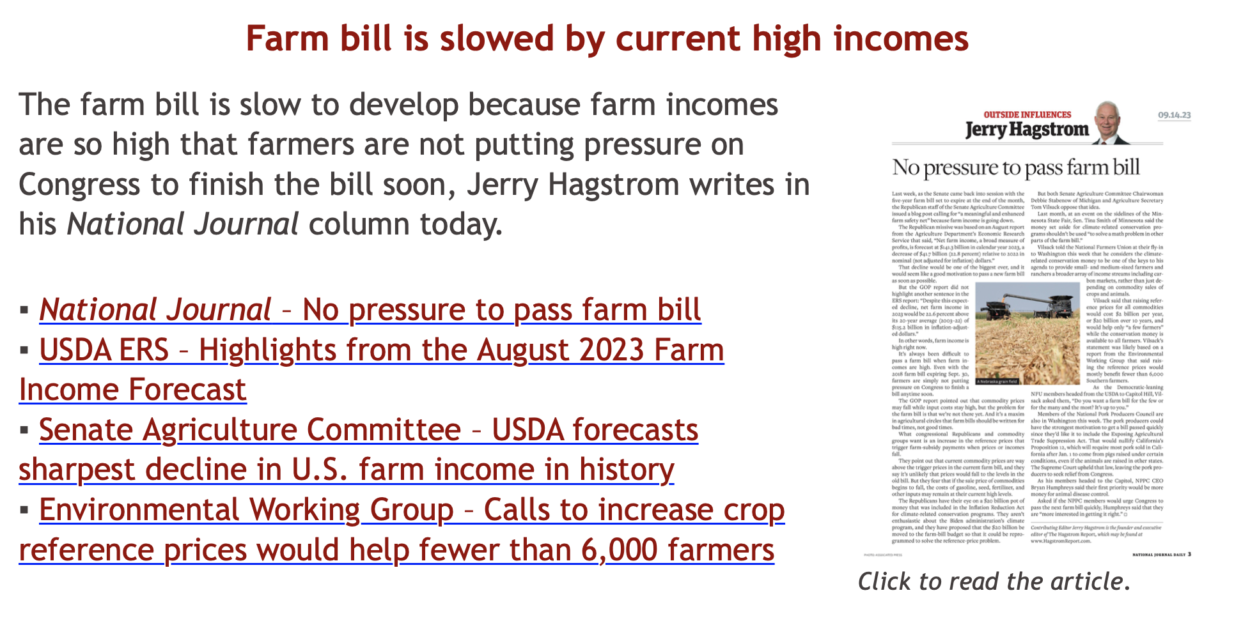
Farm bills aren’t written for the good times…
Source: Hagstrom Report (9/14/2023)

Slide 4
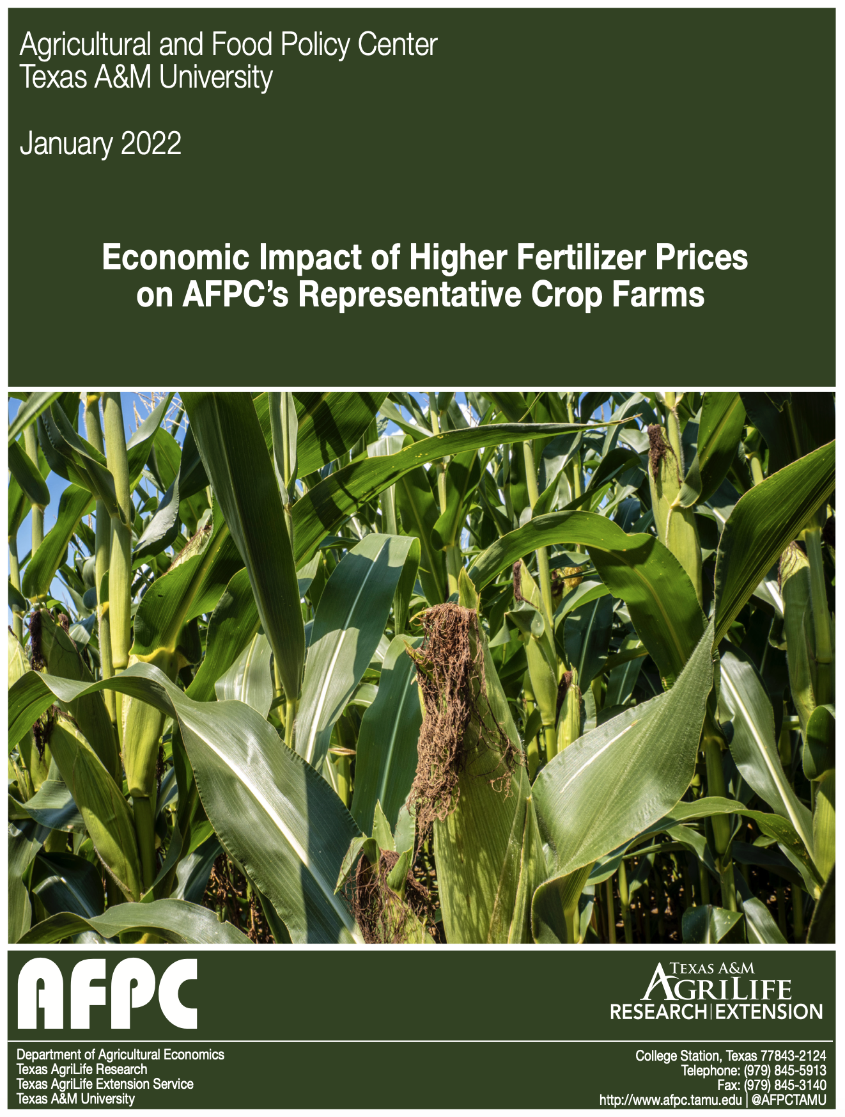
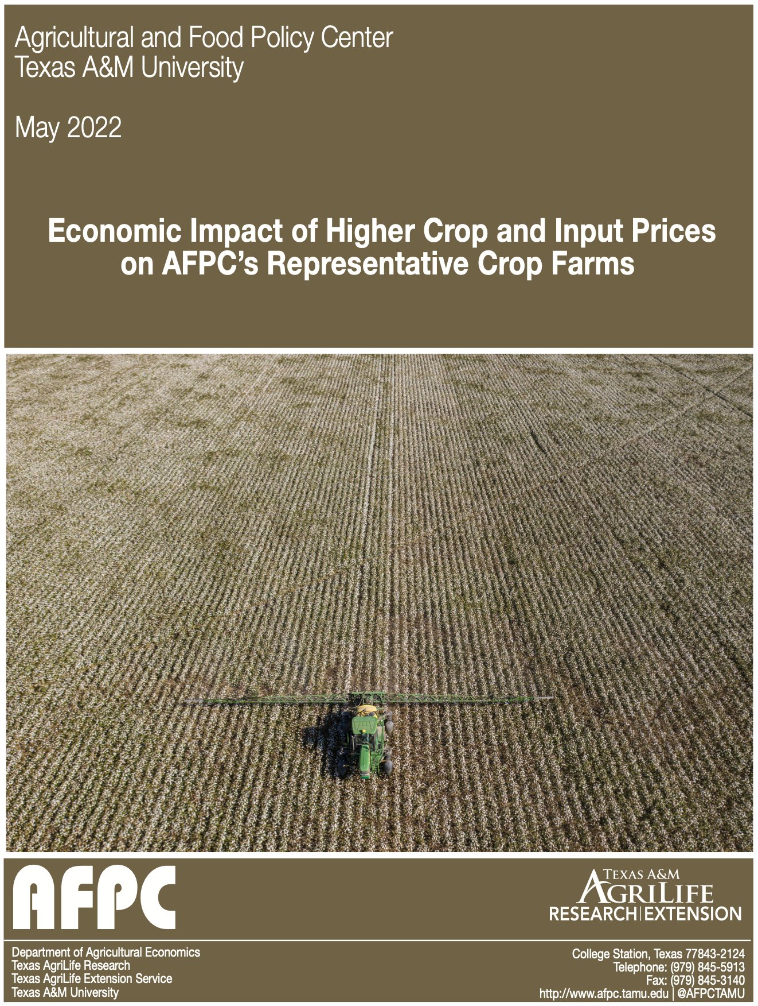
2022 Cost of Production

Slide 5
Farm Policy Concerns
I’m Hearing
Reference prices have not kept up with the cost of doing business.
Base acres are out outdated.
Payment limits are outdated.
Increasing reliance on ad hoc assistance that is not bankable and arrives too late.
Don’t mess up crop insurance and improve where possible.

Slide 6
Reference Prices
Statutory Reference Prices Set By Congress.
Effective Reference Price Can Move Up If Prices Move Up.
Cost to increase statutory Reference Prices?
  10%: ~25$ billion
  20%: ~$55-60 billion
  30%: over $100 billion
  What about changes to the Effective Reference Price calculation?

Slide 7
Effective Reference Prices
Using CBO’s May 2023 Outlook

Slide 8
Base Acres
Mandatory base update? Corn Baseline: $26.39/ac; Soybean Baseline: $11.46/ac; Likely saves money but at what expense?
Voluntary base update? Show me the money!
Rolling 5-year average? NFU 2014 proposal
Base trading or renting? 1960s & 1970s concepts
Expand/relax ineligible acres from 2018 Farm Bill?
Expand/relax Unassigned Base Acres from Bipartisan Budget Act of 2018?

Slide 9
Means Testing, Actively Engaged Rules & Payment Limits
Archaic and out of date.
Lessons learned from WHIP+ & ERP?
  Update Title 1 payment limit to include ad hoc limits?
  Expand payment limits using 75% AGI threshold (i.e., if 75% of your AGI is from farming/ranching/etc)?
  Update AGI test to include 75% threshold?

Slide 10
Crop Insurance Improvements?
Increase premium subsidy for buy-up MPCI coverage levels?
There is a confusing plethora of area-wide policy options (e.g., SCO, STAX, ECO). Each have their own unique features—for example:
Could we take the best features of each and combine? With cotton contributing the most baseline, could STAX+PLC be allowed as a compromise? What is the future of ARC?
 | SCO | STAX | ECO
Maximum Trigger Point | 86% | 90% | 95%
Maximum Coverage | 36% | 20% | 9%
Premium Subsidy | 65% | 80% | 44% - 51%
Yield Basis | Individual APH | County Average | Individual APH
Title 1 Interaction | PLC Allowed ARC Not Allowed | PLC Not Allowed ARC Not Allowed | PLC Allowed ARC Allowed

Slide 11
Budget Chaos

Slide 12
Fiscal Responsibility Act of 2023
What’s in it?
Suspends debt ceiling until 1/1/2025.
Generates savings of $1.5 trillion (2023–2033) relative to May 2023 baseline.
Savings largely achieved by capping FY2024 & FY2025 discretionary spending.
Claw back of unspent COVID funds reduces deficit by estimated $11 billion.
SNAP:
  Raises ABAWD age from 18-49 to 18-54; exceptions for homeless, veterans, and youth aging out of foster care; sunsets 10/1/2030.
  Lowers ABAWD exemptions from 12% to 8% and eliminates carryover.
  Publishes work waiver requests/approvals.
What’s not in it?
New funding for the 2023 Farm Bill! Impact?

Slide 13
Commodity Title Outlays
2002 vs 2018
Supplemental & Ad Hoc Disaster Assistance, including the Market Facilitation Program (FY18-23):
$93.3 billion
?
2023 Farm Bill

Slide 14
Federal Debt Held by the Public
1962-2022

Slide 15
Estimated Federal Outlays (FY2024-2033)
CBO May 2023 Baseline Outlook (in billions)

Slide 16
Farm Bill Projected Outlays
How will Congress react to a $1 TRILLION Farm Bill?
 | April 2018 | February 2023 | May 2023 | Change ($) Apr 18 v May 23 | Change (%)
CCC Price Support & Related Activities 1/ | 64,305 | 71,806 | 83,576 | +19,271 | +30.0%
Conservation 2/ | 59,689 | 72,610 | 75,124 | +15,435 | +25.9%
SNAP 3/ | 663,828 | 1,205,440 | 1,223,110 | +559,282 | +84.3%
Crop Insurance | 78,037 | 96,974 | 101,345 | +23,308 | +29.9%
Total | 865,859 | 1,446,830 | 1,483,155 | +617,296 | +71.3%
1/ This includes an estimated $10 billion in “Other Administrative CCC Spending” which accounts for CBO’s estimate of the amount that the Secretary may spend from the CCC using his/her discretionary authority.
2/ The totals for both the February 2023 & May 2023 updates includes $15.1 billion in estimated 10-year outlays for conservation spending authorized in the Inflation Reduction Act (IRA) of 2022.
3/ Revised economic assumptions and administrative changes to the Thrifty Food Plan (TFP) resulted in the Office of Management and Budget (OMB) projecting an additional $254 billion in SNAP outlays from FY2022-31 (https://www.whitehouse.gov/wp-content/uploads/2021/08/msr_fy22.pdf).

Slide 17
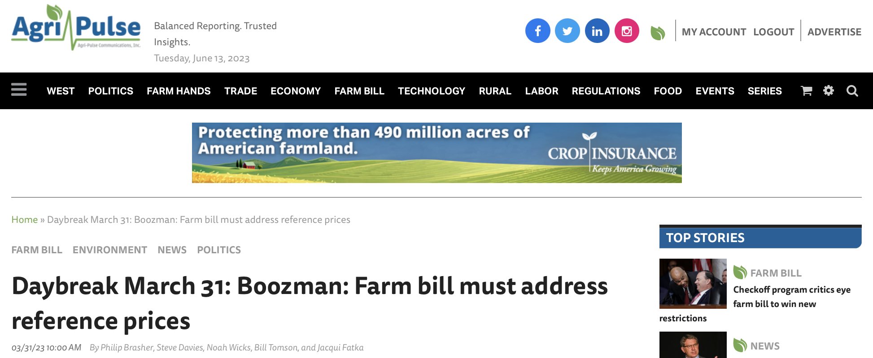
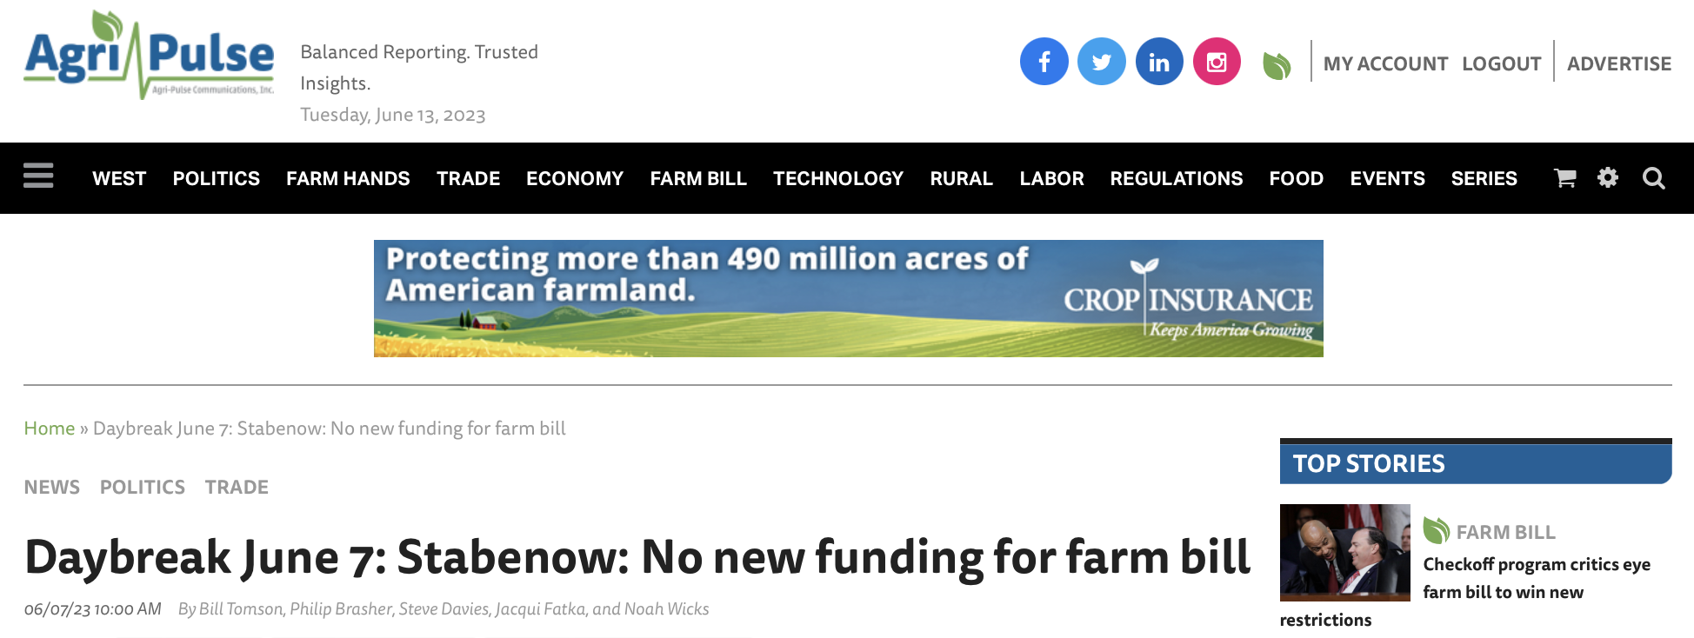
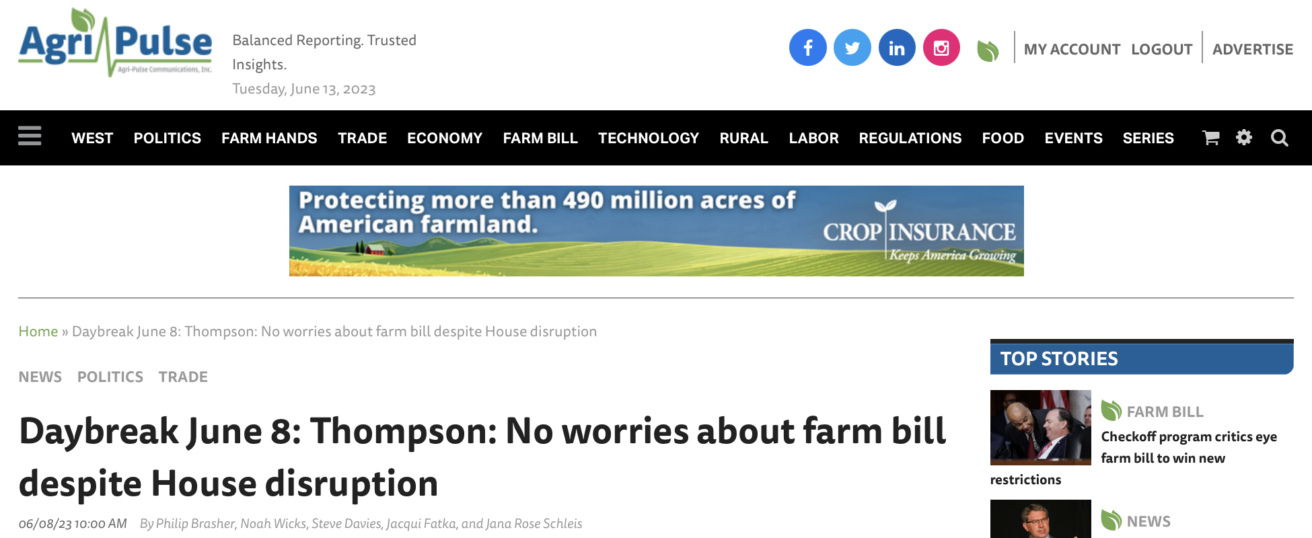
Where does that leave us?
!!!

Slide 18
Politics

Slide 19
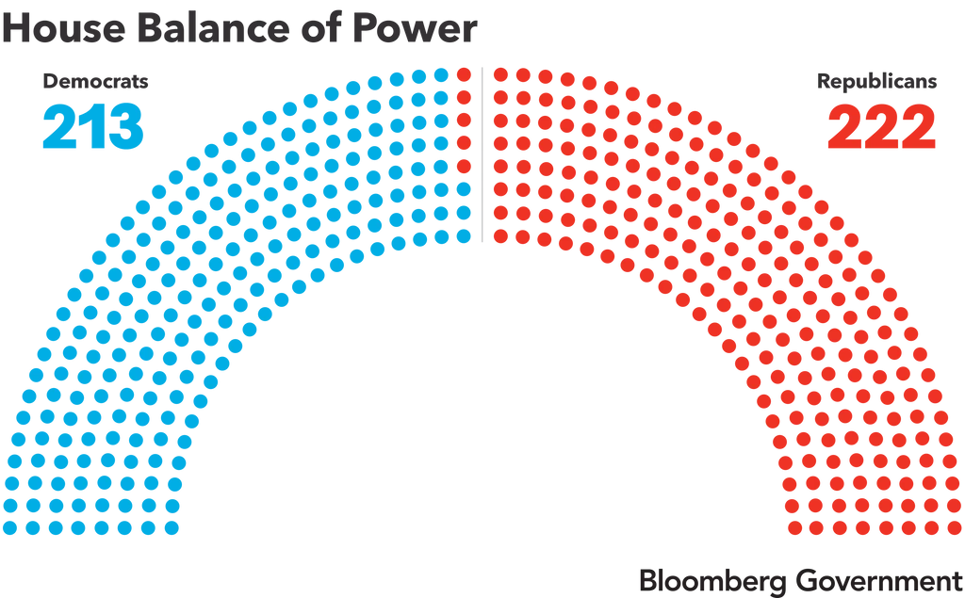
Getting to 218 in the House…
Source: https://about.bgov.com/brief/balance-of-power-republican-majority-in-the-house/ (9/12/2023)

Slide 20
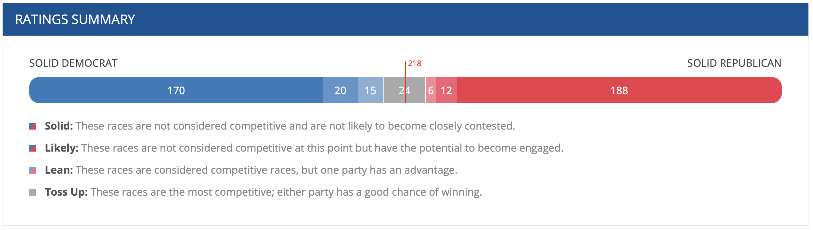
What about 2024?
Source: https://about.bgov.com/brief/balance-of-power-republican-majority-in-the-house/ (9/12/2023) and
https://www.cookpolitical.com/ratings/house-race-ratings (10/9/2023)

Slide 21
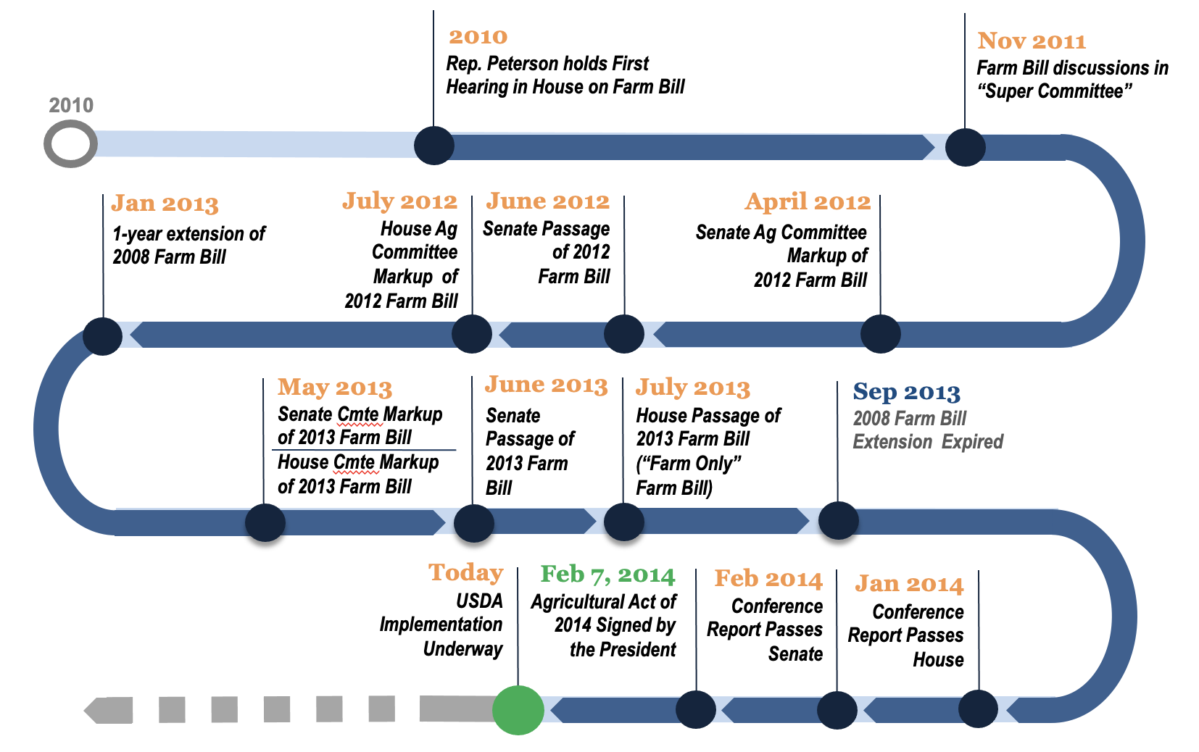
Path Forward
What’s the point of doing a new farm bill if there aren’t meaningful improvements to the farm safety net?
Pathways in the House:
  If someone says they know the path forward, they’re lying.
  Partisan? 4-vote margin.
  Is that even possible following
  the ousting of the Speaker?
  Bipartisan? Election coming.
  Another motion to vacate?
  Extension? Omnibus?

Slide 22
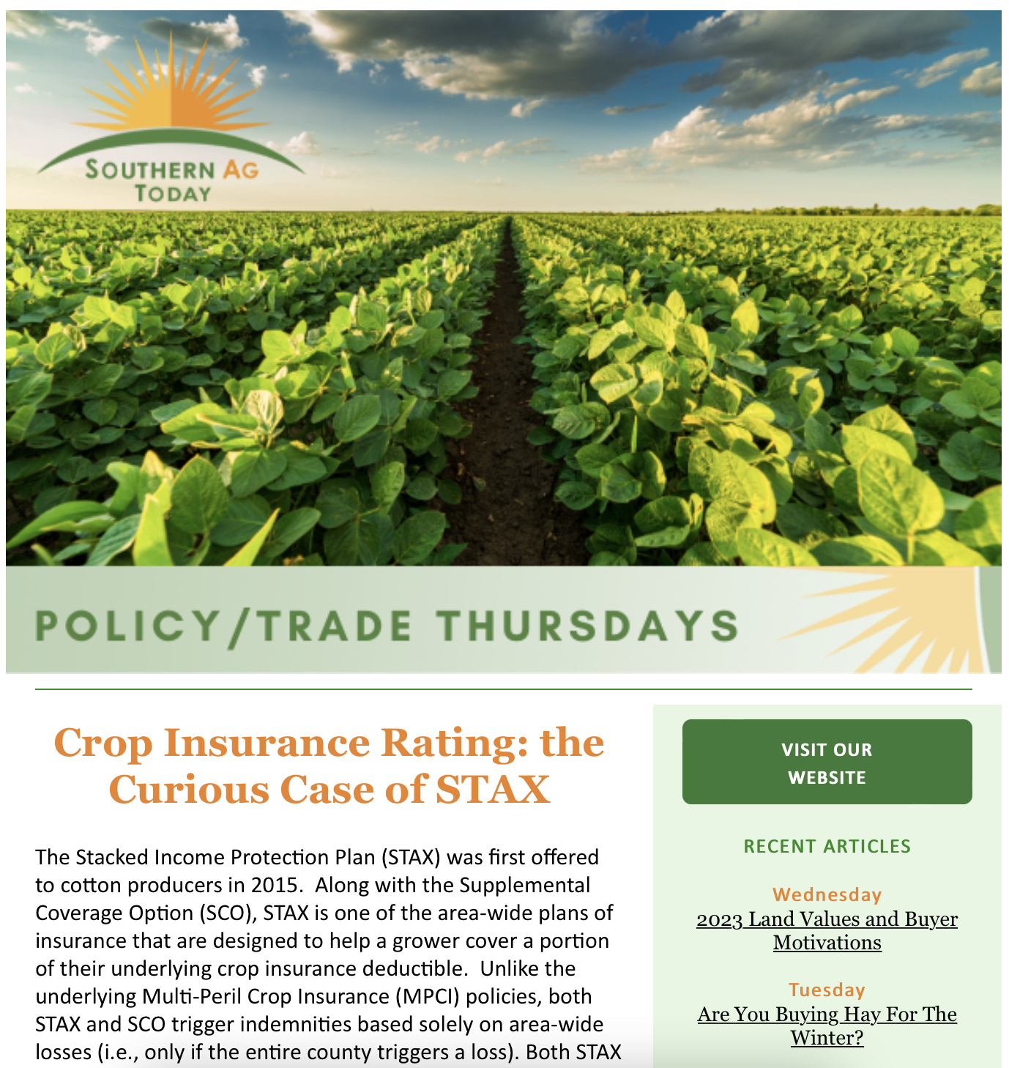

Southern Ag Today www.southernagtoday.org
Officially
launched!!

Slide 23
Questions?
Dr. Bart Fischer
bartfischer@tamu.edu
979-845-5913
www.afpc.tamu.edu

