Slide 1
Ag Finance Topic Updates
Rodney Jones, Ph.D. Oklahoma Farm Credit Agricultural
Finance Chair, OSU Dept. of Agricultural Economics

Slide 2
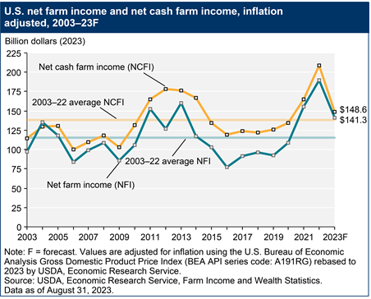
The Overall Farm Financial Picture Net Farm Income Falling

Slide 3
What’s Up (or down) with Farm Income?
2022 was in general a very strong Net income year (U.S.) Mixed bag in Oklahoma)
Net Cash income and actual Net Farm income much closer together in recent years
2023 cash receipts lower (across U.S., probably even worse for Oklahoma). Very high cash expenses all around

Slide 4
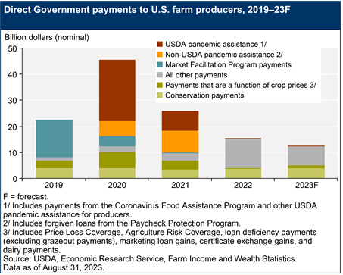
Government Payments Dropped Off Significantly

Slide 5
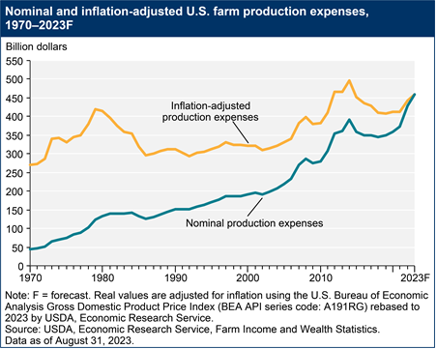
Cost Are Increasing

Slide 6
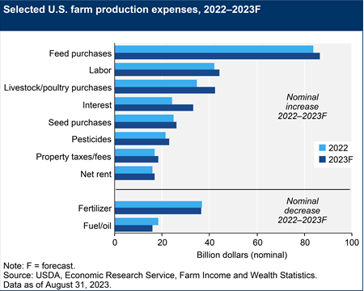
Chart Below Represents Expenses For 2023 Production Year, Not Yet Forecasting 2024

Slide 7
It’s Not Oklahoma, But Close Neighbor To The North
KFMA average Net Farm Income
2022 $164,914
2021 $319,180
2020 $173,972
2019 $108,960
2018 $101,274
2017 $ 66,564

Slide 8
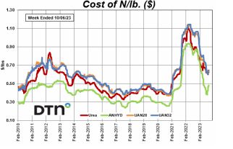
Fertilizer Prices Spiked

Slide 9
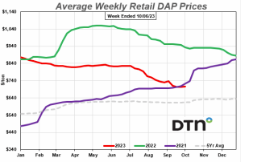
Average Weekly Retail DAP Prices

Slide 10
Facts and Observations Nation Wide
Liquidity positions are deceasing somewhat.
Equity positions remain strong.
Loan volume (mostly operating) has increased at fastest pace in nearly a decade
Repayment concerns have slightly increased, interest rates are a huge concern.
Land values remain very strong.

Slide 11
Oklahoma Observations
Crop producers
2022 presented financial challenges for many Oklahoma crop producers. 2023 has once again plagued many producers with serious production challenges, crop insurance coverage plays a big role in financial outcomes.
Most producers can lock in positive margins on 2024 crops, but not wide positive margins.
Cow Calf Producers
Strong profits appear possible going into 2024

Slide 12
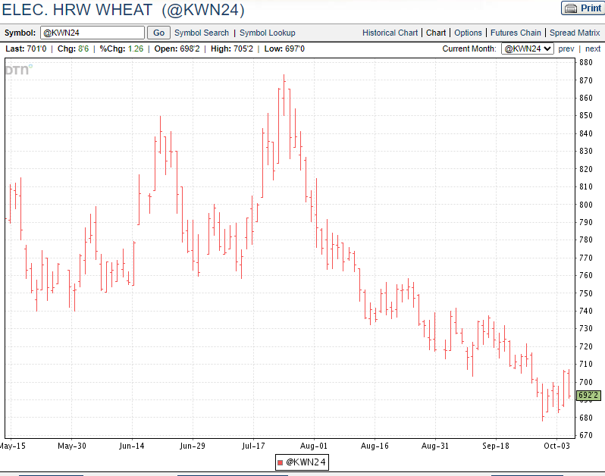
Elec. HRW Wheat

Slide 13
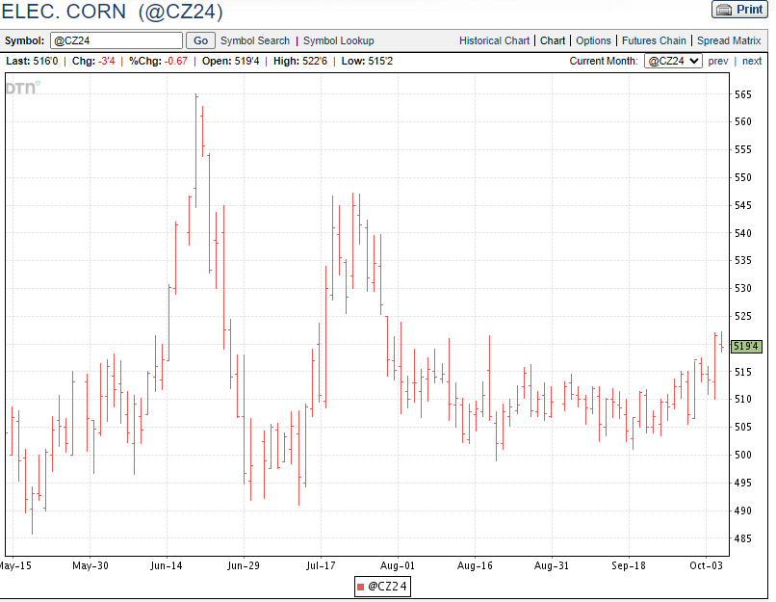
Elec. Corn

Slide 14
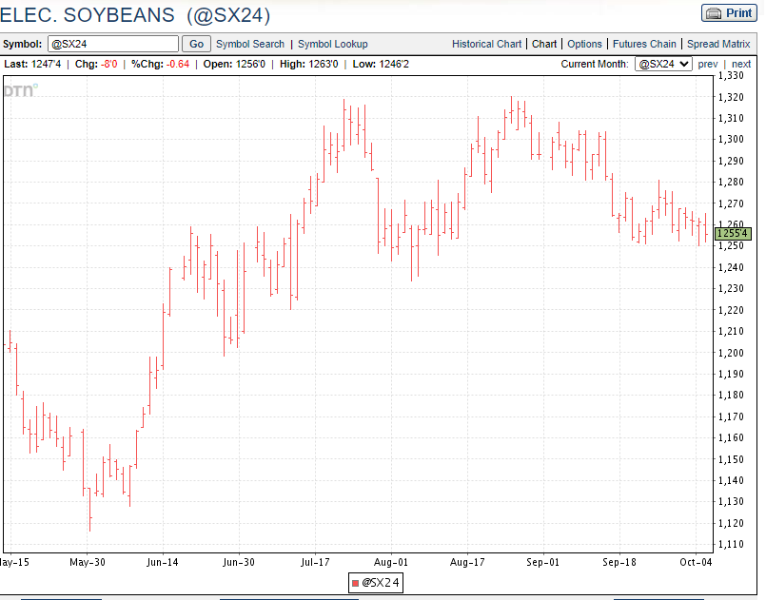
Elec. Soybeans

Slide 15
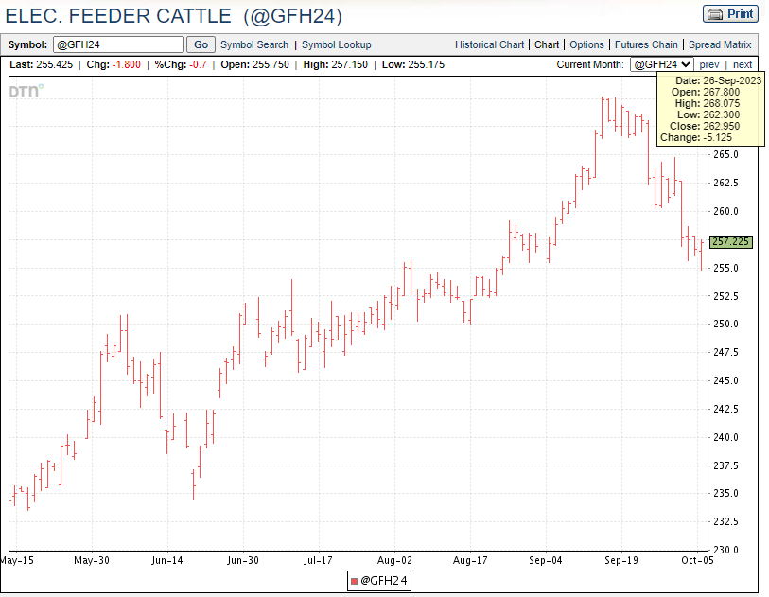
Elec. Feeder Cattle

Slide 16
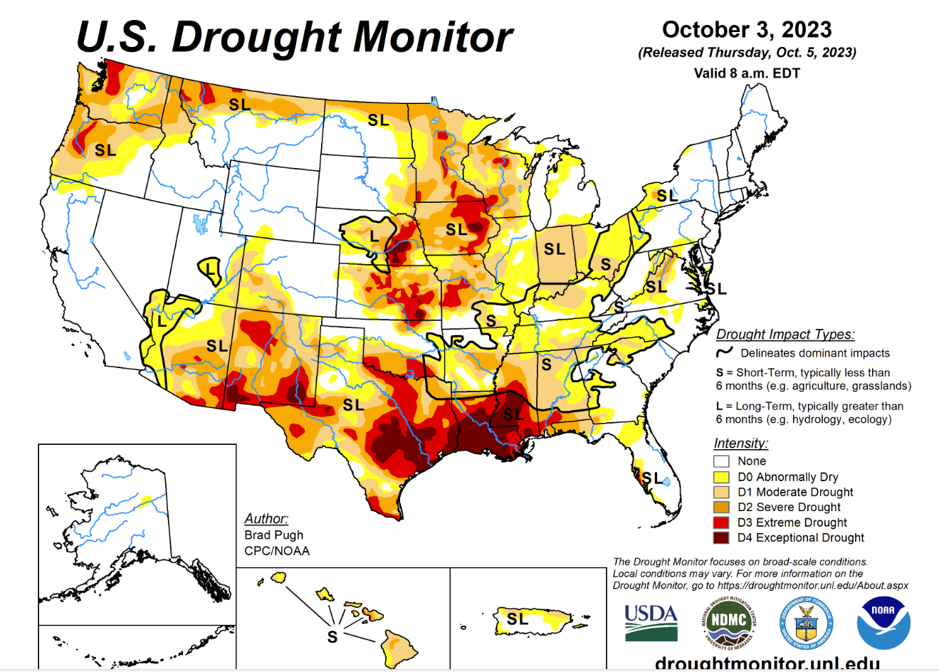
October 3, 2023 U.S. Drought Monitor

Slide 17
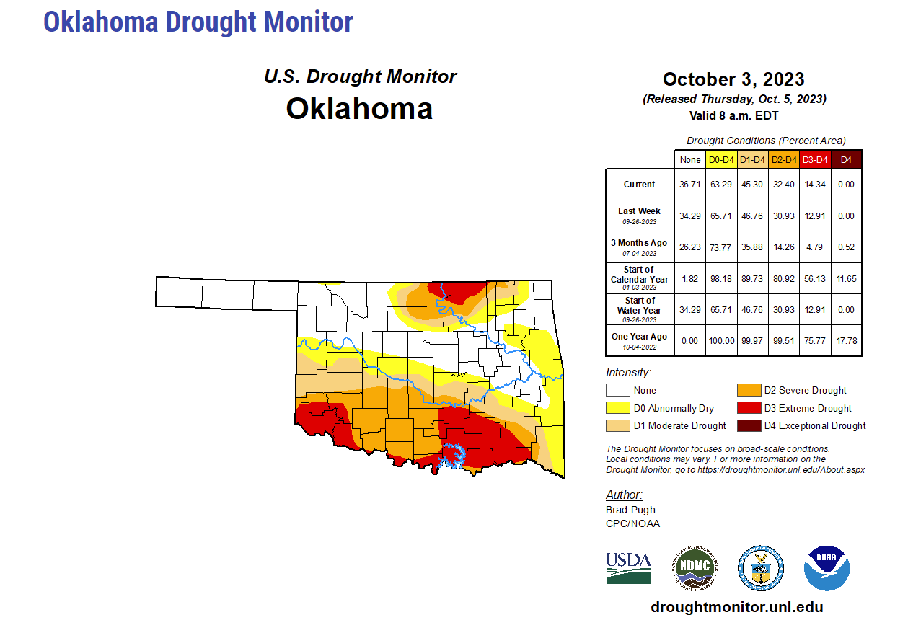
Oklahoma Drought Monitor

Slide 18
Summary
Insurance program management is critical in times like this
Events beyond our control are impacting bottom lines (weather, market challenges, etc.)
Be aware of the consequences of rising interest rates, and increasing overall capital requirements to operate and acquire assets

Slide 19
Questions???
If you would like to be added to the list for our Ag Finance electronic newsletter, send me an email at rodney.jones@okstate.edu
Join us on Facebook at OSUFarmManagment

