Slide 1
Stress and Mental Health on the Farm
Jordan Shuler, Doctoral Candidate, & Matt Brosi, PhD
Notes:
Farmers and their families are under a great deal of pressure, including natural disasters, high input and low commodity prices, and family and community challenges. These challenges often build up and create both health and mental health challenges that can multiply the effects of the problems they are already facing. Join us for to hear from doctoral student Jordan Shuler as he discusses understanding and taking on these challenges.

Slide 2
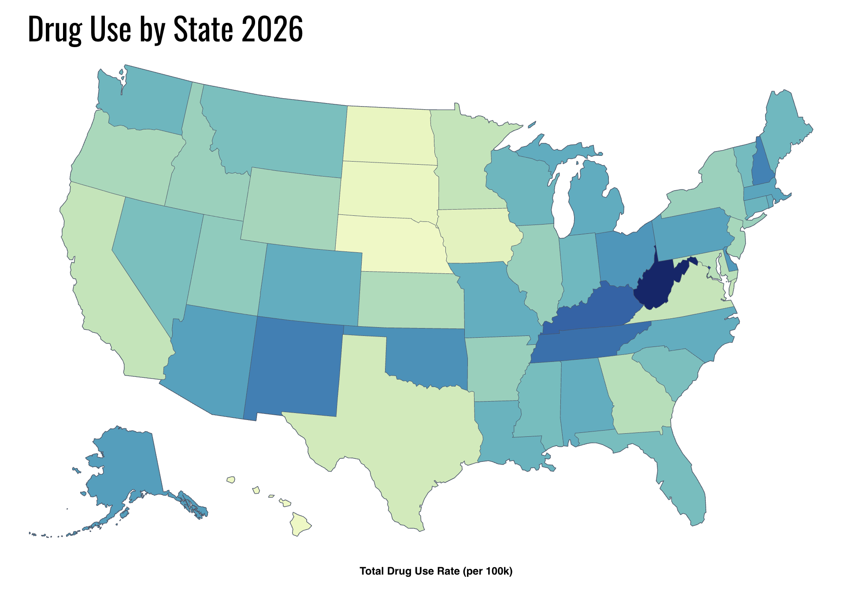

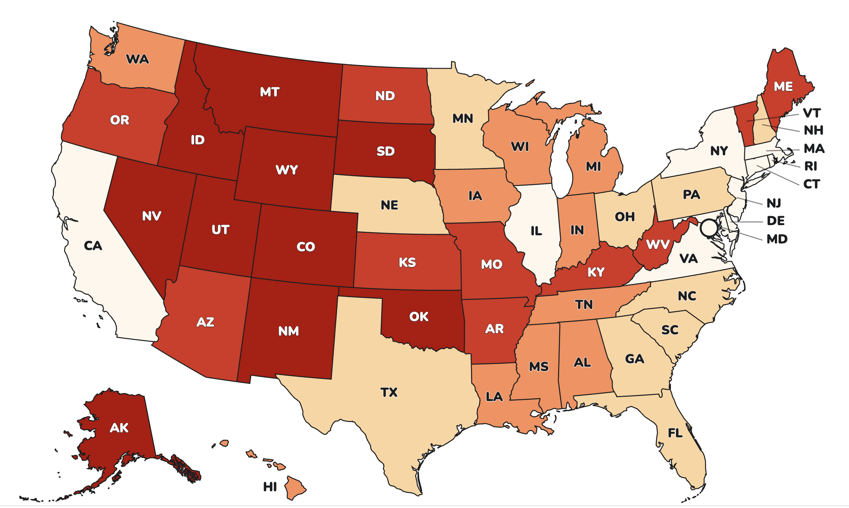
Oklahoma’s mental health crisis
Mental Health in Oklahoma
  1 in 5 adults experience mental illness per year
  1 in 20 adults have serious thoughts of suicide each year
  OK is 5th in nation for suicide rates.
  OK is 7th nationally for drug use
Where are the most MH providers in OK?
  Adults residing in rural locations receive mental health treatment less frequently and often with providers with less specialized training, compared to those in urban areas.
  **Shame, privacy, independence, and “grit” still plague the process of seeking help
Notes:
https://www.cdc.gov/suicide/facts/rates-by-state.html
https://www.nami.org/wp-content/uploads/2025/05/Oklahoma-GRPA-Data-Sheet-8.5-x-11-wide.pdf
https://worldpopulationreview.com/state-rankings/drug-use-by-state

Slide 3
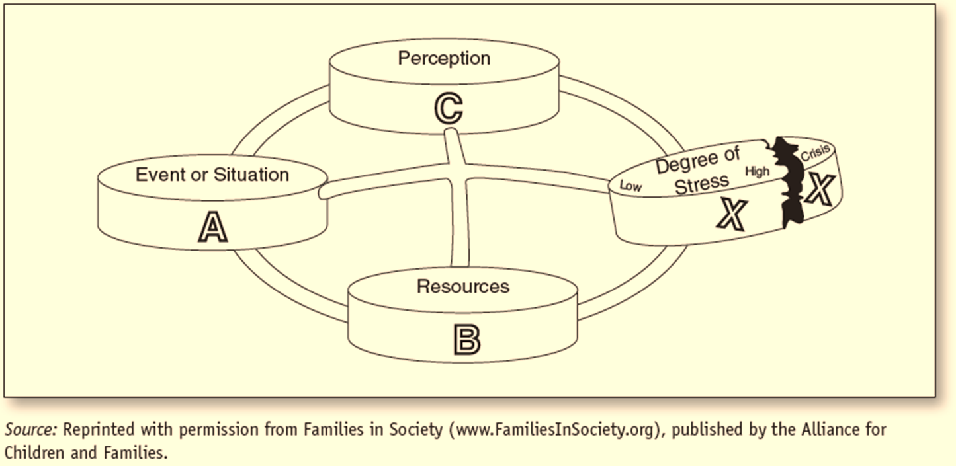
Stress, Farm Stress, and Mental Health
    Death
    Divorce
    Disease
    Disaster
    Disability
Notes:
We’ve covered a lot, but here is a way to pull much of this information together and start the process of coming up with ideas of what can be done to make a difference
References:
Hill, R. (1958). Generic features of families under stress. Social Casework, 49, 139–150
Lavee, Y., McCubbin, H. I., & Patterson, J. M. (1985). The double ABCX model of family stress and adaptation: An empirical test by analysis of structural equations with latent variables. Journal of Marriage and the Family, 811-825.

Slide 4
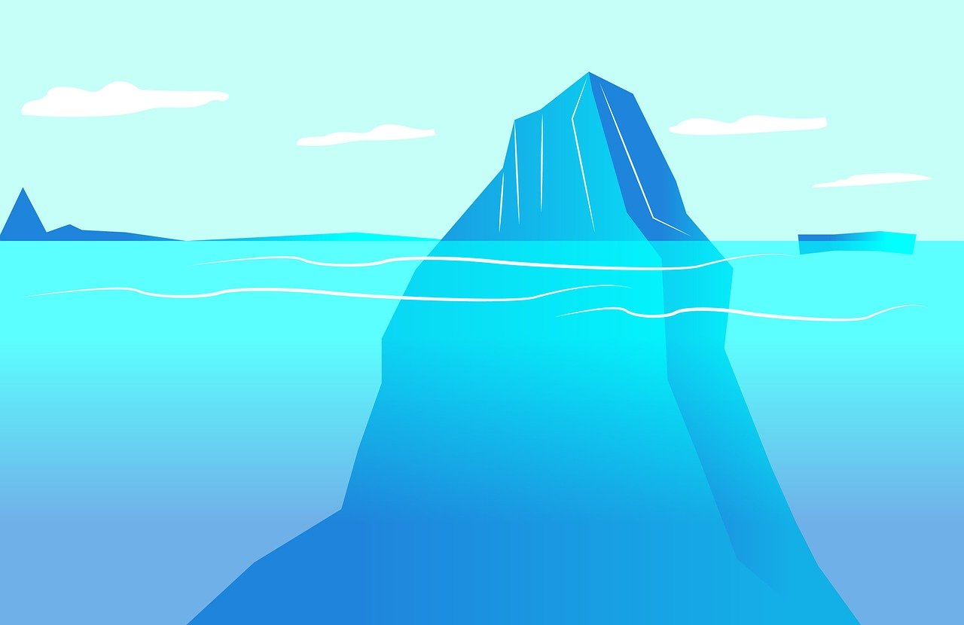
Substance Abuse and Mood Disorders
Anxiety and Depression are common – when they overwhelm us we call it a disorder
Often substance abuse disorders overlap with these other disorders
Even if you don’t experience a “disorder” your mental and family health impact your wellbeing

Slide 5


Family Systems
A "system"...
  Is made up of many parts, but makes something bigger when together.
  It's pieces constantly affect and are affected by one another.
  It has a way of keeping the system working in a steady state.
A "family system" works in a similar way, but it's parts:
  Have unique thoughts and feelings about “we/us”
  Constantly communicate and interpret messages (spoken and unspoken)
    Uses actions & emotions to keep the system working in the way it is most used to.
  *Can influence the state of “health” of each of it’s members.
Notes:
Technical Notes:
System examples
Clock or gears are interconnected pieces in which each part is effected by any piece in the system moving, even if not directly touching it.
Air conditioning units generally work by a sensor noticing when the temperature is too hot inside its space and uses a coolant and fan system to move cool air into the living area in a home until it senses that it is back to the state/temperature it is set to.
Basic Family Systems Principles
Family members CANNOT NOT communicate (even when not together memories and beliefs continue to shape future interactions with or about family members)
Pieces of the family have a strong tendency to maintain morphostasis, a tendency towards a constantly shifting equilibrium
Types of subsystems
Couple subsystem and parental subsystem can be made of the same members, but have a distinct set of roles, rules, and boundaries. In the case of divorce and separation, the systems may become more complex, with a dissolved couple system but a maintained parental system, sometimes including step-parents who are part of new couple subsystems. These pieces continue to interact. A child subsystem could include parent and child, parent and multiple children, parents and child, parents and children, or various subsets of siblings. Technically an individual can also be considered a subsystem as they have internally interacting psychological, neurological, and biological components that mutually and simultaneously interact and maintain homeostasis (including psychological homeostasis through cognitive dissonance and bias forces)
Additional details to consider for slide:
Show thought-emotion-behavior cycle...
Show Interactional Sequence cycle...

Slide 6
Skills to Build a Healthy Individual (& Family)
Take care of your biology (caution with self-medication; SLEEP)
  Beware of being hangry
Take care of your need for connectedness
  In relationships with others (overcome the isolation factor):
    Validate/normalize each other's experiences
    Challenge self and one another to grow....
Exercise your thinking brain
  Use body and mind to move from surviving to thriving
Notes:
Specific (Something that can be DONE with your body, and something a living person can do better than a dead person – active goals to do something rather than to stop doing something)
Meanigful (DON’T SKIP THIS ONE, and no one but you can tell you what is meaningful)
Adaptive (Will this make your life better/more meaningful in the long run
Realistic (if its not a 7/10 with 10 being absolutely certain, chances are it won't work)
Time-framed (the more specific the better)
https://www.actmindfully.com.au/upimages/The_Reality_Slap_-_Appendix_4_-_Goal_Setting.pdf
What do parts need? (are you neglecting hobbies, normally neglecting yourself for others benefit OR neglecting others to protect yourself, are you ignoring a part of that is hurt)
Balancing the parts of self
Take care of your biology (caution with self-medication; SLEEP)
Take care of each of your psychological parts (be playful, do what matters, be bold enough to say discomforting things)
Exercise your thinking brain (be aware of cognitive distortions, think outside the box, mindfully meditate)
Use SMART goals to direct what you do (specific, meaningful/the why, adaptive, realistic, time-framed)
In therapy relationships with others (overcome the isolation factor):
Validate/normalize each other's experiences
Explore the mind's parts, feelings, and beliefs – get them connect with one another
Challenge self and one another to grow....

Slide 7
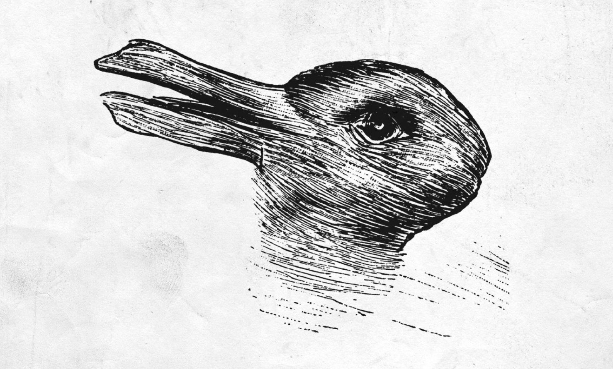
Changing Perspectives
Notes:
https://www.artofplay.com/blogs/stories/fun-with-ambiguous-images
Originally published in 1892, this German cartoon asks, "Which animals are most like each other?" The answer of course is "Rabbit and duck." The duck/rabbit is one of the most popular examples of this type of illusion.

Slide 8

Changing Perspectives – Balance
Challenge Your Thoughts
Accept and Act
Catastrophic Thinking
  I didn’t get a promotion, therefore everyone hates me and I’m about to get fired
All-or-Nothing
  I either have to be a good provider or a good parent
Shoulds
  How often is it a should when it could be a am willing or want to
Event Filter
  Opposite of rose-colored glasses
If your thoughts aren’t going to change, drop the struggle and find the wisdom you can with them
Hold your thoughts and feelings as yours, and hold them lightly
Use SMART goals to move forward
  Specific
  Motivated by Values!
  Adaptive (makes life better in the long run)
  Realistic
  Time-bound

Slide 9
Thank You!!!

