Slide 1

ORECA
Oklahoma Rural
E-Commerce Academy

Slide 2
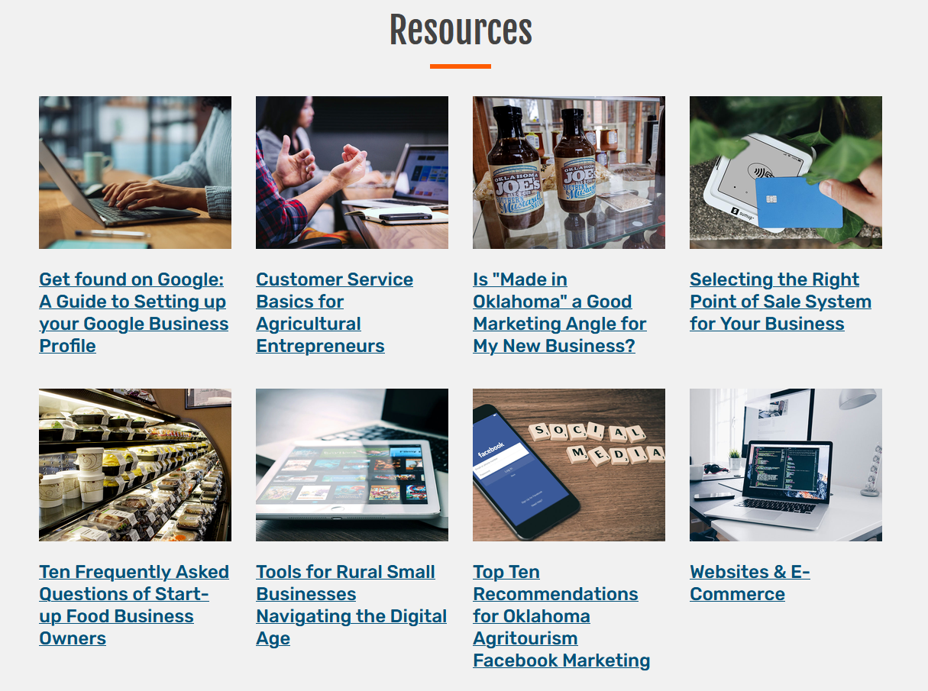
Resources

Slide 3
Outline
What is E-Commerce?
Why offer digital sales?
Selecting the right Point-of-Sale system

Slide 4
What is E-Commerce?
The buying and selling of goods and services online.
Fundamentally changes how businesses operate and how people shop.

Slide 5
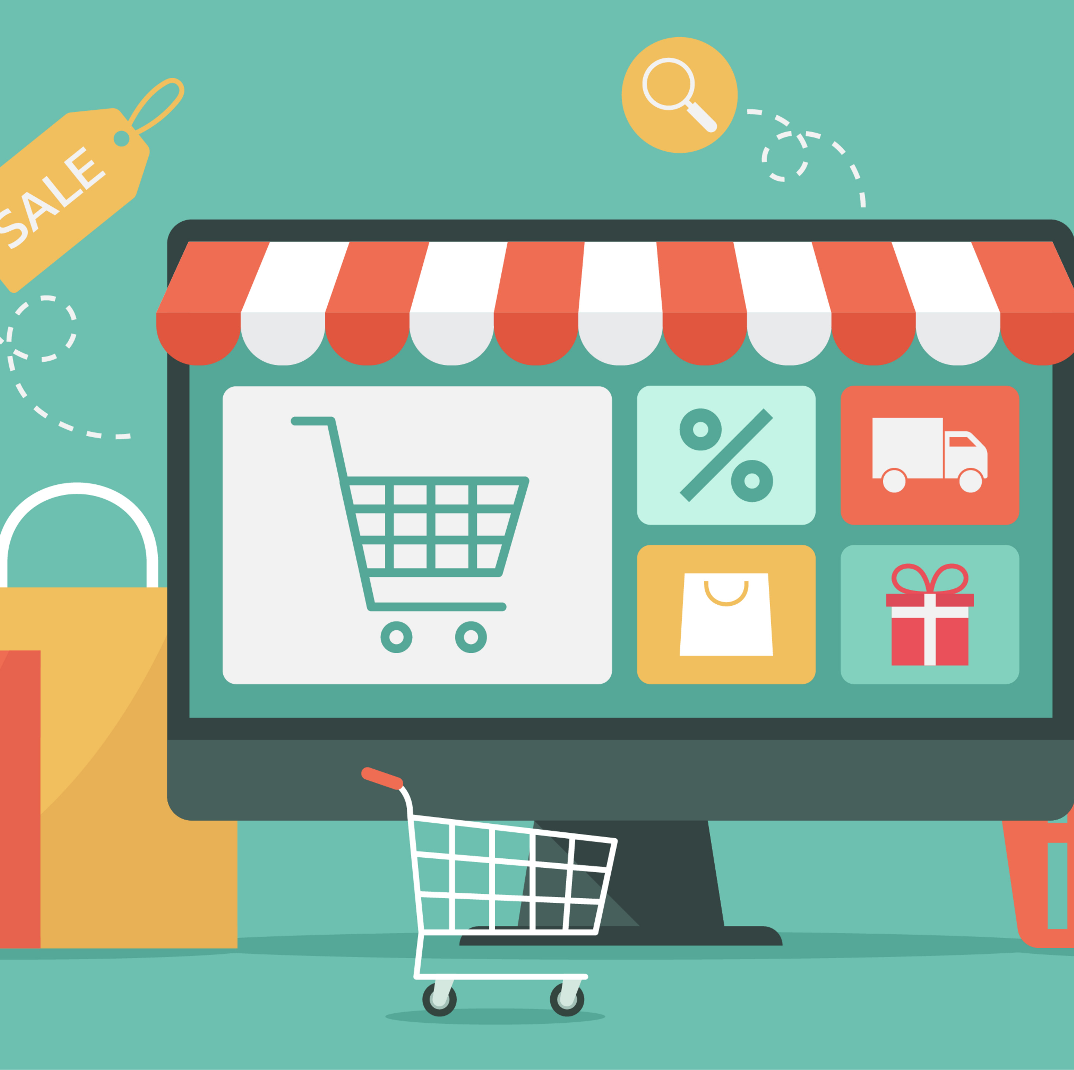
Advantage of Digital Sales
Convenience
More access to sales data
Increased efficiency
Enhanced security
New sales channels
Reach

Slide 6
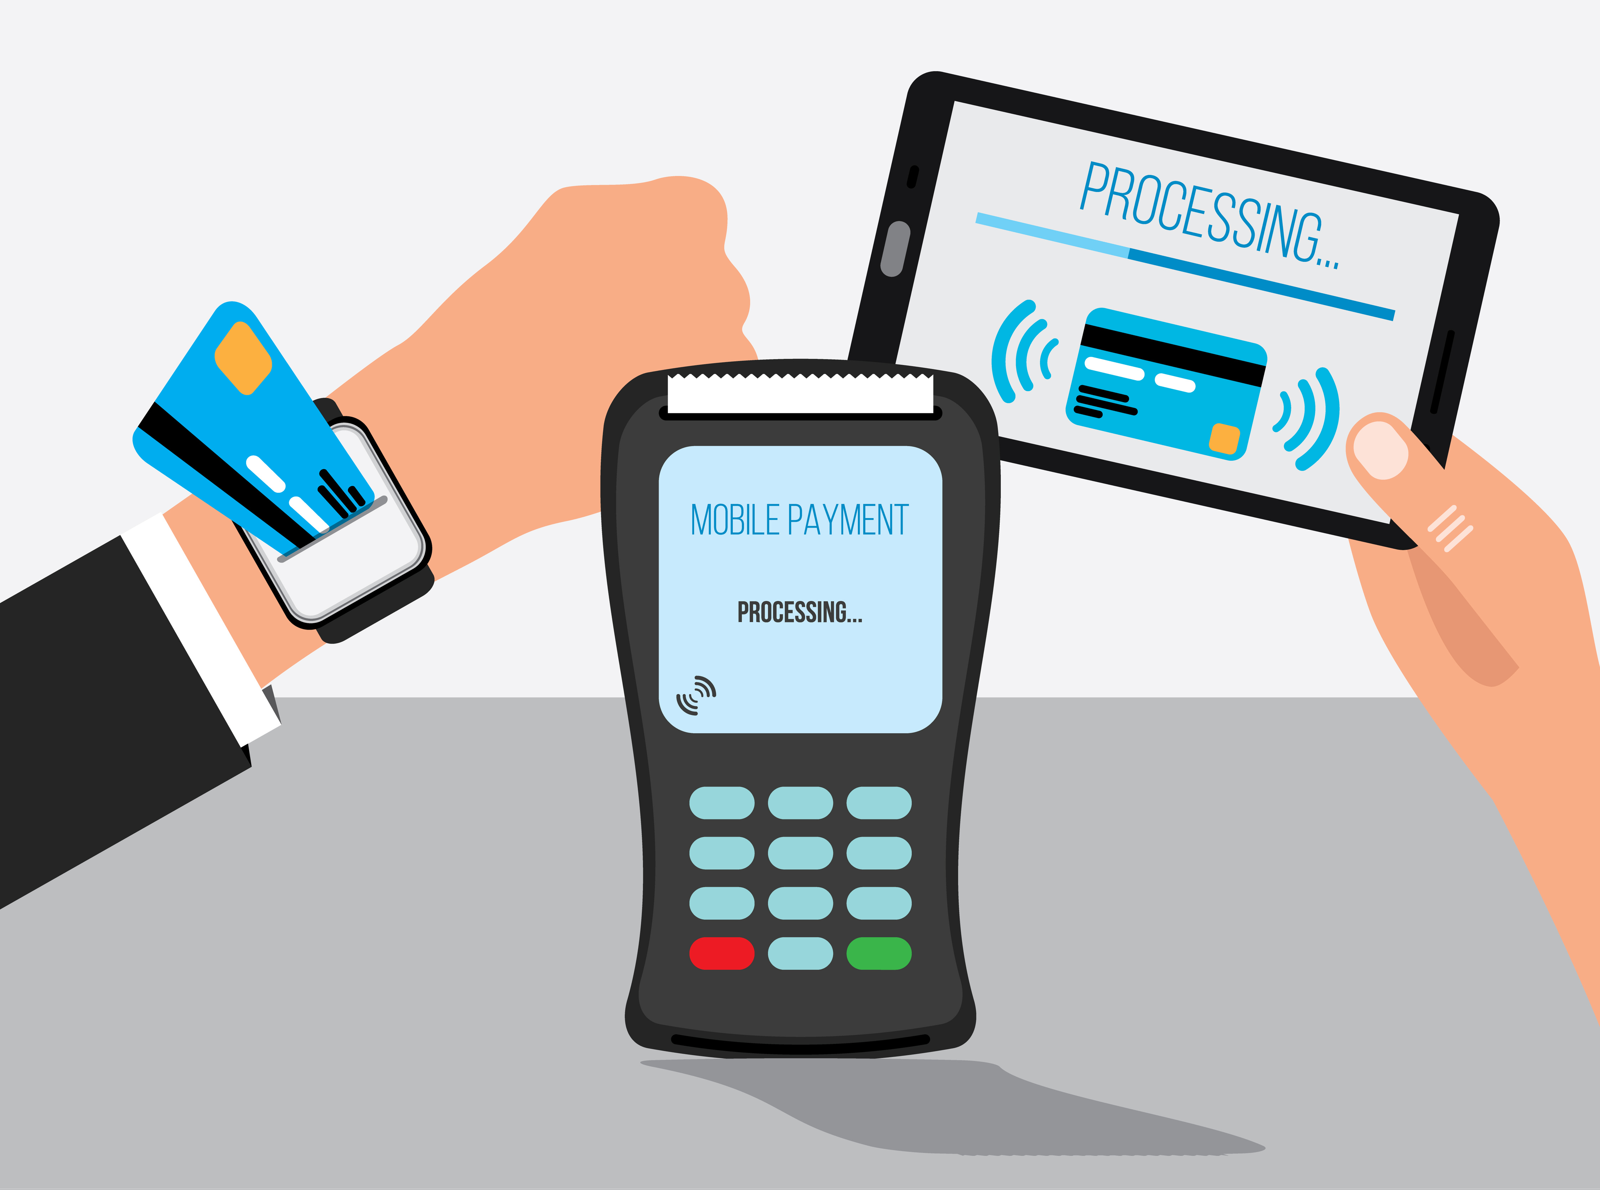
Why Offer
Digital Sales?
72% of customers use a debit card or other digital means when purchasing goods or services*
41% of Americans in 2022 reported that NONE of their purchases were paid for in cash**
  Up from 24% in 2015
*American Bankers Assoc.
** Pew Research Center

Slide 7
The variety of sales methods by rural sellers
(in order of popularity):
Online Web Stores
Online Marketplaces
Brick and Mortar
Offline Marketplaces
Wholesale

Slide 8

The Importance of Online Sales Methods to Rural Small Businesses*
49% of rural small businesses with <10 employees use at least 3 sales methods
54% of rural small business sales are made locally, 16% are made online within the state and 24% are made online outside of the state (but within the U.S.), 6% are made internationally
*Connected Commerce Council survey of 2,000 American rural businesses (2021)

Slide 9

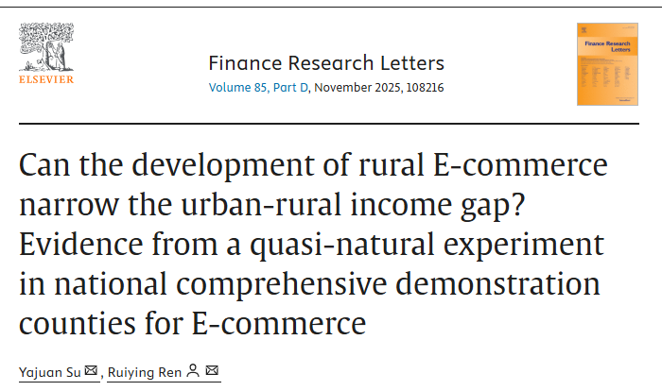
Finance Research Letters

Slide 10
Rural E-Commerce Challenges
Uneven infrastructure
Disparities in technological capabilities
Trust issues regarding online payments

Slide 11
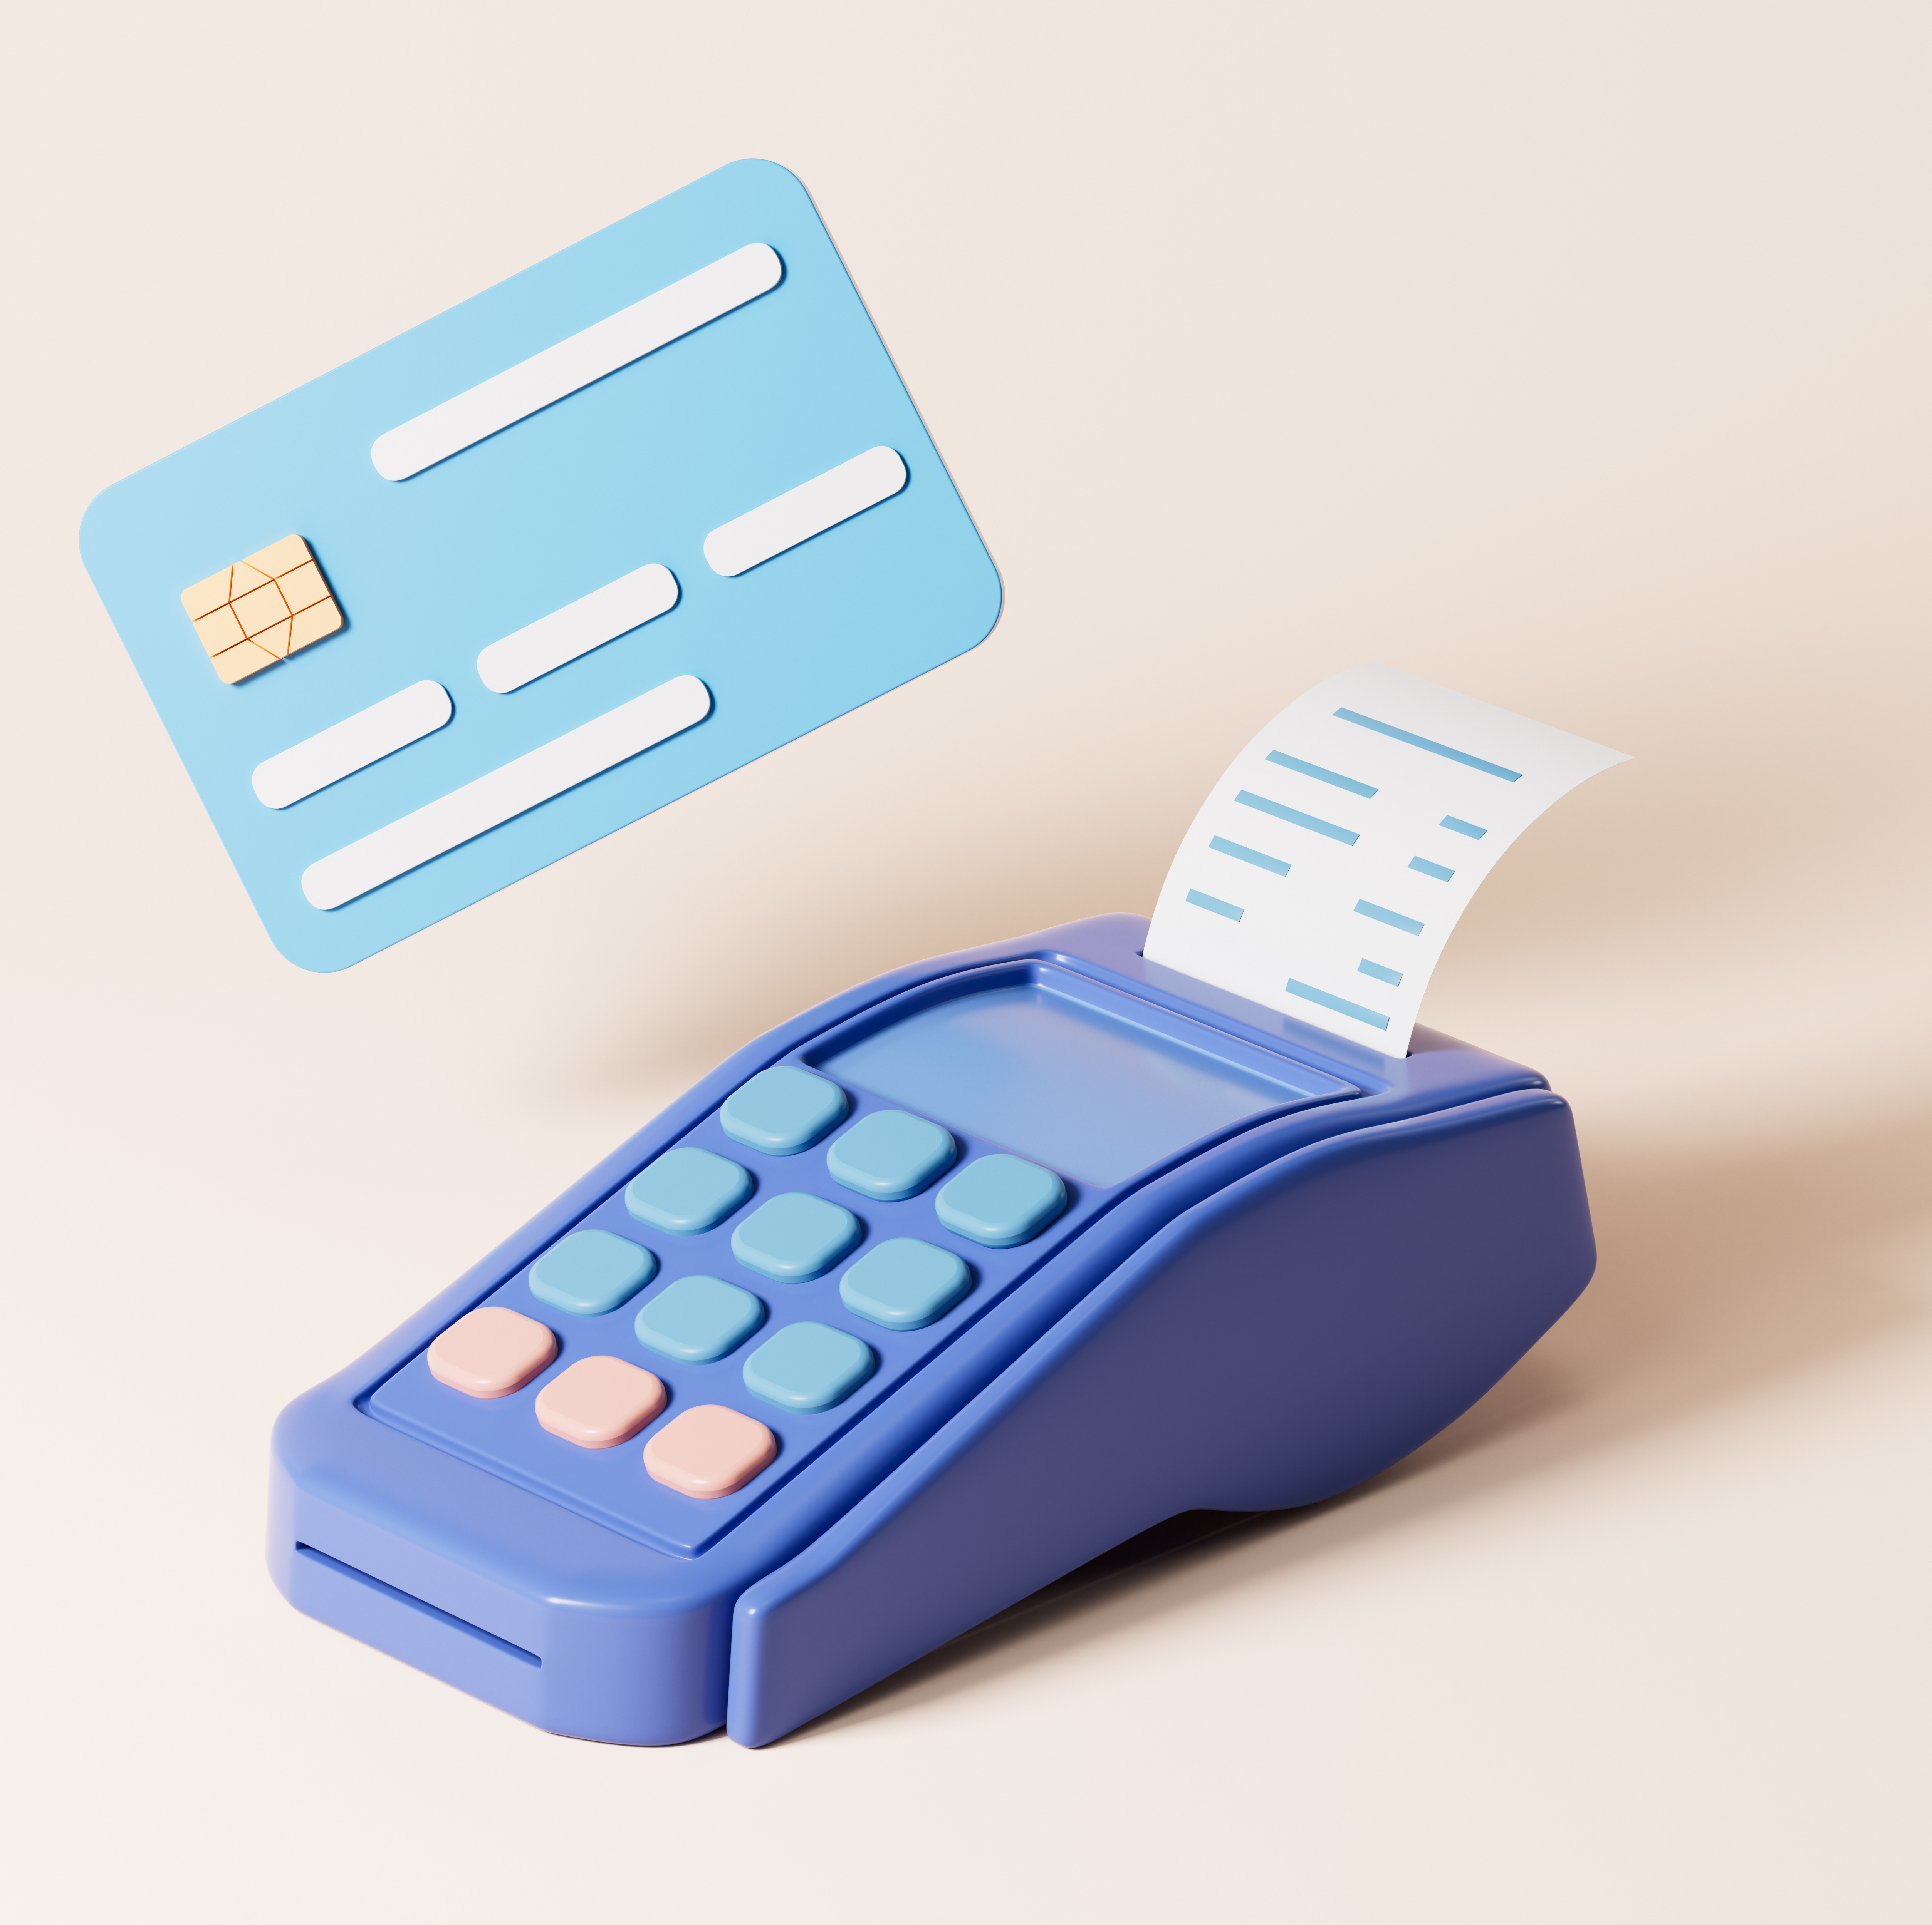
Point of Sale (POS) Systems Made Simple!

Slide 12
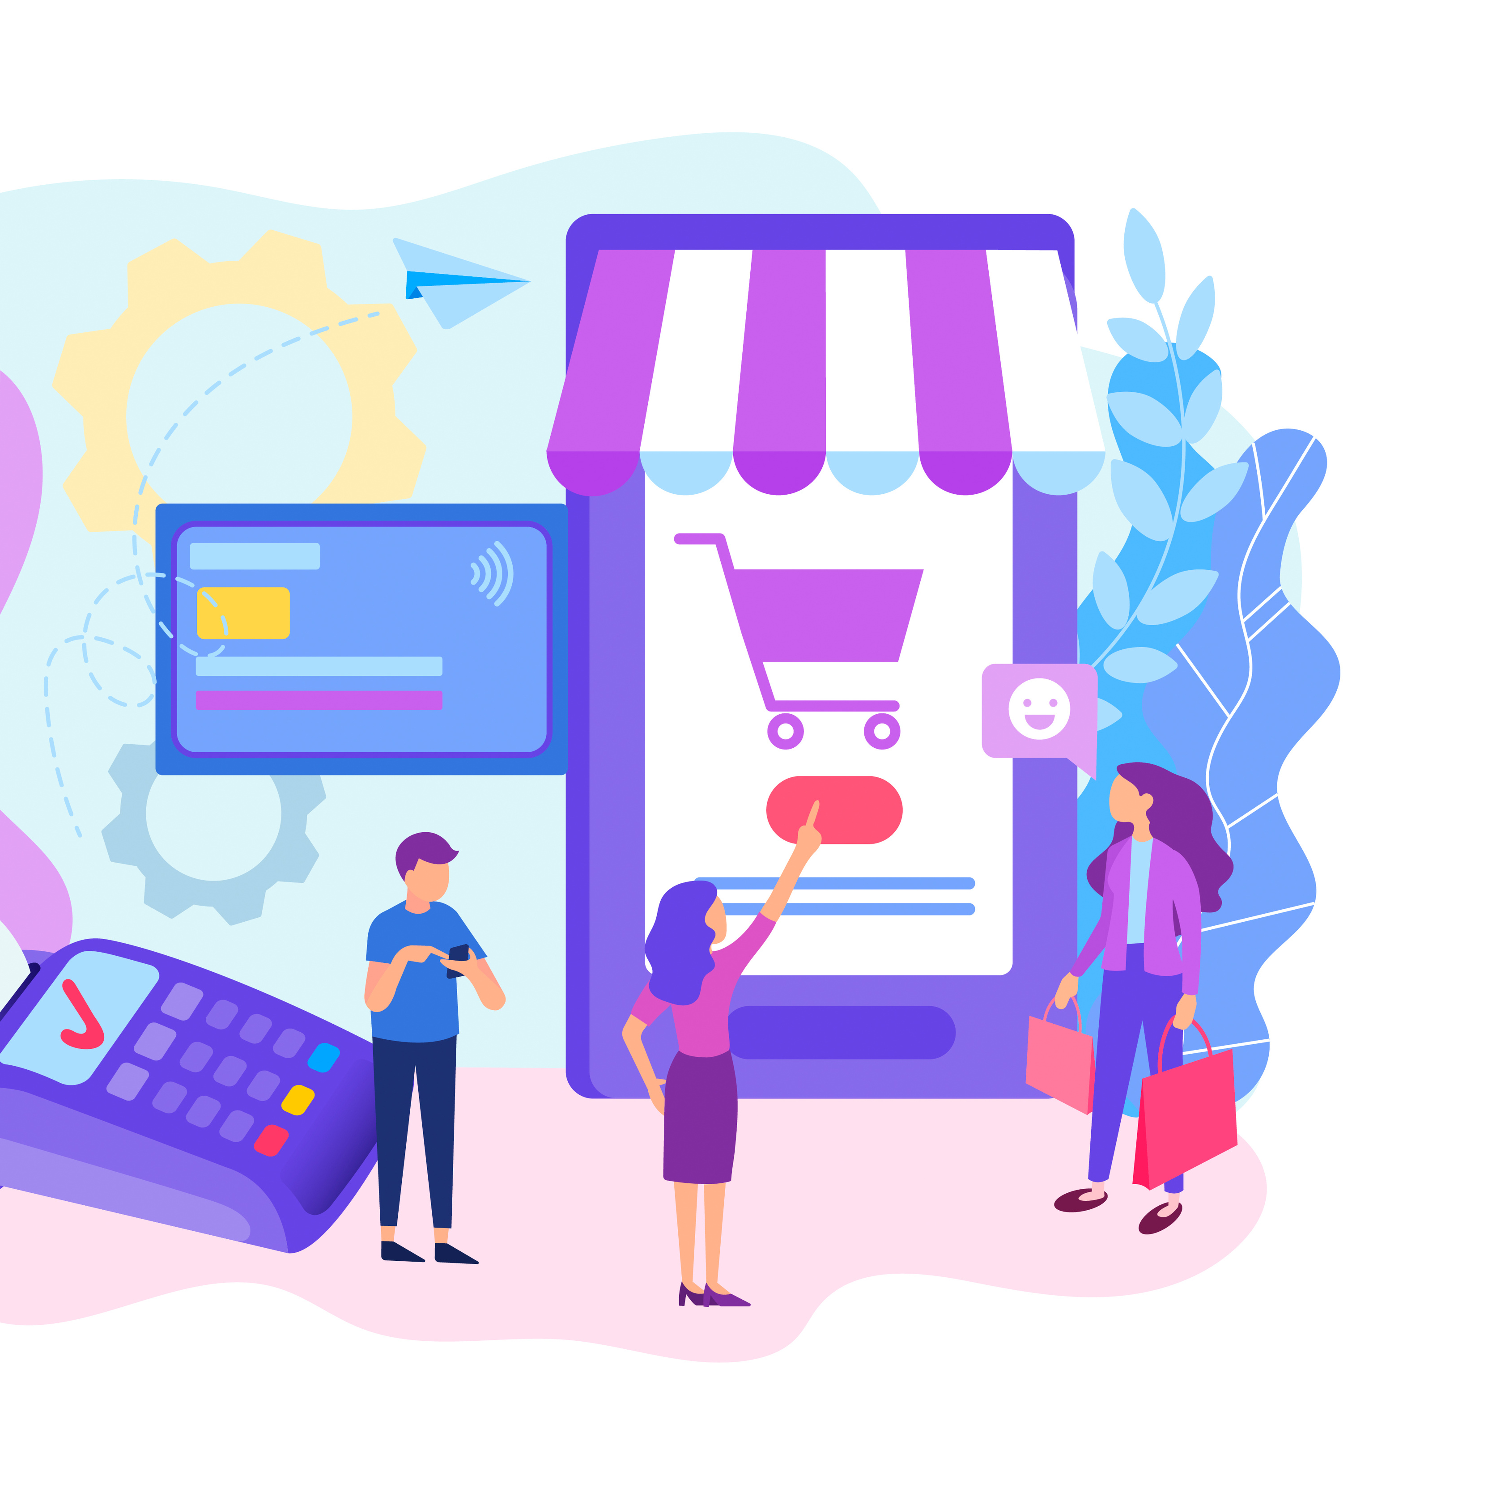
Popular Point of Sale systems compared
Square
Shopify
Lightspeed
Clover
PayPal Zettle

Slide 13
Important factors to consider
Base Price
Fees per transaction
Key Features
Hardware costs/needs
Payments accepted
Internet connection
User-friendliness
Tech support

Slide 14
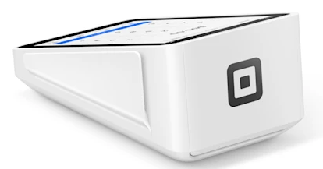
Square
Base Price- Free version, $29/mo., and custom pricing
Fees per transaction- Differs for online, in-person, and manual payments
Key Features- Free version, custom website themes, real time shipping rates with Premium
Hardware costs/needs- Free magnetic strip for card readers, $59 contactless reader
Payments accepted- In-person, online, buy now/pay later, cash (in addition to credit/debit cards)
Internet connection- Required
User-friendliness- Easy to set up and navigate
Tech support- Primarily online chat and tutorials
Pros/Cons- Easy to set up, transaction fees
can become expensive

Slide 15
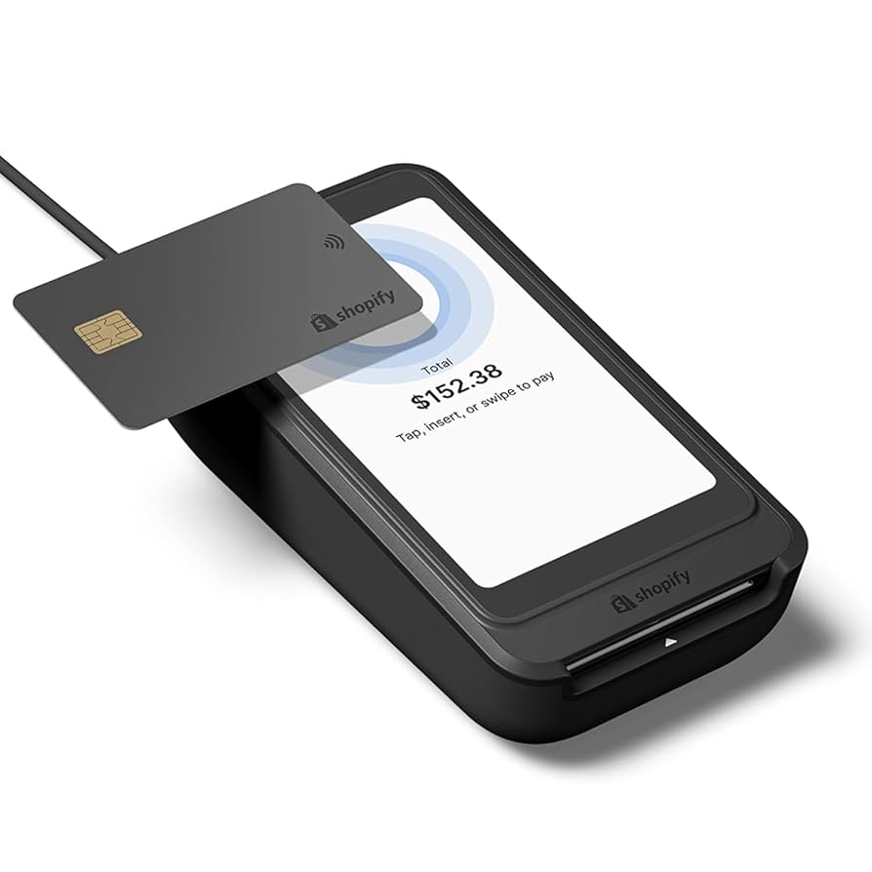
Shopify
Base Price- Only paid versions, Basic starts at $29/mo.
Fees per transaction- Differs for online, in-person, and manual payments; differs depending on plan
Key Features- Shipping discount and insurance, inventory tracking, custom reports
Hardware costs/needs- Mobile device
Payments accepted- PayPal and ACH debits (in addition to credit/debit cards)
Internet connection- Yes to process payments, other features can be used offline
User-friendliness- Easy to set up, users can create an online store
Tech support- Community forums, help center, 24/7 chat support
Pros/Cons- 24/7 customer service, limited customization

Slide 16
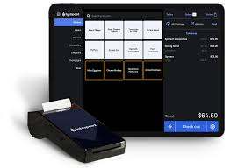
Lightspeed
Base Price- Basic starts at $89/mo. - $289/mo. for Plus
Fees per transaction- Consistent across all packages: 2.6% + $0.10/ transaction
Key Features- Inventory management, multi-store management, business reporting and analytics
Hardware costs/needs- Register: included in all plans
Payments accepted- PayPal, Apple and Google Pay, and invoicing
(in addition to credit/debit and cash)
Internet connection- Required for credit card or online payments, cash payments do not require internet connection
User-friendliness- Easy to set up, intuitive
Tech support- Most common complaint is lack of customer support
Pros/Cons- easy to set up and use, customer support is lacking, little to no customization

Slide 17
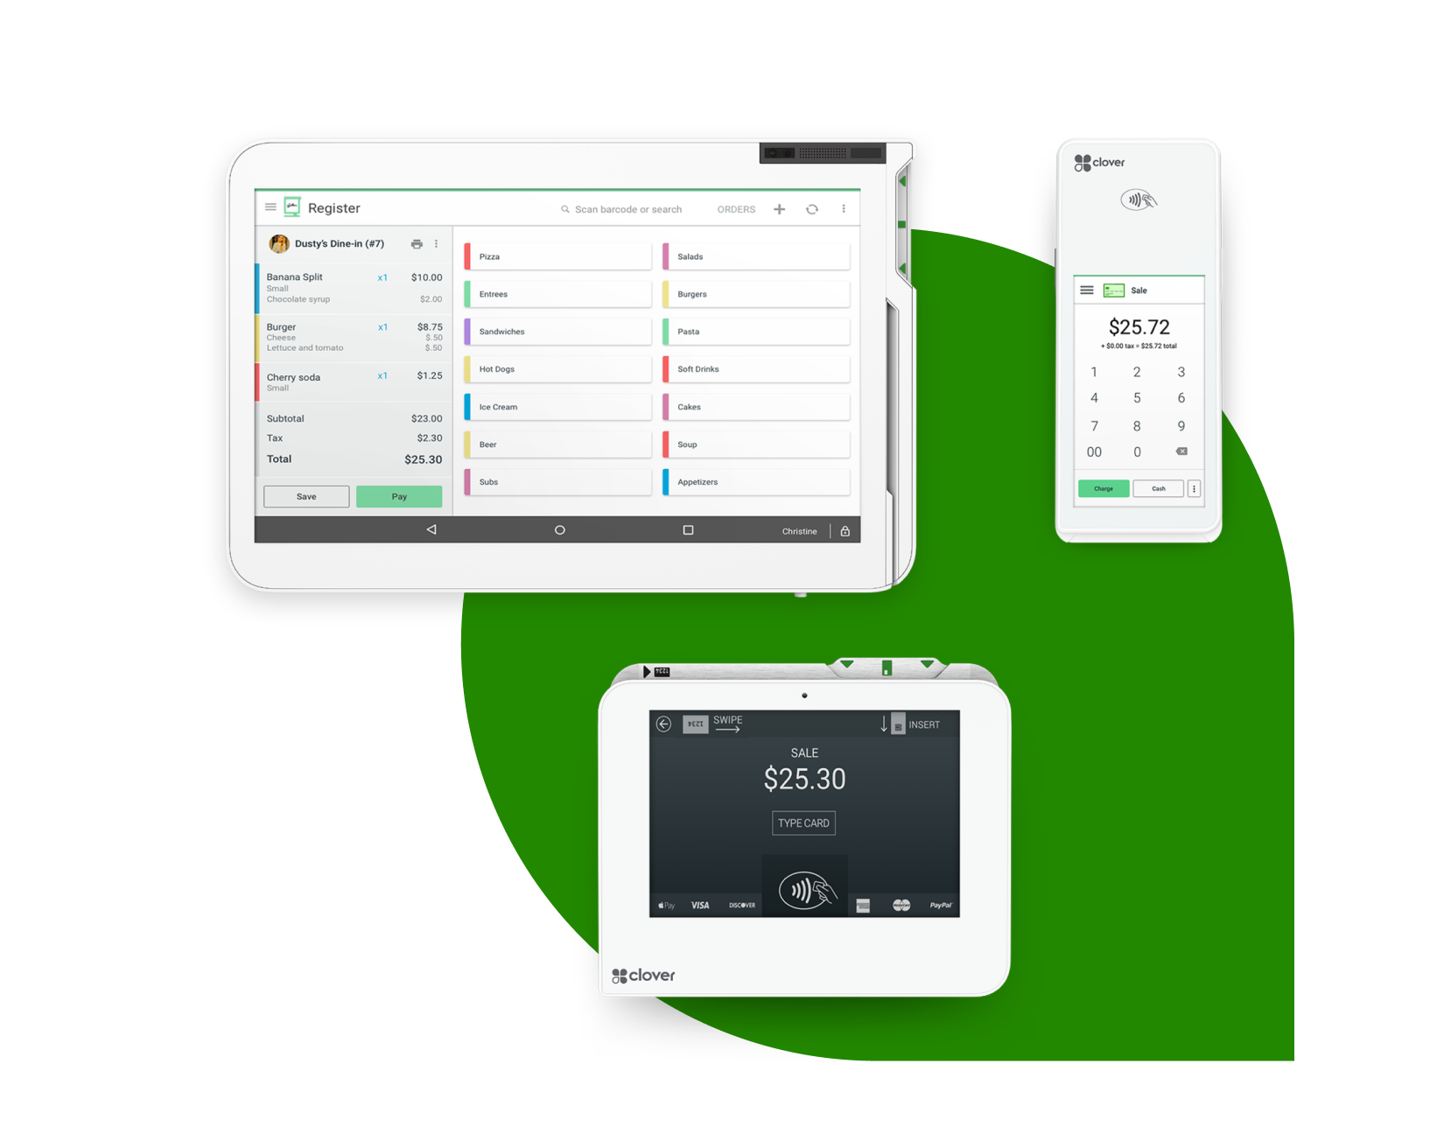
Clover
Base Price- $14.95/mo. for basic - $49.95/mo. for standard plan
Fees per transaction- Differs between card present and online payments
Key Features- Manages reoccurring payments, inventory mgmt., client database
Hardware costs/needs- $69 - $1000+
Payments accepted- online, reoccurring (in addition to credit/debit cards)
Internet connection- Required to process payments, other features can be accessed offline
User-friendliness- Easy to set up and use
Tech support- Help center, community forums, email support
Pros/Cons- Easy to set up and use, allows reoccurring payments, maintenance timing has been during peak and rush times for businesses

Slide 18
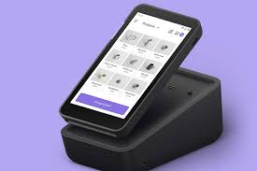
PayPal Zettle
Base Price- No monthly cost
Fees per transaction- Differs between in-person, manual, QR code, and invoicing
Key Features- Syncs to accounting software, can send low stock notifications
Hardware costs/needs- $29 card reader, $199 terminal
Payments accepted- QR Codes, invoices (in addition to credit/debit cards)
Internet connection- Required
User-friendliness- Easy to set up and use
Tech support- Hardware troubleshooting, help center, phone and chat support
Pros/Cons- easy to use, no monthly fees, requires wifi, fewer add-ons

Slide 19
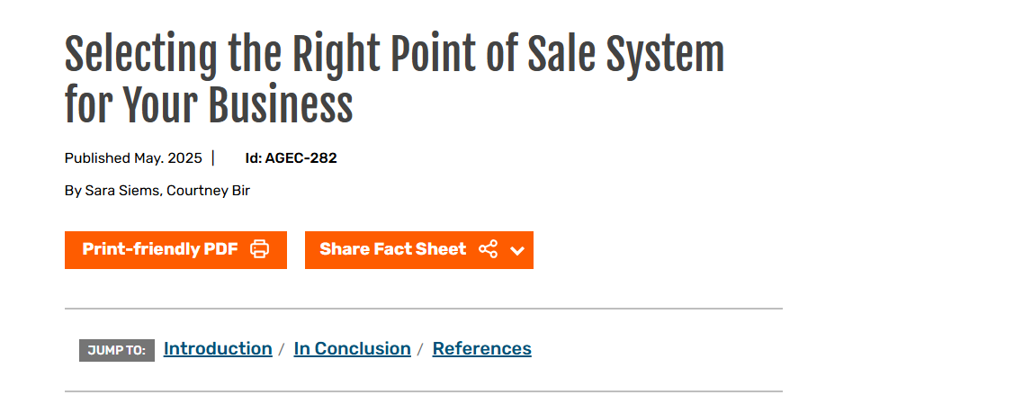

Selecting the Right Point of Sales System for Your Business

Slide 20
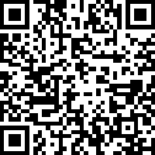
Webinar Survey:

