Slide 1
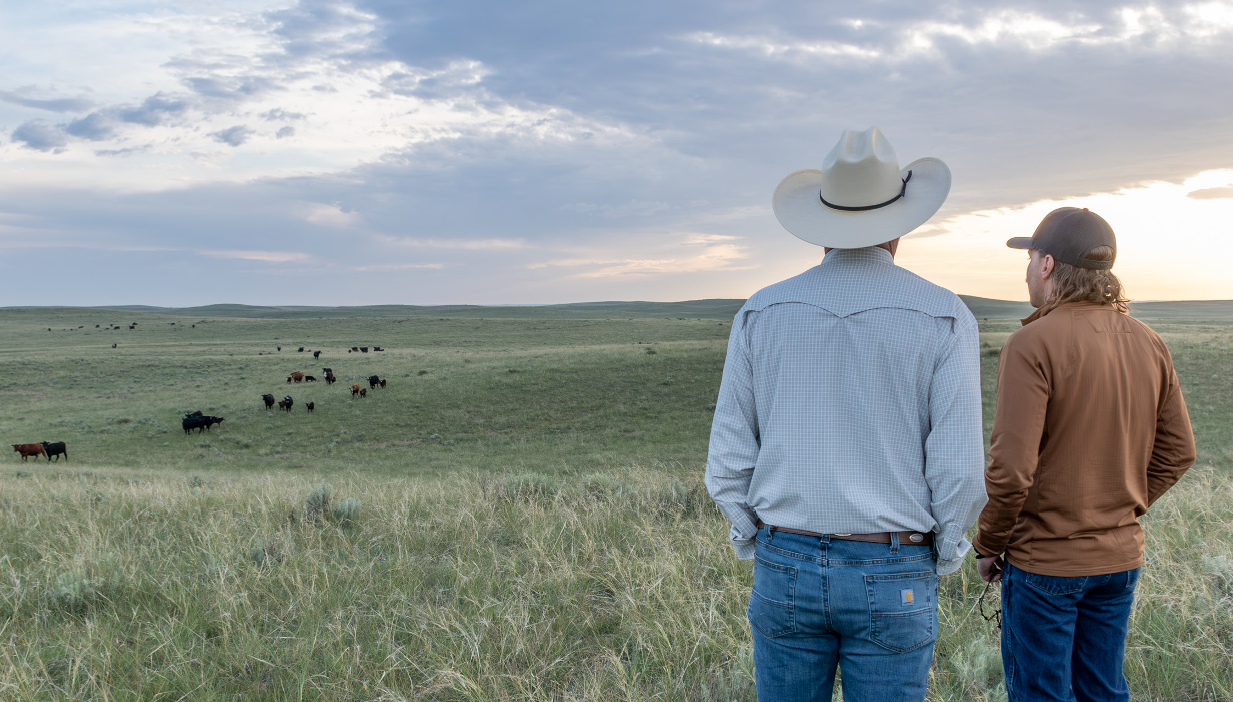
Transition Strategies for Long-Term Success
Department of Agricultural Economics Webinar| February 25, 2026
Dr. Shannon L. Ferrell, Professor of Agricultural Law, OSU Department of Agricultural Economics

Slide 2
A failure to plan is a plan to fail
Slam dunk without-a-doubt
Guardian nomination for minor children
Beneficiary designations
Durable powers of attorney
Advanced directive for health care
  Medical Power of Attorney
  Living Will
  DNR
Long-term care plan
Will
And you really need
to think about
Trust
Life insurance
Long-term care insurance

Slide 3
The unique challenges of ranch succession

Slide 4
Why is this ranch succession stuff so dang hard?
The Townsfolk
The Ranchers
Asset Description | Value | % of total assets
Financial assets | $3,125,000 | 83.3%
Primary home | $300,000 | 8.0%
Vacation home | $200,000 | 5.3%
Other assets | $125,000 | 3.3%
Total | $3,750,000 | 100.0%
Asset description | Value | % of total assets
Financial assets | $0 | 0.0%
Land and buildings | $2,700,000 | 72.0%
Machinery & equip. | $1,000,000 | 26.7%
Breeding livestock | $50,000 | 1.3%
Total | $3,750,000 | 100.0%

Slide 5
Why “split it down the middle” doesn’t work.

Slide 6
A winter wheat / cow-calf operation
Kansas Farm Management Association South Central Association Data
Asset class | Value
Breeding Livestock | $56,602
Machinery & Equipment | $1,012,499
Buildings | $82,894
Land | $2,603,650
Total Assets | $3,755,645
Avg. Net Annual Income | $169,059
69% of total asset value

Slide 7
Probability the ranch can survive a
“split it down the middle” strategy on its own revenues:
0.00%

Slide 8
What will it cost?

Slide 9
What’ll it cost, man?! What’ll it cost?!
Operation with $3.755 million in assets and average NFI of $169,059
Strategy | Who pays | Annual expense
Buy out City Kid, commercial lending | Ranch Kid | $375,565 down; $198,359 yr 1-7; $97,528 yr. 8-20
Buy out City Kid, family loan | Ranch Kid | $145,864
Op. assets to Ranch Kid, “share” land; investment | Ma & Pa | $33,901
Op. assets to Ranch Kid, “share” land; life ins. | Ma & Pa | $20,987
Ranch Kid buys op. assets | Ranch Kid | $53,455

Slide 10
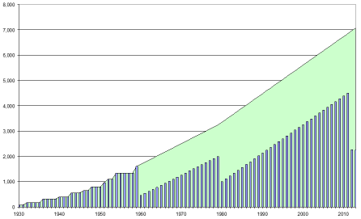
The value of transition planning
$4,750,000
Illustration courtesy Dick Wittman, Wittman Consulting

Slide 11
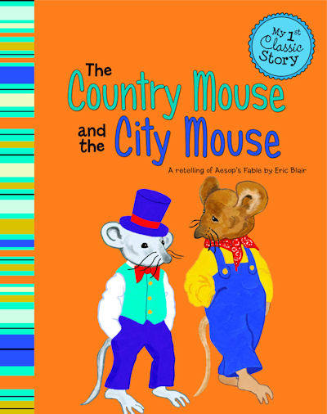
The Country Mouse and the City Mouse
Notes:
One critical piece of the transition puzzle is handling a situation where we have some kids that want to come back to the ranch and some who don’t. This is where things get tricky for us in a family business, because the lion’s share of our personal wealth may be tied up in the business, with few or maybe even no other personal assets outside of what is needed to keep the business running. We may face the situation where all of our wealth essentially needs to stay with the business, but if we do that, we have little or nothing left to give to the off-farm heirs.
There are ways to tackle this. Ideally if we have some time left on the clock, we may be able to diversify our investments to build some off-farm assets to transfer to off-farm heirs, leaving the farm business to the on-farm heirs. The sooner we get started on this, the more flexibility we have. It’s also vital that we have some conversations with all the heirs to explain what we’re doing and the equities involved.
Sometimes we just can’t bring ourselves to do that, though, so we think the best way to handle the conflict is just to, well, not handle it – we’ll just split it down the middle.

Slide 12
Table 1.
Initial asset value |  |  |  |  | $ 1,875,000
Invested for 20 years, S&P 500 Index historical average return (10.26%) |  |  |  |  | $ 13,152,170
Invested for 20 years, 20 Year U.S. Treasury Note (4.742%) |  |  |  |  | $ 4,736,074
 | Average annual return | 20 year FV, S&P 500 avg. | Relative value to ref. investment | 20 year FV, 20 year U.S. Treas. | Relative value to ref. investment
50% dividend | 4.51% | $4,986,722 | ($8,165,448) | $2,720,036 | ($2,016,039)
33% dividend | 3.01% | $3,324,481 | ($9,827,689) | $1,813,357 | ($2,922,717)
25% dividend | 2.25% | $2,493,361 | ($10,658,809) | $1,360,018 | ($3,376,056)

Slide 13
Percentages
Historical average returns
to agricultural land
Historical average returns
of S&P 500
11.5%
10.1%
5.2%
Source: Kastens, 2001
Source: Investopedia, 2024
Notes:
Farm data: Kastens, T., ”Risk and Reward: How do Farm Returns Stack up? Should Farm Managers Invest in the Stock Market?” White Paper, Kansas State University
So let’s think about that for a bit. Let’s say we have two kids: Farm Kid and City Kid. We don’t have a lot of off-farm wealth, so we’re going to just give the farm to the two kids in undivided interests. We’re telling City Kid “hey, we know you’re not interested in running a ranch, but hey, you’re getting a business asset!” And sure enough, returns to agricultural equity aren’t all that different from the returns to an equity investment like the S&P 500. But you’re also going to tell City Kid “now don’t you dare sell any of this stuff or I’ll come back from the grade and torment you for the rest of your days!” Here’s the trick to that, though – if you take out appreciation in land from those returns to ag equity, the returns fall to about 5% - not that far from what you could get in an extremely low-risk fixed return asset like a CD.

Slide 14
Annual return on equity for north-central OK farm land
1.75%
USDA Cash Rent County Estimates 8/25/2025, Garfield County: $43.50/ac
Sample of cropland-only Zillow sales, Garfield county, avg. per-acre price: $2,487.87/ac
Source: Investopedia, 2024
Notes:
360360

Slide 15
Takeaways
The runaway #1 strategy choice (used by >64% of ranches) is the one with zero chance of actually working.
Nobody thinks about *WHO’S* paying for the planning
… or lack of it.
Time can be your enemy or your ally – it just depends on when you start.

Slide 16
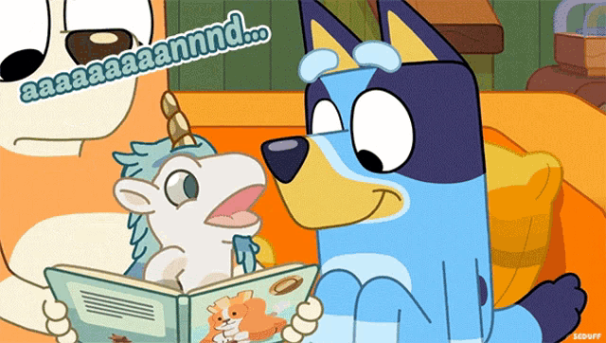
A graphic

Slide 17
Five steps forward:
A practical approach to keeping the farm and the family together

Slide 18
Five steps to a successful transition
INVENTORY: Determine where you are now
TALK: Communicate with stakeholders
PLAN: Develop a business succession plan
WILL: Develop a plan for your estate / gifts
DON’T STOP: Deploy / evaluate / revise

Slide 19
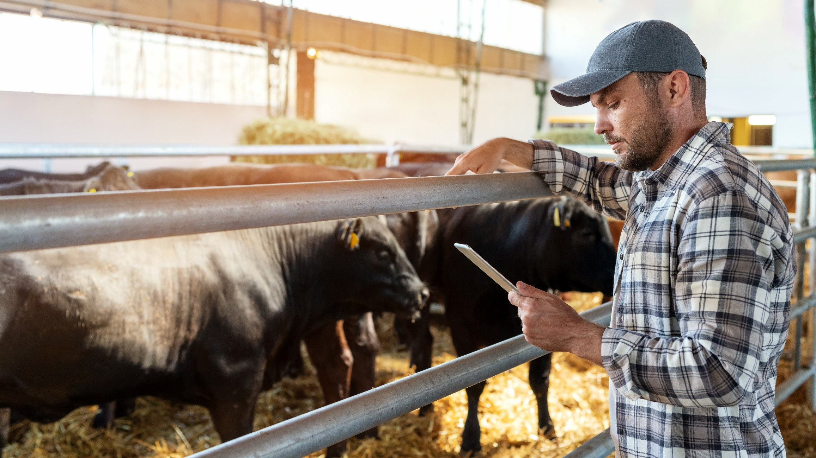
Step 1: INVENTORY
Every THING
Every ONE
Every MEASURE
Every GOAL
Every VALUE
Notes:
Step one: inventory. Literally just get the ball rolling with a deep-dive inventory of everything on your operation. Everything that moos. Every piece of land, every piece of equipment, every financial account, every person, everything! And while you’re at it, inventory your goals and your values. What exactly is it that you’re trying to accomplish with your business? What values are you trying to pass along? Are the values of the people you’re passing it to compatible with yours and with each other’s?

Slide 20
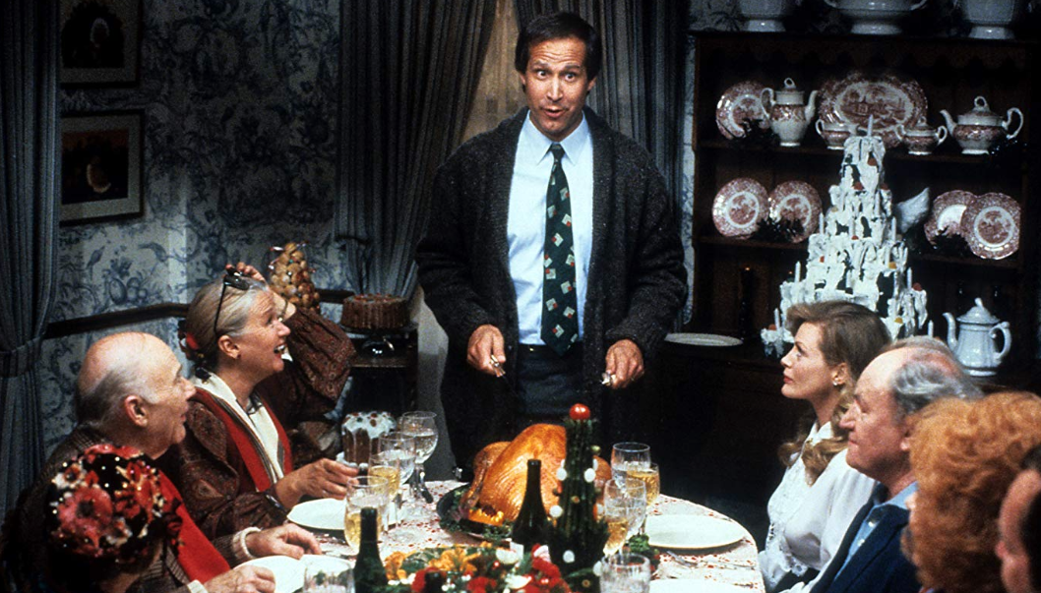
Step 2:TALK
Notes:
Step two: talk. I have a pretty decent track record with farm families in getting them to do step 1. Step 2 is where a lot of them go into the ditch because like we discussed earlier, we are NOT GREAT at talking about emotional stuff in agriculture. For that matter, I believe that is whey so many people are paralyzed from even starting their transition process – they are afraid of the feelings they might run into, so they figure it’s better to just let everyone fight it out after they’re dead, not realizing that’s a death warrant for their business.
So let’s have a family meeting (please, not at Christmas) and let’s just start slow. Ask your family two questions, and then be genuine about wanting to hear the answers. 1: What do you see as the future of this business? 2: What do you see as your role in that future. Just start with that, and then chase those answers.

Slide 21
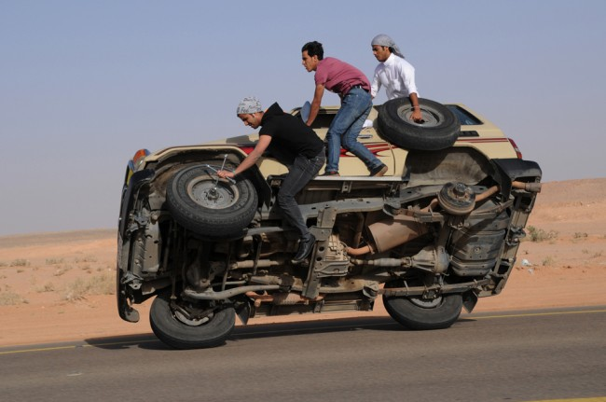
Step 3:PLAN
Notes:
Step 3: we have to transition the business. We’re trying to keep this business moving forward while it’s ownership and management are changing all at the same time. It’s like changing the tires on a car that’s still driving down the highway. It’s possible, but it’s tricky. If you want to learn more about this, let me give you a shameless plug to attend our transition sessions today during Cattlemen’s college. I’ll tell you now, though, that we need to be thoughtful about transferring ownership and control to the people who will be actively engaged in the business as we move forward. There may be a lot of reasons to transfer some (or maybe a lot) of assets while we are alive versus after we die. These lifetime transfers give us a lot of flexibility to adapt to changing circumstances and can avoid some of the uncertainty that after-death transfers can cause.

Slide 22
Table 2
Junior
Senior

Slide 23
Table 3
Junior
Senior

Slide 24
Infographic
Ma & Pa transfer land ownership to entity; transfer beneficial interests to
Ranch Kid and City Kid
Income
distributions
Land Entity
Income
distributions
Ranch Kid
City Kid
Operating Entity
Gift and/or purchase from Ma & Pa
FMV rental payments
Non-farm Financial Asset
Gift from
Ma & Pa

Slide 25
Don’t say the “r” word to a farmer!
What will you need as you step back (just a bit)
  Family living
  Healthcare
  Fun
How will you get it?
  Off-ranch investments and assets
  Continuing returns from ranch
  Sale of ownership in ranch assets

Slide 26
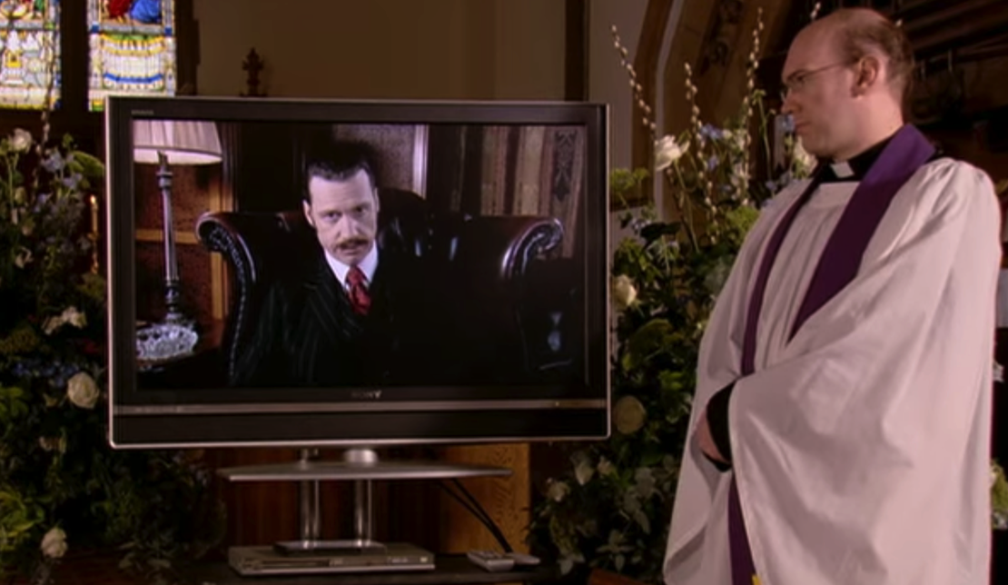
Step 4: Will
Notes:
That brings us to Step 4: Thy Will be done, along with all the other stuff on that slide I showed you a few minutes ago. Our estate plan has to align with our transition plan. And I know it goes against your gut, but you have to talk about this with your family. You think you can avoid conflicts by just springing this on people after you die, but we all know how people handle adverse surprises, and you have a hard time mediating family conflict when you’

Slide 27
The “hit by a ____________” plan and why everything needs to be in writing, dangit!
Notes:
SHANNON

Slide 28
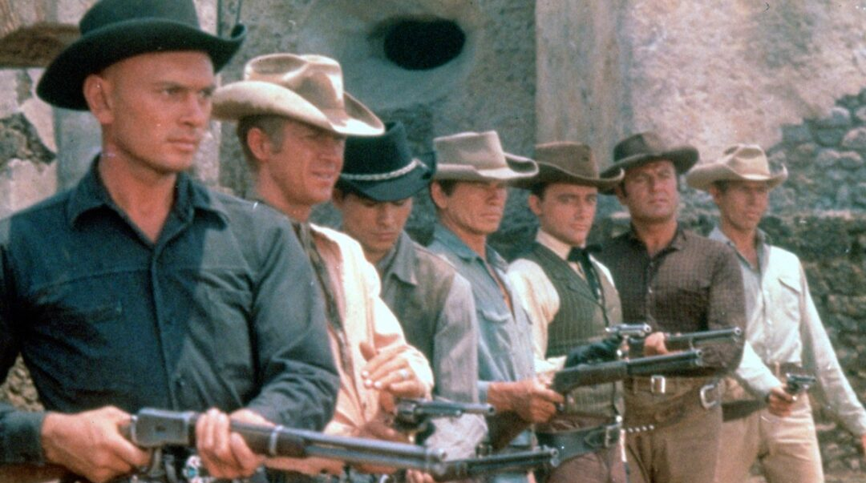
Step 5: Don’t stop
Notes:
https://sbiff.org/the-magnificent-seven/
Step 5 is get rolling with your team of professionals and keep rolling. Get a good attorney and a good tax professional that really understands agriculture. Get a human resources specialist that helps you plug your people into the right opportunities. Get a mediator to help you with the tough conversations. Then don’t stop. This is not a one and done – you’ll have to implement, evaluate, revise, and repeat as long as you are around. But if you do, you have an excellent chance of success.

Slide 29
The Accountant

Slide 30
The Attorney

Slide 31
The Investment Advisor

Slide 32
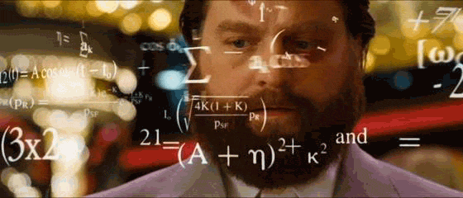
The Ranch Management Consultant

Slide 33
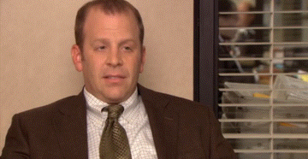
The Human Resources Advisor

Slide 34
The Referee

Slide 35
Time for a checkup!
Notes:
SHANNON

Slide 36
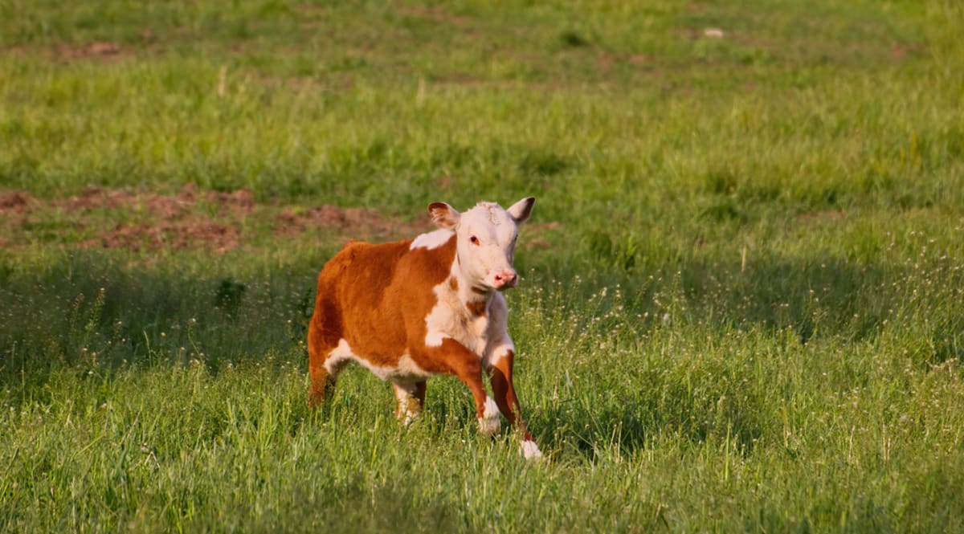
A cow in a field

Slide 37
THANKS!
Dr. Shannon L. Ferrell
Professor of Agricultural Law
OSU Department of Agricultural Economics shannon.l.ferrell@okstate.edu

