Slide 1
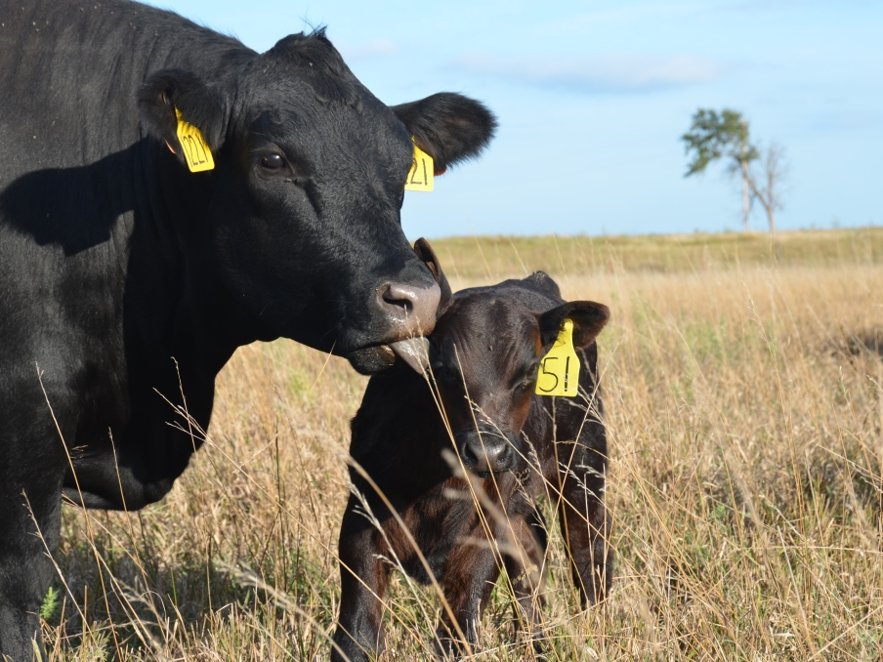

Cattle Market
Update
Derrell S. Peel
Breedlove Professor of Agribusiness and Extension Livestock Marketing Specialist
Oklahoma State University

Slide 2

2018 Market Setting
Global
U.S. Economy
Agriculture
Cattle Industry

Slide 3


Global and Macroeconomic Environment
Changes
  Political
  Policy
Uncertainty
  Global Economy
  U.S. Economy
  Trade
    Tariffs
    Exchange Rates
Volatility

Slide 4
Major Beef Market Factors
Cattle Inventory and Beef Production
Beef Demand
International Trade
Feed and Input Markets
Forage Conditions

Slide 5
Data Source: USDA-AMS
Livestock Marketing Information Center

Slide 6
Data Source: USDA-AMS
Livestock Marketing Information Center

Slide 7
Data Source: USDA-AMS
Livestock Marketing Information Center

Slide 8
Data Source: USDA-AMS
Livestock Marketing Information Center

Slide 9
Data Source: USDA-AMS, Compiled by LMIC
Livestock Marketing Information Center

Slide 10
Data Source: USDA-AMS
Livestock Marketing Information Center

Slide 11
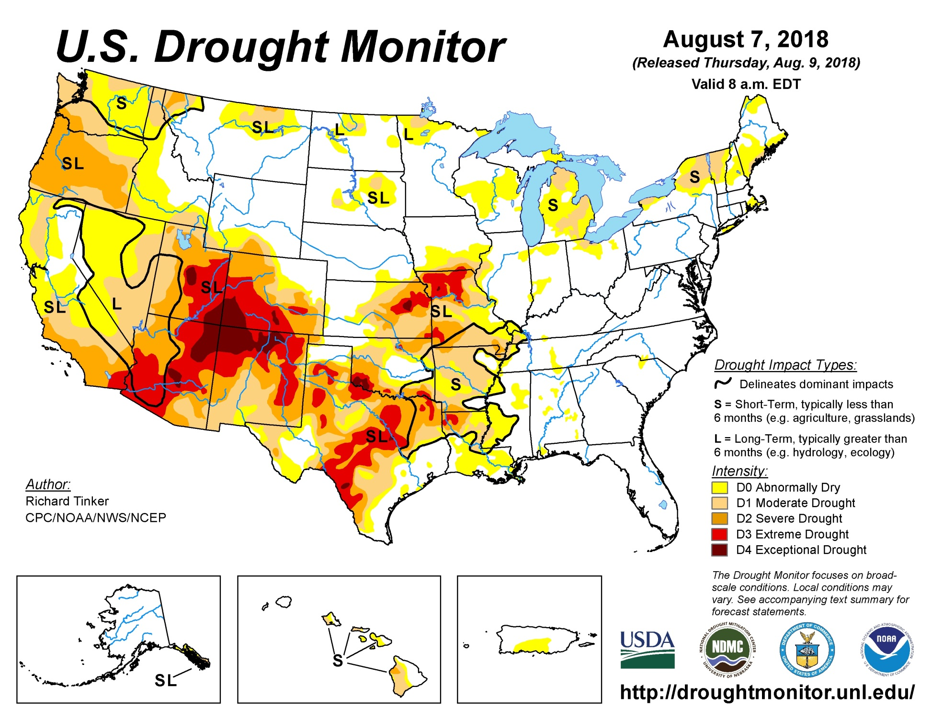

Slide 12
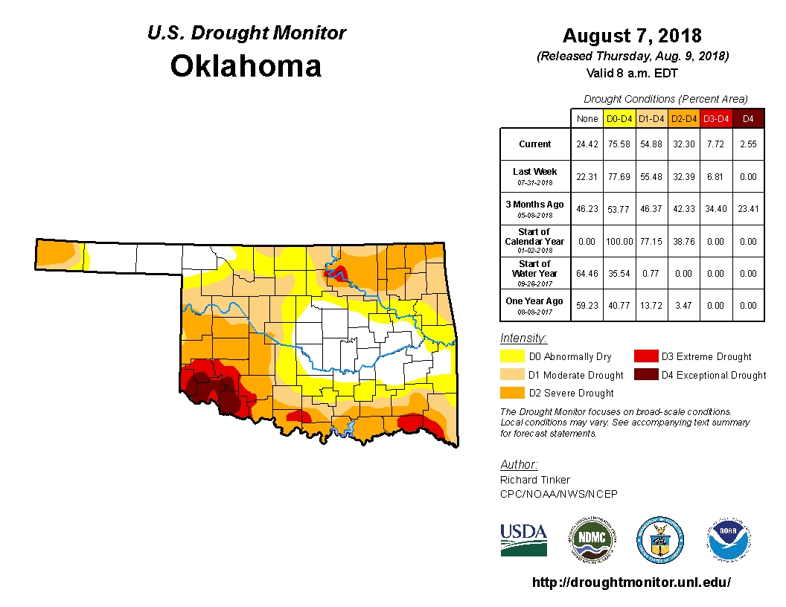

Slide 13
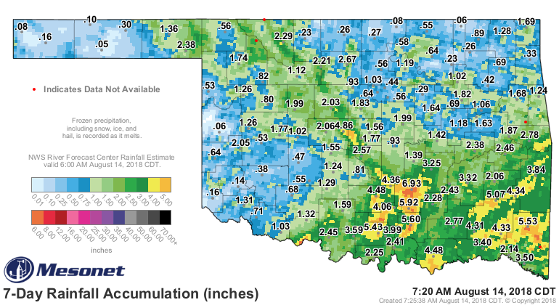

Slide 14
Data Source: USDA-NASS
Livestock Marketing Information Center

Slide 15
Data Source: USDA-NASS
Livestock Marketing Information Center

Slide 16
Data Source: USDA-NASS
Livestock Marketing Information Center

Slide 17
Cattle Slaughter
Federally Inspected, 1000 Head
 | 2016 | 2017 | % Change 2016 to 2017 | 2018 YTD % Change
Steers | 16495 | 16771 | +1.7 | -0.6
Heifers | 7698 | 8611 | +11.9 | +8.7
Dairy Cows | 2886 | 2988 | +3.6 | +4.0
Beef Cows | 2543 | 2784 | +9.5 | +11.2
Bulls | 494 | 550 | +11.4 | +2.0
Total | 30115 | 31771 | +5.3 | +3.3
Latest data: July 21, 2018

Slide 18
Data Source: USDA-AMS & USDA-NASS
Livestock Marketing Information Center

Slide 19
2018 Meat Production and Consumption
 | Production |  |  |  |  | Consum. Change | Consum. Per Capita | Consum. Change
 | 2016 | 2017 | 2016-2017 | 2018 | 2017- 2018 | 2016-2017 | 2018 | 2017-2018
 | Million lbs. | Million lbs. | % Change | Million lbs. | % Change | % Change | Retail Lbs. | % Change
Beef | 25221 | 26187 | +3.8 | 27298 | +4.2 | +2.5 | 57.7 | +1.4
Pork | 24941 | 25584 | +2.6 | 26578 | +3.9 | +0.0 | 51.2 | +2.2
Broilers | 40261 | 41217 | +2.4 | 42039 | +2.0 | +1.3 | 91.7 | +0.1
Total | 97193 | 99739 | +2.6 | 102644 | +2.9 | +1.1 | 219.2 | +1.3
2018 forecast
LMIC, July 12, 2018

Slide 20
Data Source: USDA-ERS

Slide 21
Livestock Marketing Information Center
Data Source: USDA-AMS & USDA-NASS, Compiled & Analysis by LMIC
June, 2018

Slide 22
Commercial Beef Production >>>
Beef Cow Inventory >>>
Livestock Marketing Information Center
Data Source: USDA-NASS, Compiled & Analysis by LMIC and Derrell Peel
2018 Production, 2019 inventory forecast

Slide 23
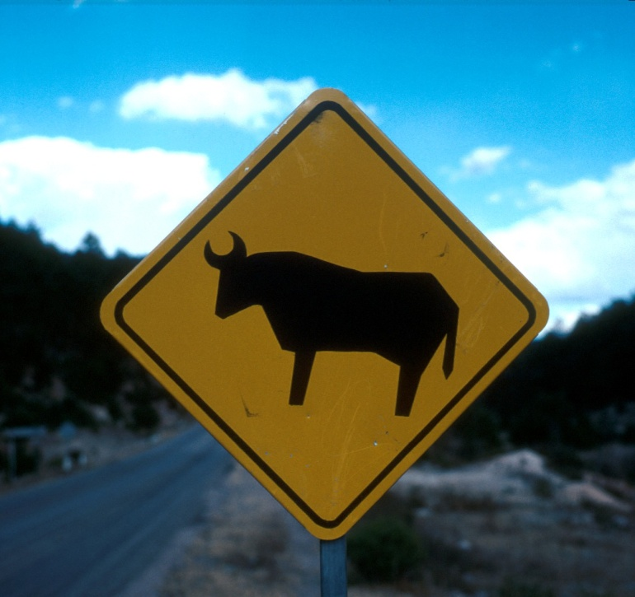

Slide 24
Data Source: USDA-ERS & USDA-FAS
Livestock Marketing Information Center

Slide 25
U.S. Beef Exports
 | 2016 (1000 lbs.) | % Change 2015 to 2016 | 2017 (1000 lbs.) | % Change 2016 to 2017 | % of Total Exports | YTD % Of 2017
Japan | 655426 | +21.5 | 826204 | +26.1 | 28.9 | +6.5
Mexico | 394952 | +8.9 | 419506 | +6.2 | 14.7 | +8.8
Hong Kong | 293813 | -7.0 | 335719 | +14.3 | 11.7 | +11.5
Canada | 311905 | -4.8 | 311905 | +1.2 | 10.8 | +1.1
S. Korea | 459158 | +44.0 | 472768 | +3.0 | 16.5 | +41.9
Total | 2555698 | +12.7 | 2861557 | +12.0 |  | +14.7
YTD: Jan-Jun

Slide 26
Data Source: USDA-ERS & USDA-FAS, Compiled and Forecasts by LMIC
Livestock Marketing Information Center

Slide 27
U.S. Beef Imports
 | 2016 (1000 lbs.) | % Change 2015 to 2016 | 2017 (1000 lbs.) | % Change 2015 to 2016 | % of Total Imports | 2018 YTD % of 2017
Australia | 767216 | -39.0 | 695253 | -9.4 | +23.2 | +2.7
Canada | 717798 | +14.2 | 741070 | +3.2 | +24.8 | +9.9
New Zealand | 612549 | -7.4 | 557529 | -9.1 | +18.6 | +8.6
Mexico | 493446 | +25.9 | 573520 | +16.2 | +19.2 | -15.0
Brazil | 152703 | +2.1 | 138430 | -9.3 | +4.6 | -22.6
Total | 3014636 | -10.6 | 2994382 | -0.7 |  | +1.0
YTD: Jan-Jun

Slide 28
Data Source: USDA-ERS & USDA-FAS, Compiled and Forecasts by LMIC
Livestock Marketing Information Center

Slide 29
Data Source: USDA-AMS
Livestock Marketing Information Center

Slide 30
Data Source: USDA-ERS & USDA-FAS
Livestock Marketing Information Center

Slide 31
Data Source: USDA-ERS & USDA-FAS
Livestock Marketing Information Center

Slide 32
Data Source: USDA-AMS, Compiled and Forecasts by LMIC
Livestock Marketing Information Center

Slide 34
2018 Cattle Price Forecasts
 |  | Feeder Steer Price (Southern Plains) |  |  |  | Fed Steer
 |  | 5-600 lb. ($/cwt.) | % chg from Last Year | 7-800 lb. ($/cwt.) | % chg from Last Year | 5-mkt avg. ($/cwt) | % chg from Last Year
2017 | III | 165.47 | +5.3 | 153.36 | +6.4 | 112.47 | -0.7
 | IV | 170.66 | +23.3 | 157.13 | +21.2 | 117.88 | +9.2
 | Annual | 166.00 | 0.0 | 148.17 | +2.1 | 121.52 | +0.5
2018 | I | 180.01 | +14.4 | 148.73 | +11.9 | 125.61 | +2.2
 | II | 170.11 | -0.2 | 144.52 | -3.2 | 116.72 | -12.1
 | III | 164-168 | +0.3 | 144-147 | -5.1 | 108-110 | -3.1
 | IV | 160-165 | -4.5 | 144-148 | -7.1 | 112-115 | -3.7
 | Annual | 167-172 | +2.1 | 144-148 | -1.5 | 115-117 | -4.5
LMIC, July 24, 2018

Slide 36
Thank You!
Please provide feedback on this session at:
https://okstatecasnr.az1.qualtrics.com/jfe/form/SV_dgVCp1DcPWmJkc5
Contact Information:
derrell.peel@okstate.edu

Slide 37
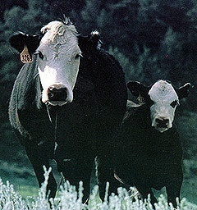

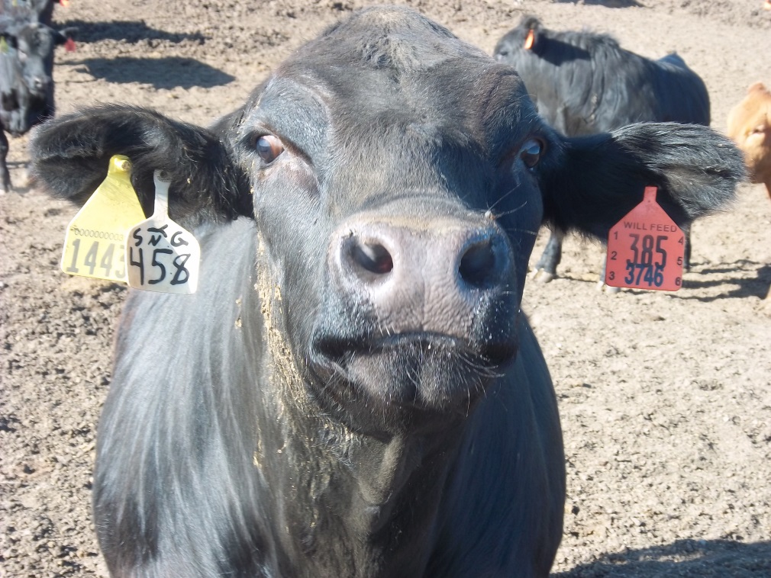
The Weekly Email Newsletter
From OSU Animal Science and Agricultural Economics
Send Email to derrell.peel@okstate.edu

Slide 38
Price-Weight Relationship
Medium/Large No. 1 Steers, Oklahoma

Slide 39
Steer Price, Total Value and Value of Gain
August 10, 2018 7 Mkt. Ave., Oklahoma
Weight (lbs) | Average Price ($/cwt.) | Total Value ($/hd) | VOG 400 lb. Beg. Weight ($/lb.) | VOG 450 lb. Beg. Weight ($/lb | VOG 500 lb. Beg. Weight ($/lb.) | VOG 550 lb. Beg. Weight ($/lb.) | VOG 600 lb. Beg. Weight ($/lb.) | VOG 650 lb. Beg. Weight ($/lb.)
400 | $185.17 | $741
450 | $174.83 | $787 | $0.92
500 | $171.39 | $857 | $1.16 | $1.40
550 | $168.88 | $929 | $1.25 | $1.42 | $1.44
600 | $166.92 | $1,002 | $1.30 | $1.43 | $1.45 | $1.45
650 | $163.56 | $1,063 | $1.29 | $1.38 | $1.37 | $1.34 | $1.23
700 | $157.22 | $1,101 | $1.20 | $1.26 | $1.22 | $1.14 | $0.99 | $0.75
750 | $152.58 | $1,144 | $1.15 | $1.19 | $1.15 | $1.08 | $0.95 | $0.81
800 | $148.86 | $1,191 | $1.13 | $1.15 | $1.11 | $1.05 | $0.95 | $0.85
850 | $145.44 | $1,236 | $1.10 | $1.12 | $1.08 | $1.02 | $0.94 | $0.87
900 | $140.37 | $1,263 | $1.05 | $1.06 | $1.02 | $0.96 | $0.87 | $0.80

Slide 40
Price-Weight Relationship
Medium/Large No. 1 Steers, Oklahoma

Slide 41
Price-Weight Relationship
Medium/Large No. 1 Steers, Oklahoma

Slide 42
Heifer Discount to Steer Price
2000-2016, Oklahoma Auctions

Slide 43
Choice Wholesale Beef Price Seasonality
2007-2016

Slide 44
Heifer Discount to Steer Price
Average by Month, Oklahoma Auctions, 2000-2016

Slide 46
Feeder Price Slide
% by Weight

Slide 47
Price Slide Example
  475 lb. Steer = $170/cwt.
  Price Slide = 9 %
  $170 x .09 = $15.3/cwt.
  Price adjustment for 505 lbs. or 30 lbs. heavier
    $15.3 x .30 = $4.59/cwt.
    505 lb. Steer price = $170 - $4.59 = $165.41/cwt.

Slide 48
Price Slide Variation by Price
475 lb. Steers
  Price Slide = 9 %
  $125/cwt. Price Slide = $11.25/cwt.
  $175/cwt. Price Slide = $15.75/cwt.
  $225/cwt. Price Slide = $20.25/cwt.

Slide 49
Major Beef Producing and Consuming Countries, 2018 Projected
PRODUCTION
USA
Brazil
EU
China
India
Argentina
Australia
Mexico
Pakistan
Turkey
CONSUMPTION
USA
China
Brazil
EU
Argentina
India
Mexico
Russia
Pakistan
Turkey
Source: USDA-FAS, Mar 2018

Slide 50
Data Source: USDA-FAS
Livestock Marketing Information Center

Slide 51
Major Beef Trading Countries,
2018 Projected
EXPORTS
India
Brazil
Australia
USA
New Zealand
Canada
Uruguay
EU
Paraguay
Argentina
IMPORTS
USA
China
Japan
South Korea
Russia
Hong Kong
EU
Chile
Egypt
Canada
Source: USDA-FAS, Oct 2017

Slide 52
Data Source: USDA-FAS

Slide 53
India: Beef Exports

Slide 54
Mexico: Beef Exports

Slide 55
China: Beef Imports

Slide 56
Data Source: USDA-FAS

