Slide 1
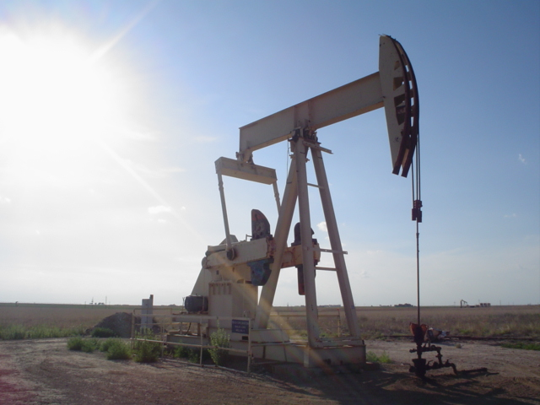
Top 10 things to consider in surface damage agreements
Know the Surface Damage Act
Know what factors are considered in SDA evaluations
Maintain a (good) relationship with mineral owners
Consider drafting a surface use agreement
Consider drafting an exploration agreement
Document the condition of the property before entry
Keep good farm records
Don’t forget restoration issues
Brainstorm non-monetary compensation forms
Brainstorm what you have that may be of value to the company

Slide 2
Top 10 things to consider in an oil and gas lease
Get a feel for your bargaining position
If you hold surface and minerals, think “optimization”
Understand the duration of your lease
Know how to read and modify a lease – be prepared with terms of your own
Understand how production on other property might hold your lease
Be clear on where, when, and how you get paid – and what if you don’t?
Understand what may be deducted from your payments
Preserve your right to audit correctness of payments
No SSN’s on leases!
Time is money – act promptly, but not rashly

Slide 3
Top 10 things to consider in wind and solar energy leases
How will the project influence surface uses?
What is the duration of the lease?
Understand how lease renewals can be made and your part in renewals
Make sure you are compensated for any increases in taxes or insurance premiums
Understand the basis of payments: generation, capacity, other?
If you are paid on a “royalty” basis, how will that calculation work?
Secure a convenient means of auditing payments.
Know the triggers for your project milestones and payments.
Be clear on how land will be released from encumbrances
Harmonize surface uses

Slide 4
Please Complete a Quick Survey Regarding This Webinar
https://okstatecasnr.az1.qualtrics.com/jfe/form/SV_4JfGlN8Bl0psxUx

