Slide 1
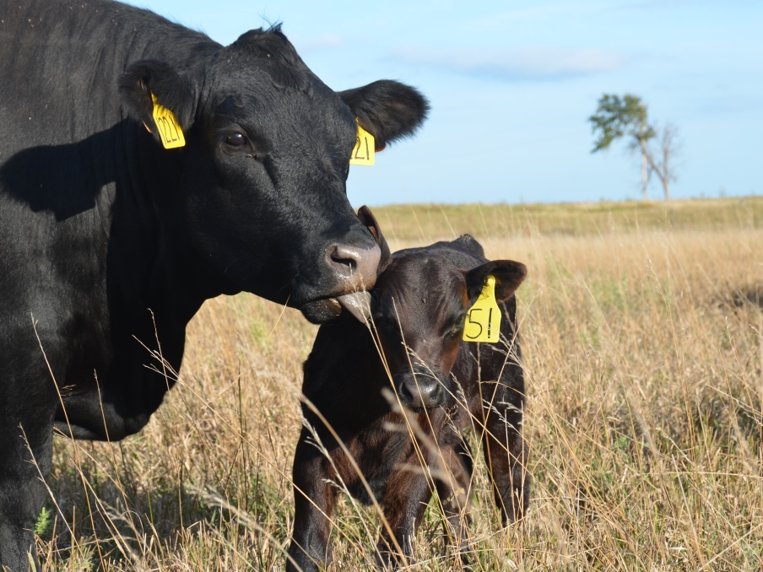

Cattle Market
Update
Derrell S. Peel
Breedlove Professor of Agribusiness and Extension Livestock Marketing Specialist
Oklahoma State University

Slide 2


Slide 3


Beef and Cattle Market Threats
Uncertain external environment
Higher input costs
  Machinery and equipment
  Fencing, etc.
Beef exports
  Tariffs
  Exchange rates
Domestic beef demand
  Competing meats
  Macroeconomic conditions
    Consumer spending
    Inflation
    Rising interest rates

Slide 4
Major Beef Market Factors
Cattle Inventory and Beef Production
Beef Demand
International Trade
Feed and Input Markets
Forage Conditions

Slide 5
Data Source: USDA-AMS
Livestock Marketing Information Center

Slide 6
Data Source: USDA-AMS
Livestock Marketing Information Center

Slide 7
Data Source: USDA-AMS
Livestock Marketing Information Center

Slide 8
Data Source: USDA-AMS
Livestock Marketing Information Center

Slide 9
Data Source: USDA-AMS

Slide 10
Data Source: USDA-AMS
Livestock Marketing Information Center

Slide 11
Data Source: USDA-AMS, Compiled & Analysis by LMIC
Livestock Marketing Information Center

Slide 12
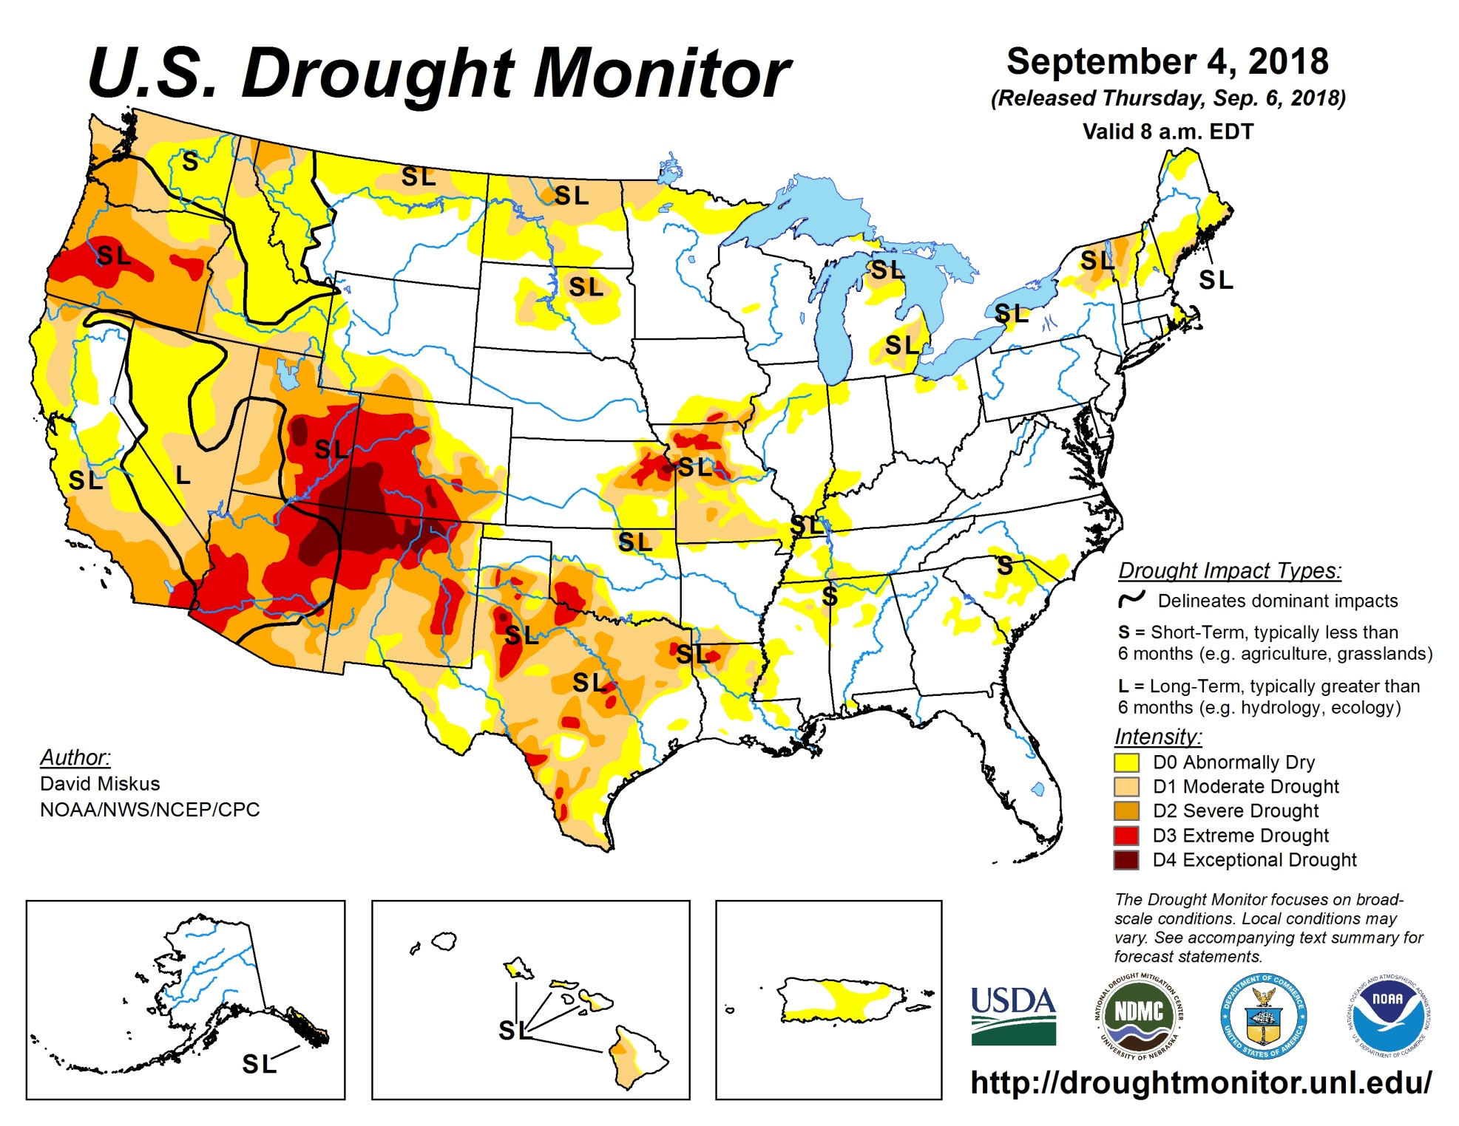

Slide 13
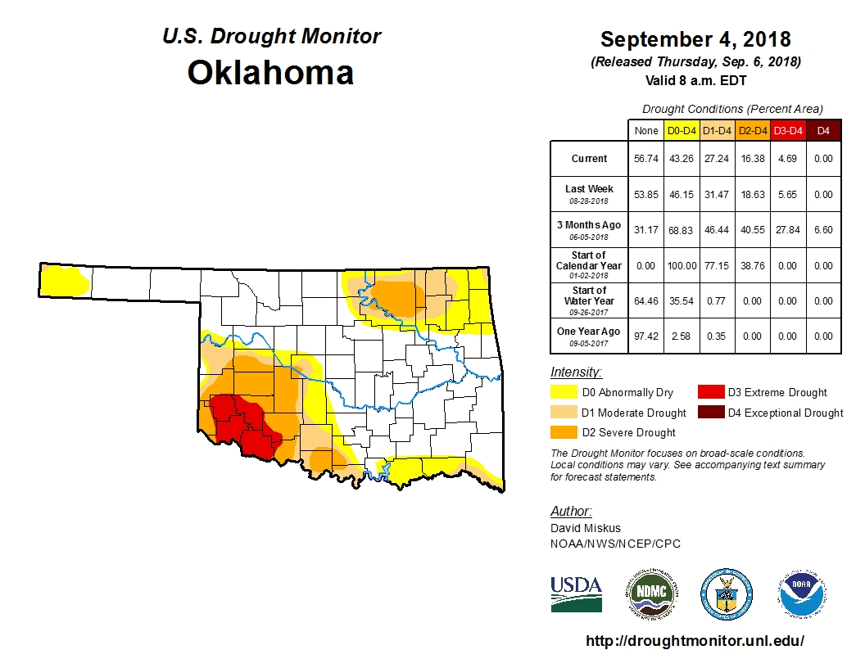

Slide 14
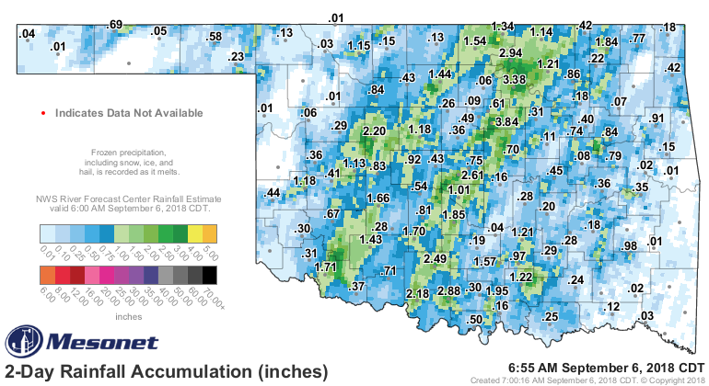
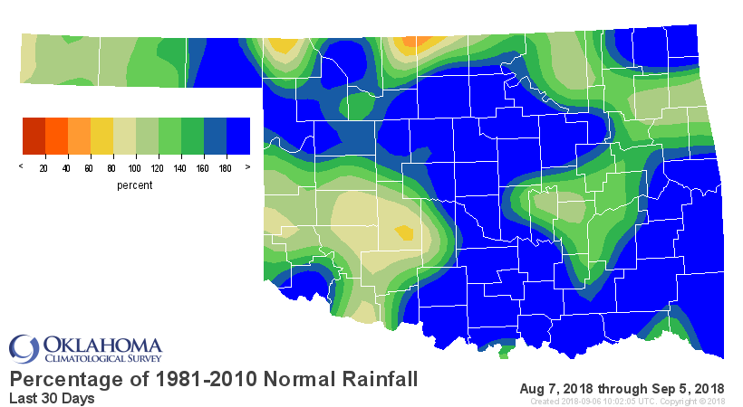

Slide 15
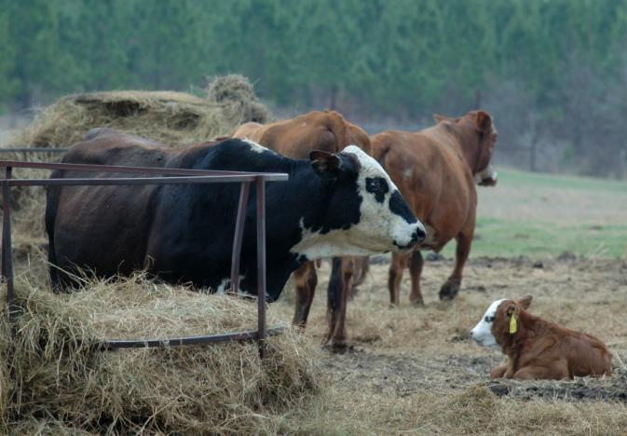
Hay Stocks, May 1
YOY Change
OK -52.0 %
TX -62.8 %
KS -30.4 %
AR -40.0 %
MO -61.3 %
5-state total -53.9 %
U.S. -35.8 %

Slide 16
Data Source: USDA-NASS
Livestock Marketing Information Center

Slide 17
Cattle Slaughter
Federally Inspected, 1000 Head
 | 2016 | 2017 | % Change 2016 to 2017 | 2018 YTD % Change
Steers | 16495 | 16771 | +1.7 | -0.9
Heifers | 7698 | 8611 | +11.9 | +8.5
Dairy Cows | 2886 | 2988 | +3.6 | +4.2
Beef Cows | 2543 | 2784 | +9.5 | +11.6
Bulls | 494 | 550 | +11.4 | +1.3
Total | 30115 | 31771 | +5.3 | +3.2
Latest data: August 18, 2018

Slide 18
Steer to Heifer Slaughter Ratio
12 month MA
July, 2018

Slide 19
Average:
Heifer % = 17.6
Culling % = 9.5
Analysis by Derrell Peel
Data Source: USDA-NASS

Slide 20
Data Source: USDA-AMS & USDA-NASS
Livestock Marketing Information Center

Slide 21
Dressed Weights
12 month Moving Average, Federally Inspected
August, 2018

Slide 22
2018 Meat Production and Consumption
 | Production |  |  |  |  | Consum. Change | Consum. Per Capita | Consum. Change
 | 2016 | 2017 | 2016-2017 | 2018 | 2017- 2018 | 2016-2017 | 2018 | 2017-2018
 | Million lbs. | Million lbs. | % Change | Million lbs. | % Change | % Change | Retail Lbs. | % Change
Beef | 25221 | 26187 | +3.8 | 27054 | +3.3 | +2.5 | 57.3 | +0.7
Pork | 24941 | 25584 | +2.6 | 26555 | +3.8 | +0.0 | 51.3 | +2.4
Broilers | 40261 | 41217 | +2.4 | 42317 | +2.7 | +1.2 | 92.5 | +1.9
Total | 97193 | 99739 | +2.6 | 102649 | +2.9 | +1.1 | 219.7 | +1.5
2018 forecast
LMIC, August 28, 2018

Slide 23
2019 Meat Production and Consumption
 | Production |  |  |  |  | Consum. Change | Consum. Per Capita | Consum. Change
 | 2017 | 2018 | 2017-2018 | 2019 | 2018- 2019 | 2017-2018 | 2019 | 2018-2019
 | Million lbs. | Million lbs. | % Change | Million lbs. | % Change | % Change | Retail Lbs. | % Change
Beef | 26187 | 27054 | +3.3 | 27455 | +1.5 | +0.7 | 57.7 | +0.7
Pork | 25584 | 26555 | +3.8 | 26897 | +1.3 | +2.2 | 51.6 | +0.8
Broilers | 41217 | 42317 | +2.7 | 42983 | +1.6 | +1.9 | 93.5 | +1.1
Total | 99739 | 102649 | +2.9 | 104022 | +1.3 | +1.1 | 221.3 | +0.7
2018 and 2019 forecast
LMIC, August 28, 2018

Slide 24
Data Source: USDA-ERS
July, 2018

Slide 25
Livestock Marketing Information Center
Data Source: USDA-AMS & USDA-NASS, Compiled & Analysis by LMIC
July, 2018

Slide 26
Commercial Beef Production >>>
Beef Cow Inventory >>>
Livestock Marketing Information Center
Data Source: USDA-NASS, Compiled & Analysis by LMIC and Derrell Peel
2018 Production, 2019 inventory forecast

Slide 27
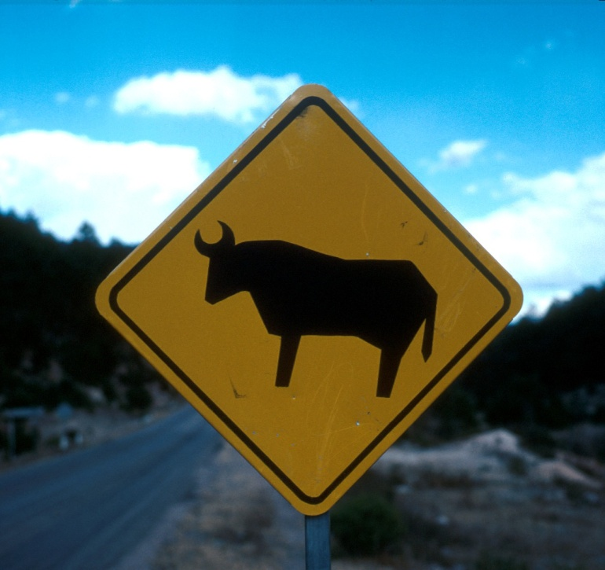

Slide 28
Data Source: USDA-FAS
Livestock Marketing Information Center

Slide 29
Data Source: USDA-FAS

Slide 30
Data Source: USDA-FAS

Slide 31
Data Source: USDA-ERS & USDA-FAS
Livestock Marketing Information Center

Slide 32
U.S. Beef Exports
 | 2016 (1000 lbs.) | % Change 2015 to 2016 | 2017 (1000 lbs.) | % Change 2016 to 2017 | % of Total Exports | YTD % Of 2017
Japan | 655426 | +21.5 | 826204 | +26.1 | 28.9 | +6.5
Mexico | 394952 | +8.9 | 419506 | +6.2 | 14.7 | +8.8
Hong Kong | 293813 | -7.0 | 335719 | +14.3 | 11.7 | +11.5
Canada | 311905 | -4.8 | 311905 | +1.2 | 10.8 | +1.1
S. Korea | 459158 | +44.0 | 472768 | +3.0 | 16.5 | +41.9
Total | 2555698 | +12.7 | 2861557 | +12.0 |  | +14.7
YTD: Jan-Jun

Slide 33
Data Source: USDA-ERS & USDA-FAS, Compiled and Forecasts by LMIC
Livestock Marketing Information Center

Slide 34
Data Source: USDA-ERS & USDA-FAS
Livestock Marketing Information Center

Slide 35
U.S. Beef Imports
 | 2016 (1000 lbs.) | % Change 2015 to 2016 | 2017 (1000 lbs.) | % Change 2015 to 2016 | % of Total Imports | 2018 YTD % of 2017
Australia | 767216 | -39.0 | 695253 | -9.4 | +23.2 | +2.7
Canada | 717798 | +14.2 | 741070 | +3.2 | +24.8 | +9.9
New Zealand | 612549 | -7.4 | 557529 | -9.1 | +18.6 | +8.6
Mexico | 493446 | +25.9 | 573520 | +16.2 | +19.2 | -15.0
Brazil | 152703 | +2.1 | 138430 | -9.3 | +4.6 | -22.6
Total | 3014636 | -10.6 | 2994382 | -0.7 |  | +1.0
YTD: Jan-Jun

Slide 36
Data Source: USDA-ERS & USDA-FAS, Compiled and Forecasts by LMIC
Livestock Marketing Information Center

Slide 37
Data Source: USDA-AMS
Livestock Marketing Information Center

Slide 38
Data Source: USDA-ERS & USDA-FAS
Livestock Marketing Information Center

Slide 39
Data Source: USDA-ERS & USDA-FAS
Livestock Marketing Information Center

Slide 40
Data Source: USDA-AMS, Compiled and Forecasts by LMIC
Livestock Marketing Information Center

Slide 41
2018 Cattle Price Forecasts
 |  | Feeder Steer Price (Southern Plains) |  |  |  | Fed Steer
 |  | 5-600 lb. ($/cwt.) | % chg from Last Year | 7-800 lb. ($/cwt.) | % chg from Last Year | 5-mkt avg. ($/cwt) | % chg from Last Year
2017 | IV | 170.66 | +23.3 | 157.13 | +21.2 | 117.88 | +9.2
 | Annual | 166.00 | 0.0 | 148.17 | +2.1 | 121.52 | +0.5
2018 | I | 180.01 | +14.4 | 148.73 | +11.9 | 125.61 | +2.2
 | II | 170.11 | -0.2 | 144.52 | -3.2 | 116.72 | -12.1
 | III | 166-169 | +1.2 | 148-150 | -2.8 | 111-112 | -0.9
 | IV | 162-166 | -3.9 | 148-151 | -4.9 | 115-117 | -1.6
 | Annual | 169-172 | +2.7 | 147-149 | -0.1 | 117-118 | -3.3
2019 | Annual | 169-174 | +0.5 | 147-151 | +0.6 | 114-118 | -1.3
LMIC, August 28, 2018

Slide 44
Price-Weight Relationship
Medium/Large No. 1 Steers, Oklahoma

Slide 45
Steer Price, Total Value and Value of Gain
August 31, 2018 7 Mkt. Ave., Oklahoma
Weight (lbs) | Average Price ($/cwt.) | Total Value ($/hd) | VOG 400 lb. Beg. Weight ($/lb.) | VOG 450 lb. Beg. Weight ($/lb | VOG 500 lb. Beg. Weight ($/lb.) | VOG 550 lb. Beg. Weight ($/lb.) | VOG 600 lb. Beg. Weight ($/lb.) | VOG 650 lb. Beg. Weight ($/lb.)
400 | $182.52 | $730
450 | $174.26 | $784 | $1.08
500 | $166.82 | $834 | $1.04 | $1.00
550 | $161.61 | $889 | $1.06 | $1.05 | $1.10
600 | $159.60 | $958 | $1.14 | $1.16 | $1.24 | $1.37
650 | $158.29 | $1,029 | $1.20 | $1.22 | $1.30 | $1.40 | $1.43
700 | $154.98 | $1,085 | $1.18 | $1.20 | $1.25 | $1.31 | $1.27 | $1.12
750 | $151.66 | $1,137 | $1.16 | $1.18 | $1.21 | $1.24 | $1.20 | $1.09
800 | $147.74 | $1,182 | $1.13 | $1.14 | $1.16 | $1.17 | $1.12 | $1.02
850 | $143.94 | $1,223 | $1.10 | $1.10 | $1.11 | $1.12 | $1.06 | $0.97
900 | $141.52 | $1,274 | $1.09 | $1.09 | $1.10 | $1.10 | $1.05 | $0.98

Slide 46
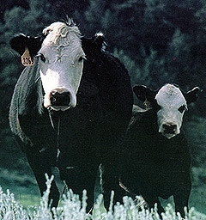

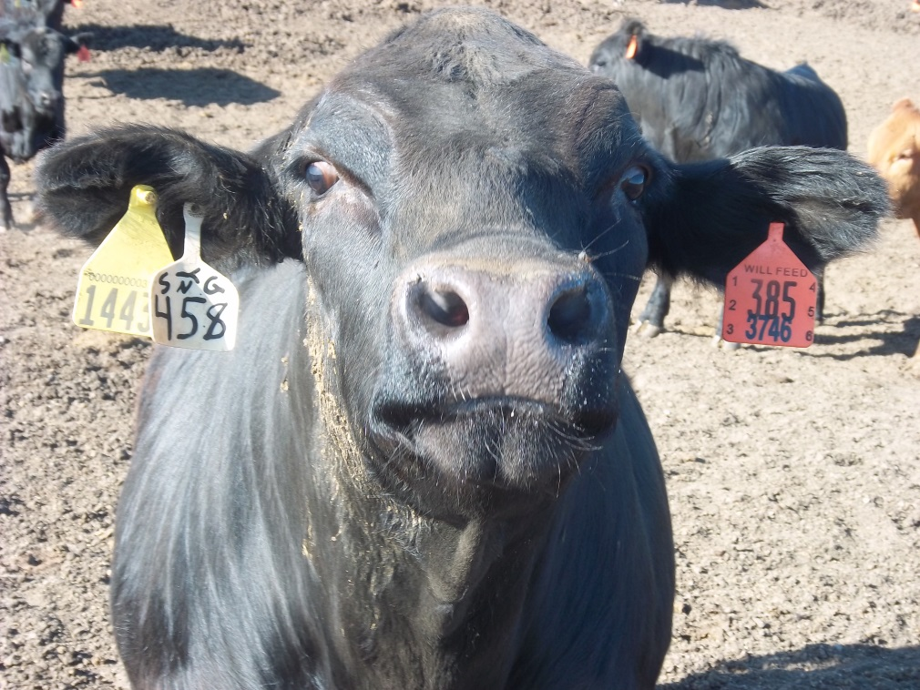
The Weekly Email Newsletter
From OSU Animal Science and Agricultural Economics
Send Email to derrell.peel@okstate.edu

Slide 47
NAFTA Impact on U.S. Agricultural Exports
 | Mexico % of Total Exports | Rank | Canada % of Total Exports | Rank | NAFTA % of Total Exports
Beef | 14.7 | 3 | 10.9 | 5 | 25.6
Pork | 32.1 | 1 | 9.4 | 3 | 41.5
Poultry | 19.5 | 1 | 4.9 | 2 | 24.5
Total Meat | 23.3 |  | 7.7 |  | 31.0
Wheat | 11.6 | 1 | -- | -- | 11.6
Wheat Flour | 58.0 | 1 | 34.3 | 2 | 92.3
Corn | 24.9 | 1 | 1.6 | 11 | 26.4
Sorghum | 9.6 | 2 | -- | -- | --
Soybeans | 6.3 | 2 | 0.5 | 18 | 6.84
Soy Oil | 25.6 | 1 | 1.6 | 13 | 27.2
Soy Meal | 20.5 | 1 | 17.4 | 2 | 37.9

Slide 48
Price-Weight Relationship
Medium/Large No. 1 Steers, Oklahoma

Slide 49
Price-Weight Relationship
Medium/Large No. 1 Steers, Oklahoma

Slide 50
Steer Price, Total Value and Value of Gain
December 8, 2017, 7 Mkt. Ave., Oklahoma
Weight (lbs) | Average Price ($/cwt.) | Total Value ($/hd) | VOG 400 lb. Beg. Weight ($/lb.) | VOG 450 lb. Beg. Weight ($/lb | VOG 500 lb. Beg. Weight ($/lb.) | VOG 550 lb. Beg. Weight ($/lb.) | VOG 600 lb. Beg. Weight ($/lb.) | VOG 650 lb. Beg. Weight ($/lb.)
400 | $191.45 | $766
450 | $184.46 | $830 | $1.28
500 | $177.78 | $889 | $1.23 | $1.18
550 | $167.09 | $919 | $1.02 | $0.89 | $0.60
600 | $161.75 | $970 | $1.02 | $0.94 | $0.82 | $1.03
650 | $159.77 | $1,039 | $1.09 | $1.04 | $1.00 | $1.20 | $1.36
700 | $156.35 | $1,094 | $1.10 | $1.06 | $1.03 | $1.17 | $1.24 | $1.12
750 | $154.03 | $1,155 | $1.11 | $1.08 | $1.07 | $1.18 | $1.23 | $1.17
800 | $151.38 | $1,211 | $1.11 | $1.09 | $1.07 | $1.17 | $1.20 | $1.15
850 | $148.68 | $1,264 | $1.11 | $1.08 | $1.07 | $1.15 | $1.17 | $1.13
900 | $148.38 | $1,335 | $1.14 | $1.12 | $1.12 | $1.19 | $1.22 | $1.19

Slide 51
Price-Weight Relationship
Medium/Large No. 1 Steers, Oklahoma

Slide 52
Steer Price, Total Value and Value of Gain
February 16, 2018 7 Mkt. Ave., Oklahoma
Weight (lbs) | Average Price ($/cwt.) | Total Value ($/hd) | VOG 400 lb. Beg. Weight ($/lb.) | VOG 450 lb. Beg. Weight ($/lb | VOG 500 lb. Beg. Weight ($/lb.) | VOG 550 lb. Beg. Weight ($/lb.) | VOG 600 lb. Beg. Weight ($/lb.) | VOG 650 lb. Beg. Weight ($/lb.)
400 | $204.97 | $820
450 | $194.05 | $873 | $1.07
500 | $185.12 | $926 | $1.06 | $1.05
550 | $178.08 | $979 | $1.06 | $1.06 | $1.08
600 | $169.98 | $1,020 | $1.00 | $0.98 | $0.94 | $0.81
650 | $163.11 | $1,060 | $0.96 | $0.93 | $0.90 | $0.81 | $0.81
700 | $157.07 | $1,099 | $0.93 | $0.91 | $0.87 | $0.80 | $0.80 | $0.79
750 | $150.65 | $1,130 | $0.89 | $0.86 | $0.82 | $0.75 | $0.73 | $0.70
800 | $145.88 | $1,167 | $0.87 | $0.84 | $0.80 | $0.75 | $0.74 | $0.71
850 | $141.97 | $1,207 | $0.86 | $0.83 | $0.80 | $0.76 | $0.75 | $0.73
900 | $137.79 | $1,240 | $0.84 | $0.82 | $0.79 | $0.74 | $0.73 | $0.72

Slide 53
Steer Price, Total Value and Value of Gain
August 17, 2018 7 Mkt. Ave., Oklahoma
Weight (lbs) | Average Price ($/cwt.) | Total Value ($/hd) | VOG 400 lb. Beg. Weight ($/lb.) | VOG 450 lb. Beg. Weight ($/lb | VOG 500 lb. Beg. Weight ($/lb.) | VOG 550 lb. Beg. Weight ($/lb.) | VOG 600 lb. Beg. Weight ($/lb.) | VOG 650 lb. Beg. Weight ($/lb.)
400 | $184.91 | $740
450 | $175.48 | $790 | $1.00
500 | $168.62 | $843 | $1.03 | $1.07
550 | $163.64 | $900 | $1.07 | $1.10 | $1.14
600 | $159.85 | $959 | $1.10 | $1.13 | $1.16 | $1.18
650 | $157.85 | $1,026 | $1.15 | $1.18 | $1.22 | $1.26 | $1.34
700 | $154.61 | $1,082 | $1.14 | $1.17 | $1.20 | $1.22 | $1.23 | $1.13
750 | $150.60 | $1,130 | $1.11 | $1.13 | $1.15 | $1.15 | $1.14 | $1.03
800 | $148.55 | $1,188 | $1.12 | $1.14 | $1.15 | $1.15 | $1.15 | $1.08
850 | $145.92 | $1,240 | $1.11 | $1.13 | $1.13 | $1.13 | $1.12 | $1.07
900 | $141.72 | $1,275 | $1.07 | $1.08 | $1.08 | $1.07 | $1.05 | $1.00

Slide 54
Steer Price, Total Value and Value of Gain
August 24, 2018 7 Mkt. Ave., Oklahoma
Weight (lbs) | Average Price ($/cwt.) | Total Value ($/hd) | VOG 400 lb. Beg. Weight ($/lb.) | VOG 450 lb. Beg. Weight ($/lb | VOG 500 lb. Beg. Weight ($/lb.) | VOG 550 lb. Beg. Weight ($/lb.) | VOG 600 lb. Beg. Weight ($/lb.) | VOG 650 lb. Beg. Weight ($/lb.)
400 | $186.47 | $746
450 | $177.90 | $801 | $1.09
500 | $168.07 | $840 | $0.94 | $0.80
550 | $160.88 | $885 | $0.93 | $0.84 | $0.89
600 | $158.90 | $953 | $1.04 | $1.02 | $1.13 | $1.37
650 | $156.88 | $1,020 | $1.10 | $1.10 | $1.20 | $1.35 | $1.33
700 | $153.91 | $1,077 | $1.10 | $1.11 | $1.18 | $1.28 | $1.24 | $1.15
750 | $152.76 | $1,146 | $1.14 | $1.15 | $1.22 | $1.30 | $1.28 | $1.26
800 | $149.78 | $1,198 | $1.13 | $1.14 | $1.19 | $1.25 | $1.22 | $1.19
850 | $145.68 | $1,238 | $1.09 | $1.09 | $1.14 | $1.18 | $1.14 | $1.09
900 | $142.77 | $1,285 | $1.08 | $1.08 | $1.11 | $1.14 | $1.11 | $1.06

Slide 55
Additional Wheat Production Costs for Grazing,
Per Acre
Yield loss 6 bushels@$5.10/bu. $30.60
Fertilizer 30 lb. N @ $0.42/lb. $12.60
Fertilizer application $ 5.00
Seed 2.0 bu. @$10/bu. $20.00
Total Additional Cost/Acre $68.20
Breakeven Wheat Pasture Cost: (assuming 119 days of grazing and 2.0 lb. ADG)
  475 lb. beg weight (1.19 acres/hd.) = $0.34/lb. gain
  575 lb. beg weight (1.43 acres/hd.) = $0.41/lb. gain
  625 lb. beg weight (1.56 acres/hd.) = $0.45/lb. gain

Slide 56
Price-Weight Relationship
Medium/Large No. 1 Steers, Oklahoma

Slide 57
Steer Price, Total Value and Value of Gain
November 3, 2017, 7 Mkt. Ave., Oklahoma
Weight (lbs) | Average Price ($/cwt.) | Total Value ($/hd) | VOG 400 lb. Beg. Weight ($/lb.) | VOG 450 lb. Beg. Weight ($/lb | VOG 500 lb. Beg. Weight ($/lb.) | VOG 550 lb. Beg. Weight ($/lb.) | VOG 600 lb. Beg. Weight ($/lb.) | VOG 650 lb. Beg. Weight ($/lb.)
400 | $192.70 | $771
450 | $181.75 | $818 | $0.94
500 | $173.82 | $869 | $0.98 | $1.02
550 | $167.02 | $919 | $0.99 | $1.01 | $0.99
600 | $164.21 | $985 | $1.07 | $1.12 | $1.16 | $1.33
650 | $163.04 | $1,060 | $1.16 | $1.21 | $1.27 | $1.41 | $1.49
700 | $162.83 | $1,140 | $1.23 | $1.29 | $1.35 | $1.47 | $1.55 | $1.60
750 | $163.30 | $1,225 | $1.30 | $1.36 | $1.42 | $1.53 | $1.60 | $1.65
800 | $161.23 | $1,290 | $1.30 | $1.35 | $1.40 | $1.48 | $1.52 | $1.53
850 | $157.80 | $1,341 | $1.27 | $1.31 | $1.35 | $1.41 | $1.42 | $1.41
900 | $152.96 | $1,377 | $1.21 | $1.24 | $1.27 | $1.31 | $1.30 | $1.27

Slide 58
Price-Weight Relationship
Medium/Large No. 1 Steers, Oklahoma

Slide 59
Heifer Discount to Steer Price
2000-2016, Oklahoma Auctions

Slide 60
Choice Wholesale Beef Price Seasonality
2007-2016

Slide 61
Heifer Discount to Steer Price
Average by Month, Oklahoma Auctions, 2000-2016

Slide 63
Feeder Price Slide
% by Weight

Slide 64
Price Slide Example
  475 lb. Steer = $170/cwt.
  Price Slide = 9 %
  $170 x .09 = $15.3/cwt.
  Price adjustment for 505 lbs. or 30 lbs. heavier
    $15.3 x .30 = $4.59/cwt.
    505 lb. Steer price = $170 - $4.59 = $165.41/cwt.

Slide 65
Price Slide Variation by Price
475 lb. Steers
  Price Slide = 9 %
  $125/cwt. Price Slide = $11.25/cwt.
  $175/cwt. Price Slide = $15.75/cwt.
  $225/cwt. Price Slide = $20.25/cwt.

Slide 66
