Slide 1
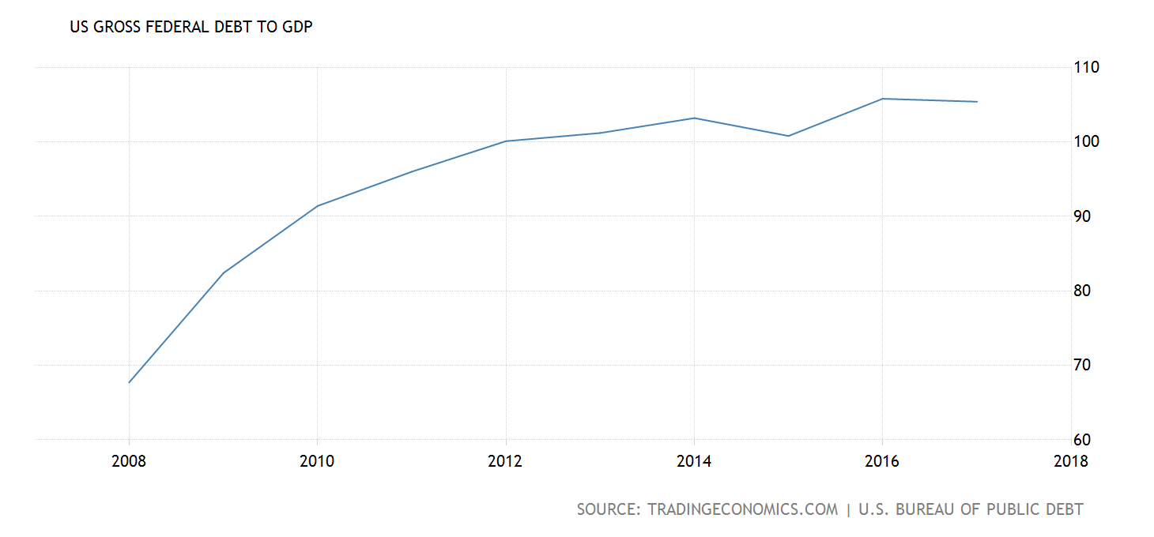
The great recession of 2008: 10 years later
Larry D. Sanders
&
Dave Shideler
Dept of AGEC
Oklahoma State University

Slide 2
Just to review: the Great Recession
The official recession period was Dec 2007-Jun 2009
The headline-country nearly went over the edge was Sep 2008
The primary cause: a huge bubble of poorly financed homes—perhaps $8-$14 trillion
Worldwide losses were even greater—perhaps many more trillions of $$

Slide 3
Reviewing the Great Recession
The US & global economy has mostly rebounded
The economy, in spite of a severe hit, has proven to be very resilient
That said, not all is well…

Slide 4
Reviewing the Great Recession
U S economy lost:
Over 8 million jobs
Consumer spending
Business investment
Some investment firms that seemed “too big to fail”
Small to mid-size firms failed
Some rural areas were forced to accelerate “consolidation” of schools, hospitals, etc.
The government basically nationalized some large firms to keep them afloat

Slide 5
Reviewing the Great Recession
Many Americans lost the American Dream
a home, a car, health insurance, a good retirement plan, good vacations, savings to send the kids to college
ceased to exist for millions of Americans
and they’ll never get it back

Slide 6
Jobs & the economy…
Jobs:
http://tipstrategies.com/archive/geography-of-jobs/
Notes:
Jobs are at the center of most concerns with the economy. 2010 continued the deepest and longest period of unemployment of any US recession since WWII. While job recovery is slowly picking up, unemployment has been stuck at close to 10% and shows no signs of quick turnaround. Until jobs rebound and people feel more confident about their own situations, consumer spending will be sluggish in recovery. Until consumer spending is back on track, businesses will be slow to re-invest in the economy.

Slide 7
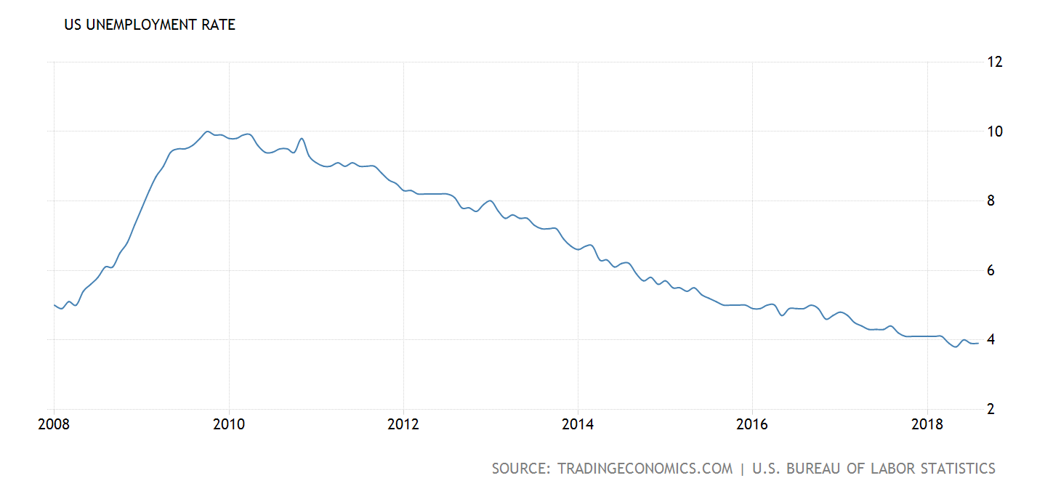
TALKING POINTS
We’re going to talk jobs for a bit because more than half of all farms get more than half their family income from off-farm, non-farm jobs.
We’ve gone from nearly 10% unemployment at the height of the recession, to hovering near 4%.
That doesn’t mean everyone went back to their original , good paying jobs.
Few were able to regain their original job status, and it took a long time to get to a second or third choice, perhaps even after retraining.
3.9%

Slide 8
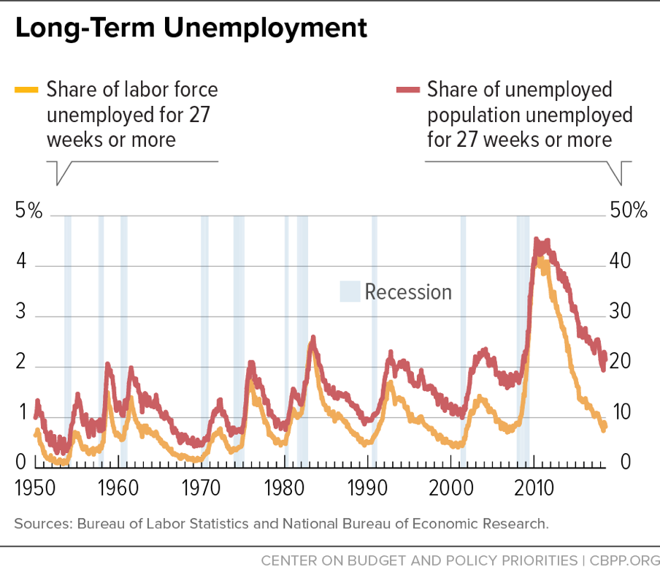
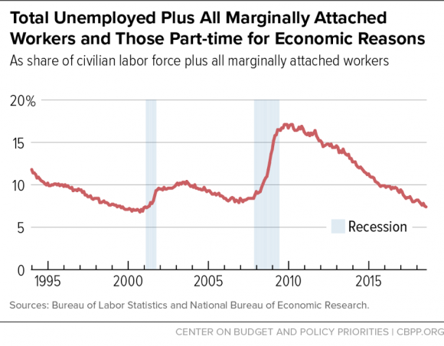
TALKING POINTS
If you consider those who have been unemployed 27 weeks or longer, they represesent about 1% of the labor force.
Of the unemployed population unemployed 27 weeks or more, they represent about 20% of the unemployed population.
If you include marginal and part-time workers with the standard unemployed, the unemployment rate is about 8-9%.

Slide 9
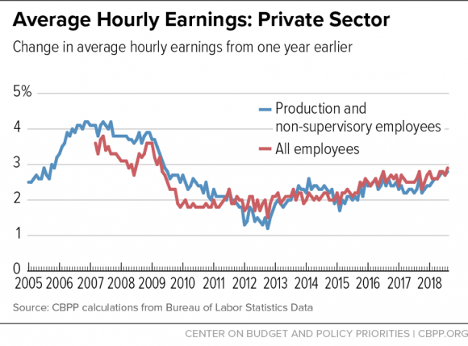
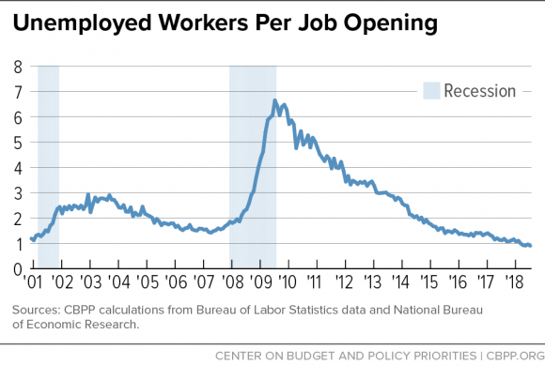
TALKING POINTS
It is no secret that, while the economy is doing better, wages continue to lag behind.
We are seeing some increase in wages on the margin, but nothing like the rate of increase before the GR.
A major reason for that has been the lack of available jobs for applicants. Other factors not discussed here have been technology and the erosion of labor unions.

Slide 10
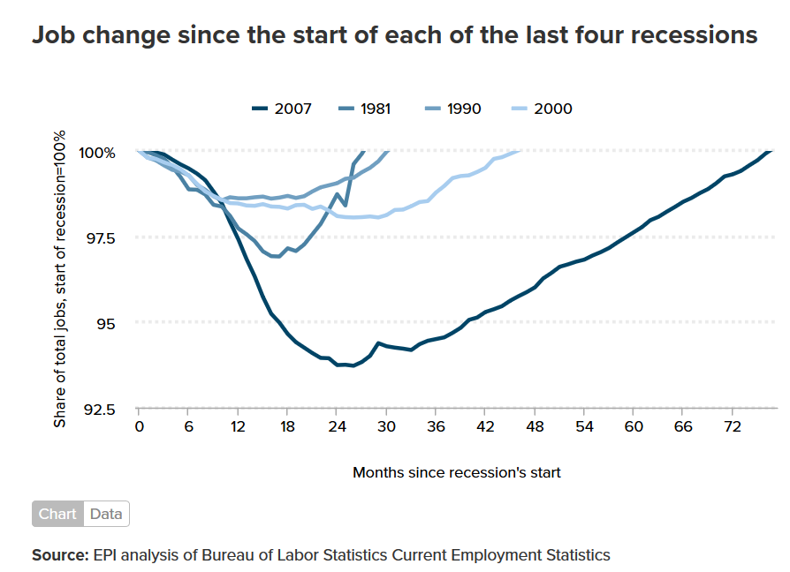
TALKING POINTS
This chart shows the average length of time for workers who lose jobs because of a recession to get back in the market.
72 months, or 6 years, was the time frame for GR workers.
And, the jobs they settled for were rarely at the pay scale of previous job.

Slide 11
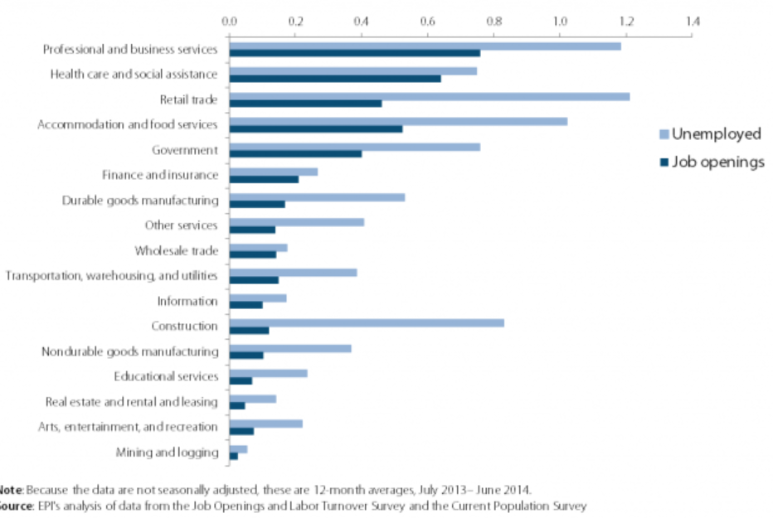
TALKING POINTS
All major categories of job openings had fewer offers available than unemployed in those categories.
Early in the GR, the ratio of job seekers per jobs was 7/1.
That ratio is now closer to 1/1, but location and other issues make matches difficult .

Slide 12
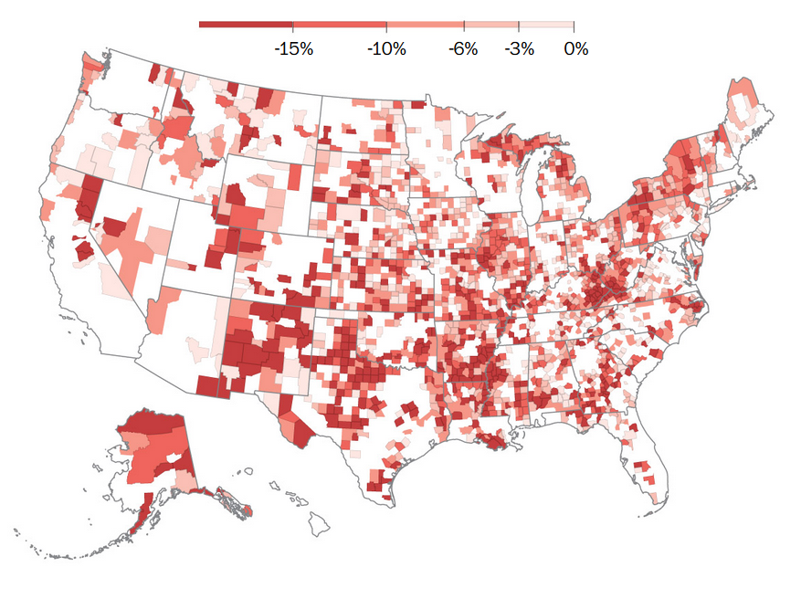
Decline in total employment
TALKING POINTS
In early stages of GR, the darker red areas show where most employment was lost.
Some of these areas have not yet fully recovered.
BUT, note the white areas. There was no significant job loss in these areas.

Slide 13
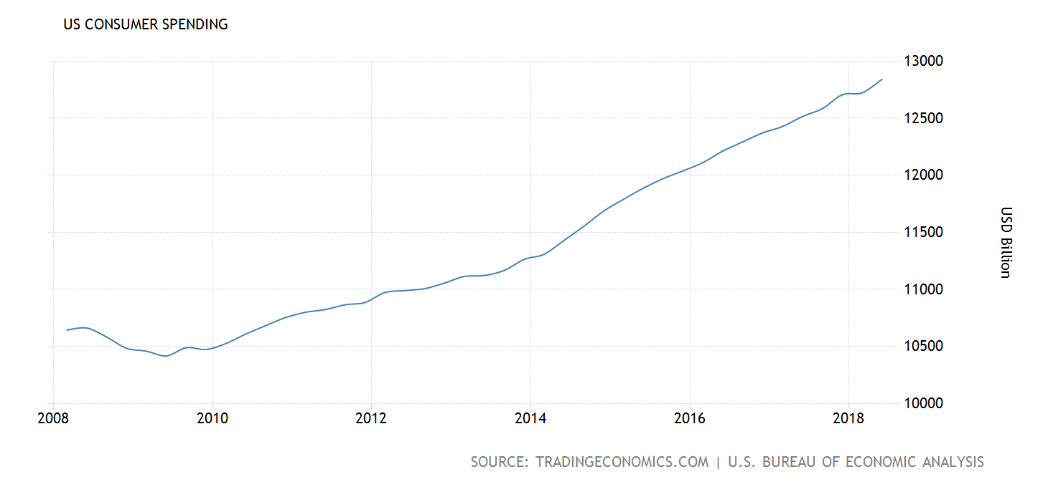
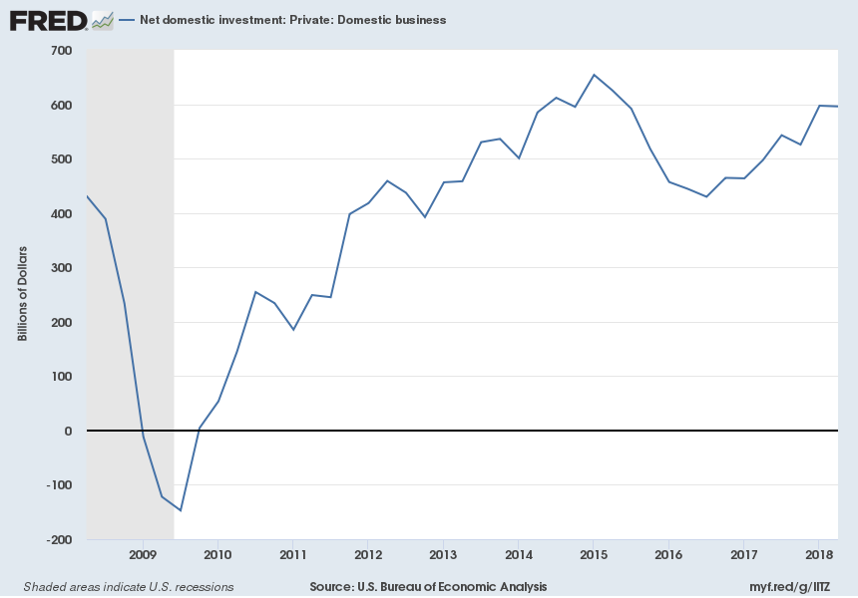
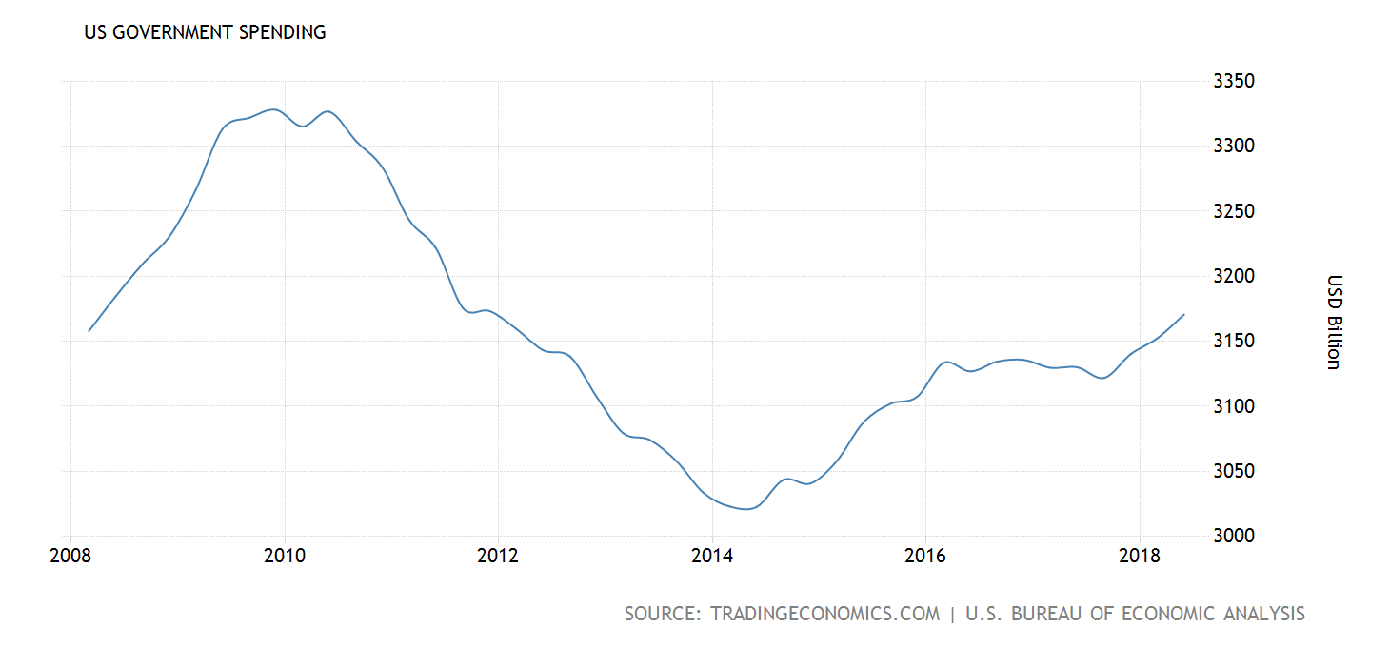
TALKING POINTS
The general economy (gross domestic product—GDP) is composed of
Consumer spending
Business investment
Government spending
Government spending kept the economy afloat during the GR.
As Consumer spending & Business investment began to return, government spending slowed—until 2015, and it has surged since 2017.
Consumer spending is back on track.
Business investment is moving in the right direction.

Slide 14
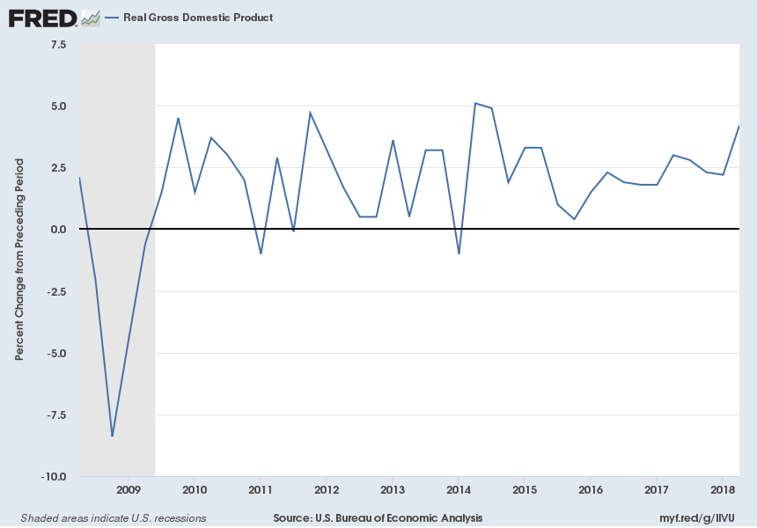
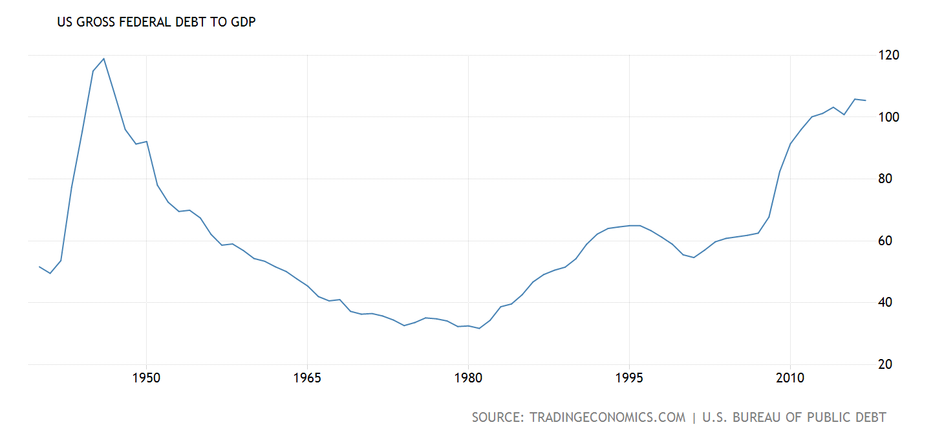
TALKING POINTS
GDP (real to the right) has recovered since the GR, but continues to be volatile.
The ratio of government debt to GDP continues to increase, primarily because of government spending. It has not been this high since 1948.
The concern is that another crisis (recession, military conflict, etc) would force the govt to greatly over-extend, leading to hyper-inflation and possible depression.
105.4%
105.4%
government debt refers to federal debt held by individuals, corporations, state or local governments, foreign governments, and other entities outside of US govt less Federal Financing Bank securities.

Slide 15
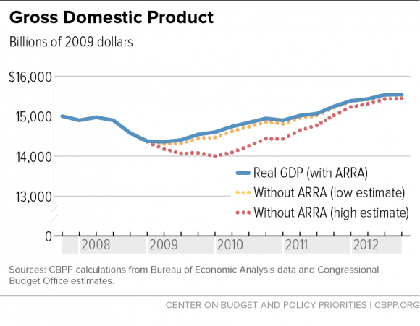
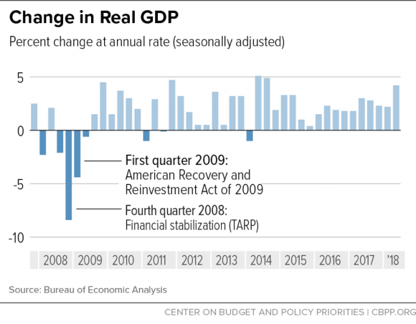
TALKING POINTS
So, the road back from the losses of the GR was really like a roller coaster ride.
Consumers and Businesses were initially unable to get back in the market.
In classic Keynesian style, Government spending helped the economy recover—TARP by Bush in 2008 & ARRA by Obama in 2009.
The loss between the green trend line and the blue recovery line may never be fully recovered.

Slide 16
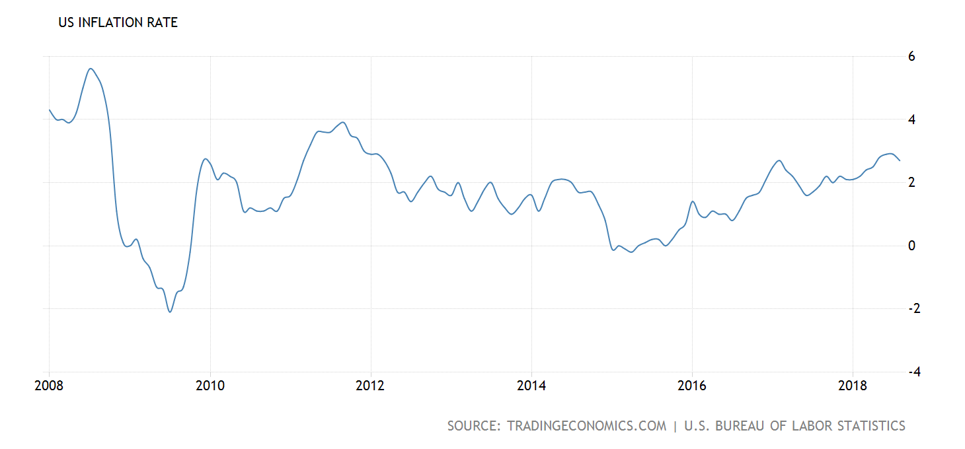
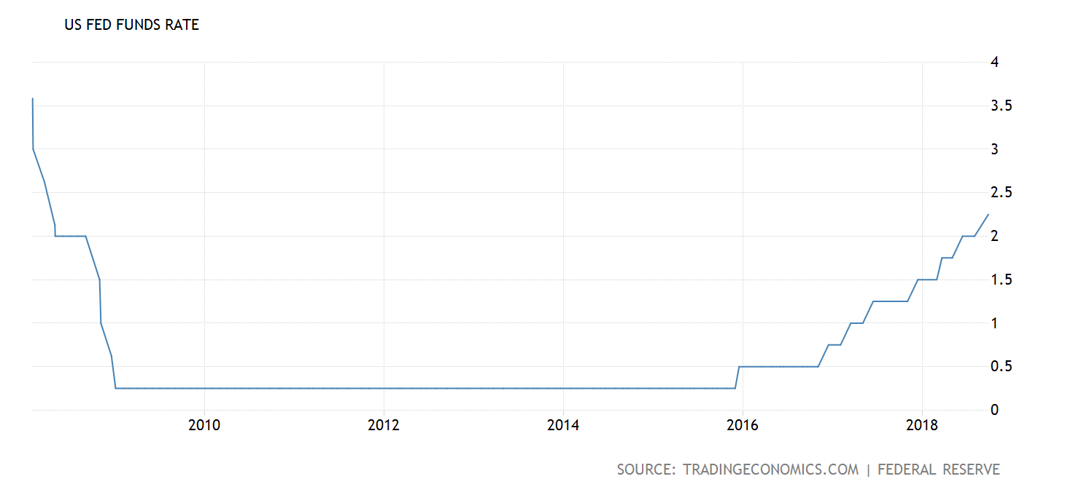
TALKING POINTS
FED has done a relatively good job keeping inflation down.
As they slowly increase interest rates, the apparent trade-off is (a) halt interest rate increases & let inflation and hopefully wages increase; or, (b) increase interest rates to stall inflation rates with the likelihood that wage growth slows.
2.25%

Slide 17
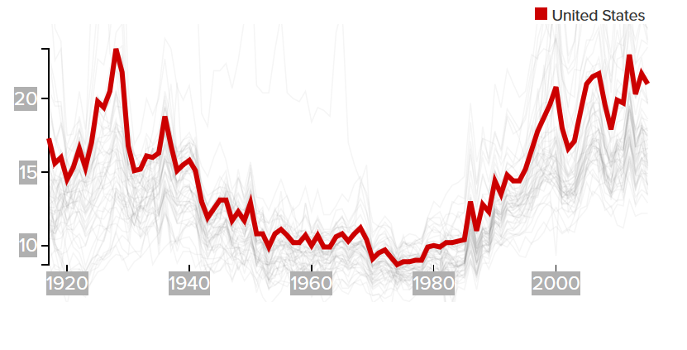
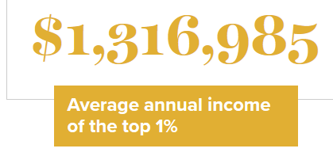
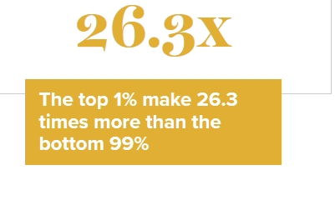
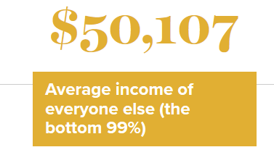
https://www.epi.org/multimedia/unequal-states-of-america/

Slide 18
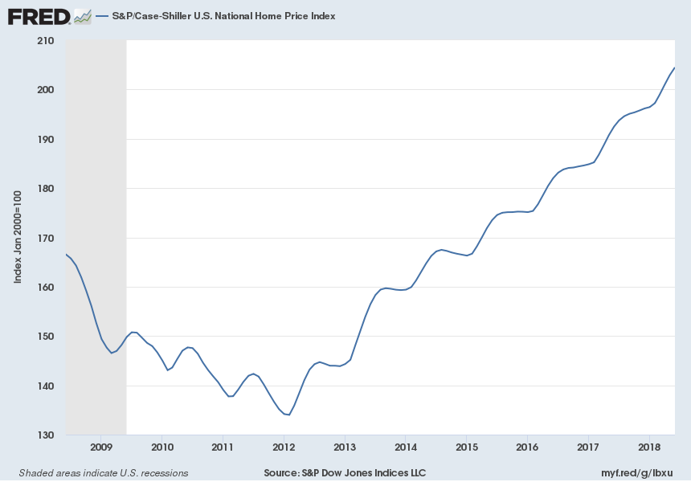

Slide 19
U.S. Agricultural Trade
Lower Bulk Export Prices and Greater Export Competition
152.3
134
114.2
112.5
Exports
Imports
Trade Surplus
Updated by Sanders

Slide 20
Top global banks
 | 2007 | 2017
TOP 4 BANKS | EUROPEAN | CHINESE
TOP 10 BANKS | 7 EUROPEAN; 2 JAPANESE; 1 US | 4 CHINESE; 3 EUROPEAN; 2 US; 1 JAPANESE

Slide 22
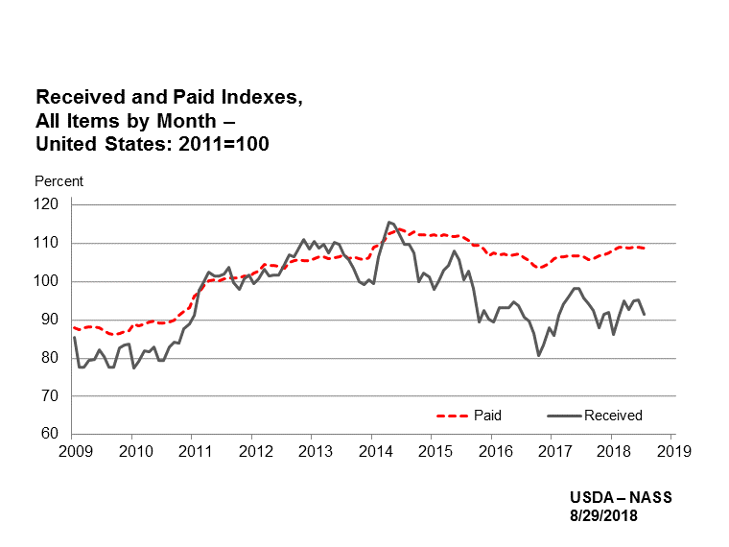
Agricultural budgets

Slide 23
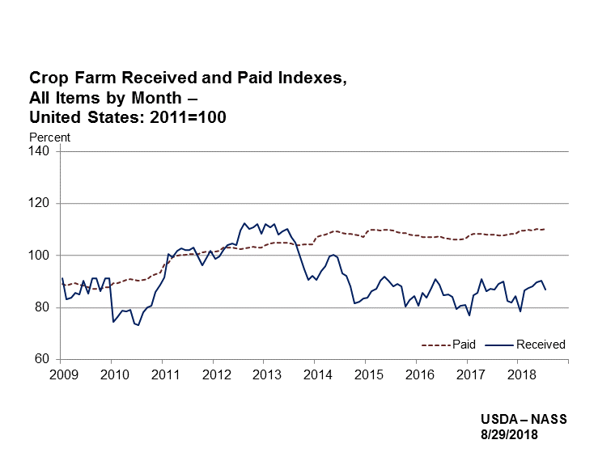
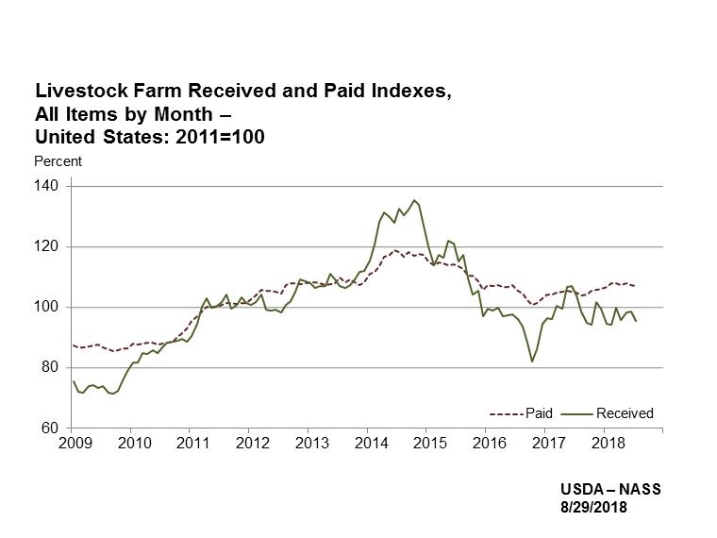

Slide 24
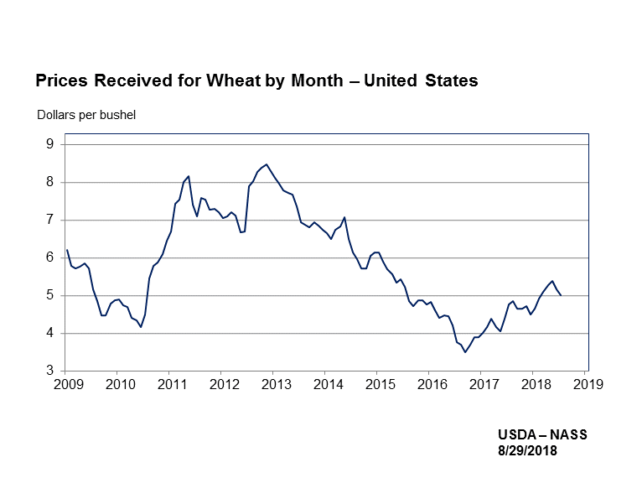
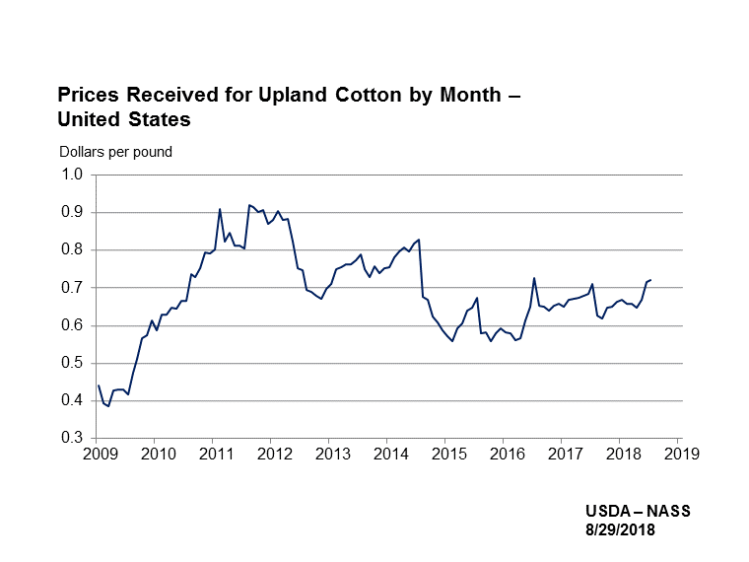
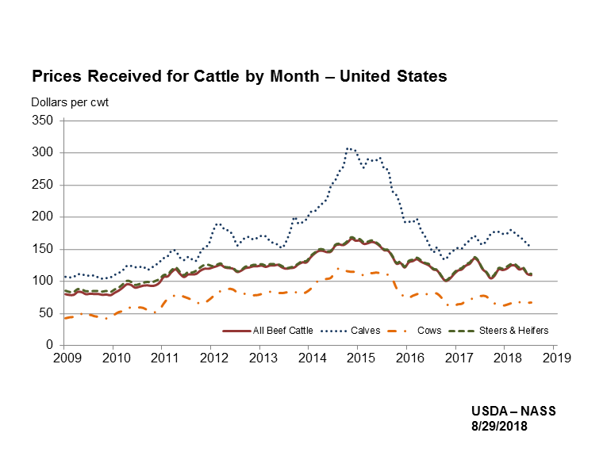
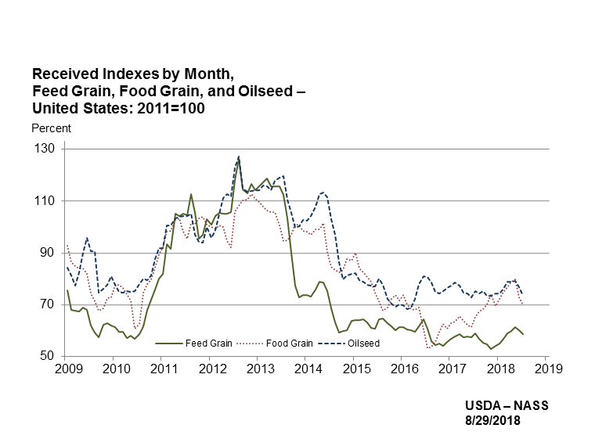

Slide 25
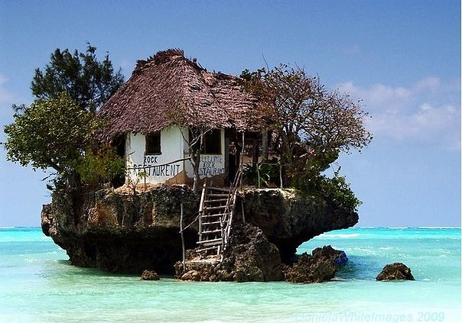
Contact information:
Larry D. Sanders
405-744-9822
larry.sanders@okstate.edu
FOR STATE/LOCAL ECONOMIC
INFO:
CONTACT:
Dave Shideler
RETIREMENT HOME 2020???

