Slide 1
Managing Farm Stress
Matt Brosi, Ph.D.
Jordan Shuler

Slide 2
Stress vs. Distress
Stress is a normative process
For farmers, stress is a part of everyday life
Being under stress is not the same thing as feeling distressed

Slide 3
Stress Defined
Positive stress = eustress

Slide 4
Distress
When stress gets too high, we experience distress.

Slide 5
Eustress vs. Distress
The Eustress-Distress Curve
Maximum Performance
Eustress: positive stress which motivates, energizes, and excites
Distress: negative stress which is oppressive, elevates emotions, and reduces performance
Good
Low
performance
illness
Eustress
Distress
Poor
poor performance
poor performance
High
low
bored
moderate
optimal
high
overwhelmed

Slide 6
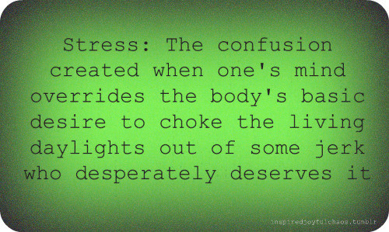
Consequences of Too Much
Stress suppresses the immune system; easier for you to get sick and harder to fight off bugs.
Numerous emotional and physical disorders linked to stress:
Sleep disturbances are a major factor!
Diminished capacity for logical thought, making accidents more likely.
Depression, anxiety, heart attacks, stroke, hypertension, immune system disturbances, digestive disturbances, skin issues, etc.

Slide 7
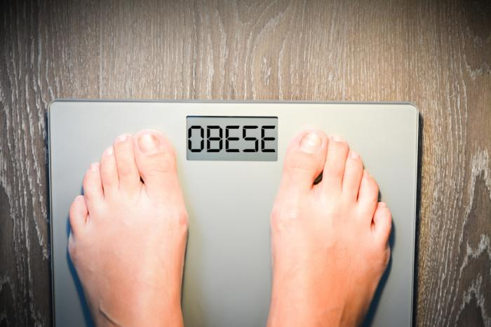
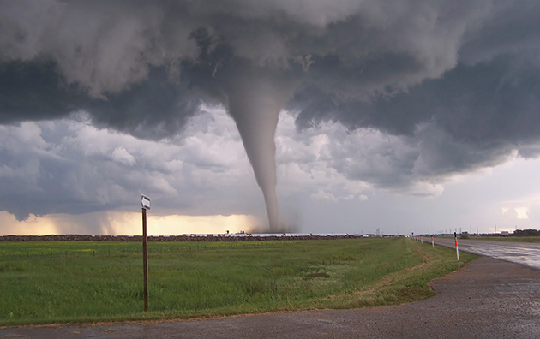
Stress in Oklahoma
Financial Stress / Poverty
16% living in poverty
Obesity
More than one in three qualify as obese
Substance Use
2nd in the nation for substance abuse problems
Divorce
3rd in the nation for divorce rates
Natural disasters
Higher than average tornado rates and drought conditions

Slide 8
Farm Stress
Distress in rural Oklahoma
Recent (and upcoming?) Farm Stress issues in OK
Loss or decrease of income
Rising debt
Concerns about drought
Farm Transitions/Losses:
Death
Divorce
Disease
Disaster
Disability

Slide 9
Farm Stress
Farming is among the most stressful and dangerous professions
Dangerous conditions
Low income
Lack of control
COVID-19
Despite more spread-out communities
Rural communities tend to be older
Higher levels of long-term health problems
Hospitals already strained
Equipment Failure
Damaged property
Foreclosures

Slide 10
Farmers and Suicide
Suicide rates higher in rural communities
Depression on the farm
Loss of income and increased debt
Health problems
Family troubles
Fear of the unknown
The connection to higher suicide rates
Farming culture
Less access to medical care
High access to lethal means

Slide 11
Warning Signs and Barriers
Acute Crisis and Warning Signs
Unique Circumstances
Thoughts about killing oneself
A specific plan
Means
Self-reliance and “toughness”
Ongoing pressure
Less experience with emotional expression

Slide 12
One More Way To Think About Stress

Slide 13
Relationships as Resources
You & Your Significant Other
Friends and Faith
Flood your relationships with Positive Experiences
Starting soft
Humility and Acceptance
Sharing your stories
Building routines of support
Faith communities

Slide 14
Putting it All Together
Reducing potentially stressful circumstances
Is there a place you could cut back pressure?
Using resources
Ag lenders and creative plans
Family or communities of support
Changing perspectives
Challenge defeating thoughts
Know a hard time doesn’t define you
Challenge can be an opportunity
Be patient with yourself

Slide 15
Additional Resources
Suicide Prevention Hotline
National hotline: 1-800-273-8255
Talk with Someone
Mental health professional: https://www.psychologytoday.com/us/therapists/online-counseling
Coffee shop groups
Faith leaders or trusted others

Slide 16
Q&A and Feedback
Questions
We appreciate your feedback!
https://okstatecasnr.az1.qualtrics.com/jfe/form/SV_9NsdbazthcfQWCV

