Slide 1
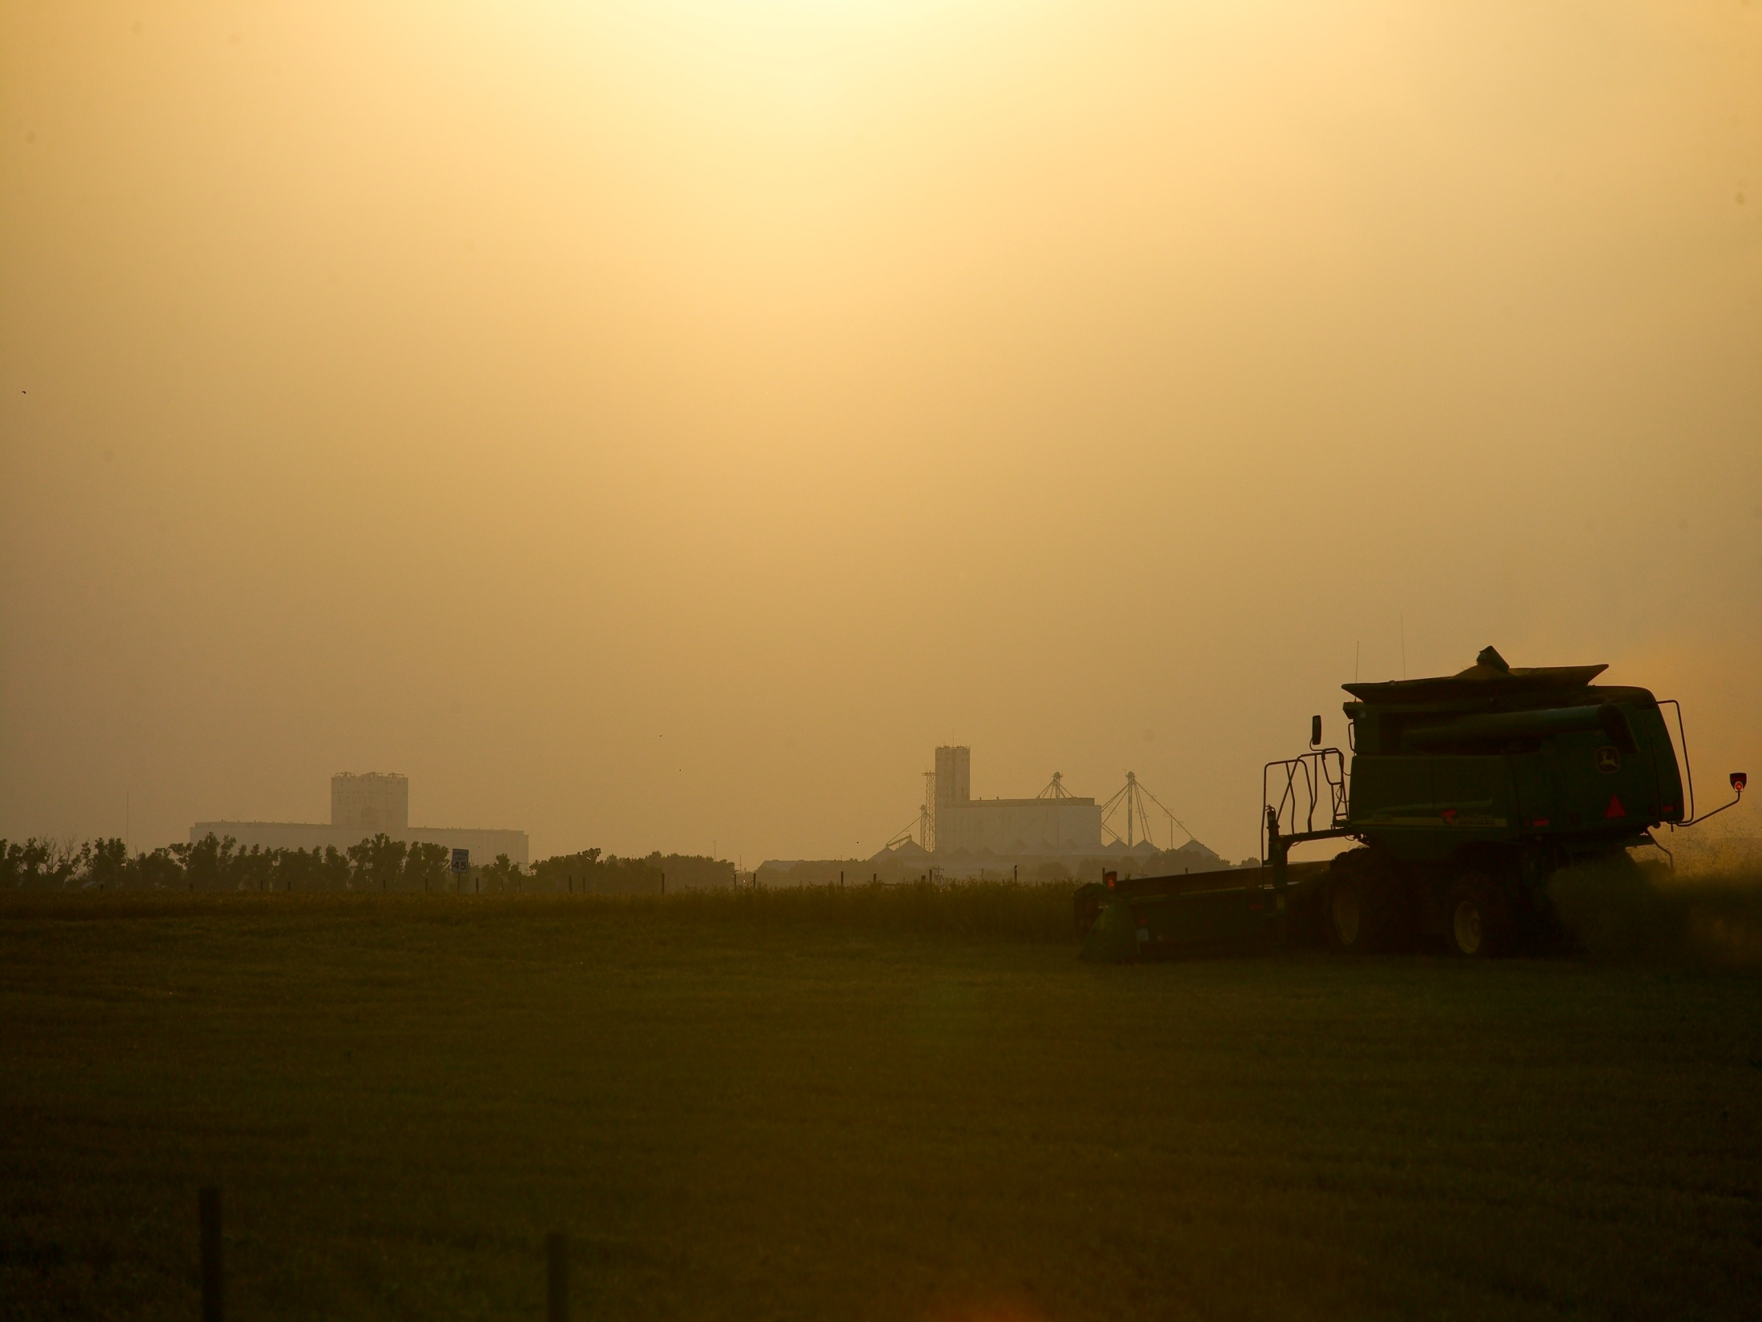
Oklahoma Farmland Rental Update
And What Rental Arrangement Might Work the Best for You
Roger Sahs, Extension Specialist
OSU Agricultural Economics Department

Slide 2
USDA/NASS (http://quickstats.nass.usda.gov/)

Slide 3
2019 Rental Rates for Non-irrigated Cropland
CIMARRON
TEXAS
BEAVER
HARPER
WOODS
ALFALFA
GRANT
KAY
WASHINGTON
NOWATA
OTTAWA
*
OSAGE
CRAIG
DELAWARE
WOODWARD
GARFIELD
NOBLE
ROGERS
ELLIS
*
MAJOR
PAWNEE
TULSA
MAYES
DEWEY
KINGFISHER
PAYNE
WAGONER
ROGER
BLAINE
LOGAN
CREEK
CHEROKEE
MILLS
LINCOLN
OKMULGEE
MUSKOGEE
ADAIR
< $21
CUSTER
CANADIAN
OKLAHOMA
OKFUSKEE
SEQUOYAH
*
WASHITA
MCINTOSH
$21 to $27.50
BECKHAM
*
CADDO
SEMINOLE
HASKELL
POTTAWATOME
HUGHES
$27.50 to $33
GREER
GRADY
CLEVELAND
PITTSBURG
KIOWA
MCCLAIN
LATIMER
$33 +
HARMON
GARVIN
PONTOTOC
*
COMANCHE
LE FLORE
JACKSON
*
STEPHENS
*
COAL
TILLMAN
COTTON
*
MURRAY
*
*
PUSHMATAHA
CARTER
JOHNSTON
ATOKA
JEFFERSON
MARSHALL
*
CHOCTAW
MCCURTAIN
LOVE
BRYAN
Source: USDA-NASS
* Indicates rate for Other (Combined) Counties

Slide 4
Average Annual Dryland Cash Rental Rates for Wheat ($/ac.)
Wheat | NW | SW | NC | E | State | 2018 vs 2016
2018 mean Median 2016 mean | 30.80 30.00 31.22 | 31.29 30.00 37.07 | 34.01 35.00 39.21 | NA 30.75 | 32.90 33.00 36.01 | -9%
Previous State Averages
2008 $33.14
2010 $31.78
2012 $32.80
2014 $35.54
2016 $36.01
North central
Northwest
East
Southwest
Source: OSU Current Report-230

Slide 5
Wheat – Monthly Average Price
Received by Oklahoma farmers during the marketing year
$6.58 1st half of decade
$5.10 2018/19
$4.47 for 2020 harvest*
* Forward contract price based on Feb 24 KC July wheat price minus 20 cent basis.
Source: USDA-NASS

Slide 6
USDA/NASS (http://quickstats.nass.usda.gov/)

Slide 7
2019 Rental Rates for Pasture
CIMARRON
TEXAS
BEAVER
HARPER
WOODS
ALFALFA
GRANT
KAY
NOWATA
OTTAWA
*
*
OSAGE
WASHINGTON
CRAIG
DELAWARE
WOODWARD
*
NOBLE
ROGERS
MAJOR
GARFIELD
PAWNEE
*
ELLIS
TULSA
MAYES
DEWEY
KINGFISHER
*
PAYNE
WAGONER
ROGER
BLAINE
LOGAN
CREEK
CHEROKEE
MILLS
LINCOLN
OKMULGEE
MUSKOGEE
ADAIR
< $12
CUSTER
CANADIAN
OKLAHOMA
*
OKFUSKEE
SEQUOYAH
*
$12 to $14.99
BECKHAM
WASHITA
MCINTOSH
*
CADDO
POTTAWATOME
SEMINOLE
HASKELL
$15 to $16.99
GREER
GRADY
CLEVELAND
HUGHES
PITTSBURG
KIOWA
*
MCCLAIN
LATIMER
$17 +
HARMON
COMANCHE
GARVIN
PONTOTOC
*
LE FLORE
JACKSON
*
TILLMAN
STEPHENS
MURRAY
COAL
COTTON
ATOKA
PUSHMATAHA
CARTER
JOHNSTON
JEFFERSON
MARSHALL
CHOCTAW
MCCURTAIN
LOVE
BRYAN
Source: USDA-NASS
* Indicates rate for Other (Combined) Counties

Slide 8
Average Annual Pasture Cash Rental Rates ($/acre)*
 | NW | SW | NC | E | State | 2018 vs 2016
Native Pasture 2016 | 11.61 10.00 10.94 | 15.32 15.00 12.78 | 16.76 15.00 13.95 | 17.97 15.00 16.73 | 15.33 13.31 13.95 | +10%
Bermuda 2016 | NA NA NA | 21.15 22.19 20.27 | 25.22 20.00 24.55 | 22.85 20.00 23.96 | 23.15 20.00 22.79 | +2%
Other Pasture 2016 | 14.43 14.00 17.83 | NA NA 17.40 | 20.40 20.00 NA | 26.82 25.00 25.55 | 22.27 20.00 22.09 | +1%
North central
* 2018 Average (black font)
2018 Median (blue font)
2016 Average (red font)
Northwest
East
Southwest
Source: OSU Current Report-216

Slide 9
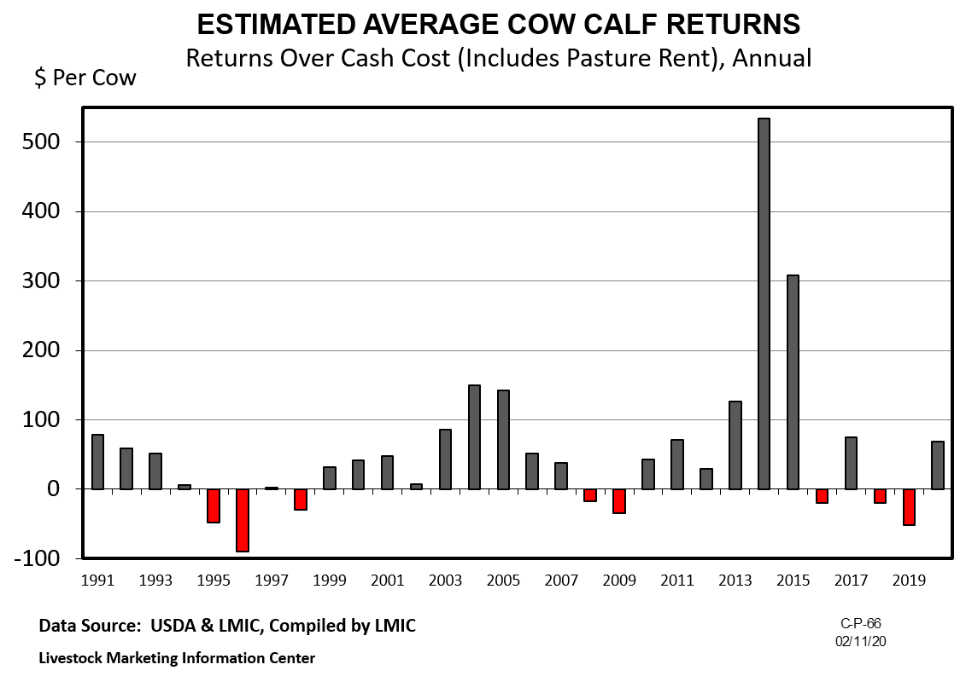

Slide 10
What Rental Arrangement Might Work the Best for You?
What portion of the income do I receive?
What portion of the costs do I contribute?
What portion of the risk do I bear?
What crop and land management practices will be followed?
What will be the condition of the land and improvements at the end of the lease?
Notes:
Often a Primary Focus
Income: Grain, cash, share of livestock, crop insurance proceeds, disaster payments, hay, straw
Costs: Fertilizer, pesticides, lime
Risks: Good year, bad year, price, yield, environmental, legal
Practices: Conservation, fert. Liming, tillage. Who’s crop gets plated first, harvested first. Rotation, grading, stocking rate.
Condition: Soil test, bechmark, fences, pasture
Agreements provide legal basis to protect rights, plan compensation. Comprehensive agreement ensures that both parties have thought about all ‘significant’ issues and are in agreement about them.

Slide 11
Cash lease agreements
Tenant pays landlord a fixed amount per acre per year.
-$/acre or $/head for grass pasture
-$/hd/day or $/cwt./mo. for grazing wheat/crop residues
-$/acre for cropland
May be single or multi-year in duration
Can add flexible component.

Slide 12
Determining a Fair Cash Rent
Market approach
Landlord’s costs plus return to equity
Residual income method

Slide 13
Cash lease advantages
Landlord
More stable income
Payment can be scheduled for any time of year
Eliminates or greatly reduces cash expenditures
Reduced management responsibility
Shifts risk
Fewer potential conflicts about sharing and marketing crops
Tenant
Total managerial freedom
Fewer chances of conflict over decisions
Receive all benefits of a “good year” and superior management
Eliminates time and effort associated with dividing crops and input purchases as well as the related record keeping

Slide 14
Cash lease disadvantages
Landlord
Can become inequitable due to changes in prices, costs and technology
Fewer opportunities for income tax management
Will not realize benefits of good price and/or yield years if the agreement is not flexible
Greater chance of soil depletion or overstocking pasture
Tenant
Must shoulder all the price and yield risk if the agreement lacks flexibility
Large capital requirements for inputs
May be required to pay part of the rent early in the year before the crop is planted
Landowners may attribute above average yields to soil rather than management

Slide 15
Share lease agreements
Landlord and tenant share proportionally in costs and risks of production, then share returns accordingly
May be single or multi-year
Typically 2/3 tenant crop share in OK
$/lb. of gain on wheat pasture-production risk shared by pasture owner and cattle owner.
Yield increasing inputs should be shared as the same percentage as returns.

Slide 16
Determining Equitable Share Arrangements
Determine the percent contribution of total value of items contributed by each party, then….
Share total returns in the same proportion as total expenses are contributed
Adjust share arrangements to reflect the impact of new technologies, improvements, land quality
Compensate tenant at the end of the lease for the unused portion of investments

Slide 17
Share lease advantages
Landlord
Receives benefits of good price and/or yield years
Land and improvements are more likely to be maintained
Tenant
Less capital may be required
Less experienced tenants can benefit from the landowner’s managerial input
Share price and yield risk with landowner

Slide 18
Share lease disadvantages
Landlord
More variable income and increased risk
Need to discuss management practices with tenant on a continuing basis
Increased capital requirements associated with share of cash expenses
Must maintain records of shared expenses
Increased responsibilities
More possibilities for conflicts with tenant
Tenant
Need to discuss management practices with landlord on a continuing basis
Joint decisions result in more opportunities for conflicts
Must share benefits of a “good year” and superior management
Must maintain records of shared expenses and divide crops

Slide 19
Put Your Agreement in Writing!
Encourages understanding by both parties
Serves as a reminder of terms agreed upon
Legal resource and guide for heirs
Serves as documentation for tax purposes
Consult with a lawyer as needed!
Notes:
Memorandum of understanding
Provides legal protection

Slide 20
Additional Resources
OSU Fact Sheets and Current Reports:
facts.okstate.edu for mobile-friendly version, http://factsheets.okstate.edu/ for pdfs
Oklahoma Pasture Rental Rates, CR-216
Oklahoma Cropland Rental Rates, CR-230
Tax Aspects of Leasing, AGEC-940
More land rental information
OSU ag land lease website: http://aglandlease.info/
NCFMC website: http://aglease101.org/
Kansas City Federal Reserve Bank https://www.kansascityfed.org/
USDA NASS https://www.nass.usda.gov/

Slide 21
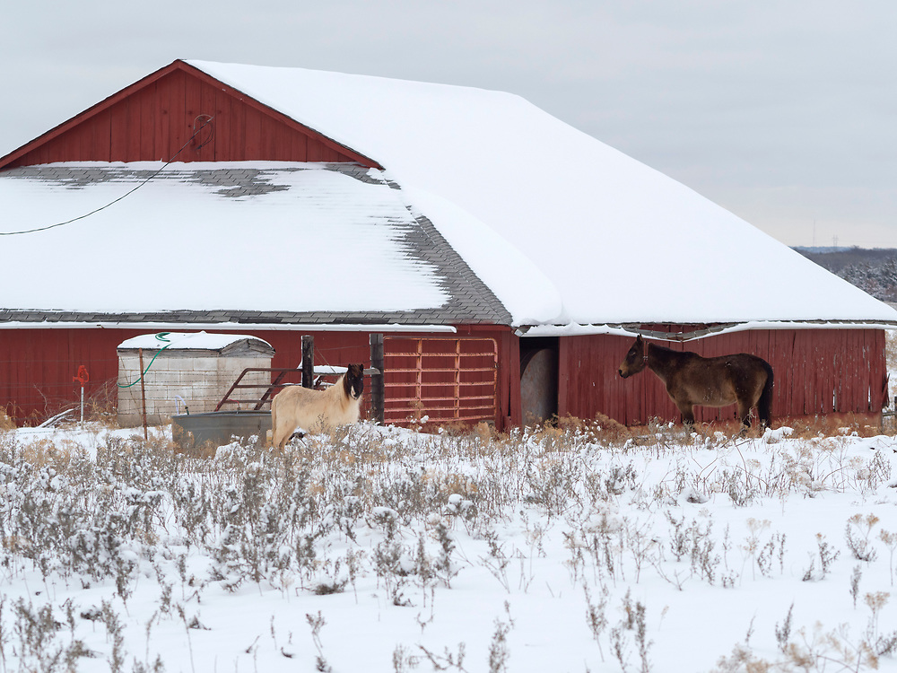
Thanks for stopping by!
Roger Sahs
520 Ag Hall
405/744-9836
roger.sahs@okstate.edu
Survey link:
https://okstatecasnr.az1.qualtrics.com/jfe/form/SV_8IhwW9CeEaQ6qfb

