Slide 1

Session 1: Tailoring Your Communication

Slide 2
Overview
9:00 - Welcome & Introductions
9:15 - Purpose & Audience of Science Communication
10:00 - Break
10:15 - Tailoring Your Message Activity
11:30 - Lunch
12:30 - Translating for the Public Panel
1:15 - Break
1:30 - Introducing Fact Sheets
2:00 - Fact Sheet Activity
2:45 - Reflections & Homework

Slide 3
WELCOME

Slide 4
Introductions
Name, major, research project, and an irrelevant piece of information
Notes:
You can include yourself as an example and introduce yourself to the group.

Slide 5
Goals for today
To improve your ability to tailor information to various audiences
We’ll get there through a mix of presentations, panels, activities, and discussion
We have a good variety of guests with us, but we’ll introduce them throughout the day

Slide 6
Translating for Academia
For all sessions, we will have a closing piece on translating what we do for academia
Becoming a better science communicator can pay dividends throughout your career no matter what path you choose.

Slide 7
PURPOSE AND AUDIENCE OF SCI COMM

Slide 8
Foundations of Communication
Purpose – What is the goal of your communication?
  Buy something
  Engage in an action
  Vote for a policy
Audience – Who do you want to take action?
  Other researchers
  Specialist audience
  Consumers in general

Slide 9
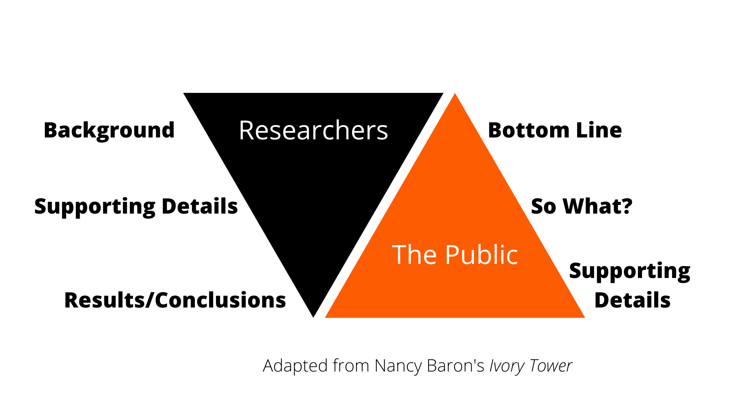
Researchers vs. the Public

Slide 10
What do we know about the public?
First, it’s not one big group. It’s a bunch of small groups
  Political beliefs
  Religion
  Rural/Urban
  Race/Ethnicity
  What media sources and channels they consume
Second, they’re different than a university audience
  About 1/3 have at least a bachelor’s degree
  About 1/10 have a graduate or professional degree

Slide 11
HOW DOES THAT AFFECT COMMUNICATION ABOUT RESEARCH WHEN WE TARGET THE PUBLIC?

Slide 12
Communicators
Typically, will have a 4-year degree
You have a purpose and goals, but they have theirs too
  That’s not a bad thing, but it’s something to remember
Varying specialties and outlets
  Someone using TikTok for science communication is going to differ in how they communicate from PBS’s NOVA
  We’re going to talk more about this in a later session, but the medium matters

Slide 13
As the day rolls along
Keep these differences between researchers, the public, and communicators in mind
That should inform how you communicate about your research

Slide 14
What’s the TL;DR Version of your research
Why do you care about your research?
Kind of like an elevator speech. Aim for 30 seconds
1 minute to think about it
Then discuss with your table
Notes:
10 minutes for this activity.

Slide 15
TAILORING YOUR MESSAGE ACTIVITY
Notes:
Utilize activity sheet 1 for this portion.

Slide 16
What do we know about researchers, communicators, and the public
We’ve talked about it some, but let’s expand this
2 minutes to jot down notes about how they differ and how they’re similar
  Especially what’s going to make them care about your research
Then discuss with table
Notes:
7 minutes for this activity.

Slide 17
Stakeholders
What is a stakeholder?
Who are your university’s stakeholders?
Notes:
Put your university or organization.

Slide 18
Who are your key stakeholders?
You might get more specific in terms of researchers, the public, and communications
You might have some that don't quite fit those groups
What do you know about them?
Notes:
Put your university or organization.

Slide 19
What are our goals when we work with each group?
What do we want them to do with the information?
5 minutes to jot down notes
Then discuss with table
Notes:
10 minutes for this activity.

Slide 20
So, what did we learn?
How do the groups differ from each other?
How do you think that’s going to affect how we get information to them?
How can we use this information within academia?
Notes:
10 minutes for this activity.

Slide 21
LUNCH

Slide 22
TRANSLATING FOR THE PUBLIC PANEL
Notes:
45 minutes for this panel. Members of this panel included people who work for the college communication office and have experience working with faculty members, producing communications pieces.
Potential Questions:
Can you tell us your name and title?
What is your background in science communication?
Where do you think researchers struggle the most in communicating with the public?
What are the most important things to address when communicating with the public?
What are your favorite research stories to tell to the public?

Slide 23
BREAK

Slide 24
FACT SHEETS

Slide 25
Introduction to Fact Sheets
Example Fact Sheets
What are Fact Sheets?
What makes for a good Fact Sheet?
What are some traps to avoid?
Notes:
30 minutes for this introduction.

Slide 26
EXAMPLES
https://extension.okstate.edu/fact-sheets/print-publications/t/protecting-infants-and-toddlers-from-positional-asphyxia-car-seats-and-sling-carriers-t-2383.pdf
https://extension.okstate.edu/fact-sheets/print-publications/hla/bermudagrass-suppression-methods-for-oklahoma-home-gardens-hla-6619.pdf
https://extension.okstate.edu/fact-sheets/print-publications/fapc-food-and-agricultural-products-center/food-business-license-and-permit-costs-in-oklahoma-the-good-the-bad-and-the-mundane-fapc-185.pdf
Notes:
Printing examples for participants to look at is beneficial. It is recommended that fact sheets from your university or organization are used.

Slide 27
Faculty member perspective
Faculty members name and their research specialty
Notes:
A faculty member who frequently publishes various pieces of communication came in and talked about experiences working with communicators, making his work fit the public, and fact sheets.

Slide 28
FACT SHEET ACTIVITY
Notes:
Utilize activity sheet 2 for this portion.

Slide 29
What part of your research does the public care about?
1 minute to jot down thoughts
Then discuss with table
Notes:
5 minutes for this activity.

Slide 30
Purpose and Audience
Who are you targeting and what do you want them to take away from your Fact Sheet?

Slide 31
How do we write for non-academic audiences?
Discussion with table
Guiding questions:
  What do we need to avoid?
  How do we get the point more quickly?
  How does this differ from a regular research article?
Notes:
5 minutes for this activity.

Slide 32
Outline Fact Sheet Draft
5 minutes to outline your fact sheet
25 minutes to for everyone to pitch your fact sheet at the table
Notes:
30 minutes for this activity.

Slide 33
Discussion
What did you take away from the activity?
How do you feel about fact sheets vs. research papers?
How can this translate to other public-oriented communications?
Notes:
10 minutes for this activity. Guests from the day were present at tables for table discussion before bringing thoughts to the whole group.

Slide 34
FINISHING THOUGHTS

Slide 35
What does it mean for academia?
Other Extension/outreach outputs
Selling your ideas to administrators
  For example, insert your own administration.
Broader impacts of research is increasingly expected for grants
  Both in terms of grant outputs and for grant applications
Notes:
Insert an example from your own institution

Slide 36
What are the key points you’re taking away from today?
How can you talk about this in job interviews and such?

Slide 37
Homework
Draft of an Extension Fact Sheet
Work with your research supervisor to do this

Slide 38
And that’s a wrap on today
We’ll see you back here on the next meeting date when we talk about being interviewed
If you have any questions, shoot me an email at (insert email)
Notes:
Fill in your own information

