Slide 1

Session 4: DIY Communication

Slide 2
Overview
9:00 – Introductions
9:10 – Recapping the first three sessions
9:15 – Media Writing
10:15 – Break
10:25 – Design
11:30 – Lunch
12:15 – Photo
1:15 – Video
2:15 – Debriefing, reflections, and prep for next session

Slide 3
WELCOME

Slide 4
Introductions
Name, major, research project, and what was the first movie you ever saw in theaters
Notes:
You can include yourself as an example and introduce yourself to the group.

Slide 5
Goals for today
Get foundational information so you can start creating your own materials​
Each will have some activity part to apply these things

Slide 6
REFLECTING ON THE PREVIOUS SESSIONS:
What are the key points you are taking away so far?
How can the fall sessions help as you’re creating materials today?

Slide 7
Media Writing
Notes:
A professor who teaches journalistic writing ran this portion. Utilize activity sheet 7 for this portion.

Slide 8
Associated Press Style
Writing Style, Precise Language, guidelines for Ethical Collection and Dissemination of News
Frequent updates (put link)
Thorough and Specific Guidance
Numerals/Abbreviations/Punctuation

Slide 9
AP Style Activity
Get to know the book. Look through and find how to properly use the following things:
  Down-to-Earth or down-to-earth
  Brand Names (Kitty Litter)
  “Words that seem innocuous to some people can have specific and deeply personal or offensive meanings to others.” P. 65 (Lame, psychotic, blind, etc.)

Slide 10
AP Style Activity (cont.)
Using your markerboard, write the following things in AP Style:
  (Your hometown)(Your state) is a great place to live.
  Measles (is/are) spreading in the community.
  An average of 10 new cases (is/are) diagnosed daily.
  Corey, who (uses/prefers) the pronoun they, starts work Monday. Corey said they are excited about the new opportunity.
  The committee met at (7 in the evening yesterday).

Slide 11
Elements of News
Timeliness
Impact
Proximity
Prominence
Novelty
Controversy
Notes:
Here, it could be helpful to look at examples of news stories and identify these elements.

Slide 12

Inverted Pyramid
Lead:
Nutgraph:
Way to think through the newsworthiness of content
Quote:
Extra info:

Slide 13
BREAK UNTIL 10:25

Slide 14
DESIGN
Notes:
A member of the university communications team did this session. Utilize activity sheet 8 for this portion.

Slide 15
Branding
What is branding?
  Brand Strategy = your brand’s identity
Why is branding important?
  Involves creating and maintaining an “image or brand message that resonates with customers, builds trust and loyalty, and drives brand recognition.”
  7 seconds—the amount of time your brand has to make a first impression

Slide 16
3 C’s of Branding
Consistency
Customization
Core design principles
  Balance
  Proportion
  Emphasis
  Contrast
  Repetition
  Pattern
  Rhythm
  Unity

Slide 17
Putting it into Practice
The average person scrolls ¼ of a mile per day on their phone
90% of snap judgments made about products are based on color alone
Create eye-catching content that cuts through the “clutter”
  Social media graphics should deliver a message both simplistically and visually
Keep in mind how your audience will be consuming content—mobile devices
  Size images to the platform
    Facebook
    Facebook and Instagram
    Facebook Story
Use your logo (JUST ONE!)
Avoid using QR codes

Slide 18
Accessibility
Minimal text
  The majority of your information should be in the post’s copy
No event flyers
Include alt-text descriptions
Use captions on videos
Contrast is important
  Color contrast checkers
Embrace the white space

Slide 19
DESIGN ACTIVITY
Notes:
Utilize activity sheet 8 for this portion. For another design activity, you could have participants critique graphics according to the things they have learned.

Slide 20
LUNCH

Slide 21
PHOTO
Notes:
A member of the university communications team did this session. Utilize activity sheet 9 for this portion.

Slide 22
Parts of a Photograph
Foreground
  The part of the image closest to the camera
Midground
  The area between the foreground and the background
Background
  The part of the image farthest from the camera
Utilize these relationships to add depth and context to the photo

Slide 23
Types of Shots and Angles
Bird’s-Eye View: overhead shot that captures all the elements in a single shot
High Angle: angle higher than eye-level, emphasizes the area around the subject, and gives a broad perspective of the scene
Low Angle: captures subject from a viewpoint lower than eye-level, making ordinary objects seem significant
Bug’s-Eye View: the camera is placed at ground level to emphasize the size and prominence of your subject
Close-Up Shot: focuses on a particular detail and gets close to eliminate any unnecessary background details, generally at eye level
Wide Angle Shot: gets a lot of perspective in one shot, enhances a lot at once, while capturing a great deal of detail

Slide 24
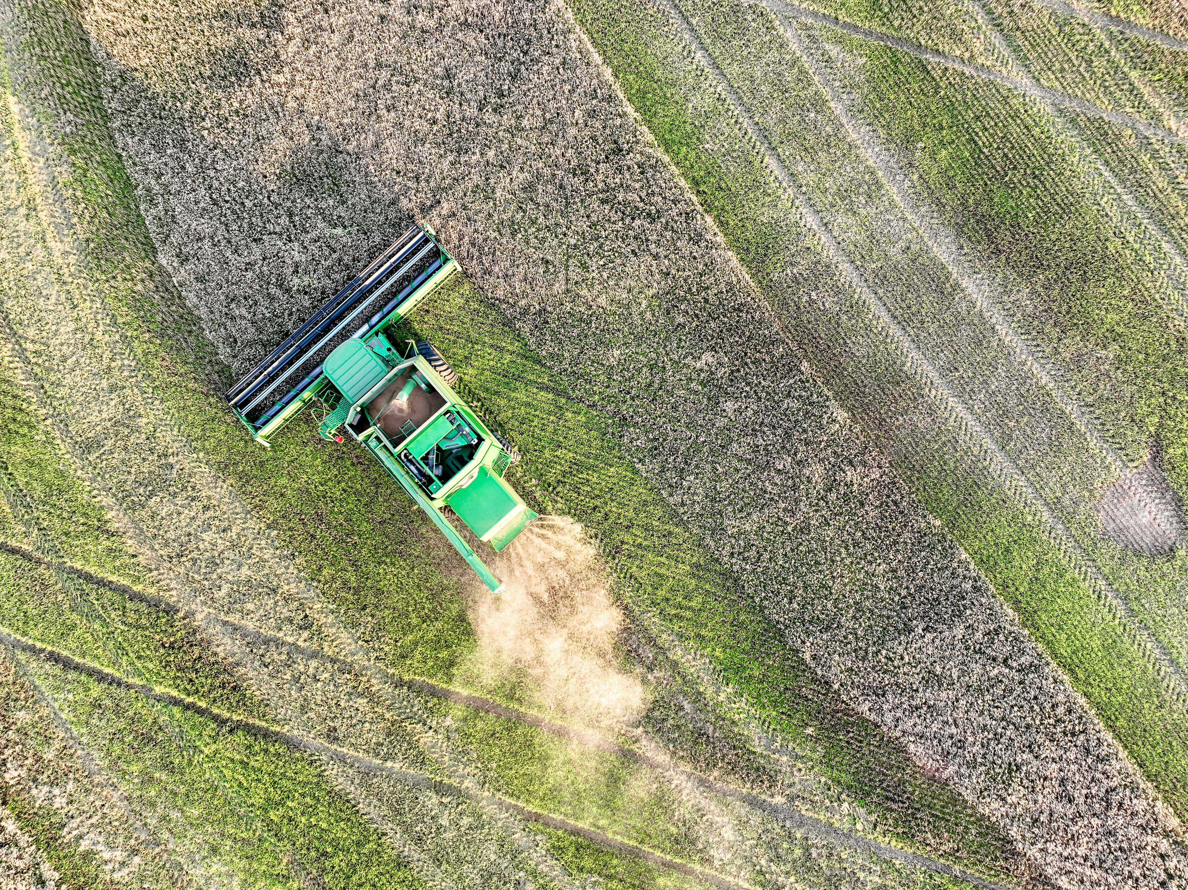
Birds-Eye View
Photo from Mitchell Alcala, Oklahoma State University

Slide 25
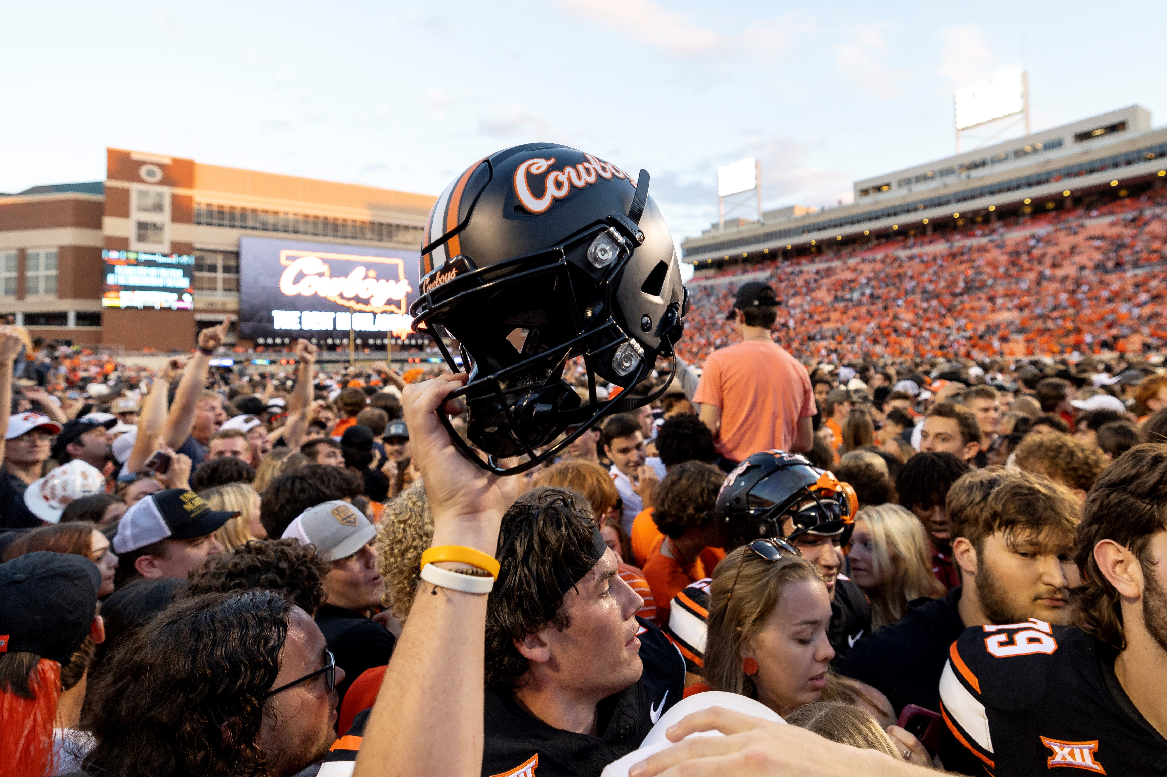
High Angle
Photo from Mitchell Alcala, Oklahoma State University

Slide 26
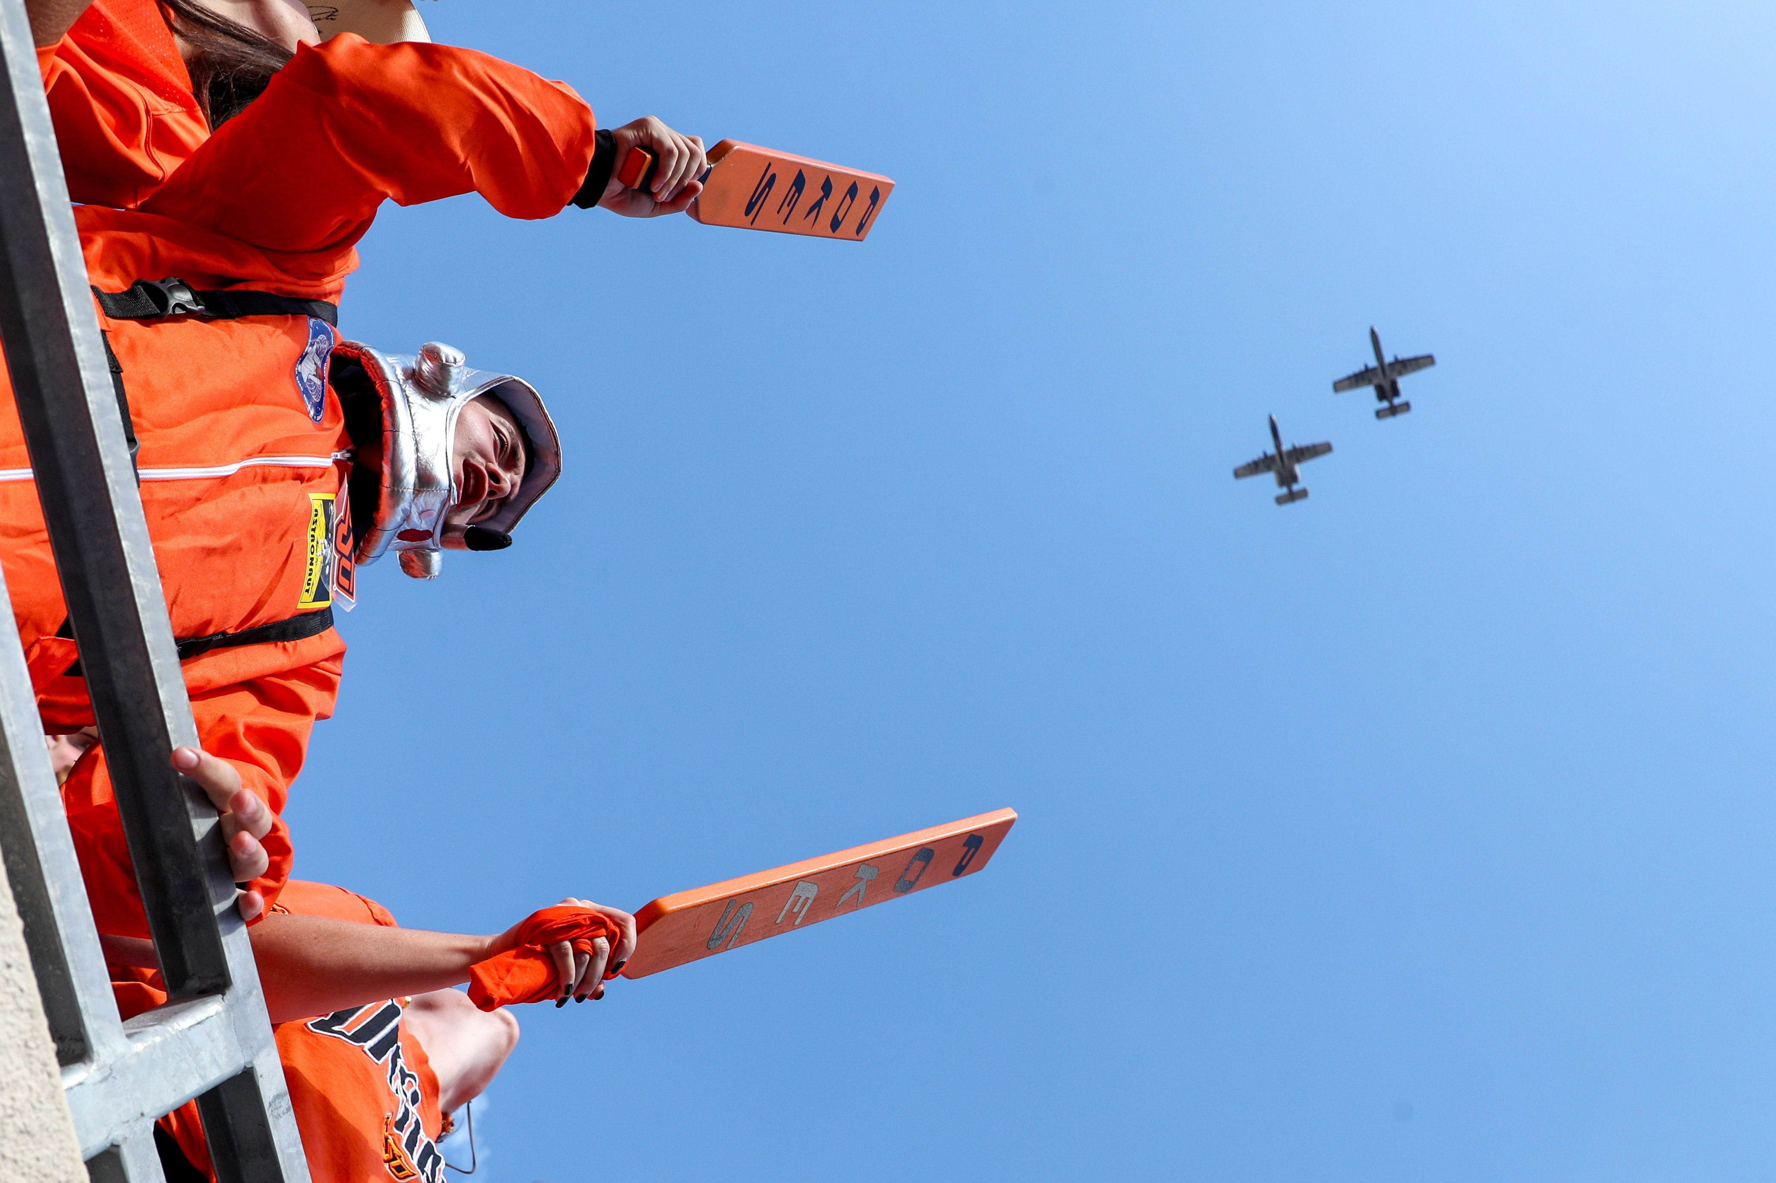
Low Angle
Photo from Mitchell Alcala, Oklahoma State University

Slide 27
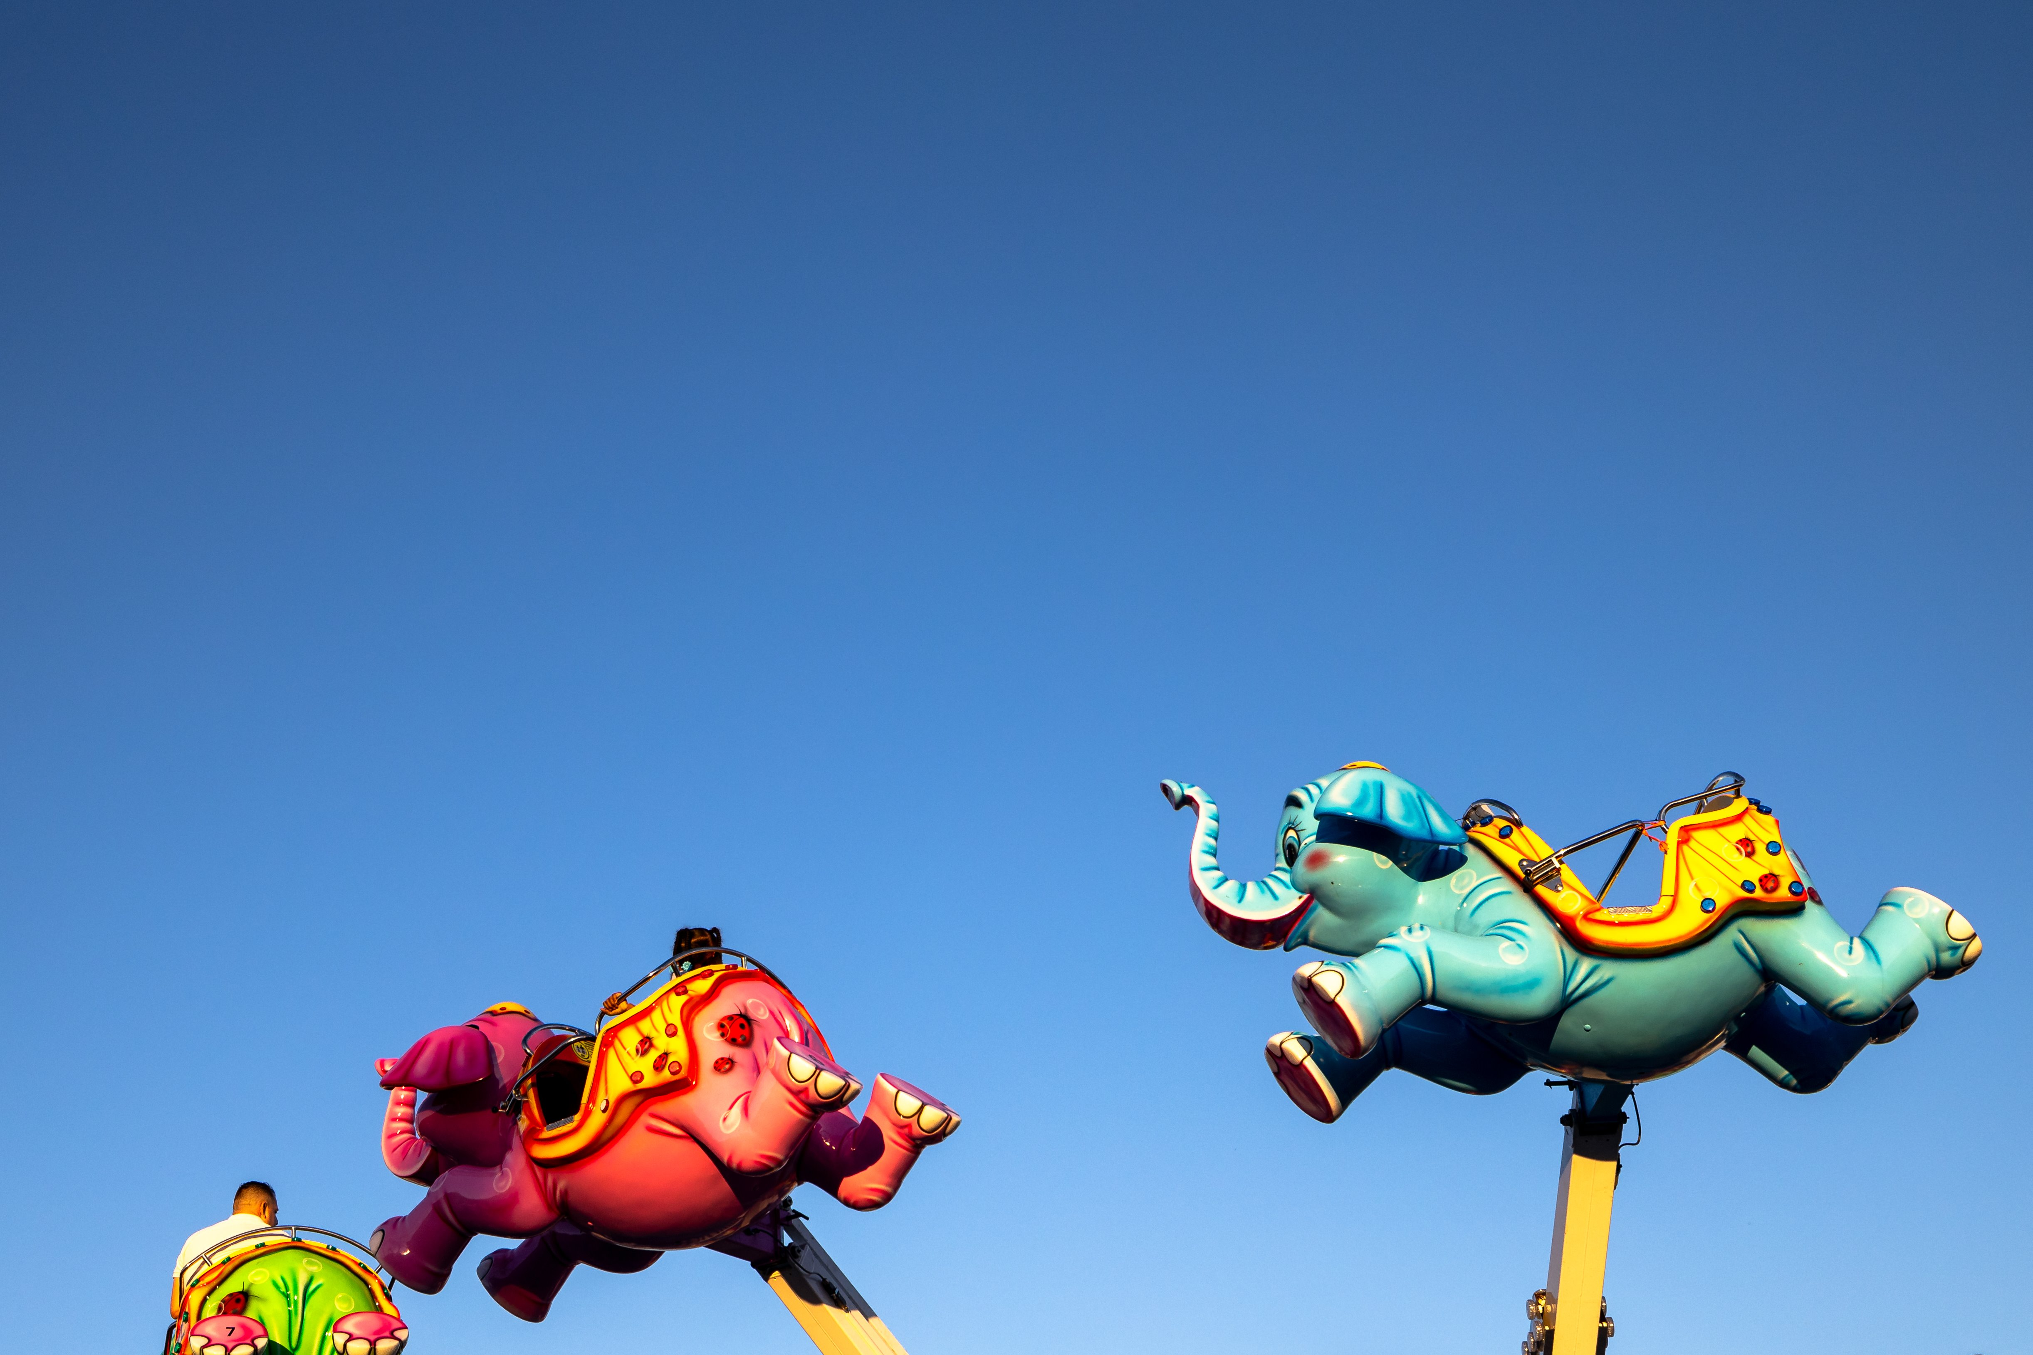
Bugs-Eye View
Photo from Mitchell Alcala, Oklahoma State University

Slide 28
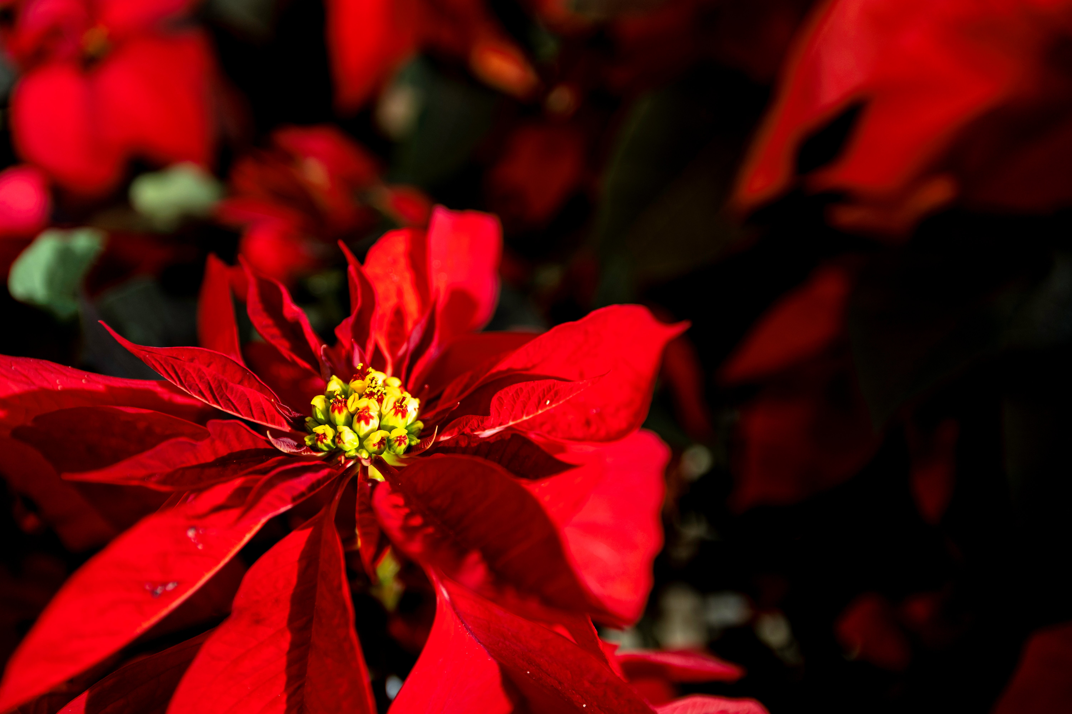
Close-Up Shot
Photo from Mitchell Alcala, Oklahoma State University

Slide 29
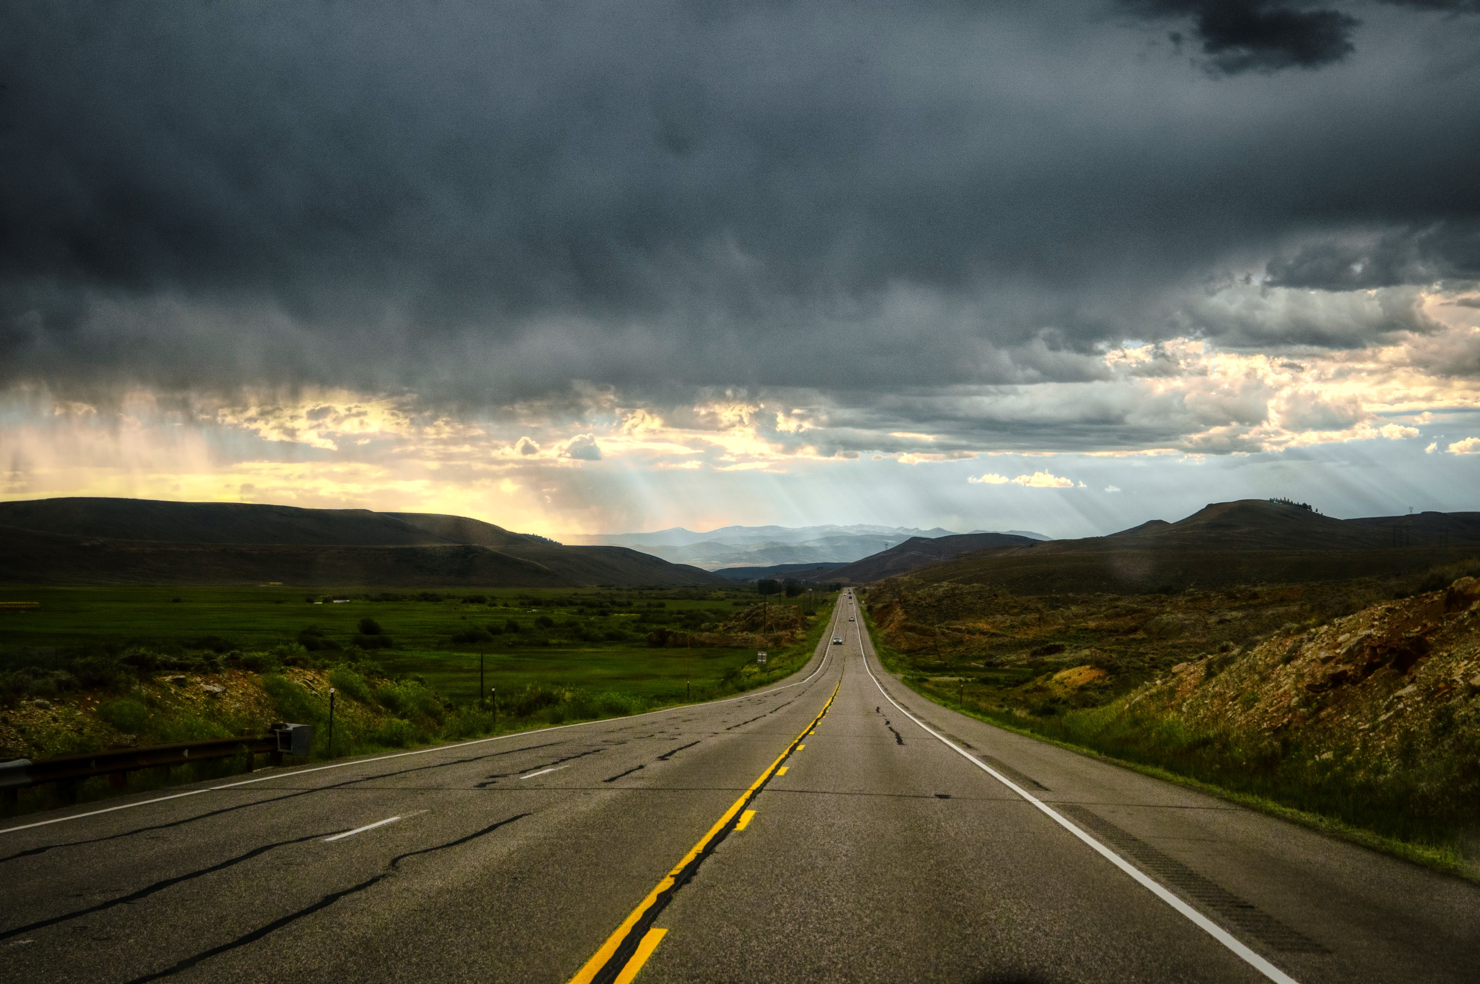
Wide Angle Shot
Photo from Mitchell Alcala, Oklahoma State University

Slide 30
Composition
The nature of something's ingredients or constituents; the way in which a whole or mixture is made up.
The one thing you need to learn today, and if you learn nothing else, PLEASE REMEMBER THIS ONE THING.
  GET YOUR SUBJECT OUT OF THE MIDDLE!!
Keep it simple: The rule of thirds is the #1 all-time classic rule of photo composition. This is a very simplified version of the golden ratio.
Adapted from Mitchell Alcala, Oklahoma State University

Slide 31
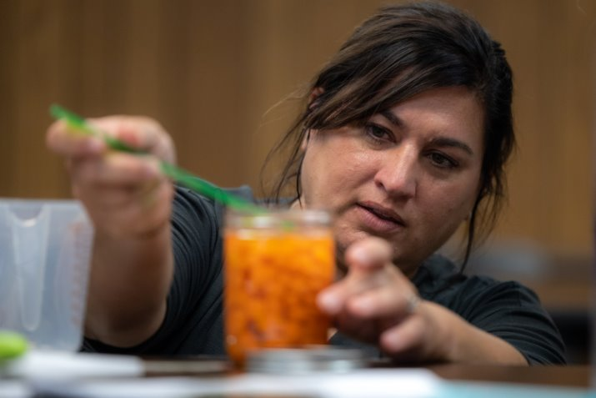
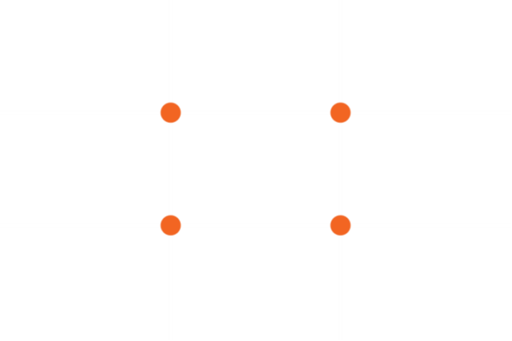
Rule of Thirds: Example One

Slide 32
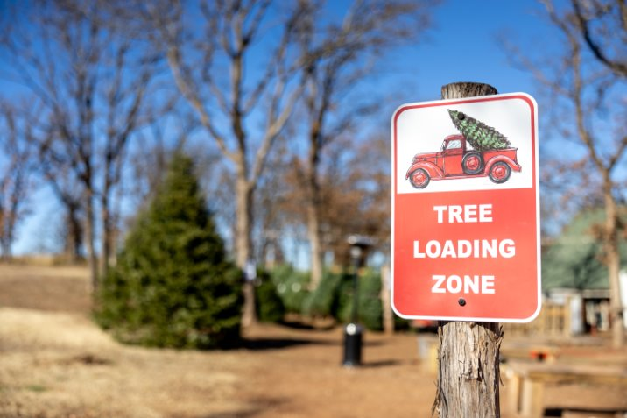
Rule of Thirds: Example Two

Slide 33
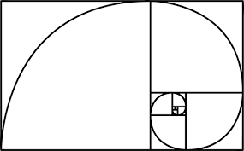
Golden Ratio
The golden ratio is all about blank space and its relation to the 'pay attention' space.
People can only take so much visually, so this helps you understand the limits of human attention to create something visually appealing.
Helps your project look even, balanced, and aesthetically pleasing.
Adapted from Mitchell Alcala, Oklahoma State University

Slide 34
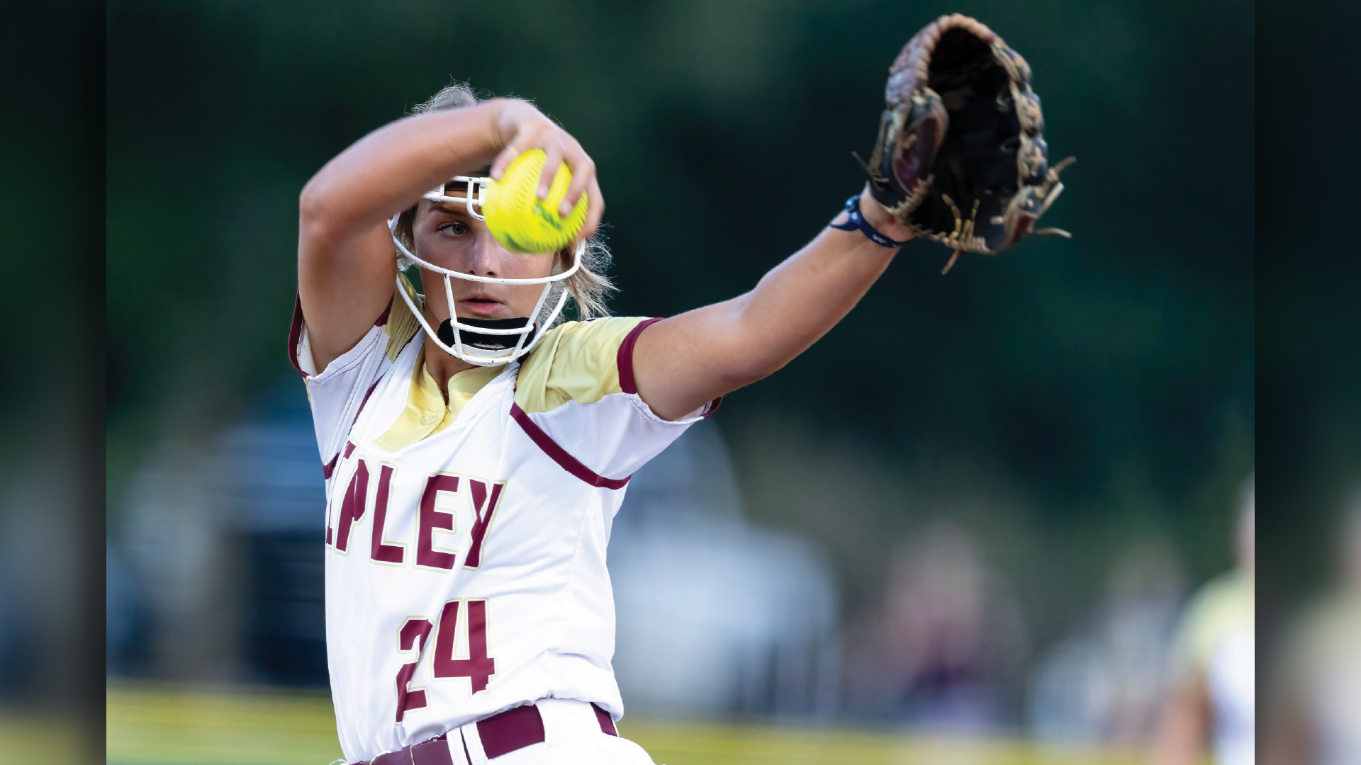
Golden Ratio: Example One

Slide 35

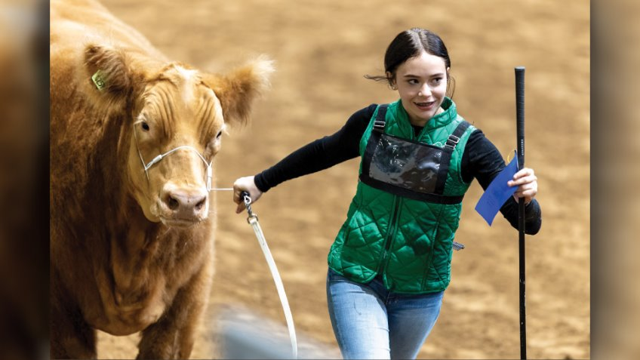
Golden Ratio : Example Two

Slide 36
VIDEO
Notes:
A member of the university communications team did this session. Utilize activity sheet 10 for this portion.

Slide 37
Steps to Create Effective Video
Know your audience
Focus on one clear message
Visual storytelling
Be authentic and enthusiastic
Keep it short and sweet
The rule of thirds also applies here. Helpful interview framing hints:
  For traditional interviews looking off camera, subject is off center.
  When looking at the camera, subject is center.

Slide 38
Tips for Success
Use captions
Engage with comments
Experiment
Collaborate
HAVE FUN!!

Slide 39
Video Activity
Practice filming an interview with a partner

Slide 40
WRAPPING UP

Slide 41
What does it mean for academia?
Designing presentations and posters​
Creating your own social media content​
Designing clearer figures for research papers​

Slide 42
What were the key points you’re taking away from today?
How can you talk about this in job interviews and such?

Slide 43
HOMEWORK
Think about what you want your 3MT presentation to be about
You don’t need the exact answer, just a general direction​
Next time: Prep for 3 Minute Thesis (March 1)​
  Info on what makes a good presentation​
  Example presentations ​
  Time for you to draft and practice your presentations
Notes:
Insert your own information

Slide 44
REFLECTIONS

Slide 45
And that’s a wrap on today
We’ll see you back here on the next meeting date for 3MT Prep
Block ___ on your calendar for the final session
If you have any questions, shoot me an email at (insert email)
Notes:
Insert your own information

