Slide 1
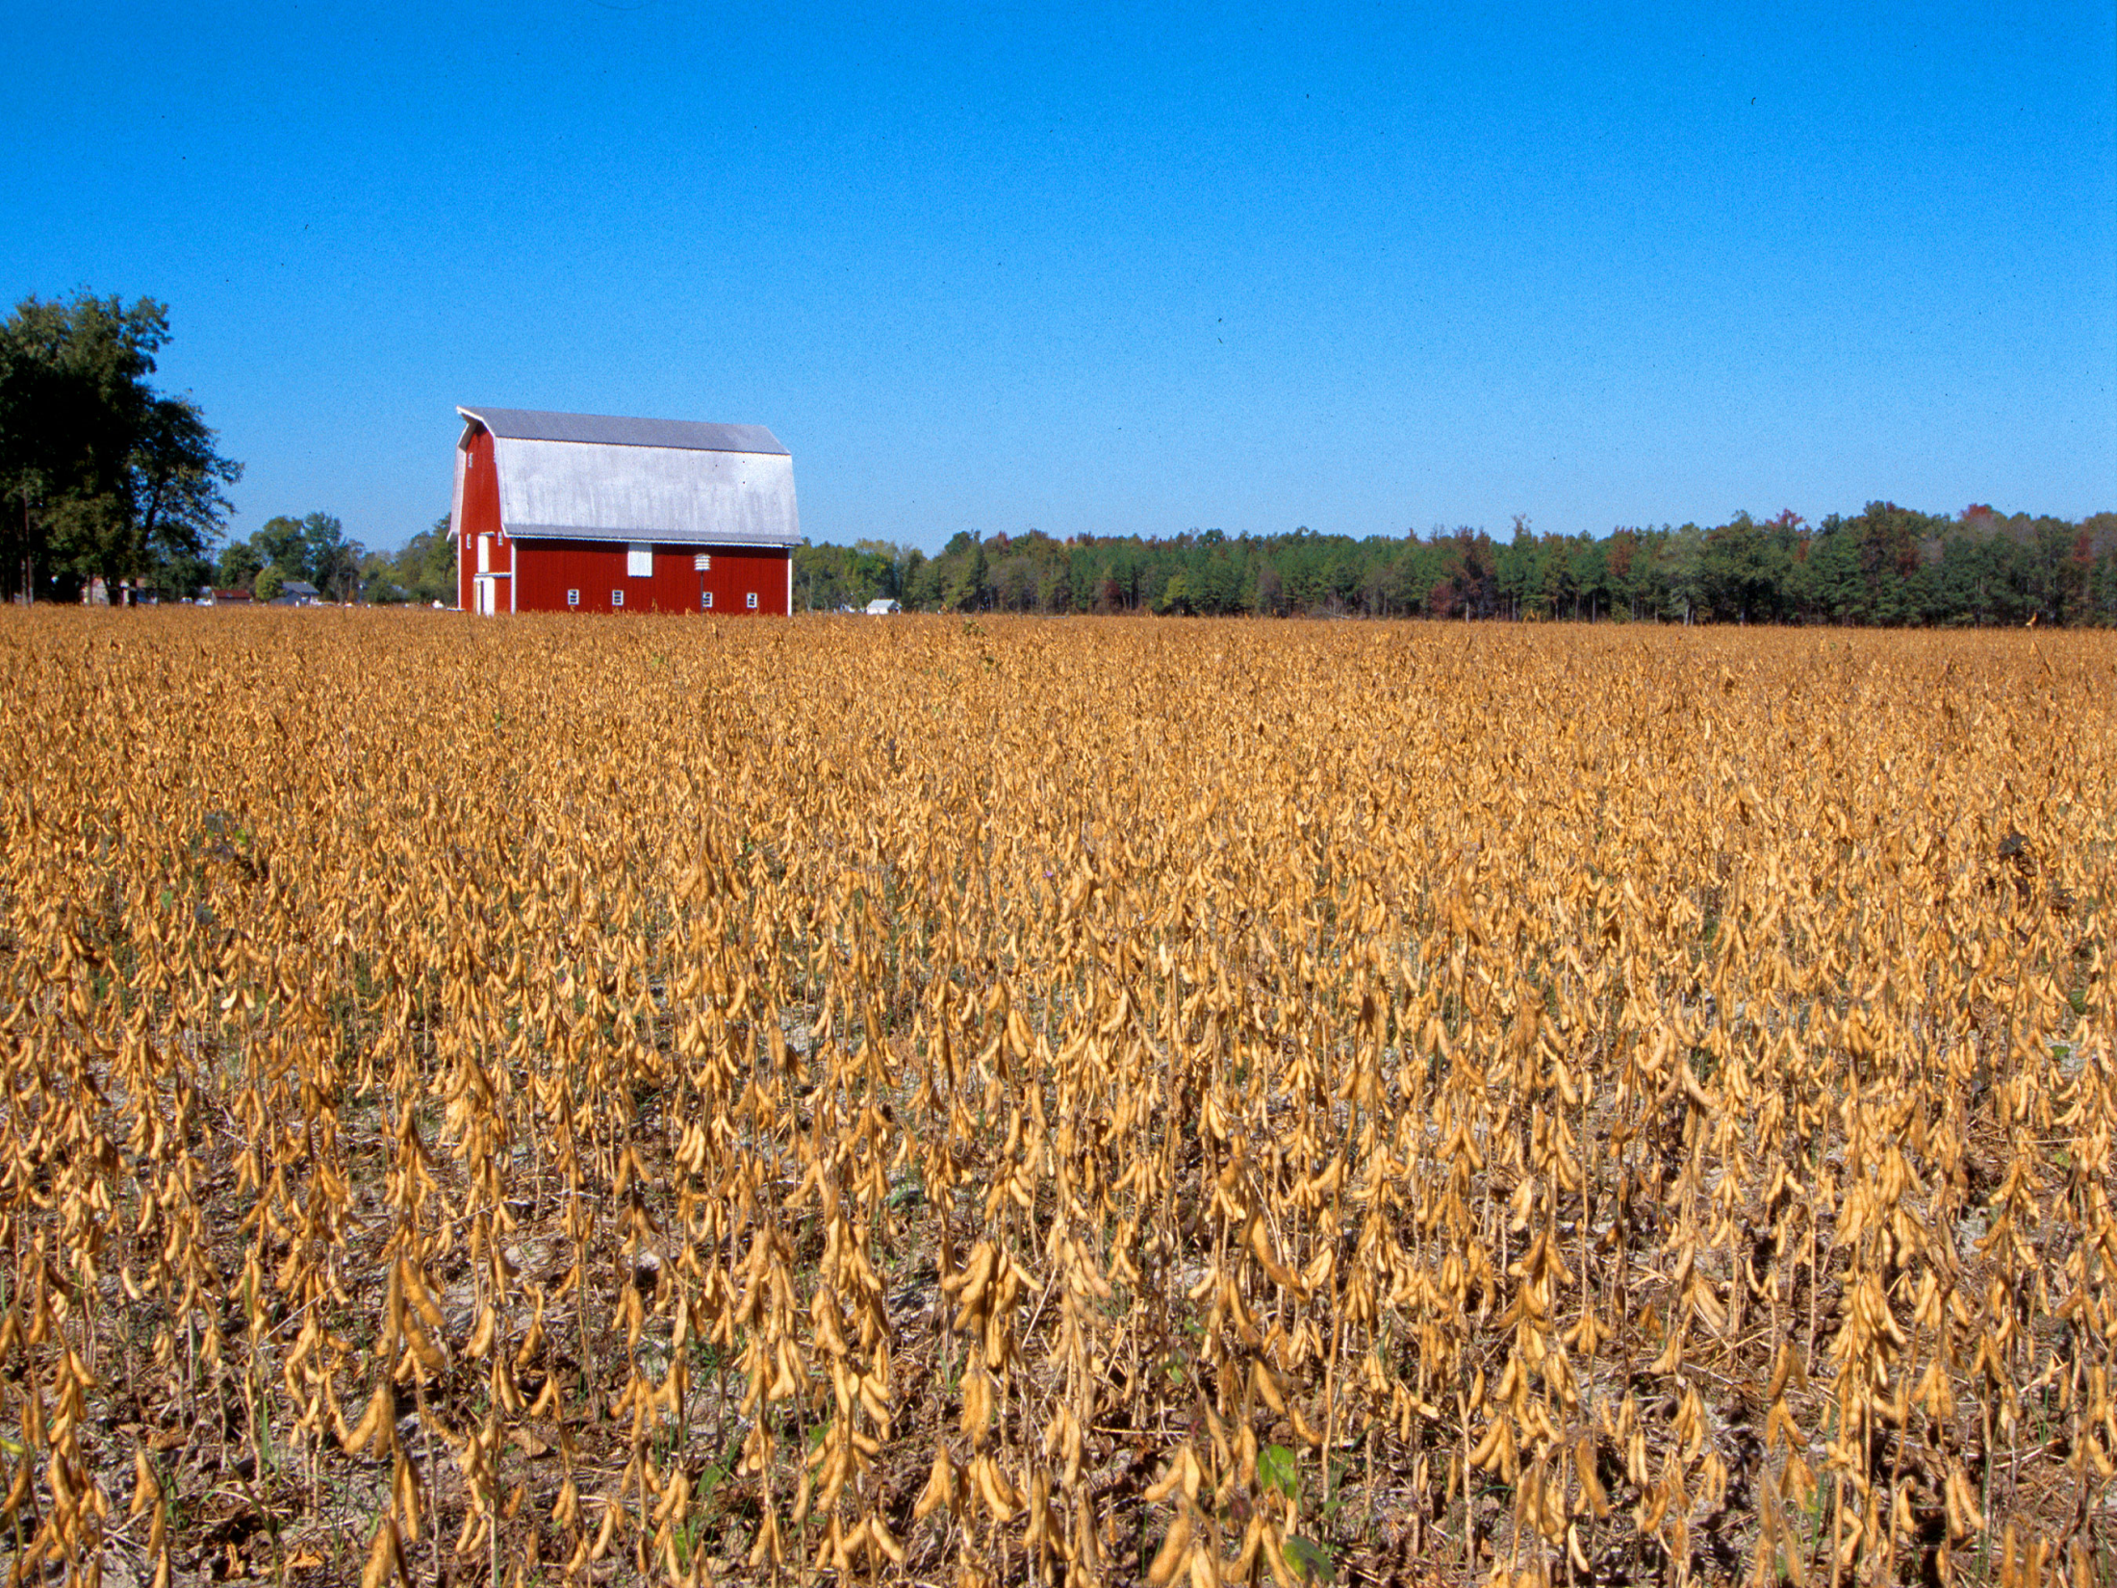
Oklahoma Agricultural Land Value Update
Roger Sahs, Extension Specialist
OSU Department of Agricultural Economics

Slide 2

Before We Discuss the 2021 Results…
OSU land values study based on actual market sales data provided by Farm Credit Associations of Oklahoma
Average farmland sale = $503,000. 1,695 sales tracts up from 1,075 in 2020.
Raised the sales price ceiling from $6,000 to $9,000.
USDA-NASS and Federal Reserve Bank of Kansas City land value reports are survey-based.
These data sources provide an interesting comparison and contrast when exploring the dynamics of the land markets.

Slide 3
Oklahoma Farmland Values
+26%
+21%
+33%
Source: OSU Ag Econ Department, 2022

Slide 4
Oklahoma Land Values by Region, 2021*
Panhandle
Tracts 29
Size 405
$/Acre $1,016
% Chg -5.7
West-Northwest
Tracts 171
Size 235
$/Acre $1,703
% Chg +14.4
North Central
Tracts 265
Size 149
$/Acre $2,520
% Chg +19.8
Northeast
Tracts 344
Size 215
$/Acre $3,005
% Chg +19.4
East-Central
Tracts 53
Size 188
$/Acre $3,226
% Chg +6.7
Southeast
Tracts 320
Size 206
$/Acre $2,888
% Chg +14.9
Southwest
Tracts 220
Size 192
$/Acre $1,618
% Chg +18.6
South Central
Tracts 293
Size 159
$/Acre $3,101
% Chg +18.0
*Tracts >= 40 Acres and <= $9000/Acre
Source: OSU Ag Econ Department, 2022

Slide 5
Oklahoma Cropland Values by Region*
3-Year Weighted Average
*Cropland tracts are defined as having 85%+ annual crop utilization.
Source: OSU Ag Econ Department, 2022

Slide 6
Oklahoma Pasture Values by Region*
3-Year Weighted Average
*Pasture tracts are defined as having 85%+ permanent pasture utilization.
Source: OSU Ag Econ Department, 2022

Slide 7
Where are the land markets headed from here?
Earnings – current and expected
Interest rates
Alternative investments
Demand for land

Slide 8

Wheat – Monthly Average Price
June – May Marketing Year
$6.40 2021
$6.58 1st half of decade
$4.55 2020
$4.30 2019
Source: USDA-NASS

Slide 9
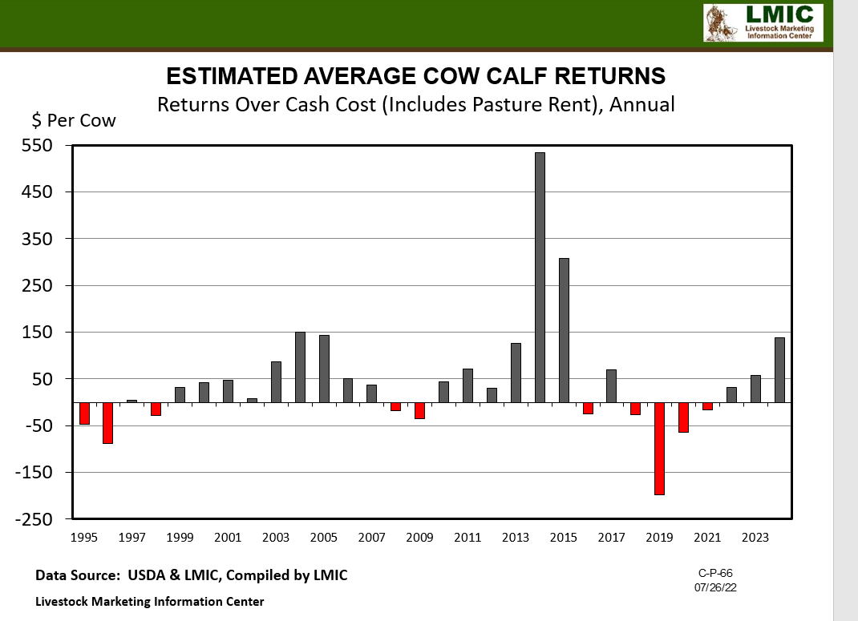

Slide 10
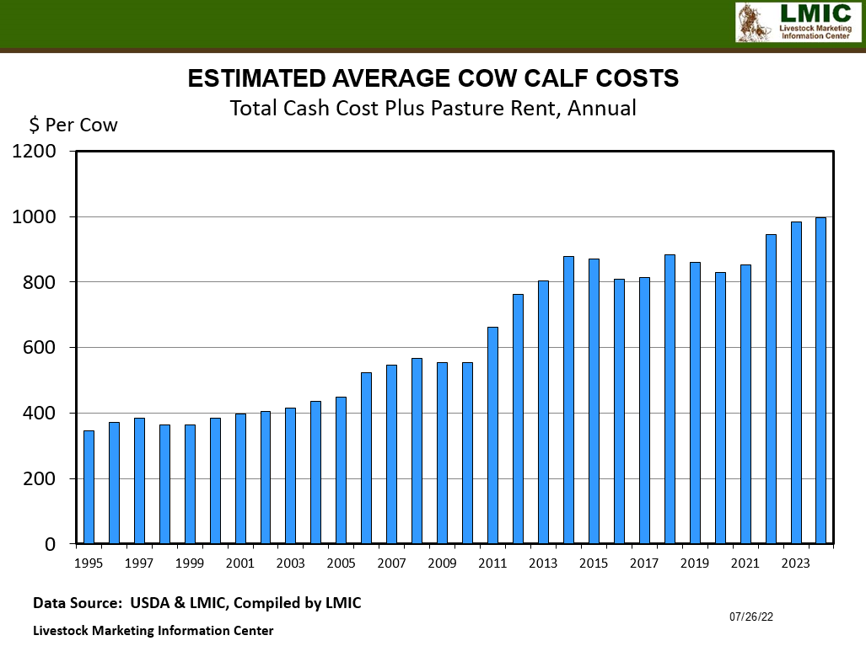

Slide 11
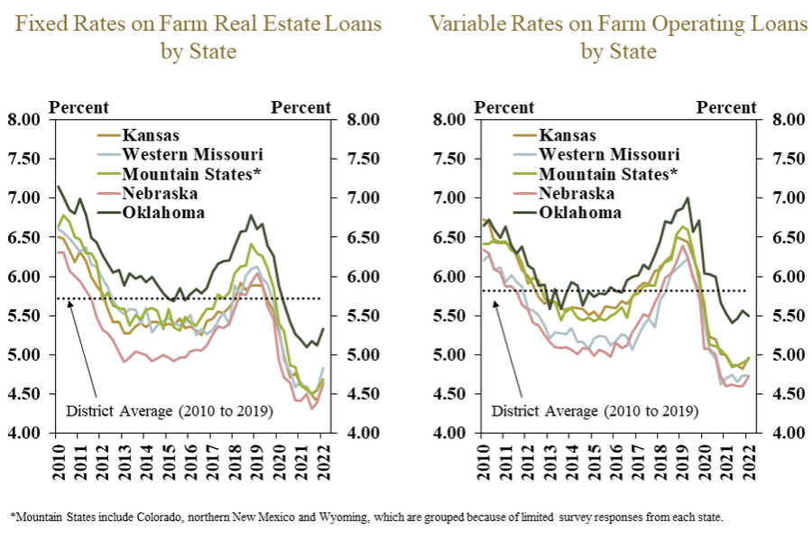
Tenth District Average Interest Rates
Source: Federal Reserve Bank of KC, May 2022

Slide 12
Capitalized Values
Land values should equal capitalized revenues
Land Values = Expected Revenues
Capitalization Rate
Cap rate converts future earnings into a current value
Example 1 cap rate = 10 year treasury rate in 2021
$45 = $3,100 per acre
.0145
Example 2 cap rate = 10 year treasury rate so far in 2022
$45 = $1,800 per acre
.0250

Slide 13
At a cap rate of 2.5%, higher wheat prices are needed to justify strength in cropland values
2021 NC region cropland value was $2445.
Assumes 35 bu/ac and 25% of gross revenues capitalized into land.

Slide 14
At $7 wheat, rising cap rates could pressure the current land markets.
Assumes 35 bu/ac and 25% of gross revenues capitalized into land.

Slide 15
USDA and OSU Cropland Values
+12.2% change from 2021
Source: USDA-NASS and OSU Ag Econ Department, 2022

Slide 16
USDA and OSU Pastureland Values
+12.5% change from 2021
Source: USDA-NASS and OSU Ag Econ Department, 2022

Slide 17
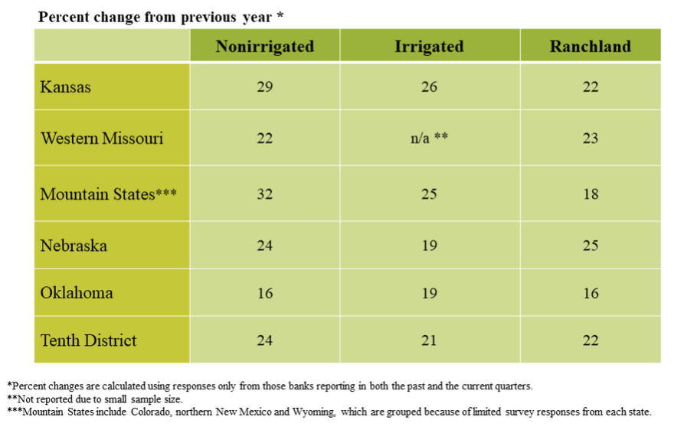
Tenth District Farmland Values by State, First Quarter 2022
Source: Federal Reserve Bank of KC, May 2022

Slide 18
In Summary….
Land values in 2021 increased at rates not seen in many a moon. Wow!
Commodity prices have been the primary force driving the increasing values
Low interest rates and lack of alternative investments were positive factors
2022 values? Higher in the short-term mostly due to inertia
Longer term beyond 2022? Commodity prices and resulting farm income, interest rate levels, the financial health of current buyers, and potential winds to navigate from inflation and drought will determine future trends.

Slide 19
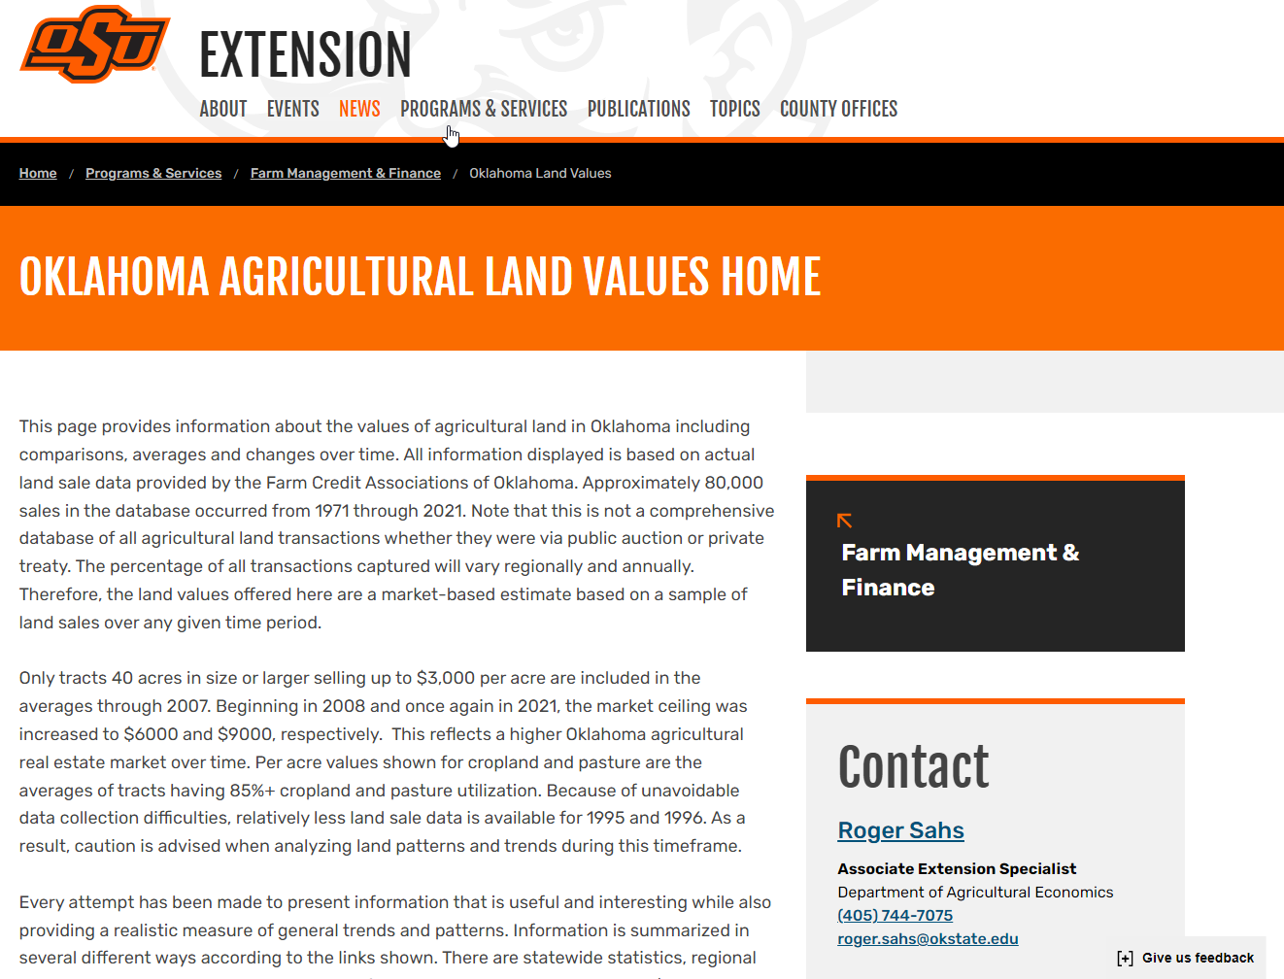
https://extension.okstate.edu/programs/farm-management-and-finance/oklahoma-land-values

Slide 20
Other Resources
Kansas City Federal Reserve Bank
http://www.kc.frb.org/
Choose Ag in Economy section, then Current Survey
USDA Ag Land Value Data and Reports
http://www.nass.usda.gov/

Slide 21
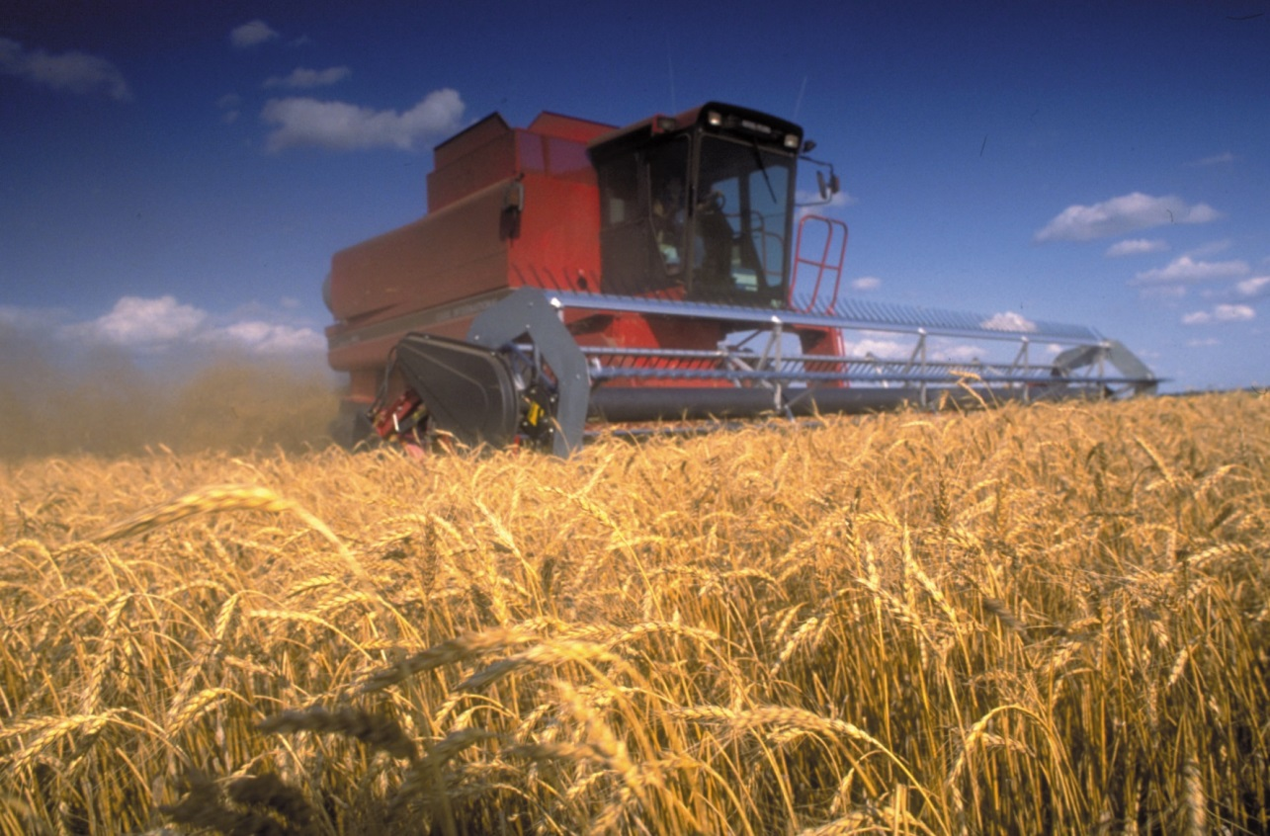
Thanks for stopping by!
webinar survey:
https://okstatecasnr.az1.qualtrics.com/jfe/form/SV_ebXqHGJ0QMn6SNM
Roger Sahs, Associate Extension Specialist
520 Ag Hall, Oklahoma State University
Roger.sahs@okstate.edu, 405.744.7075

