Slide 1
Beyond the Numbers
Using Ripple Mapping for Evaluation

Slide 2

By Sergiu Bacioiu from Romania (Water Drop – Explored) [CC BY 2.0 (http://creativecommons.org/licenses/by/2.0)], via Wikimedia Commons

Slide 3
Why Ripple Mapping?
It’s pretty easy to implement!
It allows for both qualitative and quantitative analysis
It’s visual
Helps overcome some common challenges of evaluation:
Causation
Timing
Unintended consequences

Slide 4
Steps to Build a Ripple Map
Pair up participants and conduct Appreciative Inquiry interviews
Conduct a group mapping exercise
Start with the intervention in the center
Have the group brainstorm impacts from the intervention, using interview responses a prompt
Link related impacts using marker color, arrows and other symbols
Facilitator can prompt group
Reflection: most significant/surprising impact? What story can be told? What should be done next?
Clarify, Code and Analyze

Slide 5
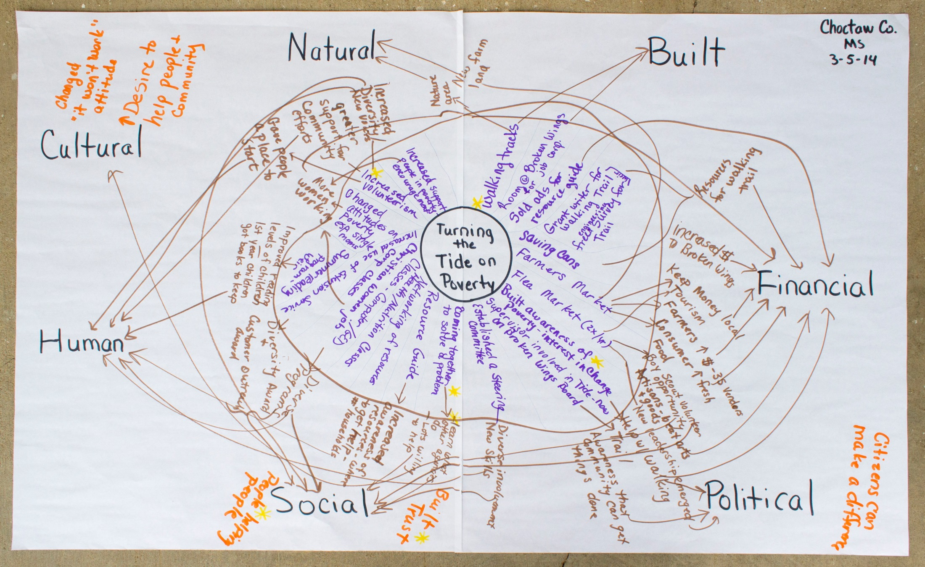

Slide 6
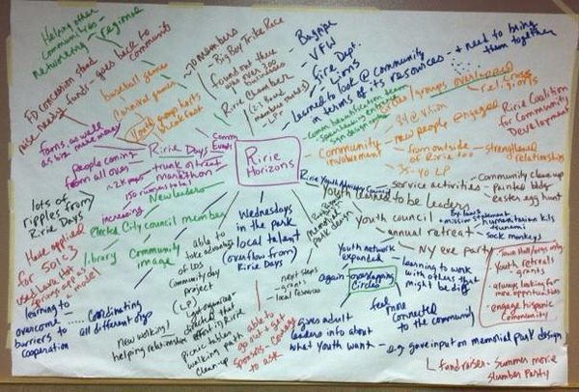

Slide 7
