Slide 1
Direct to Consumer Meat Sales- Custom Exempt
Courtney Bir
Assistant Professor
Department of Agricultural Economics
Oklahoma State University
courtney.bir@okstate.edu

Slide 2
Types of slaughter facilities
 | Federally Inspected | State Inspected | Custom Exempt | Talmadge Aiken Act
Registration | Must register and be approved by USDA, FSIS | Must register and be approved by ODAFF | Must register and be approved by ODAFF | Must register and be approved by USDA, FSIS
Inspection | Livestock and facilities are inspected | Livestock and facilities are inspected | Quarterly sanitation checks by ODAFF, no inspection of livestock | Livestock and facilities are inspected
Inspector | A USDA, FSIS inspector must be onsite when livestock are harvested and daily during processing | ODAFF inspector must be onsite when livestock are harvested and at some point daily when processing is taking place. | NA | Federal plant with state employed inspectors
Inspector overtime | The plant is responsible for paying overtime of inspectors | The plant is responsible for paying overtime of inspectors | NA | The plant is responsible for paying overtime of inspectors
Selling capabilities | Product can be sold and shipped globally. Globally requires additional export certification. | Product can only be sold within Oklahoma | Meat cannot be sold or donated; must be consumed by family or non-paying guests of the owner of the livestock | Product can be sold and shipped nationally. Globally requires additional export certification.
Plan requirements | Must create, implement and maintain HACCP and SSOP plans | Must create, implement, and maintain HACCP and SSOP plans |  | Must create, implement and maintain HACCP and SSOP plans
Standard requirements | Must meet federal facility standards |  |  | Must meet federal facility standards

Slide 3
How does custom exempt work?
Not state or federally inspected
You can sell 1/4 , 1/2 , whole live animal to consumer
You then take the “already sold” live animal to be processed
Consumer picks up meat
Meat can be consumed by buyer of the live animal and non-paying guests
Meat cannot be sold as individual pieces

Slide 4
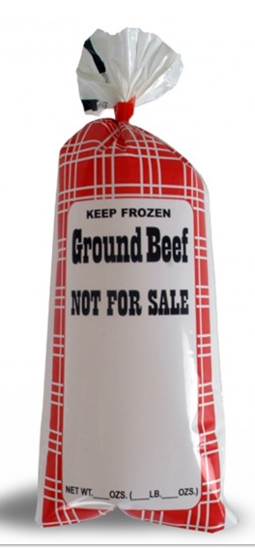
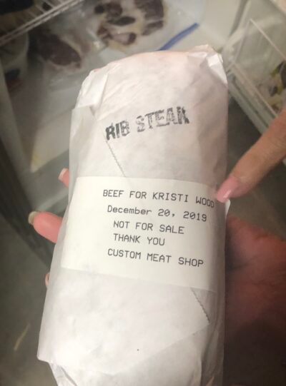
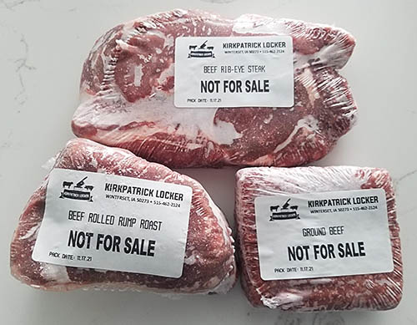





NOT FOR RESALE

Slide 5
General consideration- live animal sales
Is there a custom exempt plant near you?
Do they process the animal you are selling, poultry can be tricky
Communication with the end buyer is key!
The end buyer picks up the meat
Are there enough people interested in a ¼ or ½ near the processing plant?
Do you know the quality of the meat from your cattle?

Slide 6
General consideration- live animal sales
100% of the animal must be sold at time of slaughter
This can be any combination of buyers
Technically you can sell 1/16th of an animal but the processor may not want to do this
If multiple family members want a ¼, it may be best to encourage them to split up the meat once processed on their own

Slide 7
Finding a processor
You need to know when your animals will be ready for slaughter
You will likely have to book a slaughter date in advance
Unfortunately, you may not have processor options-dependent on your location

Slide 8
Processor considerations
Are they easy to work with?
The customer will be contacting the processor to determine fabrication specifications. This interaction is unfortunately out of your control. The customer will be paying the processor for the services
What kind of packaging do they use?
Are they going the extra mile to have nice looking cuts

Slide 9
Processor pricing examples
FAPC
Harvest fee $200 head beef, $100 pork/lamb
Custom processing- $0.75/lb (cut, grind, vacuum pack)
Big Country
Harvest fee $85 beef, $75 pork, $160 goat
Custom processing $0.99, tenderize/patties $0.75, cure (pork) $0.85
Disposal $15.00
The fatted Calf
Slaughter/disposal $75 XL fee $30
Processing $0.90, quartering $10, tenderizing $3.00 etc.

Slide 10
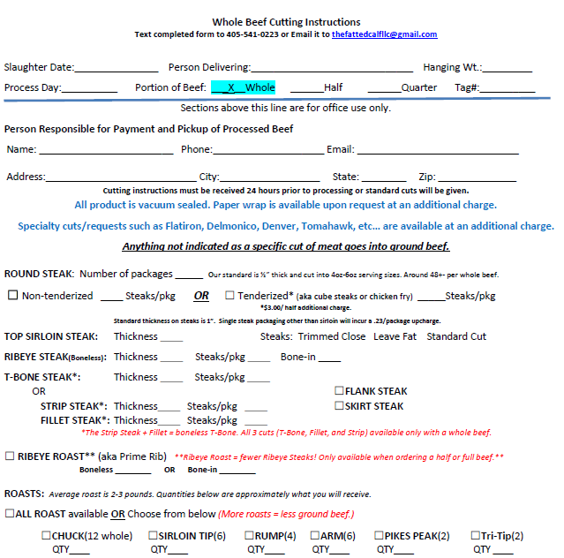
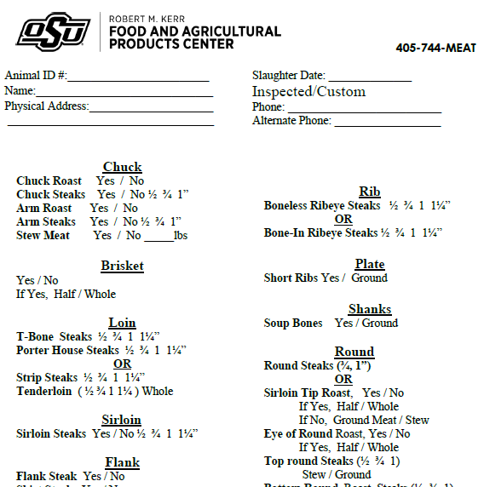

Slide 11
Dressing percentage
Dressing percentage- the portion of the live animal weight that results in the hot carcass
(hot carcass weight ÷ the live animal weight) × 100
Hot carcass weight-the weight of the unchilled carcass in pounds after the head, hide and internal organs have been removed
Can vary greatly- typically 60-64% for beef, know your cattle
Chilled carcass will loose another 2-5% due mostly to moisture loss

Slide 12
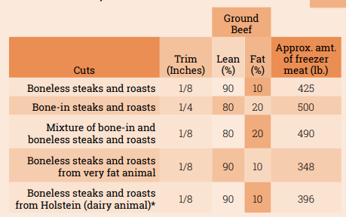
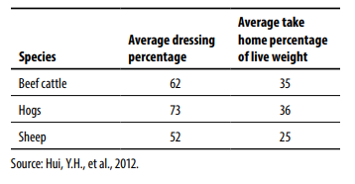
How many lbs does a consumer get?
UT extension

Slide 13
Consumer talk
It’s important to talk to the consumer about how much meat they will get
Individual animals vary- if you have a history of how your cattle do, you can give more information
Freezer space-one cubic foot of freezer space for every 35 pounds to 40 pounds of meat (USDA, 1969)

Slide 14
How to charge
By law you are selling the live animal
The animal should already be sold when you take them to be processed
This leaves selling by live weight or per head your only options (USDA FSIS)…
You need to know your costs and the premium you would like to charge
Note- what you need to charge to be profitable may be less than what people are willing to pay
There is no tax collected on live animal sales
The end consumer will pay the processor (the slaughter fee, per pound processing fee, any add-ons)
Notes:
https://www.fsis.usda.gov/sites/default/files/import/Compliance-Guideline-LIvestock-Exemptions.pdf

Slide 15
Marketing
Be very careful about wording- you are not selling lbs of meat
Example- “I am selling ¼, ½, or whole beef. The animals are 1200 lbs. In the past a 1200 lb animal is about 420 lbs of meat.”
WRONG- “I am selling 420 lbs of meat”
Social media- A good option of getting the info out there-watch wording
Farmers markets- some require you have actual product, some you can have a flier/sign up sheet
Tell your story!
Notes:
https://www.fsis.usda.gov/sites/default/files/import/Compliance-Guideline-LIvestock-Exemptions.pdf

Slide 16
Conclusions
Opportunities in both traditional and direct to consumer
Key is to make a plan in advance and map out everything you need to do along the way
Waiting until it’s time to sell calves is too late!
Communicate with the end consumer so they know what to expect and are not caught off guard

Slide 17
Questions??
Courtney Bir
Assistant Professor
Department of Agricultural Economics
Oklahoma State University
courtney.bir@okstate.edu

