Slide 1

Fall Crop Opportunities (Prospects for Fall Seeded Crops)
Rodney Jones
Rodney.jones@okstate.edu
405 744 6173
Notes:
In this video I want to lead you through the thought process of evaluating capital investments for the farm business. We will look at financial implications for the business from several different perspectives, using a realistic example that reveals some positives as well as some potentially questionable ramifications for the business.

Slide 2
Optimism of Last Year has Faded Quickly
Crop commodity prices have declined quite dramatically
Weather challenges
Discussion today is based on an assumption that we will get some weather relief in time to plant a fall seeded crop

Slide 3
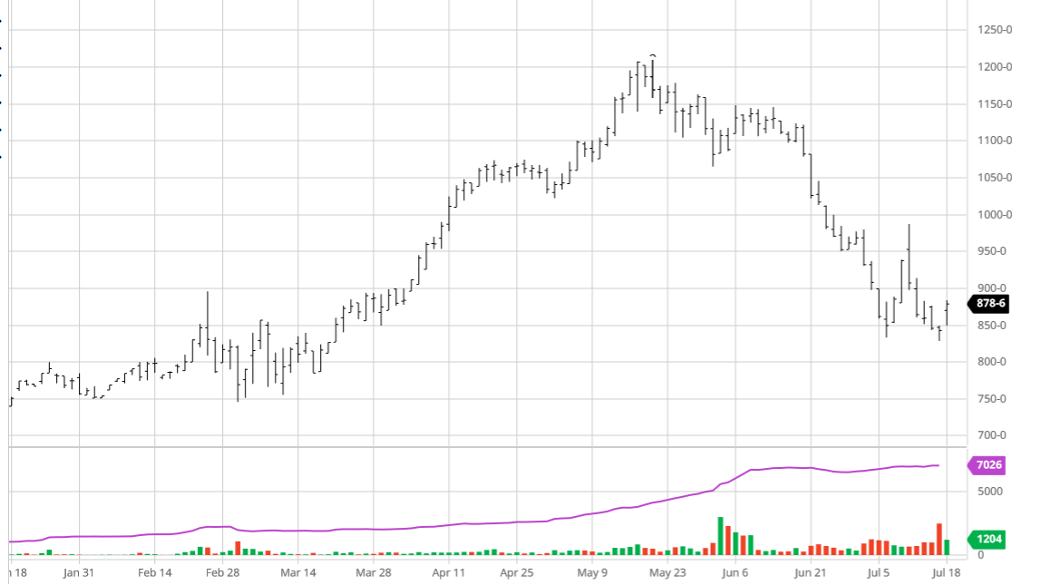
July ‘23 Wheat

Slide 4
What That Imply For a Current Local Price Forecast
Right now basis bids for contracting ‘23 wheat are significantly wider than basis bids for old crop wheat
Depending on location in Oklahoma, implies a local price forecast of $8.20 to $8.50 (in the current environment that is routinely changing by 30 to 50 cents per day)

Slide 5
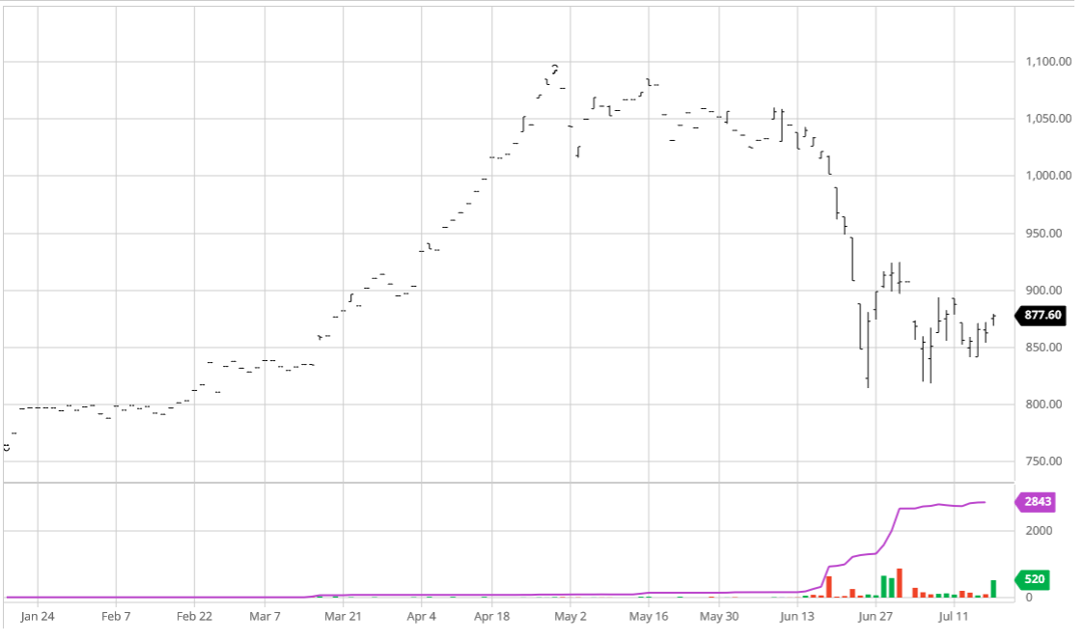
July ‘23 Canola

Slide 6
What That Imply For a Current Local Price Forecast
Canadian canola futures for ‘23 canola are slightly higher than nearby canola contracts
Canola prices are more directly negatively impacted by the strengthening value of the dollar
Implies a current forward price expectation of about $9.25 to $9.40 per bushel (again, routinely changing significantly each day)

Slide 7
Cost of Production Projection Summaries
Wheat for grain --- $280 to $310 per acre before land cost (2 years ago we were in the $200 area). Add land cost $325 to $375 per acre.
Canola --- $300 to $330 per ace before land cost (2 years ago we were just slightly over $200). Add land cost $345 to $395 per acre.
Details of major cost components later

Slide 8
What Does That Imply for B.E. Yields
Wheat
Canola
Low cost no land charge ($280 per acre), and high end of current price forecast ($8.50), BE yield = 33
High cost including a high land rent ($375 per acre) and low end of current price forecast ($8.20), BE yield = 45
Low cost no land charge ($300 per acre), and high end of current price forecast ($9.40), BE yield = 32
High cost including a high land rent ($395 per acre) and low end of current price forecast ($9.25), BE yield = 43

Slide 9
Back To The Long-Term Normal Expectation
Tight margin projections, not a lot of “economic” profit potential for “average” production expectations
Disappointing, because most of us expected a year or two more of higher returns
Difference between now and the past is the magnitude of dollars involved (50% more capital is at risk for each acre)

Slide 10
Another Option to Consider
Don’t forget to evaluate the possibility of planting a crop for fall and/or winter forage. Value of forage will be high this fall and winter. Lots of the cost components of the “grain for harvest” budgets can be cut significantly with a forage crop (especially grazing), so crop costs would be lower.
Obviously the prospects are more dependent on when it rains.

Slide 11
Possibilities For Better Margins
Look at the Cost Components
Seed
Fertilizer
Harvest
Pesticide
Crop Ins
Machinery Operations
Interest
Misc
Rent or Land Charge

Slide 12
Cost Components
Seed, more significant component of overall costs for Canola. Can we manage seeding rate to cut costs.
Fertilizer (major contributor to the cost increase from recent years until now (from $45.00 per acre to nearly $100.00 per acre)
Are you following a crop that yielded poorly in 2022, if so you may have some residual fertilizer out there, may not have to apply the normal amount for the 2023 crop. (There are ways to find out)

Slide 13
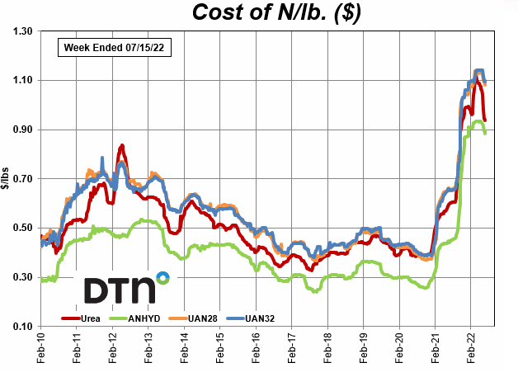

Slide 14
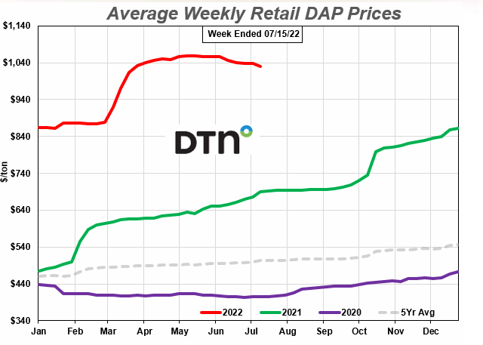

Slide 15
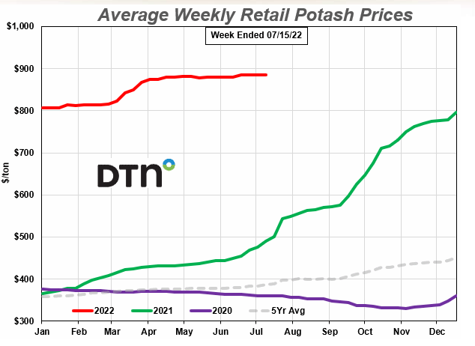

Slide 16
Cost Components
Harvest costs will remain high, 30% to 40% higher than a few years ago.
Herbicide and other pesticide costs higher, difficult to manage.
Crop Insurance, higher, but with the increased risk it is hard to recommend cutting coverage. Enterprise unit coverage saves a lot on premiums, changes the way you have to look at risk

Slide 17
Cost Components
Machinery operations. Anything that involves using fuel, or wearing out parts is much more expensive now (25% to 40% higher cost depending on operation).
The cost of machinery operation has gone up faster than the cost of herbicides (as a general observation), so reduced tillage may be something to consider to reduce costs.

Slide 18
Cost Components
Interest: has not been a huge component of overall non-land costs. However, rising rates will increase the interest cost component. It becomes a bigger contributor to “land costs” for those producers trying to buy land using borrowed funds
Rent: A year ago there was a lot of discussion about cash rents going up. Still discussions about that, but not as much upward pressure as a year ago

Slide 19
Possibilities For Better Margins
Revenue (marketing) opportunities
Market price moves are unprecedented. Use a combination of your crop-insurance choice, and forward pricing opportunities to take advantage when positive margins present themselves

Slide 20
Summary
We are all very concerned about the expanding drought conditions. With that in mind, as conditions allow planning for fall crop planting
Margin projections are tight, a lot more investment per acre is on the line
There may be some potential for cost management
A market upswing may provide opportunity to lock in modest positive margins

Slide 21
I Wish I Had “Better” Answers
Post any questions or comments in the chat box
Please give us some feedback
https://okstatecasnr.az1.qualtrics.com/jfe/form/SV_80rv8MGrEuL3Ns2

