Slide 1
Generational Differences in the Workplace
Dr. Lauren Lewis Cline
February 22, 2022

Slide 2


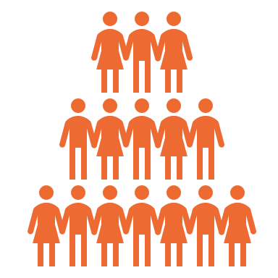
Overview
Part 1: Generations in the Workplace
Part 2: Generational Differences
Part 3: Considerations for Practice

Slide 3
Leading a More Diverse Workforce
The workforce has diversified over the past several decades
Assumption that major differences between generations causes workplace conflict and dissatisfaction (King et al., 2011)
Top 2022 Workforce Trends (Emeritus, December 2021; Forbes, January 2022)
Employee retention
Remote and hybrid work
A focus on skills over jobs
Soft {power} skill development
Emphasis on continued employee growth
Match of company and personal values
https://executive.mit.edu/course/leading-a-diverse-workforce/a056g00000URaafAAD.html

Slide 4
Generations in the Workplace

Slide 5
Boomers
1946-1965
Gen X
1965-1976
Millennials
1977-1995
Gen Z Zoomers
1996-2005
Silent Gen
1928-1945
The Greatest Generation
The Depression, World War II
Political instability -Vietnam War, Cold War, Civil Rights
Affluence
Latchkey gen.
1980s recession
Ambivalent politically, cautious
First global generation
The Great Recession
Less stability
High expectations
Digital natives
Most diverse generation
Ease of access to information
Values-driven
Post 9/11
Generations in the Workplace

Slide 6
Generations in the Workplace
https://geoffdeweaver.com/fortune-500s-must-align-core-values-culture-with-todays-demographics/

Slide 7
Generational Differences

Slide 8
Boomers
1946-1965
Gen X
1965-1976
Gen Y Millennials
1977-1995
Gen Z Zoomers
1996-2005
Individualistic
Engaged
Respect and appreciation
Pragmatic and skeptical
Disengaged
Work-life balance
Enthusiastic and self-confident
Collaborative
Socially conscious
Independent
Work ethic
Innovative
Digital natives
Practical
Diverse
Empathetic
Independent
Generational Differences - Workplace

Slide 9
Generational Differences - Values
Boomers
1946-1965
Gen X
1965-1976
Millennials
1977-1995
Gen Z Zoomers
1996-2005
Competitive
Independent
Feedback
Social
Achievement
Collaboration
Technology
Family
Flexibility
Entrepreneur
Interactive
Multi-tasker
Philanthropist
Cautious
Resourceful
Transparent
Adaptable
Ethical
Direct
Hard working
Optimistic
Team player
Prosperity
Individual choice

Slide 10
Focusing on Zoomers . . .
Key Traits of Generation Z:
Phigital
Hyper-custom
Realistic
FOMO (fear of missing out)
Weconomists
DIY (do it yourself)
Driven
(Stillman & Stillman, 2017)
https://personifycorp.com/blog/generation-z-the-big-picture

Slide 11
Focusing on Zoomers . . .
In the workplace, Gen Z is often:
More cautious
More independent
Competitive
Tech savvy
Expecting authenticity and feedback
Looking for how they can make a direct impact
Maintaining boundaries between professional and personal lives
Seeking new opportunities within organizations
Breaking boundaries, with emphasis on skills and character than professional appearance
https://www.agdaily.com/insights/leveraging-training-to-attract-the-next-generation-of-agriculture-workers/

Slide 12
Considerations for Practice

Slide 13


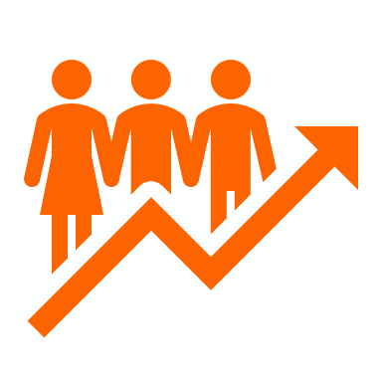
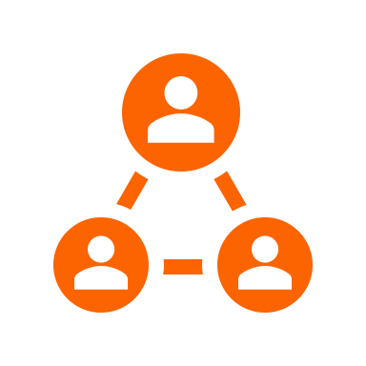
Things to think about . . .
Recruiting Gen Z in agriculture:
Focus on culture: purpose and values
Highlight STEM
Emphasize opportunities to learn and grow
Provide go-to resources that are accessible
Establish feedback loops
Target communication skill development

Slide 14
Things to think about . . .
Generations have more IN COMMON than we realize:
Personal values
Family
Integrity
Achievement
Love
Competence
Happiness
The difference is how different generations ACT on these values, not the values themselves.
(Deal, 2007)
https://www.peoplemanagement.co.uk/voices/comment/how-manage-multigenerational-teams-working-from-home#gref

Slide 15

Things to think about . . .
Generational conflict in the workplace is more likely due to issues of control, power, and authority than fundamental problems.
(King et al., 2011, p. 28)

Slide 16

Things to think about . . .
Benefits of multigenerational workplaces:
Increased empathy
Reverse mentoring
Diverse collaboration

Slide 17
Dr. Lauren Lewis Cline
Agricultural Leadership
O | 405.744.8138
C | 863.557.1713
E | lauren.l.cline@okstate.edu
444 Agriculture Hall
Stillwater, OK 74078
aged.okstate.edu

Slide 18
References
Culler, L. (May 2019). Generation Z is ready to clock in. Progressive Farmer. https://www.dtnpf.com/agriculture/web/ag/news/article/2019/05/31/generation-z-ready-clock-2
Emeritus Enterprise. (December 2021). 10 workplace trends to expect in 2022. Emeritus Blog. https://emeritus.org/blog/the-future-of-work-workplace-trends/
Gillespie, C. A. (2019). Generation Z in the workplace. Master’s thesis: Pepperdine University.
Indeed. (October 2021). GenZ vs millennials in the workplace: What are the differences? https://www.indeed.com/career-advice/career-development/gen-z-vs-millennials?aceid=&gclid=Cj0KCQiAjc2QBhDgARIsAMc3SqQbGwBJo4-HICkUP6kwpQbgNvE0oKX_xJQpDdir7XZvxeO2C1uP8-4aAssYEALw_wcB
Janssen, D., & Carradini, S.(2021). Generation Z workplace communication habits and expectations. IEEE Transactions on Professional Communication, 64(2), 137–153. https://doi.org/10.1109/TPC.2021.3069288
King, S. N., Altman, D. G., & Lee, R. J. (2011). Discovering the Leader in You (new and revised). Jossey-Bass.
Meister, J. (2002, January). Top ten HR trends for the 2022 workplace. Forbes Magazine. https://www.forbes.com/sites/jeannemeister/2022/01/05/top-ten-hr-trends-for-the-2022-workplace/?sh=6bc4ad0d3006
Stillman, D., & Stillman, J. (2017). Gen Z @ work: How the next generation is transforming the workplace (1st ed). Harper Business.

