Slide 1

Impact of Drought and Disaster Relief Insurance on Rural Oklahoma
Katherine L. Welch, Dayton M. Lambert, Amy Hagerman, Erik Krueger, Lixia H. Lambert, Tyson Ochsner, Paul Weckler
Oklahoma State University
Learn at Lunch
December 19, 2023
Acknowledgments: This research was supported with funding from the Sparks Chair in Agricultural Science and Natural Resources and Oklahoma State University Office Tier 1 Rural Renewal Initiative 1-151215: “A multi-dimensional approach for quantifying drought impacts on Oklahoma’s rural communities, and implications for water management.”

Slide 2
Problem and Objective
What are the economic losses experienced by communities in Tillman, Jackson, and Harmon counties due to drought?
  Crop and livestock sectors
How does crop insurance mitigate the effects of drought-related loss?
Provide information for drought mitigation decision-makers as they consider water use in their communities
  Effects of insured vs. uninsured crops in drought scenarios

Slide 3
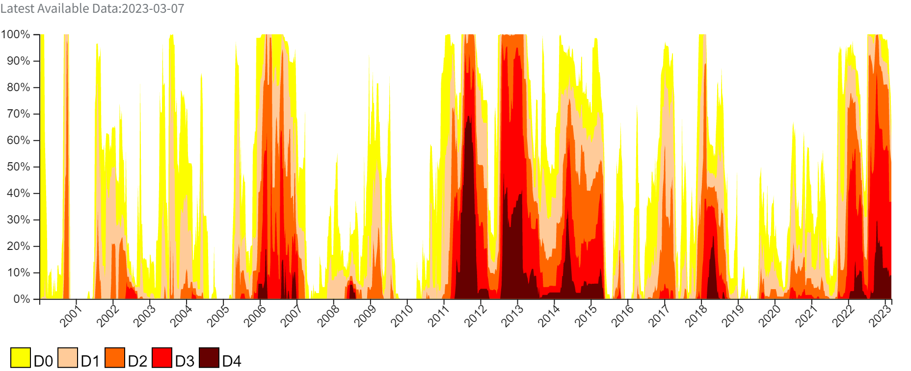
Historical Drought Severity, Oklahoma
Source: Drought.gov, National Integrated Drought Information System

Slide 4
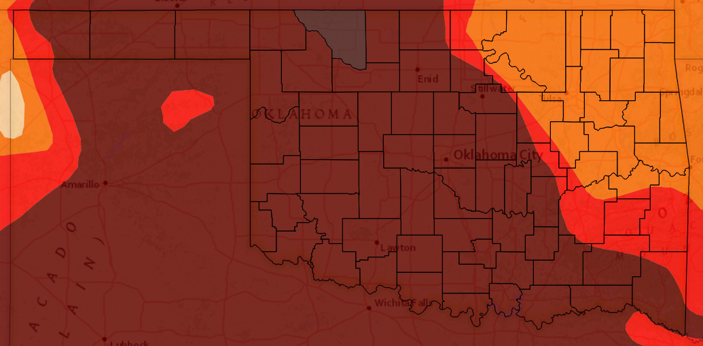
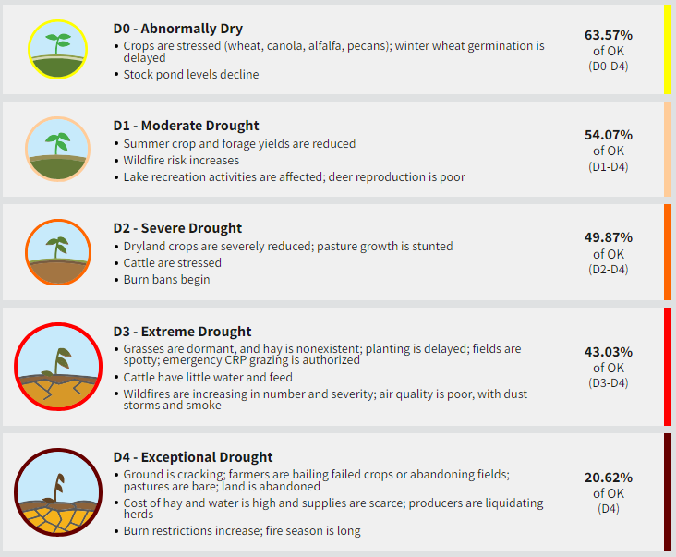
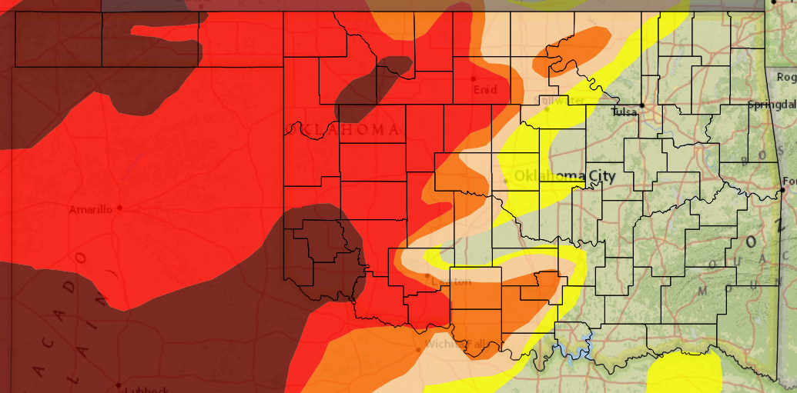
Drought, Oklahoma
2011
2022

Slide 5
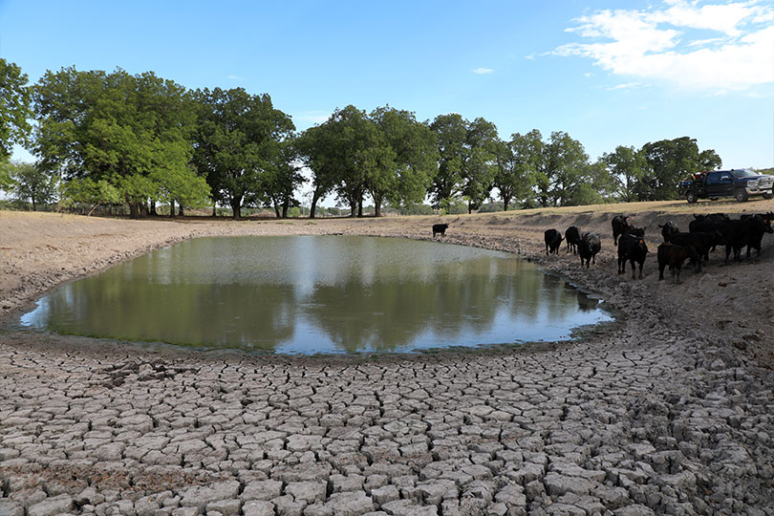
Effects of Drought
Economic loss, crop, livestock
Water restrictions
Brush fires
Loss of recreation days, low lake levels

Slide 6
Input-Output Analysis
Export Base Theory
I-O extends theory to sales
The export sector of a region produces a good/service
These goods are demanded elsewhere which generates income
The non-export sector exists to supply goods and services to the export sector
Sales bring income into a region
Income generates multiplier effect when respent locally
Effect size determined by additional rounds of local purchasing

Slide 7
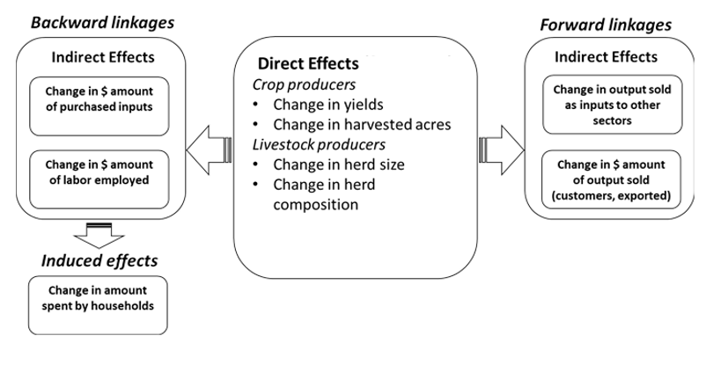
Input-Output Analysis
Types of Effects

Slide 8
MRIO – Multi-Regional Input-Output
Direct effects in one region triggers indirect and induced effects in nearby regions
MRIO captures these effects in linked regions by extending the concept of backward linkages
Single Region
Multiple Regions

Slide 9
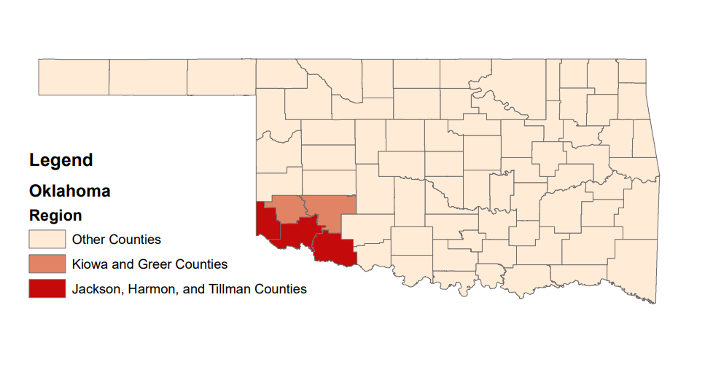
Study Region

Slide 10
Data
United States Department of Agriculture (USDA)
  Farm Service Agency (FSA)
  National Agricultural Statistics Service (NASS)
  Risk Management Agency (RMA)
Bureau of Economic Analysis (BEA)
IMPLAN
  Economic data, model platform

Slide 11
Types of Effects
Output
  Sales and receipts and other operating income
Employment
  Total number of jobs including full-time, part-time, and seasonal employment
Value Added
  Composed of proprietor income, employee compensation, other property income, and taxes on production and import
  Industry’s contribution to GDP

Slide 12
Contribution of Agricultural Sectors
Jackson, Harmon, and Tillman Counties
Employment (# of jobs) | Output ($ millions) | Value Added ($ millions)
2820 | 518 | 175
What does the existing activity of the ag sectors contribute to Oklahoma’s economy?
What if these industries did not exist → resulting effects on employment, output, and value added
Source: Authors’ calculations

Slide 13
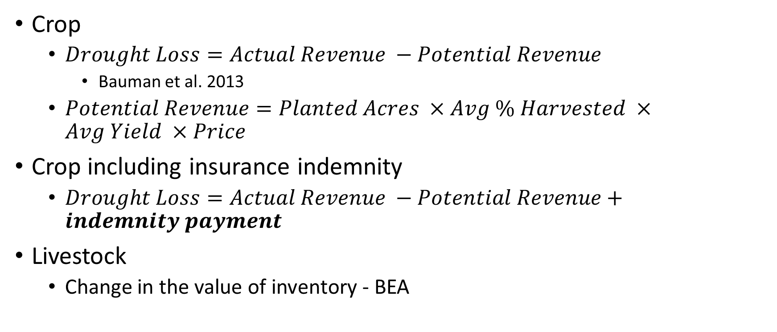
Impact Calculation
Crop
  $Drought Loss=Actual Revenue −Potential Revenue$
    Bauman et al. 2013
  $Potential Revenue=Planted Acres ×Avg \% Harvested ×Avg Yield ×Price$
Crop including insurance indemnity
  $Drought Loss=Actual Revenue −Potential Revenue+indemnity payment$
Livestock
  Change in the value of inventory - BEA

Slide 14
Drought Impact Estimation 2011-2013
Jackson, Harmon, and Tillman Counties
Sector | Commodity | Impact ($ millions) 2011 | Impact ($ millions) 2012 | Impact ($ millions) 2013 | Impact ($ millions) 2014
Grain | Wheat | -26.3 | 27.4 | -47.4 | -26.2
Grain | Corn | -0.4 | -0.4 | -1.4 | -0.6
Cotton | Cotton | -160.5 | -89.8 | -51.5 | -15.7
Other Ag | Hay | -6.5 | -3.7 | -0.04 | -0.2
Livestock |  | -16.8 | -7.7 | 2.8 | 10.4

Slide 15
Drought Impact Results 2011-2014, 2018
Jackson, Harmon, and Tillman Counties
Year | Output ($ millions) | Employment (jobs) | Value Added ($ millions)
2011 | -332 | -2250 | -141
2012 | -118 | -839 | -61
2013 | -158 | -1005 | -57
2014 | -54 | -347 | -18
Total | -662 | -4441 | -277
2018 | -209 | -1401 | -91
Total | -871 | -5842 | -368

Slide 16
Drought Impact Results (RMA) 2011-2014
Jackson, Harmon, and Tillman Counties
Year | Output ($ millions) |  |  | Employment (jobs) |  |  | Value Added ($ millions)
 | Impact | Impact + RMA | % Reduction | Impact | Impact + RMA | % Reduction | Impact | Impact + RMA | % Reduction
2011 | -332 | -239 | 28% | -2250 | -1654 | 26% | -141 | -107 | 24%
2012 | -118 | -11 | 91% | -839 | -146 | 83% | -61 | -15 | 75%
2013 | -158 | -69 | 56% | -1005 | -451 | 55% | -57 | -29 | 49%
2014 | -54 | 10 | 119% | -347 | 47 | 114% | -18 | -1 | 94%
Total | -662 | -309 | 53% | -4441 | -2204 | 50% | -277 | -152 | 45%

Slide 17
Conclusions
Total drought impacts included -$871 million in output, -5842 jobs, and -$368 million in value added over 2011-2014
Mitigating effects
  2012 – bumper wheat crop
  2013, 2014 – record high cattle prices
  Insurance indemnity payments
Future work
  Extend analysis over time and link to water availability

Slide 18
Drought Impacts 2000-2021
Jackson, Harmon, and Tillman Counties

Slide 19
Drought Severity and Output Loss
Source: Drought.gov, National Integrated Drought Information System

Slide 20
Drought Impacts and Soil Water 2000-2021
Jackson, Harmon, and Tillman Counties

Slide 21
Contact Info
  Katie Welch
  katwelc@okstate.edu
Project Lead
  Dr. Dayton Lambert
  dayton.lambert@okstate.edu
Survey Link
  https://okstatecasnr.az1.qualtrics.com/jfe/form/SV_0U4QpceJg1yof5A

