Slide 1
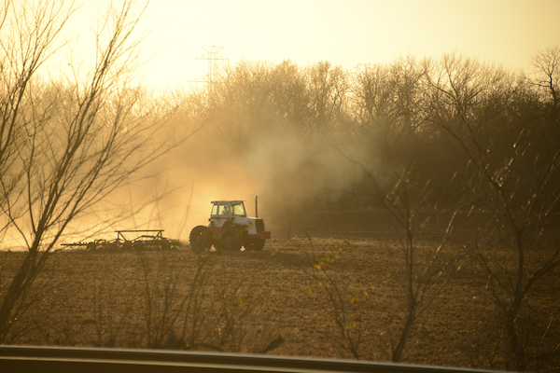
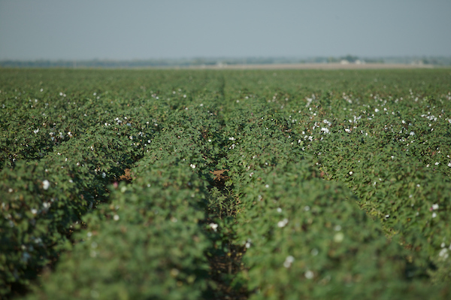
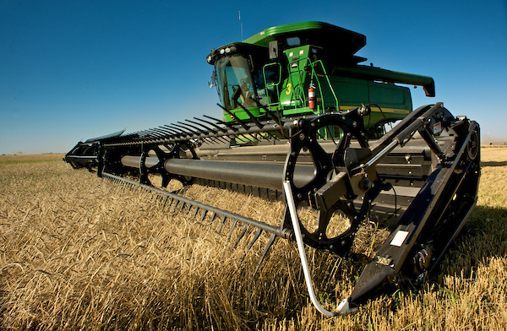

Farm Bill Update- Next Steps
Amy Hagerman
State Specialist in Agricultural and Food Policy
January 22, 2019
Email: amy.hagerman@okstate.edu
Phone: 405-744-9811
Visit us online at: agecon.okstate.edu/agpolicy/

Slide 2

Path to the 2018 Farm Bill
HOUSE
H.R. 2 Agriculture and Nutrition Act of 2018
June 21
SENATE
S. 3042: Agricultural Improvement Act of 2018 June 28
July 18
August 3
CONFERENCE
September 5
Report Signed Dec 10
FULL HOUSE
Floor Vote
FULL SENATE
Floor Vote
Dec 12 (369-47)
Dec 11 (87-13)
WHITE HOUSE
Agricultural Improvement Act of 2018, Dec 20
USDA
Program guidance

Slide 3
$867 B Projected Spending Over 10 Years
Big 4 account for 99% of spending
  Commodities
  Crop Insurance
  Conservation
  Nutrition (Supplemental Nutrition Assistance Program)
Everything else fits in the 1%
  Trade
  Credit
  Rural Infrastructure/ Development
  Research, Extension, and Related Matters
  Forestry
  Energy
  Horticulture
  Miscellaneous

Slide 4
Commodity Programs | Nutrition
Livestock Programs | Specialty Crop and Organic Programs
Conservation | Rural Development
Crop Insurance | Trade

Slide 5
Commodity Programs
AGI limits, conservation requirements, and active participation rules maintained.
  Definition of family expanded to include first cousins, nieces and nephews.
ARC/PLC election for 2019 to 2023, but option to switch each year after 2021
Base acres for land that has been in pasture or grass from 2009 to 2013 will not become unassigned base
However,
  No ARC/PLC election change can be made on base acres in grassland
  No payments under ARC/PLC will be made on base acres in grassland
  A Grassland Incentive Program payment (under the Conservations Stewardship Program) of $18/acre will be made
  The Grassland Incentive Program has separate requirements from CSP, it will just live in that funding pool.

Slide 6
Commodity Programs
Price Loss Coverage
Agricultural Risk Coverage
  Reference Prices will remain the same, except when the reference price is lower than 85% of the 5 year rolling average price (effective reference price)
    In that case the price used for PLC will be the effective reference price
    The effective reference price may not exceed 115% of the reference price
  ARC Individual is no longer an option
  Risk Management Agency (RMA) data for ARC-CO
  Up to 25 counties with more than 4,000 sq miles and more than 190,000 base acres may be broken into 2 payment areas for ARC.
  Farmers in areas affected by severe drought in 2008-2012 can update yields (one time)

Slide 7
Marketing Loans
The 2018 farm bill extends marketing assistance loan programs and increases loan rates for 2019 to 2023.
Commodity | Unit | 2014-2018 | 2019-2023
Corn | Bu | 1.95 | 2.20
Grain Sorghum | Bu | 1.95 | 2.20
Soybeans | Bu | 5.00 | 6.20
Wheat | bu | 2.94 | 3.38

Slide 8
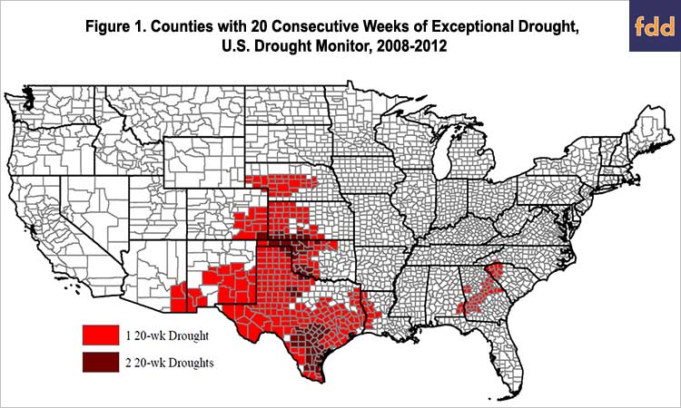
Yield Update A Benefit to Drought Affected Counties

Slide 9
Commodity Programs | Nutrition
Livestock Programs | Specialty Crop and Organic Programs
Conservation | Rural Development
Crop Insurance | Trade

Slide 10
Livestock Programs
Dairy safety net strengthened
  Margin Protection Program renamed Dairy Margin Coverage Program and lower cost for small producers
  Refund 50% of the premiums from the old MPP program, or 75% if using the money to buy future coverage
Disaster Assistance
  Maintains the Livestock Forage Program (LFP)
  Expands the Livestock Indemnity Program (LIP) to include disease and deaths of unweaned livestock, consolidating all livestock deaths under LIP.
  Eliminates payment limitation for the Emergency Assistance for Livestock, Honey Bees, and Farm-Raised Fish program (ELAP)
Emergency Response
  Establishes national Animal Disease Preparedness and Response Program
  Establishes a US only vaccine bank
  Expands support to the NAHLN

Slide 11
Commodity Programs | Nutrition
Livestock Programs | Specialty Crop and Organic Programs
Conservation | Rural Development
Crop Insurance | Trade

Slide 12
Conservation
CRP acreage from 24 million to 27 million and from 100% rental rate to 90% rental rate
Environmental Quality Incentive Program (EQIP) funding increased
Conservation Stewardship Program (CSP) maintained, but funding decreased
ACEP and RCPP maintained
Provides funding for infrastructure initiatives for watershed and flood prevention, and for watershed rehabilitation
Feral swine eradication pilot funded for threat assessment, control methods and land restoration.

Slide 13
Commodity Programs | Nutrition
Livestock Programs | Specialty Crop and Organic Programs
Conservation | Rural Development
Crop Insurance | Trade

Slide 14
Crop Insurance
Maintains policy options, including the Supplemental Coverage Option and Whole Farm Revenue Protection
For producers who graze cropland part of the year, separate policies can be purchased for grazing and crop purposes.
Research and development of insurance policies for, among other things, sorghum and farm that use more efficient irrigation systems.
Whole Farm Revenue Protection
  Discounts for beginning farmers and ranchers extended to 10 years (from 5)
  Removing caps on nursery and livestock production
  Ordering a review of procedures to reduce paperwork burden
Hemp cropland will be eligible for crop insurance—more later

Slide 15
Commodity Programs | Nutrition
Livestock Programs | Specialty Crop and Organic Programs
Conservation | Rural Development
Crop Insurance | Trade

Slide 16
Industrial Hemp
The horticulture title contains a section that legalizes industrial hemp production as an agricultural commodity
  Removes industrial hemp from the list of controlled substances
  Other cannabis products remain on the list
States will be responsible for establishing a plan to monitor, test, and enforce penalties around hemp production
  Until state laws in Oklahoma change, nothing has changed from what was presented in the hemp webinars.

Slide 17
Commodity Programs | Nutrition
Livestock Programs | Specialty Crop and Organic Programs
Conservation | Rural Development
Crop Insurance | Trade

Slide 18
Rural Development
Funding to address opioid crisis and rural mental health
Continues support of rural broadband development
Provides funds for infrastructure (e.g. hospitals, water systems, schools)

Slide 19
2018 Farm Bill Comparison
Note: Analysis by CBO of the conference report as passed by the House and by the Senate.

Slide 20
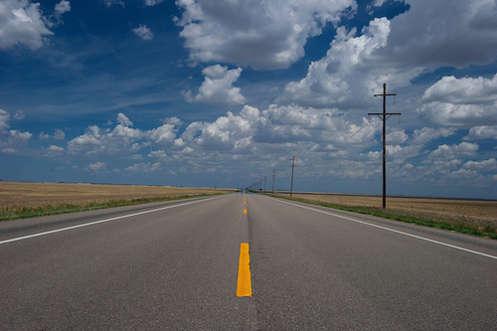
Next Steps
Federal shutdown may delay USDA releasing details and election dates
January 31 and February 11, 6:00pm webinars
Counties participating
Jan 31st Webinar Feb 11th Webinar
Beaver Beaver
Garfield Bryan
Noble Garvin
Osage & Pawnee Grady
Ottawa Grant
Pontotoc Kay
Seminole Osage & Pawnee
Wagoner Pontotoc
Pottawatomie
Roger Mills
Texas
Washington
Woodward

Slide 21
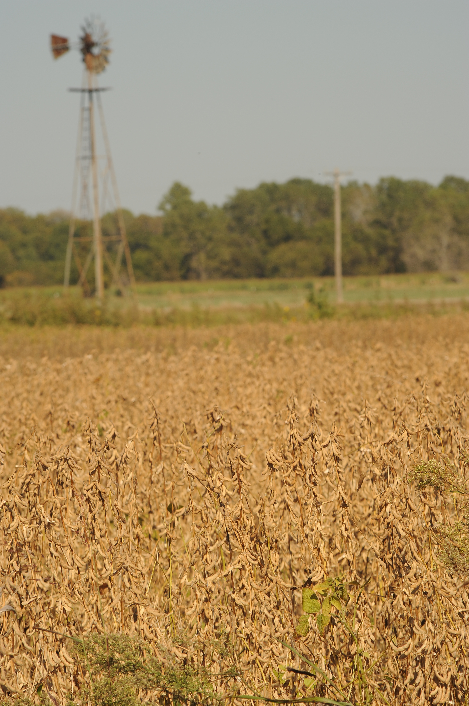
Questions?
Amy Hagerman
amy.hagerman@okstate.edu
405-744-9811
Tell us what you thought of this presentation. Fill out the online survey at: https://okstatecasnr.az1.qualtrics.com/jfe/form/SV_9mhmIEh2EiNIxwh
Visit us online at agecon.okstate.edu/agpolicy/

