Slide 1

Update on Southern Plains Ag Economy
Rodney Jones, Ph.D. Oklahoma Farm Credit Agricultural
Finance Chair, OSU Dept. of Agricultural Economics

Slide 2
We Have Been In Challenging Economic Times For About Six Years
In general more true for crop based operations than for cattle or mixed operations, but that may be changing
Degree and type of “financial stress” varies from producer to producer
Dairy industry has been particularly challenging

Slide 3
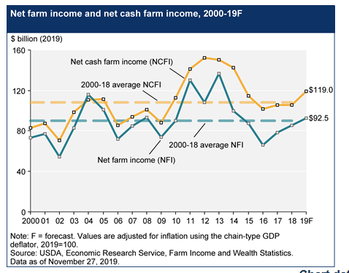
Is The Farm Financial Picture On The Road To Recovery?

Slide 4
Recovery in Farm Income?
2018 final numbers came in significantly better than forecast a year ago
The current forecast for 2019 is continued improvement for the U.S. overall
Appears to be driven by two factors.
  MFP Payments (structured a lot differently in 2019 than in 2018, wide variation in individual farm payments.
  Some input costs have come down

Slide 5
Recovery in Farm Income?
Unlikely that there will be an MFP Payment for 2020
Input costs will likely not see upward pressure
Calf prices lower than last several year average, putting pressure on cow-calf returns

Slide 6
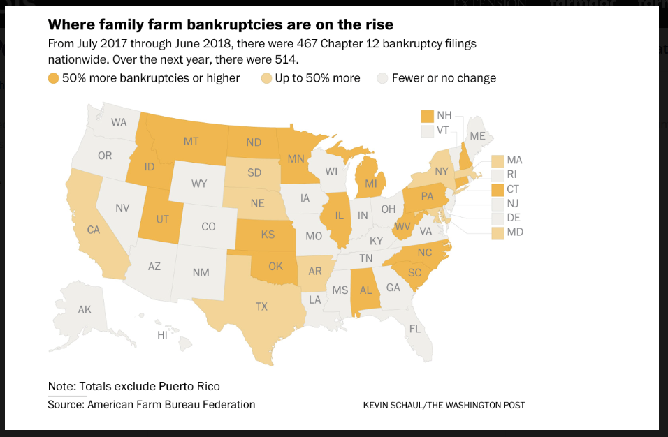
Though The Numbers Are Small, Chapter 12 Filings Have Increased
Some Indication That in At Least Some Areas, The Numbers
Increased Somewhat in Late 2019

Slide 7
Facts and Projections
Surveys of Lenders consistently reveal that agricultural conditions are steadily getting worse rather than improving. The majority of lenders consistently report that the deterioration is in general “modest”. This has been the case for at least 4 years in a row, confirming that this downturn is in general a slow erosion of financial condition, much different than the 1980’s

Slide 8
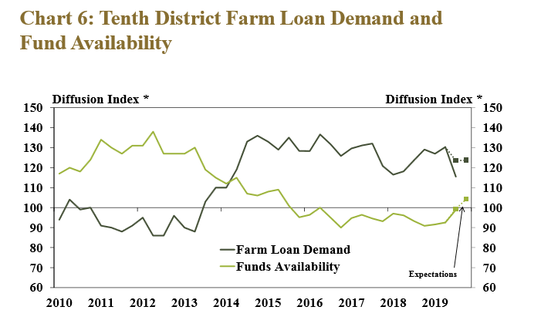
Facts and Projections
Overall farm loan demand may be stabilizing

Slide 9
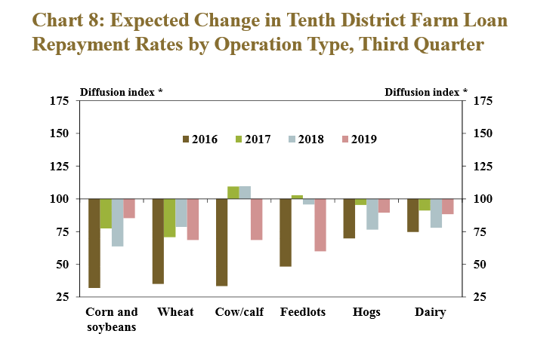
Facts and Projections
Expected Repayment issues depend on Loan Type

Slide 10
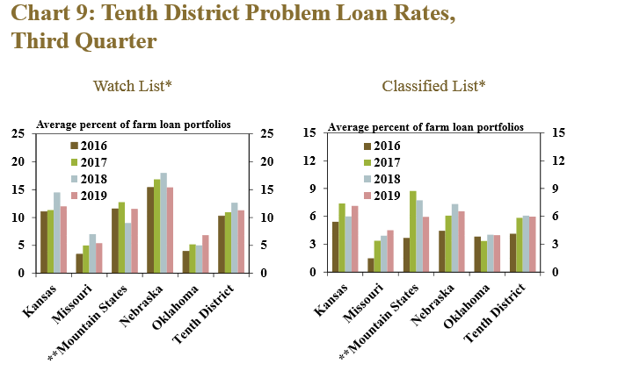
Facts and Projections
Expected Repayment issues depend on Location

Slide 11
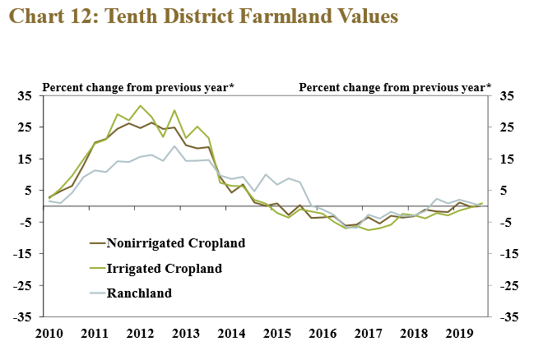
Farmland Values Very Stable
Oklahoma land values overall up slightly. (Pasture up a bit,
Cropland down slightly) For the last few years pastureland has
In general sold for higher than cropland. Starting to hear some
concern regarding the volume of land coming on the market.

Slide 12
Positive Factors Looking Forward
  Instead of continuing to go up, interest rates have stabilized or come down slightly. The risk of increases has subsided
  Other cost components appear to be stabilized
  Overall agricultural product exports have been surprisingly strong despite the trade war
  Land values (at least in Oklahoma) have been relatively stable, providing some equity support
  Cattle prices appear to be positioned to start improving

Slide 13
Negative Factors Looking Forward
  Both U.S. and World ending stock of Grain (wheat, corn and soybeans) are all at very high levels, above average. While trade agreement progress will help marginally, the fact is that there is a lot of grain in the world
  Likely will be less “ad hoc” government assistance (MLA or something similar)

Slide 14
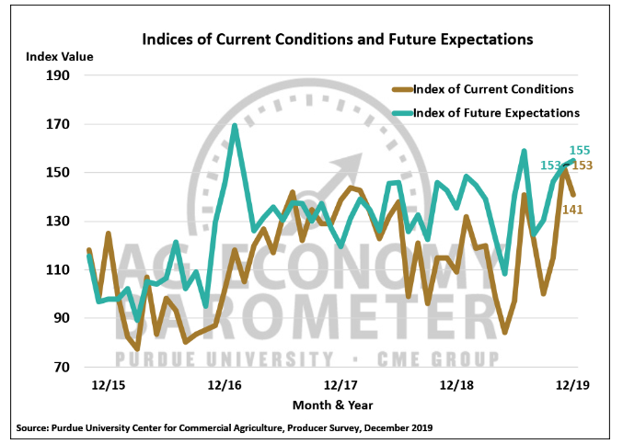
Industry Observations
Purdue University Center For Commercial Agriculture Ag Economy Monthly Barometer (400 Producers Surveyed Each Month)

Slide 15
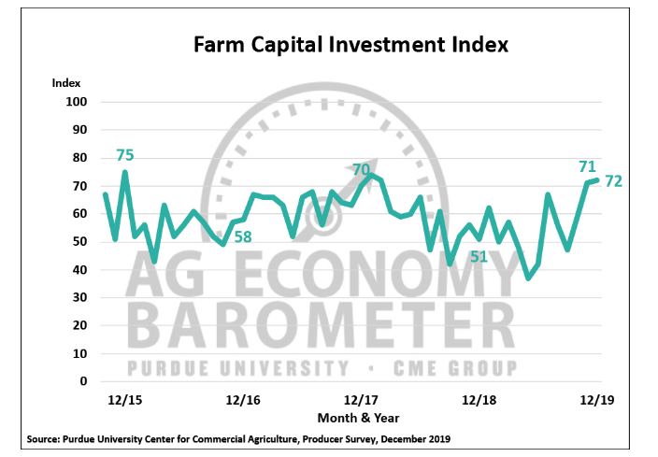
At least “some” farmers are more willing to consider
Making large capital expenditures that in recent past

Slide 16
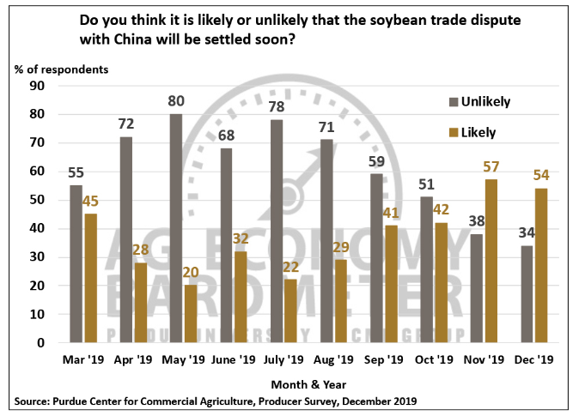
Survey respondents believe that the trade dispute with China
is on a path to resolution, and that it will benefit U.S. ag.

Slide 17
Local Observations
A recent summary of the 2017 Census of Ag revealed
  19 counties in Oklahoma lost 10% or more of farms between 2012 and 2017. Mostly Western and North Central Oklahoma. At least 10 more counties were close to that percentage loss.
  About 7 counties gained 10% or more in farm numbers. Mostly close to larger population areas

Slide 18
What Can Individual Producers Do?
As always, for commodity crop producers it’s all about cost managment
  Find a way to cut $20.00 per acre off of production costs relative to recent years (in some cases those may be permanent cost savings, in some cases those may be temporary to get through the current times)
  That strategy is working well for many producers, but in some cases not going over so well with some traditional input suppliers

Slide 19
Crop Budget Realities
Crop budget projections look challenging for 2020.
Wheat looks especially challenging because of dramatic price volatility.
However, most Oklahoma producers have wheat base, so the PLC program may provide some assistance for the 2019 and 2020 crop years.

Slide 20
In Summary
We are in an extended period of very challenging financial times for our ag sector (much more like the 1920’s than the 1980’s)
Our producers are “weathering the storm” fairly well in general, there are individual exceptions
There are some signs that conditions may be improving, especially for livestock producers

Slide 21
Questions? Please Click on the Link to Take Our Webinar Survey
https://okstatecasnr.az1.qualtrics.com/jfe/form/SV_0HQ9CIksnTH7gGx
If you would like to be added to the list for our Ag Finance electronic newsletter, send me an email at rodney.jones@okstate.edu
Join us on Facebook at OSUFarmManagment

