Slide 1
Tax Cuts and Jobs Act of 2017 Individual Taxpayer Items
J C. Hobbs
Associate Extension Specialist
Agricultural Economics Department
July 2018

Slide 2

HMMMM…..
The difference between death and taxes is death doesn’t get worse every time Congress meets.
-- Will Rogers

Slide 3
“Tax Cuts and Jobs Act”
December 22, 2017, President Trump signed H.R. 1, the “Tax Cuts and Jobs Act” into law which now changes the taxation landscape for both individuals and businesses.
Purpose: Reduce taxes but broaden the tax base to increase overall revenues
Topics: Individual taxpayer changes

Slide 4
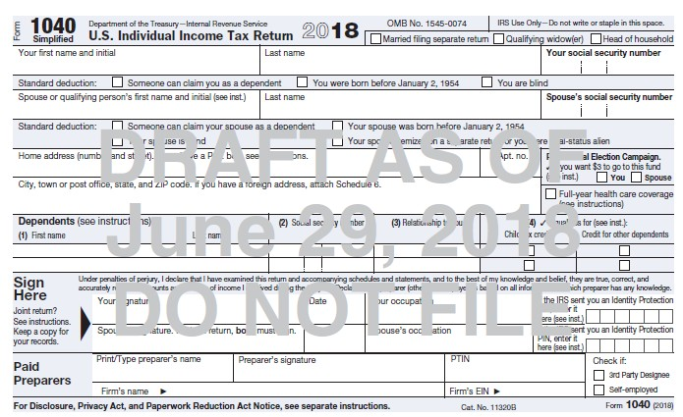
Form 1040 (page 1)

Slide 5
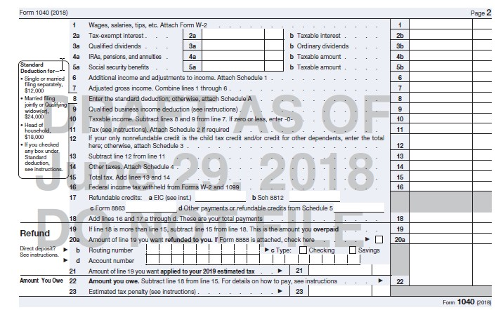
Form 1040 (page 2)

Slide 6
Individual Changes
Tax rates have changed:
2017: 10%, 15%, 25%, 28%, 33%, 35%, and 39.6%
2018: 10%, 12%, 22%, 24%, 32%, 35%, and 37%
Rate changes are effective for tax years beginning after December 31, 2017 and before January 1, 2026
Legislation is being introduced to make changes permanent

Slide 7
Tax Rate Comparison for Single Taxpayers
Old Law TCJA
Rate Break Point Rate Break Point
10% >$0 10% >$0
15% >$9,325 12% >$9,525
25% >$37,950 22% >$38,700
28% >$91,900 24% >$82,500
33% >$191,650 32% >$157,500
35% >$416,700 35% >$200,000
39.6% >$418,400 37% >$500,000

Slide 8
Tax Rate Comparison for Married Filing Joint
Old Law TCJA
Rate Break Point Rate Break Point
10% >$0 10% >$0
15% >$19,050 12% >$19,050
25% >$77,400 22% >$77,400
28% >$156,150 24% >$165,000
33% >$237,950 32% >$315,000
35% >$424,950 35% >$400,000
39.6% >$480,050 37% >$600,000

Slide 9
Standard Deduction
Standard Deduction increased for tax years beginning after December 31, 2017 and before January 1, 2026
Single = $12,000
Married Filing Joint = $24,000
Head-of-Household = $18,000
Married Filing Separate = $12,000
No change to additional deduction amount for elderly or blind ($1,300 or $1,600 dependent upon filing status)

Slide 10
Standard Deduction
If Adjusted Gross Income is $12,000 or less, then a single individual pays no tax in 2018 (the zero percent bracket)
or
If Adjusted Gross Income is $24,000 or less, then a married filing joint couple pays no tax in 2018 (the zero percent bracket)
Amount is indexed for inflation annually

Slide 11
Personal Exemptions
Personal Exemptions are SUSPENDED
For tax years beginning after December 31, 2017 and before January 1, 2026.
Reduces the exemption amount to zero.
2017 was $4,050 per exemption
2018 was to be $4,150 per exemption, but the TCJA zeroed it

Slide 12
Better off Tax wise?
Married Couple Filing Joint (no dependents)
Old Law TCJA
Adj Gross Inc 100,000 100,000
Std Deduction 13,000 24,000
Exemption 8,300 0
Taxable Income 78,700 76,000
Tax Due 10,983 8,739

Slide 13
Child Tax Credit
New law increases to $2,000 from $1,000 for each qualifying child under 17 years of age.
AGI phase outs apply but now $400,000 MFJ
Refundable amount increased to $1,400 per qualifying child
SSN required for each child
Non-child dependent was added under the new law for an amount of $500.

Slide 14
Better off Tax wise?
Married Couple Filing Joint w/2 children
Old Law TCJA
Adj Gross Inc 100,000 100,000
Std Deduction 13,000 24,000
Exemption 16,600 0
Taxable Income 70,400 76,000
Tax before Credit 9,608 8,739
Child Tax Credit 2,000 4,000
Tax Due 7,747 4,739

Slide 15
Better off Tax wise?
You will not know the exact answer to your specific tax situation until you file your 2018 income tax return.
Visit with you tax advisor before December 2018 to avoid any disasters. (such as under payment penalties)
The devil is truly in the details.

Slide 16
Kiddie Tax
Child <19 or full-time student <24 years old
Unearned vs Earned Income
Beginning for tax years after Dec. 31, 2017 earned income is taxed at single individual rates
Taxable income from unearned sources (if >$2,100 from portfolio, capital gains, etc.) are taxed using the estate and trust income tax brackets.
Estates and Trusts: 10%, 24%, 35% and 37%

Slide 17
Kiddie Tax
If Taxable Income Is: The Tax Is:
> $0 but ≤ $2,550 10% of the taxable income
> $2,550 but ≤ $9,150 $225 + 24% of excess > $2,550
> $9,150 but ≤ $12,500 $1,839 + 35% of excess > $9,150
> $12,500 and over $3,011.50 + 37% of excess > $12,500

Slide 18
Itemized Deductions
Many itemized deductions were suspended
With Standard Deduction at $24,000 MFJ ($12,000 Single) the tax relief from itemizing is greatly reduced
Typically, itemizing has value when the total itemized deductions exceeds the taxpayer’s standard deduction amount

Slide 19
Itemized Deductions
Itemized Deduction Changes for tax years beginning after December 31, 2017 and before January 1, 2026:
A Taxpayer may deduct State, Local and foreign property taxes, and State and local income taxes to a cap of $10,000 (MFJ) or $5,000 (MFS)
Home Mortgage Interest and Home Equity Mortgage Interest is allowed subject to indebtedness limitations $750,000 ($375,000 Married Filing Separate)

Slide 20
Itemized Deductions
Itemized Deduction Changes (cont.)
Unreimbursed employee expenses (travel, meals, uniform, job search, etc.)
Tax preparation expenses
Investment fees and expenses
Safe deposit box rental
Hobby expenses
Moving expenses unless a member of the military

Slide 21
Personal Property Losses
Personal Casualty and Theft Losses
For tax years beginning after December 31, 2017 and before January 1, 2026
Are suspended, except for personal casualty losses incurred in a Federally-declared disaster area.

Slide 22
Charitable Contributions
Charitable Contribution Deduction Limitation Increased
Beginning for tax years after December 31, 2017 and before January 1, 2026, the contribution limit is increased to 60% from 50%
Example: AGI = $100,000, limit is now $60,000, the $40,000 excess contribution can be carried forward five years.

Slide 23
Avoid Under Withholding Penalty
May need to adjust the number of withholding allowances on Form W-4
If you had a large amount of itemized deductions in 2017
Household income is $200,000 or more (be safe: check if income is > $150,000)
Talk to your taxpreparer soon!!!

Slide 24
Avoiding the Penalty
Must withhold at these levels:
90% of current years tax due
100% of 2017 tax paid or 110% of 2017 tax paid for high income (AGI > $150,000)
2018 withholding calculator
https://apps.irs.gov/app/withholdingcalculator/

Slide 25
Questions?
Be sure to visit your taxpreparer to avoid a surprise when it is time to file for 2018
Thank you for your attention!!
J C. Hobbs
Associate Extension Specialist
Email: jc.hobbs@okstate.edu

