Slide 1


Slide 2

August 9-10, 2018
Oklahoma City
Downtown Embassy Suites; OU Health Sciences Center
Who should attend?

Slide 3
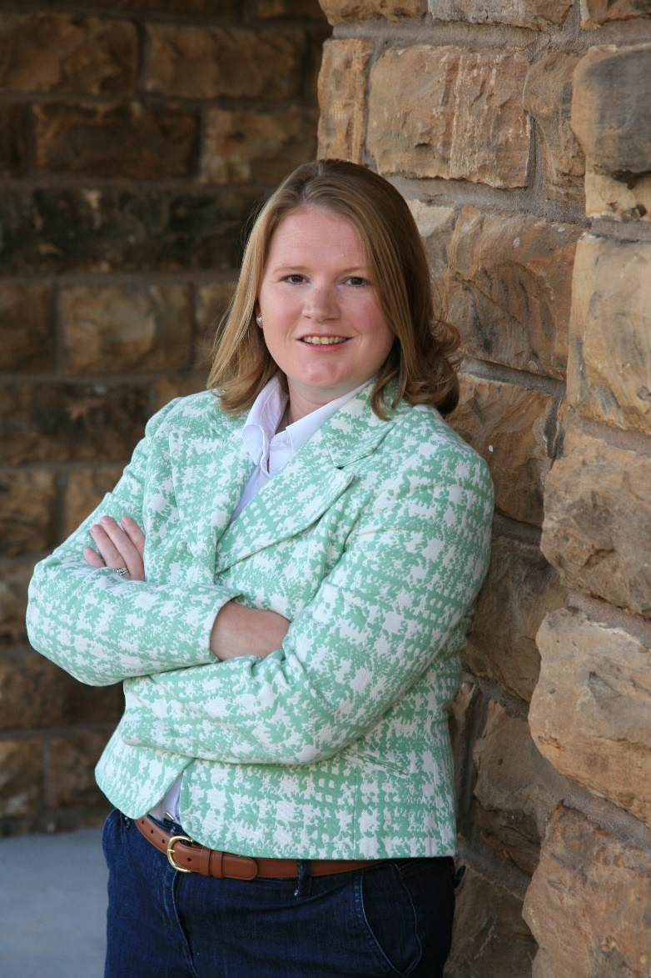
Keynote Speaker: Dr. Janeal Yancey
Janeal grew up in a small Texas town where she showed sheep and pics through FFA.
She is now a meat scientist at the University of Arkansas. In 2011 she stared the “Mom at the Meat Counter” blog after having lots of conversations about the meat industry with other moms.

Slide 4
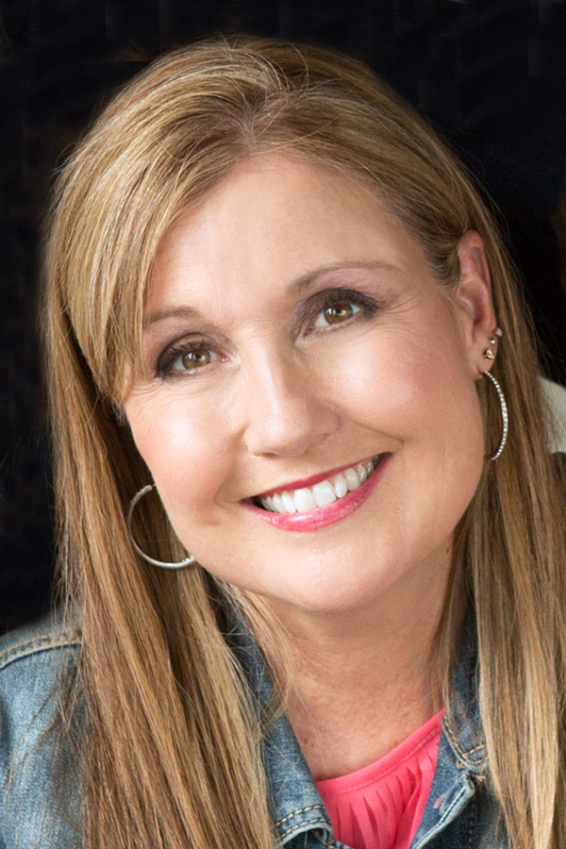
Keynote Speaker: Rebecca Long Chaney
Author and rancher in Nebraska.
In 2000 she traveled and worked abroad with her husband for a year. Eight months were spent on an 880,000-acre cattle station in the Australian outback. The journey also took them to Papua New Guinea, Tonga and New Zealand.

Slide 5
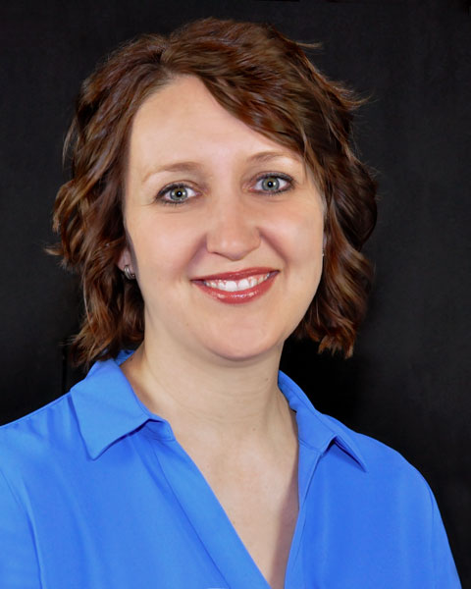
Keynote Speaker:
Marcy Luter
Marcy Luter is the Management Development Training Coordinator at Meridian Technology Center, where she regularly works with businesses to meet their goals through training and other educational opportunities.

Slide 6
Concurrent
Sessions

Slide 7
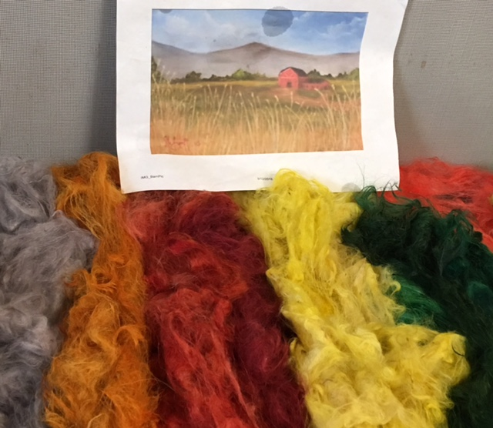
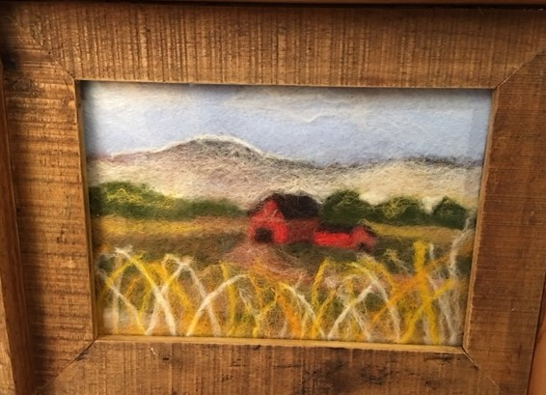
Conference Features
Made in Oklahoma (MIO) mini-mall: Vendors selling MIO products.
Exhibits: Businesses and organizations with information and resources to help producers and small business owners be more successful.
**SOCIAL** Sheila and Janice Robinson of Land Run Alpacas and Just Right Alpacas will lead a needle felting activity with dyed alpaca wool.

Slide 8
To Register:
www.okwomeninagandsmallbusiness.com
or call 405-744-9836
For questions call Sara Siems: 405-744-9826 or email at sara.siems@okstate.edu
Conference can be used as In-Service Training for Extension Educators!
  SARE scholarships for educators
  Help us promote! We’ll send you registration brochures!
  $50 to attend by August 3, $60 after August 3. $25 for school aged registrants. Registration also includes materials, a goody bag, two breakfasts, two lunches and all break service.

Slide 9
Questions?
Thank You!

