Slide 1
Farm Labor Resources
Rodney Jones
Oklahoma Farm Credit Agricultural Finance Chair

Slide 2
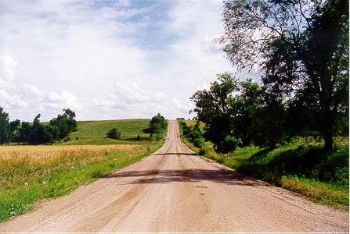

Slide 3
Seven easy steps to staffing
Assess human resource needs for the farm and ranch
Preparing to be an employer
Recruit, interview, and hire employees
Getting the new employee “on board” – tasks for new hires
On the job: working with current employees
Evaluate employees’ performance
Compensation

Slide 4
1) Assessing human resource needs What are we doing here anyway?
Assess current and future human resources
What needs to be done
Vision, Mission, Objectives, Goals
How much labor is needed
Develop a labor needs chart (work load schedule)
Break down by related types of tasks or skill set requirements

Slide 5
1) Assessing human resource needs (work load schedule)
Hours/Quarter
Tasks | 1st Quarter | 2nd Quarter | 3rd Quarter | 4th Quarter
Operating
Livestock | 500 | 250 | 250 | 300
Crops | 100 | 1000 | 500 | 100
Machinery | 100 | 300 | 100 | 50
Sub Total | 700 | 1550 | 850 | 450
Management
Recordkeeping | 120 | 300 | 120 | 300
Reporting | 40 | 40 | 40 | 40
Payroll, HR | 120 | 175 | 120 | 120
Sub Total | 280 | 515 | 280 | 460
Marketing
Market analysis | 70 | 150 | 70 | 70
Contracting | 70 | 40 | 70 | 40
Delivery mgmt | 40 | 40 | 0 | 40
Sub Total | 180 | 230 | 140 | 180
Other
Sub Total
Overall Total | 1160 | 2295 | 1270 | 1090

Slide 6
1) Assessing human resource needs (looking to the future)
Assess current and future human resources
How much labor is currently available
Broken down by various skills
Anticipated changes
Adding more land, someone retiring or slowing down, etc. (visualize an “organizational” chart)
Think about changes to your labor needs chart

Slide 7
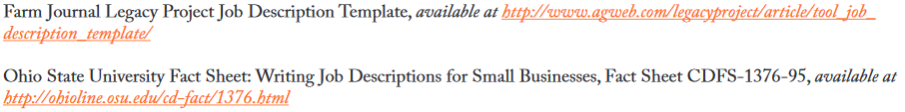
1) Assessing human resource needs Preparing job descriptions
Develop one for every “role” in the business, especially important when filling a void
Use “work load schedule” to identify the voids, then develop job description(s) to fill the void(s)

Slide 8
1) Assessing human resource needs Preparing job descriptions
Key elements of a job description
Job title
Position summary, including who supervises the position
Typical duties, tasks, and responsibilities
Working conditions
Required knowledge, skills, and abilities
How the job will be evaluated
How the job will be compensated (salary and benefits)

Slide 9
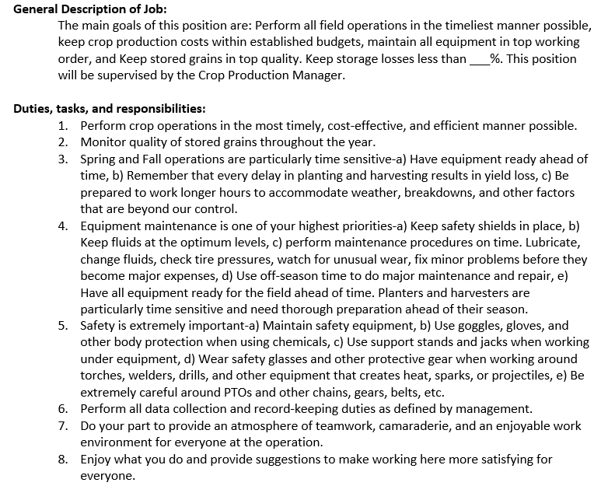
Example job description

Slide 10
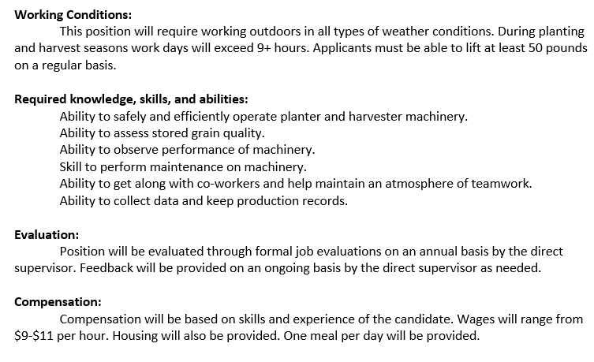
Example job description

Slide 11
2) Preparing to be an employer First off, am I an employer or not?
Employee
Independent Contractor
Given highly specific instructions about how and when to perform work
Told desired outcome with little instruction about how to achieve outcome
Employer owns tools; employee told what to use
Selects and provides own tools & equipment
Given training / supervision by supervisor
Assumed to have needed skills / no training provided
Little or no financial risk dependent on project outcome
Payment contingent; based on successful performance of project

Slide 12
2) Preparing to be an employer Setting up for employer responsibilities
Choosing an entity structure: do not try this at home!
Preparing for tax withholding: income, FICA, unemployment, state & federal
Obtain an Employer Identification Number

Slide 13
Recruit, interview, and hire
Identifying personnel needs
Make time to recruit
One of the most common mistakes small business managers make in recruiting potential employees is not investing the time and effort required to do the job well.
Having contingency plans for backup labor is a critical part of the recruiting process.

Slide 14
Recruit, interview, and hire
The recruitment process
Recruitment is the process of attracting individuals
on a timely basis,
in sufficient numbers, and
with appropriate qualifications to apply for jobs within an organization.

Slide 15
Recruit, interview, and hire
Identifying personnel needs
Recruitment methods
Suggestions from current employees
Word of mouth
Want ads
Government job services
College placement offices
Posting job announcements
Search firms

Slide 16
Recruit, interview, and hire
Information for advertisements
Give the appropriate job title
Say something positive about the business
Describe the job
Highlight positive working conditions
If appropriate, provide information on wages and benefits
Indicate how to apply

Slide 17
Recruit, interview, and hire
The difference between recruitment and
selection processes
The recruiting process focuses on generating a pool of candidates that includes several qualified people.
The selection process focuses on choosing the best candidate for the job.

Slide 18
Recruit, interview, and hire
The application
Information provided on the application concerning
previous education,
job experience, and
length of service
can be a good predictor of future performance.
If the application requests the correct type and depth of information, a group of applications can be screened in a relatively short period of time, allowing the supervisor to spend more time with qualified applicants.

Slide 19
Recruit, interview, and hire
The interview process
Prepare for the interview
Determine a small number of applicant characteristics about which you want to gather information.
Write a list of questions that will elicit information on these characteristics.
Plan to ask each applicant the same questions in the same sequence.
Develop a rating system to score each performance characteristic in which you are interested.

Slide 20
Recruit, interview, and hire
The interview process
Put the applicant at ease.
The more you do to alleviate tension, the more meaningful the interview will be.
Make it a priority to find a quiet, comfortable place where the interview may be conducted without interruption.

Slide 21
Recruit, interview, and hire
The interview process
Listen.
Open the discussion, but encourage the applicant to do most of the talking.
An interviewer who dominates the conversation or answers questions for the applicant learns very little about the prospective employee.
Use open-ended questions that require an explanation rather than a “yes” or “no” response.

Slide 22
Recruit, interview, and hire
The interview process
Fulfill your responsibilities to the applicant.
Be honest, but at the same time sell the strengths of the position.
Give the applicant plenty of opportunity to ask questions.
TREAT EVERY APPLICANT THE SAME
Notify applicants of their status as soon as decisions have been made (a particular applicant has been eliminated from consideration, etc.)

Slide 23
Recruit, interview, and hire
Check references, make a hiring decision
Consistently checking references is an important hiring practice for any organization regardless of size.
Make your hiring decision

Slide 24
4) Getting “on board” – tasks for new hires The first day on the job
Collect all employee information
Form I-9 (verify identity and authorization to work
Payroll information (W-4)
Contact information
New employee hire reporting https://www.ok.gov/oesc/newhire/app/index.php
Make sure workplace notices are posted
http://webapps.dol.gov/elaws/posters.htm
.

Slide 25
5) On the job – working with current employees Training and orientation
Training is a planned process
Employees don’t bring with them all the knowledge, skills, and abilities they need to do the job now and in the future
Training takes time, but is an investment in the future
Make sure the “trainer” is well qualified to do the “training”

Slide 26
5) On the job – working with current employees The training process
Employee training steps
Put the employee at ease and prepare the work place.
Tell the employee how to do the task.
Show the employee how the task is to be performed.
Let the employee do the task.
Review the work.

Slide 27
5) On the job – working with current employees Employee motivation: the two-factor model
Maintenance Factors
Economic factors
Security needs
Social needs
Working conditions
Status
Motivation Factors
Challenging work
Feeling of personal accomplishment
Recognition for achievement
Achievement of increasing responsibility
A sense of importance to the organization
Access to information
Involvement in decision making

Slide 28
Evaluating employee performance
Coaching and feedback
Ongoing performance feedback is critical for employee development, growth, and productivity as well as business success.
Feedback:
Make it routine so that it never feels uncomfortable, whether it is positive feedback or constructive criticism
Difficult for many farm managers

Slide 29
Evaluating employee performance
The performance appraisal interview
Five-Step Process for Conducting a Performance Appraisal
Explain the purpose of the discussion.
Elicit feedback from the employee.
Communicate your views regarding performance.
Reconcile differences.
Devise a plan of action for coming employment period.

Slide 30
7) Employee compensation
Compensation and motivation
Compensation is an important aspect of motivation.
Compensation should be competitive with that offered by other employees.
Components of compensation:
Wages
Benefits
Perks

Slide 31
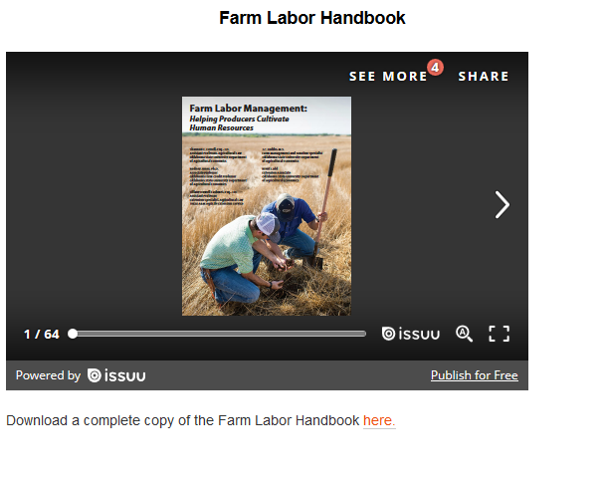
Some final thoughts
Producers don’t have time NOT to take HR seriously
http://agecon.okstate.edu/farmlabor/index.asp

Slide 32

THANKS!
Provide feedback regarding this webinar at https://okstatecasnr.az1.qualtrics.com/jfe/form/SV_e5P8z8poXkE7fsF

