Slide 1
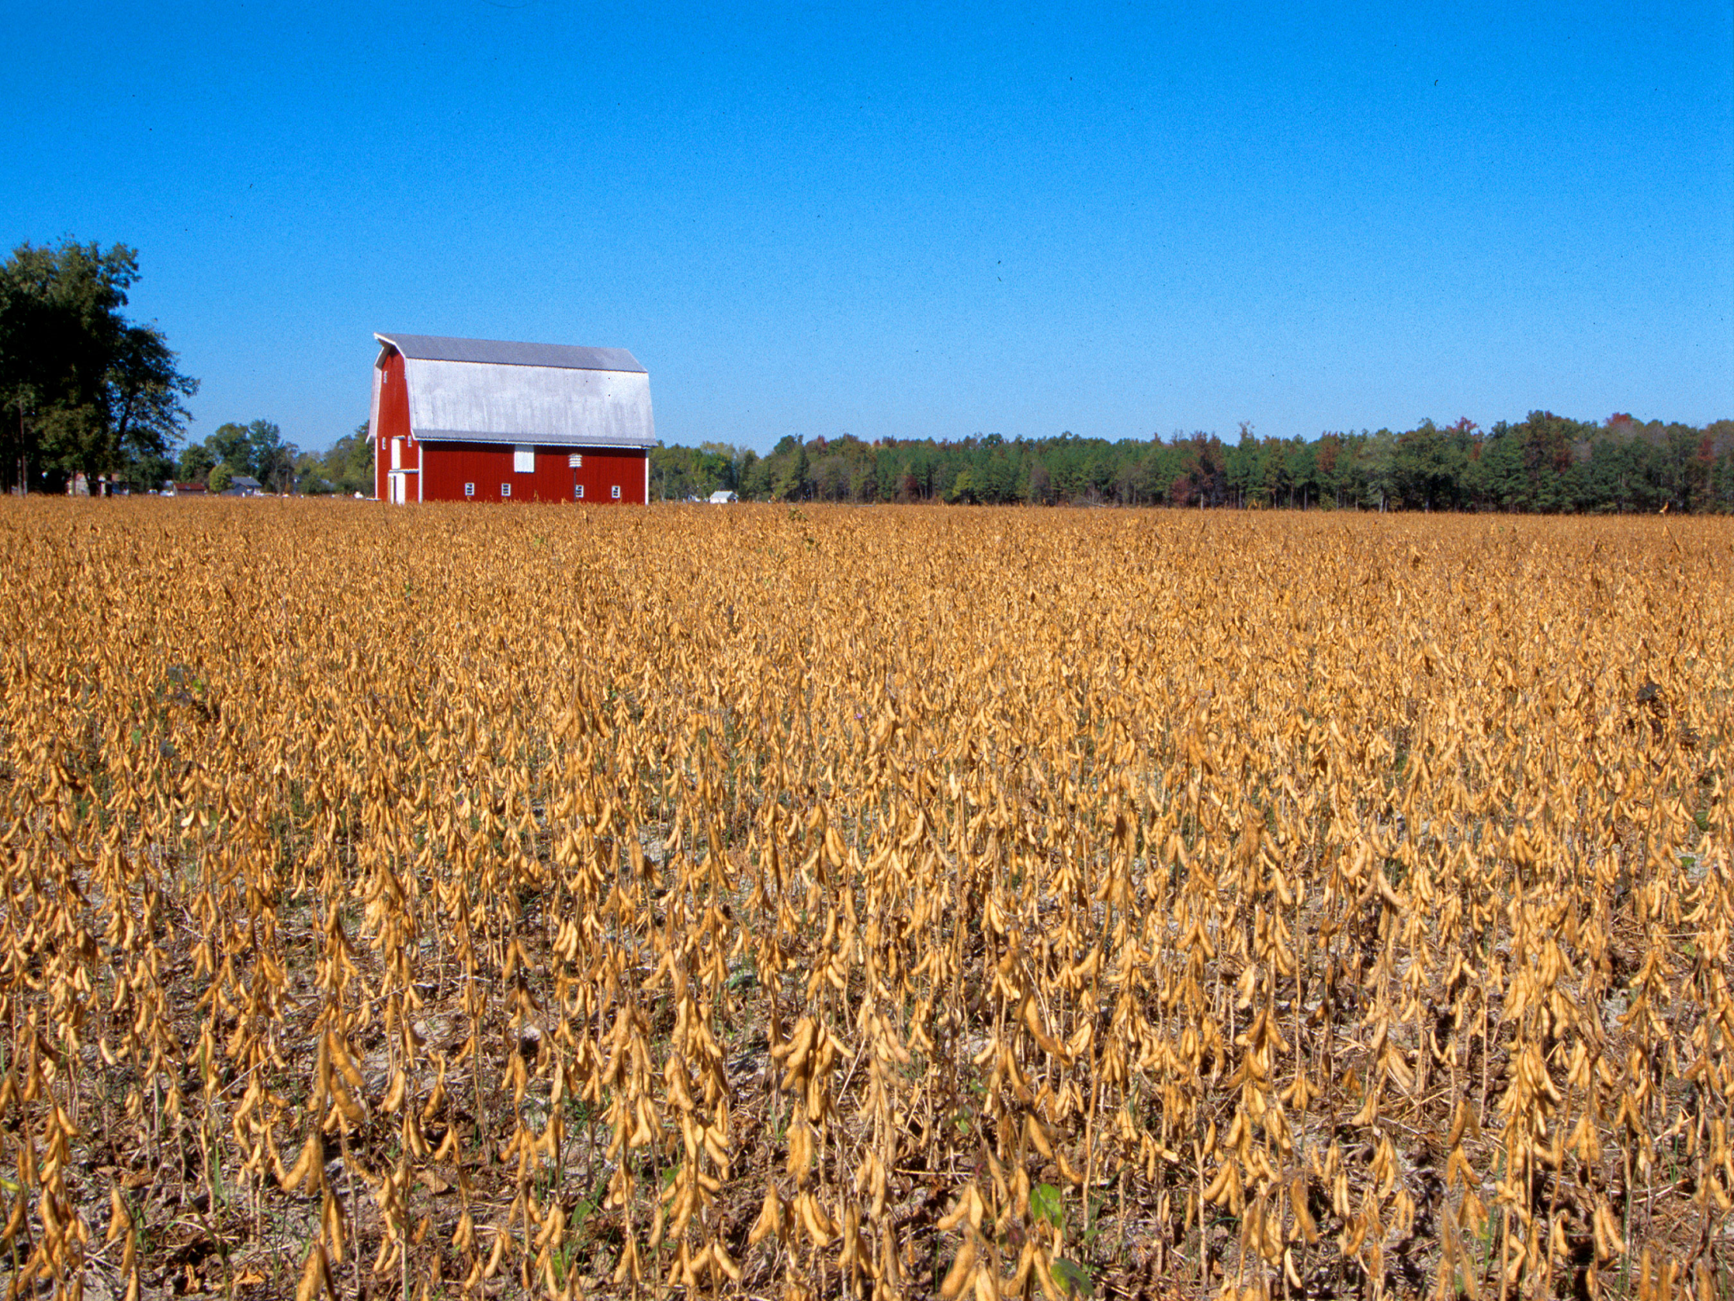
Oklahoma Agricultural Land Value Update
Roger Sahs, Extension Specialist
OSU Department of Agricultural Economics

Slide 2

Before We Discuss the 2019 Results…
OSU land values study based on actual market sales.
Average farmland sale = $340,000. Over 1,500 sales tracts.
USDA-NASS land value report is survey-based.
OSU land sales data provided by Farm Credit Associations of Oklahoma

Slide 3
Oklahoma Cropland vs Pastureland Prices

Slide 4
OK Land Values by Region, 2019*
agecon.okstate.edu/oklandvalues
Panhandle
Tracts 28
Size 331
$/Acre $962
% Chg -3.1
West-Northwest
Tracts 197
Size 172
$/Acre $1,617
% Chg +3.3
North Central
Tracts 265
Size 137
$/Acre $2,076
% Chg -2.0
Northeast
Tracts 280
Size 158
$/Acre $2,331
% Chg +5.2
East-Central
Tracts 36
Size 146
$/Acre $2,575
% Chg -8.4
State Averages
Tracts 1,501
Size 169
$/Acre $2,013
% Chg +3.8
Southeast
Tracts 213
Size 218
$/Acre $2,217
% Chg +7.1
Southwest
Tracts 275
Size 169
$/Acre $1,413
% Chg +0.2
South Central
Tracts 207
Size 152
$/Acre $2,513
% Chg +12.5
*Tracts >= 40 Acres and <= $6000/Acre

Slide 5
Recent Trends in Oklahoma Land Values
District | 2019 | Since 2018 | Since 2014 | Since 2009
 | $/ac | Change (%)
Panhandle* | 962 | -3.1 | 13.3 | 93.8
West-NW | 1,617 | 3.3 | 1.9 | 62.3
Southwest | 1,413 | 0.2 | 14.4 | 51.8
N Central | 2,076 | -2.0 | -6.8 | 57.9
S Central | 2,513 | 12.5 | 22.2 | 71.3
Northeast | 2,331 | 5.2 | 22.1 | 46.8
East-Central* | 2,575 | -8.4 | 15.8 | 45.7
Southeast | 2,217 | 7.1 | 29.3 | 64.1
Cropland | 1,838 | 0.1 | -6.6 | 55.9
Pasture | 2,081 | 2.1 | 13.0 | 50.7
All tracts | 2,013 | 3.8 | 12.2 | 56.5
*Fewer than 50 sale tracts included.
agecon.okstate.edu/oklandvalues

Slide 6
Oklahoma Panhandle Land Values
3-Year Weighted vs Annual Average

Slide 7
Oklahoma Land Values by Region
3-Year Weighted Average

Slide 8
Oklahoma Cropland Values by Region*
3-Year Weighted Average
*Cropland tracts are defined as having 85%+ annual crop utilization.

Slide 9
Oklahoma Pasture Values by Region
3-Year Weighted Average
*Pasture tracts are defined as having 85%+ permanent pasture utilization.

Slide 10
USDA and OSU Cropland Values

Slide 11
USDA and OSU Pastureland Values

Slide 12

Where are the land markets headed from here?

Slide 13
Land market influences - it’s a balancing act between…
Interest rates
Non-farm investors – more active?
Commodity prices
Debt levels
Stimulus funds like MFP and CFAP payments

Slide 14
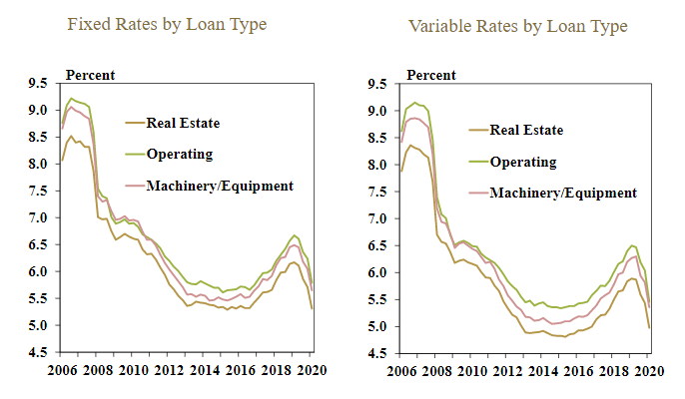
Tenth District Average Farm Loan Interest Rates, First Quarter 2020
Source: KC Federal Reserve Bank, May 2020

Slide 15
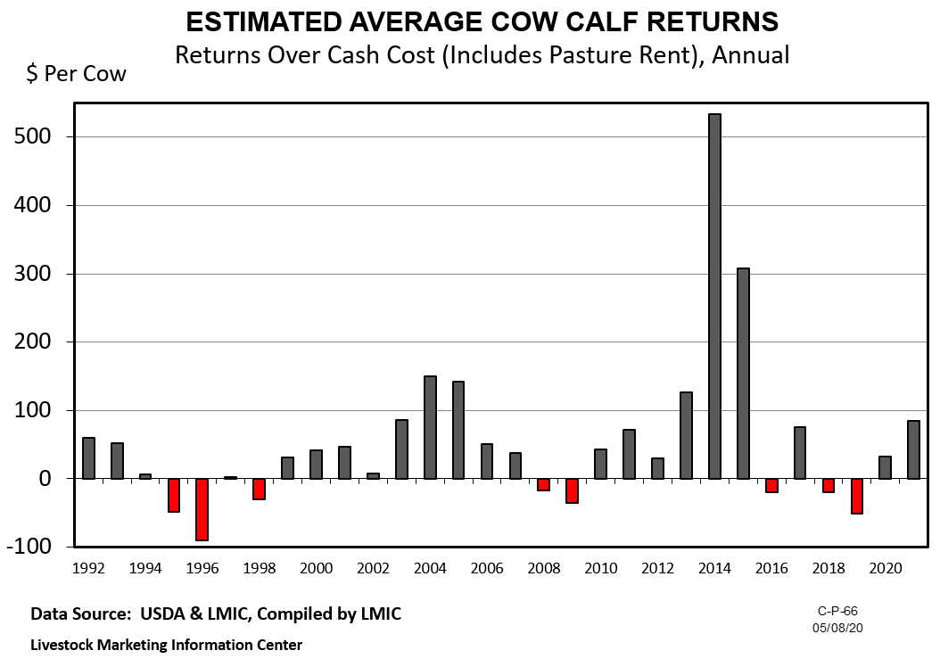

Slide 16
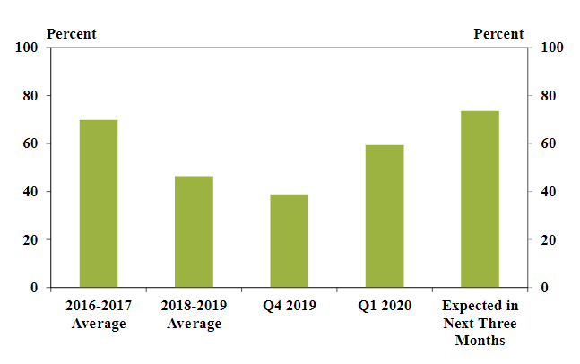
Share of Banks Reporting Lower Farm Income - Tenth District
Source: KC Federal Reserve Bank, May 2020

Slide 17
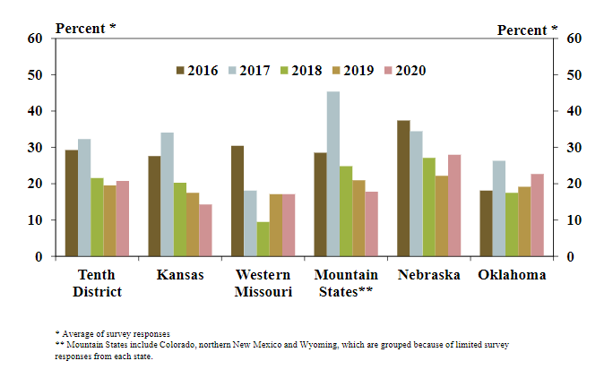
Share of Farm Borrowers with an Increase in Carryover Debt - Tenth District
Source: Kansas City Federal Reserve, May 2020

Slide 18
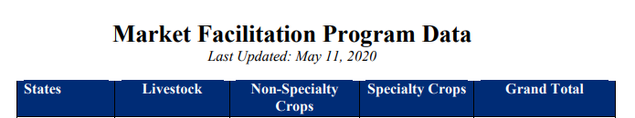
MFP Aggregate Payments for Oklahoma
2018-19
Federal stimulus funds like MFP payments have provided support to landowners and the rental markets.

Slide 19
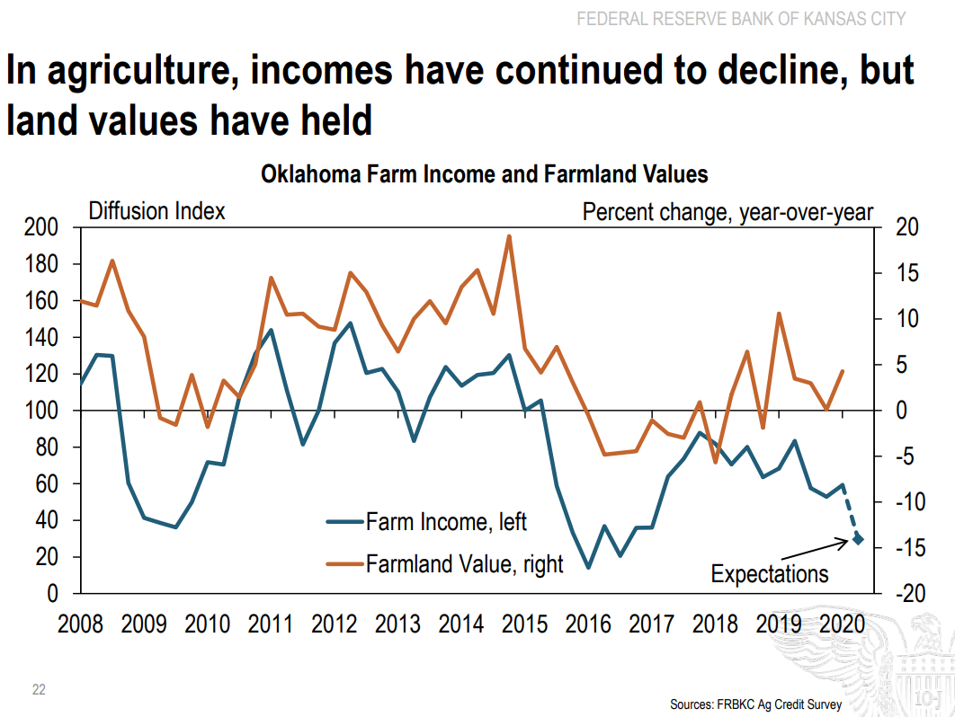

Slide 20
In Summary….
Farmland markets in Oklahoma have remained stable.
◦ Cropland - flat, Pasture +3% All tracts +4% in 2019.
◦ 2020 values? Mostly steady in the short-term.
◦ Longer term beyond 2020? Commodity prices and resulting farm income, interest rate levels, continued federal assistance, and financial health of current buyers will all determine future trends.

Slide 21
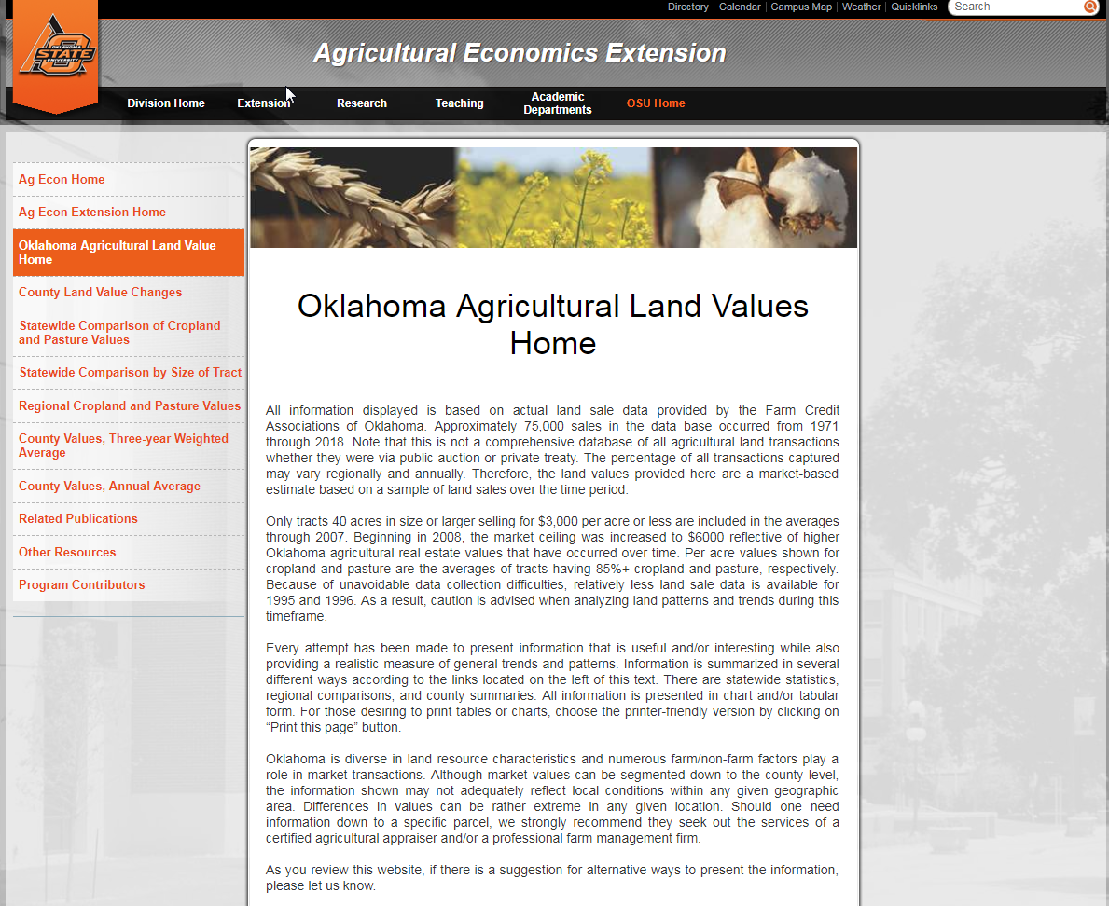
agecon.okstate.edu/oklandvalues

Slide 22
Other Resources
Kansas City Federal Reserve Bank
  http://www.kc.frb.org/
  Choose Ag in Economy section, then Current Survey
USDA Ag Land Value Data and Reports
  http://www.nass.usda.gov/
  Choose Economics and Prices Link, then Agricultural Land Values in Reports section

Slide 23
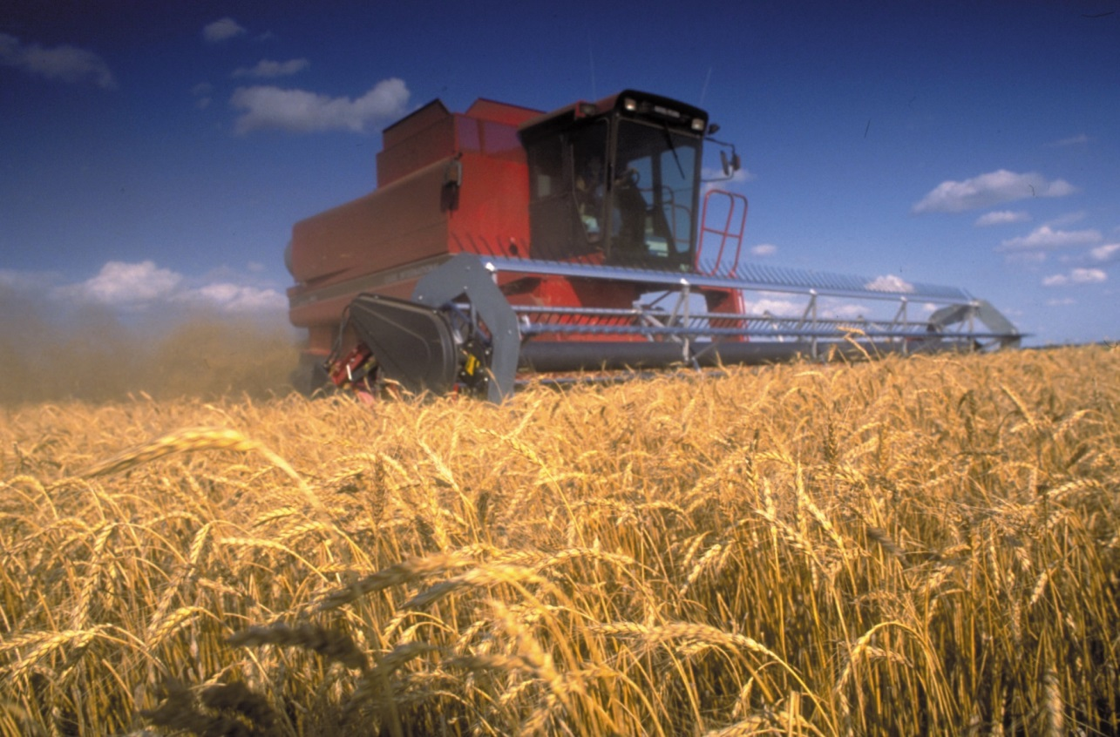
Thanks for stopping by!
Survey link: https://okstatecasnr.az1.qualtrics.com/jfe/form/SV_8CvpnLFtog7Awrb
Roger Sahs, Associate Extension Specialist
520 Ag Hall, Oklahoma State University
Roger.sahs@okstate.edu, 405.744.7075

