Slide 1
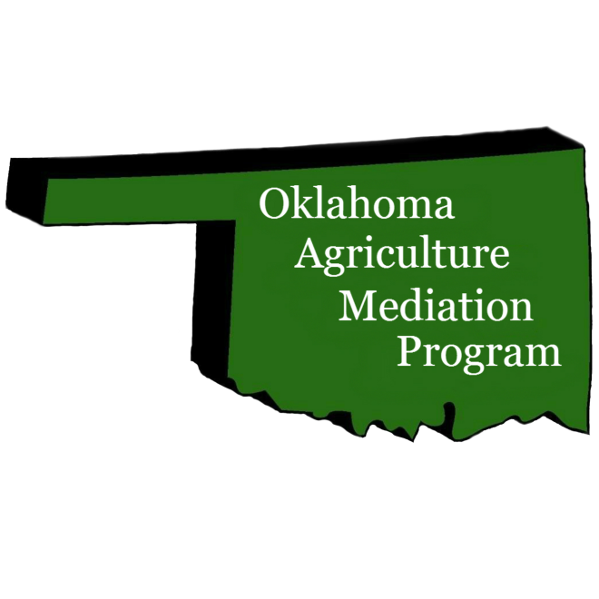
Oklahoma Agriculture Mediation Program, Inc.
Mike Mayberry, Executive Director

Slide 2
About Oklahoma Ag Mediation Program (OAMP)
USDA Certified Program since 1987, the first in the nation. Grant funds allow OAMP to provide no-cost mediation between agricultural producers and the USDA agencies as a part of the appeals process.
We also provide limited financial planning referrals for producers that are preparing for mediation.

Slide 3
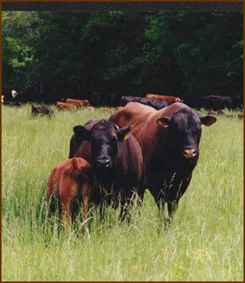
What is Mediation?
Mediation is a voluntary, informal process in which people involved in a dispute agree to meet in a confidential setting to attempt to work out a solution on their own, without having to go to court or through an appeal.

Slide 4
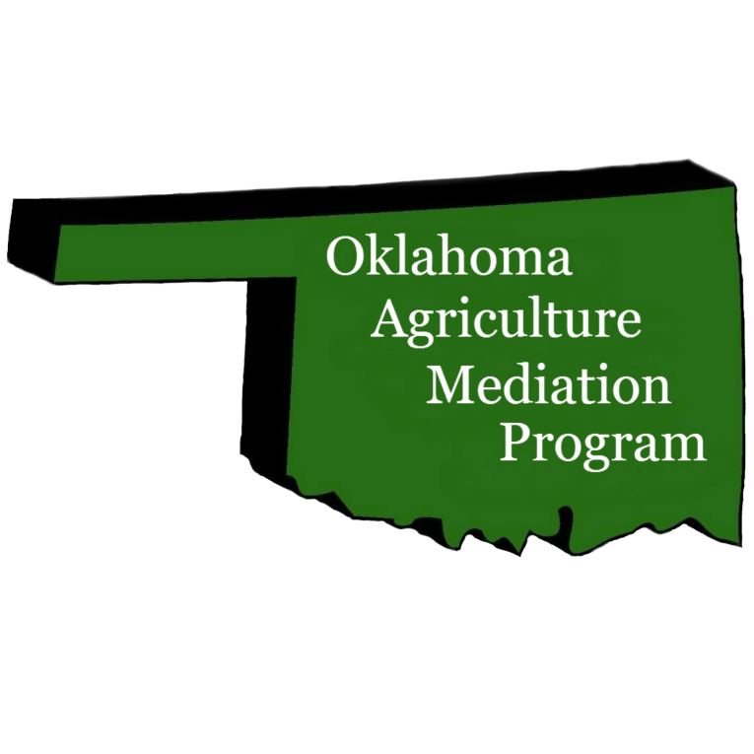
What Types of Mediations We Do:
Farm credit and loan servicing
Loan delinquency
Unfeasible farm plans
Farm Program compliance and eligibility issues
Foreclosures and Loan Accelerations
Conservation contracts

Slide 5
The 2018 Farm Bill made these additional types of cases
eligible for mediation
Pesticides
Organic certification
Lease issues
Family Farm Transition
Farmer/neighbor disputes
Other designated issues
Credit counseling

Slide 6
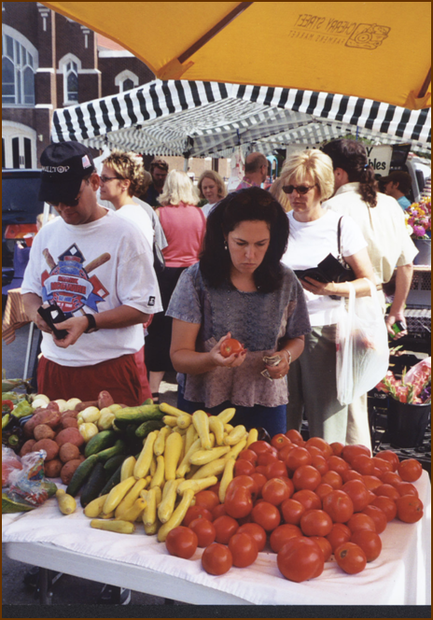
We Work In All 77 Counties With:
Oklahoma farmers or ranchers
Agricultural borrowers or lenders
Any producer who has received an adverse decision letter from any USDA agency

Slide 7
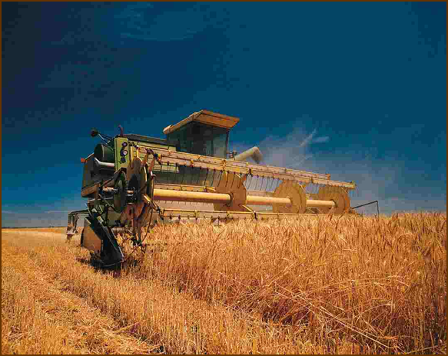
Benefits of Ag Mediation
May resolve problems within producer’s financial means
Lower cost than appeals, litigation, or bankruptcy
Promotes good working relationships between the parties
Resolves the situation quickly
Reduce stress caused by lengthy litigation and unresolved conflict

Slide 8
How does Ag Mediation Work?
You contact our office and request mediation.
We schedule the mediation and assign a mediator.
With the help of a professional mediator, both parties will have a chance to tell their story and exchange information about the situation. Mediators help with the negotiations and planning.
Unlike a judge, the mediator is neutral and will not make a decision on who is right or wrong. Instead, they assist the parties with coming to a mutual agreement. You, as the party to the mediaton, are the decision-maker.
Any settlements reached are agreed to, written down and signed by both parties.

Slide 9
Frequently Asked Questions
How much does mediation cost?
Where does it take place?
Do I need to bring a lawyer to mediation?
What documents or paperwork do I need to bring to mediation?
How long does a mediation take?

Slide 10
We are Here to Help!
Certified mediation programs have helped many farmers and creditors over the years to resolve their disputes confidentially and in a non-adversarial setting.
This helps to avoid traditional processes such as litigation, appeals, bankruptcy and foreclosure.
This program is crucial in maintaining America’s small family farmers who continuously battle the economy, low commodity prices and nature.

Slide 11
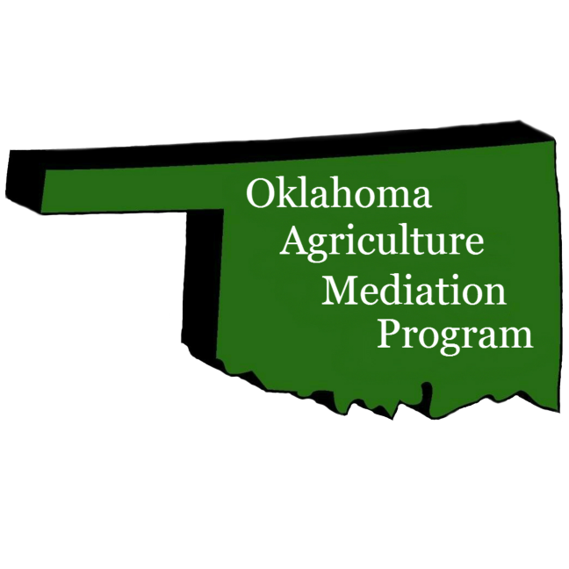


For More Information Contact:
Oklahoma Ag Mediation Program, Inc.
Website: www.ok.gov/mediation
Email: mediation@ag.ok.gov
800-248-5465 405-521-3934
Sponsored by USDA and ODAFF

