Slide 1
Stress & Stress Management
Matt Brosi, Ph.D., LMFT
Marriage and Family State Specialist, Oklahoma
Cooperative Extension

Slide 2

Stress
Stress is the feeling of being under too much mental or emotional pressure; unable to cope.
Stress reactions differ
Stress suppresses the immune system; **affects memory & emotion
Numerous emotional and physical disorders linked to stress

Slide 3
Eustress vs. Distress
Maximum Performance
Eustress: positive stress which motivates, energizes,
and excites
Distress: negative stress which is oppressive, elevates emotions, and reduces performance
Good
performance
Eustress
Distress
Poor
poor performance
poor performance
low
bored
moderate
optimal
high
overwhelmed

Slide 4
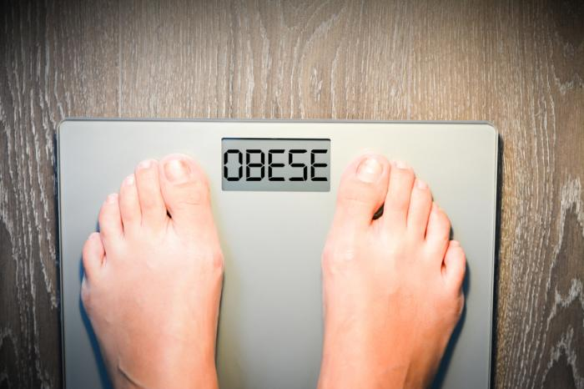


Stress in Oklahoma
Financial Stress / Poverty (under $24.6k)
  16% of Oklahomans
Obesity / health
  38% of Oklahomans qualifying
Alcohol & Drug Use
  11.9% of Oklahomans
Divorce (and remarriages, stepfamily stress, and divorce)
  32% of Oklahomans
Smoking
  Oklahoma is ranked ~36th in the U.S.

Slide 5
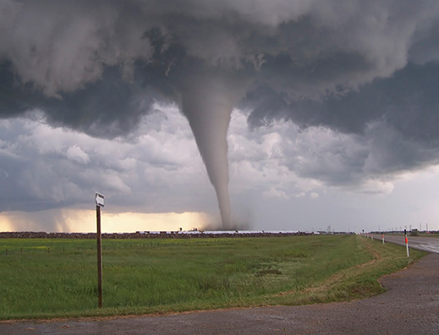
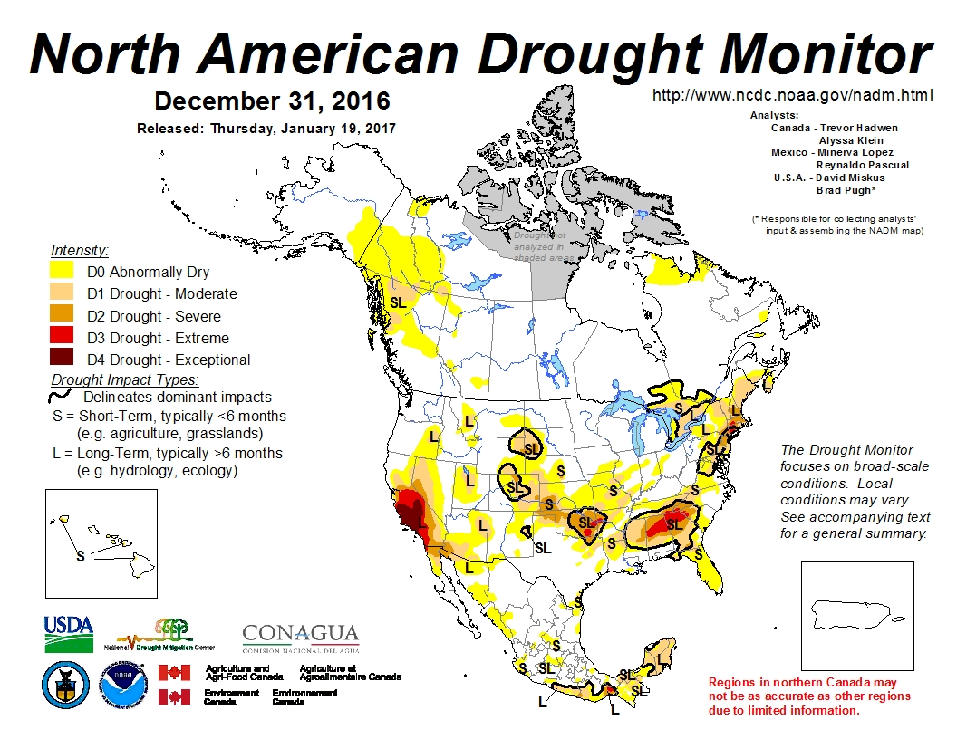

Stress in Oklahoma
Sex Trafficking
  Approx 473 cases reported in Oklahoma in 10 yrs
Domestic Violence
  Oklahoma ranked 3rd in the nation
Natural disasters
  Higher than average tornado rates & drought conditions
Farm stress
  Death, Divorce, Disease, Disability, Drought
Incarceration
  New Oklahoma incarceration record

Slide 6
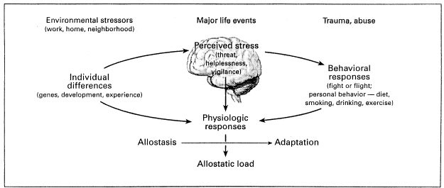
Stress Buildup…
The stress response (allostasis) is a protective system…
  When a person is faced with perceived danger, the body prepares the person for the challenge.
  Health affected when that person lives out a lifestyle that overtaxes the inbuilt coping mechanism.

Slide 7
Accumulation of Stress & Mental Health
And…approximately 1 in 25 adults in the U.S. experiences a serious mental illness.

Slide 8
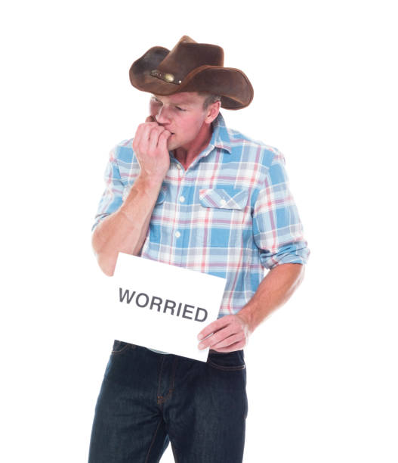
Oklahoma…..
is not ”OK”
Oklahoma has some of the highest rates for Mental Illness and Substance Use Disorders in the U.S.!
  Oklahoman’s with any mental illness = 22.4% (3rd in Nation);
  Oklahoman’s with any substance use disorder 11.9% (2nd in Nation)
  Oklahoman’s with serious mental illness = 5.24% (2nd in Nation)
  Overall mental health ranking: 49th in nation!
(SAMHSA 2017; Oklahoma Department of Mental Health and Substance Abuse Services, 2017)

Slide 9
Suicide
10th leading cause of death in the US; (CDC 2016)
  Twice as many suicides as homicides
In the U.S., suicide rates are higher in rural communities (cdc.gov)
Rates of drug overdoses in rural areas surpass those in urban areas (cdc.gov)
3rd leading cause of death age 10-14; 2nd for ages 15-34
Estimated 1 million attempts occur each year
24% Increase across past 15 years; greatest increase in past 10 years (National Vital Stats System)
Older white males most common
Age 18-25 most common suicidal thoughts & attempts
Firearms most common method

Slide 10
Feeling overworked, too busy, and too stressed to manage your stress?
YOU’RE NORMAL!
44% of Americans report their stress has increased over the last five years and that the top stressors are job security, money, and work factors
Notes:
THIS IS AN OUTDATED GRAPH; FIND NEW ONE!!!

Slide 11
Prescription Drug Misuse
Taking a prescription medication in a method other than what it was intended.
  Taking a drug prescription to get high, stay numb, etc.
Taking an opioid medication in a way other than prescribed
  Higher dose
  More often
  Snorting; Injecting
Mixing opioids with alcohol or certain drugs that are not safe to use
Notes:
When drugs are used repeatedly, the body can simultaneously build up a tolerance to opioids and become dependent on them.
Tolerance occurs when the body needs to use more and more to get the same effect. Dependence occurs when a person relies on the drug to prevent withdrawal symptoms.

Slide 12
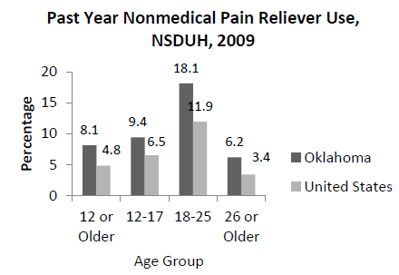
Opioid Epidemic in Oklahoma
Oklahoma ranks 9th nationally for the rate of overdose deaths involving opioids
8.1% of Oklahomans reported using painkillers non-medically
Oklahoma = 15.8 drug overdose deaths per
100,000 compared to the national rate of 11.9
(drugabuse.gov; IMS Health, 2014a; IMS Health, 2014b; www.cdc.gov).
Notes:
Prescription drug abuse is Oklahoma’s fastest growing drug problem.
Of the nearly 3,200 unintentional poisoning deaths in Oklahoma from 2007-2011, 81% involved at least one prescription drug.
In 2010, Oklahoma had the fourth highest unintentional poisoning death rate in the nation (17.9 deaths per 100,000 population).
Prescription painkillers (opioids) are now the most common class of drug involved in overdose deaths in Oklahoma (involved in 87% of prescription drug-related deaths, with 417 opioid-involved deaths in 2011).
The most common prescription drugs involved in overdose deaths are hydrocodone, oxycodone, and alprazolam. In Oklahoma, more overdose deaths involved hydrocodone than methamphetamines, heroin, and cocaine combined.
40% of opioid-related deaths had other substances in their body at the same time

Slide 13
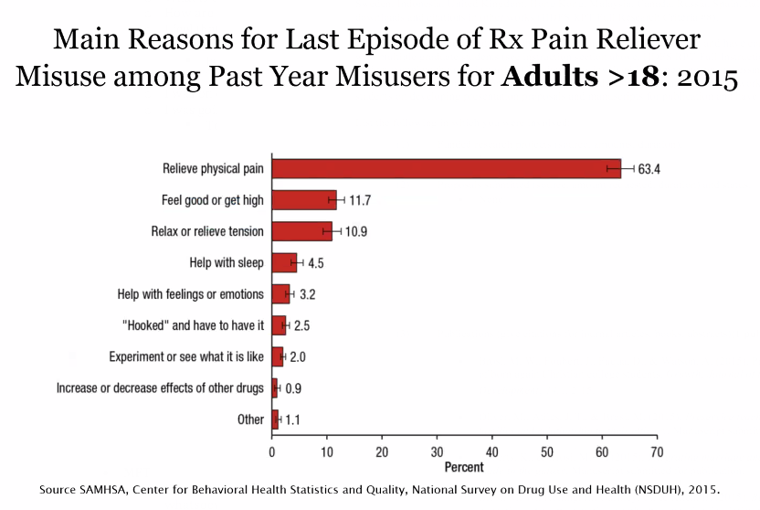
How are People Introduced to Opioids?
Often called the “disease of despair”
Notes:
Saxe, M. The Rise and Fall (?) of the Opioid Epidemic [PowerPoint Slides]. Retrieved from cwrumedicine.org
Who Prescribes Opioids?
Primary care providers (over 50% of total volume)
Orthopedists
Physiatrists
Pain specialists
Emergency physicians
General Surgeons
Neurologists
Dentists

Slide 14
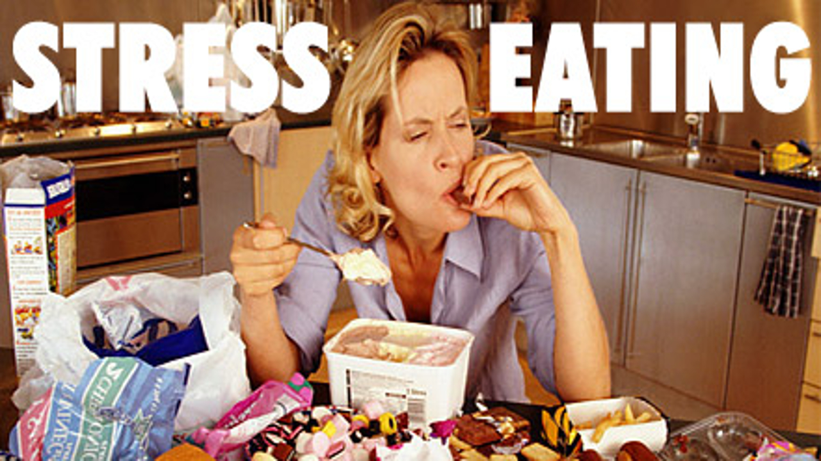

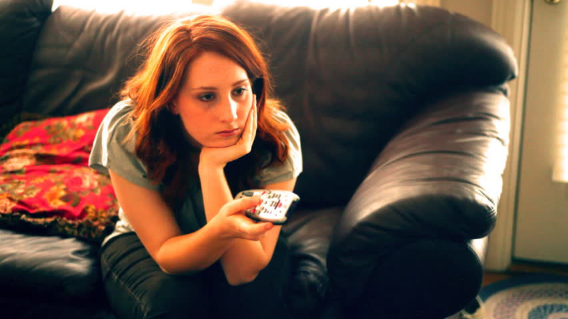
Managing Stress
  Commonly used techniques:
  Alcohol
  Overeating/Undereating; eat unhealthy
    Or Skip meals due to stress
  Too much sleep/ Not enough sleep
  Ignoring/Avoidance
    (“disconnect” on their phones!)

Slide 15
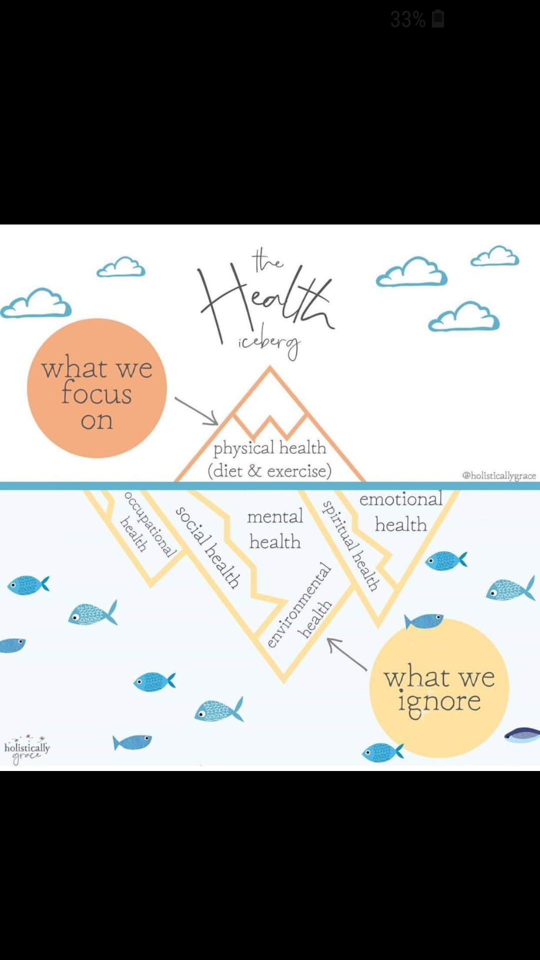

Slide 16
Self Care and Other Care?
1) Introspection; how am I doing?
2) Observation; how are the others in my life doing?
  Mental health awareness 101
    Folks can correctly identify depression, but many don’t know what to do about it. (CAPE)
  Integrate care; increase education and awareness
      (Ex: Hair stylists being trained in DV)
Notes:
What is Self-Care?
We hear the term self-care and see it in many parenting programs, but do we know what it really means? Self-care includes any actions you take to care for your health. These actions can be for your physical, mental or emotional health. Good self-care can be quite difficult in this world we live. We all lead very busy lives. Many of us have full time jobs, go to school and have families. We are often taught that we should always put others before ourselves. We may believe that caring for ourselves is selfish. We often don’t realize how much stress we are living with in our daily lives and how important it is to take good care of ourselves to be able to take care of others. It isn’t selfish — it is critical! We need to make self-care a priority in our lives rather than something that just happens by accident from time to time. Here are several good ideas to think out as you define self-care for your own life:
Be aware of the things you may be doing that take up your time but do not support self-care. For example, you may be spending a lot of time on the Internet or the television. These can be relaxing but need to be in moderation. Small doses can be good by making you laugh, learning about something new or just having some down time. Too much time spent on these things can result in lack of exercise or isolating yourself from others.
Get involved in something you love! For some people this may be a sport. For others this may be volunteering in your community. For some people it may be a book club or favorite hobby. Take time to do the things you love in life. Find other people who love the same things you love so that you can feel connected and motivated.
Turn off your cell phone or screen your calls. You may not be able to turn your phone off when a child is at day care or with a babysitter, but you can turn it off at night. There is no rule that says you have to answer your phone when it rings. Call people back at a time that works for you.
Treat your fun commitments as seriously as your business commitments. If you have plans to do something fun, mark it on your calendar just like you would with a work appointment. Do not cancel the fun commitments if it is not absolutely necessary. You won’t regret it.
References: UK Violence Intervention and Prevention Program (2016). “So What is Self Care?” Adapted from https://www.rainn.org/index.php. Retrieved October 2016 from http://www.uky.edu/vipcenter/content/resources-0.
Source: Kerri Ashurst, Senior Extension Specialist for Family and Relationship Development, University of Kentucky; College of Agriculture, Food and Environment
Self-Care Tips to Use Every Day
In this fast-paced world, we are often so focused on others that we do not take any time to care for ourselves. We may even think there is no time left to care for ourselves. Here are some ideas to use every day to build self-care into our lives:
Acknowledge yourself every day. It is not selfish to care for yourself. It is critical for your happiness in life. You have needs and deserve to have well-being. You have dreams that are worth the time it takes to pursue them.
Gift yourself every day. Gifts don’t have to cost anything. An extra 30 minutes of sleep can be a wonderful gift to yourself. We can take just a few minutes a day to gift ourselves with a few moments alone to read or journal. We can gift ourselves with a moment to stop and think, to accept something in our lives or to forgive someone.
Restore yourself every day. Take just a few moments each day to think about something that makes you happy. Even if you can’t experience it right now, it will still make you smile and relax to think about it. Sometimes very simple things make us happy, like the smell of baking cookies or a quick phone call to tell someone we love them. Take the opportunity to do those things that make you happy whenever you can.
Speak up for yourself every day. There is something about telling someone what you are feeling that makes your load a little lighter in life. Think about who you trust. Share that you need help. Share that you are afraid. Give people that love you a chance to support you when you need it.
Take the pressure off yourself every day. Do you set unrealistic expectations of yourself? Do you never finish your to-do list? Try to let some things go. Forgive yourself and take the word “should” out from your self-talk. Remind yourself about the things you did accomplish when you lay down in bed each night.
Feel proud of yourself every day. Take a moment each day to recognize the obstacles you have overcome. Look at the lessons you have learned from bad experiences that will help you in the future. Do not focus on your imperfections and failings. Focus on the positive.
References: Stafford, R. M. (2015). Six Simple Self-Care Tips That Changed My Life. Health Media Ventures, Inc. Retrieved October 2016 from http://news.health.com/2015/09/17/6-simple-self-care-tips-that-changed-my-life/.
Source: Kerri Ashurst, Senior Extension Specialist for Family and Relationship Development, University of Kentucky; College of Agriculture, Food and Environment

Slide 17
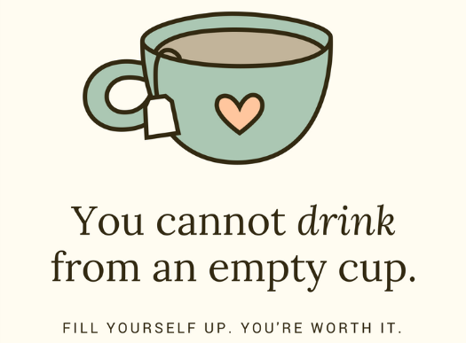
Self Care
Be aware of your “fillers” (‘isms’…)
Do something new
Connect with others
Turn off your (and others’) cell phones
Get outside (without ‘working’)
Mindfulness:
  Focus your attention
  Relax your breathing
  Quite your mind
  Apps can assist (Headspace, Calm, MindShift)
Notes:
What is Self-Care?
We hear the term self-care and see it in many parenting programs, but do we know what it really means? Self-care includes any actions you take to care for your health. These actions can be for your physical, mental or emotional health. Good self-care can be quite difficult in this world we live. We all lead very busy lives. Many of us have full time jobs, go to school and have families. We are often taught that we should always put others before ourselves. We may believe that caring for ourselves is selfish. We often don’t realize how much stress we are living with in our daily lives and how important it is to take good care of ourselves to be able to take care of others. It isn’t selfish — it is critical! We need to make self-care a priority in our lives rather than something that just happens by accident from time to time. Here are several good ideas to think out as you define self-care for your own life:
Be aware of the things you may be doing that take up your time but do not support self-care. For example, you may be spending a lot of time on the Internet or the television. These can be relaxing but need to be in moderation. Small doses can be good by making you laugh, learning about something new or just having some down time. Too much time spent on these things can result in lack of exercise or isolating yourself from others.
Get involved in something you love! For some people this may be a sport. For others this may be volunteering in your community. For some people it may be a book club or favorite hobby. Take time to do the things you love in life. Find other people who love the same things you love so that you can feel connected and motivated.
Turn off your cell phone or screen your calls. You may not be able to turn your phone off when a child is at day care or with a babysitter, but you can turn it off at night. There is no rule that says you have to answer your phone when it rings. Call people back at a time that works for you.
Treat your fun commitments as seriously as your business commitments. If you have plans to do something fun, mark it on your calendar just like you would with a work appointment. Do not cancel the fun commitments if it is not absolutely necessary. You won’t regret it.
References: UK Violence Intervention and Prevention Program (2016). “So What is Self Care?” Adapted from https://www.rainn.org/index.php. Retrieved October 2016 from http://www.uky.edu/vipcenter/content/resources-0.
Source: Kerri Ashurst, Senior Extension Specialist for Family and Relationship Development, University of Kentucky; College of Agriculture, Food and Environment
Self-Care Tips to Use Every Day
In this fast-paced world, we are often so focused on others that we do not take any time to care for ourselves. We may even think there is no time left to care for ourselves. Here are some ideas to use every day to build self-care into our lives:
Acknowledge yourself every day. It is not selfish to care for yourself. It is critical for your happiness in life. You have needs and deserve to have well-being. You have dreams that are worth the time it takes to pursue them.
Gift yourself every day. Gifts don’t have to cost anything. An extra 30 minutes of sleep can be a wonderful gift to yourself. We can take just a few minutes a day to gift ourselves with a few moments alone to read or journal. We can gift ourselves with a moment to stop and think, to accept something in our lives or to forgive someone.
Restore yourself every day. Take just a few moments each day to think about something that makes you happy. Even if you can’t experience it right now, it will still make you smile and relax to think about it. Sometimes very simple things make us happy, like the smell of baking cookies or a quick phone call to tell someone we love them. Take the opportunity to do those things that make you happy whenever you can.
Speak up for yourself every day. There is something about telling someone what you are feeling that makes your load a little lighter in life. Think about who you trust. Share that you need help. Share that you are afraid. Give people that love you a chance to support you when you need it.
Take the pressure off yourself every day. Do you set unrealistic expectations of yourself? Do you never finish your to-do list? Try to let some things go. Forgive yourself and take the word “should” out from your self-talk. Remind yourself about the things you did accomplish when you lay down in bed each night.
Feel proud of yourself every day. Take a moment each day to recognize the obstacles you have overcome. Look at the lessons you have learned from bad experiences that will help you in the future. Do not focus on your imperfections and failings. Focus on the positive.
References: Stafford, R. M. (2015). Six Simple Self-Care Tips That Changed My Life. Health Media Ventures, Inc. Retrieved October 2016 from http://news.health.com/2015/09/17/6-simple-self-care-tips-that-changed-my-life/.
Source: Kerri Ashurst, Senior Extension Specialist for Family and Relationship Development, University of Kentucky; College of Agriculture, Food and Environment

Slide 18
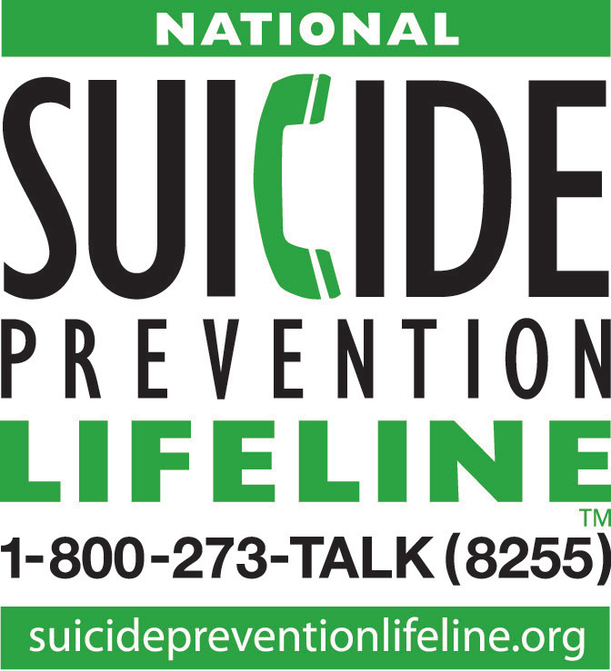
What Can You Do for Suicide?
Listen for Clues; Acute Suicidal Crisis
Ask the Question
  Don’t wait; be persistent
Avoid:
  Minimizing
  Judging
Question
    Assess their Plan (how, when, the means to complete)
Persuade
  “Will you go with me to get help?” Or “Will you let me help you get help?”
  *Lethal Means Reduction; reduce access to methods while getting help and for duration after
Refer
  Help find someone who can help.
Notes:
The period when a person transitions from being at risk for suicide or considering suicide to being ready to actually make an attempt.
Can come on rapidly
intersection of external stress and internal symptoms; escalate rapidly from distressed to suicidal
Can be difficult to predict
Specific factors can trigger/tip the scale
Can lead to an unplanned suicide attempt
Almost 50% of attempts occurred within 10 minutes of first thoughts of suicide! (16% 1-7 days; 15% 1-4 weeks)
Is often brief
Impulsivity of readiness to take one’s life often fades; may flare up episodically
If a highly lethal means is not available, the individual’s chance of survival is greater.
When discussing lethal means reduction with others, the goal is to maximize their safety by reducing immediate access to the means as much as possible while they are at risk for suicide. There are two main options for reducing access to firearms.
Best: store firearms away from the home.
Second best: secure storage inside the home (many options; ammo too).
**Any measures that put time and distance between a suicidal person and a firearm may save their life. And…wait for a long period of stability prior to returning.
Lethal Means Reduction:
Reduce access to medications, remove unneeded medications from the home; keep only non-lethal quantities on hand; and lock up abuse-prone drugs such as prescription painkillers, anxiety pills, amphetamines, sedatives, and tranquilizers.

Slide 19

Please complete the survey for this webinar at:
https://okstatecasnr.az1.qualtrics.com/jfe/form/SV_bOslEMVisB6Mh5b
Thank you!

