Slide 1

Impacts of COVID-19 on Agriculture and Rural Oklahoma
OSU Department of Agricultural Economics
www.agecon.okstate.edu

Slide 2

This is new, complex territory in terms of economic impact.
Series authors provided a high level analysis of COVID-19 impacts based on the information as of May.
We have nothing else to compare this with—it is simultaneously affecting every household, business and sector globally.

Slide 3

COVID 19 Disrupted Lives, Directly and Indirectly
According to a US Census Bureau survey conducted between April 23 and May 12
47.6% of surveyed households indicated loss of employment income
8.7% indicating not enough to eat (sometimes/often) in the past week
36.2% delayed medical care due to Covid-19 in the last four weeks
36.2% missed last month’s rent or mortgage payment or are not confident regarding next month

Slide 4
What will the new ‘normal’ look like?
The series looked at impacts on:
Food Industry
Livestock
Crops
Agricultural Cooperatives
Rural Electric Cooperatives
Broadband
Small Business
Rural Employment
Tourism
Local Government
Macroeconomy
For example:
Will consumers return to previous levels of eating away from home, or will new patterns of cooking at home persist?
Will the shift to online presence lead entrepreneurs to new opportunities and ventures?
What is the future of brick and mortar businesses?
How will the food supply chain change, and what will that mean for food prices?

Slide 5
Impacts on agriculture and
food sectors
Food Industry
Livestock
Crops
Agricultural Cooperatives

Slide 6
Estimating the Impact of COVID-19 on Oklahoma’s Food Industry
Willoughby, Holcomb, Graves and Johnson (2020)
The food service sector was heavily impacted by COVID-19
2 out of every 3 restaurant jobs were lost during the height of COVID-19
$240 billion in restaurant revenue losses in 2020
The food retail sector faced logistical challenges, but also opportunities
Supply disruptions, reduced hours, and costly safety measures for employees and shoppers
Increase in business for 2020, with some new jobs created or a temporary increase in wages
The food manufacturing sectors also appear to have mixed impacts
Safety measures for workers has slowed production and potentially increased the costs
Increased demand for online/delivery of products
Smaller businesses that cater to restaurants have experienced a drop in demand, up to 80% in some cases for small Made in Oklahoma companies

Slide 7
Economic Impact of COVID-19 on Oklahoma Livestock and Broiler Industries
Raper and Peel (2020)
Cattle and calves, swine and broilers are the top 3 Oklahoma agricultural industries based on value of production.
COVID-19 shifted consumer spending on food away from home from 54% of their food budget to approximately 15%.
COVID-19 also affected the workforces of most livestock packing and processing facilities resulting in sharply reduced livestock slaughter and meat production.
By sector, estimated damages are:
  $240 million to the Oklahoma swine industry
  $575 million to the Oklahoma beef cattle industry
  $35-$50 million to the Oklahoma broiler industry

Slide 8
The COVID-19 Impact on Oklahoma Crop Producers
Hagerman and Anderson (2020)
COVID-19 has likely impacted crop prices, but how much is difficult to say given other events occurring in the same marketing period.
  Phase 1 China Trade Deal news
  Reduction in gasoline demand and a price war between Saudi Arabia and Russia
  Record world wheat ending stocks and near record corn, soybean, and cotton ending stocks
When COVID-19 became a market problem
  About 85 percent of Oklahoma grain crops had been sold
  The winter crops had been planted, and the summer crops were in the planning stages
It is too early to say the impact on crops
  Much depends on how market impacts persist in 2020
  Wheat prices, for a short period, may have been slightly higher. Corn and cotton prices have probably been lower

Slide 9
Impact of COVID-19 on Oklahoma’s Agricultural Cooperatives
Kenkel (2020)
Joint challenge of continuing service and operations while taking all appropriate steps to safeguard employees and customers
  Increased work load and higher costs
  Innovation
  Broadband access
  Contactless or limited contact transactions
  Limited travel for training
  Governance
  Labor (cotton gins)
Financial implications are more difficult to determine, but will likely accrue as time goes on

Slide 10
Impacts on small business and rural economies
Rural Electric Cooperatives
Broadband
Small Business
Rural Employment
Tourism
Local Government

Slide 11
Impact of COVID-19 on Oklahoma’s Rural Electric Cooperatives
Kenkel (2020)
Oklahoma’s rural electric cooperatives deliver electricity over 116,000 miles of line to reach more than 648,000 customer meters.
Electric cooperative personnel have been implementing both safe-distancing and work-from-home options for their employees
  Closed lobbies
  Drive through payment drop off
  Safe distancing for line workers and crews
Financial challenges
  Voluntary suspension of disconnects
  25% to 30% increase in 30 to 60 day balances outstanding
  Peak past due payments of $6 million by May, up 35% from the prior year
  Reduction in service load from oil and gas shutdowns

Slide 12
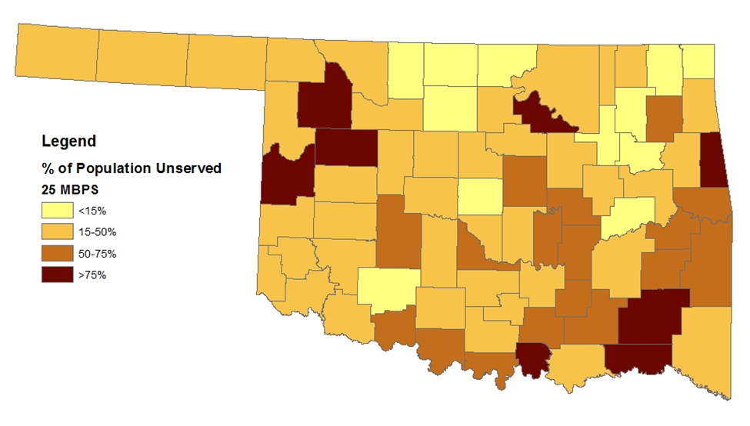
Broadband Access across Oklahoma during COVID-19
Whitacre (2020)
“New normal” in the wake of COVID-19 will likely include higher levels of awareness about the importance of broadband for all members of society
Increased broadband demand due to COVID
  Telework
  School
  167,000 out of 700,000 students (24%) lacked an Internet connection at home
We had challenges going into COVID
  47th out of 50 states in terms of average speeds and percent of residents connected
  48% of rural residents vs 74% nationally
  40% of Oklahoma households making less than $20,000 per year have no Internet connection
Figure 2: Broadband Availability by Oklahoma County (2017)
Source: FCC Form 477, December 2017

Slide 13
Impact of COVID-19 on the Small Business Sector
Arati (2020)
Capacity for the 381,000 Oklahoma small businesses to adapt is mixed
Challenges
  Disruptions in marketing channels and customer base
  Large decline in sales, 90% or even 100% at the peak
  Small business do not have the cash reserves for sustained closure
  Need to adapt rapidly (e.g. curbside pickup) and online marketing through digital media.
Small business owners need to prioritize
  Inspiring confidence and maintaining customer trust,
  Demonstrating good health practices and
  Continuing to be flexible to change.
Table 1. COVID-19 Disaster Relief funds for Oklahoma small businesses
Program type | Applications Approved | Dollars
EIDL advance | 32,100 | $ 101,866,000
EIDL | 2,884 | $ 260,145, 015
PPP | 60,050 | $5,392,464,543
Source: Compiled from US. Treasury and SBA funding reports as of May 16th, 2020 – PPP and May 17th 2020 – EIDL

Slide 14
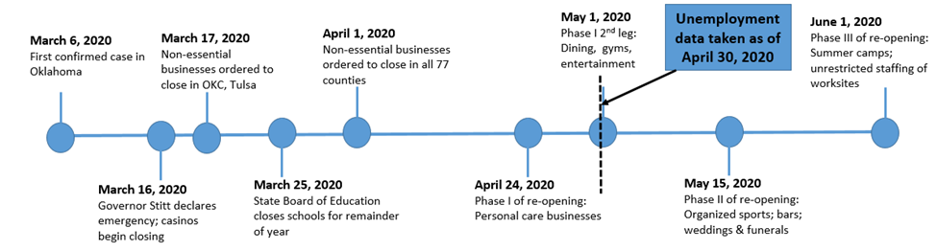
COVID-19 Employment Outlook Across Oklahoma Counties
Whitacre (2020)
Over 70% of the total expected job losses in the state are predicted to occur in the state’s 18 metropolitan counties
  Higher numbers of retail and hospitality businesses
Oklahoma lost 297,000 non-farm employees between February and April 2020
  In comparison, the 2 year peak of the Great Recession had 400,000 non-farm employees lost
While many job losses due to the pandemic are expected to be temporary, the length of time to recover and the nature of those jobs that do return is uncertain.

Slide 15
COVID-19 Impacts on Tourism
Siems (2020)
Prior to the pandemic, Oklahoma was experiencing sustained growth in its tourism industry.
  Oklahoma employed over 214,000 people in the tourism sector which includes arts, entertainment and recreation
  Layoffs were estimated at nearly 40% by late April
As Oklahoma reopens, tourism revenue for outdoor venues may recovery quickly this summer.
  Parks and outdoor venues--39% increase in May compared to January-February expectations
  Virtual tours and livestream events provide visibility, even if they does not generate revenue.
Revenue from tourism more broadly is likely to remain low as social distancing guidelines remain in place and inter-state travel is reduced.

Slide 16
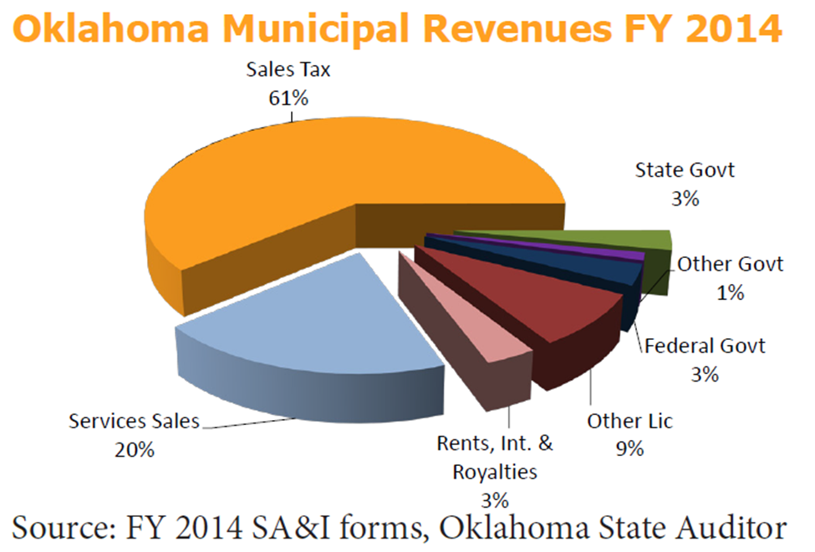
Local Government Impacts: Analysis of Known and Potential COVID-19 Impacts
Lansford (2020)
Oklahoma Municipal Revenues FY 2014 for Cities and Towns
Local government bodies in Oklahoma include schools districts, cities/towns, and county governments
COVID-19 has altered both revenues and expenses of local governments
  These interactions are complex, and impacts will be lagged based on tax payment dates
  Costs and logistical challenges for government workers
  Temporary business closures decreased sales tax
  State revenues that support school districts, for example, are expected to be lower

Slide 17
Impacts on the broader economy (macroeconomy)

Slide 18
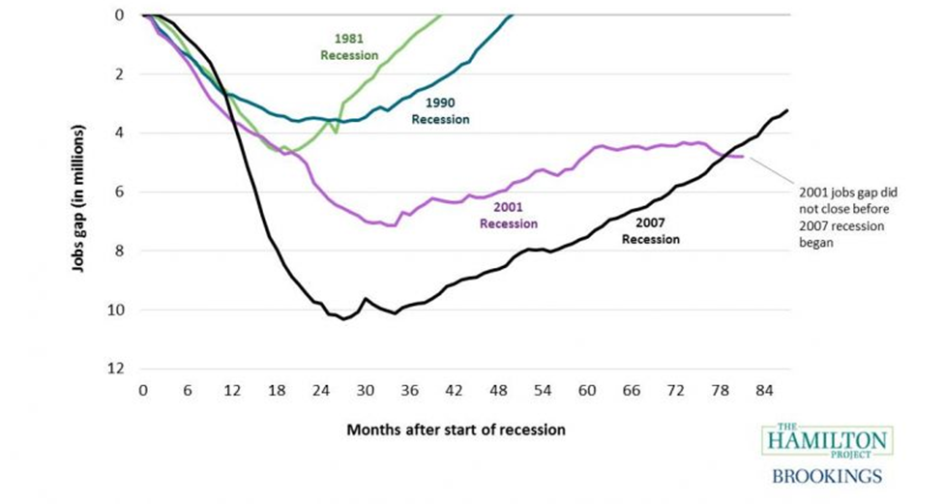
How the Coronavirus has Impacted the General Economies of the US and Oklahoma
Sanders and Bir (2020)
This is somewhat worse than the Great Recession of 12 years ago, and not yet as bad as the Great Depression.
Federal Reserve and fiscal policy from Congress are attempting to get more money flowing in the economy.
  These actions also have the potential to increase inflation.
  Stimulus programs help individuals during this difficult time, but also increase the national debt.
Oil/gas and agriculture, two mainstay sectors for rural Oklahoma, were already struggling prior to COVID-19.
  COVID-19 impact on Oklahoma energy and state revenue will be deeper and longer than initial estimates.
  Oklahoma unemployment around 8% as of March, as compared to 3.1% in January

Slide 19

Amy Hagerman
amy.hagerman@okstate.edu

