Slide 1
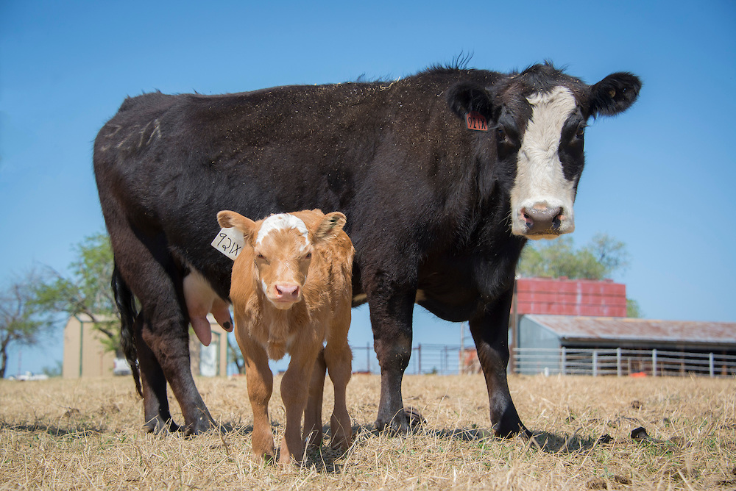
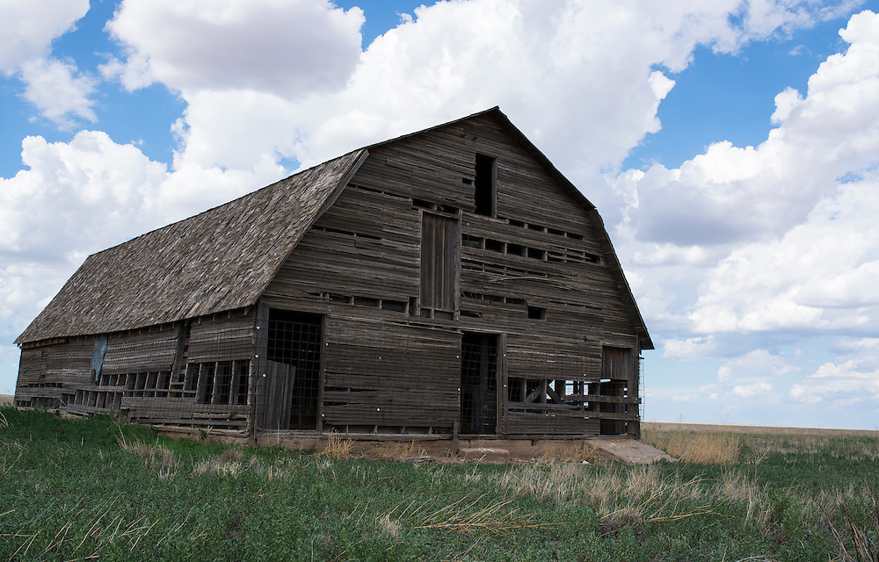
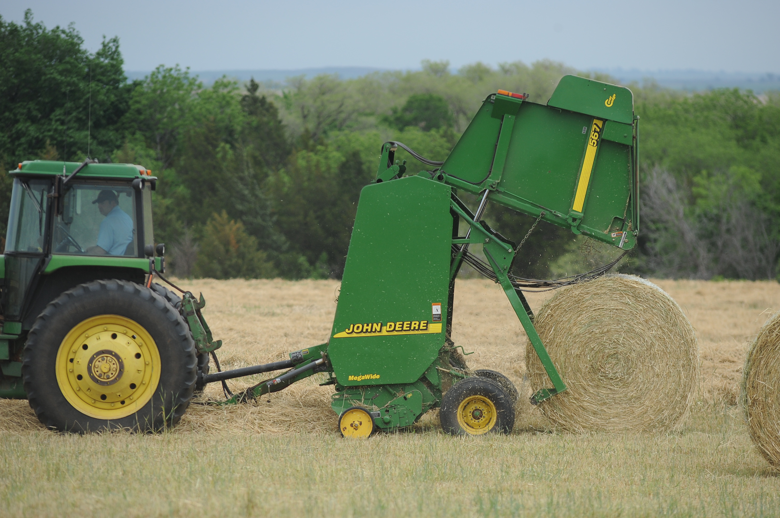
Tips for Working with Your Local Lender
Scott Clawson
Area Ag Economics Specialist
Notes:
That you Brent and good afternoon everyone. As Brent said my name is Scott Clawson and a decent portion of my professional experience has been spent in banking in various capacities. So that is what provides the context for the discussion today.
The disclaimer I want to toss out there first is that all banks and borrowers are different. So while all of this information I feel is pretty valid for everyone borrowing money, depending on the size of your loan request, your leverage position, and other factors, some of these items may or may not come in to play.

Slide 2
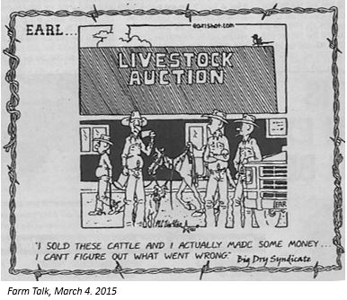
Notes:
Since I spend most of my time east of 35, I tend to see more livestock related operations. So note the date of this comic for some context, but the reason I put this up there is to highlight a point. This operator says he made money on his cattle, but how does that information get translated to the lender? In many situations, my experience indicates a breakdown of communication between the lender and borrower causes most problems.
Most of the time for the rest of this we will be talking about what to communicate but the biggest thing is to communicate and to do it proactively, not reactively.

Slide 3
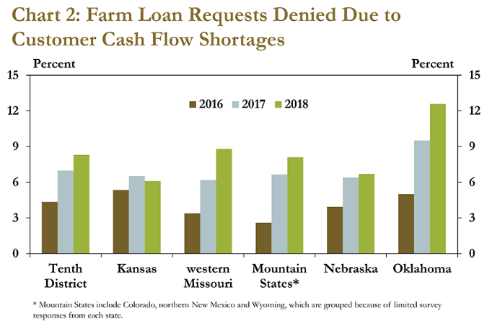
https://www.kansascityfed.org/research/indicatorsdata/agcreditsurvey/articles/2018/5-17-2018/decline-in-farm-income-slows-but-persists
Notes:
Here is some information to help frame some discussion. This is from the most recent Ag Credit Survey from the KC Fed.
On the far right of the image, it shows loans denied because of cash flow shortages.
As we deal with lower crop commodity prices and being in the high supply portion of the cattle cycle, our relationship and communication with our lender will be vital.

Slide 4
What specifically are we talking about?
Some perspective on the relationship from both points of view
What should we provide and why?
Underwriting discussion: Collateral, loan structure, etc.

Slide 5
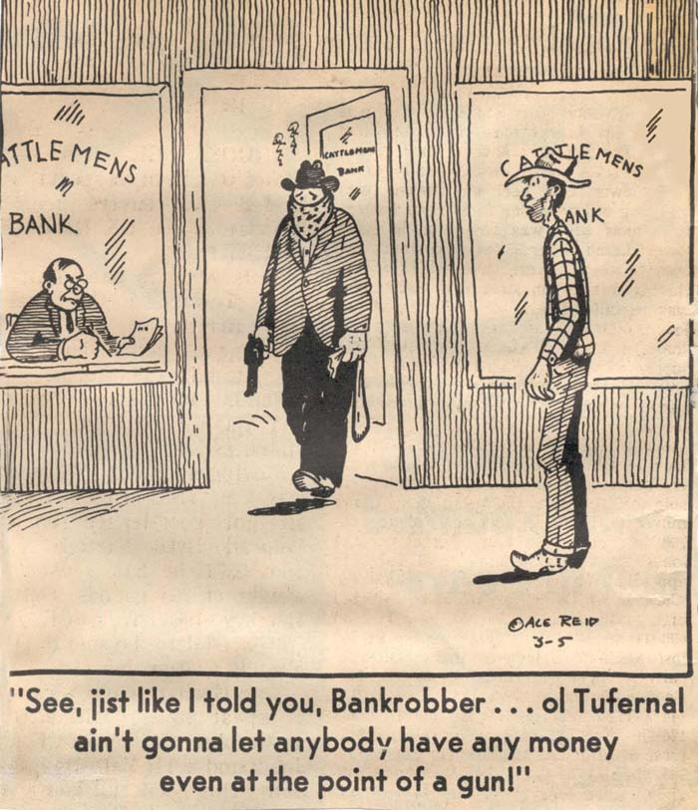
MUTUALLY BENEFICIAL
Borrower
Needs $ to execute a plan
Tends to look at “best case
Lender
Needs loan growth
Tends to focus on the “but, what if”
90/10 rule

Slide 6

What should we provide and why?
Usually 3 fundamental documents that could be requested from the borrower
Credit application
Personal financial statement
Tax returns
Notes:
These are usually the pieces of information that are requested or required to be completed. Here let’s focus on the first two. The thing that I would like to stress here is time, especially on your PFS/Balance sheet. Take some time to make sure that your information is accurate and up to date. The PFS/BS can tell us some current information, but we really need to compare them year to year. So if we just put something together haphazardly, not including some things and remembering things from the year before it can really damage the perception of your financial situation.

Slide 7
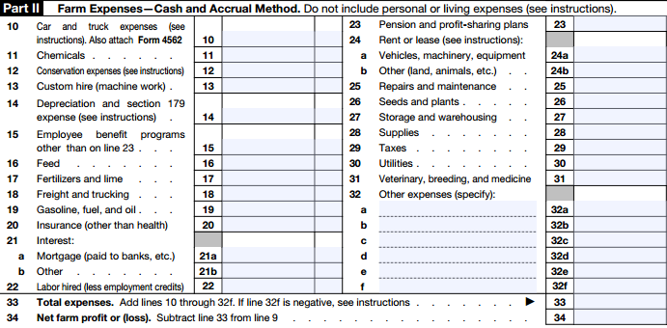
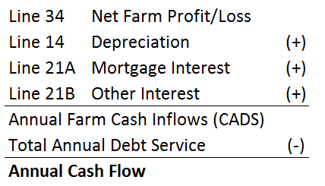
Notes:
So lets talk about the much maligned tax return. My biggest concern with all farm financial analysis from lenders/borrowers, etc is the overvaluing of the tax return as a financial document. I am okay with it to determine our taxable income.
In the defense of the lenders, they are required to gather these so its not their fault. And its what all of us have to provide.
Lets look at how a rough cash flow is usually assembled from a tax return. Discuss graphic above…
At the end of the day there are problems with using this.
Inventory changes are not accounted for (# of hd we are running or keeping around)
Most folks take every possible deduction out there, in many cases the lines can get gray, and I distracts from what is really needed to run the enterprise.
Depreciation is tricky and can inflate cash flow due to financing options

Slide 8
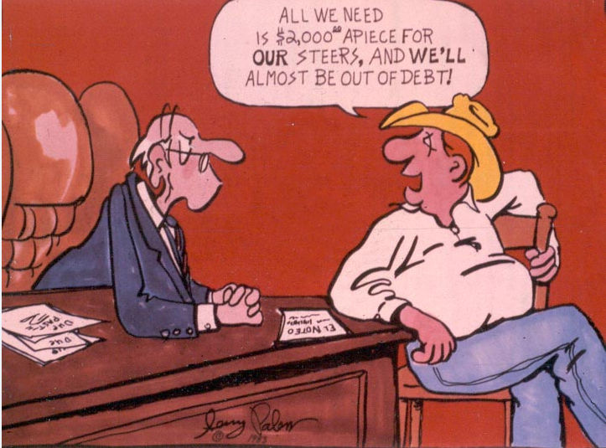

Slide 9
What alternatives could we provide?
Projected cash flow
Enterprise budget
What else should be communicated?
Operational goals and plans
Changes to the normal course of business
In short, have a plan!
Notes:
As a borrower, go back and look at your TR and see what story that tells. That may surprise you.
So what else can we provide? Enterprise budgets, projected cash flows.
Essentially, just have a plan on paper that covers your bases or processs

Slide 10
Underwriting the loan
Loan types include installment loans, single pay notes, and revolving credit lines.
Term Length
Matched to collateral
1 year notes are typically short livestock runs (stockers) or operating funds
2-5 years are common on breeding livestock, farm equipment, etc.
Long term installment notes are typically designed for real estate.
Rate
Long term fixed rates are a risk source for banks
Its beneficial for the customer to have fixed rate real estate investments
Don’t expect nationally advertised mortgage rates to apply
Loan Structure
Term
Interest rate
Collateral
Payment Options

Slide 11
The wrap-up
Policies
Bankers have policies or rules that they have to abide by. In most cases these are guidelines that can be flexed in certain situations.
More regulations all of the time!
Relationships are vital!
Spend time on financial decisions. Prepare financial documents: cash flows, balance sheets, income statements, along with production records
Find a lender you like
If you don’t already have a lender, go around and meet a few. Or call other producers in your area and see where they have had a good experience
Not all banks are the same.
Some have ag preferences, some don’t. A bank is not a bank.
COMMUNICATE!
https://okstatecasnr.az1.qualtrics.com/jfe/form/SV_cAMjCYzyXpCx1nD

