Slide 1
Record keeping
Courtney Bir
Assistant Professor
Oklahoma State University
courtney.bir@okstate.edu

Slide 2
FIRST- what do you mean?
Production records?
Records for taxes?
Financial analysis/planning?
Comes down to- What are your goals???

Slide 3
General considerations
Make time for recordkeeping,
Determine which information is economically feasible to collect
Summarize the data for use in the decision-making process
Know records needed for programs you are enrolled in- i.e.) FSA, grants, etc.

Slide 4
Production Records-cow calf
Cow Information
Sire Information
Calf Information
Herd Information
Computer Requirements
Additional Considerations

Slide 5
Production Records-cow calf
Software ranges from $149-$600 (2017)
Consider commercial vs seedstock needs (may consult with breed organization)
Consider level and cost of software support that will be provided by the company
Consider specific cattle information that is required by the software

Slide 6
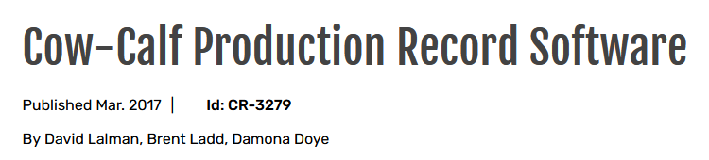
Production Records-cow calf
https://extension.okstate.edu/fact-sheets/cow-calf-production-record-software.html

Slide 7
Production Records-forage
Managers will want to maintain records on variety, planting rates, fertilizer rates, pesticides, fuel consumption, grain, hay, or forage matter produced, etc.

Slide 8
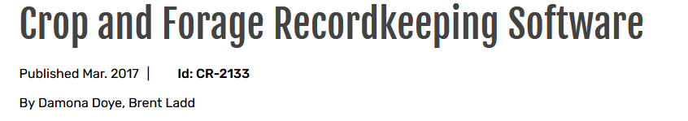
Production Records-forage
Program purchase costs range from $199 to $750 (2017)
https://extension.okstate.edu/fact-sheets/crop-and-forage-recordkeeping-software.html

Slide 9
Production Records-Goats
Goat record keeping program keeps track of goat kid births, weaning weights and adjusted weaning weights
Helps to properly select breeding does that are highly productive and profitable
Excel sheet: https://extension.okstate.edu/programs/meat-goat-production/goat-kidding-record-keeping-software.html
Working on sheep right now!

Slide 10
Taxes
Taxes can be a strong motivation for record keeping….
Tax management is only ONE PART of farm management
Tax minimization is not necessarily profit maximization….
ANY kind of record keeping is a good start to financial analysis

Slide 11
Quicken
We are currently working on updating the Quicken manual and building an online course
We currently have partnered with Nebraska in this effort
https://extension.okstate.edu/programs/farm-management-and-finance/quicken-for-farm-financial-records/quicken-for-farm-ranch-records-manual.html
We will be updating the manual and offering an online course

Slide 12
WHY do financial analysis/planning?
Determine where am I?
Where do I want to be?
How can I get there?

Slide 13
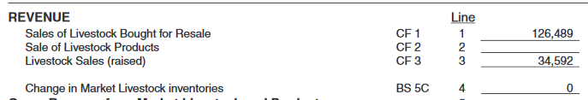
FARM Business Financial Statements
THE CORE OF FINANCIAL DECISION MAKING INFO
Balance Sheet
also called the Net Worth Statement or Statement of Owner’s Equity
Income Statement
Cash Flow Statement
Balance sheet can help project interest and principal payments on loans
Notes:
Balance sheet, income statement and cash flow statement provide the CORE of farm financial decision making information.

Slide 14
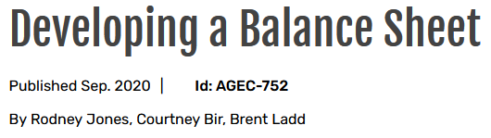
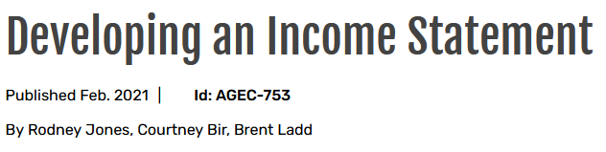
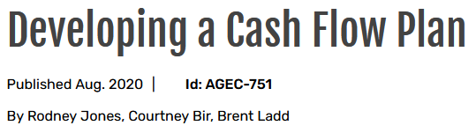
https://extension.okstate.edu/fact-sheets/developing-a-balance-sheet.html
https://extension.okstate.edu/fact-sheets/developing-an-income-statement.html
https://extension.okstate.edu/fact-sheets/developing-a-cash-flow-plan.html

Slide 15
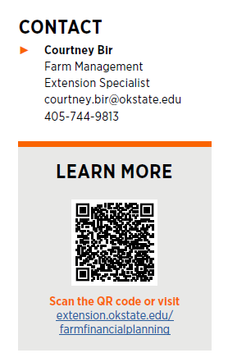
Farm Financial Planning

Slide 16
How can we help you?
We use software called FINPACK
FINAN- Annual financial analysis
FINLRB- Financial long range planning
FINFLO- Monthly cash flow planning
Annual plan- Annual cash flow planning
NOTE: All of the work we do together is confidential!!

Slide 17
How to start
We start with beginning and ending balance sheets
Sometimes it takes several attempts with producers to identify their assets
We then work towards full farm analysis
Interested people just need to email, we partner them with the physically closest trained person.
We send them a starter sheet that works them through the beginning balance sheet on paper
We can auto-feed Quicken into the system

Slide 18
Balance Sheet
The balance sheet is the starting point for our plans/analysis
A snapshot of the assets and liabilities of a business at specific points in time
Documents solvency position of business
It’s an evaluation of credit risk
Evaluation o the strengths and weaknesses of the business financial position

Slide 19
Balance Sheet
Assets- everything owned or payable to the business
Liabilities- all obligations owed
Owners Equity/Net Worth- total assets minus total liabilities

Slide 20
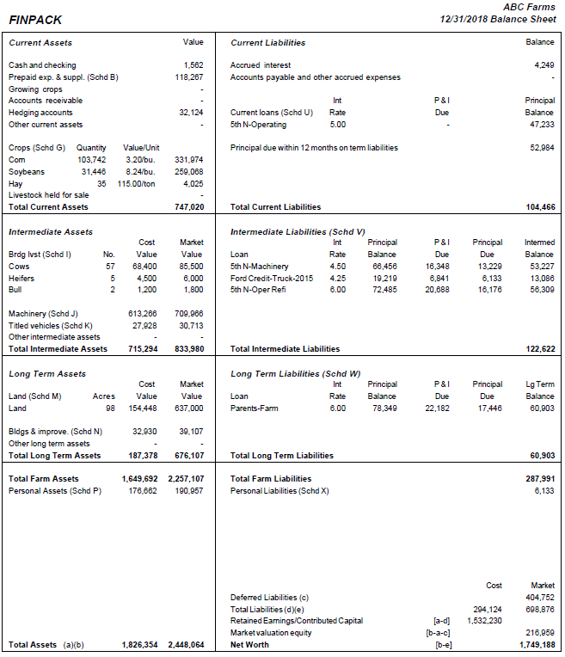
This is what you get after balance sheet completion. Great for taking to your lender!

Slide 21
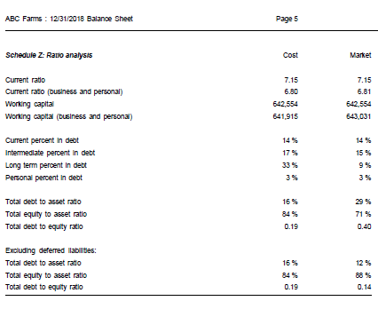
All the ratios calculated for you!

Slide 22
Future: What is benchmarking?
Database that summarizes actual farm data from thousands of agricultural producers who use FINPACK for farm business analysis
Individual producer information is unavailable in FINBIN and is strictly protected. All queries require a minimum number of farms fitting the search criteria.
This information can be used to see how your farm finances comparing to other “like” farms
Can also help us give you averages, or general numbers when you call

Slide 23
Questions??
Courtney Bir
Assistant Professor
Oklahoma State University
courtney.bir@okstate.edu

