Slide 1
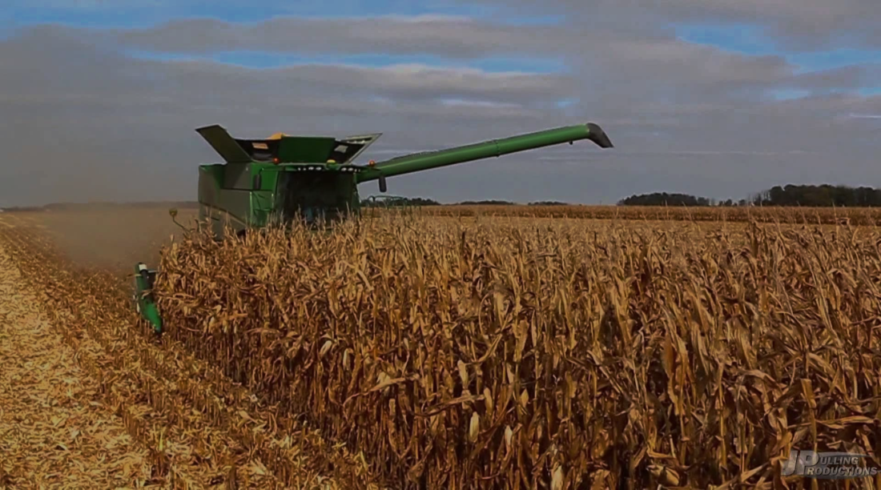
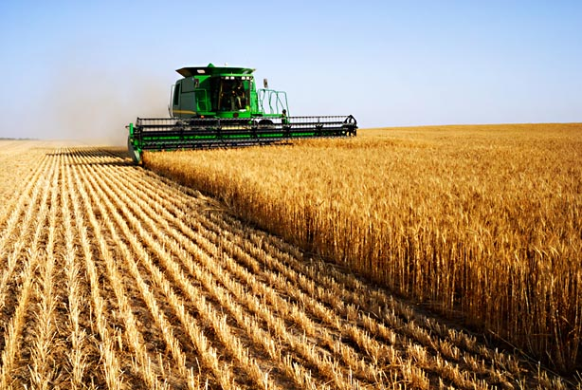
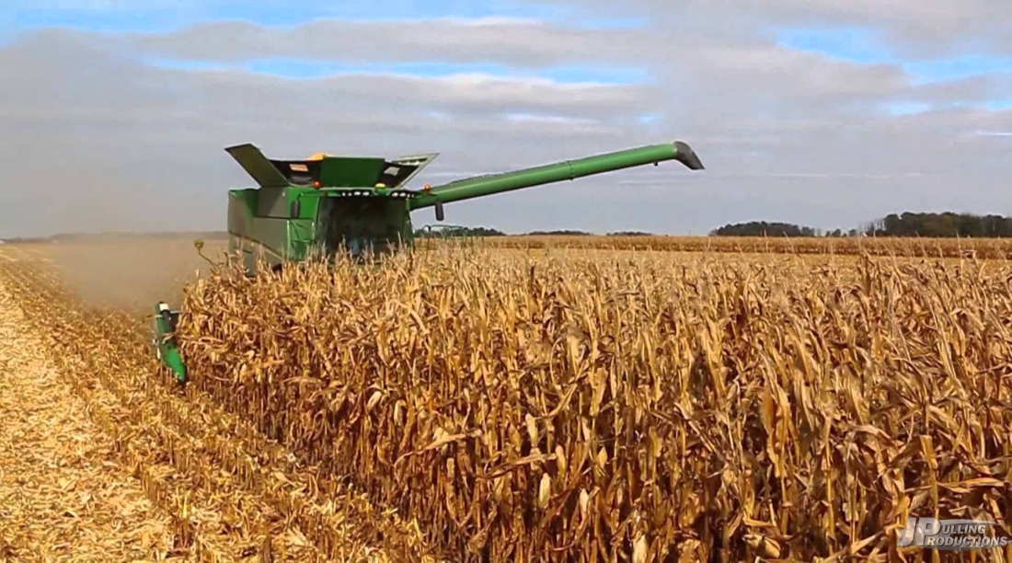
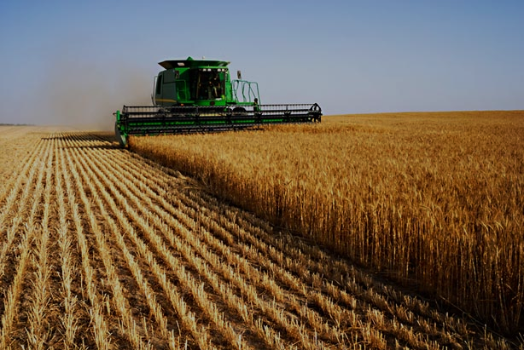
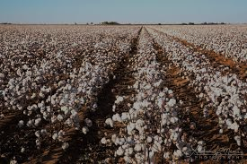
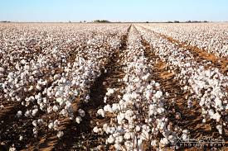
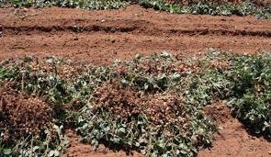
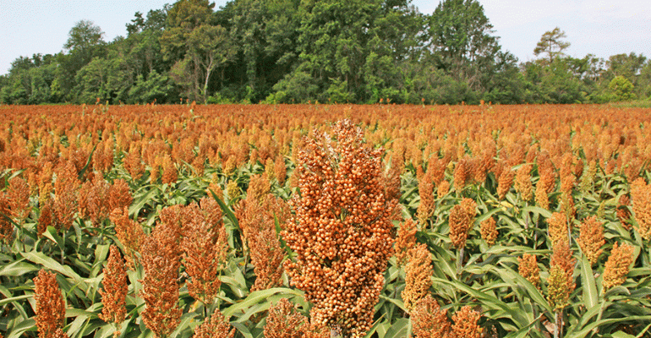
Oklahoma Crop Agriculture
Kim Anderson
Cooperative Extension Crop Marketing Specialist
Oklahoma State University

Slide 2
Thought for the day!
“Copying one person’s work is plagiarism. Copying two or more persons’ work is research.” Dr. Luther Tweeten (OSU 1977).
Data and Budgets provided by:
Troy Marshall, USDA/NASS
Trent Milacek, OCES Enid
Roger Sahs, OCES Stillwater
Dave Shideler, Ag Econ Stillwater

Slide 3
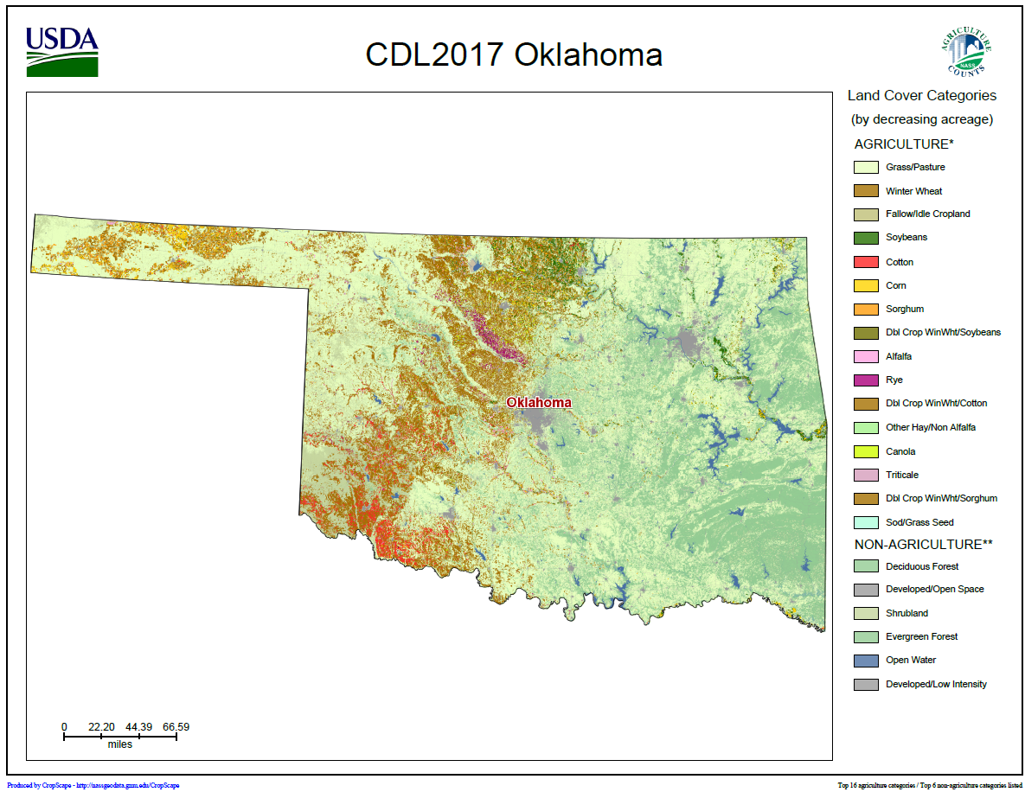
nassgeodata.gmu.edu/cropscape

Slide 5
Forward Contract Prices for 2018 Harvest Delivery
Crop | F. Contract | Basis ¢ | F. Contract Price | Forward Contract
Wheat | KC July | -58 → -40 | $5.40 | $4.90
Corn | CBT Dec | -55 → 10 | $4.05 | $3.50
Sorghum | CBT Dec | -65 | $4.05 | $3.40
Soybeans | CBT Nov | -90 | $10.35 | $9.45
Cotton | ICEUS Dec | -5 | 78.40¢ | 73¢
Canola |  |  |  | $6.48
Sesame |  |  |  | 33¢

Slide 6
CFTC Commitments of Traders
Commodity | 1/9/18 | 2/20/1 | 3/6/18
 | (Thousand Contracts)
SRW Wheat | -142 | -67 | -33
HRW Wheat | -20 | 12 | 21
Corn | -227 | 19 | 164
Soybeans | -103 | 99 | 184

Slide 7
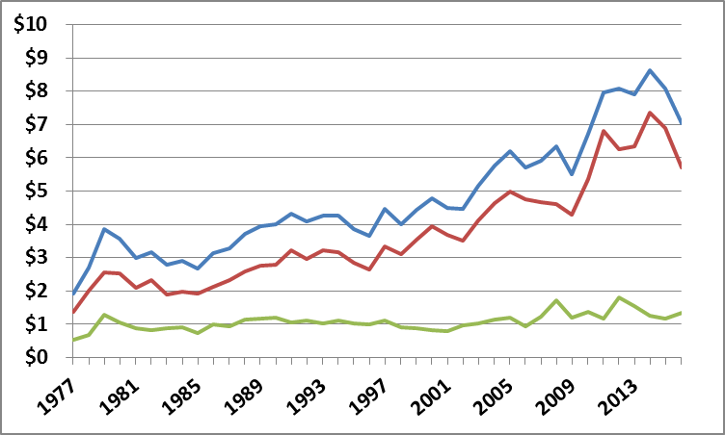
Oklahoma Farm Income (Billion Dollars)
Total
$6.2
$4.8
$1.4
Livestock
Crop
Bureau of Economic Analysis: CA45 Farm Income and Expenses

Slide 8
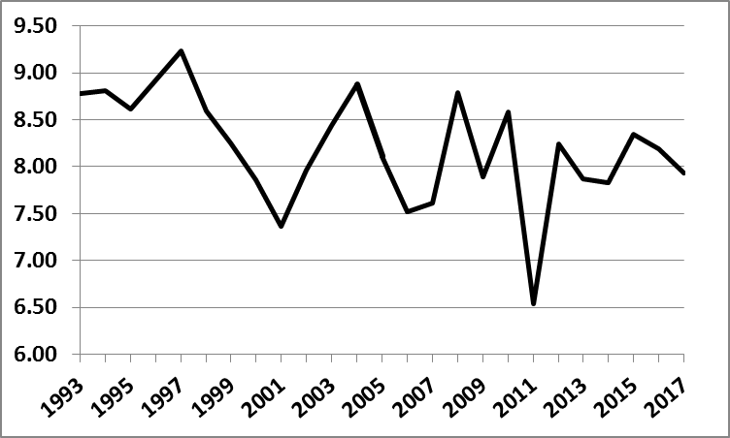
Oklahoma Harvested Crop Acres
Harvested
(Million Acres)
Corn, sorghum, oats, barley, rye wheat, soybeans, peanuts, cotton,
canola, vegetables, hay, others (includes double crop and cover crops).

Slide 9
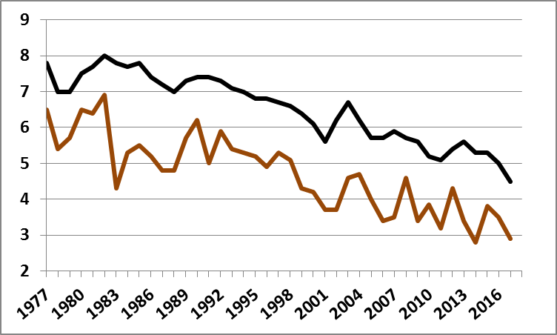
Oklahoma Wheat
Planted
(Million Acres)
Harvested
(Million Acres)

Slide 10
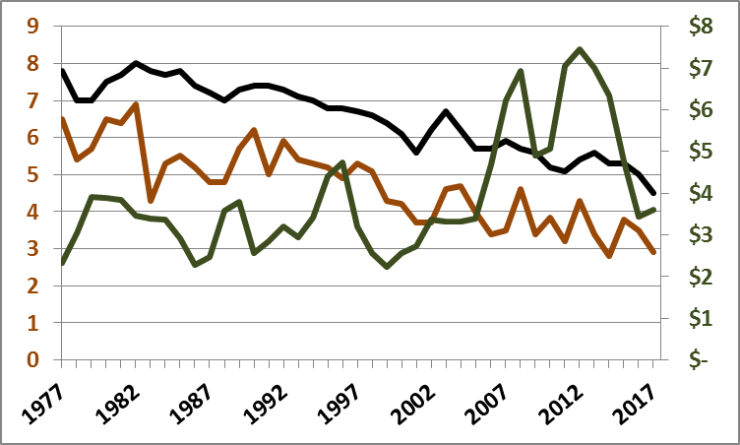
Oklahoma Wheat
Planted
(Million Acres)
Price
($/Bu)
Harvested
(Million Acres)

Slide 11
U.S. HRW Wheat
Item | 2016 | 2017 | 2018
Planted | 26.6 | 23.4 | 23.1
Harvested | 21.9 | 17.6 | 17.6
% Harvested | 82 | 75 | 76
Yield | 49.5 | 42.5 | 39.1
Production | 1,081 | 750 | 687
Source: Informa Economics, IEG

Slide 12
Hard Red Winter Wheat
State | Oklahoma | Kansas | Texas
 | March 13, 2018
Poor -Very Poor | 72% | 53% | 53%
Good-Excellent | 7% | 12% | 13%
 | March 12, 2017
Poor -Very Poor | 16% | 23% | 20%
Good-Excellent | 42% | 40% | 35%
Source: USDA/NASS

Slide 13
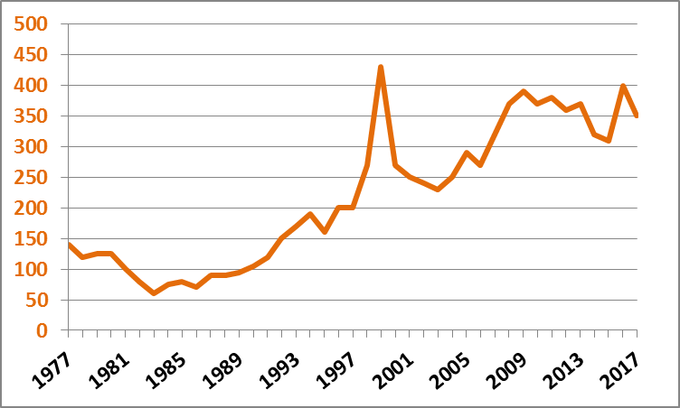
Corn: Planted Acres
Planted
(1,000 Acres)
Planted
(1,000 Acres)

Slide 14
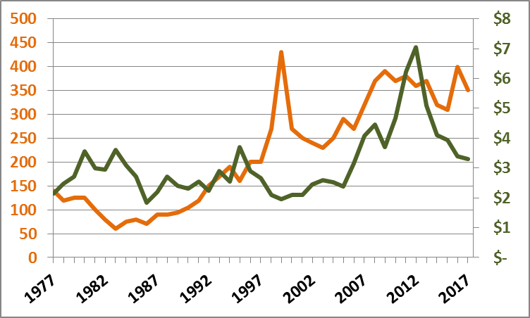
Corn: Planted Acres & Price
Planted
(1,000 Acres)
Price
($/Bu)

Slide 15
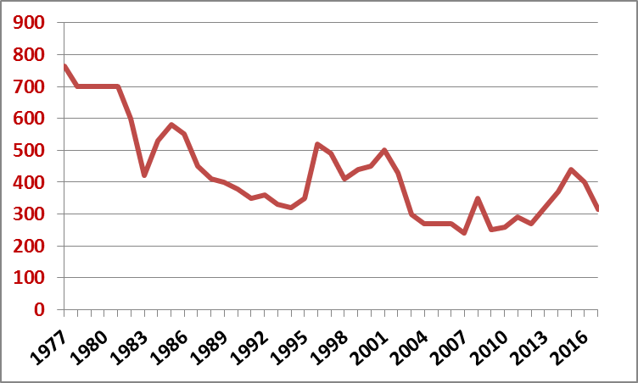
Sorghum: Planted Acres
Planted
(1,000 Acres)
Planted
(1,000 Acres)

Slide 16
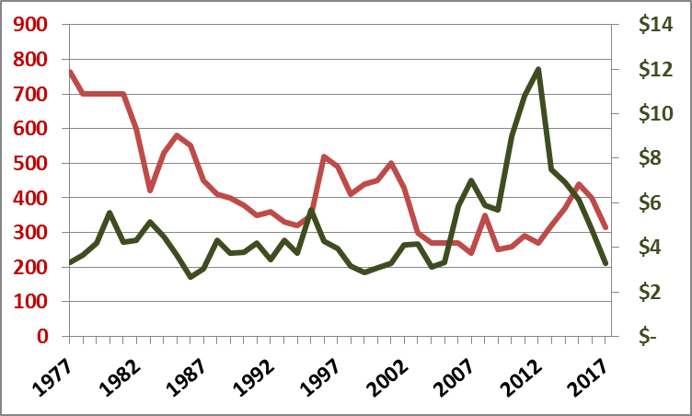
Sorghum: Planted Acres & Price
Price
($/Bu)
Planted
(1,000 Acres)

Slide 17
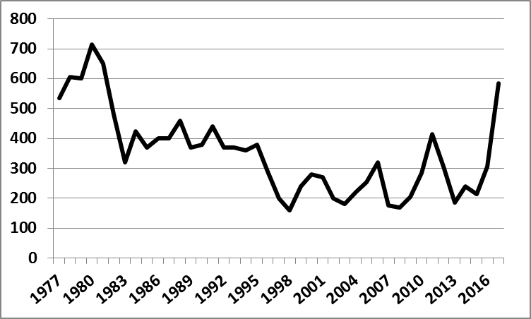
Cotton: Planted Acres
Planted
(1,000 Acres)
Planted
(1,000 Acres)

Slide 18
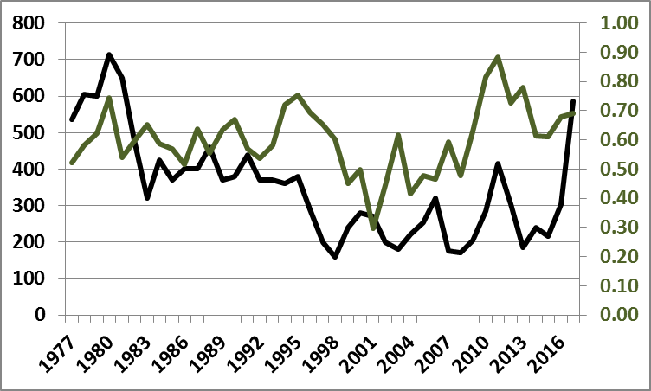
Cotton: Planted Acres & Price
Price
(¢/lb.)
Planted
(1,000 Acres)

Slide 19
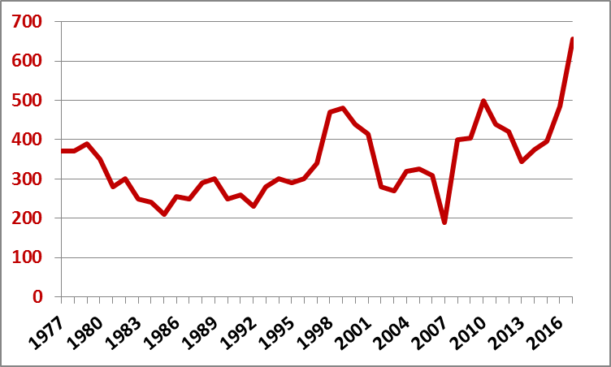
Soybeans: Planted Acres
Planted
(1,000 Acres)
Planted
(1,000 Acres)

Slide 20
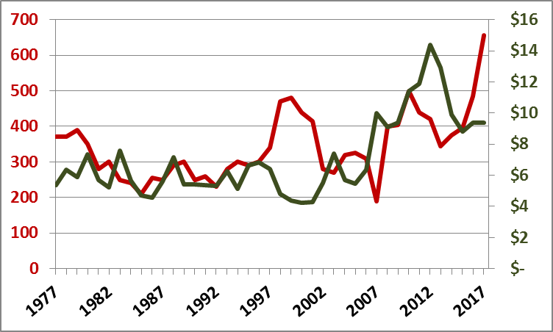
Soybeans: Planted Acres & Price
Price
($/Bu)
Planted
(1,000 Acres)

Slide 21
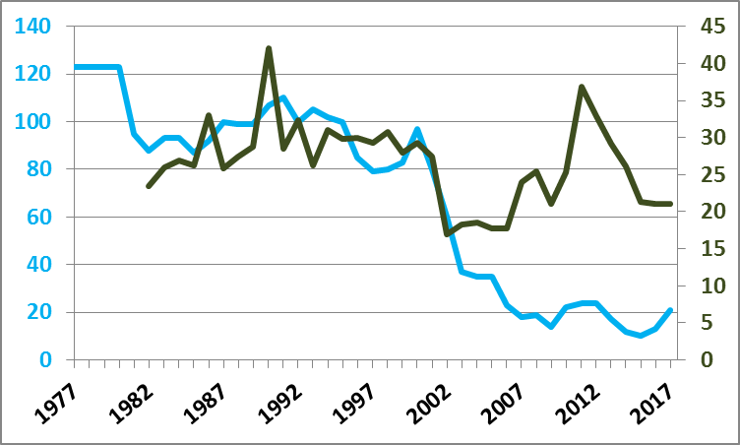
Peanut: Planted Acres & Price
Price
($/Cwt.)
Planted
(1,000 Acres)

Slide 22
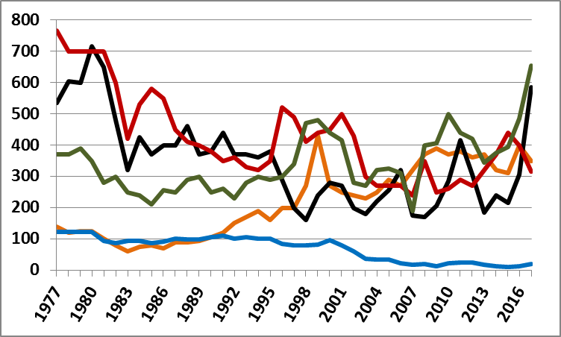
Major Crops: Planted (1,000 Acres)
Sorghum
Soybeans
Corn
Cotton
Peanuts

Slide 23
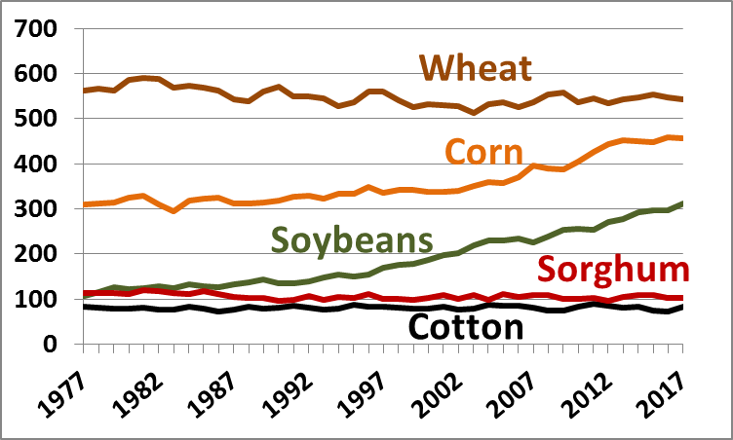
World: Harvested Acres (Million)

Slide 24
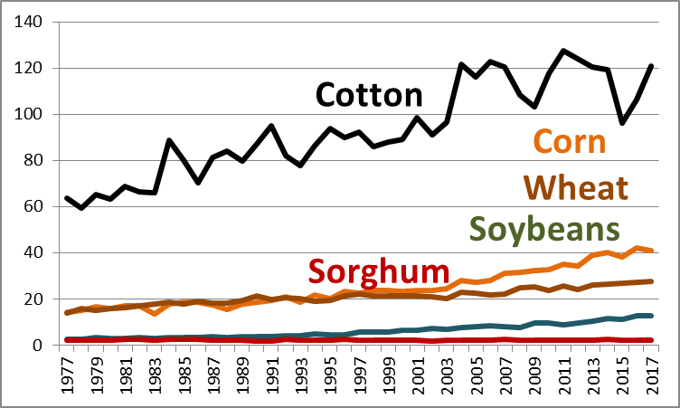
World: Production (Billion Bu/480 Bales)

Slide 25
World: Harvested (Million Acres)
World: Production (Billion Bu/480 Bales)

Slide 26
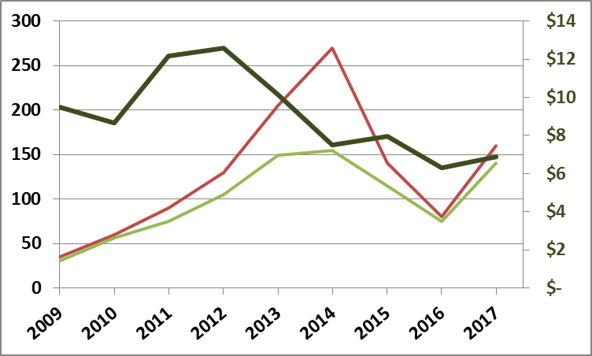
Canola
Price
$/50# bu
Planted
1,000 Ac
Harvested
1,000 Ac

Slide 27
Summary of Crop Harvested Acres: (5-year average; 1,000 acres)
Crop | 2012 | 2017 | Change | Percentage
Wheat | 3,870 | 3,280 | -590 | -15
Corn | 293 | 307 | 14 | 5
Sorghum | 208 | 331 | 123 | 59
Soybeans | 350 | 437 | 87 | 25
Cotton | 166 | 277 | 111 | 67
Cotton 12-17 | 140 | 555 | 415 | 296
Hay | 2,930 | 3,150 | 220 | 8

Slide 28
Net Return: Garfield Co.
Enterprise | Return over Variable Costs | Return over Fixed Costs
Wheat (35 bu; $4.90) | $21 | ($0)
Canola (30 bu; $6.75) | ($13) | ($39)
Corn (80 bu; $3.50) | $14 | ($13)
Sorghum (50 bu; $3.40) | $7 | ($20)
Soybeans (25 bu; $9.45) | $26 | ($19)
Peanuts (4000#; $0.20) | $297 | $112
Cotton (600#; $0.68) | $104 | $73
Peanuts & Cotton Budgets for SW OK

Slide 29
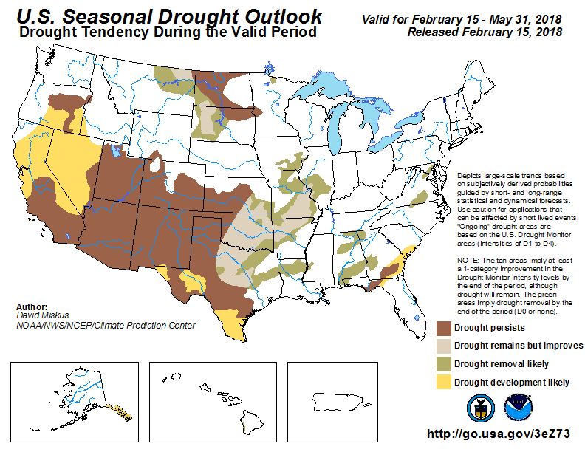

Slide 30
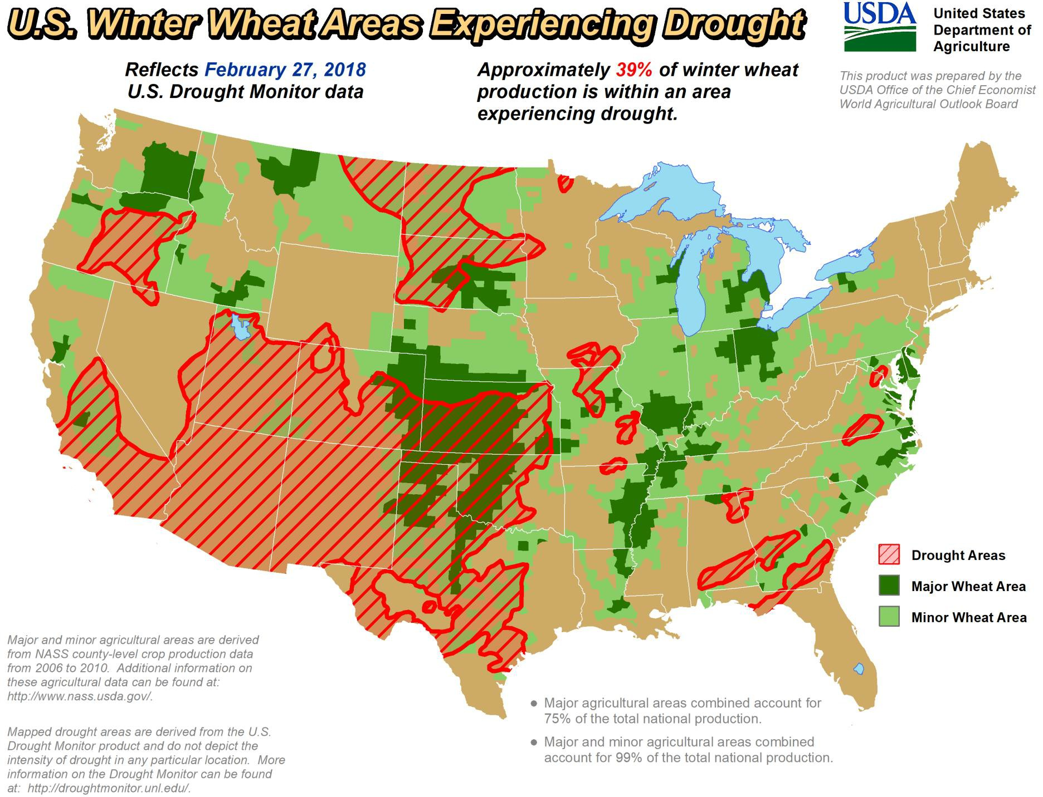

Slide 31
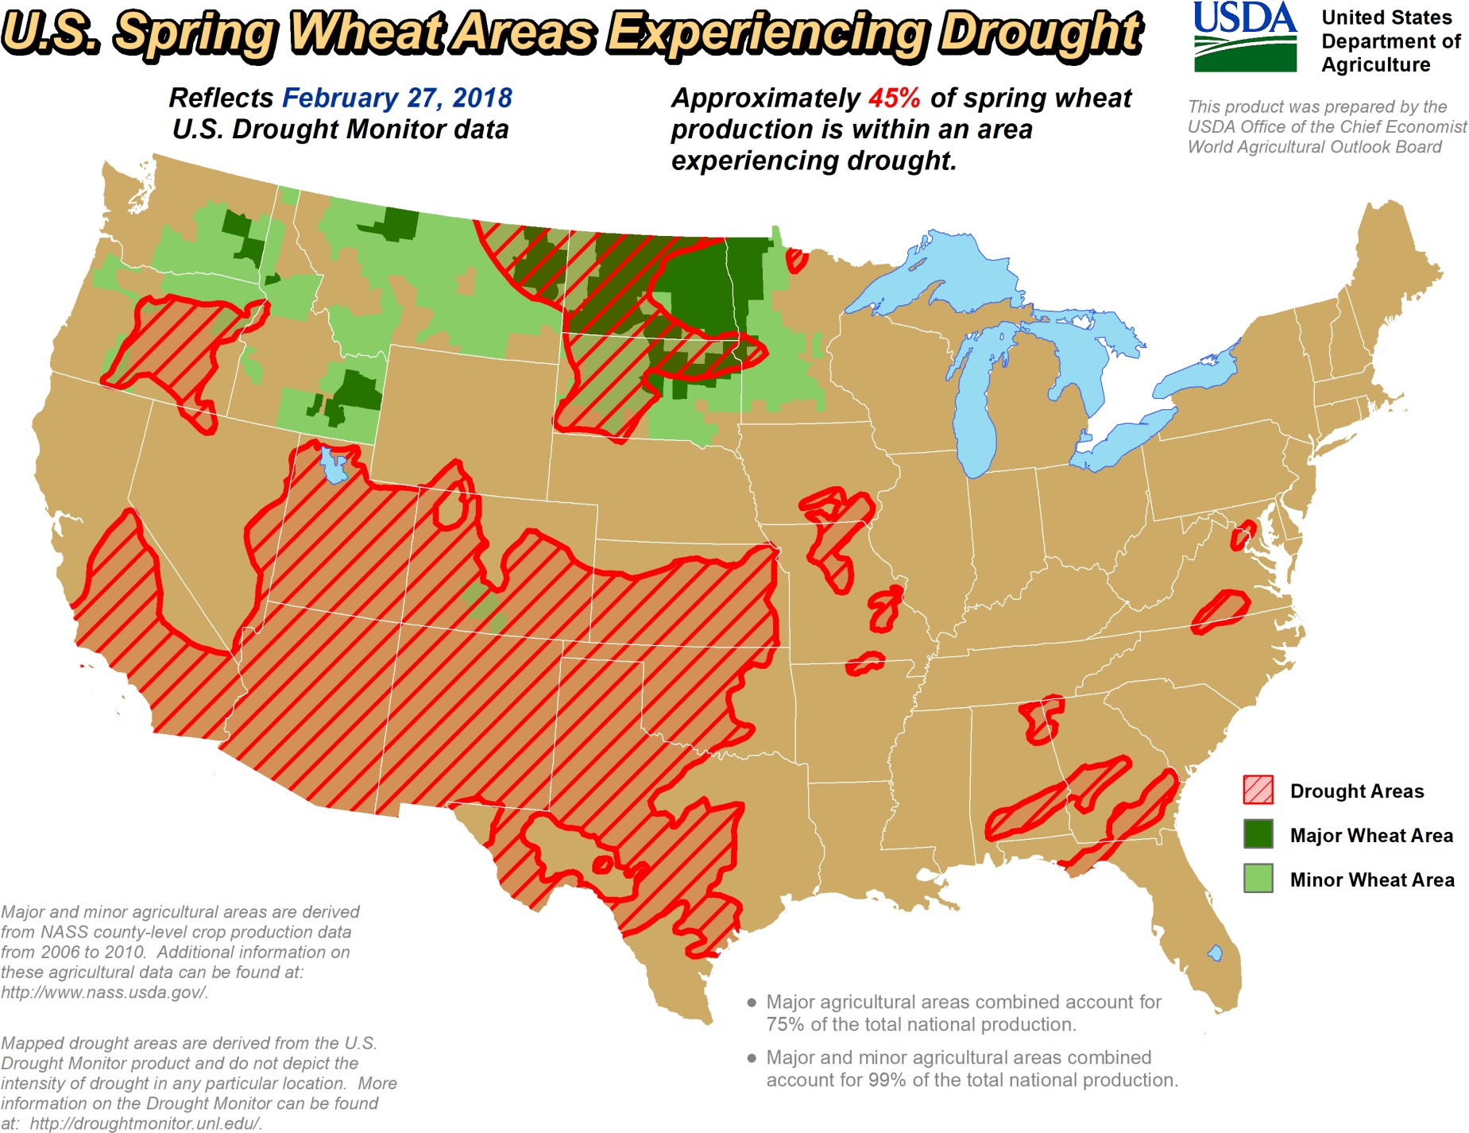

Slide 32
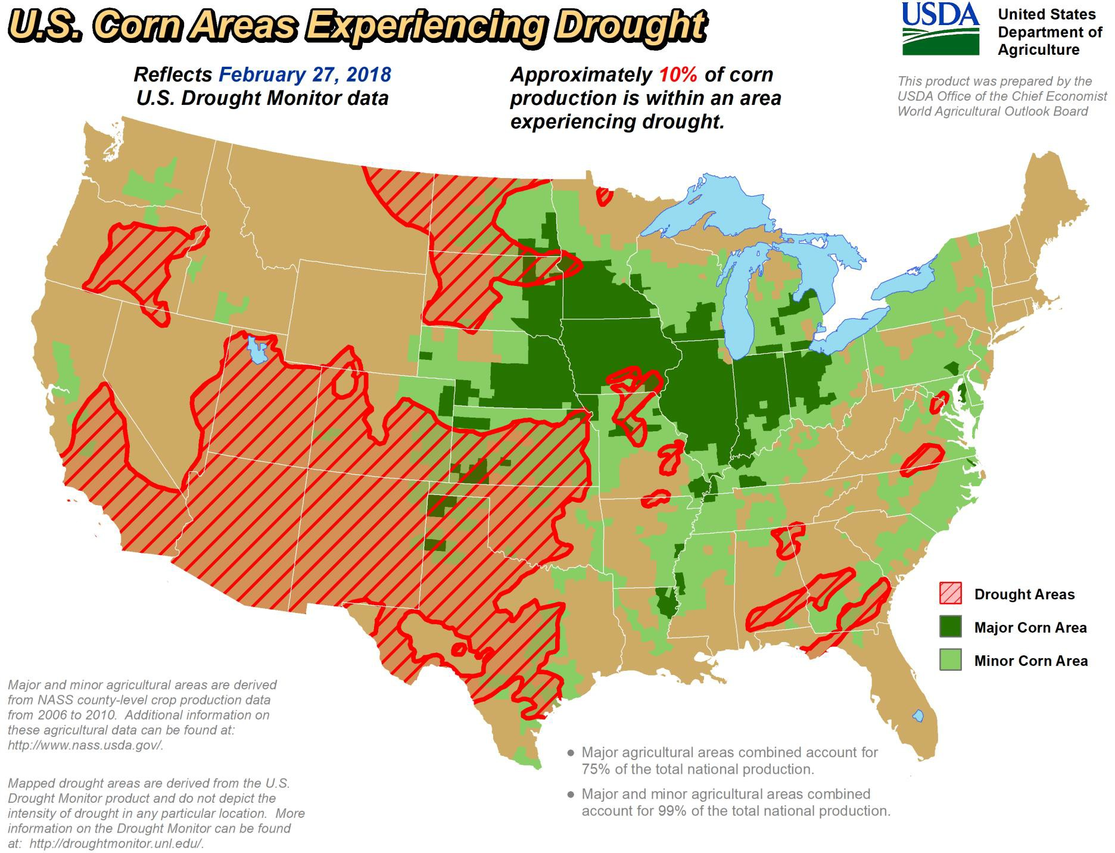

Slide 33
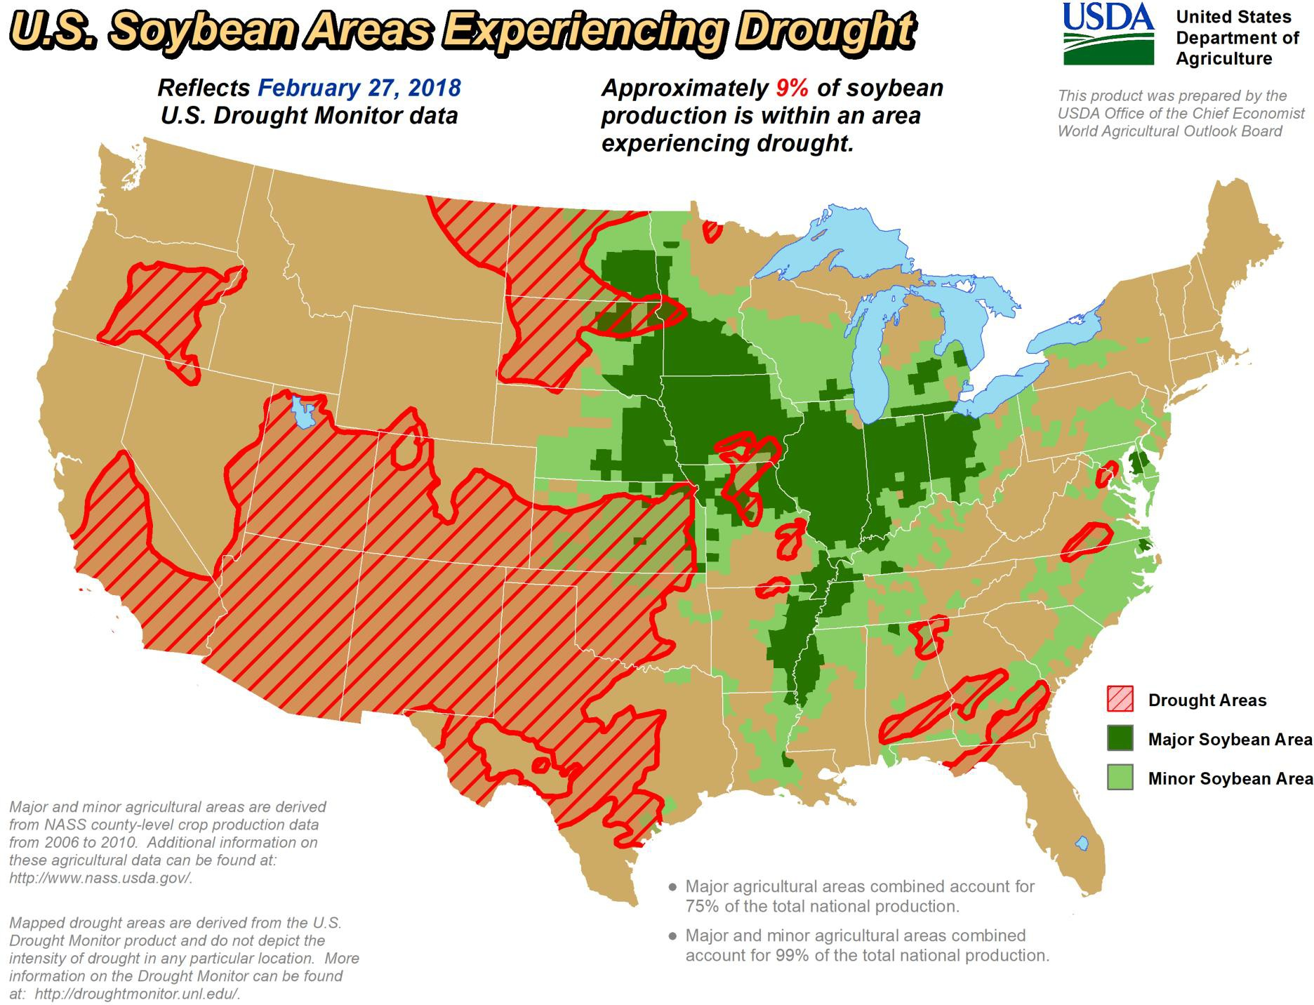

Slide 34
Certified Organic (Oklahoma)
Number of farms: 23 (2015); 34 (2016)
Total acres increased from 6,082 (2015); 18,008 (2016).
29 farms had crop sales,
5 livestock and/or poultry sales
4 livestock and/or poultry products sales.
13 growers harvested 7,032 acres of field crops with sales of $2,030,942.
soybeans ($863,120),
wheat ($687,480),
dry hay ($455,967).
Cattle (all cattle except milk cows and beef cows) $457,523.
Source: Troy Marshall, USDA/NASS

Slide 35
Certified Organic (Oklahoma)
Total sales of vegetables grown in the open of $259,558 were produced on 14 acres from 13 farms.
tomatoes $73,360,
squash $23,534,
potatoes $18,720,
lettuce $16,712
cabbage $15,865.
Berries and other fruits (excluding apples and citrus) grown on 6 acres from 8 growers
$96,276
Egg sales came to $98,500
Source: Troy Marshall, USDA/NASS

Slide 36
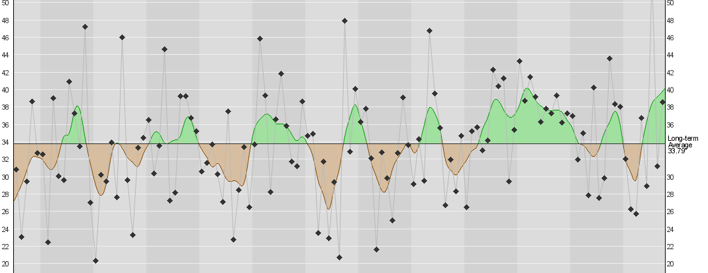
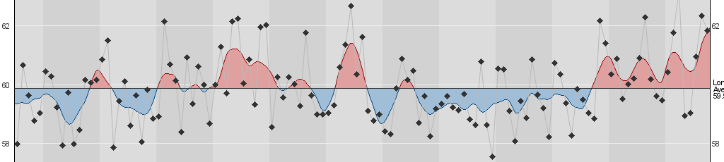
Oklahoma Climatological Survey
Annual Precipitation/Temperature History with 5-year Tendencies
1900s
1910s
1920s
1930s
1940s
1950s
1960s
1970s
1980s
1990s
2000s
2010s
Precipitation
Temperature

Slide 37
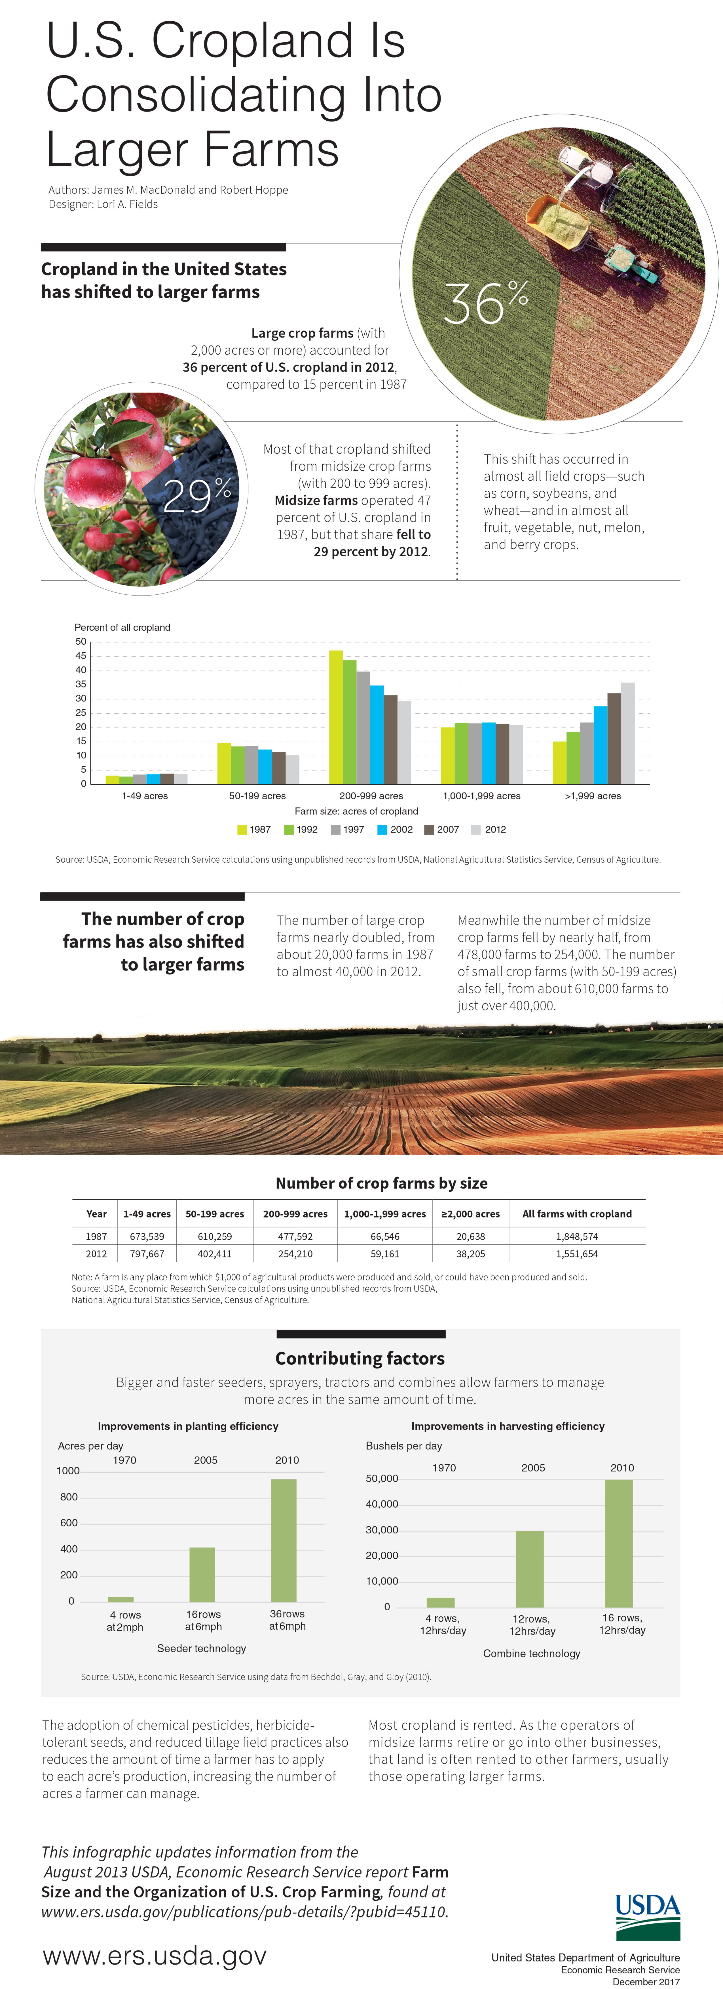
Farm Size: Acres of Cropland

Slide 38
Farm Size: Contributing Factors

Slide 39
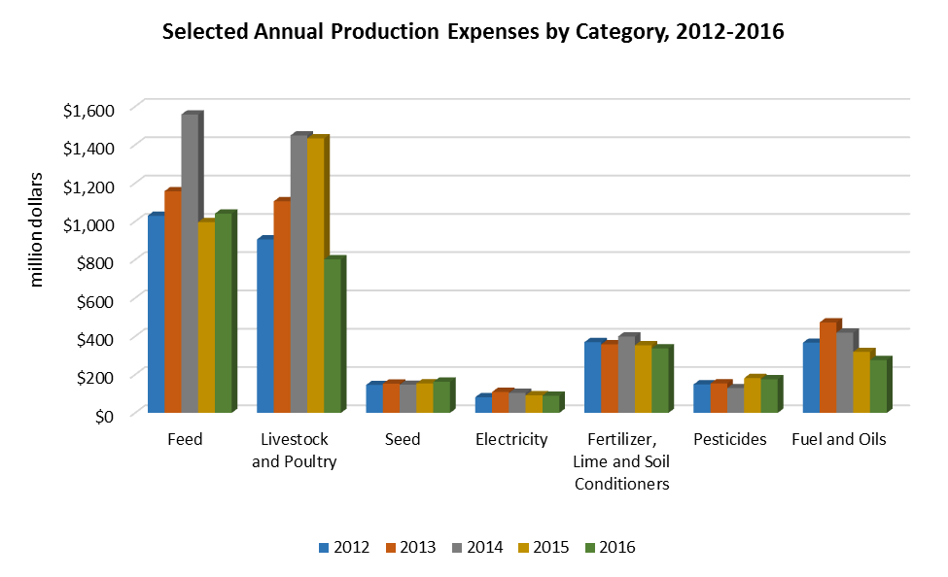
Selected Annual Production Expenses by Category: 2012-16
Source: Oklahoma Agricultural Statistics 2017, USDA/NASS
Oklahoma Department of Agriculture Food & Forestry

Slide 40

Questions?
Providing Inspiration for Agricultural Success

