Slide 1
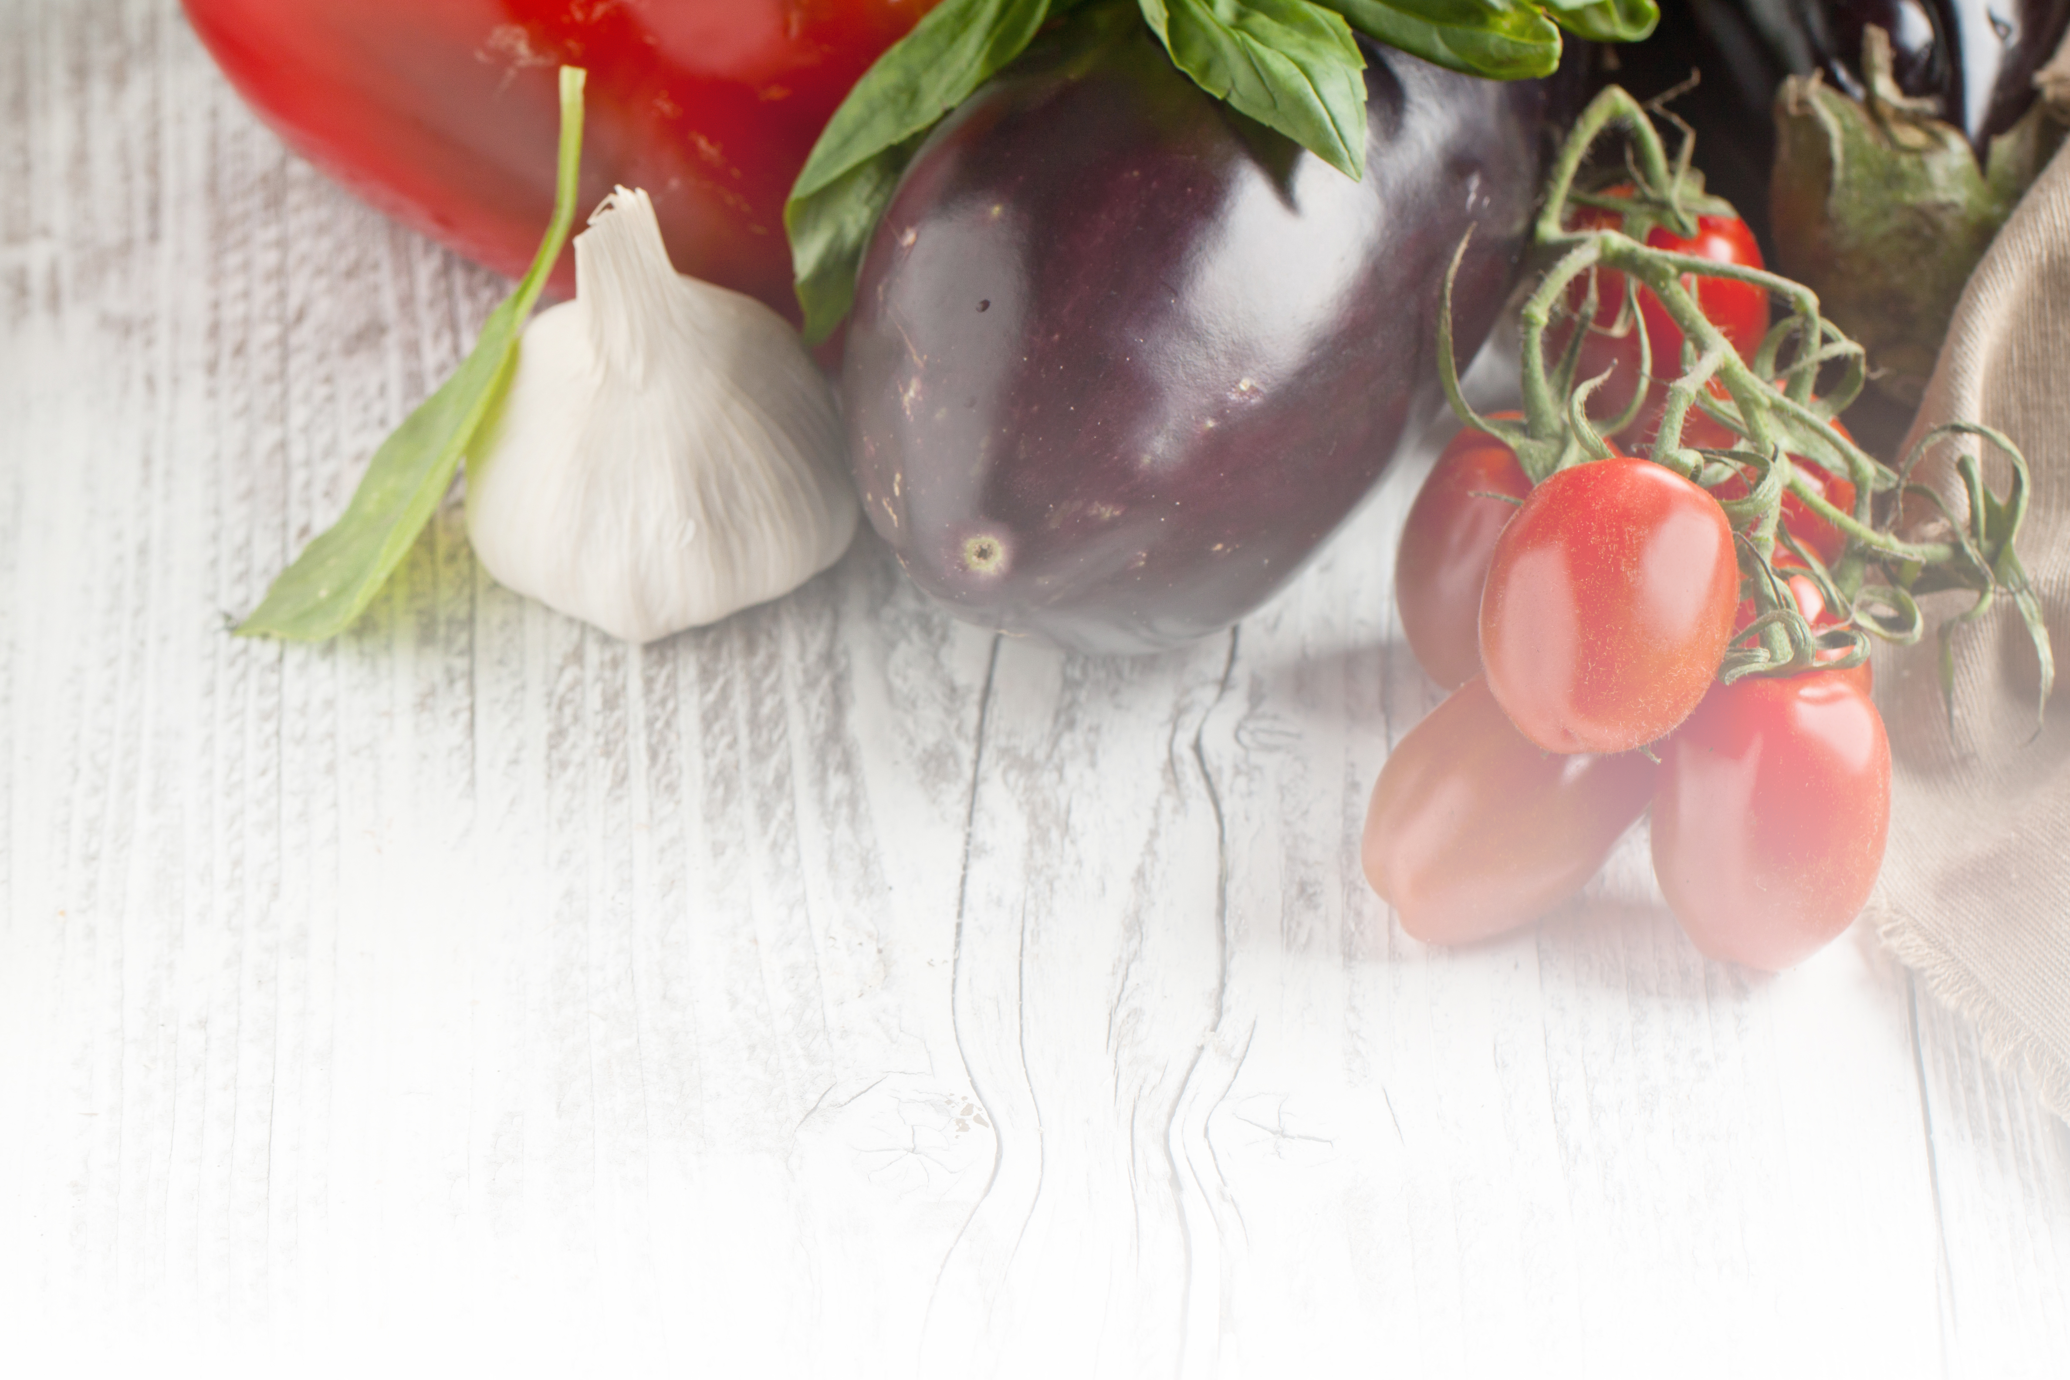


Best Practices for Reducing Foodborne Illness on Oklahoma’s
Small Farms
Notes:
Today‘s presentation is intended as a resource for you when working with small farmers growing produce for sale to the public. Feel free to customize it for your audience. We will discuss best practices for reducing foodborne illness both on the farm and at the market. At the conclusion, I’ll also list several helpful links for many of the commonly asked questions I receive when working with small farmers or farmers markets.

Slide 2
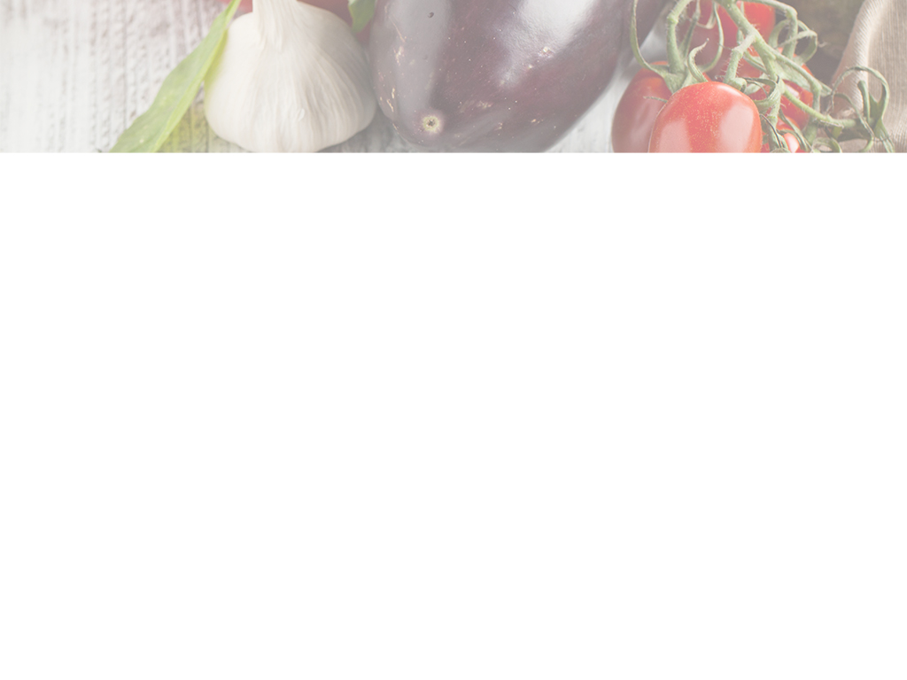
What is the Oklahoma Cooperative Extension Service?
Science-based education programs
Educators in every county
  Agricultural enterprises
  Natural resources and environmental management
  Food, nutrition, health and safety
  Youth, family and community development
Notes:
Because I work with clients not traditionally associated with the Oklahoma Cooperative Extension Service, I always start with the basics of who the extension service is and talk about the services offered. I often meet business clients in county offices. They are amazed that they can get this soil tested, get advice from Master Gardeners or find tons of recipes and fact sheets.

Slide 3
What is the Oklahoma Small Business Development Center?
High quality, free entrepreneurial and small business advisement
  Confidential consulting
  Educational programs
  Information and research
Notes:
In late 2016, the Oklahoma Cooperative Extension Service and Oklahoma Small Business Development Center hired James Arati and myself to offer free personalized business advisement to Oklahoma’s farmers, ranchers and small businesses. As the consulting arm of the Small Business Administration in Oklahoma, we offer confidential advisement, educational programs and many information and research tools. Whether a small business is just starting, looking to grow or to expand to international markets, we can work with to develop advisement tailored to that individual or business. While James and I specialize in agribusinesses, we have a statewide team of advisors with expertise in many areas.

Slide 4
Why are farmers markets popular?
Desire for safe, nutritious food
Want to meet farmers who grew the food
Enjoy atmosphere
Satisfaction of doing good for community and environment
Notes:
Since 1994, the United States has seen an increase in farmers markets due to demand for “local foods.” James and I are also tasked with building a more prominent local food system in Oklahoma. Farmers markets are a popular avenue for small farmers to sell their local produce.
Why are consumers interested in buying local foods, and why are they flocking to farmers markets? More and more, consumers these days are looking to local farmers as a source for the food they feed their families.
They are looking for safe, nutritious food that they think will be safer and more nutritious than what they can buy at the grocery store.
Many want to meet the farmers who grew the food. Some like visiting with neighbors and friends, listening to live music, and sampling fresh food while they shop. For others, it may be the festival-like atmosphere or that down-home feel that makes you feel like you are doing something good for your community and the environment.
With this interest in local foods, Oklahoma farmers who grow the food have a huge responsibility. The reality is that whether the produce comes from a large farm or a small farm, from just down the road or a thousand miles away…it must be kept safe all the way from the farm to the market.

Slide 5
Foodborne Illness in the U.S.
1 out of 6 Americans suffer from foodborne illness each year
128,000 hospitalizations
3,000 deaths
Source: The Centers for Disease Control and Prevention
Notes:
If we do not protect our harvest and use sound production and handling methods, the risk of foodborne illness threatens. The Centers for Disease Control and Prevention estimate that 1 out of every 6 people in America suffer from a foodborne illness each year (or “food poisoning” as some people call it). Many cases of foodborne illness go unreported because symptoms last for a few hours or days and clear up on their own. Not everyone is so lucky. There are more than 128,000 hospitalizations in the U.S. and about 3,000 people who die each year from food that they eat.

Slide 6
Farmer’s liability
1993 Jack in the Box e.coli outbreak – $160 million
2009 Peanut Corporation of America - $3 million settlement, bankruptcy, 98 federal felony convictions
From 1979 – 2014, settlements ranged from $151 to $6.2 million
Source: USDA Economic Research Service
Notes:
So what is a farmer’s liability if something happens as a result of the local food they grow? Making someone sick with food that you produce and sell can have serious consequences not only in terms of consumer health, but in liability issues for you.
The 1992-1993 Jack in the Box e.coli outbreak sickened hundreds of people in four states and killed four people. The e.coli outbreak costs the company $160 million and changed the way restaurants prepare hamburgers.
A 2009 peanut outbreak resulted in a $3 million dollar settlement, company bankruptcy and 98 felony convictions.
USDA Economic Research Service data shows that settlements over a 35-year period ranged from $151 to $6.2 million dollars.

Slide 7
Most common commodities for outbreaks at farmers markets
Leafy greens – lettuce, spinach
Tomatoes
Melons
Also juice, sprouts, berries, green onions, nuts, cheese samples, home canned products
Notes:
We often think of meats and poultry as being the culprits, but if you put together the illnesses attributed to leafy greens, fruits and nuts and produce that grows on vines, produce is a big cause of outbreaks.
Leafy greens such as lettuce and spinach, tomatoes and melons are the most common commodities sold at farmers markets that cause outbreaks.
There have also been outbreaks associated with juice, sprouts, berries, green onions and even nuts, cheese samples and berries.
Also a very deadly type of foodborne illness that can occur is botulism which can be a problem with improperly canned products. When there are outbreaks of botulism, they are often associated with low acid home-canned products that have not been processed correctly.
Many people think it won’t happen at my local market…that because a food is grown locally and sold at the local farmers market, it will not be a cause of illness. But the fact is there have been outbreaks associated with farmers markets and the types of products sold at farmers markets.

Slide 8
Difficult to remove contamination
Once produce is contaminated, it is difficult, if not impossible, to remove the contamination.
Notes:
So why is produce such a problem? Won’t it be safe if you just wash it? The problem is that once produce is contaminated, it is difficult, if not impossible, to remove the contamination. Here is why. Plants have openings on leaves for gas exchange. They allow the plant to take in carbon dioxide and give off water and oxygen vapor.
If that water is contaminated, or if the surface of the plant has harmful microorganisms present, then they can enter the plant through these openings. Once inside, it is difficult, if not impossible to remove them. So contamination may not just be on the surface. It can actually be inside.
So the goal of food safety with produce is: Don’t let produce get contaminated with pathogens in the first place, and handle produce to minimize growth of harmful pathogens on the farm, during transport and also in the market.

Slide 9
Farm points of contamination
Growing
Harvesting
Storing
Packing
Transporting to market
Notes:
Food safety begins on the farm and must continue at each step along the way - through growing, harvesting, storing, packing, transporting to market and even being handled in the market. “Best Practices” must be used to prevent contamination of the food, all along the way.
Food safety involves the land used, the water used, the hygiene and health of the farm workers, the cleanliness of facilities and equipment, the conditions under which the products are harvested and stored and even the conditions during transport of the product to market.

Slide 10
Farm risk potential
Unclean hands touching food
Sick workers
Workers going to bathroom on ground or field
Water
Domestic and wild animals
Parasites
Land previously used for animal production
Notes:
Viruses like norovirus can contaminate produce when workers are shedding viruses and handle produce with unclean hands. Contamination can take place when someone handles an animal, and then handles produce. Contamination can happen when workers go to the bathroom on the ground in or around growing areas.
Contamination can come from land used previously for animal production or animals wandering through produce fields or areas where produce is growing. Contamination occurs when produce is irrigated with contaminated water supplies.
Some land uses may not be acceptable for growing edible fruits and vegetables. Using high-risk lands to grow produce may lead to contamination of produce by disease-causing pathogens. Some land uses will result in a need to undergo soil testing or to observe a waiting period before edible crops are planted on that land.

Slide 11
Best practices – farm production
Observe waiting periods
  Animal use, human waste, flooding, manure fertilizer, compost, chemicals
Avoid lower elevations
Avoid windborne soil from contaminants
Test surface water quarterly, well water annually
Test soil
Notes:
Reducing the risk of foodborne pathogens starts with careful selection and thought to where crops are planted. The U.S. EPA and the National Organic Program have recommended a 90-day waiting period after raw manure application for crops that do not touch the soil – such as tomatoes or corn and a 120 day waiting period for crops that touch the soil – like carrots and turnips.
If you have land that has been heavily used for animal production, do not plant in these areas for several months after the animals have been removed from the site. This provides time for the disease-causing microorganisms to die off before crops are planted.
Wait at least 2 weeks before planting after raw manure application.
Another example of a high risk land use is using land that has been exposed to human waste such as septage and biosolids. If your soil is exposed to these, a long waiting period of at least 3 years is required before it will be safe to plant edible crops. Pathogens in soil are reduced over time by ultra-violet light, competition from other soil organisms, fluctuating soil moistures and temperatures.
Another high risk land use is the use of flood prone areas for growing produce. Flood waters can bring pathogens and other unwanted debris and contaminants into the growing areas. Crops exposed to flood waters should be destroyed.
Be especially careful if production fields are lower in elevation where there is a threat of potential runoff contaminating crops. In these cases, it is necessary to reduce run-off entering the growing areas. One way to do this is to establish barriers that can divert run-off so that it does not flood into the growing areas.
It is also important to consider whether or not contamination can be blown into your fields. Can dust from high risk areas like animal facilities or poultry houses be blown into the growing area? If the answer is yes, then you should consider planting a windbreak to block potential contamination. Breaks with varying heights of tall grasses, evergreen shrubs and then trees are most effective.
With all of these risks, it’s advisable to test your soil before planting your vegetable crops.

Slide 12
Best practices – farm handling
Refrigeration
  Most fruits and vegetables - 41°
Clean facilities and equipment
  Rinse, wash, rinse, sanitize
Clean transportation vehicles
Clean hygiene and health of workers
Sanitation training for workers
Notes:
So the goal of food safety with produce is: Don’t let produce get contaminated with pathogens in the first place, and handle produce to minimize growth of harmful pathogens on the farm, during transport and also in the market.
Refrigeration is a way to limit growth of microorganisms. Cooling is also a way to maintain best quality of the product. Removing field heat as soon as possible preserves quality and enhances safety. Lower temperatures slow the growth rate of most bacteria. Bacteria multiply rapidly between 60 and 120 degrees Fahrenheit. So cooling is a way to slow their growth. Most produce can be stored at 41 degrees Fahrenheit; however, some are susceptible to chill injury and should be stored at slightly higher temperatures.
When cleaning and sanitizing facilities and equipment, the correct procedure to follow is:
Rinse (to remove as much dirt and organic matter as possible)
Wash
Rinse (to remove detergent residue that can affect the sanitizer strength) and then
Sanitize.
Tractors and trucks that have been used in areas of the farm that might have contacted raw manures or composts should be washed and sanitized before going into growing areas. In addition, packing and storage areas must be cleaned. Pressure washing is a good way to clean tractors, trucks, packing and storage areas.
Harvesting tools like knives, machetes or pruners should be washed and sanitized periodically during use.
Plastic containers should be washed and sanitized between uses. It is best to use containers labeled “food grade.” If cardboard boxes are used, buy new, clean boxes and use them once. If you want to reuse cardboard boxes, line the boxes and change the lining between uses.

Slide 13
Best practices - workers
Clean clothes
No jewelry
Don’t eat, drink or smoke around foods
Avoid working with gastrointestinal issues for at least 24 hours
Avoid working with jaundice
Respiratory illnesses – don’t handle food or containers
More Info: Oklahoma Farm and Ranch Employment Handbook (pg. 16) - http://agecon.okstate.edu/faculty/publications/4206.pdf
Notes:
Farm hands can be a source of contamination so certain sanitary and hygiene practices should be followed. Workers should have clean clothes when they show up for work. Jewelry can not only harbor germs that can get on produce, but if the jewelry is lost in the product, it can be a physical hazard causing injuries such as broken teeth, cuts and can even be a choking hazard to someone who consumes it.
What happens with your hands when you eat, drink or smoke? Where are they going? The answer is, hands go to your mouth. Then when you touch the produce, you can transfer microorganisms that may be in the mouth to the product you are handling.
Another “best practice” is to exclude workers who are sick from handling produce and produce packaging materials. If they are suffering from a gastrointestinal upset, have vomiting or diarrhea, then they should wait until they have been symptom free for at least 24 hours before returning to work. If they have jaundice which is a yellowing of the skin that can be a symptom of hepatitis, you should require a doctor’s release before you allow them to return to work. If they have an illness like a sore throat, etc. – reassign them to non-food-handling jobs and non-container-handling duties. It is important to train your workers about what to do if they are sick.
Naturally, if a worker is ill, there is greater risk of them contaminating the produce they handle with a disease-causing organism. Most importantly, ill employees should not handle the produce.
Gloves are not required for use by workers during harvesting, but whenever gloves are used, disposable, single-use gloves are the best choice, and certain practices should be followed. If good practices are not followed, then the gloves themselves can be a source of contamination.
Wash hands prior to putting on the gloves. Avoid touching hair, skin, face, etc. with the gloves. Change gloves after meals, smoking, using the bathroom, or anytime they become damaged or could have become contaminated. Remember, gloves are used to protect the food, not your hands.
What should you do if produce gets contaminated with blood or other bodily fluids? The answer is: discard produce that may have come in contact with blood or other bodily fluids. Bury the contaminated produce or compost it in an area where it will not contaminate other produce in the field.

Slide 14
Wash hands after:
Handling food
Eating
Smoking
Using restroom
Touching nose, face, hair or other contaminant
Notes:
It's good practice to teach workers how and when to wash their hands and the importance of handwashing to prevent the spread of disease. It important not to eat, drink or smoke in the areas around the foods being harvested, stored and sold. Teach your workers to wash their hands before beginning work and upon returning to work after breaks. This includes after using the restroom, smoking or using tobacco, eating or handling trash.
Another important step in maintaining good worker hygiene is to train employees on the steps of proper handwashing and when hands should be washed. Don’t assume that everyone knows when and how to wash their hands correctly. The Centers for Disease Control and Prevention have identified handwashing as one of the best ways to prevent illnesses, including foodborne illnesses and other infectious diseases.

Slide 15
Proper handwashing
Rinse with clean, warm, running water (>100°)
Soap
Rub hands for at least 20 seconds
Clean around nails
Rinse hands under warm, running water
Dry hands with clean paper towels or hot air dryer
Use hand sanitizer
Notes:
To properly wash hands, follow these steps.
Wet hands with clean, running water
Apply soap
Rub hands together vigorously for at least 20 seconds, paying special attention to cleaning around and under fingernails and between fingers.
Rinse hands thoroughly
Dry hands with a clean paper towel, if using a home bathroom, don’t use cloth towels
Use the towel to turn off the faucet and open the door.
Use hand sanitizer as an addition, not a supplement

Slide 16
Best practices – at the market
Sanitize surfaces
Clean, washable containers
Keep food and containers off ground
Cover or package breads, cakes, cookies
Keep meats separate from produce
Clean hygiene and health of workers
Notes:
Once the produce is at the market, it’s important to follow best practices as well. Keep your equipment and work surfaces in the market clean. Wash and sanitize work surfaces, packing bins, utensils, etc. Pressure washing is a good way to clean. Detergents can be used, and different types are needed for different situations. The strength of the sanitizer needed also varies by situation. Check with restaurant supply stores for sources of these or order them online.
If vendors use their own containers, recommend they use:
Materials like plastic that are easy to clean and sanitize between uses
Single use containers like clean cardboard boxes that are only used once.
If they plan to use baskets or wooden bins or other containers that will be reused and are difficult, if not impossible, to clean thoroughly, then recommend they line the containers with clean dish towels or fabrics that can be washed between uses or that they use paper towels.
Also, keep containers at least six inches above the ground or the floor.
If a vendor is selling breads, cakes or cookies, it’s recommended to cover or package those goods. Also keep meats separated from produce to avoid cross contamination.
Clean hygiene and health of workers is just as important as it was on the farm. The same hygiene and health practices should be used as we discussed on the farm.

Slide 17
Sanitizing solution
1 tablespoon unscented chlorine bleach per gallon of water
  Spray bottle
    Mix fresh daily
  Soak
    At least one minute, air dry
  Surface application
  Rinse with drinking water if organic
Notes:
Plain, unscented chlorine bleach is one of the cheapest and most effective sanitizers you can buy. To sanitize surfaces that will come in contact with food, the U.S. Food and Drug Administration allows a maximum amount of 200 parts per million chlorine. That is one tablespoon of chlorine bleach per gallon of water. To sanitize surfaces that will not come in contact with food (such as floors, walls, etc.), a concentration of 400 parts per million is allowed. That solution can be made using 2 tablespoons of plain, unscented chlorine bleach per gallon of water.
Chlorine bleach and water sanitizing solutions degrade with time and with exposure to sunlight or heat, therefore, sanitizing solutions should be made fresh daily.
This solution can be used as a surface application in a spray bottle or by soaking at least one minute and allowing to air dry.
Even the National Organic Program allows the use of chlorine for sanitizing. However, once you have sanitized, you must rinse with clean water safe for drinking so the chlorine level is reduced to that of drinking water (about 2 - 4 parts per million).

Slide 18
Food sampling best practices
Ask your local health department authorities
Minimize bare hand contact with foods
Use clean equipment, utensils
Sanitize dishes, countertops, utensils that come into contact with food
Notes:
According to the Oklahoma Department of Health, food can be sampled in Oklahoma. (Resource is available at the conclusion.) However, some county health department officials will tell some markets they cannot sample produce. It’s important to always check with your local authorities.
If produce can be washed, be sure the rinse water is suitable for drinking. Some firm produce can be scrubbed to reduce dirt.
Avoid bare hand contact with ready to eat food. This does not necessarily mean the use of gloves. You can also use tongs, tissue paper, toothpicks for individual servings, etc. Make sure all equipment and utensils are clean.
Dishes, countertops and utensils that come into contact with food need to be sanitized.

Slide 19
Cut foods
Hold at 41° or colder, or on ice
Discard after 2 hours, or after 1 hour if above 90°
Rinse with drinking water
Cover food
Notes:
Once produce is cut, it must be handled like a potentially hazardous food or a time-temperature control for safety food – it must stay cold or be discarded within a short amount of time. Keep samples in a refrigerator, in a cooler with ice or a freezer gel pack, or nestled in ice. If this is not an option, label them with the time or record the time the samples are prepared and discard them after sitting out for 2 hours or 1 hour if the surrounding temperature is above 90 degrees Fahrenheit. This will meet or even exceed the FDA model food code requirements for safe handling of foods that must have time and temperature control for safety.
Produce that will be sampled in the market should be rinsed with cool running water that is safe for drinking. If the produce is firm, like a melon, for instance, the surface can be scrubbed with a clean, sanitized vegetable brush. Brushes can be sanitized in a solution of 1 tablespoon of plain, unscented household chlorine bleach per gallon of water – allowing the brush to remain in the solution for at least one minute.
Cut samples should be kept covered to prevent contamination from flies and other insects.

Slide 20
When in doubt:
Ask the market manager
Contact your county health department
Contact your county Oklahoma Cooperative Extension Service office
Notes:
If a local farmer has questions about best practices, advise the farmer to contact the farmers market manager for policies, contact their county health department, or county extension staff.

Slide 21
Links for FAQ
County Health Departments -https://www.ok.gov/triton/modules/health/map/county_map.php
Food Safety Regulations in Oklahoma - http://oda.state.ok.us/food/
OK Home Baking Act (Cottage Law) -http://factsheets.okstate.edu/documents/fapc-183-understanding-the-oklahoma-home-bakery-act/
Food Safety Modernization Act/Oklahoma Produce Safety Program - http://www.oda.state.ok.us/food/ProduceSafety.htm
FAPC Produce Safety - http://fapc.biz/services-and-disciplines/food-safety/produce-safety
Notes:
Need more information on a specific item such as the home baking act or health department questions? The following two pages of links can answer many questions that come up with small farmers or farmers markets.

Slide 22
Links for FAQ (2)
Start-Up Production: Acidified Foods, Oklahoma State Department of Health - https://www.ok.gov/health2/documents/20170310%20StartupProduction-AcidifiedFoods.pdf
Farmers Market Guidelines, Oklahoma State Department of Health, Oklahoma Department of Agriculture, Food and Forestry - https://www.ok.gov/health2/documents/FarmersMarket%20Guidelines-final.pdf
Food Demo/Sampling Requirements received from Oklahoma State Department of Health, Consumer Protection Division, 12/8/17 - https://app.box.com/s/6euegcbyusuje2r2gfy2c8k1h48yk9zz

Slide 23
Resources Used
Enhancing the Safety of Locally Grown Produce
  https://campus.extension.org/
    The University of Georgia Cooperative Extension
    Clemson Cooperative Extension
    Virginia Cooperative Extension
Notes:
This presentation is a condensed version of an online program available at e-extension called Enhancing the Safety of Locally Grown Produce. The course was put together by extension staff at the University of Georgia, Clemson and Virginia.

Slide 24
Link for this Presentation
https://app.box.com/s/p8zdcle1ig720vgkgks9f8bkwvzhouoq
Notes:
I hope this presentation will be helpful to small farmers in your county. As we get ready for farmers market season, perhaps you can gather vendors, Master Gardeners or similar groups together to help them learn good basic practices for reducing foodborne illnesses. At this link, you will find this presentation as a Powerpoint presentation as well as an accompanying tip sheet that can be branded with your county information at the bottom right.

Slide 25
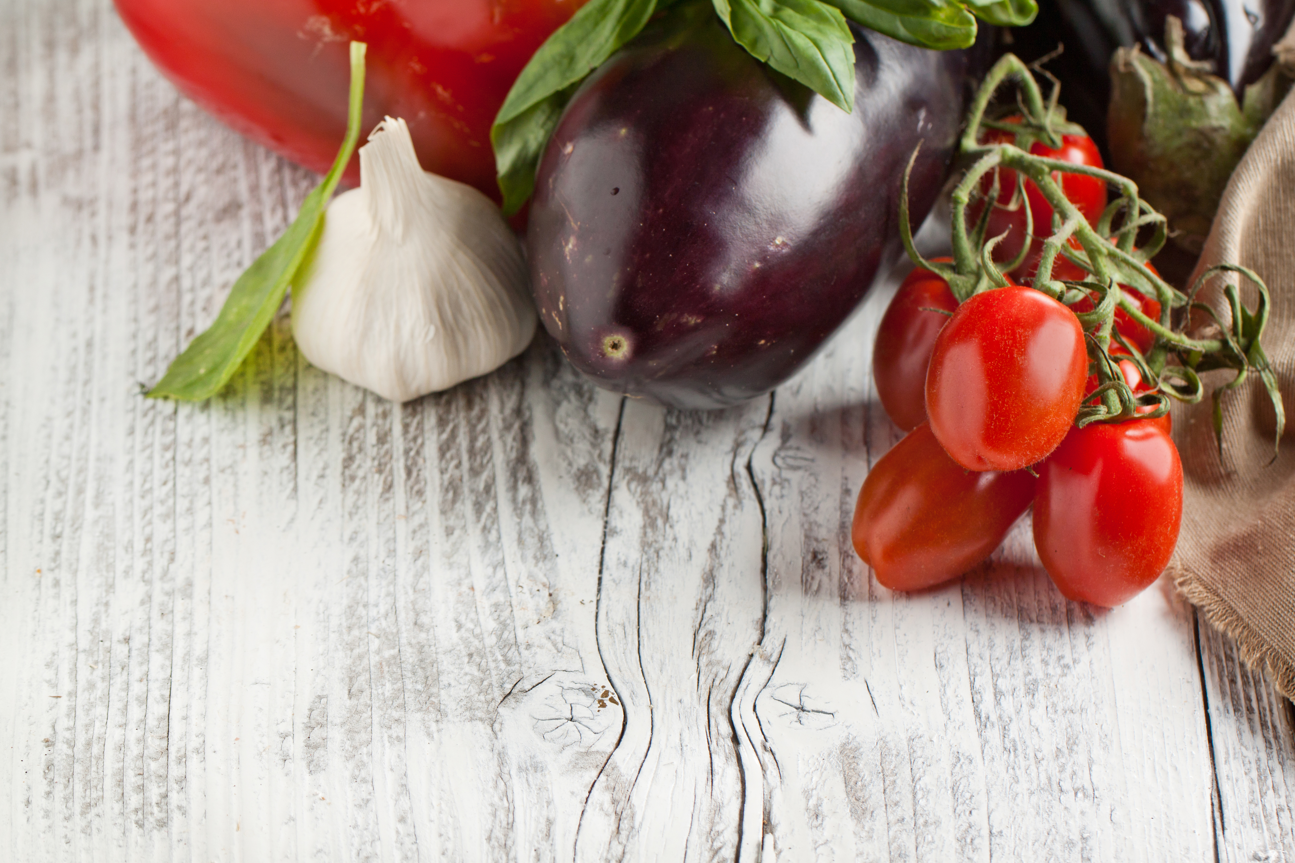
Questions?
James Arati | 405-321-4774 | jarati@okstate.edu
Lisa Bryant | 580-332-4100 | lisa.bryant@okstate.edu

