Slide 1
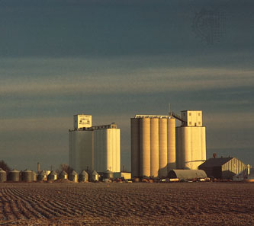

2020 Feedgrain & Soybean
Market Outlook
Oklahoma State University Market Update
March 10, 2020
Daniel O’Brien
Extension Agricultural Economist

Slide 2
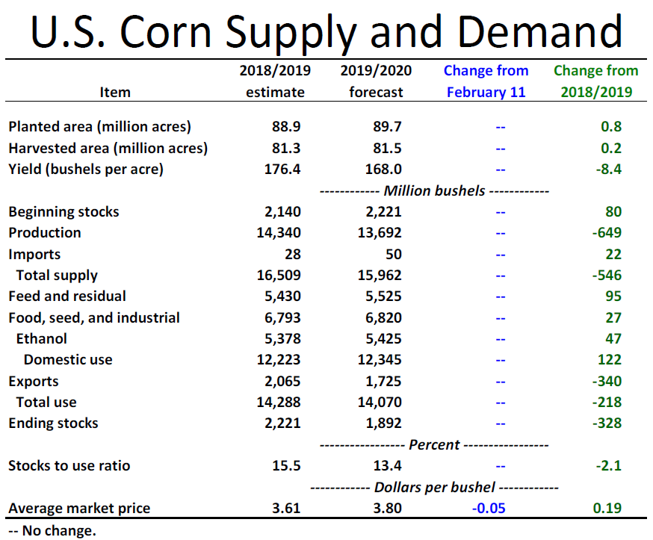

Slide 3
U.S. Corn Supply-Demand 3/10/2020 WASDE + USDA Outlook Conf.*
 | MY 2017/18 | MY 2018/19 | MY 2019/20 | MY 2020/21*
U.S. Corn Area Planted million acres | 90.167 | 88.871 | 89.700 | 94.000
U.S. Corn Area Harvested mln acres | 82.733 | 81.276 | 81.476 | 86.600
U.S. Corn Yield bushels per harvested acre | 176.6 | 176.4 | 168.0 | 178.5
U.S. Corn Production million bu. or ‘mb’ | 14,609 | 14,340 | 13,692 | 15,460
Beginning Stocks mb | 2,293 | 2,140 | 2,221 | 1,892
Imports mb | 36 | 28 | 50 | 25
Total Supply mb | 16,939 | 16,509 | 15,962 | 17,377
Ethanol Production mb | 5,605 | 5,376 | 5,425 | 5,450
Non-Ethanol FSI mb | 1,452 | 1,415 | 1,395 | 1,390
Exports mb | 2,438 | 2,065 | 1,725 | 2,100
Feed & Residual mb | 5,304 | 5,432 | 5,525 | 5,800
Total Use mb | 14,798 | 14,288 | 14,070 | 14,740
Ending Stocks mb | 2,140 | 2,221 | 1,892 | 2,637
% Ending Stocks-to-Use | 14.5% | 15.5% | 13.5% | 17.9%
U.S. Avg. Farm Price $/bu. | $3.36 | $3.61 | - ** $3.80 | $3.60
?

Slide 4
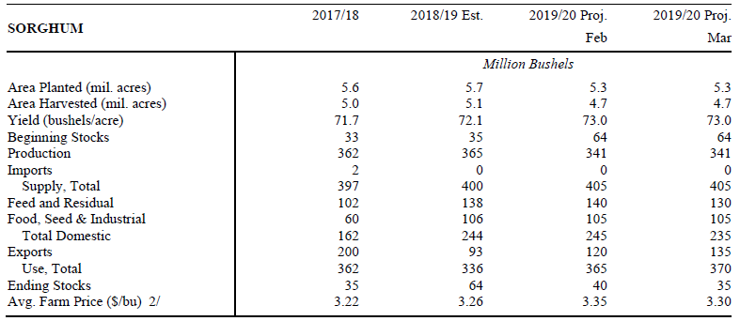

Slide 5
U.S. Sorghum Supply-Demand 3/10/2020 WASDE + Outlook Conf.
 | MY 2017/18 | MY 2018/19 | MY 2019/20 | MY 2020/21*
U.S. Sorghum Area Planted mln acres | 5.629 | 5.690 | 5.265 | 5.700
U.S. Sorghum Area Harvested mln acres | 5.044 | 5.061 | 4.675 | 5.100
U.S. Sorghum Yield bushels per harvested acre | 71.7 | 72.1 | 73.0 | 67.5
U.S. Sorghum Production mln bu. ‘mb’ | 362 | 365 | 341 | 344
Beginning Stocks mb | 33 | 35 | 64 | - ** 35
Imports mb | 2 | 0 | 0 | 0
Total Supply mb | 397 | 400 | 405 | - ** 379
Food, Seed & Industrial Use mb | 5,605 | 5,376 | 5,425 | 100
Exports mb | 200 | 93 | + ** 135 | 100
Feed & Residual mb | 102 | 138 | - ** 130 | 140
Total Use mb | 362 | 336 | + ** 370 | 340
Ending Stocks mb | 35 | 64 | - ** 35 | - ** 39
% Ending Stocks-to-Use | 9.7% | 19.1% | - ** 9.5% | - ** 11.5%
U.S. Avg. Farm Price $/bu. | $3.22 | $3.26 | - ** $3.30 | ** $3.20
?

Slide 6
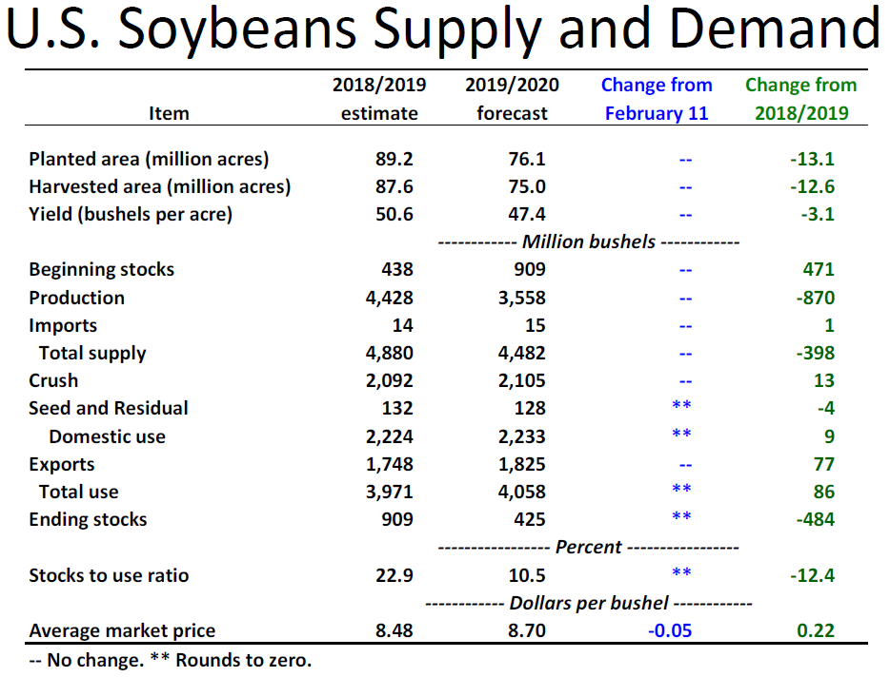

Slide 7
U.S. Soybean Supply-Demand 3/10/2020 WASDE + Outlook Conf.
 | MY 2017/18 | MY 2018/19 | MY 2019/20 | MY 2020/21*
U.S. Soybean Area Planted mln acres | 89.542 | 87.5940 | 75.021 | 85.000
U.S. Soybean Area Harvested mln acres | 90.162 | 89.167 | 76.100 | 84.200
U.S. Soybean Yield bushels per harvested acre | 49.3 | 50.6 | 47.4 | 49.8
U.S. Soybean Production mln bu. ‘mb’ | 4,412 | 4,428 | 3,558 | 4,195
Beginning Stocks mb | 302 | 438 | 909 | 425
Imports mb | 22 | 14 | 15 | 15
Total Supply mb | 4,735 | 4,880 | 4,482 | 4,635
Domestic Crush mb | 2,055 | 2,092 | 2,105 | 2,105
Exports mb | 2,134 | 1,748 | 1,825 | 2,050
Seed & Residual mb | 109 | 131 | 128 | 134
Total Use mb | 4,297 | 3,971 | 4,058 | 4,314
Ending Stocks mb | 438 | 909 | 425 | 320
% Ending Stocks-to-Use | 10.2% | 22.9% | 10.5% | 7.4%
U.S. Avg. Farm Price $/bu. | $9.33 | $8.48 | - ** $8.70 | $8.80
?

Slide 8

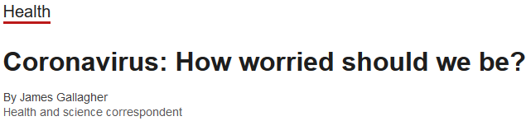

The number of total confirmed cases in China rose to 4,515 as of 27 January, up from 2,835 a day earlier. The country has meanwhile further tightened travel restrictions to try and curb the spread of the virus. The city of Wuhan, thought to be the epicentre of it, is already in effective lockdown as is much of surrounding Hubei province.
The coronavirus causes severe acute respiratory infection and there is no specific cure or vaccine. Most of the deaths have been of elderly people or those with pre-existing respiratory problems.

Slide 9


“This unknown has put a lot of negative pressure on prices and agriculture prices. Grain as well as livestock has been caught up in this big swirl of uncertainty. So it's not that the coronavirus is going to directly impact people’s eating habits, but agriculture is one of these industries that got caught up in this whirlwind of concern and worry,” said Frayne Olson, NDSU Extension Service crops economist/marketing specialist. “We just don't know what is going to happen, and as a result, people get very conservative and prices start to fall.”

Slide 10
White House officials have said agricultural exports to China under the phase one deal would be between $40 billion and $50 billion in each of the next two years, but have provided few other details.
“For the grain and livestock market, this is a matter of timing. When will China make these additional purchases? The concern right now is because of the coronavirus and because of the focus on trying to control that. Purchasing U.S. ag products has fallen down the list of importance for China,” Olson said. ….
Olson added, ….. there is a clause in the phase one agreement that if something out of the ordinary occurs or if there is a drought or some major event, they do have the ability to come back and negotiate.”

Slide 11
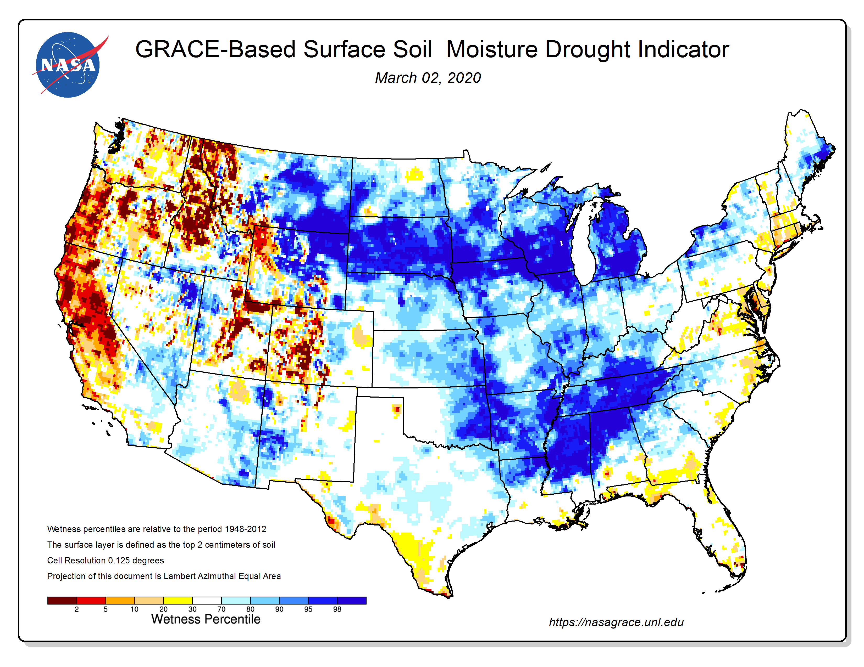
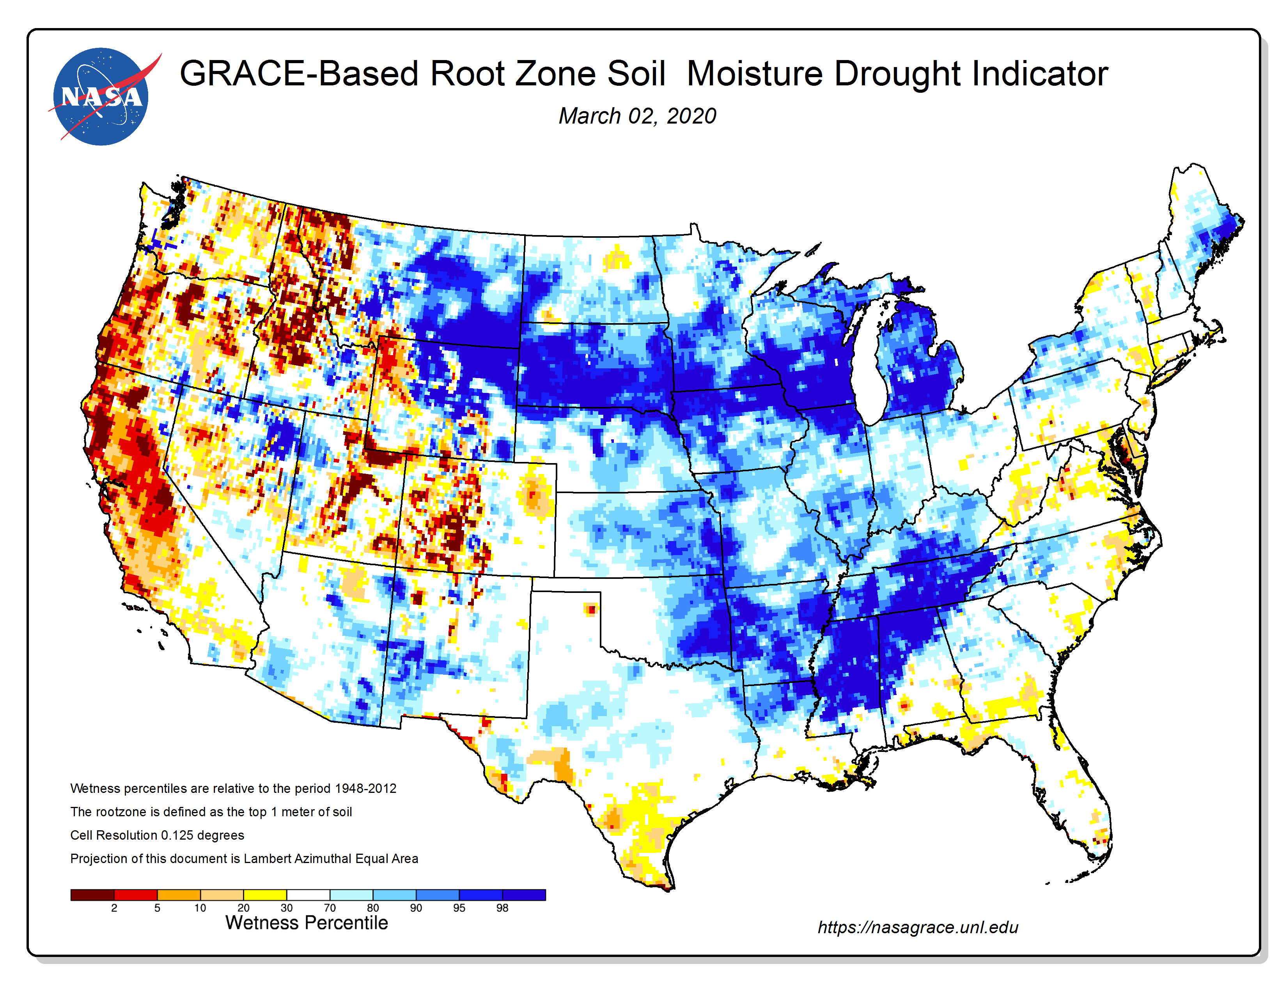

Slide 12
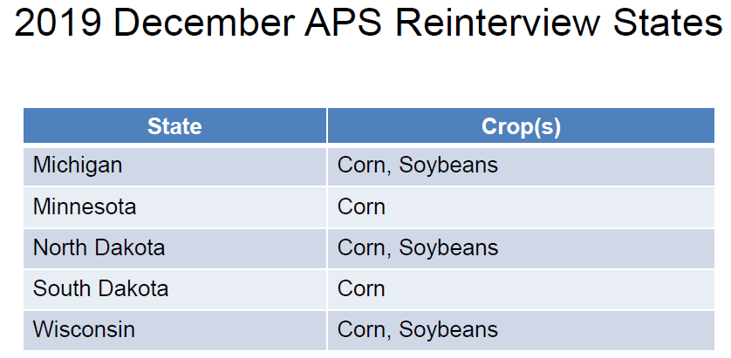

Slide 13
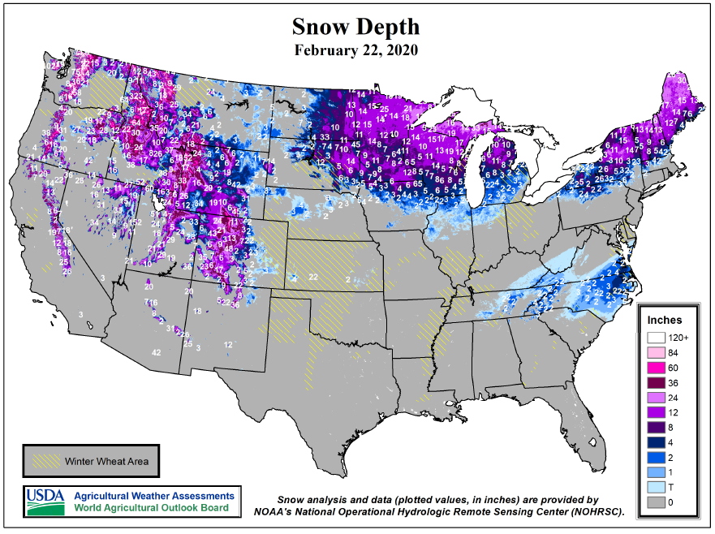

Slide 14

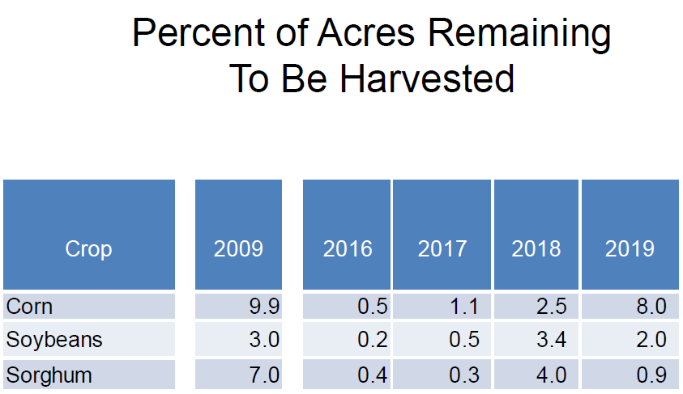


KSU Estimate of
Crops Which were Not Yet
Harvested on 12/1/2019
≈ 1,095 mb
≈ 71 mb
≈ 6 mb

Slide 15
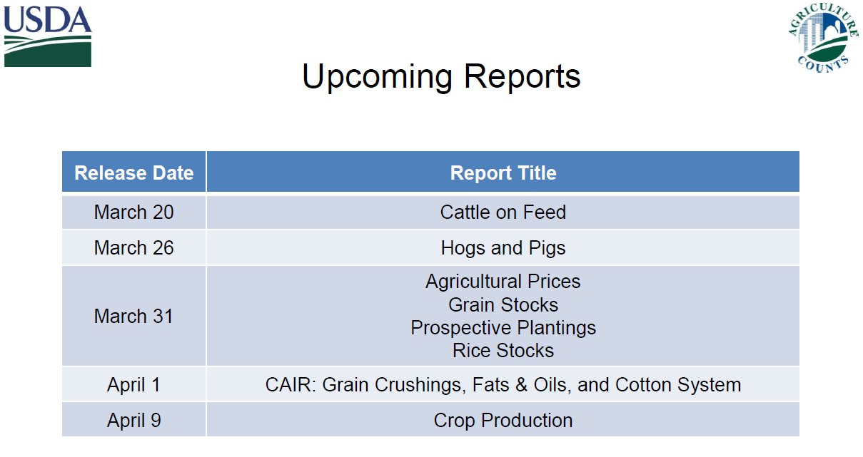
For USDA NASS

Slide 16
Unpredictable Grain Markets in Year 2020
The “Ups & Downs” of U.S. Trade Tensions
  U.S.-Japan Trade Agreement (+)
    Likely positive impact on U.S. grain exports vs TPP Countries
  USMCA Trade Agreement ^{U.S.-Mexico-Canada} ⇨ To be ratified (+)
    Mexico grain purchases from the U.S.
    Canada grain export competition vs U.S. (Wheat, Oilseeds)
  U.S. vs China (?)
    Soybeans, Sorghum, Beef (Working out resolution in “Phases”)

Slide 17
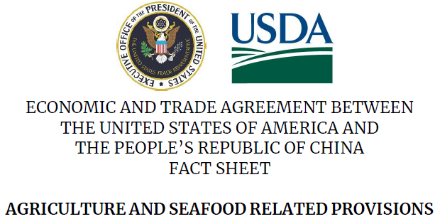
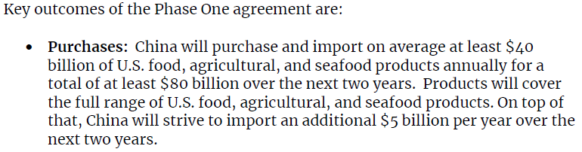

Slide 18
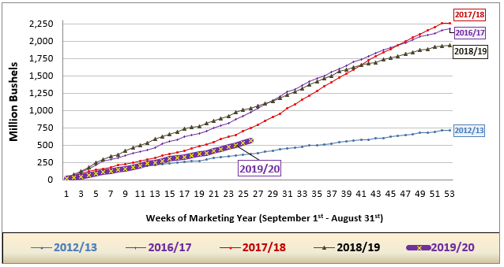
U.S. Corn Exports – Weekly thru 2/20/2020

Slide 19
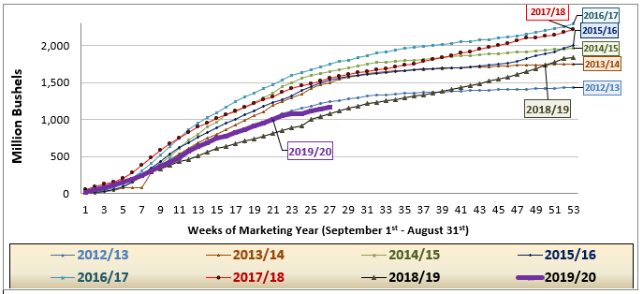

U.S. Soybean Exports – Weekly thru February 27, 2020

Slide 20
Market “Realities” to be determined ….
“Final” 2019 U.S. Corn & Soybean Crops (“Sometime” in 2020)
  Corn²⁰¹⁹ < 13.692 bln bu?  End Stocks < 1.892 bb?
  Soybeans²⁰¹⁹ < 3.558 bln bu?  End Stocks < 475 mb?

Slide 21
More Grain Market Events to Anticipate
2020 Production of Export Competitors
  2020 Soybeans ^{So-Am} → Up 3.3% & Up 10.2% vs last 2 years
  2020 Corn ^{So-Am + Ukraine} → Up 29% vs 2015-2017 Average
  ARG-Brazil-Ukraine  Ag Export ^{“Open Door”} w. U.S.-China Trade Issue
U.S. Dollar Strength ⇨ Limiting U.S. grain exports
  USD$ Index ^{Trade Wghtd} → DEC ²⁰¹⁹ up 7.3% since low in FEB ²⁰¹⁸
  Brazil Reals ÷ USD$ ≈ 4.12 in OCT-DEC ²⁰¹⁹ (vs low of 1.56 in JUNE ²⁰¹¹)

Slide 22
More Grain Market Factors…..
U.S. Spring Plantings (April-May ²⁰²⁰)
  Corn ²⁰²⁰ Up 4-7 mln ac? →  from 89.7 to 94-97 mln ac?
  Soybeans ²⁰²⁰ Up 4-8 mln ac? →  from 76.1 to 80-84 mln ac?
“Bearish” Positions of Grain Futures’ Traders…..
  BUT – “Strong” local Basis in Cash Markets & Demand Centers
    Corn → Strong basis @ US. Ethanol Plants
    Soybeans → Moderate-to-weak basis in many areas – but improving
    HRW Wheat → Strong basis @ Elevators in the Central / Southern Plains

Slide 23
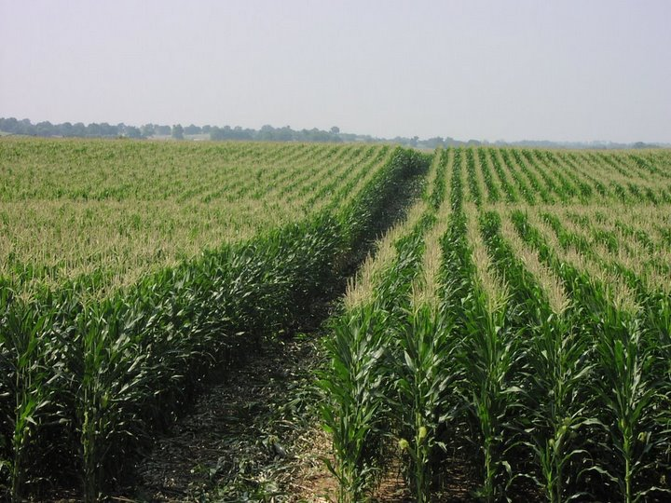

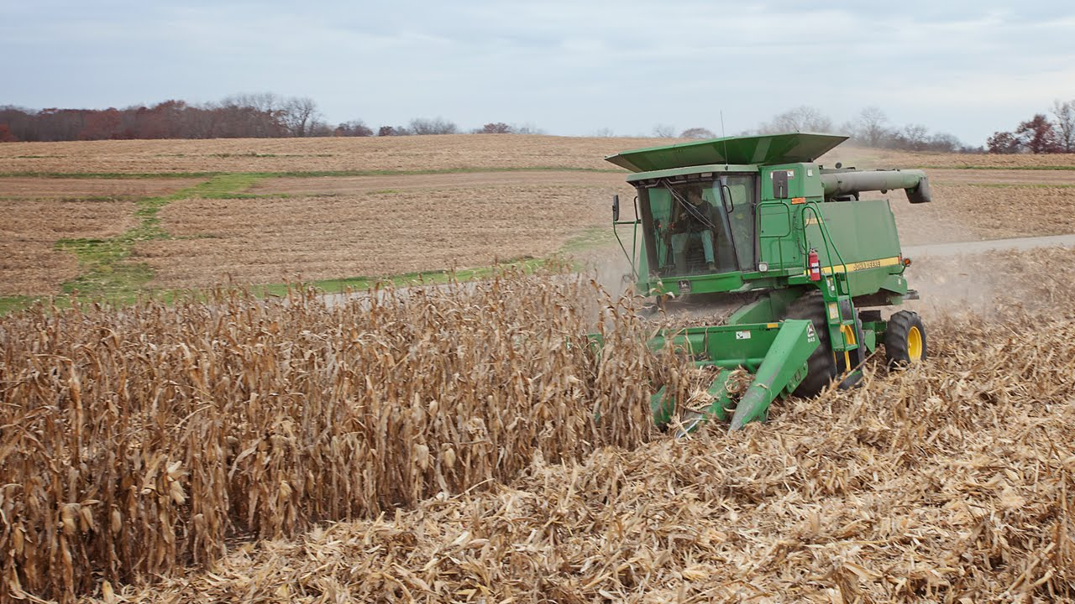
Corn Markets

Slide 24
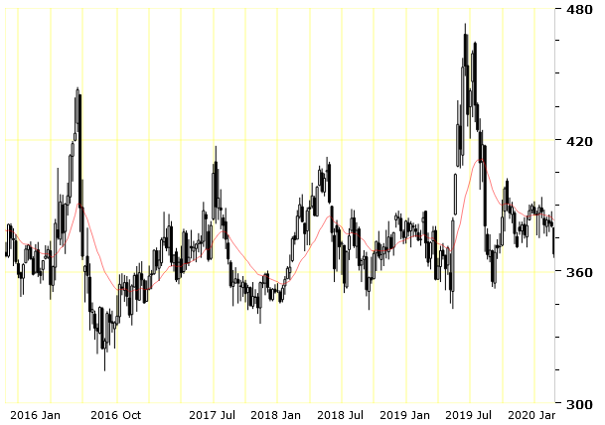
CME Corn Futures
Weekly Chart: December 2015 – February 27, 2020
MAR 2020
$3.68
2/27/2020
$3.71 ¼
(12/12)
$3.68
$3.52
(9/9/2019)
$3.37
(7/12/2018)
$3.43
(5/13/2018)
$3.35
(12/12/2017)
$3.15 (8/31/2016)

Slide 25
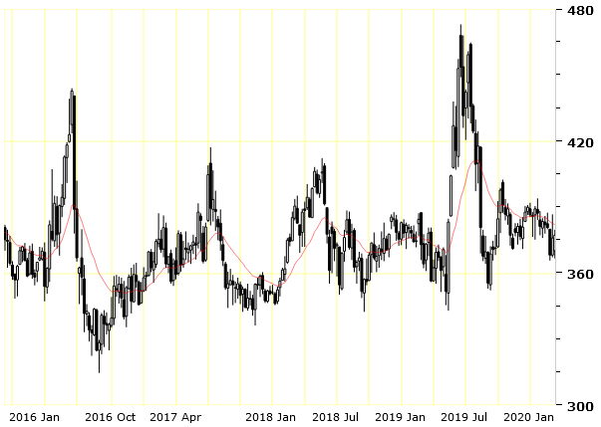
CME Corn Futures
Weekly Chart: December 2015 – March 9, 2020
MAR 2020
$3.79 ¾
3/10/2020
12:50 p.m.
$3.80
$3.71 ¼
(12/12)
$3.52
(9/9/2019)
$3.37
(7/12/2018)
$3.43
(5/13/2018)
$3.35
(12/12/2017)
$3.15 (8/31/2016)

Slide 26
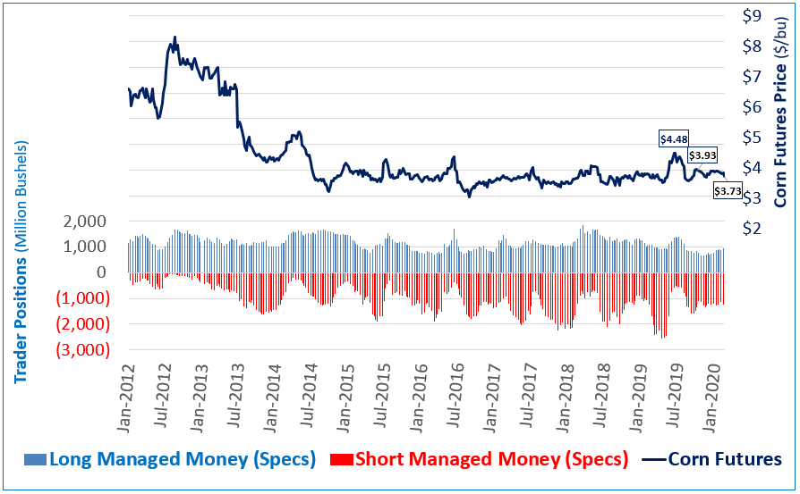
Managed Money (Spec) Positions in CME Corn
CFTC Commitment of Traders to February 20, 2020

Slide 27
Probability of Corn Futures Trends
Examining 1990-2019 (Last 30 years)
Likelihood of Level-Higher DEC Corn Futures??
  Trends through Spring-Summer (June-July)?
    ⇨ Spring-Summer Price  occurred 30/30 Years (100%)
  Which direction did prices move by Fall (Nov-Dec)??
    Price moving sideways / higher = 9/30 Years (30%)
    Price moving lower = 21/30 Years (70%)

Slide 28
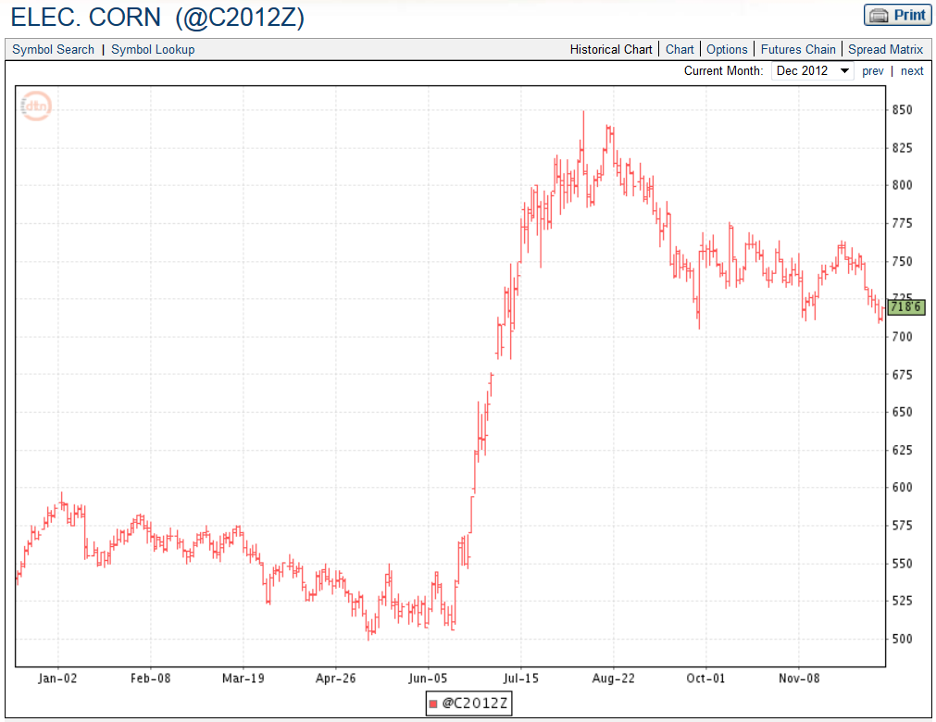
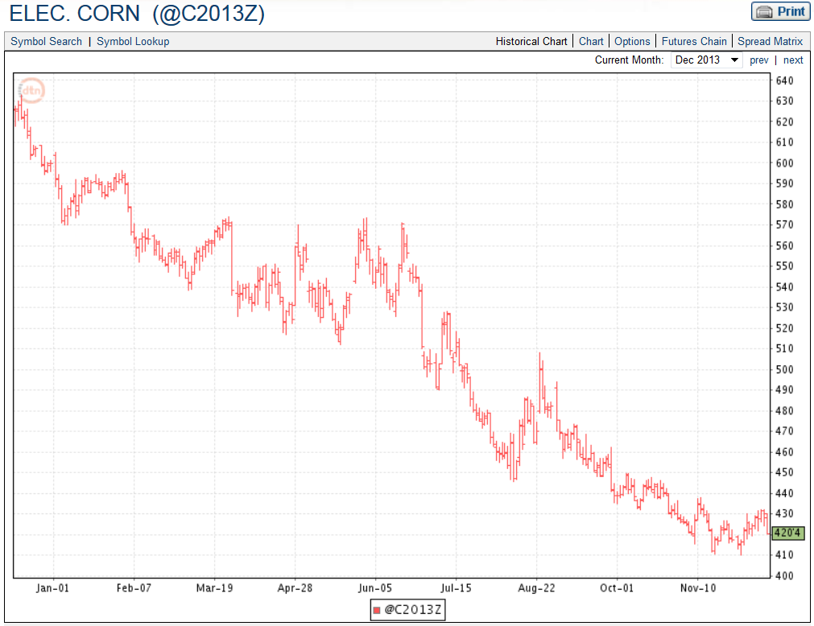
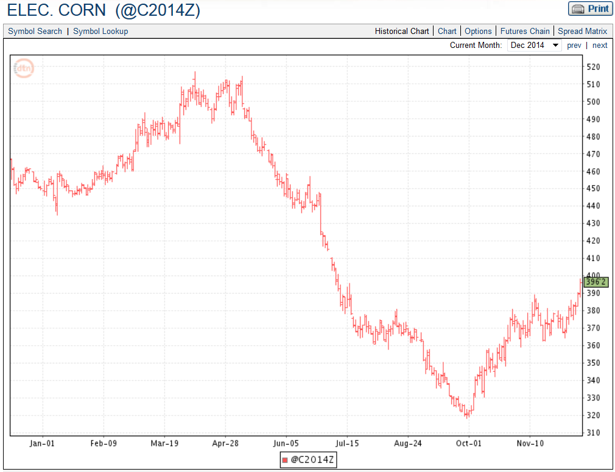
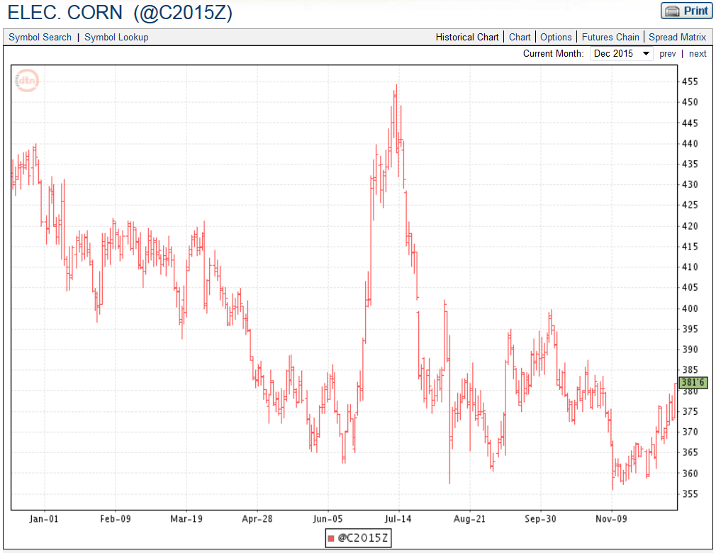
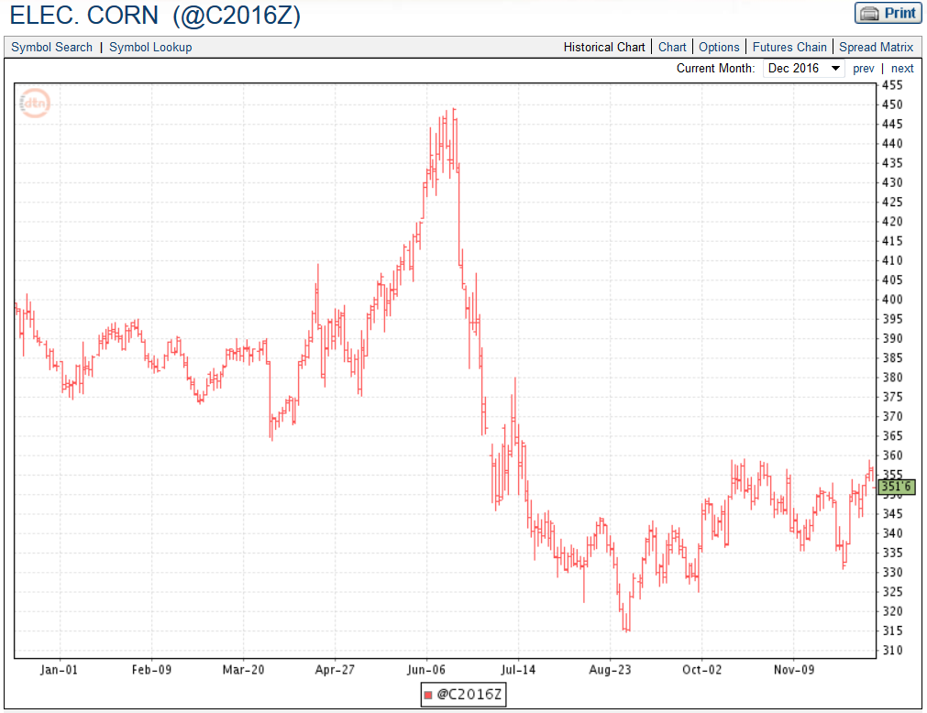
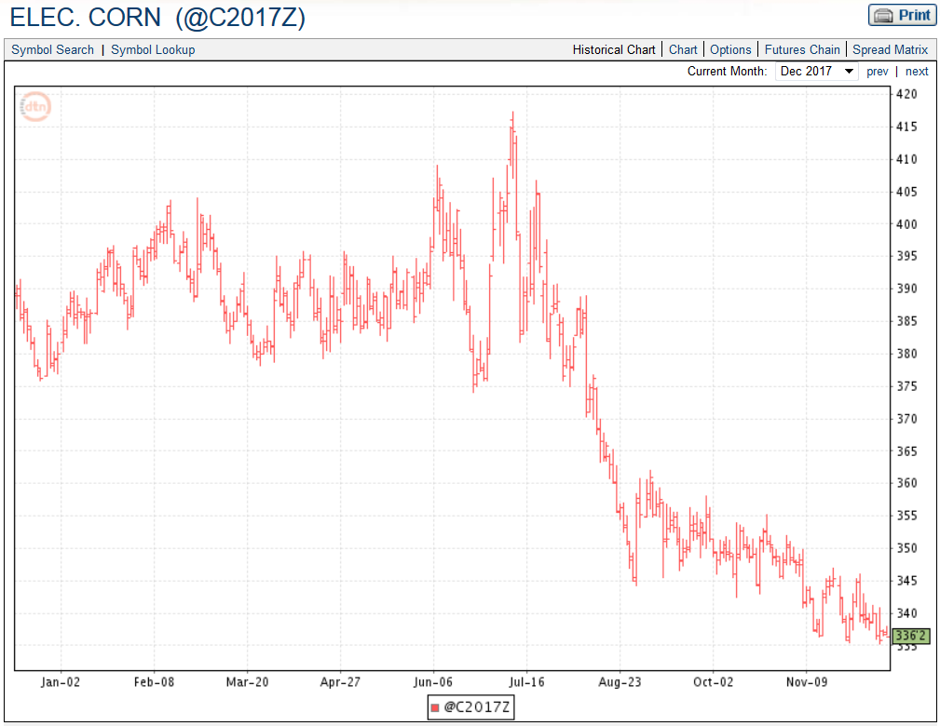
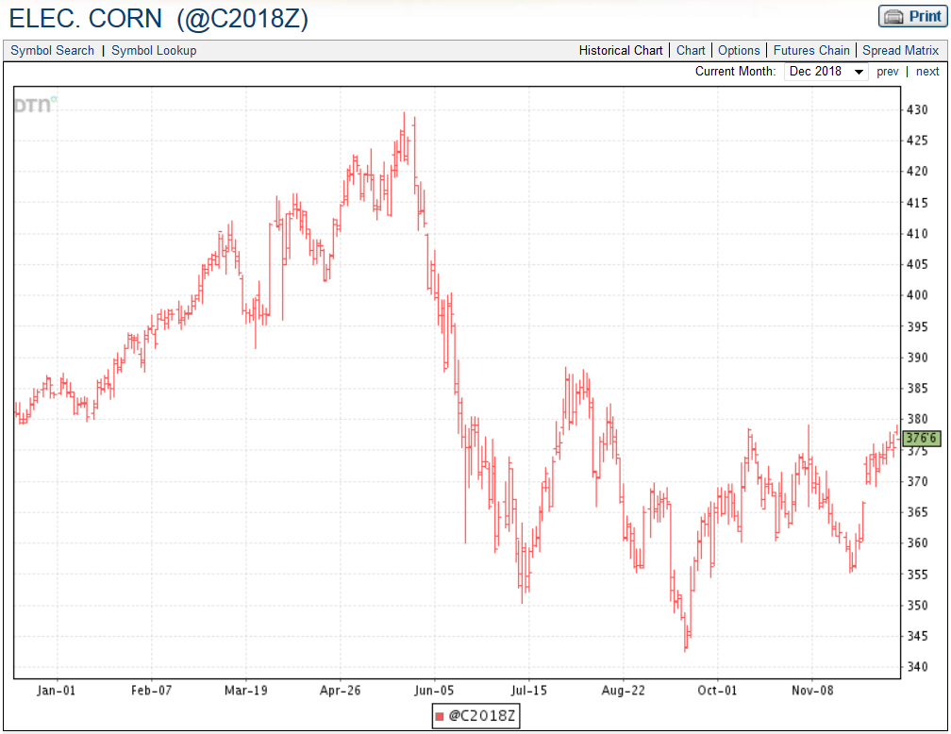
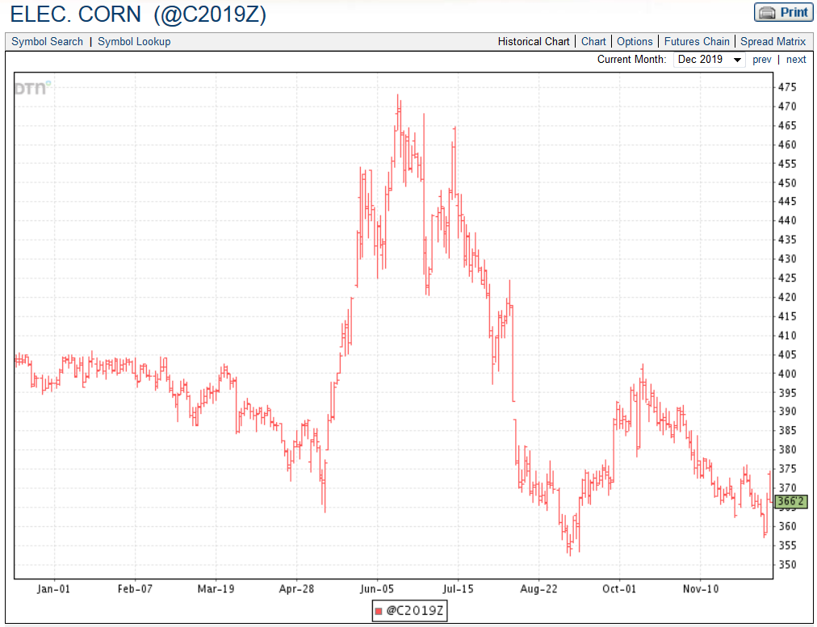

Slide 29
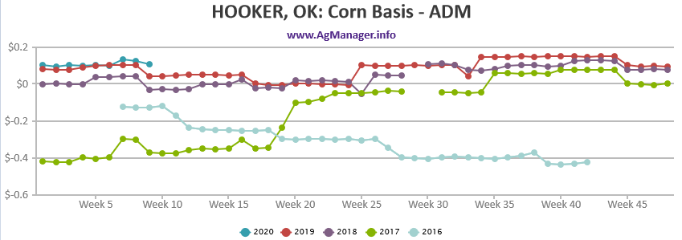

Slide 30

Oklahoma Grain Cash Bids
Monday, March 6, 2020 (Source: USDA AMS)

Slide 31
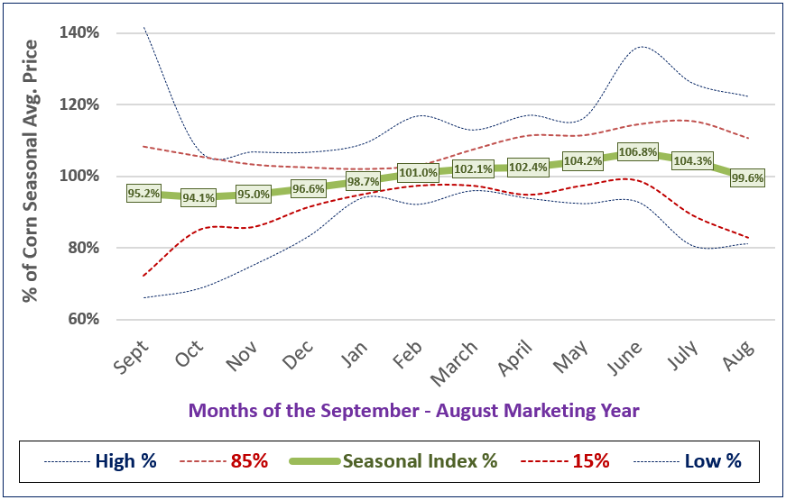
Seasonality of Kansas Corn Prices – last 15 years

Slide 32
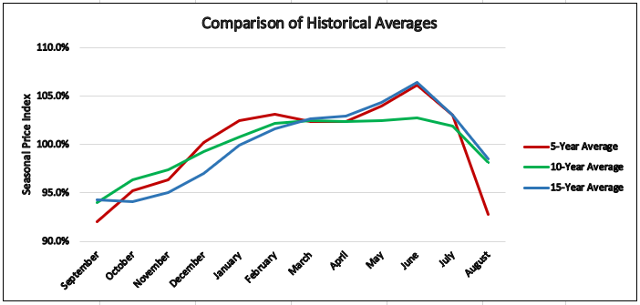
Seasonality of Kansas Corn $’s – last 5-10-15 years

Slide 33
U.S. Corn Stocks…..
Corn: “Moderate” Stocks & % S/U
  End Stocks ^{2019/20} → 1.892 bln bu (vs 2.221 bb last yr)
  % Stocks/Use ^{2019/20} → 13.5% S/U (vs 15.5% S/U last yr)

Slide 34
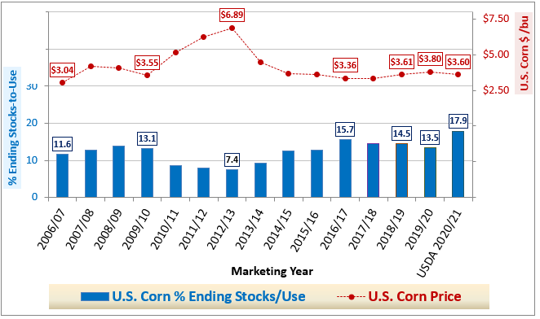
U.S. Corn % Stocks/Use vs Price$

Slide 35
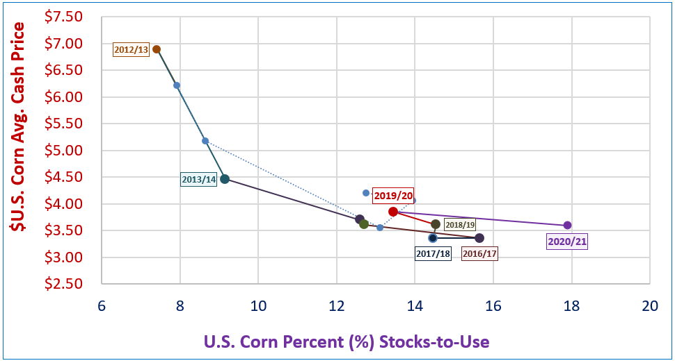
U.S. Corn % Stocks/Use vs Price$
?

Slide 36
World & World-less-China CORN Stocks & %S/U

Slide 37
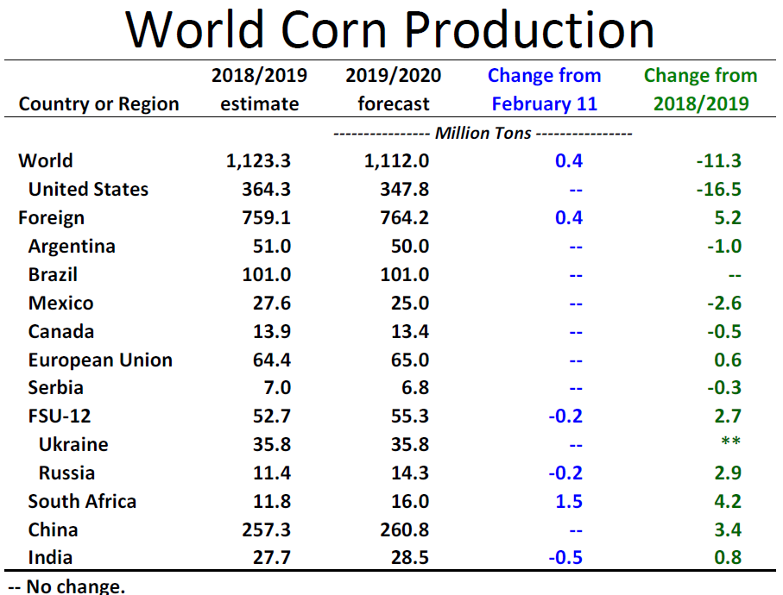

Slide 38
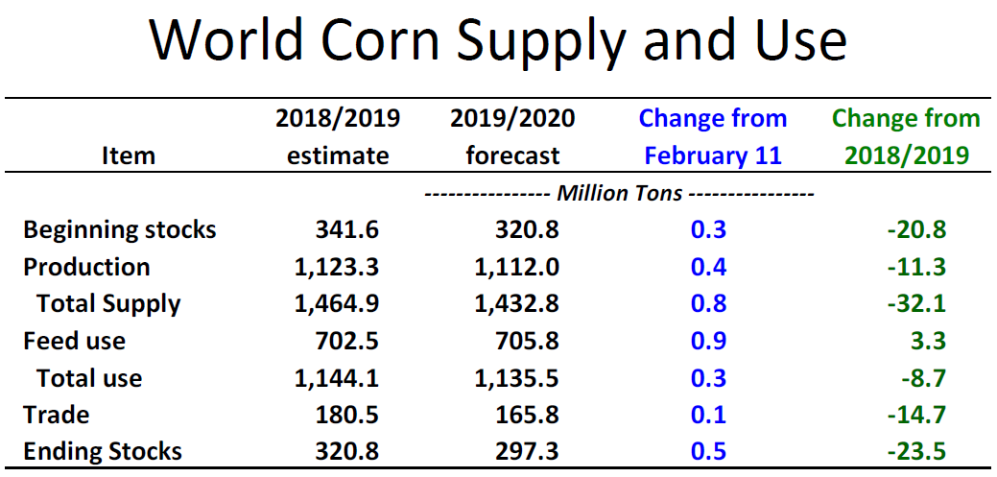

Slide 39
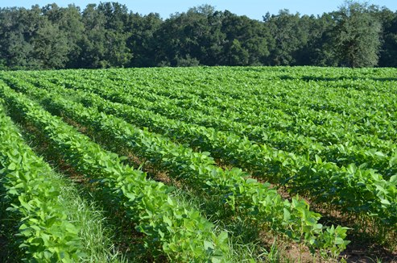
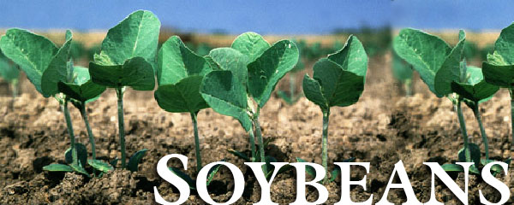
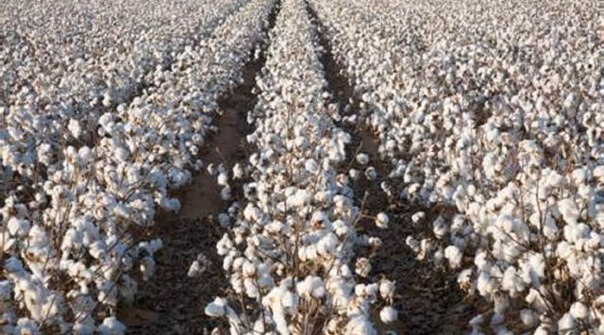
Soybean Markets

Slide 40
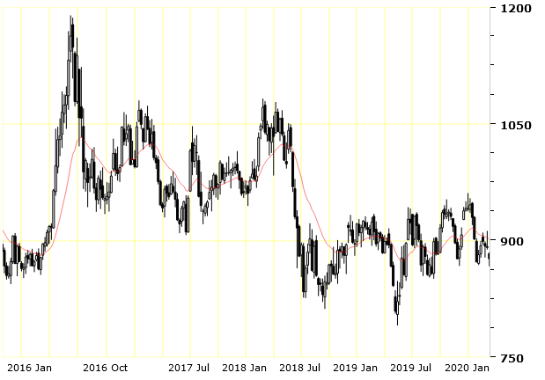
CME Soybean Futures
Weekly Chart: Fall 2015 through March 9, 2020
MAR 2020
$8.73
3/10/2020
$8.73
$8.51
(9/9/2019)
$8.53 ¼
(9/11/2015)
$8.12 ¼
(9/18/2018)
$7.91
(5/13/2019)

Slide 41
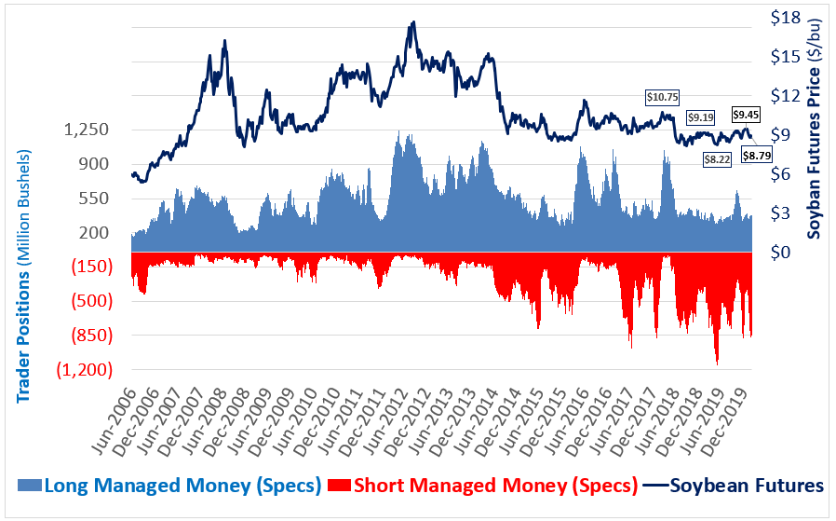
Managed Money (Spec) Positions in Soybeans
CFTC Commitment of Traders to February 20, 2020

Slide 42
Probability of Soybean Futures Trends
Examining 1990-2019 (Last 29 years)
Likelihood of Level-Higher NOV Soybean Futures??
  Trend through Spring-Summer (May-August)??
    ⇨ Spring-Summer Price  occurred 23/29 Years (85%)
  Which direction did prices move by Fall (Oct-Nov)??
    Price moving sideways / higher = 13/29 Years (41%)
    Price moving lower = 17/29 Years (59%)

Slide 43
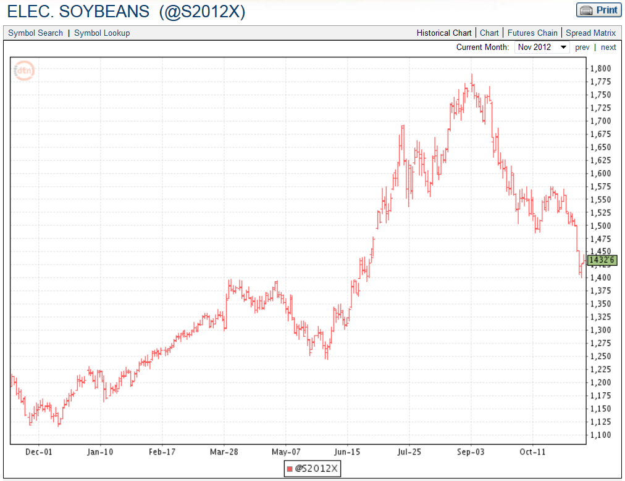
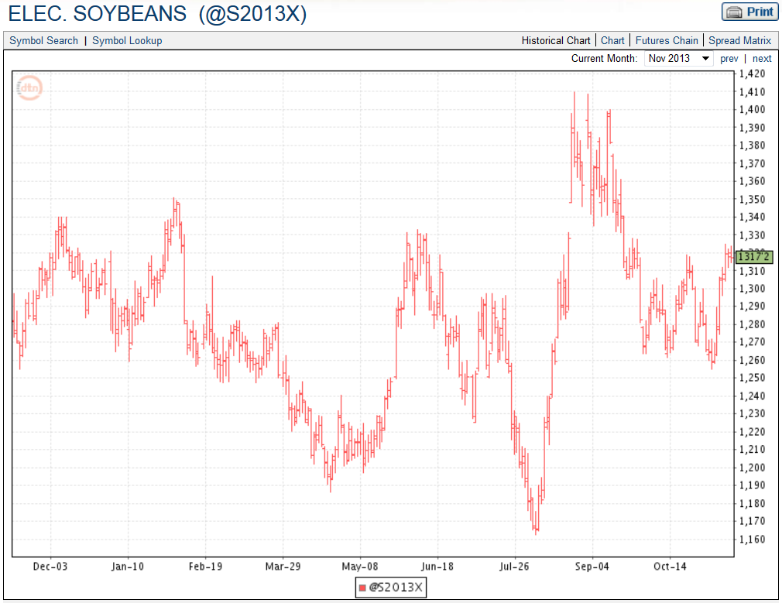
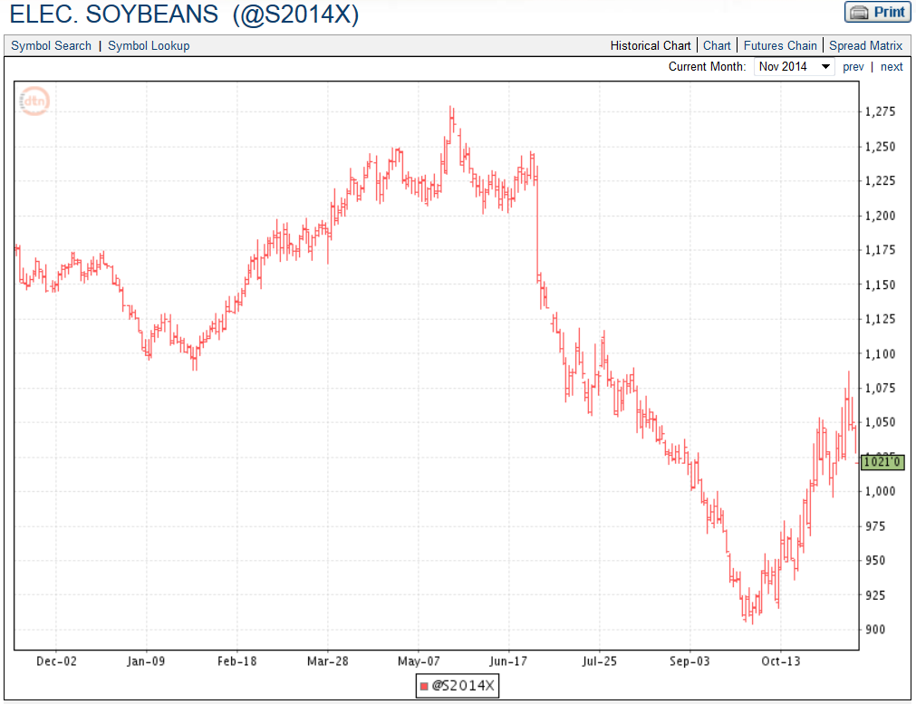
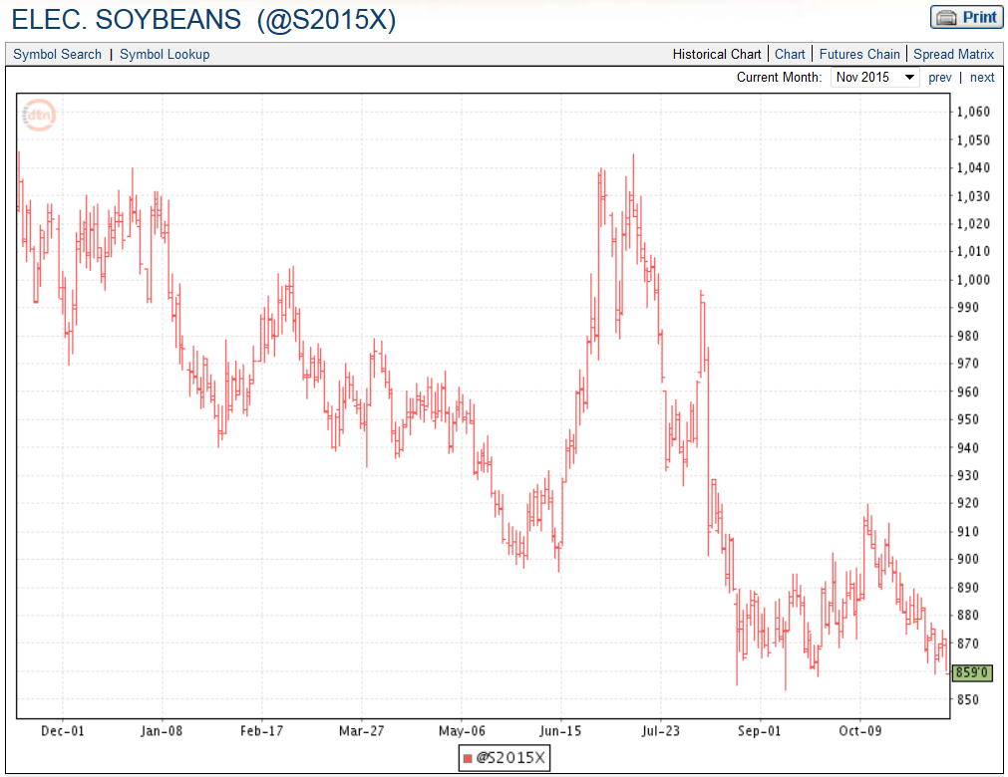
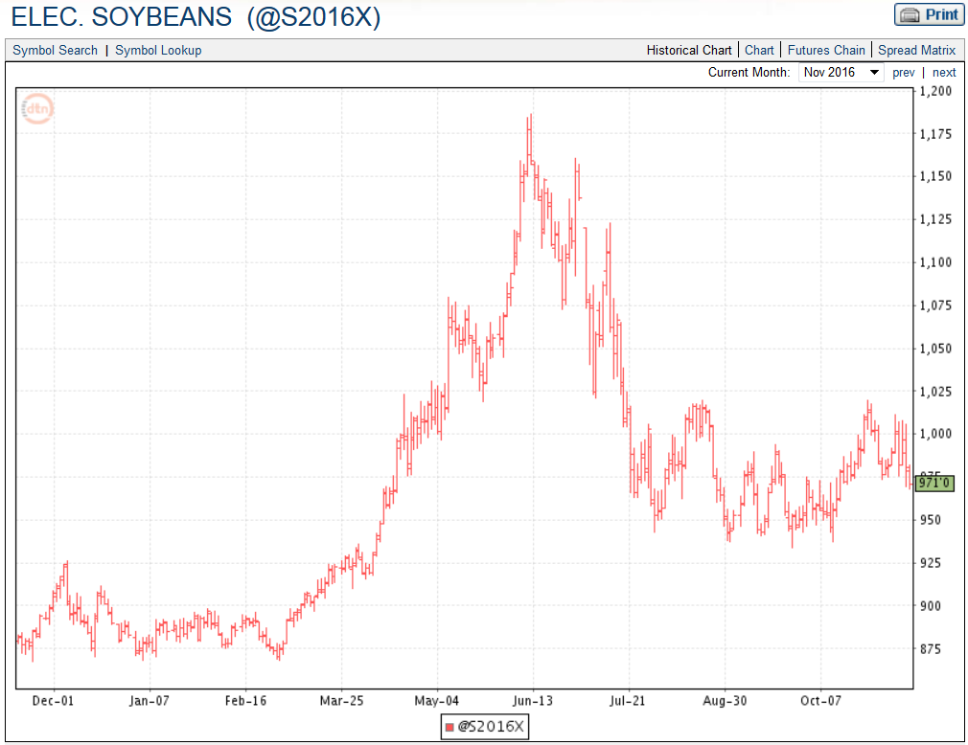
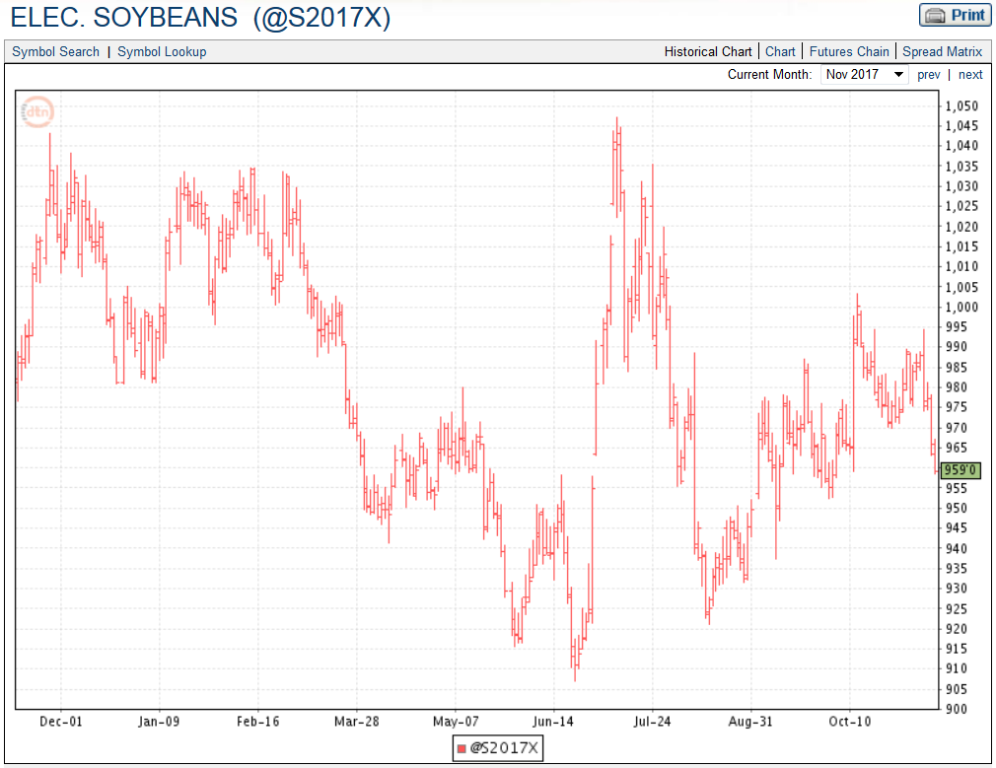
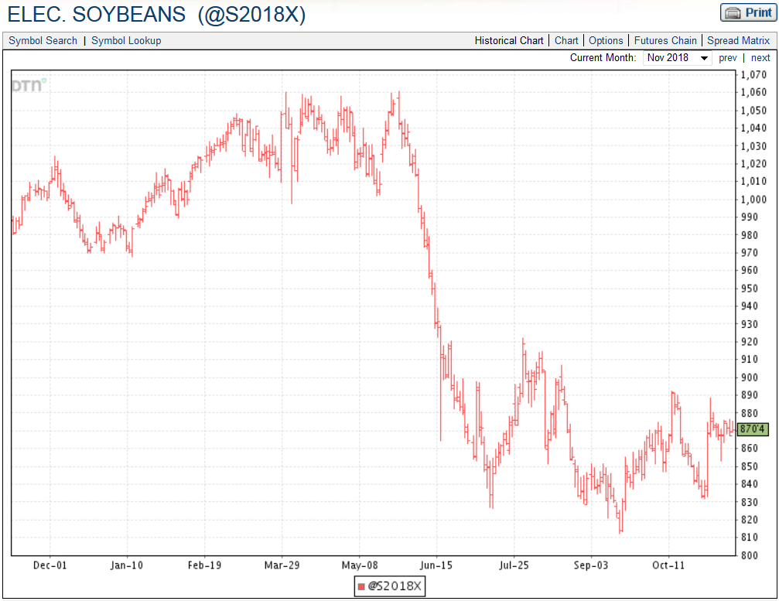
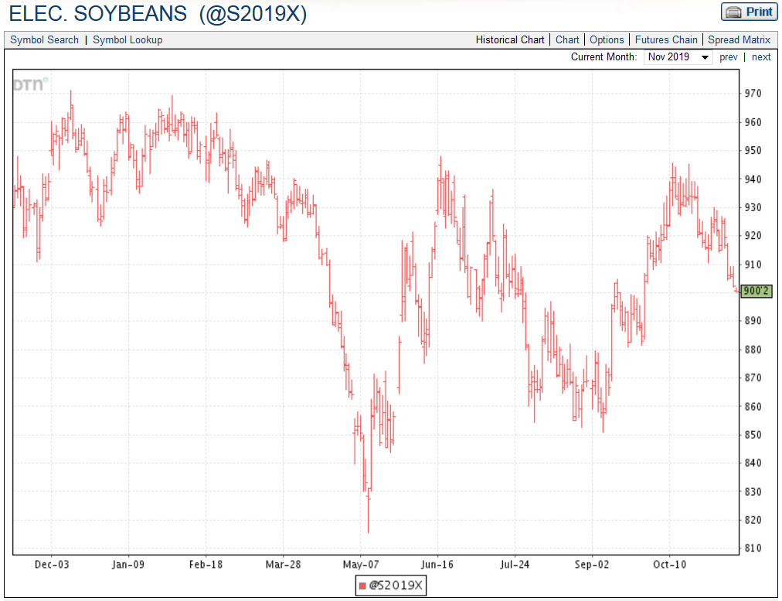

Slide 44
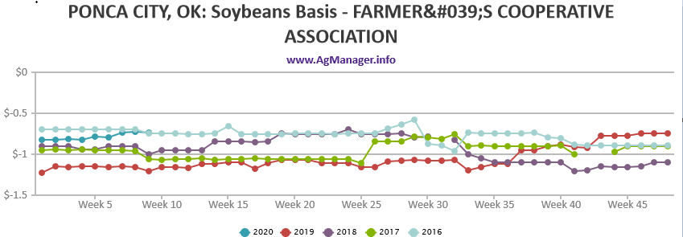

Slide 45
Oklahoma Grain Cash Bids
Monday, March 6, 2020 (Source: USDA AMS)

Slide 46
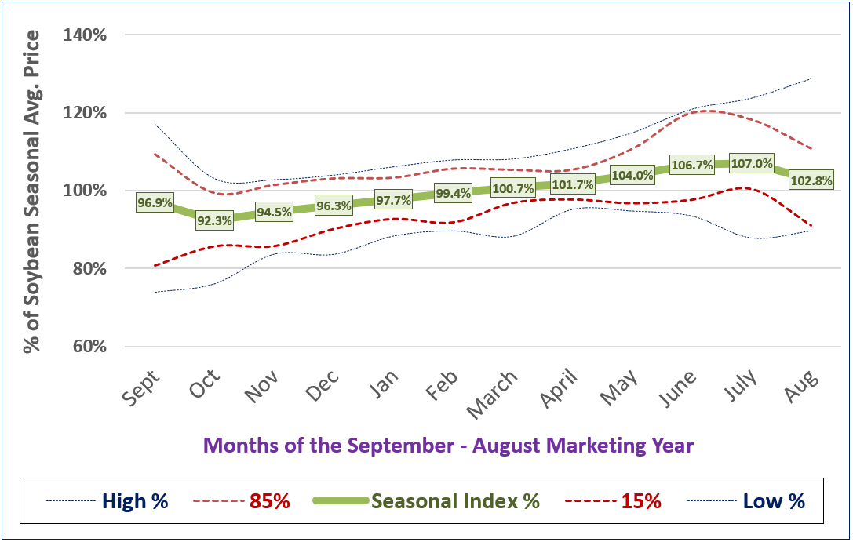
Seasonality of KS Soybean Prices – last 15 years

Slide 47

Seasonality of KS Soybean $’s – last 5-10-15 years

Slide 48
U.S. Soybean Stocks…..
Soybean: “Moderate-Large” Stocks & % S/U
  End Stocks ^{2019/20} → 425 mln bu (vs 909 mb last yr)
  % Stocks/Use ^{2019/20} → 10.5% S/U (vs 22.9% last yr)

Slide 49

U.S. Soybean % Stocks/Use vs Price$

Slide 50

U.S. Soybean % Stocks/Use vs Price$

Slide 51


Slide 52





Questions?
Daniel O’Brien – Extension Ag Economist
Blog: www.ksugrains.wordpress.com
KSUGrains on Twitter www.AgManager.info

Slide 53
Which pre-harvest grain sales strategy to use?
1. Wait for better forward
pricing opportunities
2. (To Manage Price Risk)
Buy Put Options to allow for rising futures & narrowing basis
1. Basis Contract
(Lock in narrow basis)
2. (To Manage Price Risk)
Minimum Price Contract to lock in basis & allow for rising futures
Rising Futures
Futures $
Price
Futures $
Price
Cash $
Cash $
Time
Time
Expected
Changes
Narrowing Basis
“Stronger” Basis
Widening Basis
“Weaker” Basis
1. Futures Short Hedge
or HTA Contract
(Lock in futures, not basis)
2. (To Manage Price Risk)
Buy Put Options to protect from falling futures
1. Forward Cash Contract
(Lock in futures & basis)
2. (To Manage Price Risk)
Minimum Price Contract to protect from wider basis & falling futures
Falling Futures
Futures $
Futures $
Price
Price
Cash $
Cash $
Time
Time

Slide 54
Harvest/Postharvest Grain Sales Strategies
1. Store & Wait for better
cash sale prices
2. (To Manage Price Risk)
Buy Put Options to allow
for rising futures &
narrowing basis
Use Marketing Loan
1. Basis Contract & Store
(Lock in narrow basis)
2. Sell Grain, Buy Call Option
3. (To Manage Price Risk)
Minimum Price Contract
(Lock in basis)
Use Marketing Loan
Rising Futures
Futures $
Futures $
Cash $
Price
Cash $
Price
Time
Time
Expected
Changes
Narrowing Basis
“Stronger” Basis
Widening Basis
“Weaker” Basis
1. Sell Cash Grain
2. Storage Hedge or HTA
(Lock in futures, not basis)
3. (To Manage Price Risk)
Buy Put Options to protect
from falling futures
Use Marketing Loan
1. Sell Cash Grain
2. Forward Cash Contract
(Lock in futures & basis)
3. (To Manage Price Risk)
Minimum Price Contract
to protect from wider
basis & falling futures
Use Marketing Loan
Falling Futures
Price
Futures $
Futures $
Cash $
Price
Cash $
Time
Time

