Slide 1

Entrepreneurship Education

Slide 2

Business Start-up Notebook

Slide 3
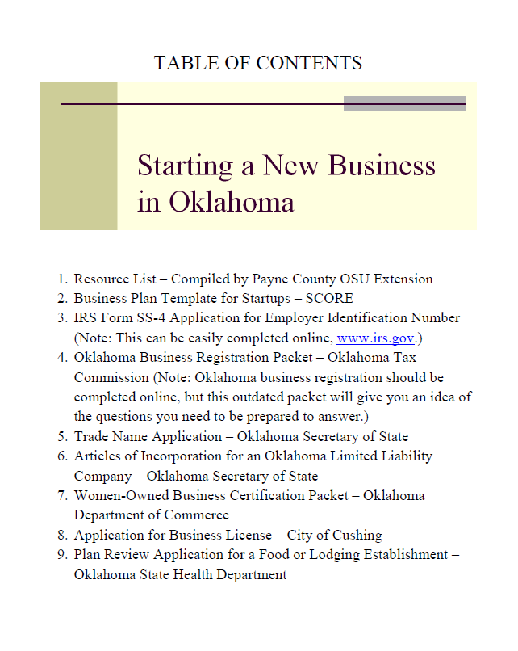

Slide 4
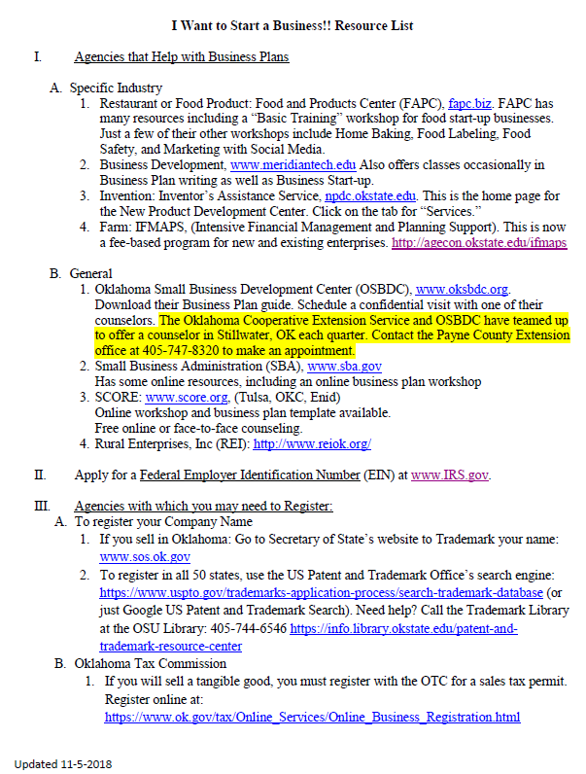
Replace with your own Career Tech Center
Invite James Arati to your county office.

Slide 5
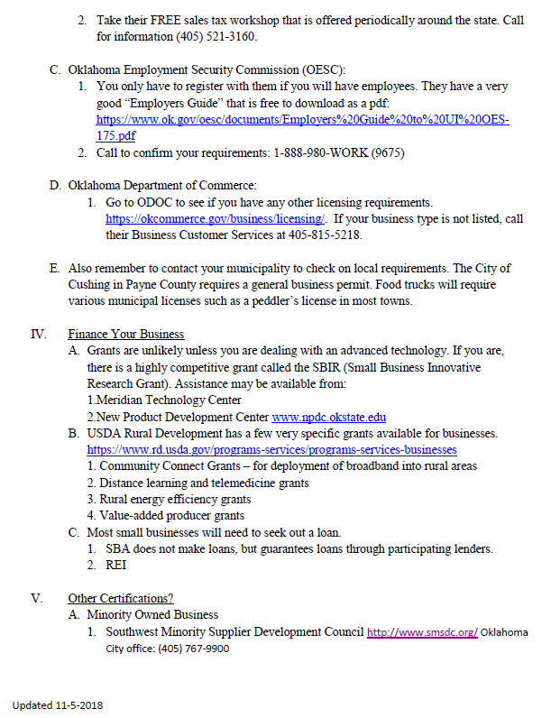
Call the municipal offices in your county.

Slide 6
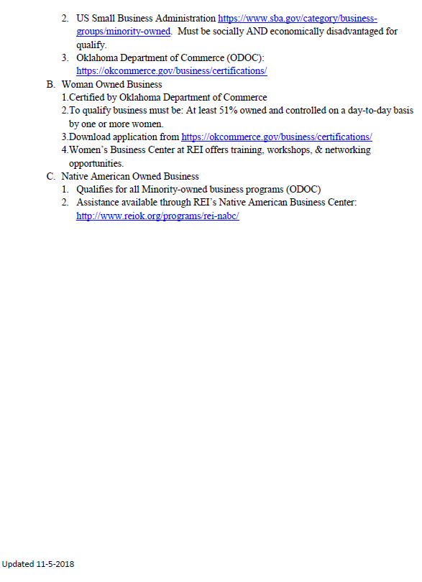

Slide 7
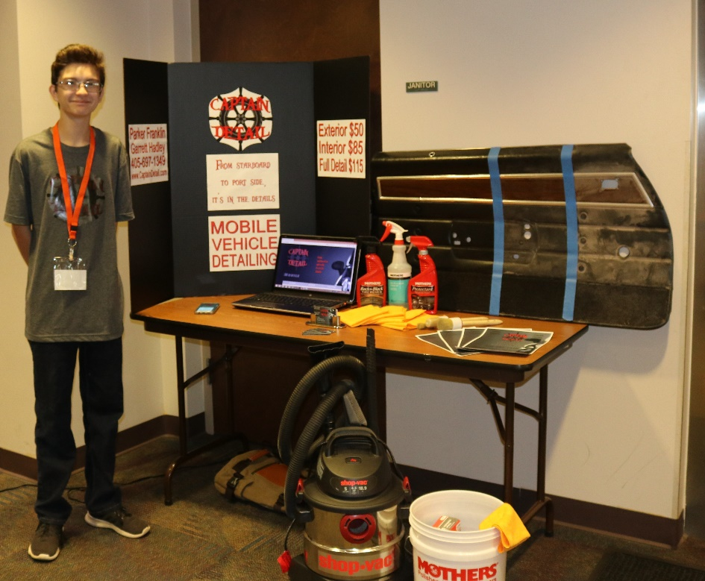
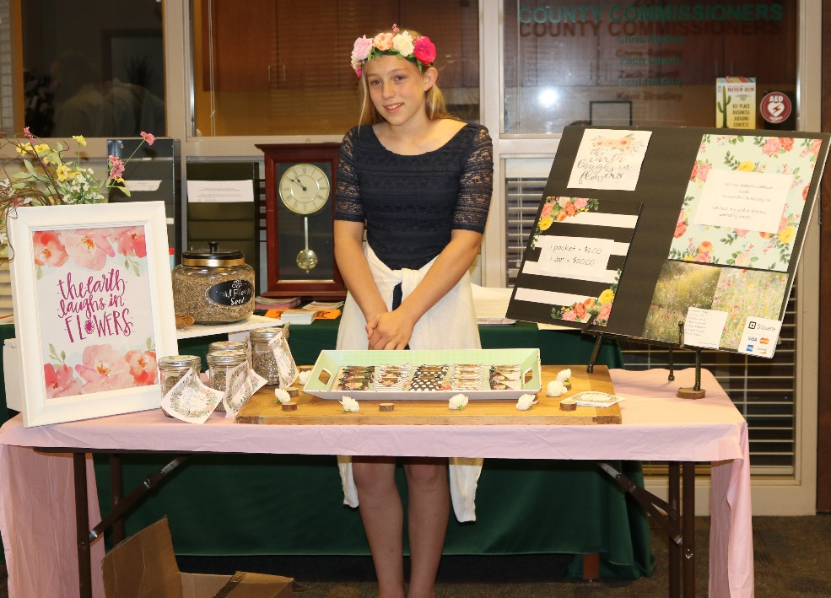
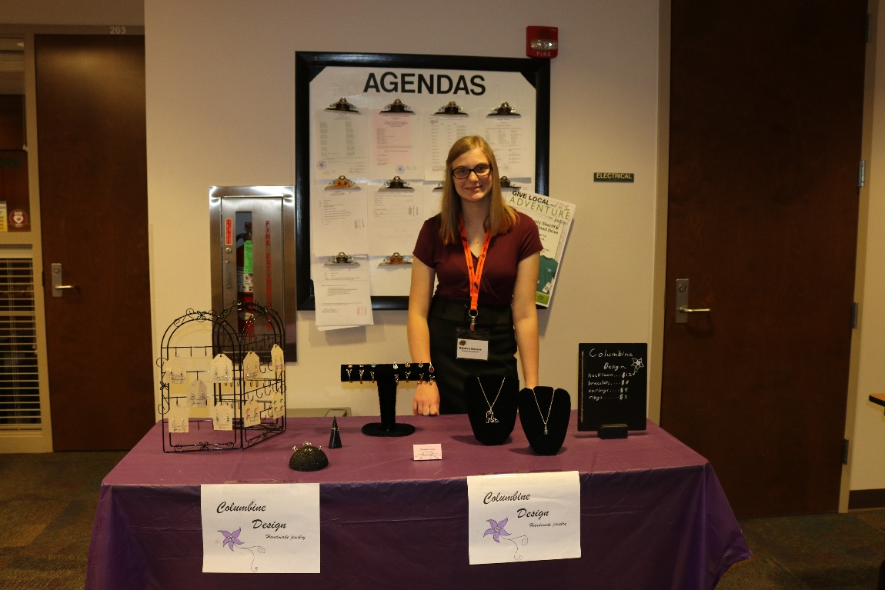
Young Entrepreneur Expo
Booth Display Competition

Slide 8
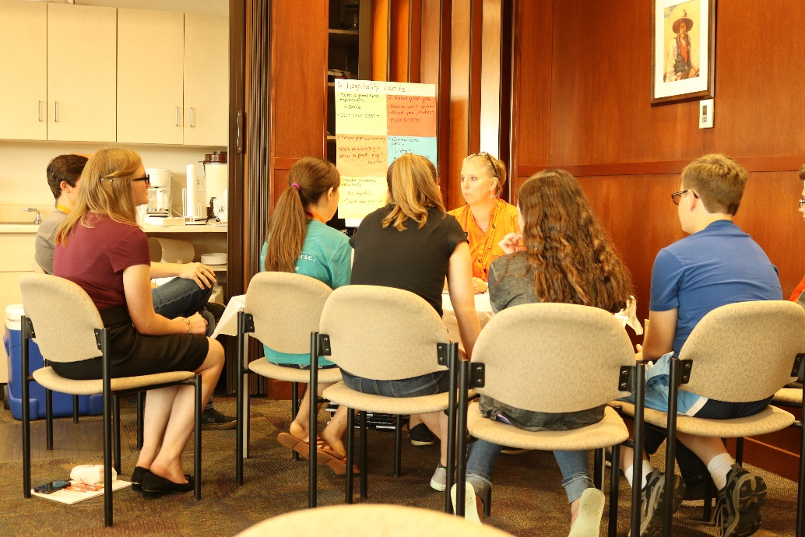
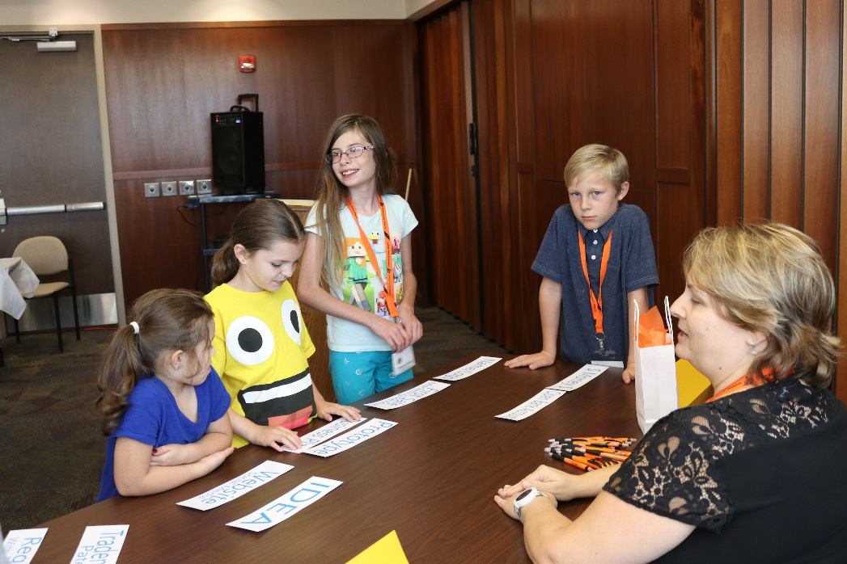
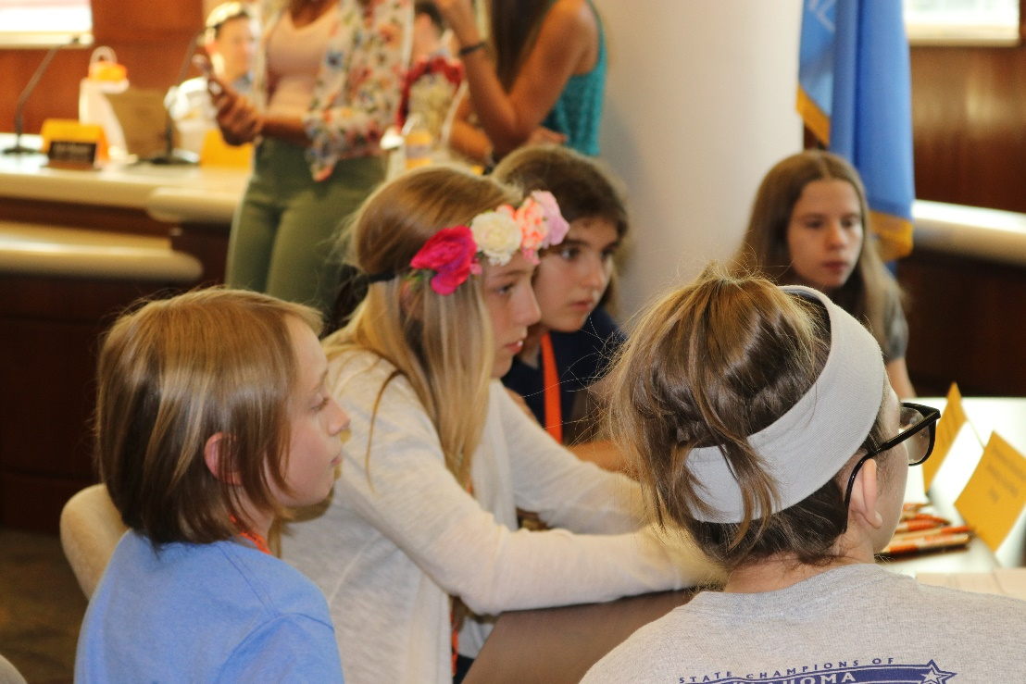
Roundtable Activities

Slide 9



Slide 10
New Entrepreneur Training Program
The Entrepreneur Training Program offered by Payne County OSU Extension is an
8-session program for individuals who are seriously considering starting a business in Payne County or who have recently started a small business in the county.
Other details:
Extension educators will work with local partners and service providers to teach valuable workshops on topics that are crucial to business start-up.
Cost of the program is $95 per person. This includes all 8 sessions, educational materials, and light refreshments.
Program fees may be paid in 1, 2 or 3 payments.
Locations will vary throughout Stillwater and Payne County.
Participants will be expected to attend at least 6 of the 8 sessions.
Small and home-based businesses are highly encouraged to participate.
Class size will be limited to 10 individuals.

Slide 11
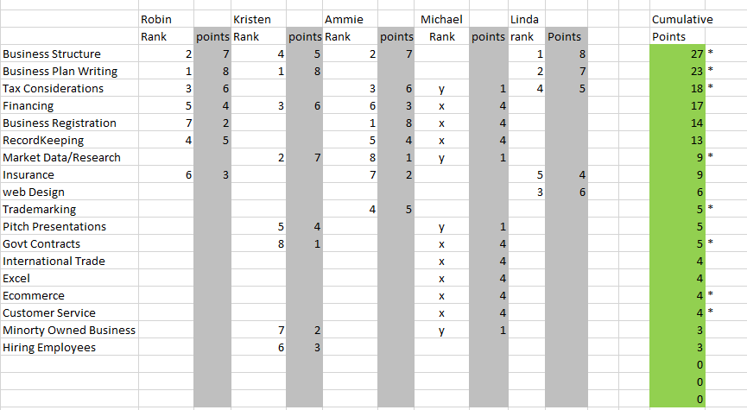
How I decided what topics to cover:

Slide 12
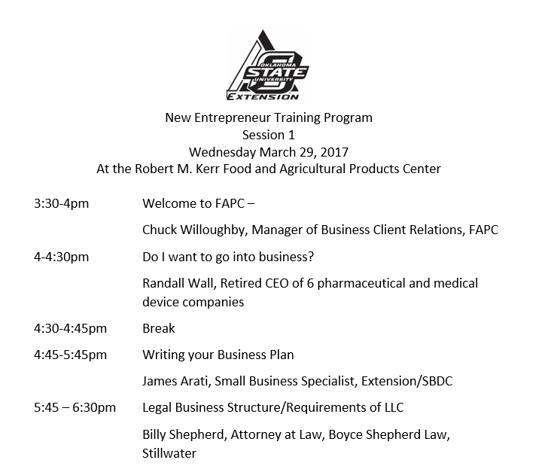

Slide 13
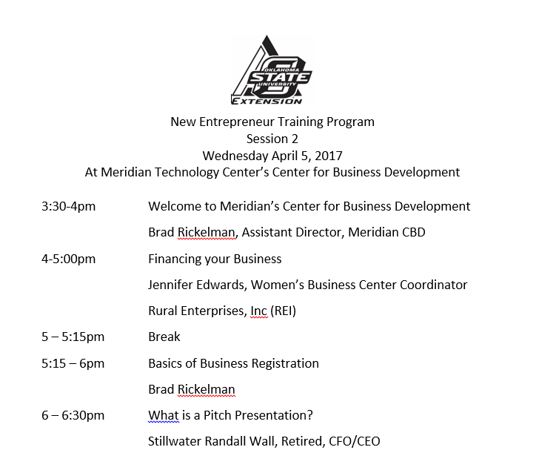

Slide 14
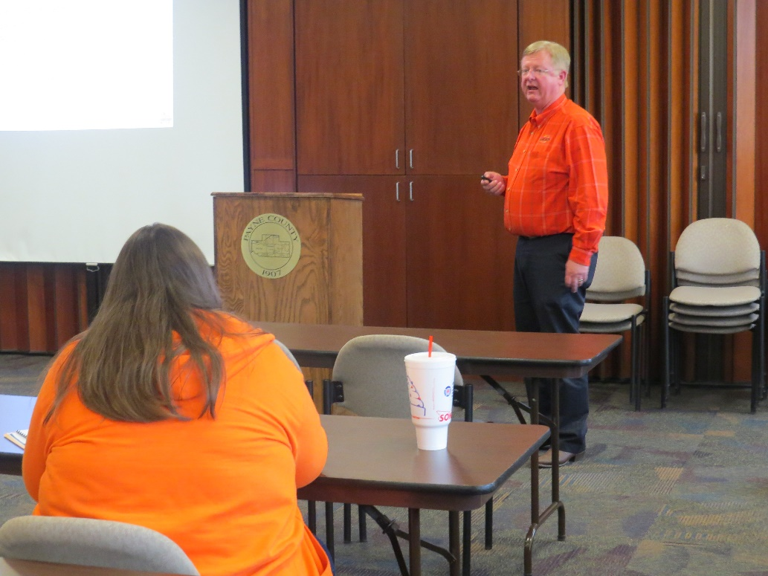
Session 3: Marketing Topics at Visit Stillwater
Session 4: QuickBooks at Meridian Technology Center
Session 5: Market Data/Market Research (Dave Shideler)
Session 6: Web Design (Brian Whitacre) at Stillwater Public Library
Session 7: Networking and Public Speaking Skills at the United Way office
Session 8: Insurance, HR/Hiring issues, Tax issues at Payne County Administration Building
Final Session: The Pitch Presentations at Stillwater Chamber of Commerce

Slide 15
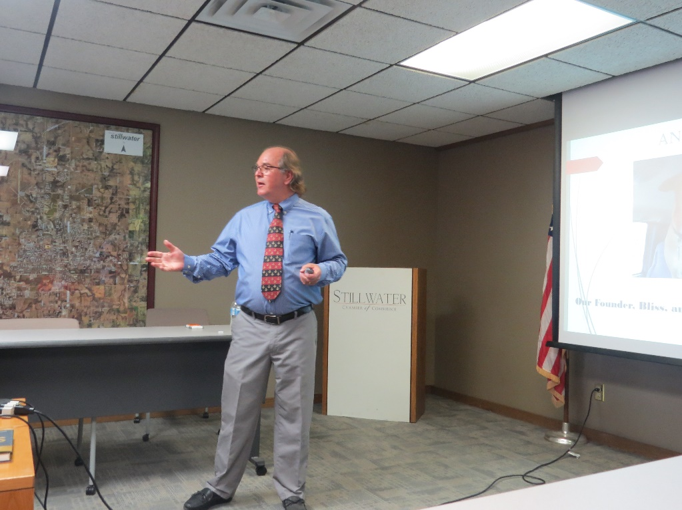
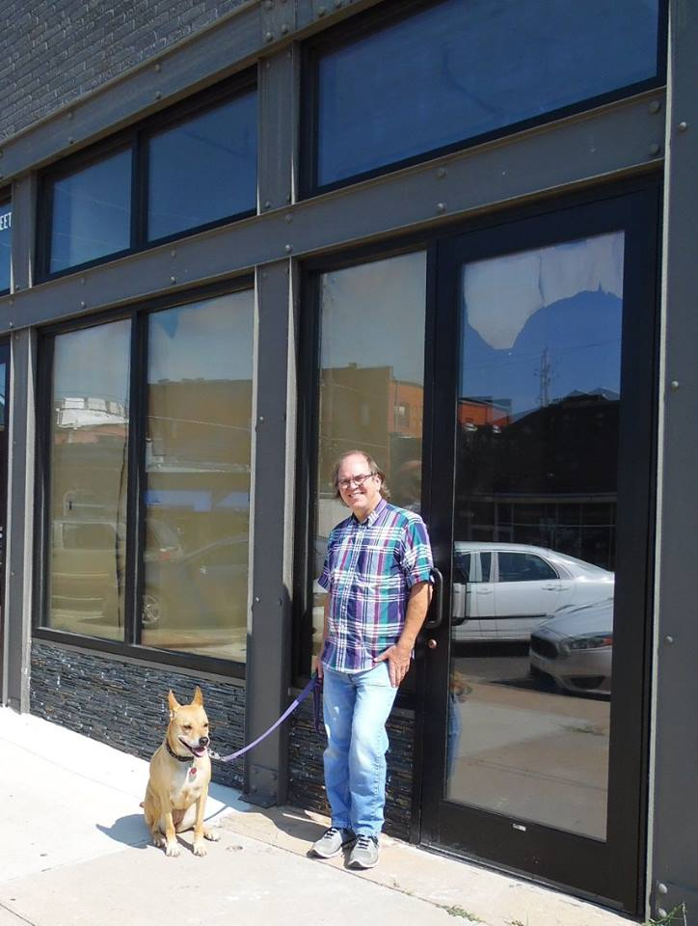

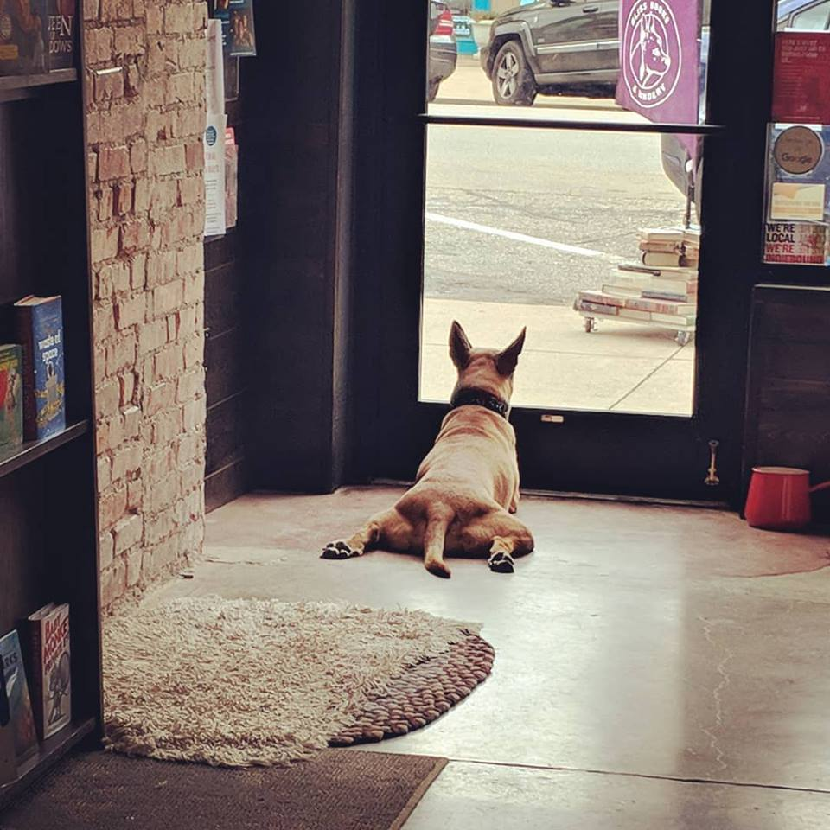
Bliss Books and Bindery
Roger Mullins

Slide 16
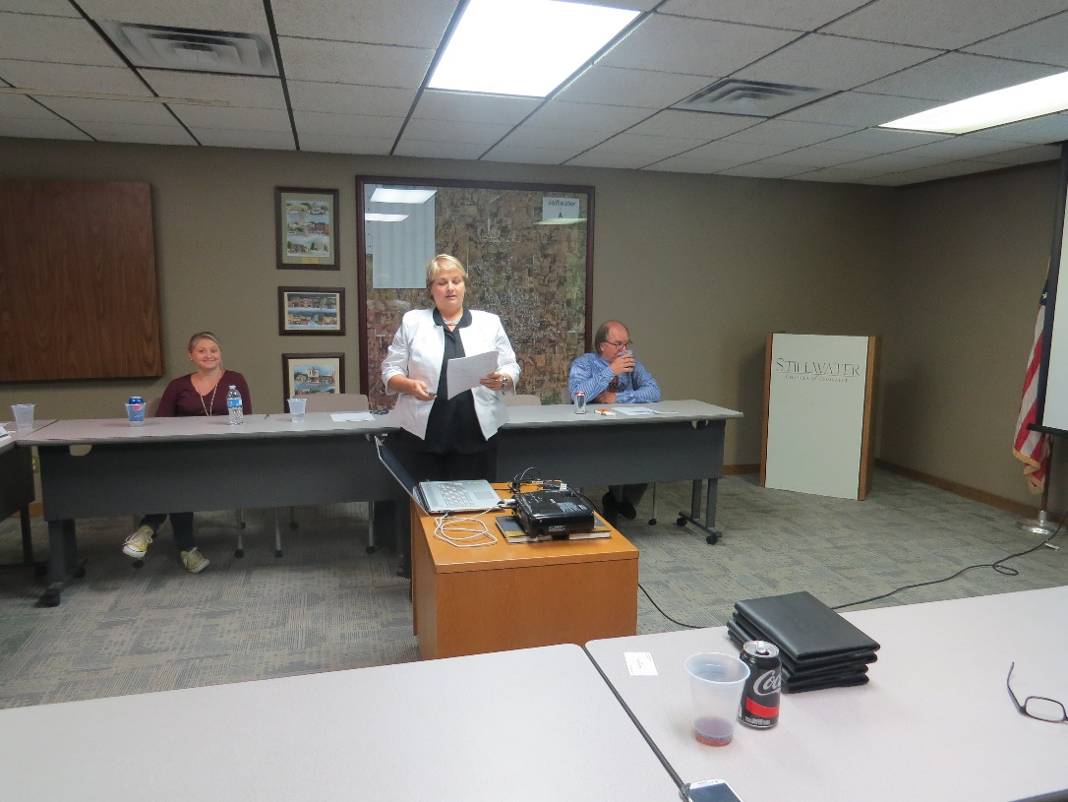
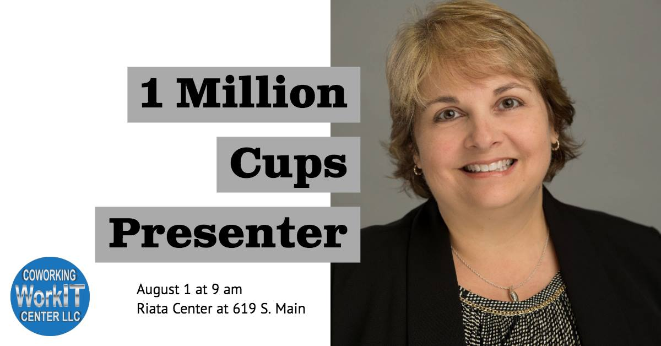
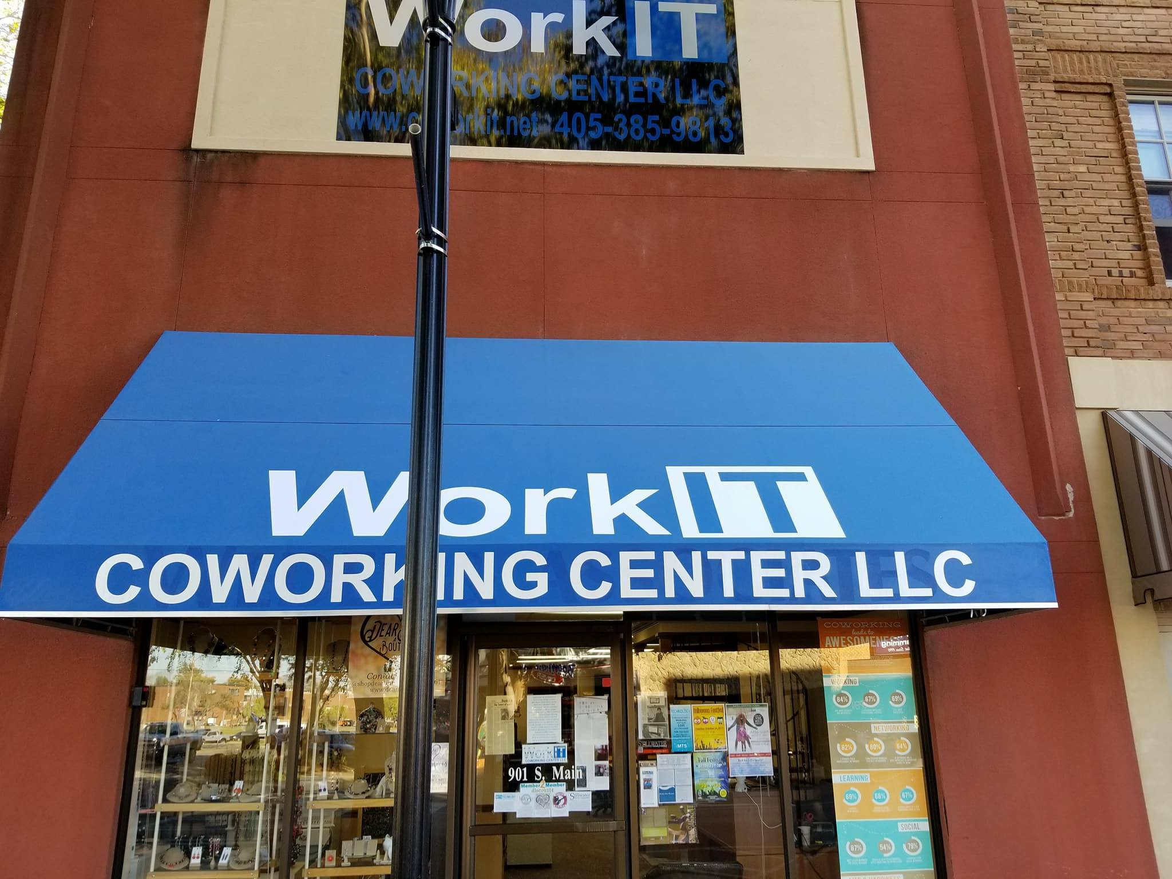
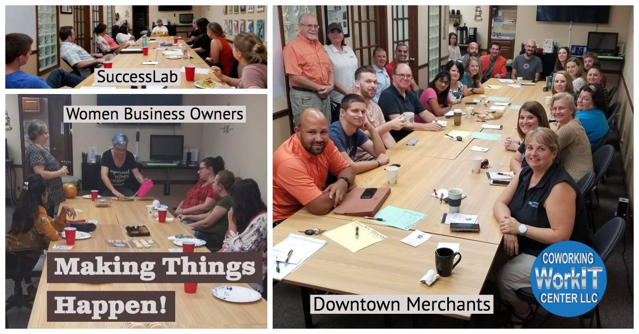
WorkIT Coworking Center
Kristen Hadley

Slide 17
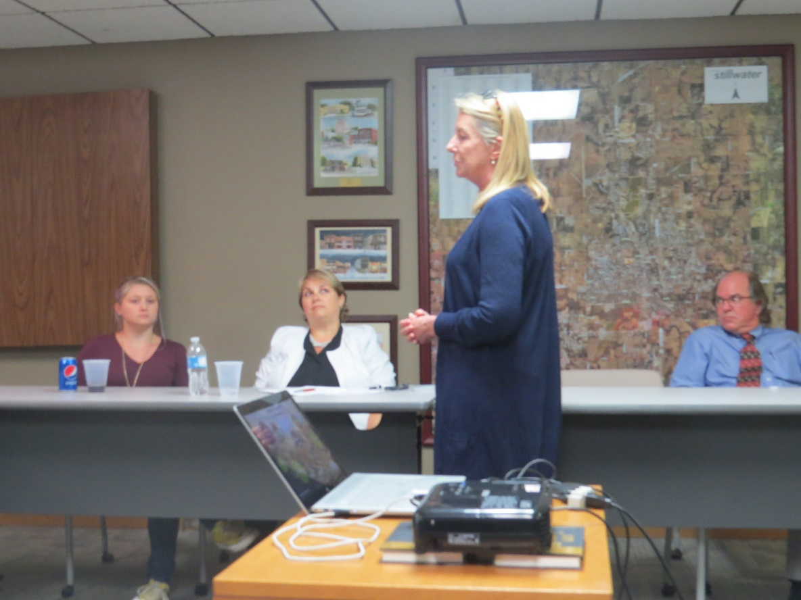

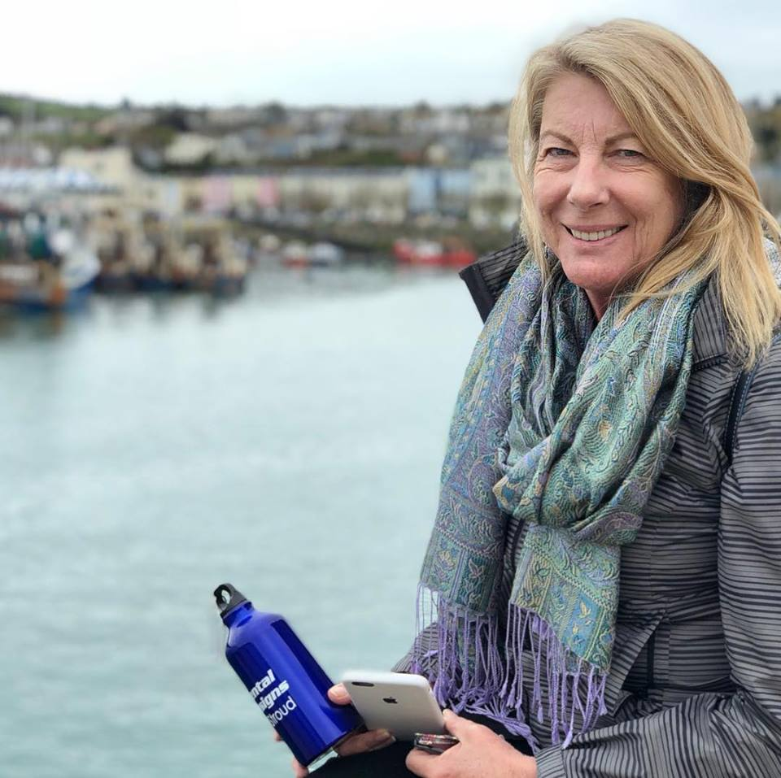
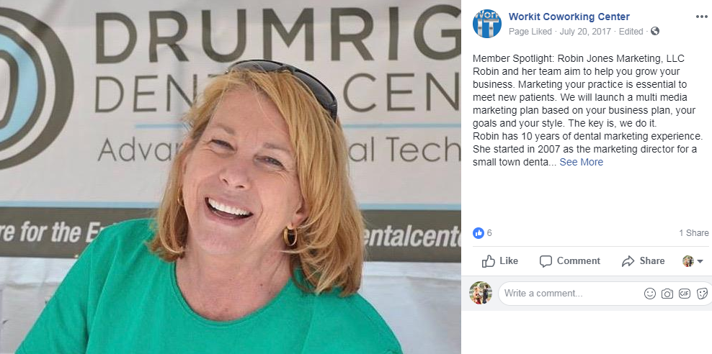
Robin Jones Marketing

Slide 18
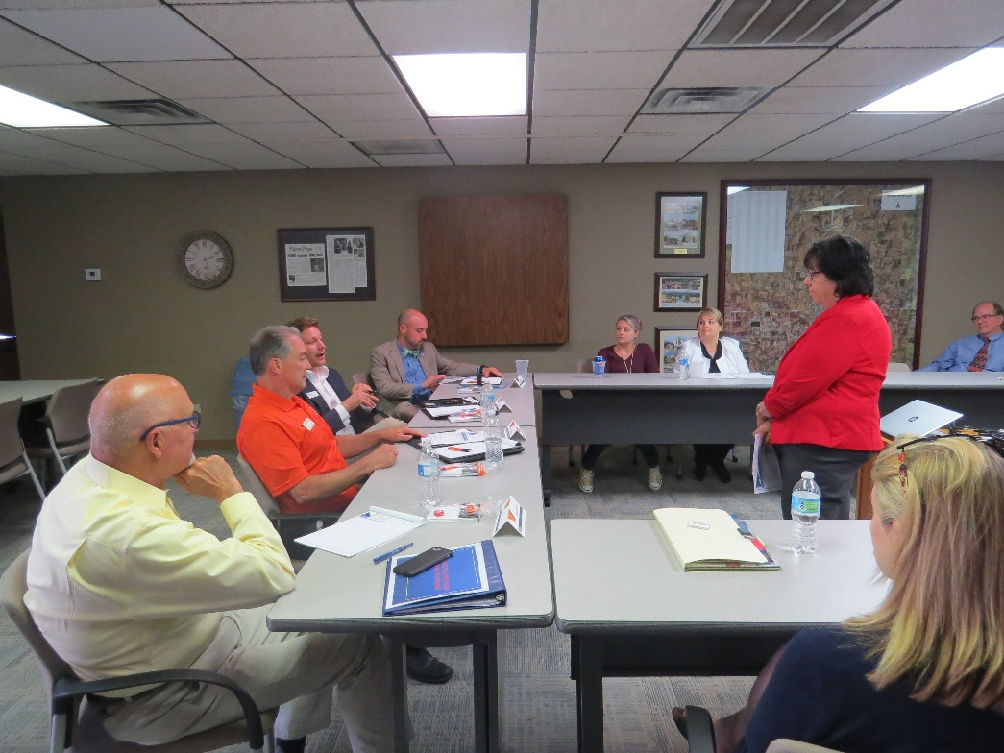


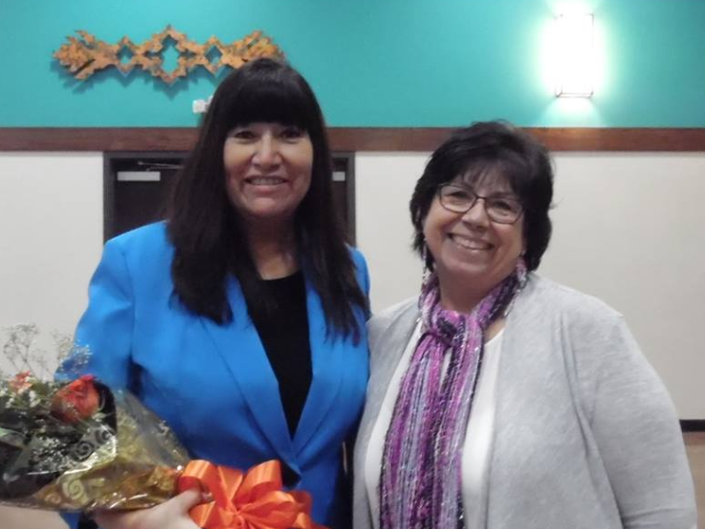

Linda Andre

Slide 19
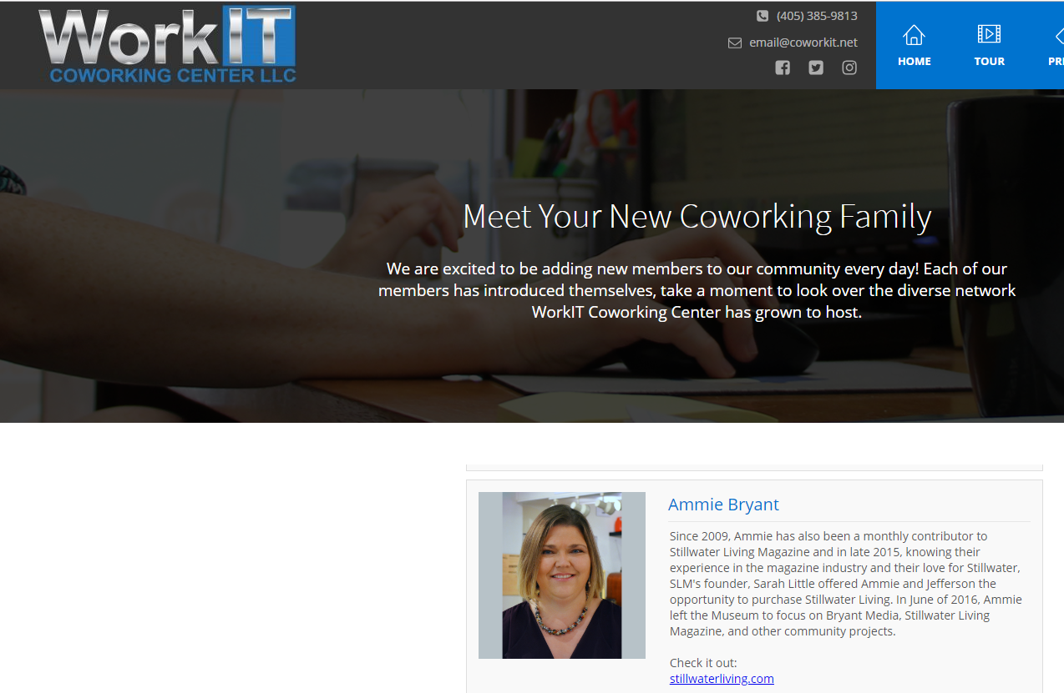
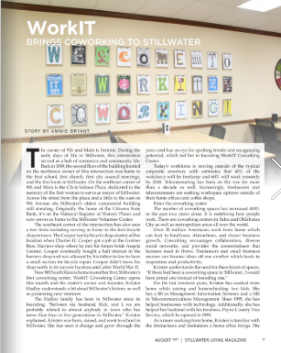

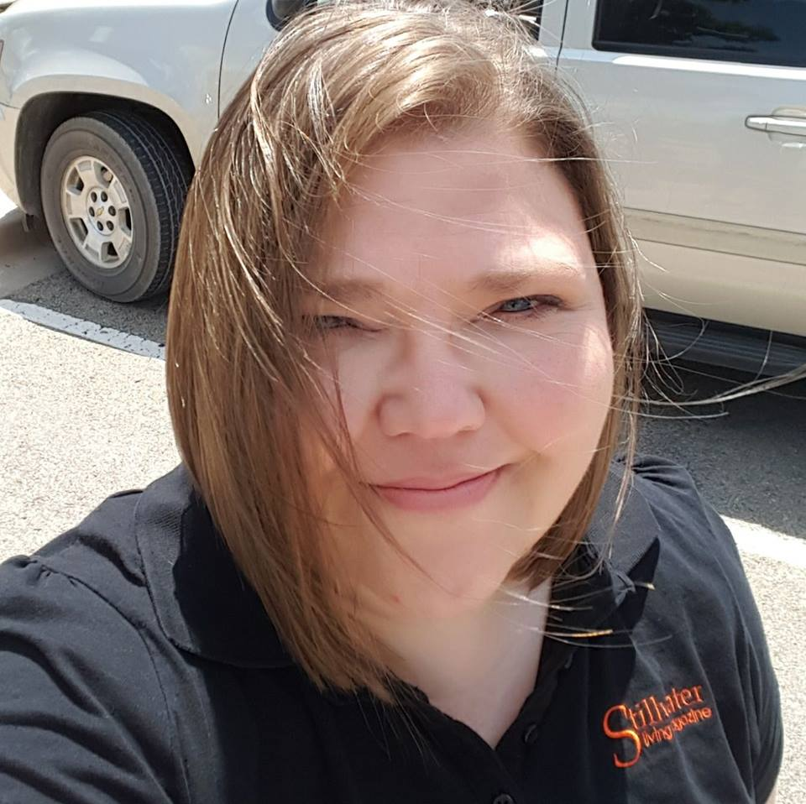
Stillwater Living Magazine
Ammie Bryant

Slide 20
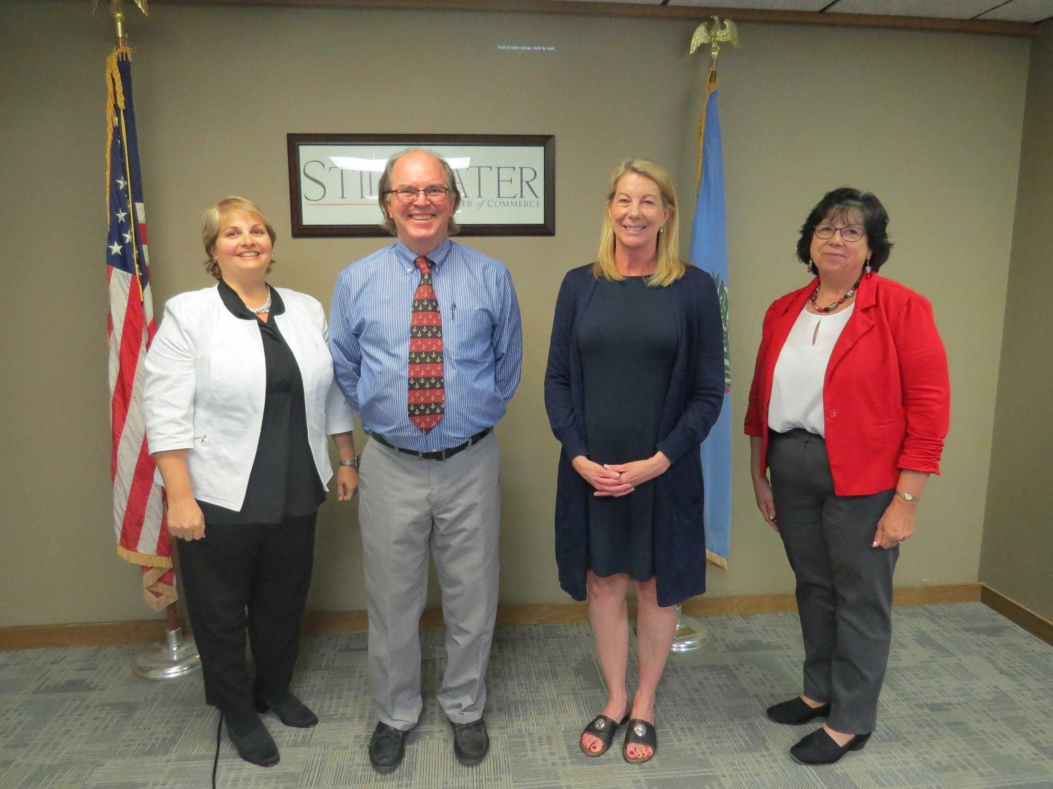

Slide 21
