Slide 1


Broadband in OK: 2018 Update
Brian Whitacre
Professor and Extension Economist
10/29/2018

Slide 2
Agenda
Broadband definition
Availability / Adoption Maps
  What communities can do to get it / upgrade it
What can Extension do about broadband locally?
  E-commerce workshops / library hotspot lending
  Fact sheets

Slide 3
What is “Broadband”?
The official FCC definition changes over time!
Current definition (enacted in 2015):
  25 MBPS download, 3 MPS upload
Previous definitions:
  200 KBPS at least 1 direction (prior to 2008)
  786 KBPS down (2008)
  4 MBPS down, 1 MBPS up (2010)
25 MBPS Download, 3 MBPS Upload
ANY Technology (cable, fiber, wireless, satellite, etc.) that can meet this threshold is officially “broadband”

Slide 4
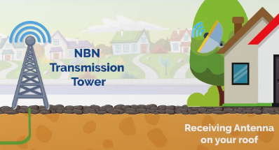
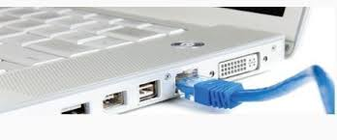

Fixed vs. Mobile
“Fixed” technology:
  Includes what most think of as “wired:” Cable, Digital Subscriber Line (DSL), Fiber
  Also includes: Fixed wireless and satellite
Mobile technology:
  Cellular networks (i.e. wireless)
  Generations of wireless networks & download speeds:
    3G (~3 MBPS)
    4G (~10 MBPS)
    4G LTE (~40 MBPS)
    5G is coming!* (~10GBPS+)
Some satellite companies now claim to provide 25 /3
Mobile technology typically comes with monthly data limits
*Rural areas won’t be the first served (as usual)

Slide 5
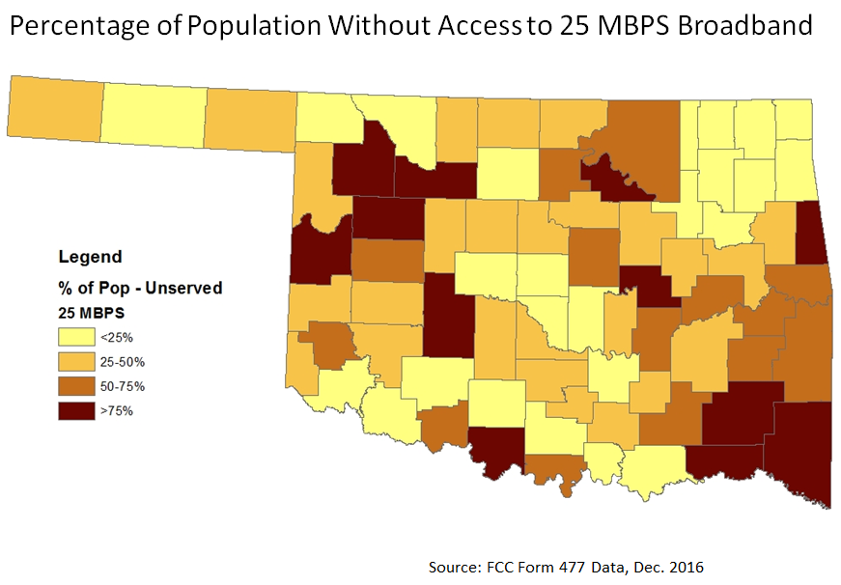
Broadband Availability

Slide 6
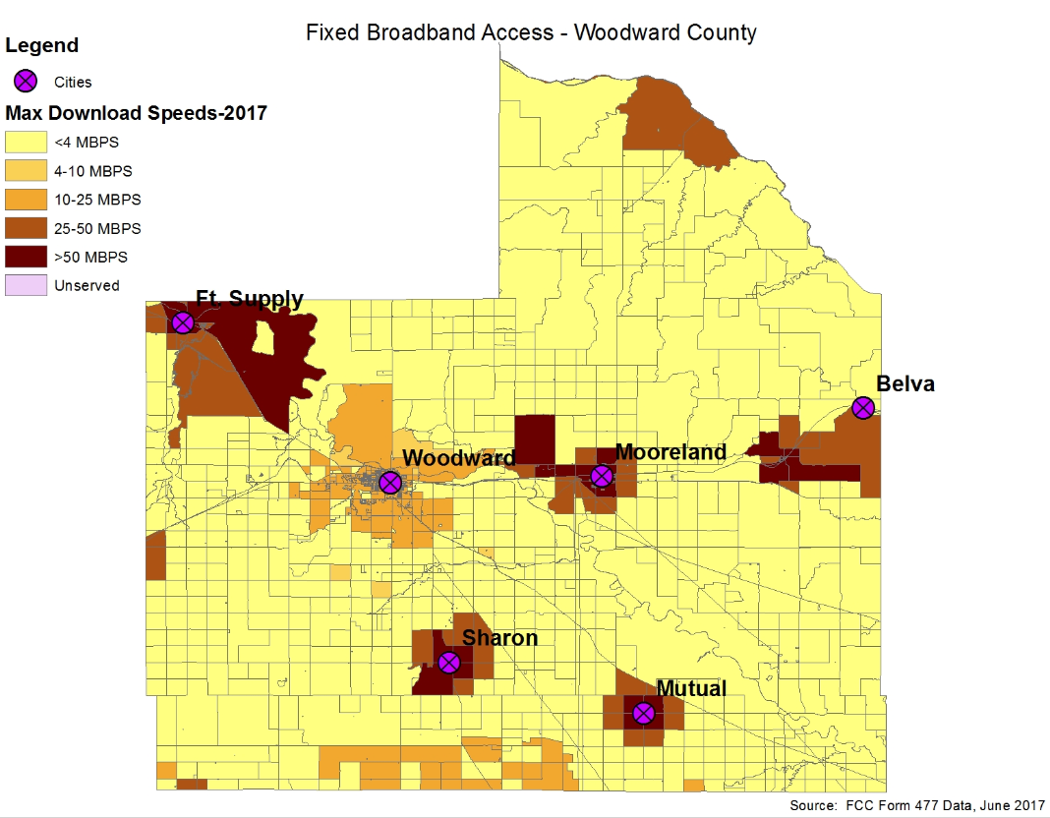
County Maps Available

Slide 7
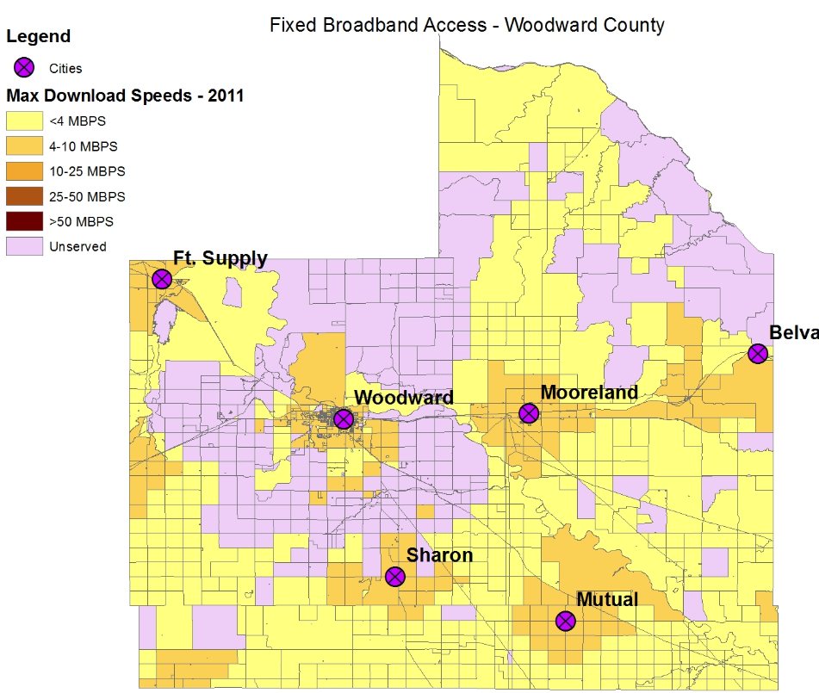
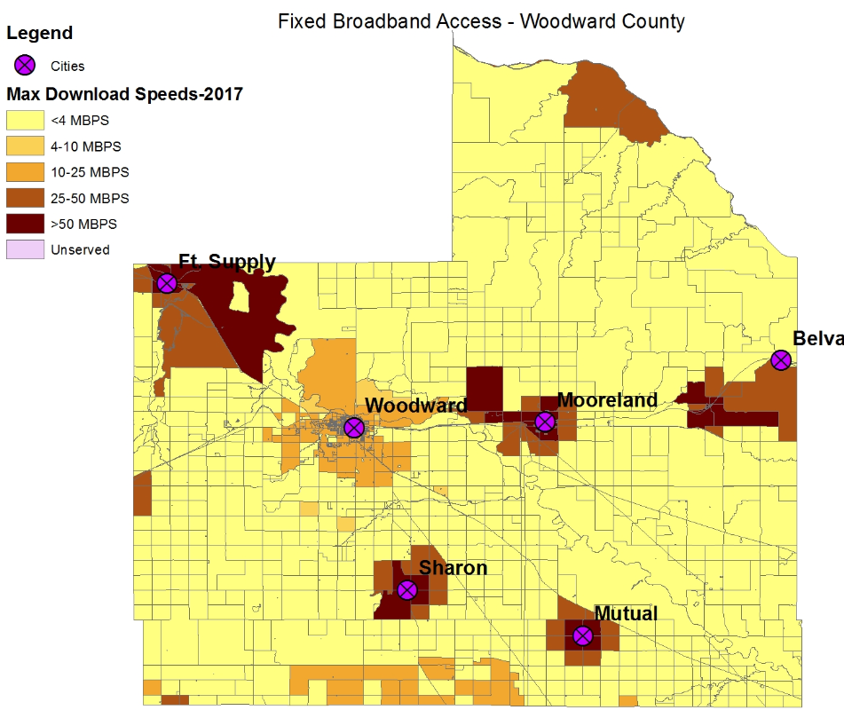
Broadband Availability Over Time
2011
2017

Slide 8
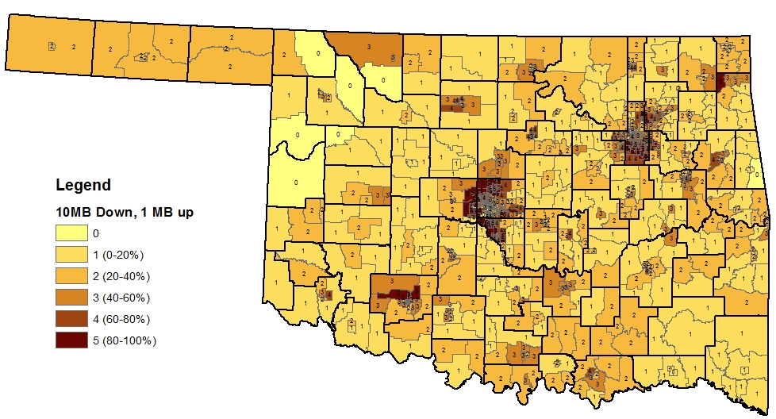
Broadband Adoption Maps
% Households with 10 MBPS
June 2016 FCC Form 477 Data

Slide 9
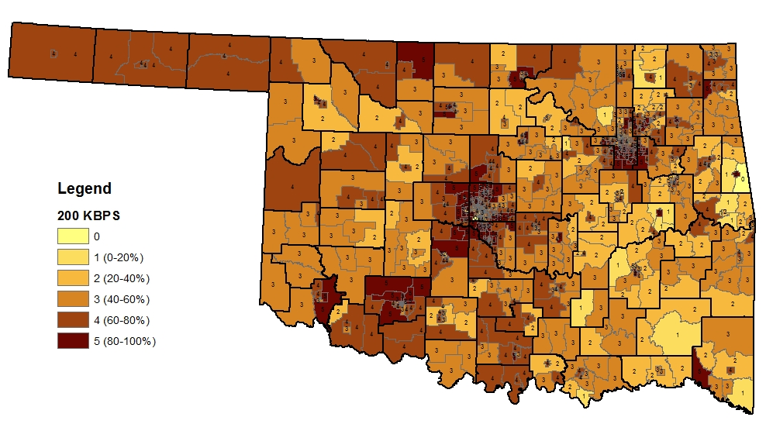
Broadband Adoption Maps
% Households with 0.2 MBPS
June 2016 FCC Form 477 Data

Slide 10
What Can Communities Do to Get Broadband?
OK allows community-owned broadband networks (many states don’t)
  Examples in OK: Sallisaw, Tuttle, Ponca City
Rural electric cooperatives are seeing an increasing role in providing broadband
  Northeast Oklahoma Electric Cooperative (Bolt Fiber)
  East Central Oklahoma Cooperative (Creek, McIntosh, Muskogee, Okfuskee, Tulsa, Wagoner)
  Oklahoma Electric Cooperative (OKC area)

Slide 11
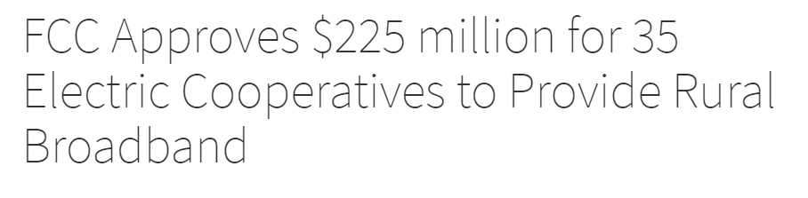
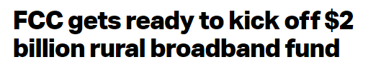


Headlines

Slide 12
How to Increase Broadband Availability Locally?
Talk to communities that have successfully implemented municipal broadband
  What steps to take?
Talk to USDA RD about funding available
  Including additional $600M for this purpose!
Have local providers look into FCC’s “Connect America Fund”
Explore Fixed Wireless solutions
  Booming in recent years

Slide 13
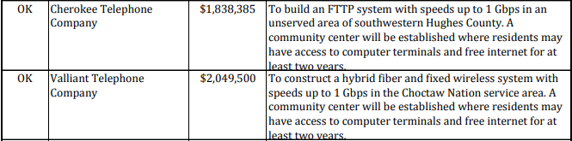
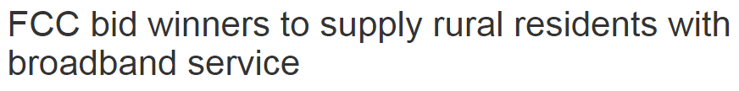

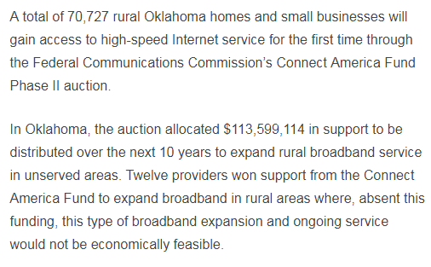
Examples of Oklahoma BB Projects
USDA-funded projects

Slide 14
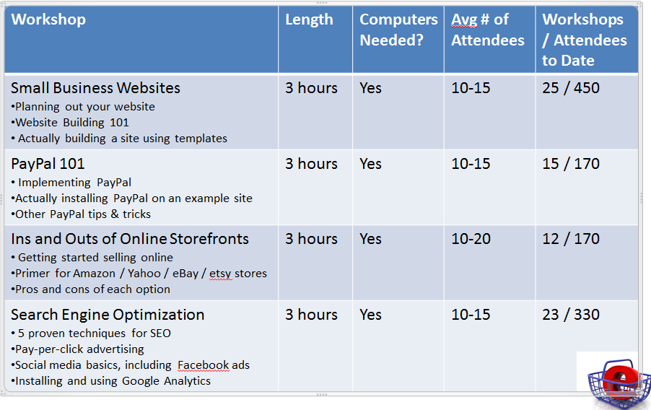
What Can Extension Do?
E-commerce workshops

Slide 15
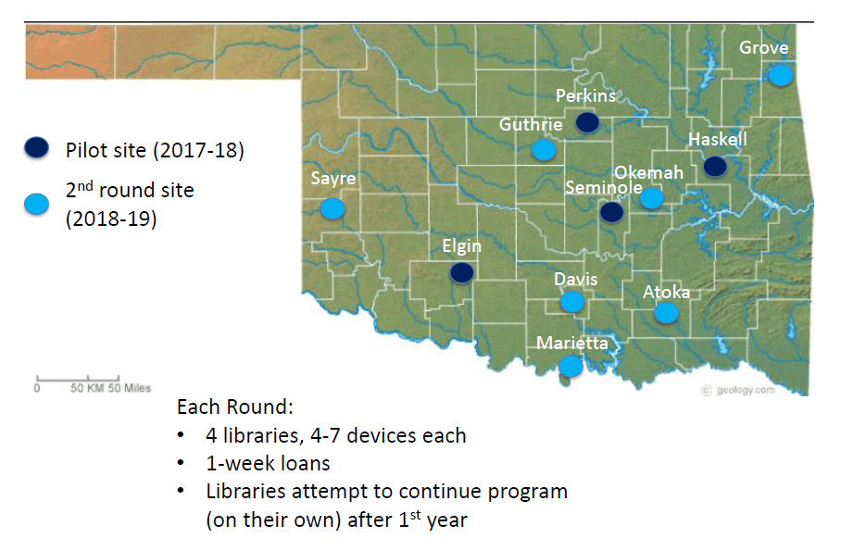
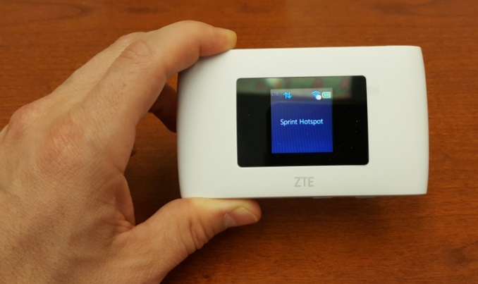
What Can Extension Do?
Rural Library Hotspot Lending Program

Slide 16
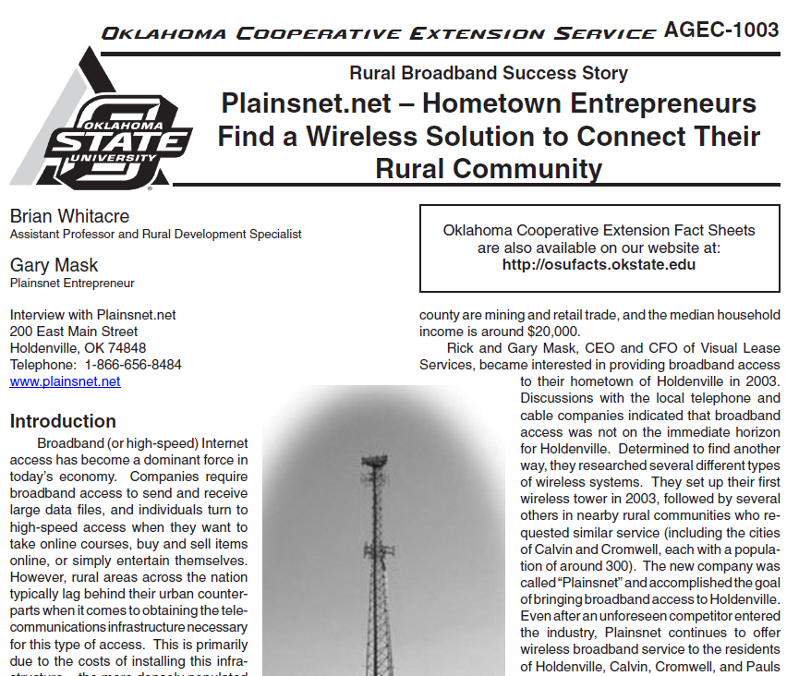
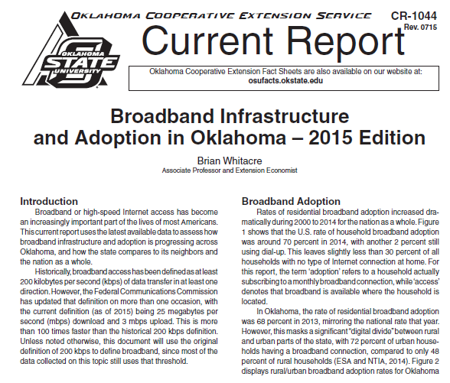
What Can Extension Do?
Fact Sheets

