Slide 1
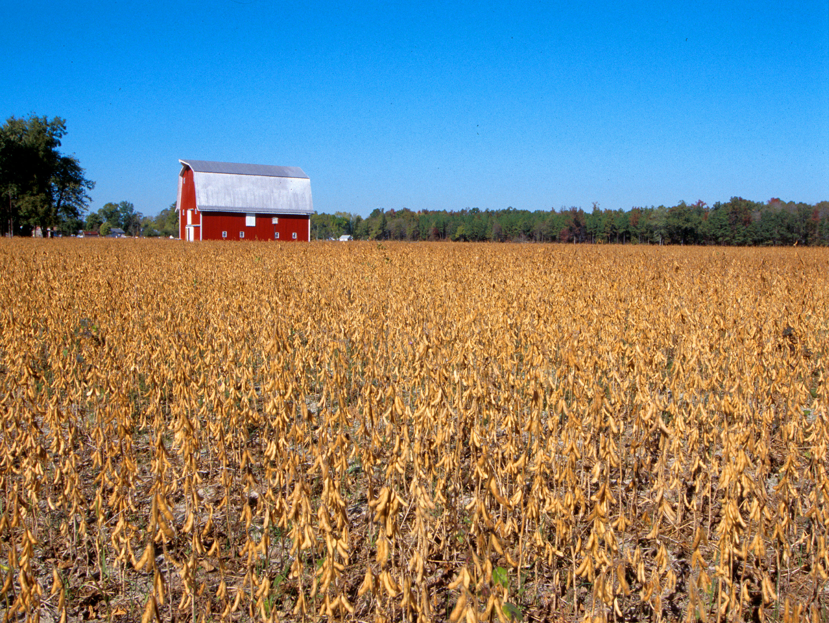
Oklahoma Agricultural Land Value Update
Roger Sahs, Extension Specialist
OSU Department of Agricultural Economics

Slide 2

Before We Discuss the 2020 Results…
OSU land values study based on actual market sales.
Land sales data provided by Farm Credit Associations of Oklahoma
Average farmland sale = $390,000. 1,075 sales tracts down from 1,500 in 2019.
USDA-NASS and Federal Reserve Bank of Kansas City land value reports are survey-based.
These data sources provide an interesting comparison and contrast when exploring the dynamics of the land markets.

Slide 3
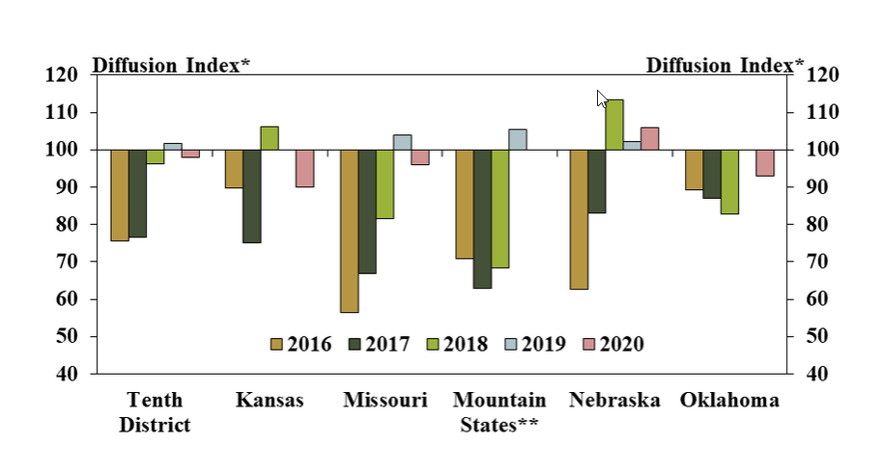
Farmland Sales Volume
Source: KC Federal Reserve Bank, February 2021

Slide 4
Oklahoma Farmland Values
Source: OSU Ag Econ Department, 2021

Slide 5
Oklahoma Land Values by Region, 2020*
Panhandle
Tracts 38
Size 251
$/Acre $1,078
% Chg +12.1
West-Northwest
Tracts 154
Size 272
$/Acre $1,489
% Chg -7.9
North Central
Tracts 170
Size 141
$/Acre $2,103
% Chg +1.3
Northeast
Tracts 168
Size 232
$/Acre $2,517
% Chg +8.0
East-Central
Tracts 38
Size 121
$/Acre $3,024
% Chg +17.4
State Averages
Tracts 1,075
Size 190
$/Acre $2,052
% Chg +1.9
Southeast
Tracts 99
Size 128
$/Acre $2,513
% Chg +13.4
Southwest
Tracts 222
Size 202
$/Acre $1,364
% Chg -3.5
South Central
Tracts 186
Size 149
$/Acre $2,628
% Chg +4.5
*Tracts >= 40 Acres and <= $6000/Acre
Source: OSU Ag Econ Department, 2021

Slide 6
Recent Trends in Oklahoma Land Values
District | 2020 | Since 2019 | Last 10 Years
 | $/ac | Change (%)
Panhandle* | 1,078 | 12.1 | 88.4
West-NW | 1,489 | -7.9 | 49.0
Southwest | 1,364 | -3.5 | 37.9
N Central | 2,103 | 1.3 | 58.4
S Central | 2,628 | 4.6 | 77.4
Northeast | 2,517 | 8.0 | 56.6
East-Central* | 3,024 | 17.4 | 73.5
Southeast | 2,513 | 13.4 | 79.4
Cropland | 1,797 | -2.2 | 48.3
Pasture | 2,184 | 2.5 | 52.0
All tracts | 2,052 | 1.9 | 54.1
1st half, past decade | 2nd half, past decade
Change (%)
86 | 1
62 | -8
47 | -6
62 | -2
48 | 20
28 | 23
24 | 40
35 | 33
70 | -13
35 | 13
43 | 8
*Fewer than 50 sale tracts included.
Source: OSU Ag Econ Department, 2021

Slide 7
Oklahoma Cropland Values by Region*
3-Year Weighted Average
*Cropland tracts are defined as having 85%+ annual crop utilization.
Source: OSU Ag Econ Department, 2021

Slide 8
Oklahoma Pasture Values by Region*
3-Year Weighted Average
*Pasture tracts are defined as having 85%+ permanent pasture utilization.
Source: OSU Ag Econ Department, 2021

Slide 9
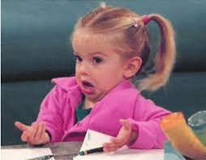
Where are the land markets headed from here?

Slide 10
Land market influences - it’s a balancing act between…
Interest rates
Non-farm investors – more active?
Commodity prices
Debt levels
USDA support payments

Slide 11
Capitalized Values
Land values should equal capitalized revenues
Land Values = Expected Revenues
Capitalization Rate
Cap rate converts future earnings into a current value
Example 1 cap rate = 10 year treasury rate so far in 2021
$35 = $2430 per acre
.0144
Example 2 cap rate = 10 year treasury rate over the past several years
$35 = $1613 per acre
.0217

Slide 12
At a historical cap rate of 2.2%, higher wheat prices are needed to justify strength in cropland values
2020 NC region cropland value was $1920.
Assumes 35 bu/ac and 25% of gross revenues capitalized into land.

Slide 13
At $6 wheat, rising cap rates could pressure the current land markets.
Assumes 35 bu/ac and 25% of gross revenues capitalized into land.

Slide 14

Wheat – Monthly Average Price
June – May Marketing Year
$6.58 1st half of decade
$4.60 2020
$4.31 2019
$4.77 2018
Source: USDA-NASS

Slide 15
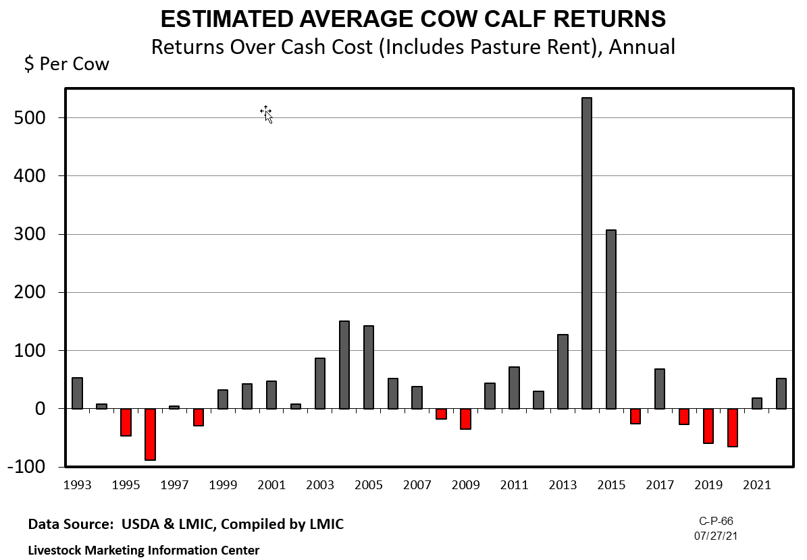

Slide 16
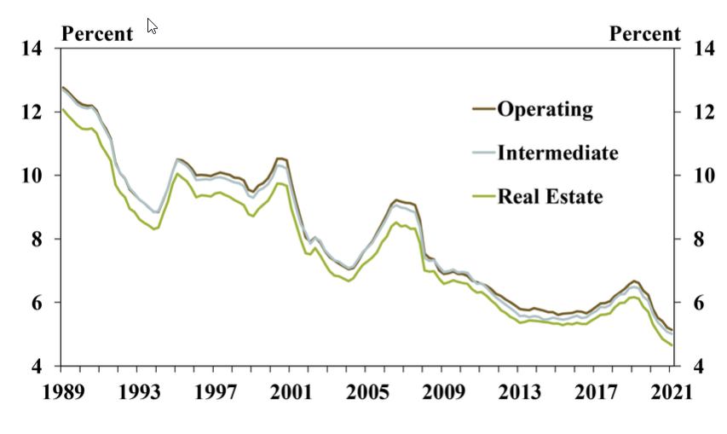
Interest Rates by Loan Type
Source: Federal Reserve Bank of KC, May 2021

Slide 17
USDA and OSU Cropland Values
+7.1% change from 2020
Source: USDA-NASS and OSU Ag Econ Department, 2021

Slide 18
USDA and OSU Pastureland Values
+8.1% change from 2020
Source: USDA-NASS and OSU Ag Econ Department, 2021

Slide 19
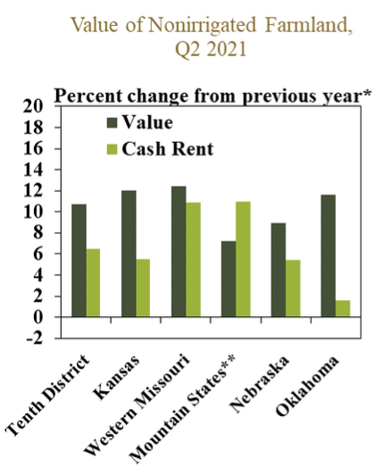
Source: Federal Reserve Bank of KC, August 2021

Slide 20
In Summary….
Farmland markets in Oklahoma remained mostly steady in 2020
◦ Cropland -2%, Pasture +2%, All tracts +2%
◦ 2021 values? Higher in the short-term.
◦ Longer term beyond 2021? Commodity prices and resulting farm income, interest rate levels, continued federal assistance, the financial health of current buyers, and any potential headwinds from Covid will all determine future trends.

Slide 21
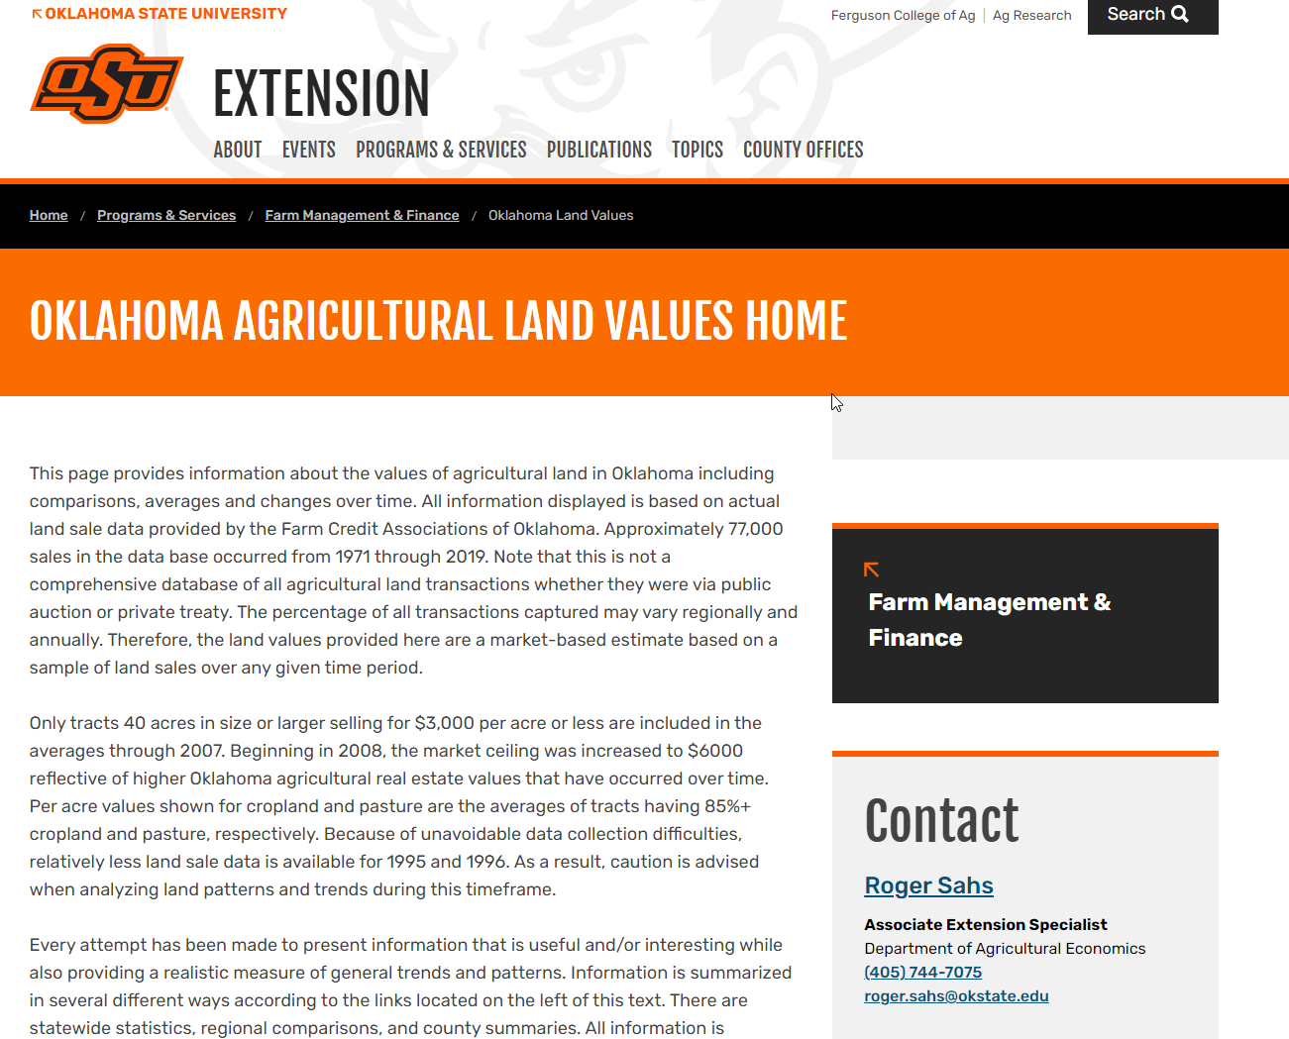
https://extension.okstate.edu/programs/farm-management-and-finance/oklahoma-land-values

Slide 22
Other Resources
Kansas City Federal Reserve Bank
  http://www.kc.frb.org/
  Choose Ag in Economy section, then Current Survey
USDA Ag Land Value Data and Reports
  http://www.nass.usda.gov/

Slide 23
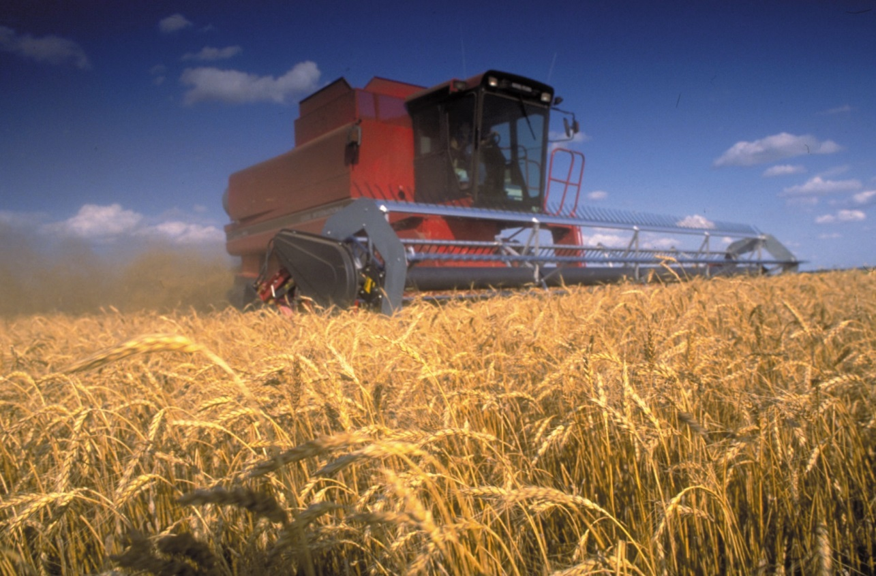
Thanks for stopping by!
webinar survey: https://okstatecasnr.az1.qualtrics.com/jfe/form/SV_2uawTXCdn3XmEiW
Roger Sahs, Associate Extension Specialist
520 Ag Hall, Oklahoma State University
Roger.sahs@okstate.edu, 405.744.7075

