Slide 1
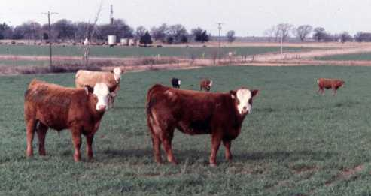

Winter Stocker Considerations, 2019
Derrell S. Peel
Breedlove Professor and Extension Livestock Marketing Specialist

Slide 2
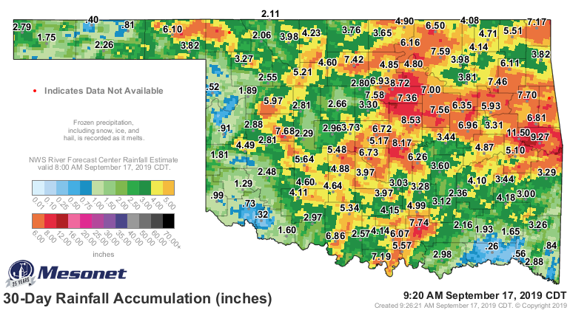

Slide 3
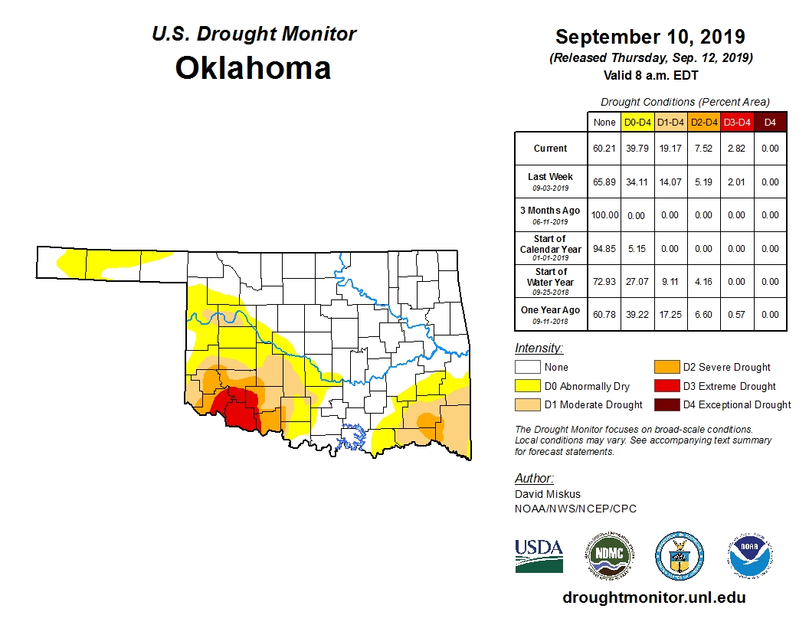

Slide 4
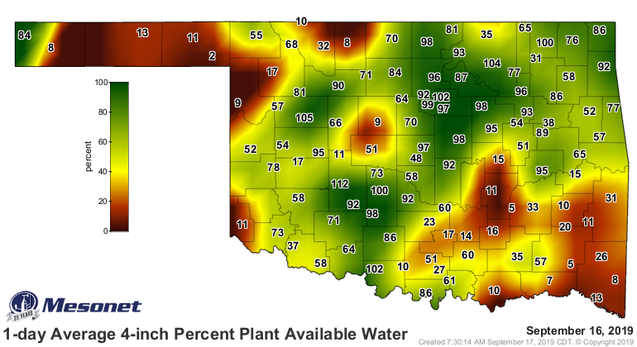

Slide 5
Cattle Market Dynamics
Cattle markets are very jittery/defensive
Large cattle supplies
Turbulent trade/macroeconomic environment
Feed market uncertainty
Tyson plant fire aftermath
Weak feeder futures

Slide 6
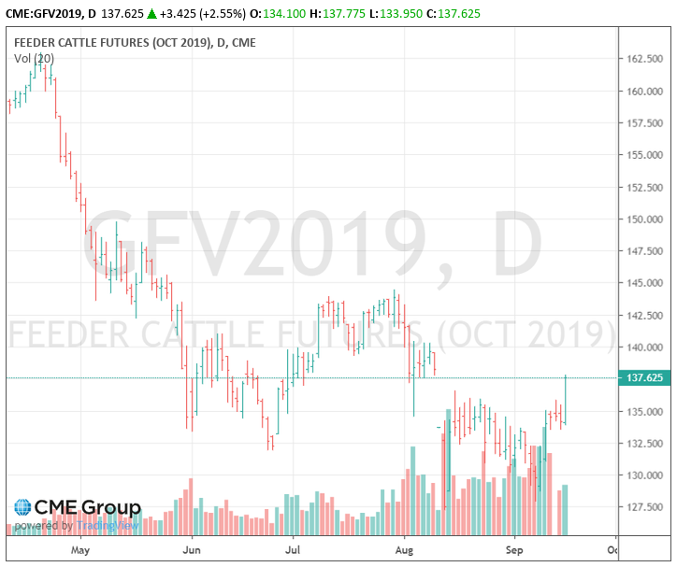

Slide 7
Steer Price and Feeder Futures Monthly, OKC med/large #1 and Feeder Futures

Slide 9
Price-Weight Relationship Medium/Large No. 1 Steers, Oklahoma

Slide 10
Steer Price, Total Value and Value of Gain September 13, 2019, Oklahoma Combined Auction
Weight (lbs) | Average Price ($/cwt.) | Total Value ($/hd) | VOG 400 lb. Beg. Weight ($/lb.) | VOG 450 lb. Beg. Weight ($/lb | VOG 500 lb. Beg. Weight ($/lb.) | VOG 550 lb. Beg. Weight ($/lb.) | VOG 600 lb. Beg. Weight ($/lb.) | VOG 650 lb. Beg. Weight ($/lb.)
400 | $160.74 | $643
450 | $152.11 | $684 | $0.83
500 | $147.10 | $736 | $0.93 | $1.02
550 | $143.69 | $790 | $0.98 | $1.06 | $1.10
600 | $141.31 | $848 | $1.02 | $1.09 | $1.12 | $1.15
650 | $139.01 | $904 | $1.04 | $1.10 | $1.12 | $1.13 | $1.11
700 | $137.93 | $966 | $1.08 | $1.12 | $1.15 | $1.17 | $1.18 | $1.24
750 | $139.07 | $1,043 | $1.14 | $1.20 | $1.23 | $1.26 | $1.30 | $1.39
800 | $136.48 | $1,092 | $1.12 | $1.16 | $1.19 | $1.21 | $1.22 | $1.26
850 | $130.62 | $1,110 | $1.04 | $1.06 | $1.07 | $1.07 | $1.05 | $1.03
900 | $125.67 | $1,131 | $0.98 | $0.99 | $0.99 | $0.97 | $0.94 | $0.91

Slide 11
Additional Wheat Production Costs for Grazing, Per Acre
Yield loss 6 bushels@$4.50/bu. $27.00
Fertilizer 30 lb. N @ $0.42/lb. $12.60
Fertilizer application $ 5.00
Seed 2.0 bu. @$10/bu. $20.00
Total Additional Cost/Acre $64.60
Breakeven Wheat Pasture Cost: (assuming 119 days of grazing; 2.5 lb. ADG and 400 lbs./acre stocking rate)
475 lb. beg weight (1.19 acres/hd.) = $0.26/lb. gain
575 lb. beg weight (1.43 acres/hd.) = $0.31/lb. gain
625 lb. beg weight (1.56 acres/hd.) = $0.34/lb. gain
Sep 2019

Slide 12
Additional Wheat Production Costs for Grazing, Per Acre
Yield loss 6 bushels@$5.30/bu. $31.80
Fertilizer 30 lb. N @ $0.42/lb. $12.60
Fertilizer application $ 5.00
Seed 2.0 bu. @$10/bu. $20.00
Total Additional Cost/Acre $69.40
Breakeven Wheat Pasture Cost: (assuming 119 days of grazing; 2.0 lb. ADG and 400 lbs./acre stocking rate)
475 lb. beg weight (1.19 acres/hd.) = $0.35/lb. gain
575 lb. beg weight (1.43 acres/hd.) = $0.42/lb. gain
625 lb. beg weight (1.56 acres/hd.) = $0.46/lb. gain

Slide 13
Winter Stockers, Nov 1- Feb 28
Purchase 475 pound steers @ $150.00/cwt.
Gain 2.5 lbs./day for $0.45/lb. of gain
4% death loss, $25/head Vet/Med
$12.00/head/month other costs
6% Interest, $8/head marketing
Sell 773 pound steers after 119 days
Selling Breakeven $124.79
Gain/acre = 250 pounds

Slide 14
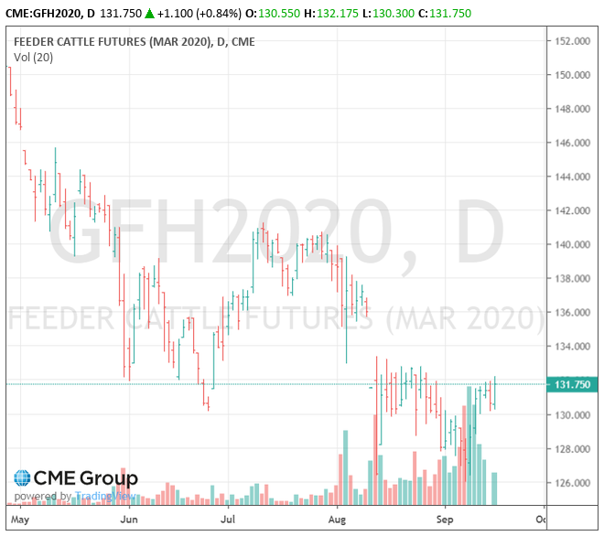

Slide 15
Oklahoma City Steer Basis $/cwt. (10 year ave.)
MONTH 450 750
JAN 44.56 0.97
FEB 48.73 1.87
MAR 49.50 1.70
APR 45.23 2.30
MAY 42.29 2.15
JUN 36.51 0.80
MONTH 450 750
JUL 28.78 2.03
AUG 34.77 2.20
SEP 29.79 1.96
OCT 29.57 1.40
NOV 40.87 1.57
DEC 45.06 1.57

Slide 17
Winter Stockers, Nov 1- Feb 28
Purchase 475 pound steers @ $166.00/cwt.
Gain 2.5 lbs./day for $0.45/lb. of gain
4% death loss, $25/head Vet/Med
$12.00/head/month other costs
6% Interest, $8/head marketing
Sell 773 pound steers after 119 days
Selling Breakeven $135.12
Gain/acre = 250 pounds

Slide 19
Med/Large Frame #1 Steer Basis, OKC
400-500 lb. Steers (NOVEMBER)
Ave (2014-2018) 50.01
Max (2014) 87.02
Min (2017) 30.47
700-800 lb. Steers (NOVEMBER)
Ave (2014-2018) 2.31
Max (2015) 5.18
Min (2018) -1.05

Slide 20
