Slide 1
Farm Policy Update
Amy Hagerman
State Specialist in Agricultural and Food Policy
Learn at Lunch
September 25, 2018

Slide 2

Policy happenings in Washington DC
Appropriations bill for USDA
2018 Farm Bill
Trade negotiations
September 30, 2018
September 30, 2018

Slide 3
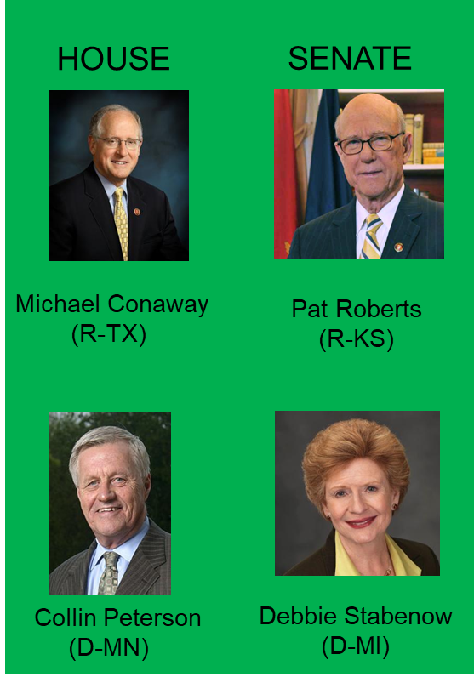
The next farm bill… 2018…2019…???
HOUSE
H.R. 2 Agriculture and Nutrition Act of 2018
June 21
SENATE
S. 3042: Agricultural Improvement Act of 2018 June 28, 2018
July 18
August 3
CONFERENCE
September 5
?
?
FULL HOUSE
Floor Vote
FULL SENATE
Floor Vote
?
?
WHITE HOUSE
Signature

Slide 4
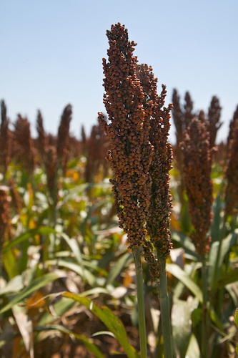
Overview of versions under discussion
Focus is risk management
  ARC/PLC, Crop Insurance
Maintains omnibus concept
  Nutrition and farm programs remain together
Sharp partisan differences may stall progress in conference
  Supplemental Nutrition Assistance (SNAP, formerly Food Stamps)
  Conservation
Overall effort to increase efficiency and cut costs, with very different philosophies on how to achieve that.

Slide 5
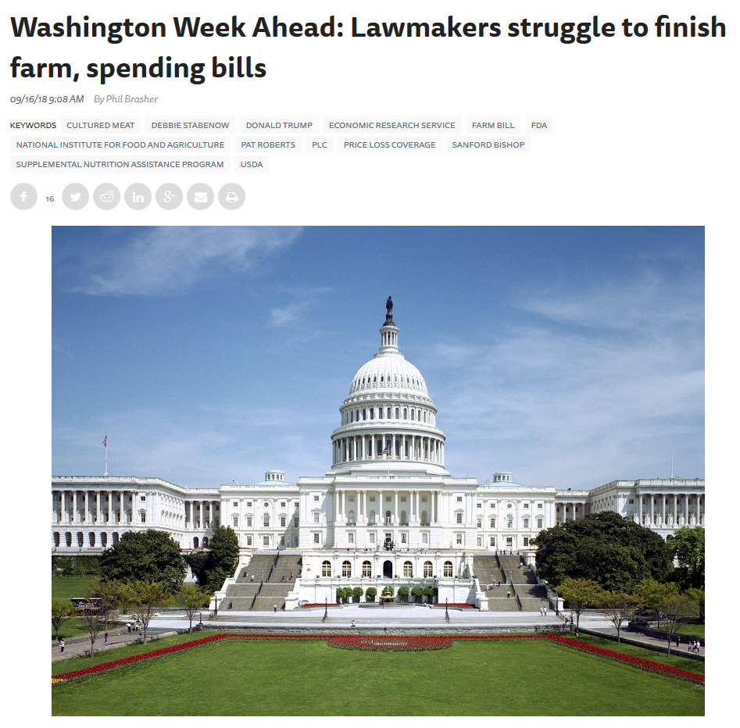
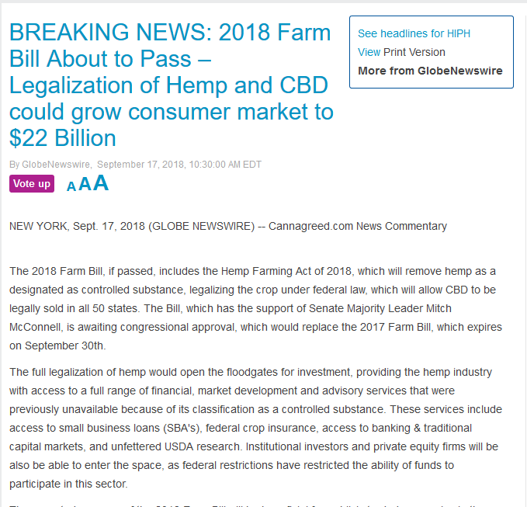
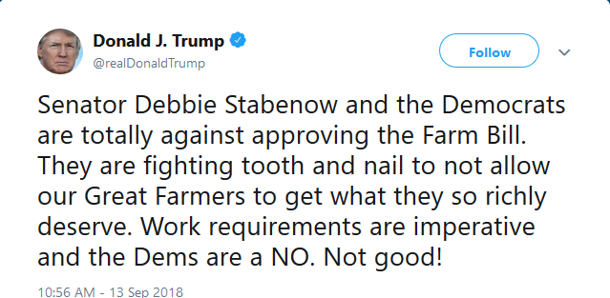
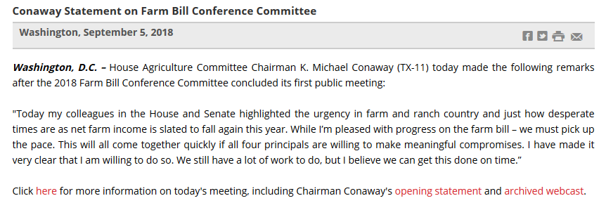
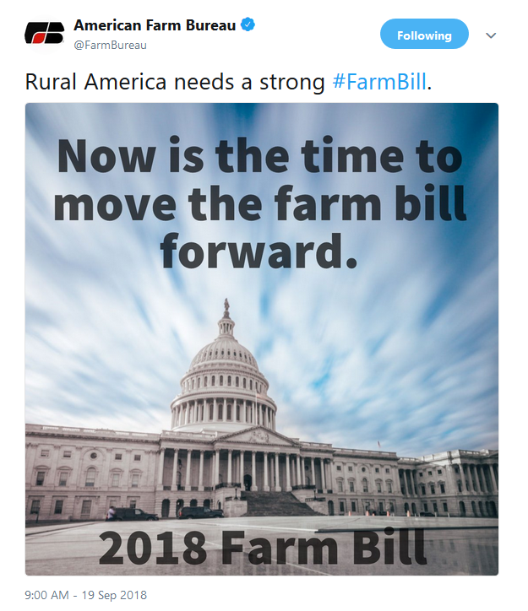
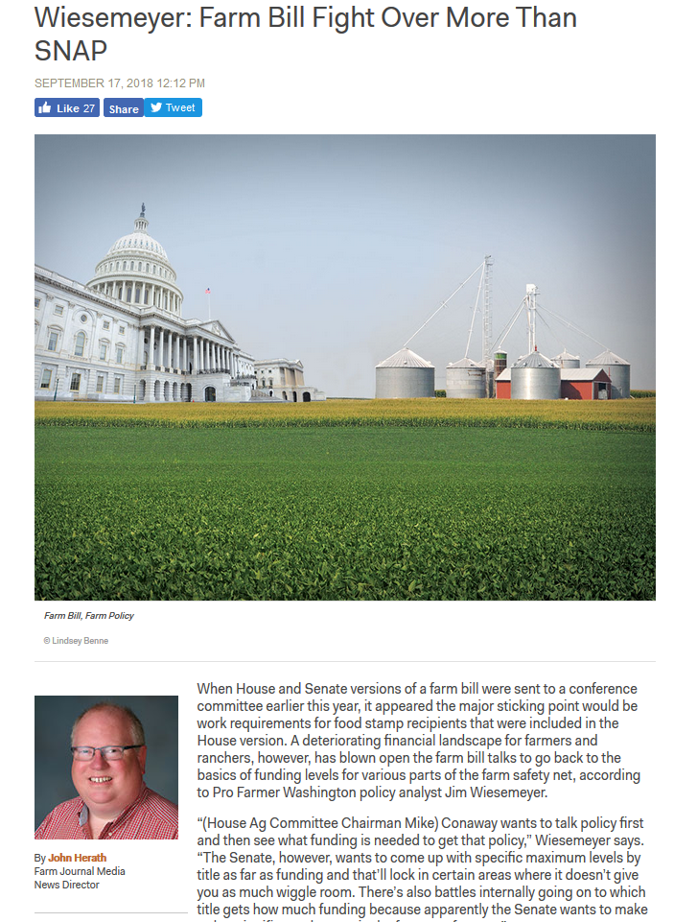
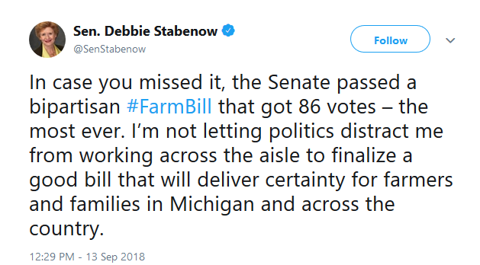
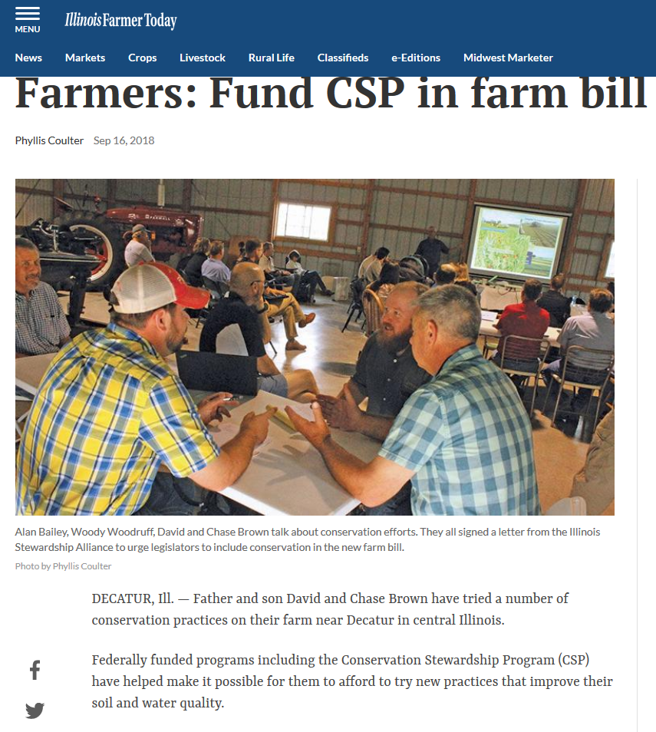
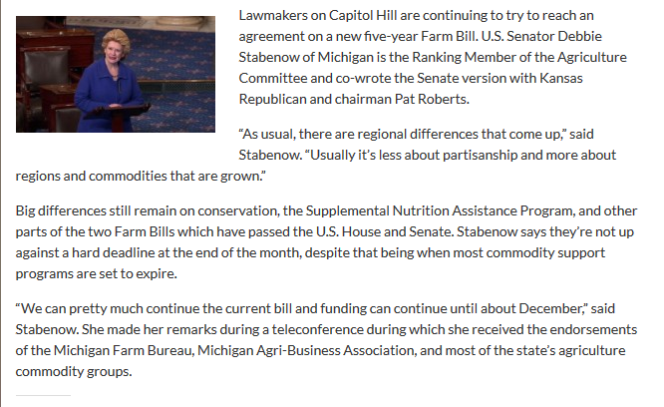
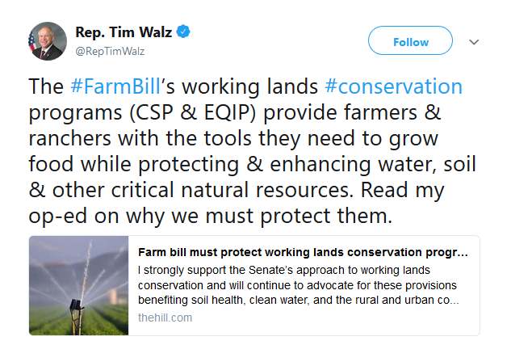
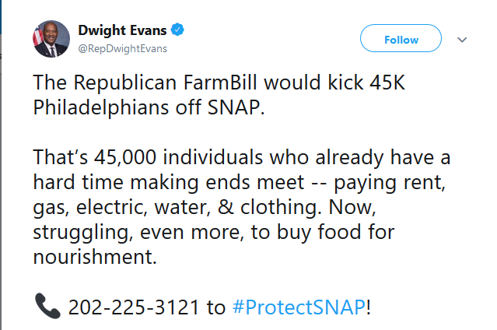
In the news and social media

Slide 6

Trade Negotiations
Trade negotiations with Mexico and Canada
Trade war with China
Tariffs
Retaliatory tariffs affecting agriculture

Slide 7
Market Disruption Losses
July, 2018
  Up to $12 billion in funds
  Aimed at targeted commodities
August, 2018
  3 different mechanisms
    Market Facilitation Program ($4.7 billion)
    Food Purchase and Distribution Program ($1.2 billion)
    Agricultural Trade Promotion Program ($200 million)
Details on rate calculations: https://www.usda.gov/oce/trade/USDA_Trade_Methodology_Report.pdf

Slide 8
Market Facilitation Program
Payment of 50% of actual 2018 production
Sign-up September 4 to January 15
Requirements
  Active engagement
  AGI < $900,000
  Conservation Compliance
Separate $125,000 payment limits for crops and dairy/hogs.
Decision on the other 50% of production will be made in early December.
Details on rate calculations: https://www.usda.gov/oce/trade/USDA_Trade_Methodology_Report.pdf

Slide 9
Questions?
Amy Hagerman
amy.hagerman@okstate.edu
405-744-9811
We appreciate your feedback:
https://okstatecasnr.az1.qualtrics.com/jfe/form/SV_1CcDUbdo9XMwXAN
Visit us online at agecon.okstate.edu/agpolicy/

