Slide 1
Understanding the U.S. Renewable Fuel Standard
Todd Hubbs

Slide 2
RFS Overview
RFS Legislative Background
The RFS was established in 2005 and expanded in 2007 to improve energy security and promote renewable fuels.
Renewable Fuel Mandates
RFS mandates specific volumes of renewable fuels blended into transportation fuels via Renewable Volume Obligations.
Fuel Categories and Emissions
Four fuel categories include cellulosic, biomass-based diesel, total advanced, and conventional biofuels based on emissions and feedstock.
EPA Standards and Market Impact
EPA annually sets percentage standards translating volumes to blended fuel requirements, promoting renewable fuel markets.
Notes:
The U.S. Renewable Fuel Standard (RFS) was established under the Energy Policy Act of 2005 and expanded by the Energy Independence and Security Act of 2007. The stated goal was to enhance energy security, promote the development of low-greenhouse gas transportation fuels, and support rural economies. The RFS mandates specific volumes of renewable fuels to be blended into transportation fuels, enforced through Renewable Volume Obligations (RVOs). These mandates are categorized into four types: cellulosic, biomass-based diesel, total advanced, and conventional biofuels. Each category is defined by its greenhouse gas emission reductions, feedstock, and fuel characteristics. The EPA converts statutory volumes into percentage standards annually, ensuring that a specified fraction of renewable fuel is blended for every gallon of petroleum fuel sold. This structure creates a policy-driven market that incentivizes the production and use of renewable fuels.

Slide 3
Mandate Structure
Prioritization of Biofuels
RFS mandates prioritize biofuels based on greenhouse gas emission reductions.
Equivalence Values
Equivalence values standardize compliance using energy content: ethanol at 1, biodiesel 1.5, renewable diesel up to 1.6 (it was 1.7).
Regulatory Flexibility
The EPA can modify mandates via waivers to address production shortfalls and economic or environmental concerns.
Mandate Timeline
The 2007 statute sets volumetric biofuel standards through 2022, shifting focus from conventional to advanced fuels.
Notes:
The RFS mandates are structured to prioritize biofuels based on their lifecycle greenhouse gas emission reductions. Cellulosic biofuels, with the highest reductions, can fulfill all mandate categories. Biomass-based diesel can meet its own, the undifferentiated, and conventional mandates, but not the cellulosic mandate. Conventional biofuels are limited to their own category. Equivalence values are assigned to biofuels based on energy content per gallon, with ethanol set at 1, biodiesel at 1.5, and renewable diesel at 1.6 or 1.7. These values standardize compliance across different fuel types. The 2007 statute outlined volumetric standards through 2022, starting with conventional biofuels and transitioning to advanced biofuels. The EPA has authority to modify these mandates through waivers, addressing shortfalls in production or economic/environmental harm. This nested and flexible structure ensures that the RFS can adapt to market and production realities while promoting cleaner fuel alternatives.

Slide 4
Compliance Basics and Renewable Identification Numbers (RINs)
Obligated Parties' Responsibilities
Refiners and importers must meet annual Renewable Volume Obligations by acquiring and retiring RINs to comply with RFS program.
Role of Renewable Identification Numbers
RINs are credits generated from renewable fuel production that can be traded to provide flexibility in meeting compliance requirements.
Fuel Type D-Codes
Each renewable fuel type has a unique D-code, such as D3 for cellulosic biofuel, D4 for biomass-based diesel, and D6 for ethanol identifying its category.
Compliance Calculation and Incentives
Obligated parties calculate RVOs based on EPA standards, ensuring accountability and incentivizing renewable fuel production.
Notes:
Compliance with the RFS program is primarily the responsibility of obligated parties, such as refiners and importers of gasoline or diesel. These entities must meet annual Renewable Volume Obligations (RVOs) for each renewable fuel category by acquiring and retiring Renewable Identification Numbers (RINs). RINs are credits generated when renewable fuel is produced and can be traded among parties, providing flexibility in meeting compliance requirements. Each fuel type is assigned a D-code that identifies its category, such as D3 for cellulosic biofuel and D4 for biomass-based diesel. Obligated parties calculate their RVOs using EPA-established percentage standards and must demonstrate compliance annually. This system incentivizes renewable fuel production while ensuring accountability and transparency in the marketplace.

Slide 5
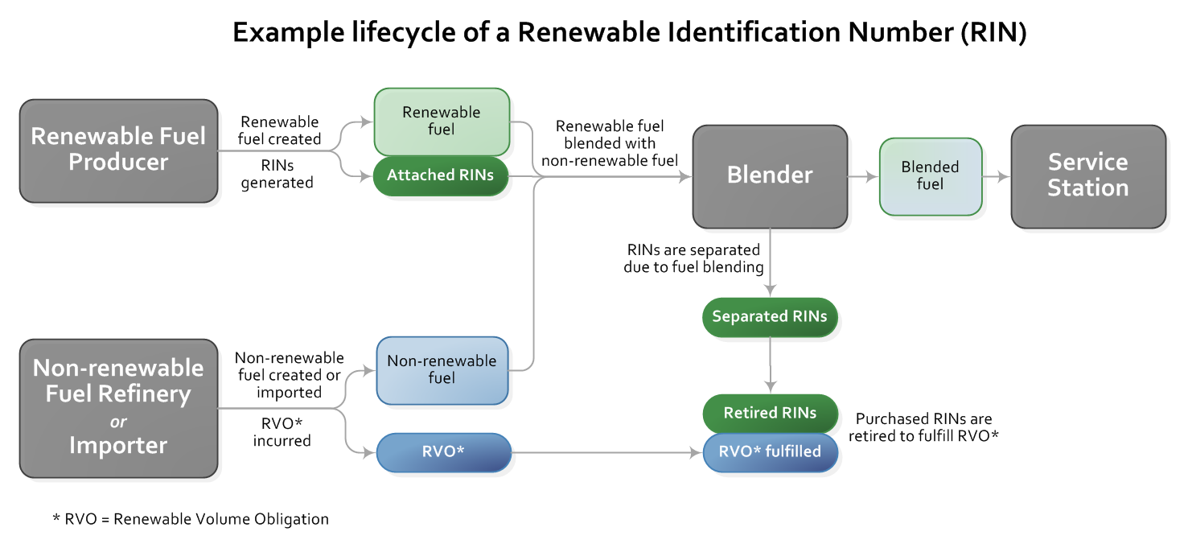
Example Lifecycle of a Renewable Identification Number (RIN)

Slide 6
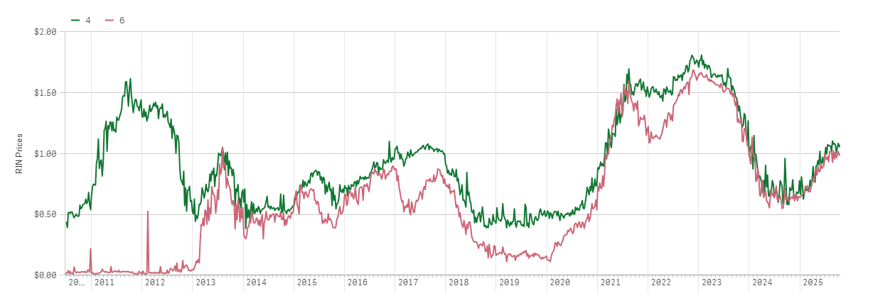
D4 and D6 RIN Prices

Slide 7
RIN Trading and Compliance Flexibilities
RIN Trading Market
RINs can be traded among obligated parties and third parties, creating a flexible and dynamic compliance market.
Compliance Timing and Expiry
RINs are valid for compliance in the generation year or the following year before expiring, allowing timing flexibility.
Deficit Carryforward and Waiver Credits
Compliance deficits can be carried forward with conditions; cellulosic waiver credits offer alternative compliance options.
Notes:
RINs can be traded between obligated parties and third parties, creating a dynamic market that facilitates compliance. Obligated parties may separate RINs from renewable fuel after blending or purchase them on the open market. RINs can be used for compliance in the year they are generated or the following year, after which they expire. The program also allows for compliance deficits to be carried forward under certain conditions, although these must be resolved in the subsequent year. Additionally, EPA offers cellulosic waiver credits when cellulosic biofuel volumes are reduced, providing obligated parties with alternative compliance options. These mechanisms ensure flexibility while maintaining the integrity of the program’s environmental goals.

Slide 8
Waiver Authorities
Cellulosic Waiver Authority
Allows reductions in cellulosic RVO if production falls short, enabling proportional decreases in renewable mandates.
General Waiver Authority
Can be invoked if compliance severely harms economy or environment, or if domestic supply is inadequate.
Biomass-Based Diesel Waiver
Allows up to 15% reduction for 60 days due to feedstock disruptions or price increases in biomass diesel.
Small Refinery Exemptions (SRE’s)
Small refineries can petition for exemptions due to disproportionate economic hardship from mandate compliance.
Notes:
The RFS includes several waiver authorities that allow the EPA to adjust mandates based on specific conditions. The cellulosic waiver permits reductions in the cellulosic RVO if production falls short, and allows proportional reductions in total advanced and renewable RVOs. The general waiver can be invoked if compliance would severely harm the economy or environment, or if there is inadequate domestic supply. The biomass-based diesel (BBD) waiver allows up to a 15% reduction for 60 days in response to feedstock disruptions or significant price increases. Additionally, small refineries with less than 75,000 barrels of crude oil throughput annually can petition for exemptions due to disproportionate economic hardship. These provisions provide flexibility in implementing the RFS, ensuring that mandates remain feasible and responsive to market and environmental conditions. They also highlight the complexity of balancing policy goals with practical challenges in renewable fuel production and distribution.

Slide 9
Implementation Challenges
Cellulosic Biofuel Shortfall
Cellulosic biofuel production repeatedly missed targets, relying mainly on landfill gas breakdown products.
E10 Blend Wall Limitations
The 10% ethanol cap in gasoline caused mandates to exceed limits as fuel consumption declined.
Political and Economic Conflicts
Higher compliance costs led to disputes between refiners and biofuel producers over RFS effectiveness.
Pandemic Impact on Implementation
COVID-19 reduced fuel demand, prompting EPA to lower renewable volume obligations for 2020 and 2021.
Notes:
Implementing the RFS has faced significant challenges. One major issue is the shortfall in cellulosic biofuel production, which has consistently failed to meet statutory targets. Most production has come from captured landfill gas, qualifying as cellulosic due to paper lignin breakdown. This shortfall led the EPA to reduce cellulosic mandates annually from 2007 to 2022. Another challenge is the E10 blend wall, limiting ethanol content in gasoline to 10%. This cap, based on projected gasoline consumption, became problematic as actual consumption declined, causing the conventional mandate to exceed the blend wall and increasing compliance costs. These costs sparked political conflict between refiners and biofuel producers, with debates over the RFS's effectiveness and industry investment. The COVID-19 pandemic further complicated implementation, drastically reducing fuel consumption and prompting the EPA to lower RVOs for 2020 and 2021. These challenges underscore the need for adaptive policy mechanisms and ongoing evaluation of the RFS's impact.

Slide 10
Statutory and Final U.S. Renewable Fuel Standard Volume Obligations (RVOs)
The Vision
The Reality

Slide 11
2026-2027 Proposed RVO mandates
Proposed Volume Requirements (billion RINs)* | 2026 | 2027
Cellulosic biofuel | 1.30 | 1.36
Biomass-based diesel | 7.12 | 7.50
Advanced biofuel | 9.02 | 9.46
Renewable fuel | 24.02 | 24.46
Conventional (implied mandate) | 15.0 | 15.0
* One RIN is equivalent to one ethanol-equivalent gallon of renewable fuel.

Slide 12
Recent Developments
Recent Developments
EPA's Annual RVO Mandate
The RFS mandates the EPA to issue annual Renewable Volume Obligations without a sunset clause beyond 2022.
Post-2022, EPA uses rulemaking to establish renewable fuel volume targets under the Clean Air Act.
Latest RVO Rule Setting
Changed renewable diesel/SAF from 1.7 to 1.6 RIN
Half RIN rule making for foreign fuel and feedstock
Settled SRE backlog for the most part (if such an issue can ever really be settled)
Notes:
A key feature of the RFS is its lack of a sunset clause, requiring the EPA to continue issuing annual RVOs beyond 2022. The EPA now has broad discretion to set these volumes based on various criteria, including environmental impact, energy security, production rates, infrastructure, consumer costs, and economic factors. In June, the EPA proposed RVOs for 2026 and 2027. A final rulemaking is expected soon, which will significantly influence the future of renewable diesel. This shift represents a transition from fixed statutory mandates to a more dynamic, criteria-based approach. The outcome of this rulemaking will likely shape the trajectory of renewable fuel adoption in the U.S., reinforcing the importance of policy in driving sustainable energy solutions.

Slide 13
Impact on Agricultural Markets
Impact on Agricultural Markets
New demand for crops linked to biofuels
Major demand shifter/ price shifter
Acreage:

Slide 14
Corn Used for ethanol

Slide 15
Soybean Oil for Biodiesel

Slide 16
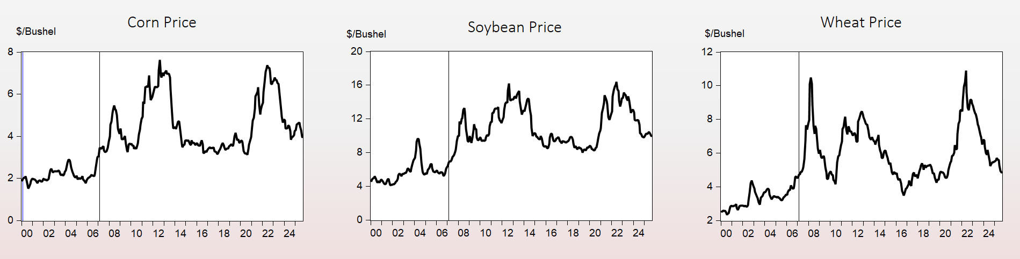
Price Impacts

Slide 17

Todd Hubbs
Department of Agricultural Economics
Webinar survey QR Code:
O | 405.744.6061
E | todd.hubbs@okstate.edu
120 Agricultural Hall
Stillwater, OK 74078

